Slide 1
CS 446
Erin Keith

Slide 2
Processes and Threads
Chapter 2

Slide 3
Topics
Scheduling

Slide 4
Scheduling
Early on, we needed to share with others.
Now, generally one user and CPUs are fast!
Switching processes is expensive, so scheduling is still important.

Slide 5
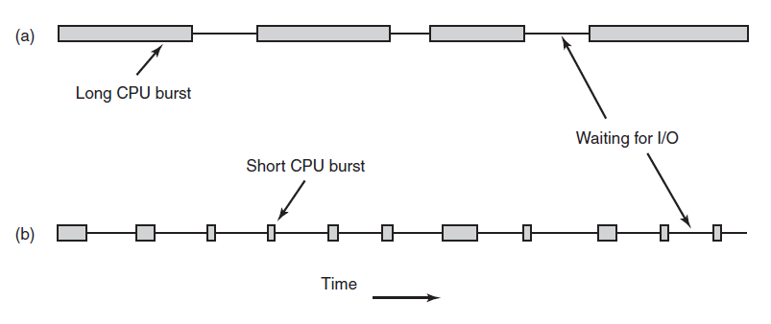
Introduction to Scheduling Process Behavior
Figure 2-39. Bursts of CPU usage alternate with periods of waiting for I/O. (a) A CPU-bound process. (b) An I/O-bound process.

Slide 6
When to Schedule
New process created
Process exits
Process blocks on I/O
semaphore
I/O interrupt
from I/O device

Slide 7
Categories of Scheduling Algorithms
Batch.
Interactive.
Real time.

Slide 8
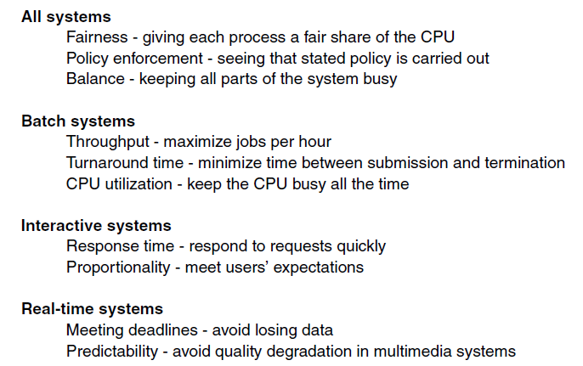
Scheduling Algorithm Goals
Figure 2-40. Some goals of the scheduling algorithm under different circumstances.

Slide 9
Scheduling in Batch Systems
First-Come First-Served
Shortest Job First
Shortest Remaining Time Next

Slide 10
First-Come First-Served
Queue of ready processes
First job starts and runs
Other jobs enter queue
When running process is blocked, first ready queue runs
When process becomes unblocked, it goes to end of queue

Slide 11
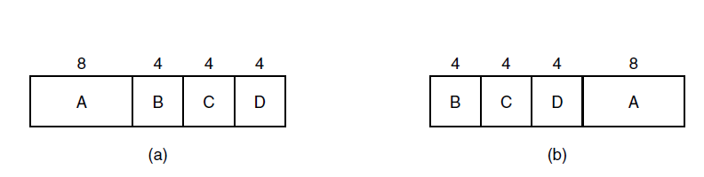
Shortest Job First
Figure 2-41. An example of shortest job first scheduling. (a) Running four jobs in the original order. (b) Running them in shortest job first order.

Slide 12
Shortest Remaining Time
Process whose remaining time is shortest always chosen first
Run times must be known in advance
5 jobs, A-E, with runtimes 2, 4, 1, 1, 1 and arrival times 0, 0, 3, 3, 3.
Shortest job: A, B, C, D, E for 4.6
Shortest time: B, C, D, E, A for 4.4

Slide 13
Scheduling in Interactive Systems
Round-Robin Scheduling
Priority Scheduling
Multiple Queues
Shortest Process Next
Guaranteed Scheduling
Lottery Scheduling
Fair-Share Scheduling

Slide 14
Round-Robin
quantum: time interval during which a process is allowed to run
if process is blocked or uses its quantum, it is put back into the queue
some waste on context switching if shorter quantum
longer quantum means greater likelihood of blocking (more efficient)

Slide 15
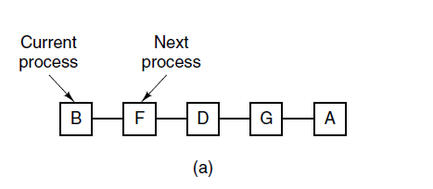
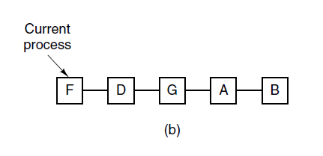
Round-Robin Scheduling
Figure 2-42. Round-robin scheduling. (a) The list of runnable processes. (b) The list of runnable processes after B uses up its quantum.

Slide 16
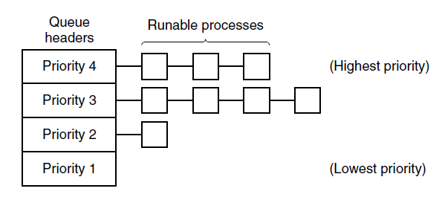
Priority Scheduling
Figure 2-43. A scheduling algorithm with four priority classes.

Slide 17
Multiple Queues
Combination of round-robin with long quanta and priority scheduling with priority classes
Initially given one quantum, then swapped out
Next, it would be moved down a class and given 2 quanta
reduces swaps
longer running processes give favor to shorter ones

Slide 18
Scheduling
Guaranteed
promise to give fraction of CPU cycles
Lottery
randomize “lottery tickets”
more important processes get more tickets
Fair-Share
priority based on user

Slide 19
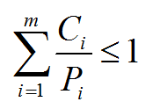
Scheduling in Real-Time Systems
Time plays an essential role
Categories
Hard real time
Soft real time
Periodic or aperiodic
Schedulable satisfies

Slide 20
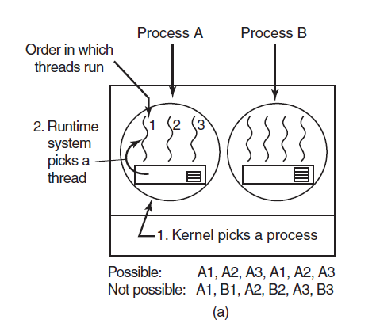
Thread Scheduling (1)
Figure 2-44. (a) Possible scheduling of user-level threads with a 50-msec process quantum and threads that run 5 msec per CPU burst.

Slide 21
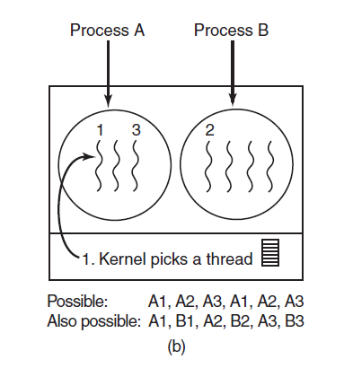
Thread Scheduling (2)
Figure 2-44. (b) Possible scheduling of kernel-level threads with the same characteristics as (a).

Slide 22

The Dining Philosophers Problem (1)
Figure 2-45. Lunch time in the Philosophy Department.

Slide 23
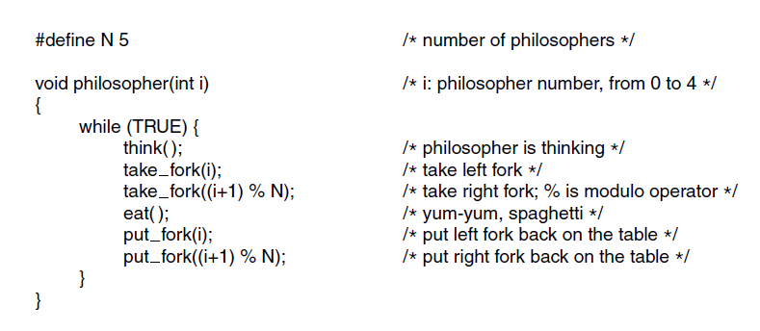
The Dining Philosophers Problem (2)
Figure 2-46. A nonsolution to the dining philosophers problem.

Slide 24
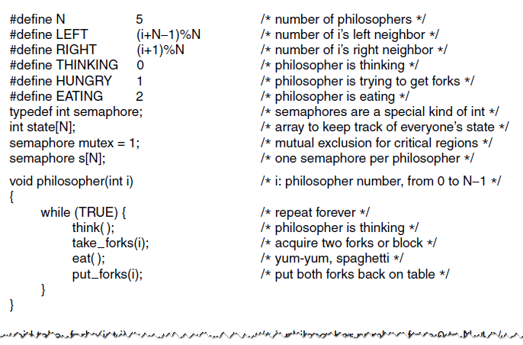
The Dining Philosophers Problem (3)
Figure 2-47. A solution to the dining philosophers problem.

Slide 25
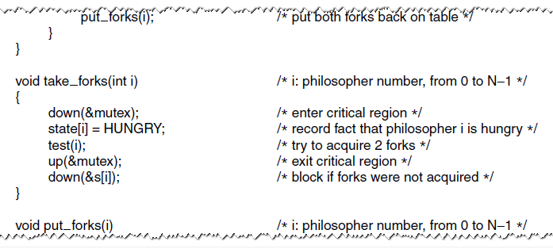
The Dining Philosophers Problem (4)
Figure 2-47. A solution to the dining philosophers problem.

Slide 26
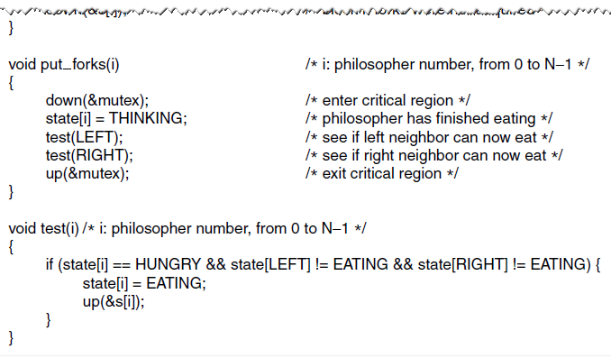
The Dining Philosophers Problem (5)
Figure 2-47. A solution to the dining philosophers problem.

Slide 27
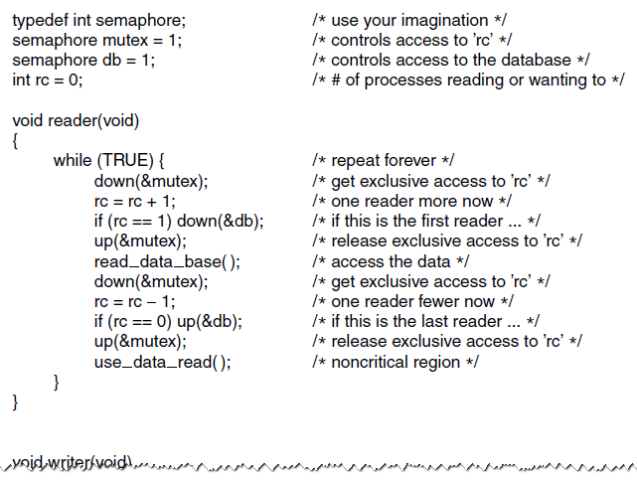
The Readers and Writers Problem (1)
Figure 2-48. A solution to the readers and writers problem.

Slide 28
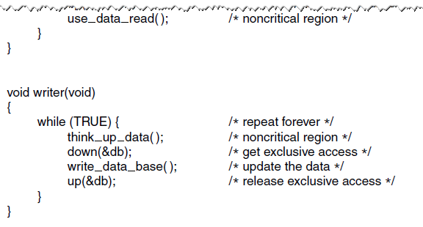
The Readers and Writers Problem (2)
Figure 2-48. A solution to the readers and writers problem.

Slide 29
Next Class
File Systems
Modern Operating Systems:
Chapter 4
Files
Directories
Implementation

