Slide 1
File Systems
Chapter 4
Tanenbaum & Bo, Modern Operating Systems:4th ed., (c) 2013 Prentice-Hall, Inc. All rights reserved.

Slide 2
Topics
Files
Directories
8_FILE_SYSTEMS

Slide 3
File Systems (1)
Essential requirements for long-term information storage:
It must be possible to store a very large amount of information.
Information must survive termination of process using it.
Multiple processes must be able to access information concurrently.
Tanenbaum & Bo, Modern Operating Systems:4th ed., (c) 2013 Prentice-Hall, Inc. All rights reserved.

Slide 4
File Systems (2)
Think of a disk as a linear sequence of fixed-size blocks and supporting two operations:
Read block k.
Write block k
Tanenbaum & Bo, Modern Operating Systems:4th ed., (c) 2013 Prentice-Hall, Inc. All rights reserved.

Slide 5
File Systems (3)
Questions that quickly arise:
How do you find information?
How do you keep one user from reading another user’s data?
How do you know which blocks are free?
Tanenbaum & Bo, Modern Operating Systems:4th ed., (c) 2013 Prentice-Hall, Inc. All rights reserved.

Slide 6
File Systems
  Files: logical units of information created by processes
  Persistent: not affected by process creation and termination
  File system: part of operating system dealing with files
8_FILE_SYSTEMS

Slide 7
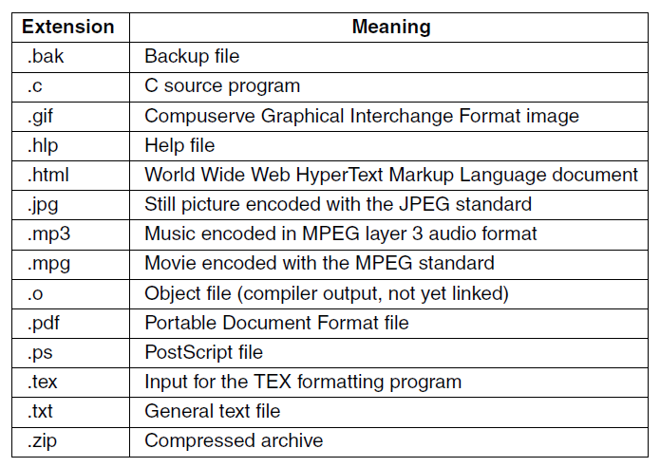
File Naming
Figure 4-1. Some typical file extensions.
Tanenbaum & Bo, Modern Operating Systems:4th ed., (c) 2013 Prentice-Hall, Inc. All rights reserved.

Slide 8
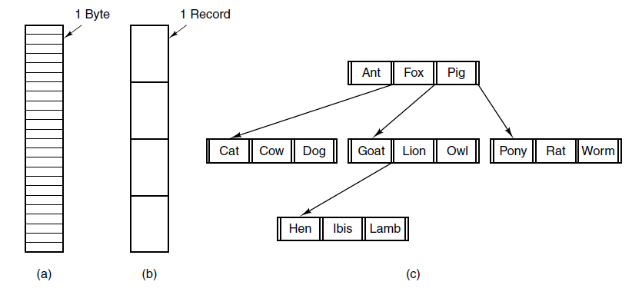
File Structure
Figure 4-2. Three kinds of files. (a) Byte sequence.
(b) Record sequence. (c) Tree.
Tanenbaum & Bo, Modern Operating Systems:4th ed., (c) 2013 Prentice-Hall, Inc. All rights reserved.

Slide 9
File Systems
  Byte Sequence: used on UNIX and Windows
    maximum flexibility
  Record Sequence: adds structure
    read operation returns one record
    write operation overwrites/appends one record
  Tree: records stored in tree based on “key”
    allows for rapid searching of key
8_FILE_SYSTEMS

Slide 10
File Types
  Regular: contain user information
  Directories: system files for maintaining structure of file system
  Character special files: model serial I/O devices, such as terminals
  Block special files: model disks
8_FILE_SYSTEMS

Slide 11
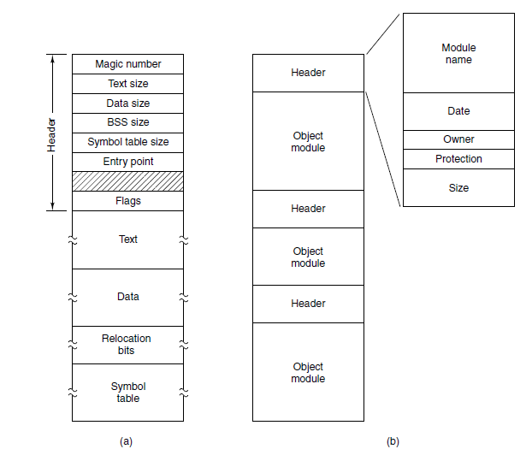
File Types
Figure 4-3. (a) An executable file. (b) An archive
Tanenbaum & Bo, Modern Operating Systems:4th ed., (c) 2013 Prentice-Hall, Inc. All rights reserved.

Slide 12
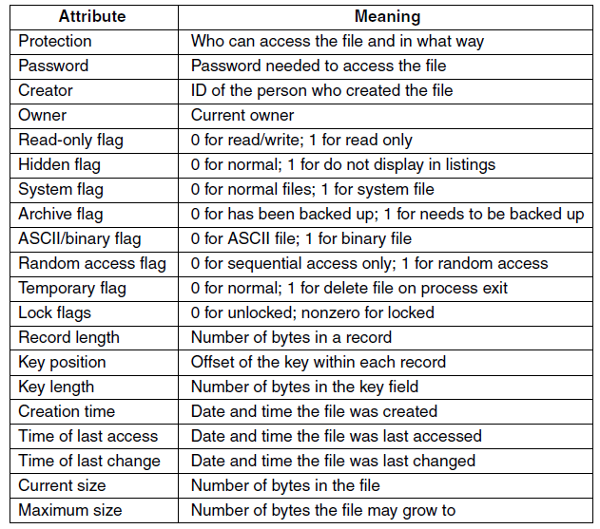
File Attributes
Figure 4-4. Some possible file attributes.
Tanenbaum & Bo, Modern Operating Systems:4th ed., (c) 2013 Prentice-Hall, Inc. All rights reserved.

Slide 13
File Operations
Create
Delete
Open
Close
Read
Write
Append
Seek
Get attributes
Set attributes
Rename
Tanenbaum & Bo, Modern Operating Systems:4th ed., (c) 2013 Prentice-Hall, Inc. All rights reserved.

Slide 14
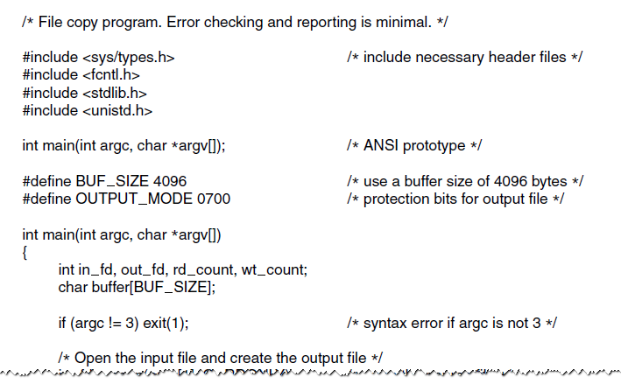
Example Program Using File System Calls (1)
Figure 4-5. A simple program to copy a file.
Tanenbaum & Bo, Modern Operating Systems:4th ed., (c) 2013 Prentice-Hall, Inc. All rights reserved.

Slide 15
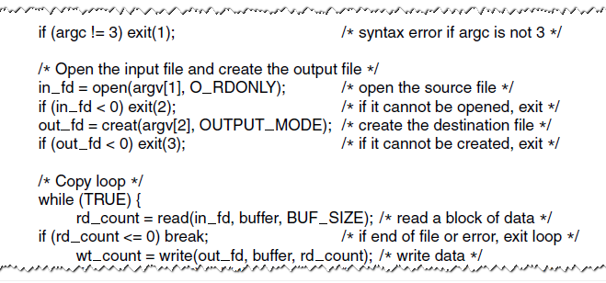
Example Program Using File System Calls (2)
Figure 4-5. A simple program to copy a file.
Tanenbaum & Bo, Modern Operating Systems:4th ed., (c) 2013 Prentice-Hall, Inc. All rights reserved.

Slide 16
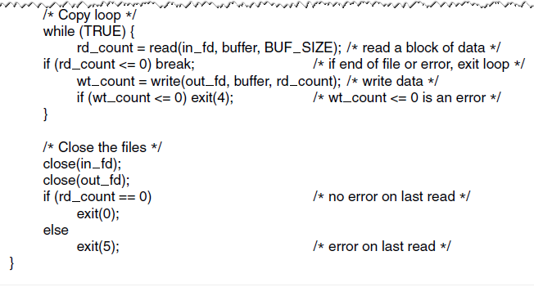
Example Program Using File System Calls (3)
Figure 4-5. A simple program to copy a file.
Tanenbaum & Bo, Modern Operating Systems:4th ed., (c) 2013 Prentice-Hall, Inc. All rights reserved.

Slide 17
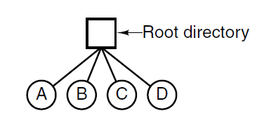
Single-Level Directory Systems
One directory containing all of the files
Figure 4-6. A single-level directory system containing four files.
Tanenbaum & Bo, Modern Operating Systems:4th ed., (c) 2013 Prentice-Hall, Inc. All rights reserved.

Slide 18
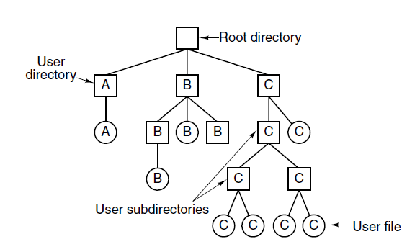
Hierarchical Directory Systems
Figure 4-7. A hierarchical directory system.
Tanenbaum & Bo, Modern Operating Systems:4th ed., (c) 2013 Prentice-Hall, Inc. All rights reserved.

Slide 19
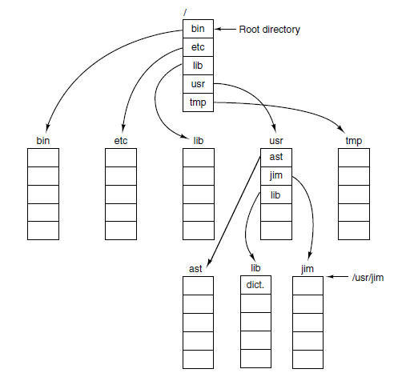
Path Names
Figure 4-8. A UNIX directory tree.
Tanenbaum & Bo, Modern Operating Systems:4th ed., (c) 2013 Prentice-Hall, Inc. All rights reserved.

Slide 20
Path Names
  absolute path name: path from root directory to file
  current working directory: designated directory where work is being done
  relative path name: path from current working directory to file
8_FILE_SYSTEMS

Slide 21
Directory Operations
Create
Delete
Opendir
Closedir
Readdir
Rename
Link
Unlink
Tanenbaum & Bo, Modern Operating Systems:4th ed., (c) 2013 Prentice-Hall, Inc. All rights reserved.

Slide 22

Next Class
File Systems
Modern Operating Systems:
Chapter 4
  Implementation
  Management and Optimization
8_FILE_SYSTEMS

