Slide 1
File Systems
Chapter 4
Tanenbaum & Bo, Modern Operating Systems:4th ed., (c) 2013 Prentice-Hall, Inc. All rights reserved.

Slide 2
Topics
Implementation
Management and Optimization
9_FILE_SYSTEMS

Slide 3
File System Layout
  stored on disks
  disks divided into one or more partitions
    individual file systems on each partition
  MBR: Master Boot Record – sector 0
    used to boot computer
      BIOS reads and executes MBR
      program in boot block – first block contains program which loads OS contained in partition
    contains partition table
      starting and ending addresses of each partition
  Super block: contains key parameters about file system
9_FILE_SYSTEMS

Slide 4
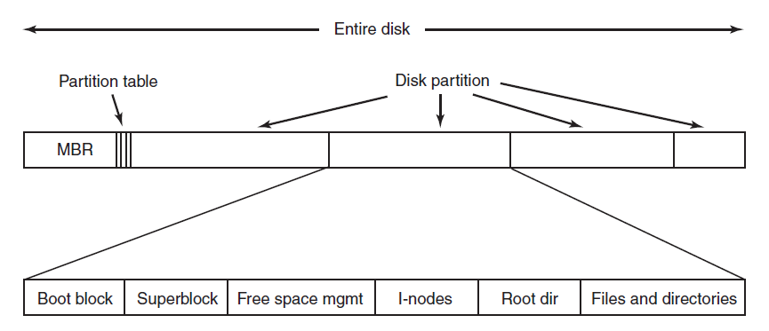
File System Layout
Figure 4-9. A possible file system layout.
Tanenbaum & Bo, Modern Operating Systems:4th ed., (c) 2013 Prentice-Hall, Inc. All rights reserved.

Slide 5
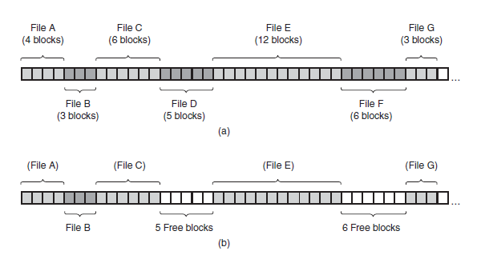
Implementing Files
Contiguous Layout
Figure 4-10. (a) Contiguous allocation of disk
space for seven files. (b) The state of the
disk after files D and F have been removed.
Tanenbaum & Bo, Modern Operating Systems:4th ed., (c) 2013 Prentice-Hall, Inc. All rights reserved.

Slide 6
Contiguous Layout
PROS
CONS
  simple
    address
    blocks in file
  read performance
    entire file read in single operation
  fragmentation
9_FILE_SYSTEMS

Slide 7
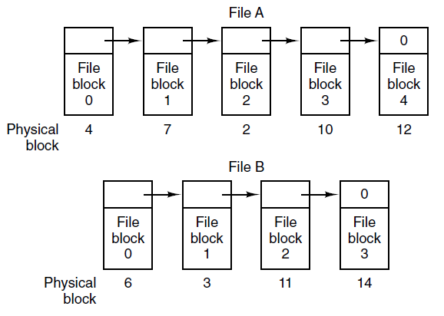
Implementing Files
Linked List Allocation
Figure 4-11. Storing a file as a linked list of disk blocks.
Tanenbaum & Bo, Modern Operating Systems:4th ed., (c) 2013 Prentice-Hall, Inc. All rights reserved.

Slide 8
Linked List Allocation
PROS
CONS
  every disk block can be used
  just store address of first block
  slow to get to blocks in list
  pointer takes up bytes
    now the math is weird
9_FILE_SYSTEMS

Slide 9
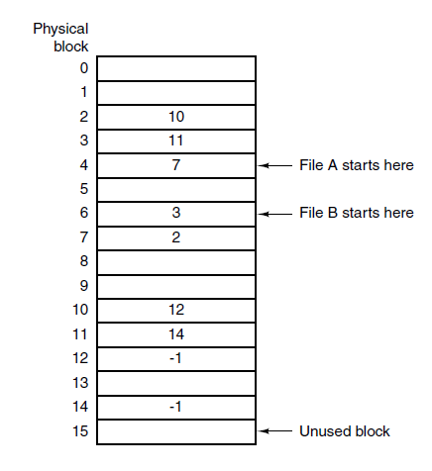
Implementing Files
Linked List – Table in Memory
Figure 4-12. Linked list allocation using a file
allocation table in main memory.
Tanenbaum & Bo, Modern Operating Systems:4th ed., (c) 2013 Prentice-Hall, Inc. All rights reserved.

Slide 10
Linked List Allocation – Table in Memory
PROS
CONS
  solves size and random access problems
    chain is in table not disk
  table needs to be in memory all the time
    kinda big!
    1-TB disk, 1-KB block size => 1 billion entries
9_FILE_SYSTEMS

Slide 11
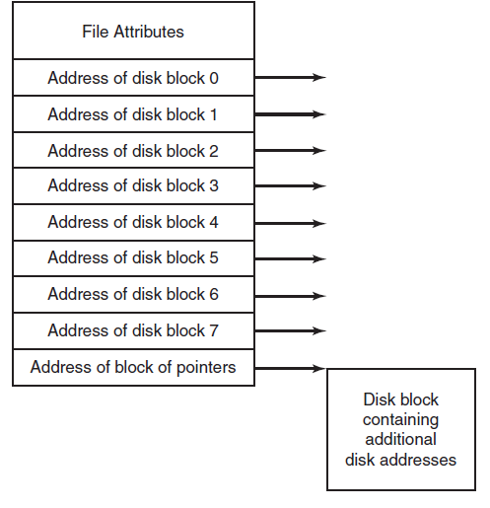
Implementing Files
I-nodes
Figure 4-13. An
example index-node.
Tanenbaum & Bo, Modern Operating Systems:4th ed., (c) 2013 Prentice-Hall, Inc. All rights reserved.

Slide 12
I-nodes
PROS
CONS
  only in memory when file is open
  max number of files long
    not blocks
  ls -i
  fixed number of address
9_FILE_SYSTEMS

Slide 13
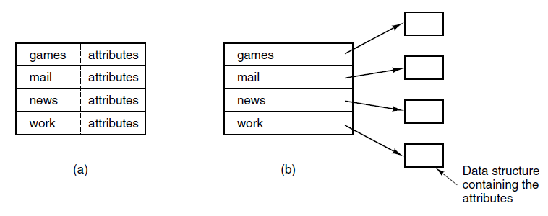
Implementing Directories (1)
Figure 4-14. (a) A simple directory containing fixed-size entries with the disk addresses and attributes in the directory entry. (b) A directory in which each
entry just refers to an i-node.
Tanenbaum & Bo, Modern Operating Systems:4th ed., (c) 2013 Prentice-Hall, Inc. All rights reserved.

Slide 14
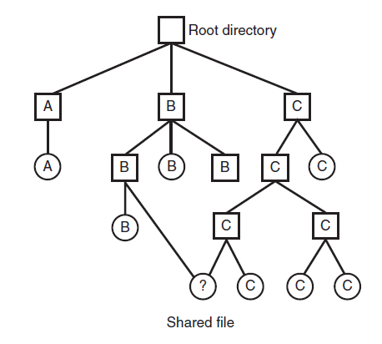
Shared Files (1)
Figure 4-16. File system containing a shared file.
Tanenbaum & Bo, Modern Operating Systems:4th ed., (c) 2013 Prentice-Hall, Inc. All rights reserved.

Slide 15
Shared Files
Problem:
  copy of disk addresses made to B’s directory
    changes made by C will not be visible to B
Solutions
  directories point to i-nodes
  symbolic link
      file that contains a reference to another file or directory
      new file, called LINK, now contained in B’s director
9_FILE_SYSTEMS

Slide 16
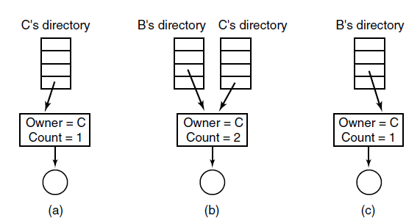
Shared Files (2)
Figure 4-17. (a) Situation prior to linking. (b) After the link is created. (c) After the original owner removes the file.
Tanenbaum & Bo, Modern Operating Systems:4th ed., (c) 2013 Prentice-Hall, Inc. All rights reserved.

Slide 17
Journaling File Systems
Steps to remove a file in UNIX:
Remove file from its directory.
Release i-node to the pool of free i-nodes.
Return all disk blocks to pool of free disk blocks.
Tanenbaum & Bo, Modern Operating Systems:4th ed., (c) 2013 Prentice-Hall, Inc. All rights reserved.

Slide 18
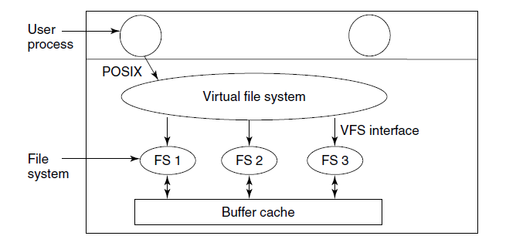
Virtual File Systems (1)
Figure 4-18. Position of the virtual file system.
Tanenbaum & Bo, Modern Operating Systems:4th ed., (c) 2013 Prentice-Hall, Inc. All rights reserved.

Slide 19
Block Size
Large:
  wasted space
Small:
  too many seeks
9_FILE_SYSTEMS

Slide 20
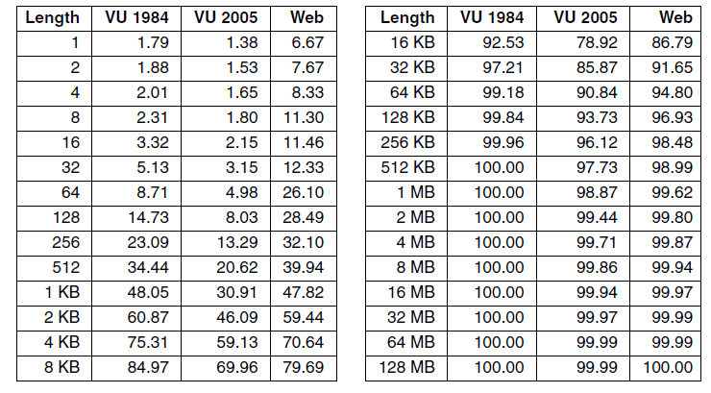
Disk Space Management (1)
Figure 4-20. Percentage of files smaller than a
given size (in bytes).
Tanenbaum & Bo, Modern Operating Systems:4th ed., (c) 2013 Prentice-Hall, Inc. All rights reserved.

Slide 21
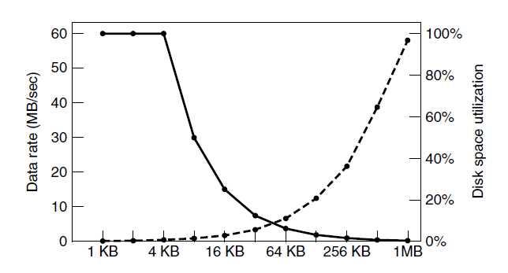
Disk Space Management (2)
Figure 4-21. The dashed curve (left-hand scale) gives the data rate of a disk. The solid curve (right-hand scale) gives the disk space efficiency. All files are 4 KB.
Tanenbaum & Bo, Modern Operating Systems:4th ed., (c) 2013 Prentice-Hall, Inc. All rights reserved.

Slide 22
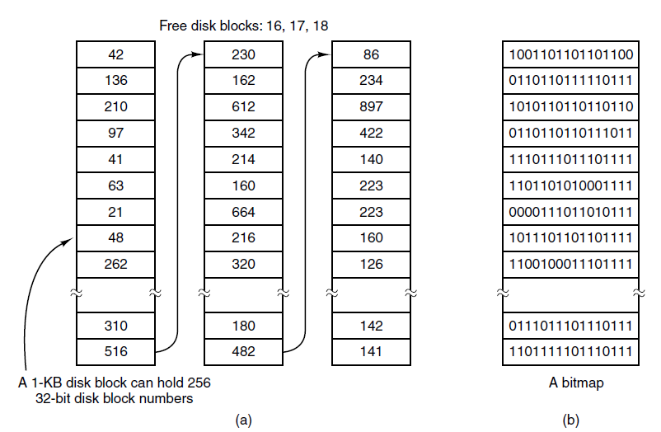
Keeping Track of Free Blocks (1)
Figure 4-22. (a) Storing the free list on a
linked list. (b) A bitmap.
Tanenbaum & Bo, Modern Operating Systems:4th ed., (c) 2013 Prentice-Hall, Inc. All rights reserved.

Slide 23
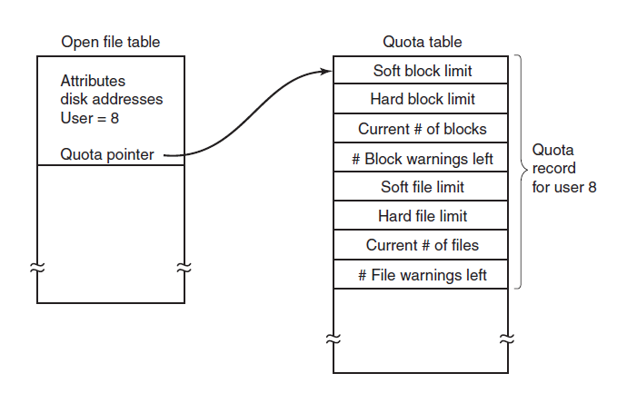
Disk Quotas
Figure 4-24. Quotas are kept track of on a
per-user basis in a quota table.
Tanenbaum & Bo, Modern Operating Systems:4th ed., (c) 2013 Prentice-Hall, Inc. All rights reserved.

Slide 24
File System Backups (1)
Backups to tape are generally made to handle one of two potential problems:
Recover from disaster.
Recover from stupidity.
Tanenbaum & Bo, Modern Operating Systems:4th ed., (c) 2013 Prentice-Hall, Inc. All rights reserved.

Slide 25
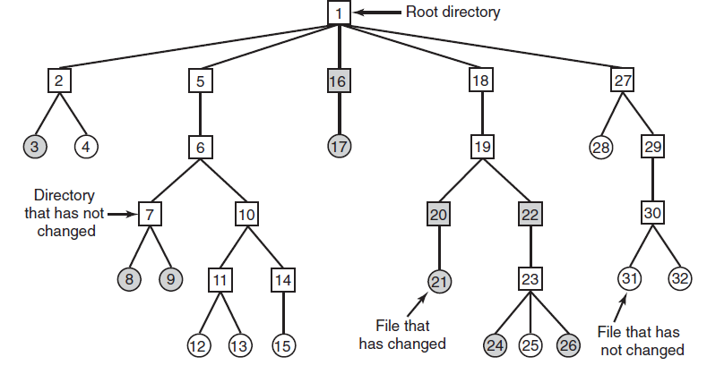
File System Backups (2)
Figure 4-25. A file system to be dumped. The squares are directories and the circles are files. The shaded items have been modified since the last dump. Each directory and file is labeled by its i-node number.
Tanenbaum & Bo, Modern Operating Systems:4th ed., (c) 2013 Prentice-Hall, Inc. All rights reserved.

Slide 26
File System Backups
  Mark modified files and all directories
  Unmark directories that have no modified files or directories in or under
  Dump all directories that are marked for dumping
  Dump remaining files that are marked for dumping
9_FILE_SYSTEMS

Slide 27
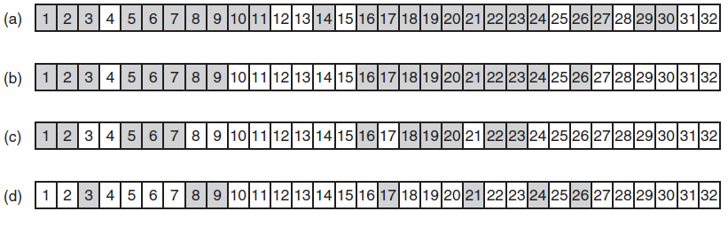
File System Backups (3)
Figure 4-26. Bitmaps used by the logical dumping algorithm.
Tanenbaum & Bo, Modern Operating Systems:4th ed., (c) 2013 Prentice-Hall, Inc. All rights reserved.

Slide 28
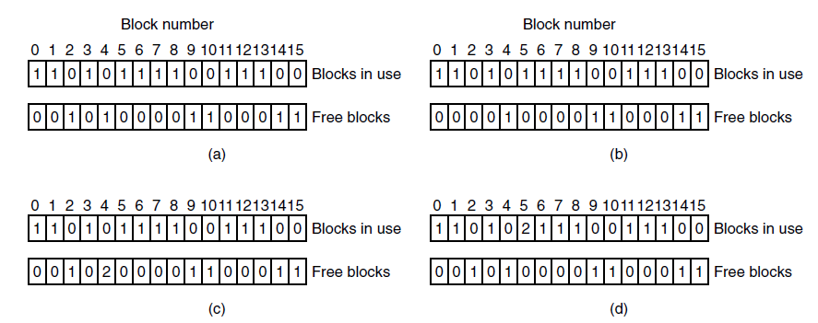
File System Consistency
Figure 4-27. File system states. (a) Consistent. (b) Missing block. (c) Duplicate block in free list. (d) Duplicate data block.
Tanenbaum & Bo, Modern Operating Systems:4th ed., (c) 2013 Prentice-Hall, Inc. All rights reserved.

Slide 29
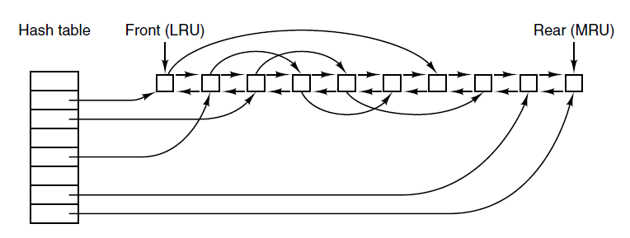
File System Performance (1)
Figure 4-28. The buffer cache data structures.
Tanenbaum & Bo, Modern Operating Systems:4th ed., (c) 2013 Prentice-Hall, Inc. All rights reserved.

Slide 30
File System Performance (2)
Some blocks rarely referenced two times within a short interval.
Leads to a modified LRU scheme, taking two factors into account:
  Is the block likely to be needed again soon?
  Is the block essential to the consistency of the file system?
Tanenbaum & Bo, Modern Operating Systems:4th ed., (c) 2013 Prentice-Hall, Inc. All rights reserved.

Slide 31

Next Class
Memory Management
Modern Operating Systems:
Chapter 3
  Abstractions
  Address Spaces
  Virtual Memory
  Page Replacement
9_FILE_SYSTEMS

