Slide 1











PLANT
CARE MANAGER
Presented by Group 36
Object Oriented Programming (AI3101)

Slide 2
OUR TEAM
  Prithviraj Patil (SE23UARI141)
  Anush Mohanty (SE23UARI011)
  Ritwick Sharma (SE23UARI105)
  Sathvik Voleti (SE23UARI113)
  Rishab Mahendra (SE23UARI102)

Slide 3
PROBLEM STATEMENT
Challenge
  Keeping track of different watering schedules for multiple plants is difficult.
  Paper logs are easily lost or damaged.
  Users often forget when they last watered their plants.
Solution
  A digital Plant Care Manager that centralizes plant data.
  Provides distinct Water Now tracking and Check Due logic to identify neglected plants instantly.

Slide 4
INPUT PARAMETERS
The application accepts the following inputs via Dialogs and Forms:
  Plant Identity
    Name: (Plant Name) → JTextField.
    Species: (Plant Species) → JTextField.
  Care Schedule
    Watering Interval: (Selection of days) → JComboBox.
  User Notes
    Care Log: (Text Notes) → JTextArea.

Slide 5
APPROACH
  Core Technology: Java Swing (GUI) & AWT (Layouts).
  Layout Management
  BorderLayout: Used for the main window structure (West/Center/East).
  BoxLayout: Used for the right-side Action panel to stack buttons vertically.
  GridLayout: Used for the Quick Actions panel.
  DefaultListModel: Manages the dynamic list of plants, allowing real-time updates.

Slide 6
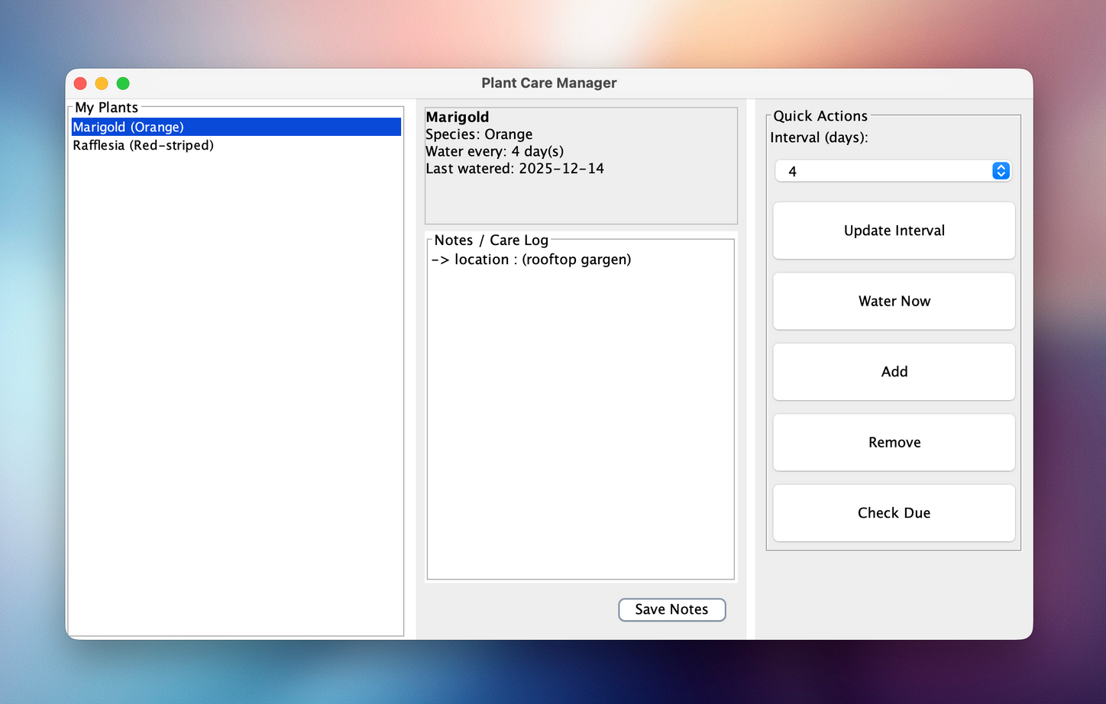
OUTPUT

Slide 7
FEATURES
Plant List (Left Panel)
  A scrollable list of all registered plants using JList.
Details View (Center Panel)
  A JLabel displays bold names and formatted dates.
  Editable Notes: A persistent text area to read/write notes for the selected plant.
Action Panel (Right Panel)
  Quick Actions: Buttons to Water Now, Update Interval, and Check Due.
  Pop-up Feedback: JOptionPane dialogs provide confirmation for saves, adds, and alerts.

Slide 8
MEMBER 1
SE23UARI141
Role: Logic & Action Buttons (Right Panel)
  Quick Actions UI: Designed the right panel using BoxLayout and GridLayout to stack control buttons neatly.
  Watering Logic: Implemented the waterNow action to update the lastWatered timestamp.
  Check Due Algorithm: Developed the logic to iterate through the list, calculate date differences, and identify plants overdue for watering, displaying them in a summary dialog.

Slide 9
MEMBER 2
SE23UARI011
Role: List Management (Left Panel)
  Model Integration: Implemented DefaultListModel<Plant> to allow dynamic addition and removal of plant objects.
  Component Implementation: Configured the JList and wrapped it in a JScrollPane to handle overflow.
  Selection Logic: Added the ListSelectionListener to detect user clicks and trigger updates in the Detail and Note panels.

Slide 10
MEMBER 3
SE23UARI105
Role: System Architecture & Main Layout
  Frame Setup: Implemented the PlantCareManagerSimple class extending JFrame.
  Window Properties: Configured setSize(800, 480), setDefaultCloseOperation, and centering logic.
  Root Layout: Established the primary BorderLayout container to divide the application into three distinct functional zones (West, Center, East).

Slide 11
MEMBER 4
SE23UARI113
Role: Data Modeling
  Plant Class: Designed the Plant class to encapsulate private attributes: name, species, intervalDays, and lastWatered.
  Date Handling: Implemented java.util.Date to track the exact timestamp of watering events.
  Formatting Logic: Created the detailString() method to generate user-friendly output for the UI, converting raw dates into readable formats.

Slide 12
MEMBER 5
SE23UARI102
Role: Detail View & Notes (Center Panel)
  Information Display: Implemented the JLabel for showing plant details, utilizing HTML for bold text and line breaks.
  Notes System: Integrated JTextArea with line-wrapping (setLineWrap) for user logs.
  Persistence Logic: Coded the Save Notes button ActionListener to write text back to the Plant object and confirm via JOptionPane.

Slide 13
CONCLUSION
The application successfully solves the problem of plant tracking using a clean, event-driven Swing interface.
1.
It demonstrates mastery of Layout Managers, Listeners, and Object-Oriented principles.
2.

Slide 14
FUTURE SCOPE
1.
Persistence: Save data to a file or database so it survives application restarts.
Images: Allow users to upload photos of their actual plants.
2.
3.
Reminders: Background threads to trigger popup notifications when a plant becomes due.

Slide 15
THANK
YOU

