Slide 1

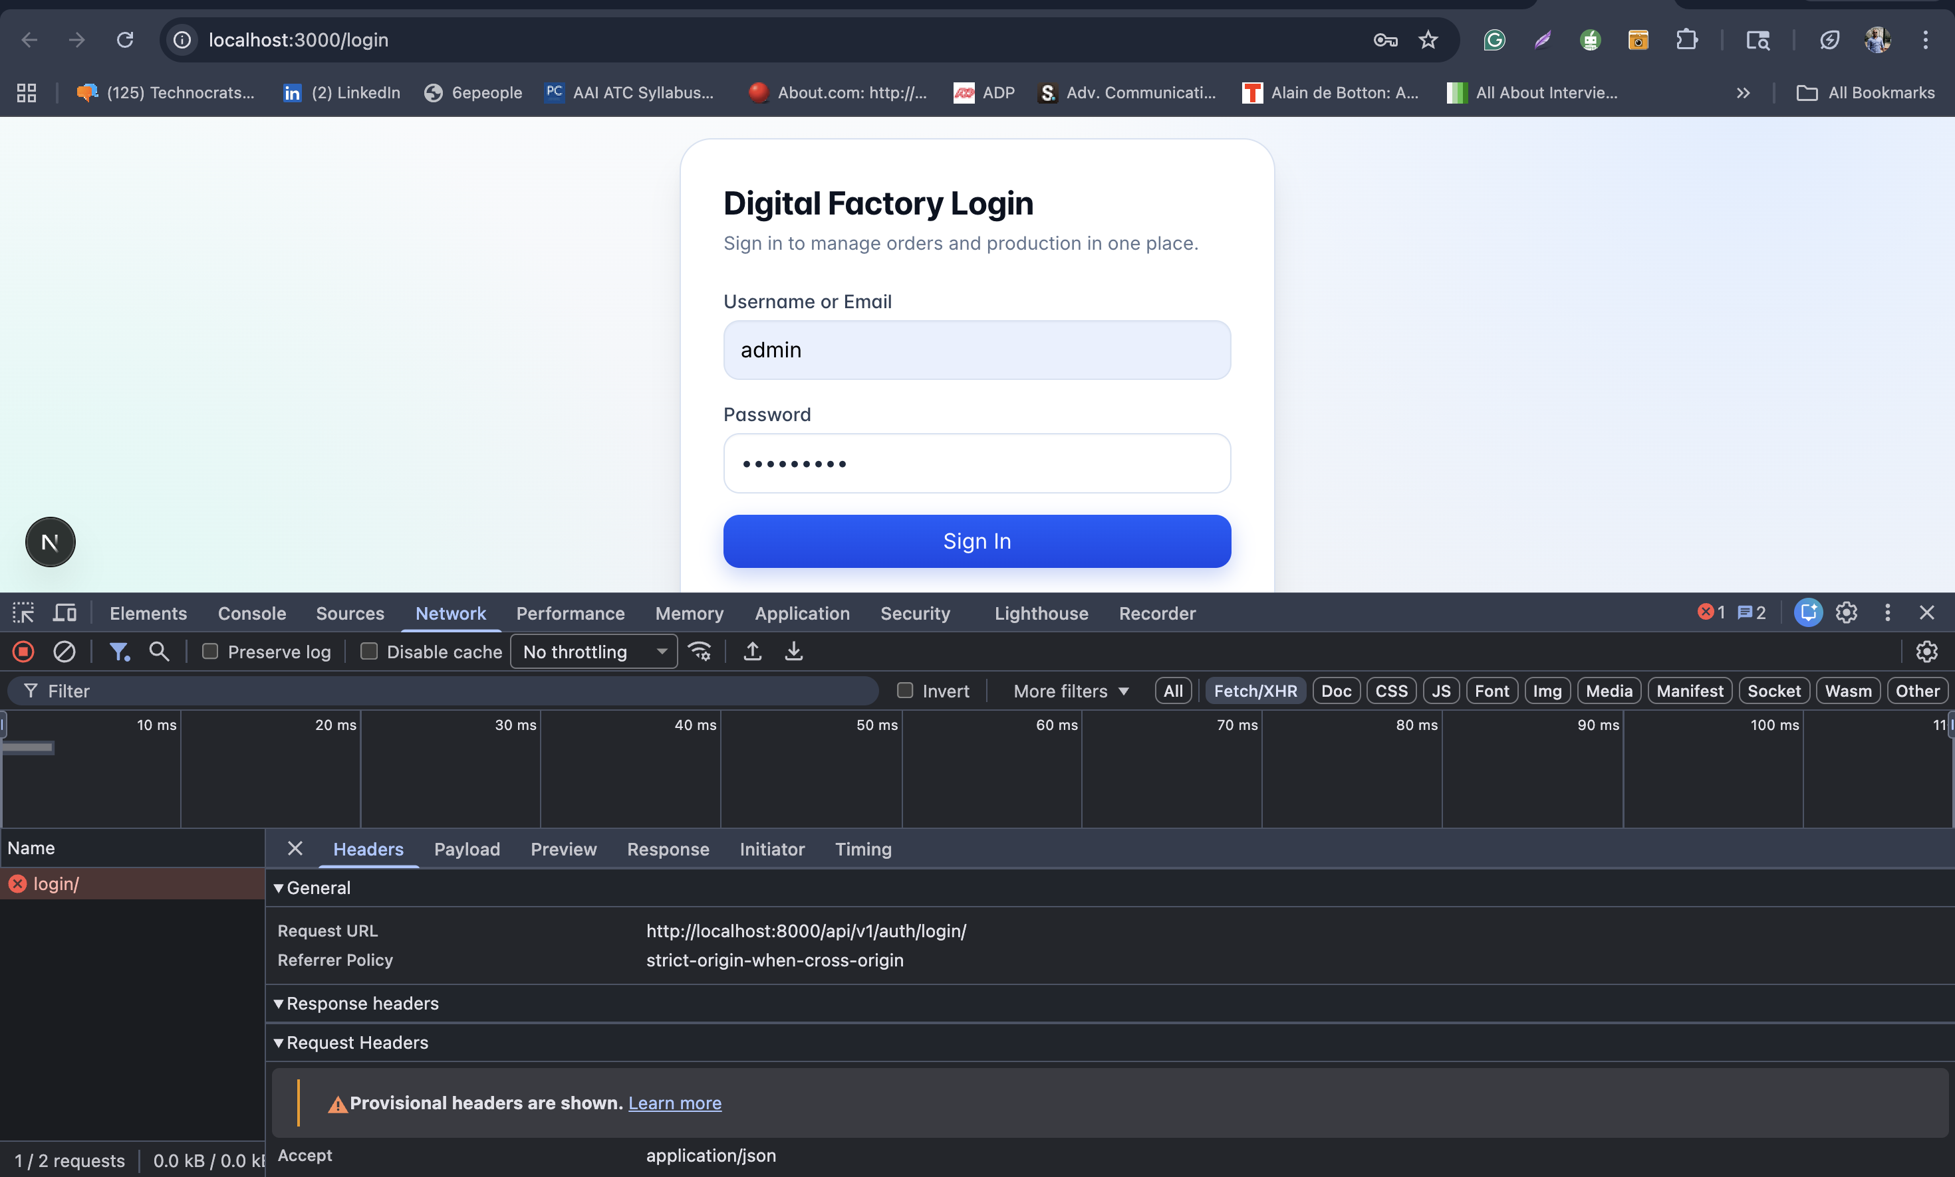
Digital Factory Management System
Digital Factory Management System
Client Pitch Deck ERP + CRM + Reusable Kanban Engine

Slide 2
Digital Factory Management System
The Business Problem
Most factories operate on disconnected tools across production, inventory, quality, and sales.
Leadership lacks one live control plane for operations + revenue execution.
Result: delayed decisions, missed follow-ups, and weak forecasting confidence.

Slide 3
Digital Factory Management System
Our Solution
Unified ERP + CRM platform with premium execution UX.
Factory operations and sales pipeline connected in one data model.
Reusable Kanban workflow engine for current and future modules.

Slide 4
Digital Factory Management System
Why This Product Wins
Operational Advantage
Strategic Advantage
Single platform reduces data duplication and coordination overhead.
Reusable board architecture scales to orders, support, approvals, procurement.
Fast adoption via premium interface and role-aware navigation.
Production-ready backend and API architecture.
Audit and permission controls for enterprise governance.
Roadmap-ready foundation for automation and integrations.

Slide 5
Digital Factory Management System
Product Experience
Premium UI built for executive demos and everyday operator speed

Slide 6
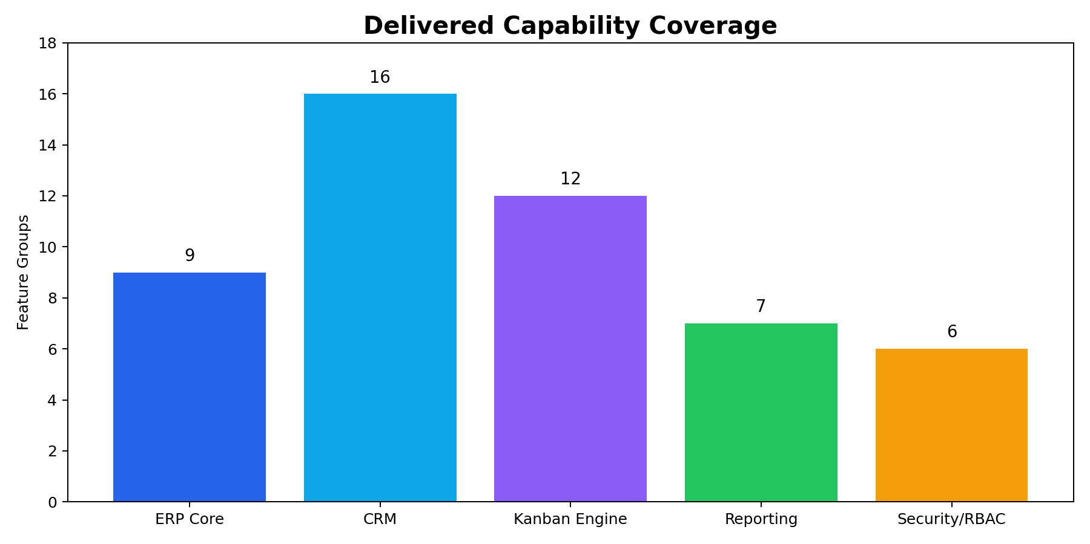
Digital Factory Management System
Capability Depth
Broad module coverage across operations, CRM, analytics, and governance

Slide 7
Digital Factory Management System
Client Outcomes
Faster lead-to-order execution and better follow-up discipline.
Higher production visibility and improved planning confidence.
Stronger accountability through assignment and timeline/audit trails.
Better leadership decisions through live KPIs and operational reports.

Slide 8
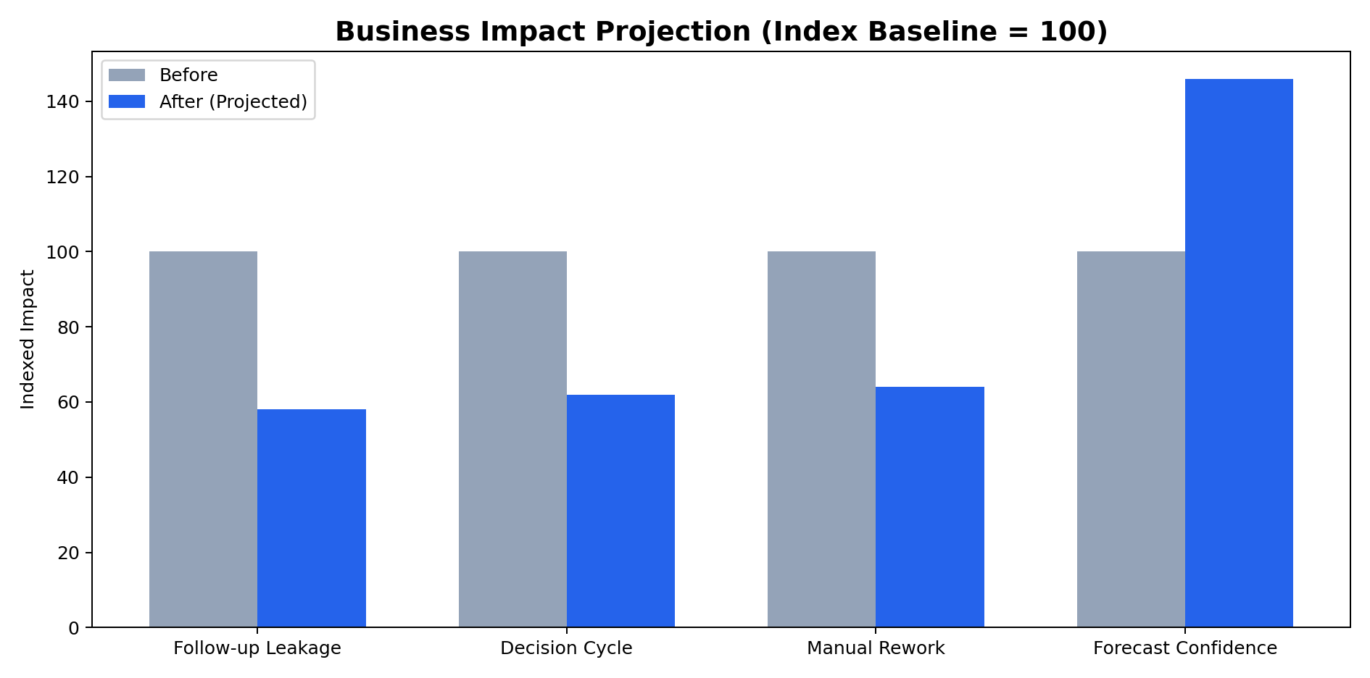
Digital Factory Management System
ROI Projection Narrative
Expected improvements after unified platform rollout

Slide 9
Digital Factory Management System
Demo Story (5-Minute Pitch)
1) Dashboard snapshot of operations health
2) Order/production/inventory/quality quick walkthrough
3) CRM pipeline board + stage movement
4) Quotation + timeline + customer context
5) Close with ROI and roadmap

Slide 10
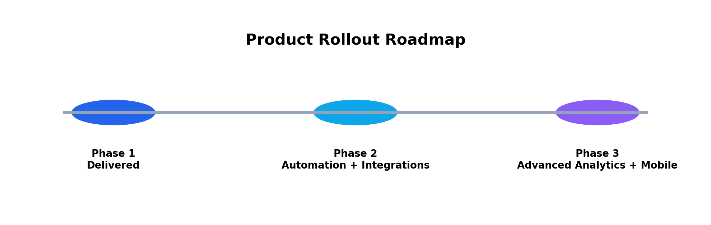
Digital Factory Management System
Implementation Roadmap
Phased rollout strategy for predictable value delivery

Slide 11
Digital Factory Management System
Commercial Positioning
Position as strategic platform investment, not a point solution.
Show immediate operational value and long-term extensibility.
Support/SLA + phase-2 automation roadmap strengthens deal confidence.

Slide 12
Digital Factory Management System
Final Pitch Close
Digital Factory Management System is ready for production use today.
It unifies operations and revenue workflows with premium enterprise UX.
The architecture is built to scale as your process digitization expands.

