Slide 1

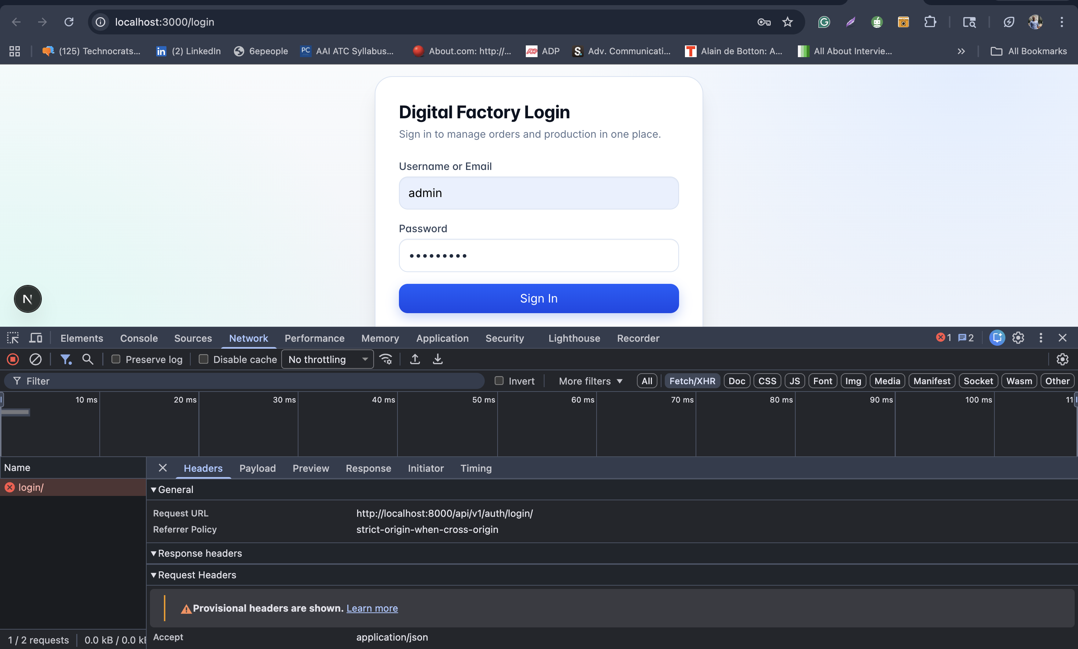
Digital Factory Management System
End-to-End Project Report
Digital Factory Management System Client Handover Deck | April 15, 2026

Slide 2
Digital Factory Management System
Executive Summary
Unified ERP + CRM platform for factory operations and revenue execution.
Production-grade architecture with role-based controls and auditability.
Premium UX with dark/light themes, fast workflows, and reusable Kanban boards.

Slide 3
Digital Factory Management System
Delivery Scope
ERP Core (Delivered)
CRM + Kanban (Delivered)
Auth, users, buyers, lines, orders, production entries
Inventory, quality, workforce, planning, reports hub
CSV export-ready analytics and dashboard visibility
CRM dashboard, leads, accounts, contacts, opportunities
Activities, tasks, notes, quotations, timeline, reminders
Reusable Kanban engine with generic board + move APIs

Slide 4
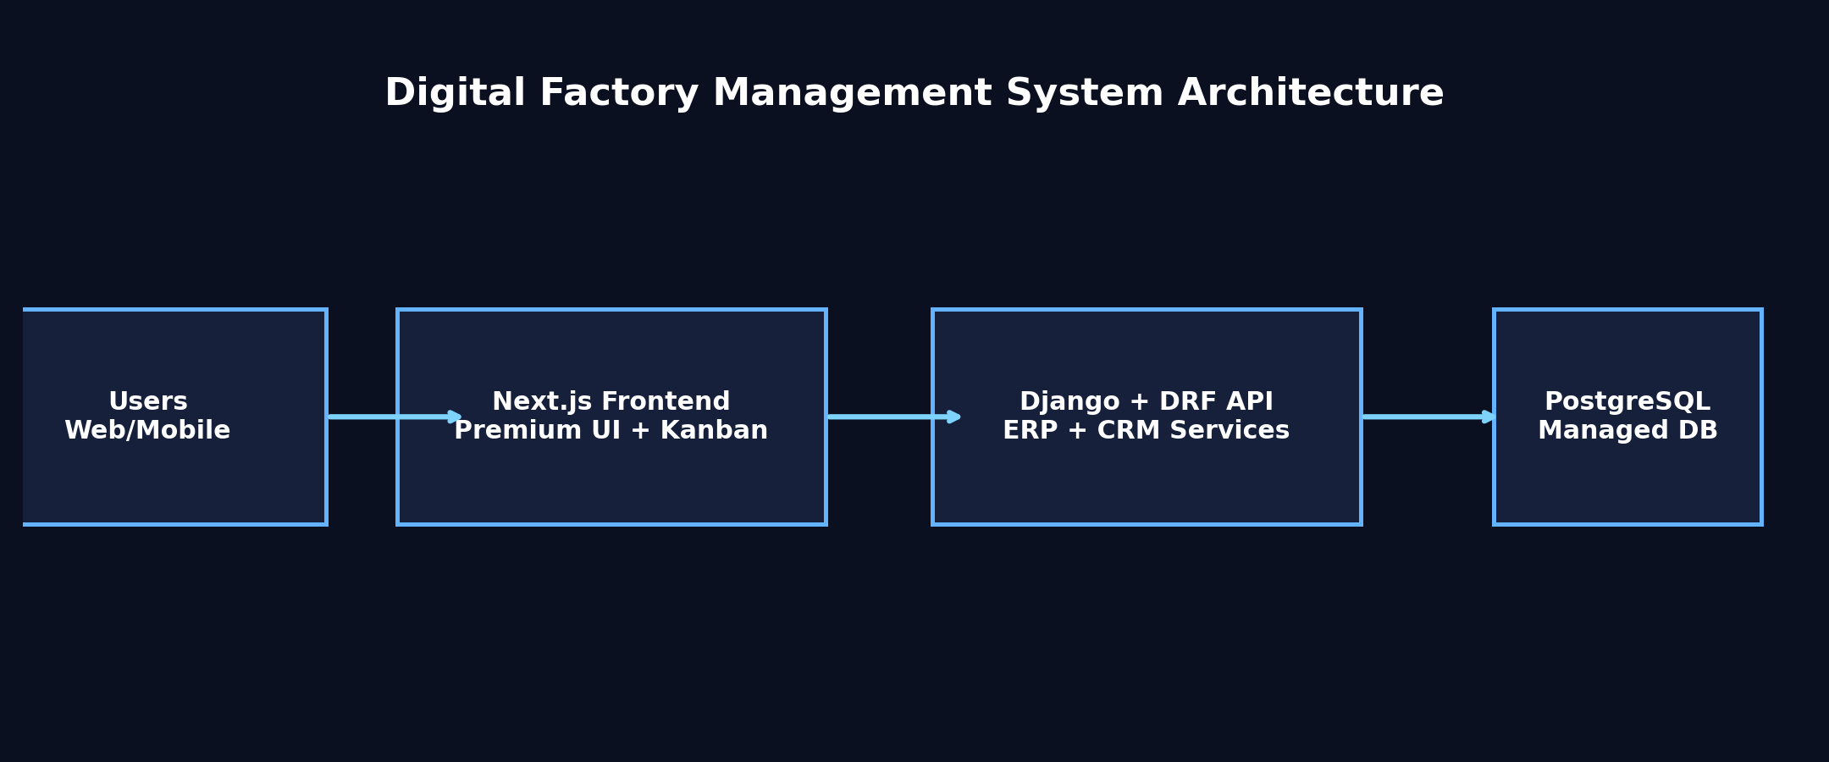
Digital Factory Management System
System Architecture
Frontend (Next.js) + Backend (Django/DRF) + Managed PostgreSQL

Slide 5
Digital Factory Management System
Technology Stack
Frontend
Backend
Next.js 16, React 19, TypeScript, Tailwind CSS
TanStack Query, React Hook Form + Zod
dnd-kit for reusable Kanban interactions
Django 5, DRF, django-filter, SimpleJWT
PostgreSQL with Render deployment model
Gunicorn + WhiteNoise production server setup

Slide 6
Digital Factory Management System
Security & Governance
JWT authentication with access + refresh token model.
Role-based permissions enforced at API layer and UI action layer.
Assignment history, stage transition history, and audit event tracking.
CORS/CSRF/host controls configured for production domains.

Slide 7
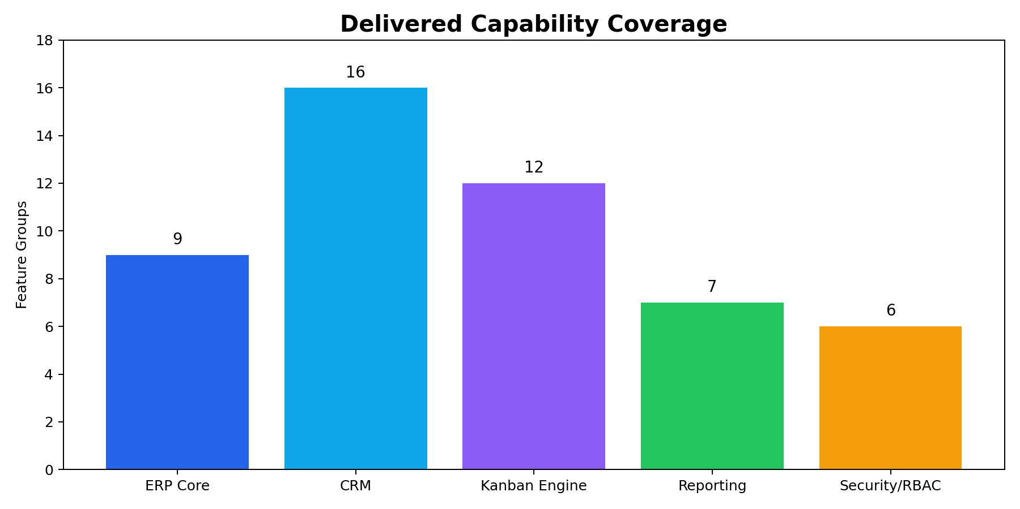
Digital Factory Management System
Delivered Capability Coverage
Feature groups delivered across ERP, CRM, Kanban, analytics, and controls

Slide 8
Digital Factory Management System
CRM Functional Coverage
Lead lifecycle: create, assign, status flow, conversion to account/contact/opportunity.
Account and contact management with owner, tags, and customer context.
Opportunity execution with pipelines, stages, probability, and win/loss outcomes.
Activities, tasks, notes, quotations, and timeline in one workflow.

Slide 9
Digital Factory Management System
Reusable Kanban Engine
Generic board architecture by module key (lead/opportunity/task supported).
Configurable stages, filtered cards, summaries, and drag-drop stage movement.
Backend transition validation, audit capture, and stage history persistence.
Extensible foundation for orders, support tickets, approvals, and procurement.

Slide 10
Digital Factory Management System
Premium UI Snapshot
Premium login and dashboard UX direction with dark-theme-first experience

Slide 11
Digital Factory Management System
API Coverage Highlights
Full CRM CRUD endpoints for leads/accounts/contacts/opportunities/activities/tasks/notes/quotations.
Workflow endpoints: convert, kanban board fetch, kanban move, bulk actions, assignment, timeline.
Analytics endpoints: CRM dashboard summary + filter metadata.
ERP APIs retained and integrated without breaking existing operational modules.

Slide 12
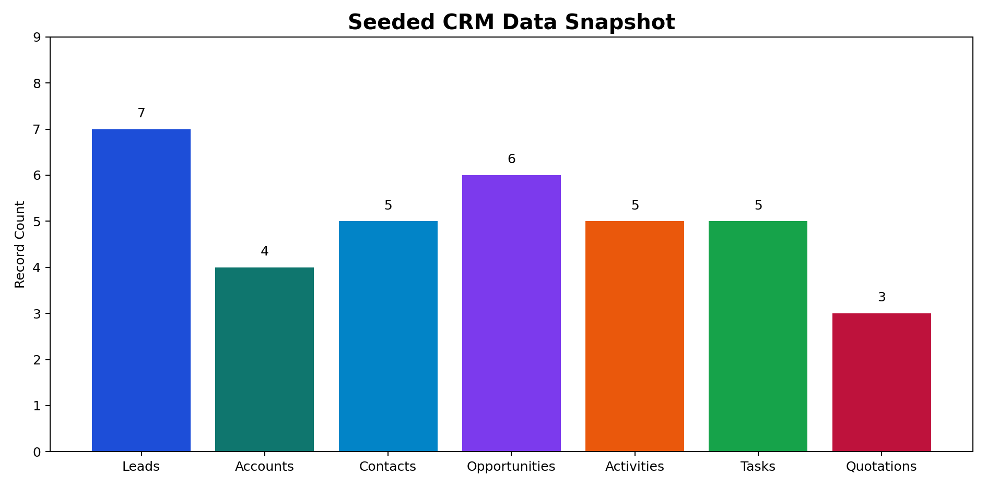
Digital Factory Management System
Seeded CRM Data Snapshot
Demo-ready data loaded for immediate walkthrough and training

Slide 13
Digital Factory Management System
Quality Validation Summary
Backend system checks pass.
CRM API tests pass (`apps.crm.tests.test_api`).
Frontend lint and production build pass.
Hydration mismatch mitigated by root layout hardening and theme alignment.

Slide 14
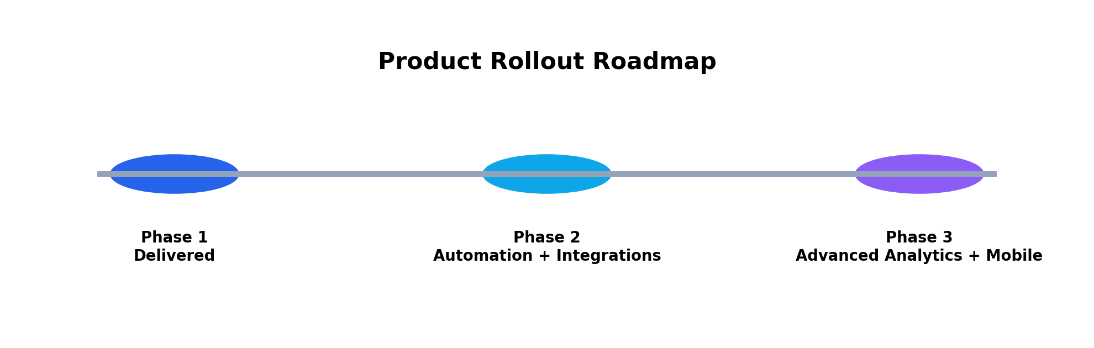
Digital Factory Management System
Roadmap
Phased expansion plan: automation, integrations, advanced analytics, and mobile workflows

Slide 15
Digital Factory Management System
Go-Live Runbook
Monitor `/api/v1/health/` and auth success/failure rates.
Validate CORS/CSRF env values with live frontend domain.
Track CRM overdue follow-ups and pipeline movement as adoption KPI.
Run backup/restore checks and release rollback readiness.

Slide 16
Digital Factory Management System
Closing
The platform now operates as a unified factory + revenue business OS.
Current release is production-ready with modular scalability for future phases.
All deliverables, code, tests, seed data, and client docs are complete.

