Slide 1
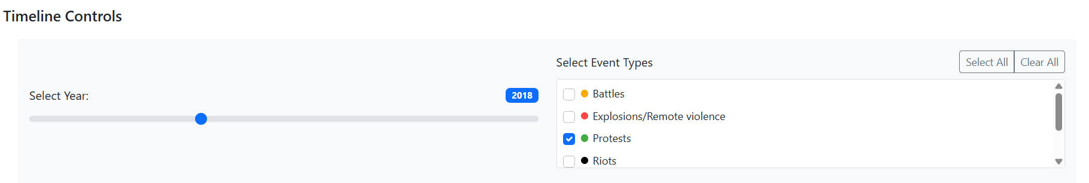
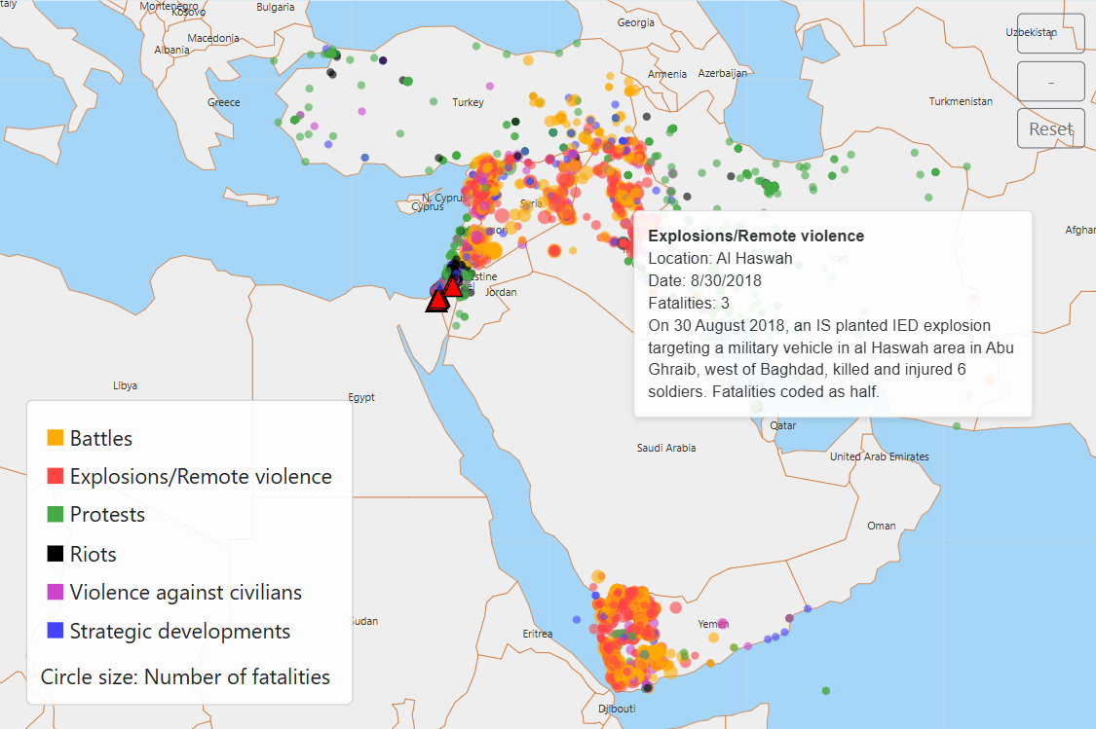
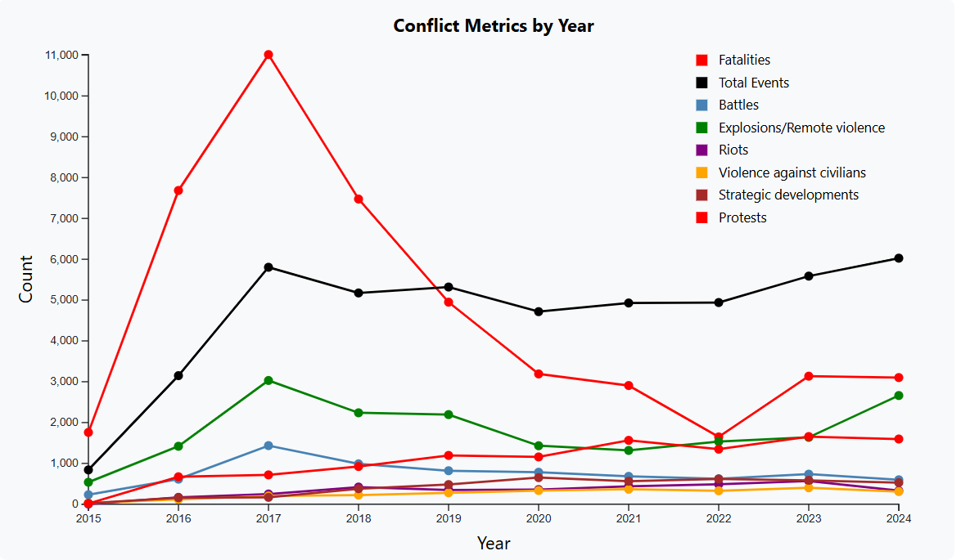
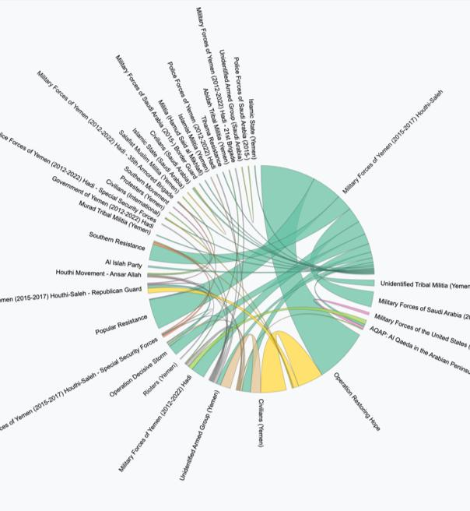
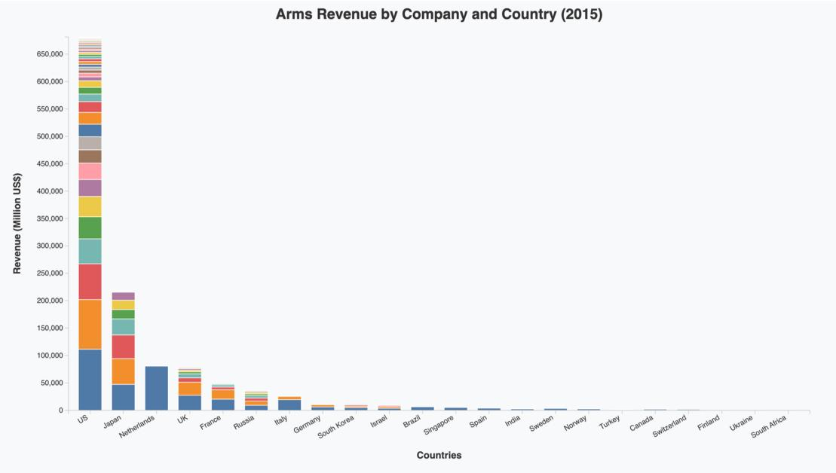
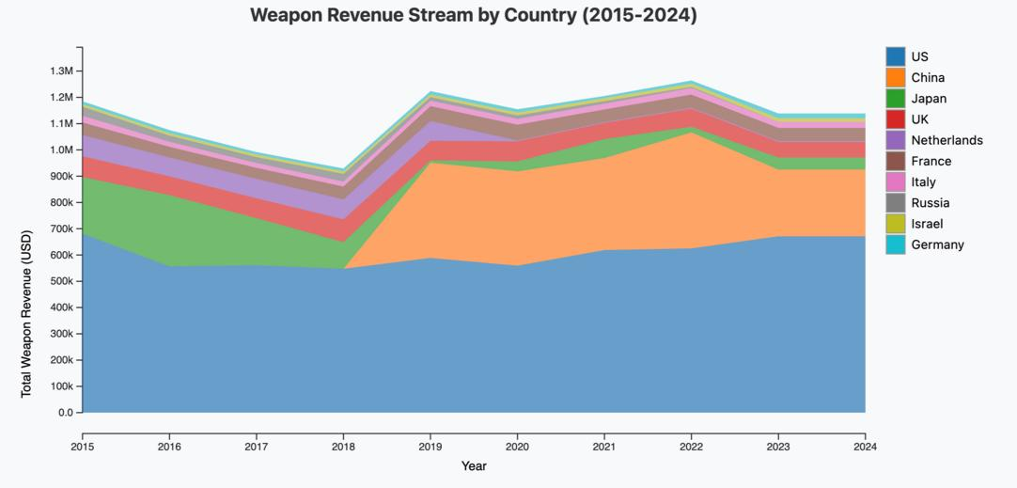
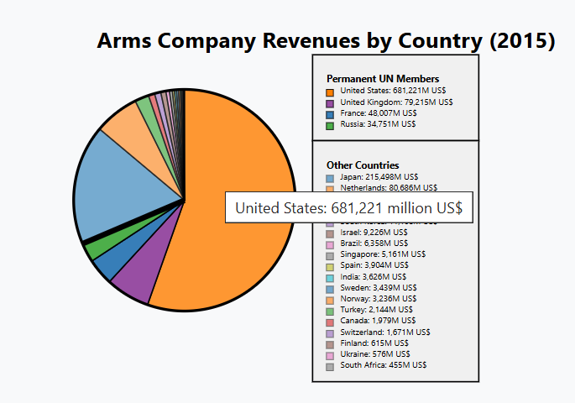
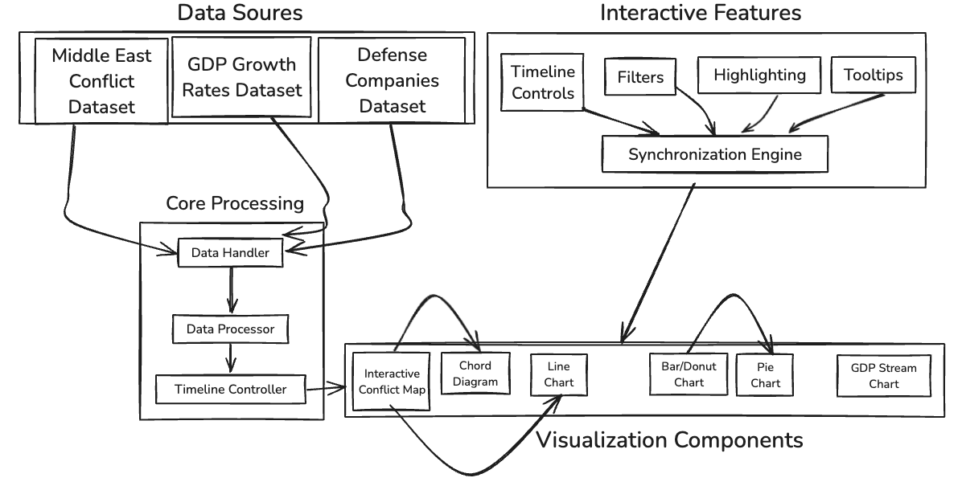
BattleLens – Exploring the Dynamics of Conflict and Defense Economies
Introduction
The Middle East exemplifies how conflict and commerce intertwine. Known for unrest and as a major arms trade hub, it reveals a complex network where weapons manufacturing thrives amid war's devastation. Understanding this is essential. The global weapons industry, driven by political alliances and economic incentives, both fuels and mitigates conflicts. How do arms sales impact producing nations' GDP? What links conflicts to defense revenues? How can we promote transparency and accountability? Data holds the answers. By analyzing Middle Eastern conflicts and their ties to the defense industry, we expose the economic forces behind violence. BattleLens offers an interactive journey to reveal these narratives. We aim to empower decision-makers with insights to make informed choices in a world shaped by the business of war. Conflict isn't just destruction; it's about profit, resilience, and the struggle for stability—a story we invite you to explore.
Datasets
Dataset1: Middle East Conflict Dataset (ACLED) - This dataset documents political violence and demonstrations worldwide, featuring over 36,000 events. Each entry includes details such as the event ID, date, location (country, region, administrative levels), actors involved, and the event type (e.g., battles, protests, riots, or explosions). Key attributes capture fatalities, targeted civilians, and interaction types between actors, along with geographical precision and sources of information. The dataset provides insights into patterns of violence, geopolitical trends, and social unrest across different regions over time..
Dataset2: This dataset lists Annual GDP Growth Rates (percent change) for countries and regions from 1980 to 2024, showing trends in global economic performance. It includes the country name, the GDP growth rate for each year, and highlights year-over-year changes, providing insights into economic fluctuations and regional growth patterns.
Dataset3: This dataset lists the top 100 defense companies in 2015-2024, detailing their rank, leadership, country, defense revenues, percentage revenue change, total revenue, and the share of revenue from defense. It highlights financial trends and key players in the global defense industry.
System Description
1. Interactive Conflict Map
Visualization: Displays conflict events on a Middle East map using scaled circles to represent fatalities.
Interactions: Includes zoom controls, timeline filtering, and event type selection via checkboxes.
Extension: Synchronizes with other visualizations through shared timeline controls and event filters.
2. Chord Diagram
Visualization: Illustrates relationships between conflict actors using an interactive chord diagram.
Interactions: Highlights connections via interactive ribbons that trigger map location pinpoints.
Extension: Integrated with the map through synchronized highlighting and event filtering.
3. Line Chart
Visualization: Displays trends in total fatalities and events, with distinct lines for event types (e.g., battles, protests).
Interactions: Hover-enabled tooltips and zoom/pan controls for detailed exploration.
Extension: Supports dynamic data aggregation for multiple event types, enhancing analytical depth.
4. Companies Bar/Donut Chart
Visualization: Shows arms revenue data per country using a dual-chart system—stacked bar chart transitioning to a donut chart.
Interactions: Click-to-transform animation, detailed tooltips for company revenue percentages, and synchronized timeline updates.
Extension: Smooth bar-to-donut transformation with integrated legend for detailed breakdowns.
5. Pie Chart
Visualization: Highlights global arms revenue distribution, emphasizing UN Security Council members (China, France, Russia, UK, US).
Interactions: Hover effects with detailed tooltips, dynamic updates based on year selection.
Extension: Distinct color schemes and visual separators between UN and non-UN members, with automated legend positioning.
6. GDP Stream Chart
Visualization: Integrates arms revenue and GDP growth data (2015–2024) using a stream chart. Stream thickness indicates GDP growth; y-axis position reflects arms revenue.
Interactions: Hover-enabled tooltips display detailed revenue and GDP data for selected years.
Extension: Combines weapon revenue and GDP datasets to emphasize correlations, with potential for additional filters and synchronization with other visualizations.
STORY FLOW
Event Surge: Conflict events skyrocketed from 840 in 2015 to 6,026 in 2024, with major spikes in 2017 and 2024, reflecting significant escalations.
A World of Instability
In a world shaped by political instability and economic disparity, the Middle East stands as a poignant example of how conflict and commerce intertwine.
Beneath the Surface
Beneath the surface of these conflicts lies a complex network of economic dependencies and strategic interests, where weapons manufacturing and defense economies thrive.
The Economic Lens
How do arms sales affect the GDP of producing nations? What patterns emerge when we connect the dots between conflict events and defense revenues?
Unveiling Hidden Narratives
Through this exploration, we aim to empower policymakers, researchers, and citizens with the insights needed to make informed decisions about a world deeply impacted by the business of war.
Political Violence: Dominates events, peaking in 2017–2018.
Demonstrations: Steady rise indicates increasing civilian activism.
Strategic Developments: Gradual growth suggests long-term conflict planning.
Results and Analysis
Arms Trade Dominance by Security Council Members:
Permanent members of the UN Security Council (US, UK, France, Russia, China) dominate the global arms trade. Data from weapon manufacturers highlights that these nations contribute more than 70% share of global arms sales, often supplying weapons to conflict zones, including the Middle East.
Revenue from Conflict-Driven Markets:
Countries like the US, Russia, and France generate substantial revenue from arms exports to Middle Eastern countries. This economic incentive aligns with data showing increased arms sales during periods of intensified conflict in the region, suggesting these nations have a financial stake in sustaining such unrest.
Political Influence and Military Alliances:
Many Middle Eastern conflicts involve alliances or support from Security Council members, either through direct military involvement (e.g., US in Iraq) or arms supplies to proxies (e.g., Russian weapons to Syria). The strategic geopolitical positioning of the Middle East, coupled with economic gains, highlights a pattern where these nations perpetuate instability rather than resolve it.
System Design
Prithvi Shirke Raghav Kapoor Ravi Dasari Chirag Dhawan
pshirke1@asu.edu rkapoo22@asu.edu rdasari9@asu.edu cdhawan@asu.edu

