Slide 1


MARKETING FOR FINANCE CASE STUDY
GROUP 7
RUT CHOLERA
PRATHAM MALHOTRA
PRITHVI SESHADRI
SUSHMITA SADHWAN
DHRUV CHOPRA

Slide 2
PROBLEM STATEMENT
Targeting Challenge: Banks face difficulty in identifying ideal customers for campaigns, needing in-depth analysis of diverse data points like occupation, income, age, and credit history.
Data Analysis Vital: Thorough exploration of customer data uncovers essential patterns, aiding informed decisions for effective marketing strategies.

Slide 3
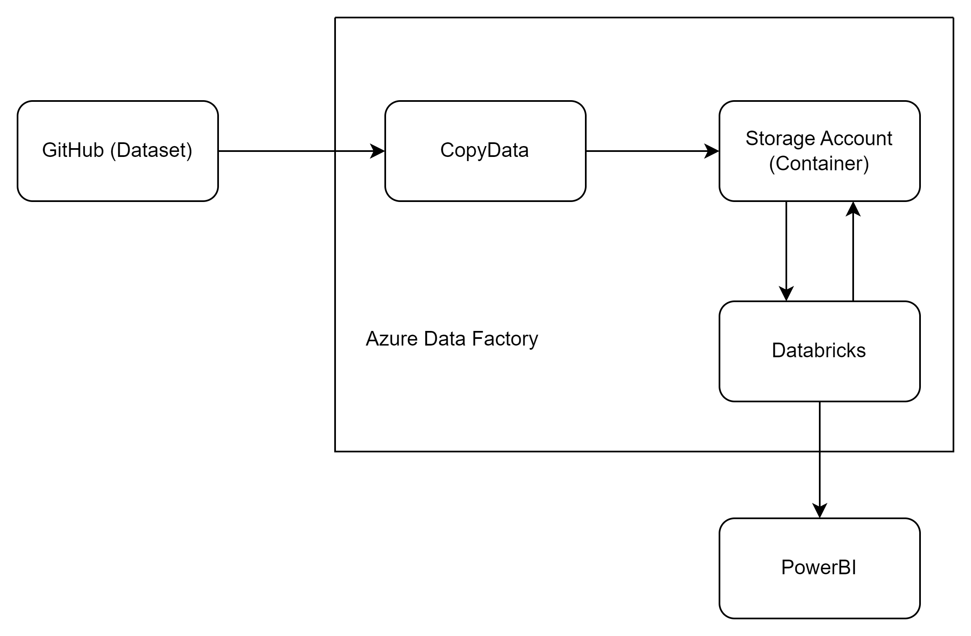
FINAL ARCHITECTURE

Slide 4
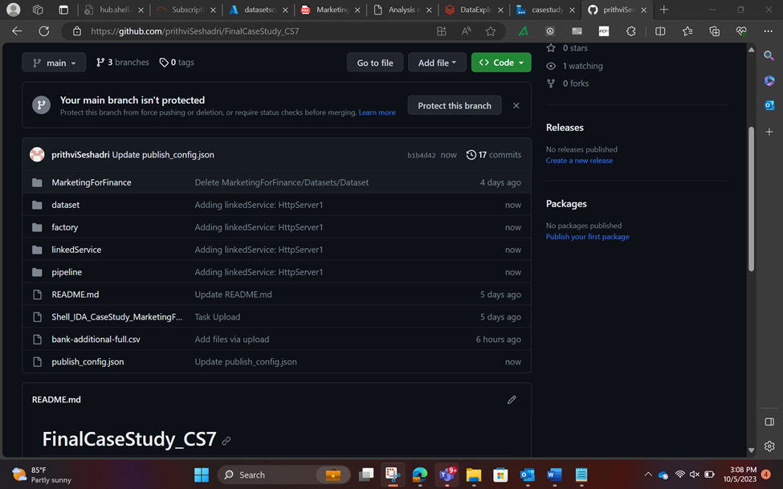
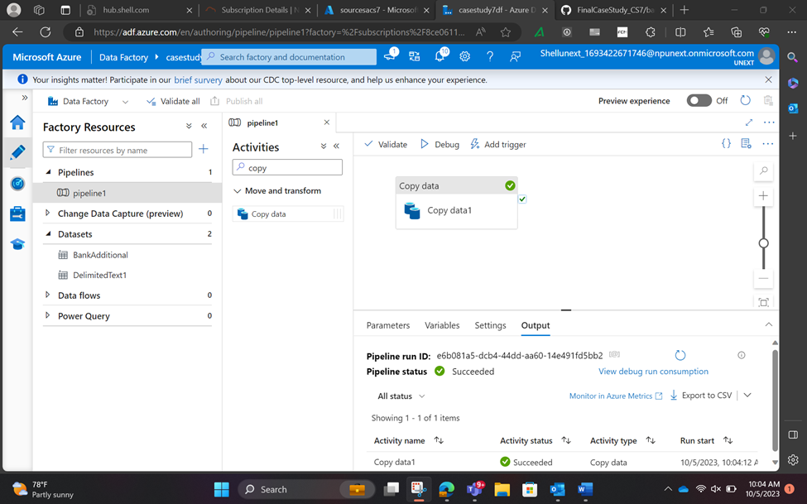
DATA LAYERS SNAPSHOTS

Slide 5
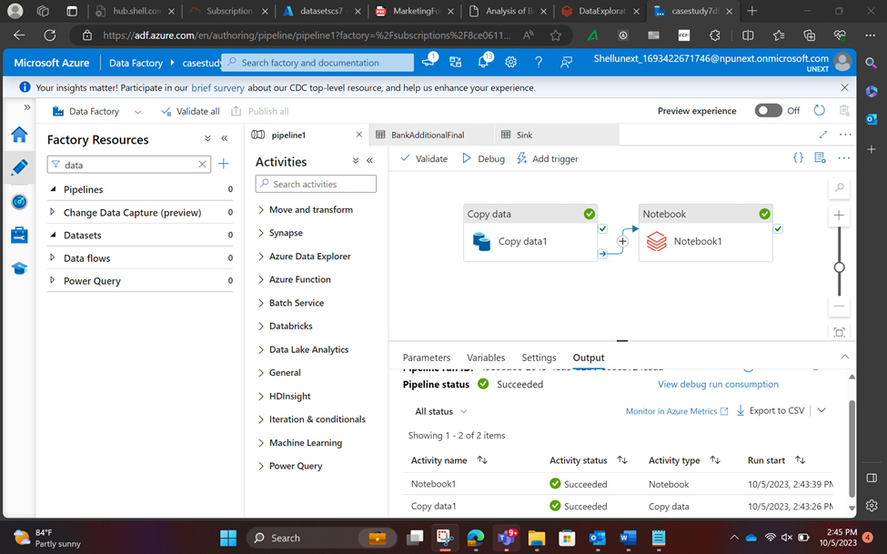
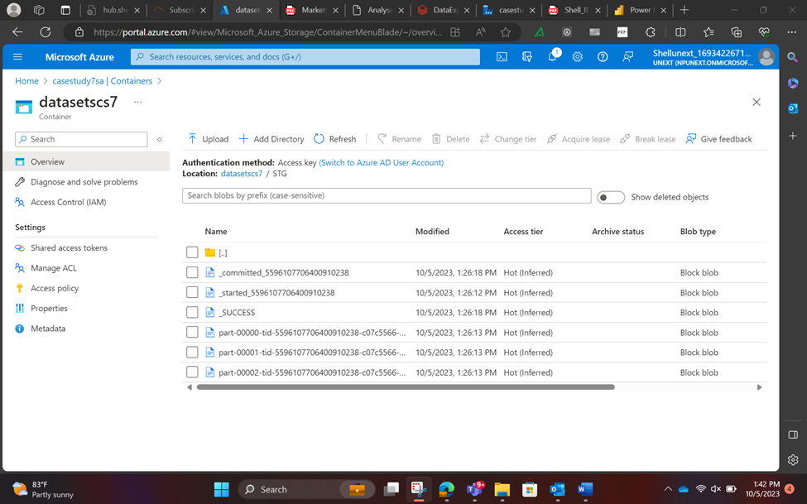
DATA LAYERS SNAPSHOTS

Slide 6
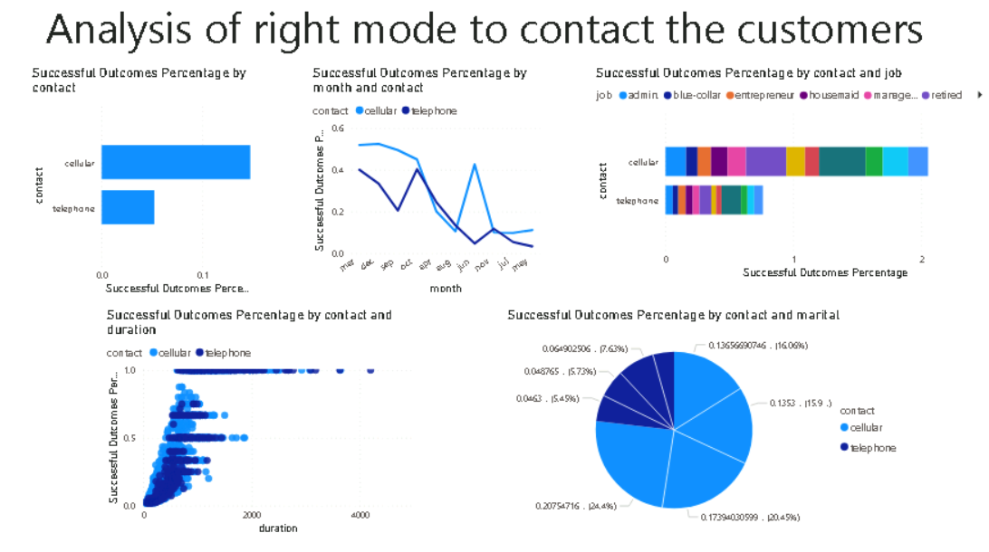
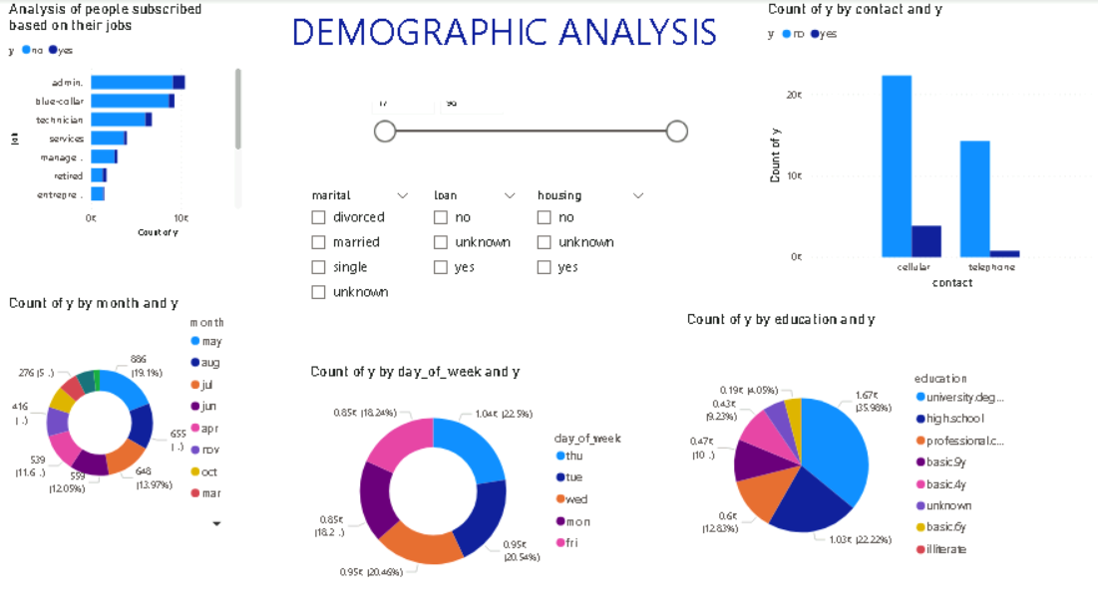
POWERBI DASHBOARD SNAPSHOTS

Slide 7
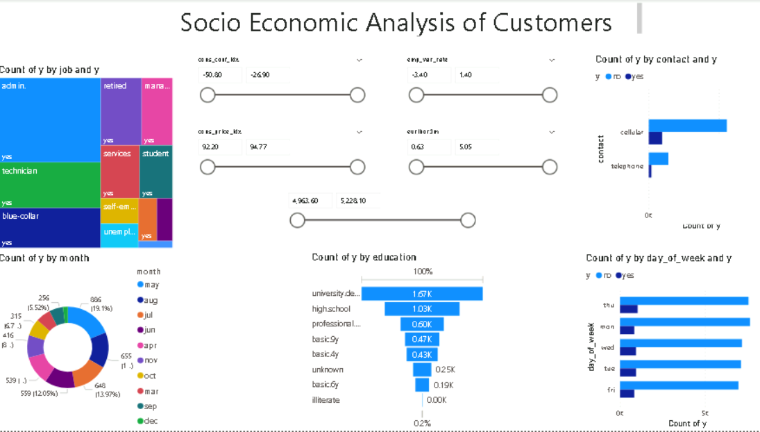
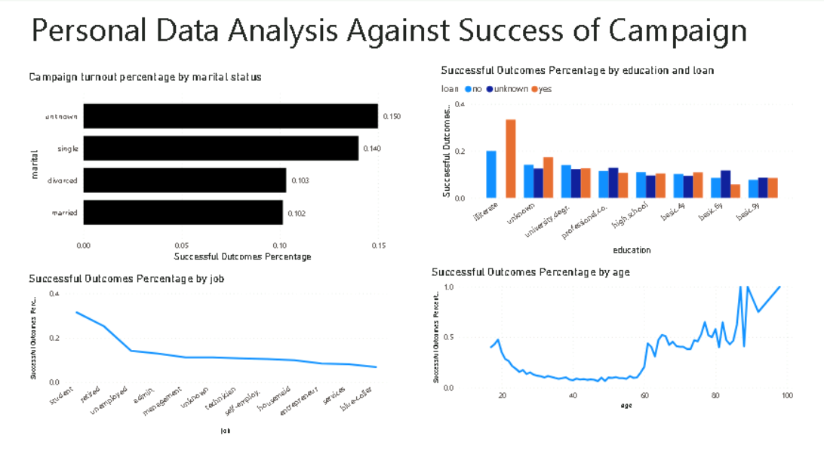
POWERBI DASHBOARD SNAPSHOTS

Slide 8
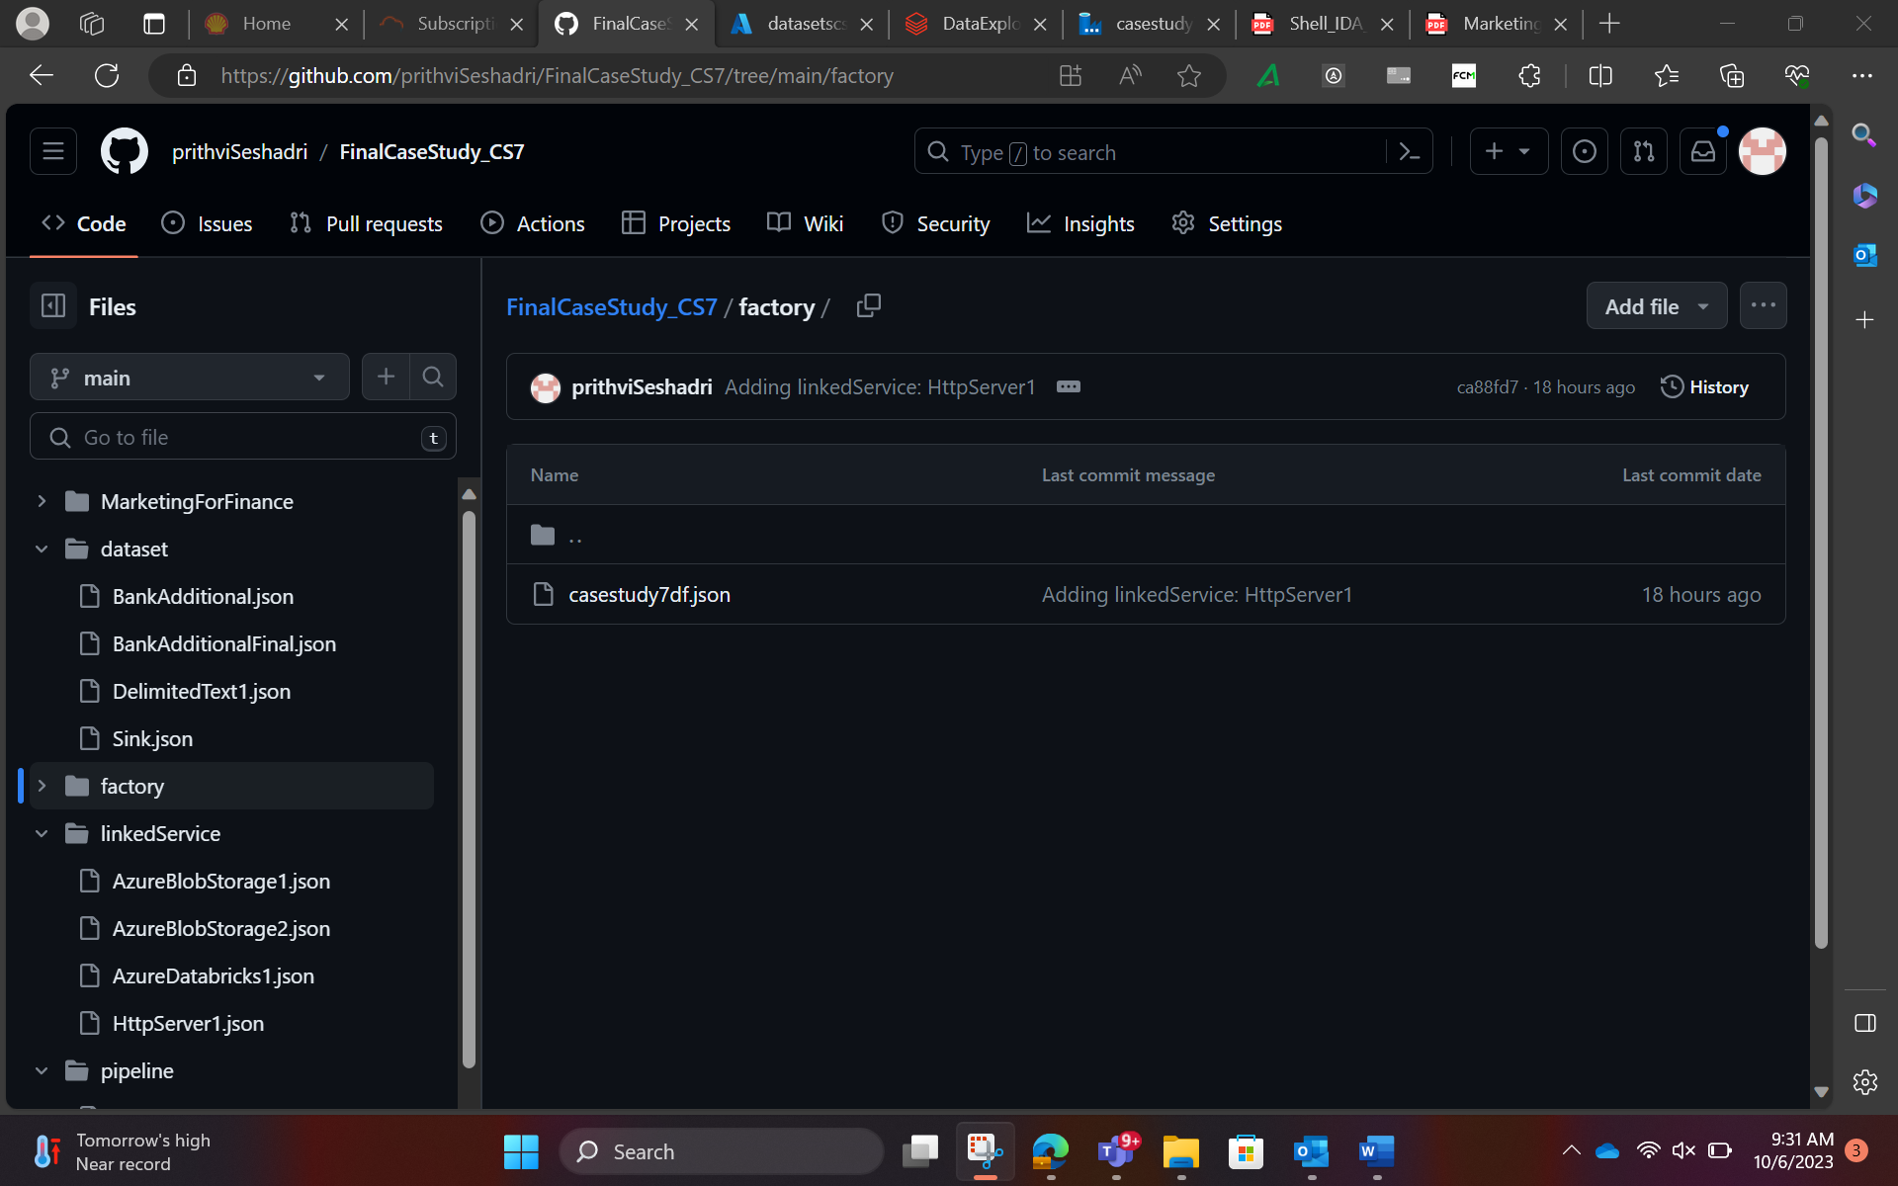
GITHUB REPOSITORY AND SOURCES

Slide 9
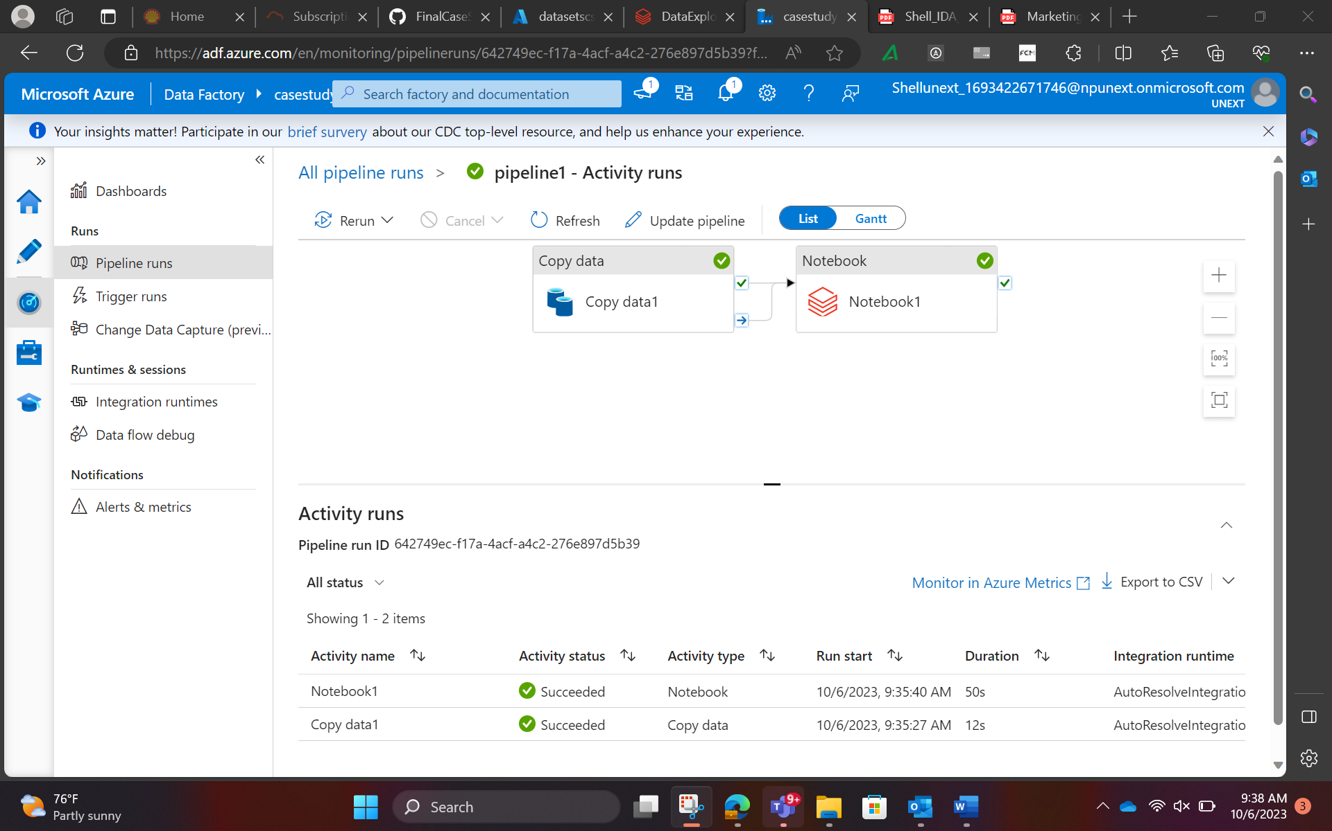
SYSTEM DEMO

Slide 10
CHALLENGES AND LEARNINGS
Challenge: Data Security
Keeping our information safe in the cloud is like securing a virtual vault. Azure helps, but we must understand how to lock it properly.
Learning: We need to learn how Azure's security features work, like digital locks, to protect our data effectively.
Challenge: Internet Speed and Connection
Imagine Azure as a super-fast highway for data. Sometimes, the route might be slow, causing delays. Understanding and managing this speed is crucial.
Learning: We need to optimize our data so that it travels smoothly on Azure's highway, ensuring fast and reliable connections.
Challenge: Balancing Costs
Azure is like a giant store; we pay for what we use. It's easy to overspend. Figuring out how to balance what we need with what we can afford is essential.
Learning: We must learn to budget and choose Azure services wisely, like shopping for items within our budget, to get the best value for our money.

Slide 11
Q&A

Slide 12
THANK YOU

