Slide 1


RNSYNG
Incidence based payment

Slide 2
TEAM
Prithviraj Raddy : Sol. Architect
Ujwala Suram
Sachin Biradar
Multazeem Mehdi
: Backend and Dev
: DB & Service Layer
: Front End Dev
Rajasthan
Hackathon 4.0
Use Case:
Rajasthan Nursery Subsidy Yojna-NextGen
Github: https://github.com/prithviapp2/RNSYng
AgriPropark

Slide 3
Problem Statement
Manual intervention of data makes the system sub-transparent to farmers
Exchange of information through semi-automated process causes unusual delays among departments and finally to citizens
Data intermediaries creating information friction to government and relevant stakeholders
Farmers
State Treasury
RNSYNG
Dept. authorized Nurseries
Forest Department

Slide 4
Benefits of RNSYNG
Difficulty of Forestation goals could be easily achieved through community awareness. In RNSYNG, farmer’s peer-peer community enriches peer awareness and hence improved forestation
Crypto currency of RNSYNG could support forest department as revenue center, rather cost center, through exchange values
Presently global warming being a hyper sensitive subject, our solution will position India as a world leader in Global Forestation Index.
Increase the happiness meter of the farmer as citizens.

Slide 5
















Solution Architecture
IoT & AI System
Seed Quality check
using Image and weight analytics.
Plant quality check using satellite and drone based image analytics on leaves
Plant count sensors using GPS co-ordinates
Bio-Metric scan
Nursery Wallet
Farmer Wallet
2
Business Network, DLT Ledger
Business Network for incidence Based payment system
RNSY
7
ApnaKhata
3
RNSY
Token
Token
Farmer
Registry
Depository
Land Registry
Locality Sensitive Hashing > 80%
Farmer-Land Registry
RNSYng
RNSY
Token
Farmer-Land- Registration
Smart Contract
State Treasury Wallet
Aaadhar ID
BioMetric Id
Locality Sensitive Hashing
Bank Details
GPS Co-ordinates
5
6
1
4
Register
Manage
Manage
LandRegistration
Consensus based Approval for Land Registry
Provide seedlings
Monitor Alerts
Manual inspection
Land Registration
Farmer ID
LandOwnership Certificate
Survey Number
KPI fall below benchmark threshold
Dept. Authorized Nurseries.
Farmer
Forest Dept.
State Treasury
Wallet supported with Exchange,
And 2F authentication for key exchanges
Node, Miner
Node, Miner
Node, Miner

Slide 6
RNSYNG, Workflow
1
Farmers registers in Apnakhata.
2
Apnakhata completes the registration
3
Farmers Land owners certificate and survey number from Land Records departments is obtained Farmers provide additional information like Aadhar, Bio-metric, Bank, GPS coordinates for their land. Stores the decentralized real-time collaborative land record documents
4
Dept. authorized Nurseries verifies the documents using consensus mechanism
Nurseries supply the seedling to farmer after a IoT based validation i.e. image analytics and weight based analytics
Forest department monitors alerts of each land.
Forest department performs manual inspection, when the KPI of a farmer, farm land is falling below the benchmark threshold limits
5
Amount as subsidiaries is dispersed to Farmer’s wallet Amount as service charges are dispersed to Nurseries wallet
6
7
The crypto-currency is dispersed to the wallets using RNSYToken

Slide 7
Our Process Differentiator
Locality Sensing Hashing that proactively verifies the land records collision
Track and Trace of all information using off-chain, and on-chain models supporting brownfield implementation
Eliminate nearly 100% of human intervention using IoT, Blockchain and Data science platforms
for quality control of seedling and plants
Enact manual intervention when desired outcomes of the farmer is falling below benchmark threshold. Also include consensus based approvals wherever manual interventions are involved.
Cryptocurrency that supports all currency exchanges
A room for future enhancement to support Supply Chain Management, intra nursery shipment, and evaluating the nursery itself.

Slide 8
Our Technology Differentiator
Blockchain
Blockchain allied with AI, and IoT
Machine Learning
Image analytics for seedling quality check.
Image analytics to check the health of plant
IoT
Bio-metric data feeder
Quality control of seedling
Quality control of plants, by having plant count sensor and health check using image analytics
Drones navigation using GPS coordinates of the drones.
Track and Trace the seedling using barcode

Slide 9
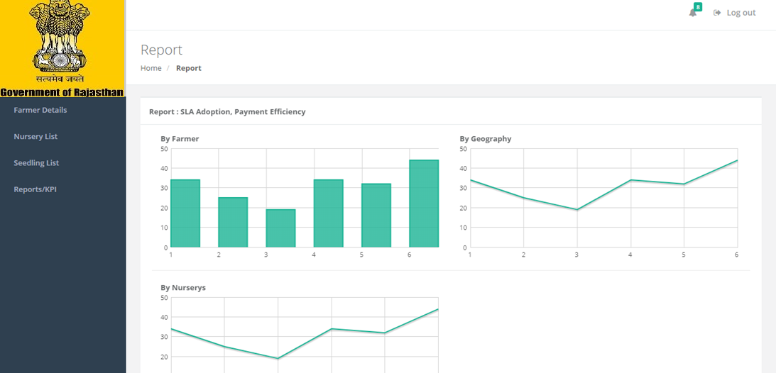
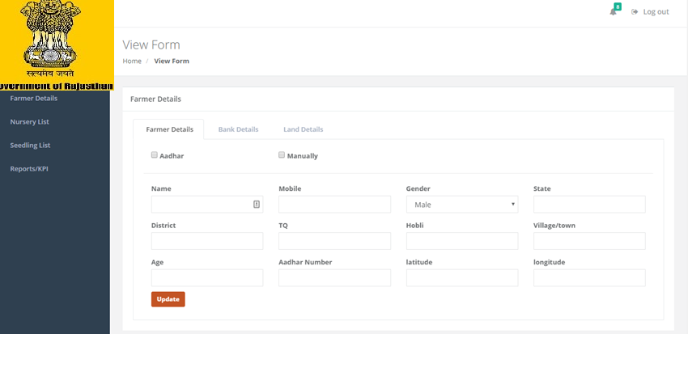
Demo Screens
Reports/KPI
Perform KPI on fertility/productivity against benchmark analysis by Geography (State, Zone, District), farmer (comparing peer farmers)
SLA adaption for enrolment, verification by Nurseries, and Treasury
Payment efficiency in the Benefit Delivery Life Cycle

Slide 10
THANK YOU!

