Slide 1

MANAGEMENT & ENTREPRENEURSHIP
Case Study
From 9 Tables to
25+ Franchises
The Kapoors Cafe Journey — Built on Grit, Systems & Smart Business Design
Mr. Arpit Kapoor | Founder & CEO, Kapoors Cafe
Indian Restaurant Industry | Franchise Business Model | M&E Case Study
Management & Entrepreneurship

Slide 2
Founder Background
Mr. Arpit Kapoor — from financial comfort to adversity, and back stronger
Early Life
Born & Raised in Delhi
Grew up in a financially stable family. Strong values and entrepreneurial instinct instilled early.
Schooling
Sherwood College, Dehradun
Prestigious residential school — built discipline, leadership, confidence and resilience.
Graduation
Modest College — Adapted Well
Mr. Arpit Kapoor
Family faced a financial setback. Shifted to a modest institution; learned to hustle without privilege.
Founder & CEO
Kapoors Cafe
Catalyst
Financial Setback — Turning Point
Family business decline forced a mindset shift — from comfort-seeker to self-made problem-solver.
Key Insight: Adversity became the catalyst — not comfort, but challenge shaped the entrepreneurial mindset.

Slide 3
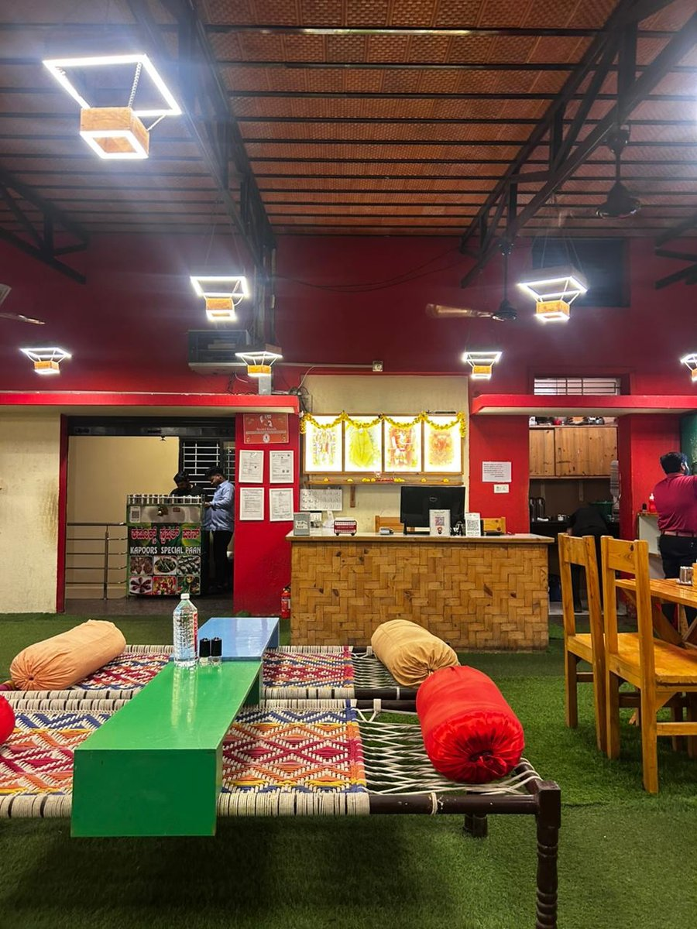
Entrepreneurial Start — Kapoors Cafe
₹12 Lakh. 9 Tables. One Big Dream. HSR Layout, Bengaluru.
Brand
₹12L
Kapoors Cafe — 'Chak De Phattey'
Format
Casual dhaba-style dining with modern ambiance
Initial Capital
Cuisine
North Indian comfort food — parathas, dal, kulcha
100% self-funded
from call centre savings
Strategy
Build local loyalty first, then think scale
Year 1
9 Tables | HSR Layout
Achieved break-even within first operating year
Kapoors Cafe — Actual Outlet

Slide 4
Growth Journey
Disciplined expansion — from a single outlet to a scalable franchise network
Start
Yr 2–3
Yr 4–5
Yr 6+
1 Outlet
3–5 Outlets
Franchise Model
25+ Franchises
HSR Layout
₹12L invested
9 tables
Proved concept
Reinvested profits
Brand built
Launched Tier B
First partners on
SOPs codified
Pan-India
Tier A & B network
500–600 employees
Key Scaling Decisions
Franchising over owning
No family in franchises
Capital-light expansion; partners take on local ops risk
Meritocracy preserved — partners selected on capability, not relations
SOP-first culture
Reinvest profits early
Replicability ensures quality consistency across all outlets
Every rupee of early profit went back into systems and brand

Slide 5
Business Model
Franchise-based, capital-light, quality-controlled
Core Model Pillars
Revenue Channel Split
Franchise-Based
Partners invest capital; brand provides systems, training & supply chain support
Dual Revenue Channel
70% offline dine-in + 30% online delivery — balanced, resilient revenue mix
Centralized Procurement
Raw materials sourced centrally — cost control & quality uniformity
Brand Licensing
Value Proposition
Franchisee pays royalty/fee; brand retains IP and quality authority
Low risk for franchisees. Proven brand. Plug-and-play operations. Strong ROI within 2–3 years.

Slide 6
Franchise Investment Model
Two-tier structure designed for diverse investor profiles
TIER B — STANDARD
TIER A — PREMIUM
₹90L – ₹1 Cr
₹2.5 Cr – ₹3 Cr
Investment Range
Investment Range
Tier B city / smaller market
Lower footfall zone
Smaller outlet footprint
Setup + training included
Brand support from Day 1
Suitable for first-time investors
Metro / Tier A city market
High footfall premium locations
Larger outlet with full setup
Full fit-out + equipment included
Dedicated relationship manager
Higher revenue ceiling — ₹50–55L/month
Both tiers include: brand license, SOP manual, supplier tie-ups, staff training, and ongoing operational support.

Slide 7
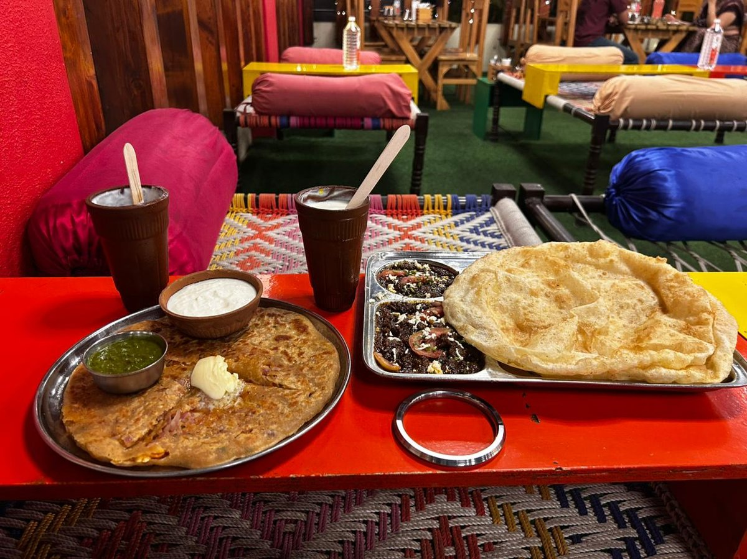
Revenue Model
Consistent monthly revenue with significant peak upside
₹30–35L
₹50–55L
25+
~70%
Average Monthly Revenue
Peak Monthly Revenue
Active Franchise Outlets
Offline Revenue Share
Kapoors Cafe — Signature Dishes
Weekends:
Contribute ~55% of weekly revenue
Online Growth:
30% delivery mix, growing 8–10% YoY
Per Outlet:
₹30–35L/month at steady state

Slide 8
Profitability & Unit Economics
How the numbers work — per outlet, per month
Monthly Cost Structure (Per Outlet — Avg. ₹30–35L Revenue)
Unit Economics at a Glance
Cost Head | % of Revenue | Approx. ₹ (Lakh)
Raw Materials / Food Cost | 28–32% | 8.4–9.6L
Staff & Labour | 18–22% | 5.4–6.6L
Rent & Utilities | 12–15% | 3.6–4.5L
Royalty to Brand | 4–6% | 1.2–1.8L
Marketing & Promotions | 3–5% | 0.9–1.5L
Packaging & Delivery Costs | 3–4% | 0.9–1.2L
Misc / Contingency | 2–3% | 0.6–0.9L
Total Costs | 70–82% | ~24–26L
NET PROFIT MARGIN | 15–25% | 5–8L / month
Break-Even Period
18–24 months
Monthly Net Profit
₹5–8 Lakh
Annual ROI (Tier B)
~18–22%
Annual ROI (Tier A)
~20–26%
Payback Period
~4–5 years

Slide 9
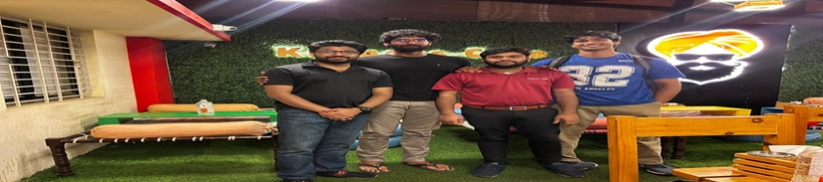
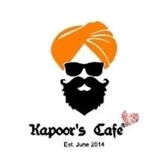
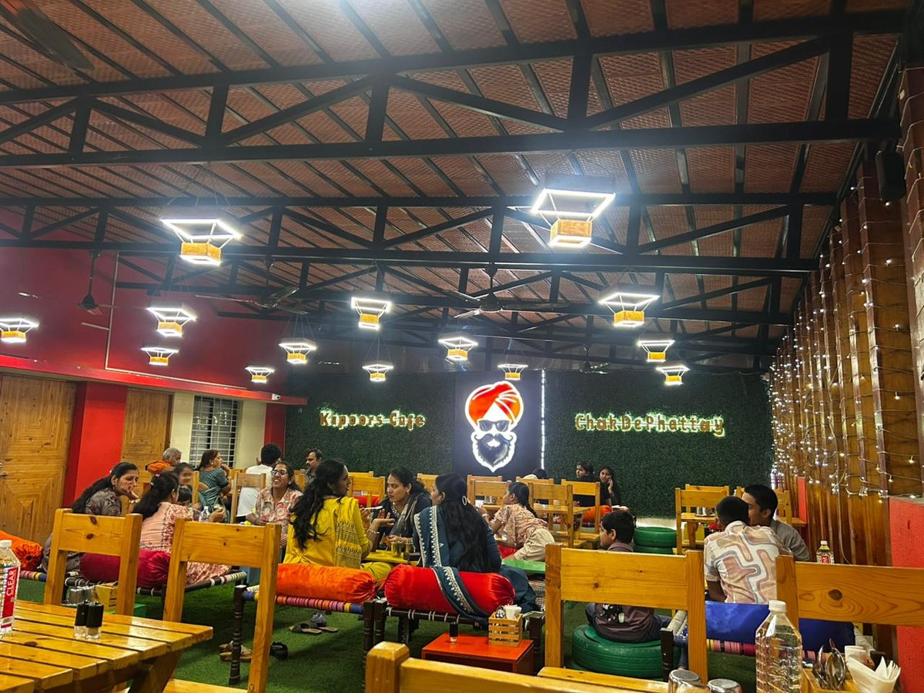
Operations & Customer Flow — Kapoors Cafe
70% offline dominance with a fast-growing 30% digital wing
Kapoors Cafe — A packed house — the offline experience at its best
OFFLINE — 70%
ONLINE — 30%
Table turnover: 3–4x weekdays, 5x weekends
Walk-ins + reservations via phone & in-person
Handles events, birthdays, corporate lunches
Customer experience drives word-of-mouth growth
Avg. order value: ₹400–₹600 per person
Table turnover: 3–4x weekdays, 5x weekends
Walk-ins + reservations via phone & in-person
Handles events, birthdays, corporate lunches
Customer experience drives word-of-mouth growth
Avg. order value: ₹400–₹600 per person
Delivery via Swiggy, Zomato & own channel
Growing at 8–10% YoY — strong upward trend
Avg. delivery order: ₹300–₹450 per order
Peak hours: 12–2 PM and 7–10 PM daily
Target: grow online share to 40% by Year 3

Slide 10
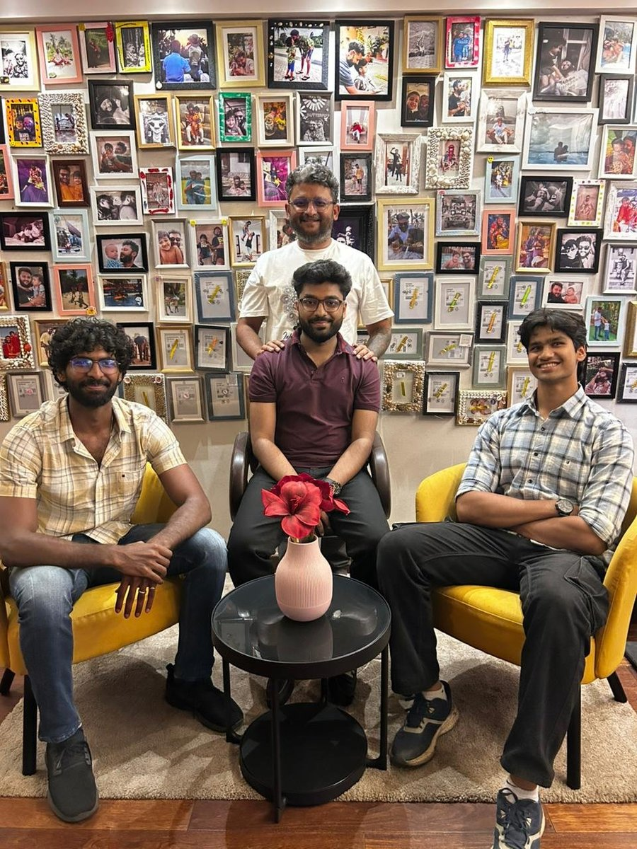
People & Culture
The human engine behind the business — built on trust, not transactions
500–600
Culture & People Philosophy
Employees across
all outlets
Employees = Family
Long-term retention focus; staff welfare treated as business investment, not cost.
Franchise Partners = Friends
Relationships built on mutual respect, shared success & transparent communication.
Meritocracy First
Promotions & opportunities based on performance — not seniority or connections.
Training Culture
Regular upskilling in SOPs, food safety, hospitality & brand values.
Low Attrition Goal
Retention-focused policies reduce hiring cost and preserve institutional knowledge.

Slide 11
Organizational Structure
Lean at the top — scalable at the edges
ARPIT KAPOOR — FOUNDER
Visionary | Brand Owner | CEO
PARENTS
BROTHER
CORE MGMT
Advisory | Strategic Guidance
Operations Partner | Execution
Finance, Marketing, Ops Heads
FRANCHISE PARTNERS (25+ Outlets)
Policy: NO family member
holds a franchise
Merit-only selection ensures
objectivity, trust & brand integrity.
Team with Branch Manager at Kapors Cafe outlet

Slide 12
Licensing & Legal Framework (India)
Every outlet must clear this compliance checklist before operations begin
FSSAI
License
GST
Registration
Trade
License
Shops &
Estab. Act
Fire & Health
Licenses
Food Safety &
Standards Authority
of India
Mandatory if
turnover > ₹20L
(restaurants: ₹40L)
Issued by local
municipal body
(annual renewal)
State-specific
registration for
commercial premises
NOC from Fire Dept
+ Health/Sanitation
certificate mandatory
Additional Compliance Requirements
FSSAI Renewal
Eating House License
Annual — penalty of ₹5L+ for lapse; crucial for franchise credibility
Required in metro cities like Delhi, Mumbai — separate from trade license
Liquor License
Copyright / Trademark
Optional — needed only for outlets serving alcohol (Tier A outlets)
Brand name, logo & menu IP registered under Trade Marks Act, 1999

Slide 13
Taxation Benefits for This Business
How the tax framework works in the franchise model's favour
5% GST → Competitive Pricing
Simplified GST Compliance
Operating under 5% GST (no ITC) keeps pricing competitive vs hotel-restaurant rivals at 18%. Lower tax pass-through = better value perception.
Monthly/quarterly GSTR-1 & 3B filings. Composition scheme option for smaller outlets (turnover < ₹1.5 Cr) simplifies compliance further.
Franchise Model Spreads Tax Liability
MSME Registration Benefits
Each franchisee is an independent legal entity — separate GST registration, separate P&L. Brand company carries only royalty/fee income tax.
Eligible for priority lending, collateral-free loans under CGTMSE, subsidized electricity & protection against delayed payments.
New Tax Regime Advantage
TDS on Franchise Fees
For franchise partners with lower deductions, New Regime offers lower effective rates — improves post-tax returns on franchise investment.
Royalty income from franchisees subject to TDS under Sec 194J (10%). Proper structuring ensures clean, audit-proof income recognition.

Slide 14
Slab / Feature | OLD REGIME | NEW REGIME (Default from FY 2024–25)
Up to ₹3 Lakh | Nil | Nil
₹3L – ₹6L | 5% | 5%
₹6L – ₹9L | 20% | 10%
₹9L – ₹12L | 20% | 15%
₹12L – ₹15L | 30% | 20%
Above ₹15L | 30% | 30%
Standard Deduction | ₹50,000 | ₹75,000
HRA / 80C / 80D | Available | NOT available
Best for... | High deductions (HRA, investments) | Simpler filing, lower middle-slab rates

Slide 15
Government Policies & Support
Key schemes that empower restaurant & franchise entrepreneurs in India
Startup India
MSME Scheme
PM Mudra Yojana
DPIIT — Dept. of Promotion of Industry & Internal Trade
Ministry of Micro, Small & Medium Enterprises
Ministry of Finance — via Scheduled Commercial Banks
Key Benefits:
Key Benefits:
Key Benefits:
3-year income tax holiday (Sec 80-IAC)
Self-certification for 9 labour laws
Faster IP filing at reduced fees
Access to ₹10,000 Cr Fund of Funds
Collateral-free loans under CGTMSE
Interest subvention on term loans
Udyam Registration for subsidies
Priority sector lending access
Shishu: up to ₹50,000
Kishore: ₹50,000 – ₹5 Lakh
Tarun: ₹5 Lakh – ₹10 Lakh
No collateral for Shishu & Kishore
Relevance:
Relevance:
Relevance:
Applicable if business registered as Startup — useful in early years
Most franchise outlets qualify — turnover < ₹250 Cr threshold
Ideal for small franchise partners entering the business

Slide 16
Key Challenges
Reality check — the hard truths behind a franchise restaurant business
High Initial Investment
HIGH
Licensing Complexity
HIGH
01
₹90L–₹3 Cr per outlet locks up capital; wrong location choice can mean prolonged break-even.
02
5+ licenses required before operations; delays in FSSAI, fire NOC or municipal approvals can push timelines.
GST Compliance Burden
MEDIUM
Quality Consistency at Scale
HIGH
03
Monthly filings, reconciliation of GSTR-1 & 3B, TDS management — requires dedicated finance resources.
04
Maintaining food quality & service standards across 25+ outlets with different partners is the #1 challenge.
High Competition
MEDIUM
Talent Retention
MEDIUM
05
Urban markets saturated with QSR chains, cloud kitchens & well-funded startups. Differentiation is critical.
06
Restaurant sector has 35–40% annual attrition. Skilled chefs & managers exit to competitors or start own ventures.

Slide 17
Risk Management
How the business mitigates its biggest threats — proactively and systematically
RISK: Quality Degradation
→ SOP Standardization
RISK: Partner Mismanagement
→ Franchise Audits
Comprehensive SOPs for every outlet — recipe portions, plating, cleaning & staff conduct. Non-negotiable, audited quarterly.
Surprise and scheduled audits by central quality team. Mystery shoppers deployed monthly. Failing 2 audits = franchise review.
RISK: Brand Dilution
→ Brand Control Framework
RISK: Cash Flow Issues
→ Franchise Fee Structure
All marketing, social media & menu changes approved by HQ. Franchisees cannot independently rebrand, discount or alter core offerings.
Upfront franchise fee + royalty model ensures brand entity has predictable cash inflows independent of outlet performance swings.
RISK: Regulatory Non-Compliance
→ Compliance Tracker
RISK: Key Person Dependency
→ Succession Planning
Centralised license renewal calendar. Legal team flags due dates 60 days in advance. Non-renewal triggers brand support intervention.
Core management trained to operate without founder in day-to-day decisions. Documented brand playbook enables decentralized leadership.

Slide 18
VISION & FUTURE GROWTH
"My goal is not just profit — it is to employ 5,000 families."
50+
40%
5000+
Franchise
Expansion
Online
Growth
Employment
Goal
Scale from 25 to 50+ outlets in 3 years
Focus: Tier 2 & 3 cities
Capital-light franchising model continues
Grow online from 30% to 40% of revenue
Own delivery app launch planned
Cloud kitchen model for delivery-only markets
Direct + indirect jobs across franchise network
Women's employment drive in partner outlets
Skill development centre for F&B workforce

Slide 19
CONCLUSION
A Blueprint for Scalable
Entrepreneurship in India
Success built on grit, savings & execution — not privilege or luck
Kapoors Cafe: proven brand built from ₹12L to 25+ franchise network
People-first culture — employees as family, partners as friends
Smart compliance: 5% GST, MSME benefits & government schemes leveraged
Vision extends beyond revenue — social impact through employment
Execution > Ideas: the systems, SOPs & audits are what make it scalable
Management & Entrepreneurship | Kapoors Cafe Case Study | Mr. Arpit Kapoor

