Slide 1
Survey:
Log Analysis of Intrusion Detection System using Machine learning:
PRESENTERS:
Chris Melvin
Prithvik Adithya
Shivendra Arulalan
Adnaan Khan
Varun Venkat

Slide 2
Introduction to IDS
Intrusion Detection Systems (IDS) play a vital role in cybersecurity, helping to monitor and detect unauthorized activities within a network or system.
What is IDS? An Intrusion Detection System is a security mechanism designed to detect and respond to unauthorized access, data breaches, and abnormal behaviors within a network or system. By analyzing network traffic, system logs, and user activities, IDS can identify patterns indicative of malicious intent or security breaches.
Historically, IDS emerged as a response to the growing threat of cyberattacks, aiming to identify and mitigate various types of threats.

Slide 3
Introduction to IDS
Key Features of IDS:
Monitoring
Alerting
Anomaly Detection
Signature Detection
Importance of IDS: In a rapidly evolving digital landscape, where cyber threats grow in sophistication and diversity, IDS offers a critical defense against potential breaches. By promptly detecting unauthorized access attempts, malware intrusions, and unusual activities, IDS empowers organizations to take swift action to mitigate risks, protect sensitive data, and maintain the integrity of their systems.

Slide 4
Classification and Types of IDS
IDS can be classified into several types based on their deployment and detection approaches.
Major types include Network-based IDS (NIDS), Host-based IDS (HIDS), and Hybrid IDS.
Network-based IDS (NIDS): Monitors network traffic for signs of attacks or unauthorized activities. It focuses on detecting anomalies in the network flow.
Host-based IDS (HIDS): Monitors activities on individual systems or hosts, looking for deviations from normal behavior.
Hybrid IDS: Combines elements of both NIDS and HIDS for improved accuracy and coverage.

Slide 5
Network-based Intrusion Detection Systems (NIDS)
NIDS are essential components of network security, analyzing network traffic for signs of intrusion.
They use signatures and behavior analysis to identify known attack patterns and anomalous behavior.
NIDS are capable of identifying threats at the network level, providing an early warning system for potential attacks.
The architecture of NIDS involves sensors distributed throughout the network, sending traffic data to a central analysis point.
Host-based Intrusion Detection Systems (HIDS)
HIDS focus on protecting individual hosts by monitoring their internal activities.
They analyze system logs, file integrity, and user behavior to detect unusual or unauthorized actions.
HIDS are particularly effective in identifying attacks that target specific systems or vulnerabilities.
The architecture of HIDS includes agents deployed on each host, collecting and analyzing data locally.

Slide 6
Challenges & Limitations of IDS
IDS face challenges related to accuracy and efficiency.
False Positives: IDS may raise alarms for legitimate activities, leading to alert fatigue.
False Negatives: Some attacks may go undetected, allowing threats to penetrate the network.
Keeping up with evolving attack techniques and patterns is a constant challenge.
Research and innovation are necessary to improve detection accuracy and minimize false alarms.

Slide 7
IDS Applications:
Intrusion Detection Systems (IDS) find application in a wide market – enhancing security.
When studying IDS in detail, we understood that all the IDS application mainly fall into 4 major applications.
IDS in Web Applications
IDS in IoT Applications
IDS in Network Monitoring Systems
IDS in Industrial Control Systems (ICS)

Slide 8
IDS in Network Monitoring Systems
Continuous Monitoring: Intrusion Detection Systems (IDS) keep a constant watch on network activity for any signs of suspicious behavior.
Pattern Recognition: IDS identify potential threats by comparing network data against established attack patterns.
Anomaly Detection: IDS search for unusual deviations from normal network behavior that might indicate new or emerging threats.
Real-time Alerts and Swift Action: When a threat is detected, IDS send immediate alerts to administrators, enabling quick response to potential security breaches.
Enhanced Cybersecurity and Data Protection: IDS act as a frontline defense, enhancing overall cybersecurity by safeguarding network integrity and sensitive data from unauthorized access or compromise.

Slide 9
IDS in Industrial Control Systems (ICS)
Continuous Monitoring: IDS in Industrial Control Systems (ICS) provide constant surveillance to detect any unusual activities or potential threats within critical infrastructure.
Pattern Recognition: These IDS systems recognize known attack signatures and suspicious patterns in network traffic or device behavior, alerting operators to potential risks.
Anomaly Detection: ICS IDS actively identify deviations from expected operational behavior, helping uncover novel threats or abnormal actions within industrial processes.
Real-time Alerts and Swift Action: Upon detecting a threat or anomaly, IDS swiftly generate alerts that enable prompt responses by operators, preventing potential disruptions or damages.
Safeguarding Critical Infrastructure: IDS within ICS contribute to enhanced cybersecurity, ensuring the reliability and safety of industrial systems by preventing unauthorized access and protecting vital processes from potential compromise.

Slide 10
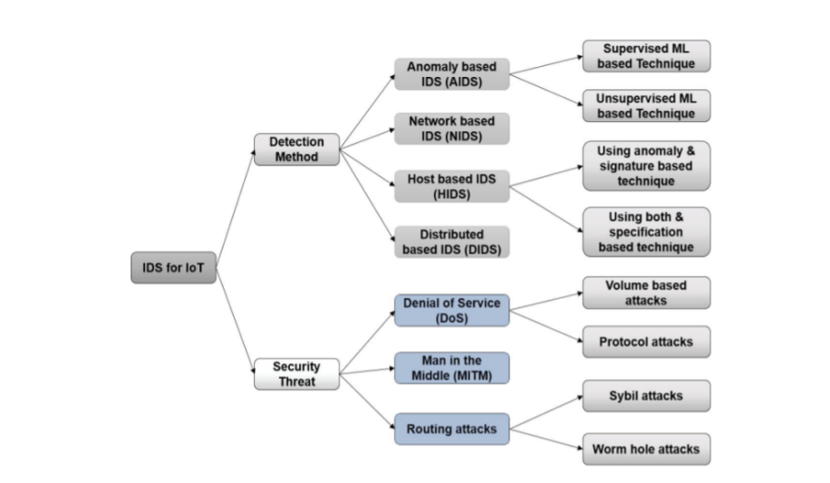
IDS in IoT Applications

Slide 11
IDS In WEB APPLICATION
IDS in Web Applications
IDS is instrumental in securing web applications by detecting attacks targeting vulnerabilities.

Slide 12
Introduction to ML in IDS
Background on Intrusion Detection Systems (IDS): IDS is a system that monitors network traffic for suspicious activities and issues alerts when such activities are discovered. It's a critical component for securing networks against unauthorized access and attacks.
Importance of ML in enhancing IDS: Traditional IDS might not be sufficient to handle sophisticated and dynamic cyber threats. Machine Learning (ML) offers the ability to learn from data, detect complex patterns, and adapt over time, improving both accuracy and efficiency in intrusion detection.
Overview of various ML models used in IDS: From basic ML models like Decision Trees and SVM to more advanced Deep Learning models like Neural Networks, the integration of various ML models helps in creating powerful, adaptable IDS.
Objective of employing ML: The primary objectives include increasing detection accuracy, improving efficiency, and enabling scalability to large network environments.

Slide 13
Sensitivity Analysis of Attacks in IDS (Paper by K. Talty et al.)
Analysis of Vulnerability in ML Models in IDS: This study emphasizes that ML models in IDS can be vulnerable to specific attacks, including poisoning (inserting deceptive data to mislead the learning process) and evasion (manipulating data to escape detection).
Introduction to Poisoning and Evasion Attacks: These attacks can significantly degrade the performance of IDS by manipulating training or testing data.
Sensitivity Analysis Techniques: Sensitivity analysis is used to understand how different changes to the input variables affect the output of a particular algorithm.
Conclusion: Understanding these vulnerabilities and developing mechanisms to mitigate them is essential for building robust and resilient IDS.
Deep Learning Approach for IDS (Paper by C. Yin et al.)
Use of Recurrent Neural Networks (RNN) in IDS: This approach leverages RNN's ability to process sequential data, allowing for enhanced pattern detection in network traffic.
Deep Learning Models' Ability to Detect Complex Patterns: Deep Learning can identify intricate dependencies and abnormalities in data that might be missed by traditional algorithms.
Application and Advantages of RNN in Real-time Detection: RNN models can process large volumes of data in real-time, offering timely detection and response.
Conclusion: This approach underlines how Deep Learning, particularly RNN, can significantly enhance the detection capabilities of IDS.

Slide 14
Big Data Analytics in IDS (Paper by E. Viegas et al.)
Introduction to Big Data Challenges in IDS: With the proliferation of devices and increase in data traffic, handling Big Data in IDS becomes a significant challenge.
Multi-Objective Approach for Longer Model Lifespans: This paper presents an approach to prolong model lifespans by considering various objectives, making IDS more adaptable to evolving threats.
Importance of Scalable Models in Big Data Analytics: Building models capable of scaling with the increased data size ensures that the IDS remains effective and efficient.
Conclusion: The research emphasizes the need to tailor ML models to meet Big Data requirements, thereby enhancing IDS's overall efficacy.
Comparative Analysis of ML Algorithms in IDS (Paper by S. Thirimanne et al.)
Comparison of Different ML Algorithms for IDS: This study compares various algorithms like SVM, Decision Trees, Random Forests, etc., in IDS.
Criteria: Accuracy, Computation Time, Scalability: These are the primary parameters used in evaluating each algorithm's effectiveness.
Findings: The research provides insights into the best-performing algorithms for various scenarios and datasets.
Conclusion: The choice of algorithm plays a vital role in IDS performance, and selecting the appropriate model can lead to significant improvements.

Slide 15
Technical Implementation: Overview of Models
Decision Trees (DT): A supervised learning method used for classification and regression. DT is highly interpretable and has been implemented to identify patterns leading to intrusions.
K-Nearest Neighbors (KNN): An instance-based learning algorithm, where the classification of a new instance is based on the majority class among its 'K' nearest neighbors in the feature space.
Support Vector Machines (SVM): A classification method that finds the hyperplane best separating different classes. Implemented for its effectiveness in high-dimensional spaces.
Dataset Used: NSL-KDD: A widely-used dataset in intrusion detection, chosen for its diversity in representing various attack types and network behaviors.
Objective: Leveraging these models to enhance the accuracy and efficiency of intrusion detection, understanding their strengths and weaknesses in different scenarios.

Slide 16
Technical Implementation: Models on NSL-KDD Dataset
Data Preprocessing: Preprocessing steps include normalization, handling missing values, and encoding categorical features, essential for preparing the NSL-KDD dataset.
Model Training and Evaluation: Each model (DT, KNN,SVM) has been trained using specific hyperparameters and evaluated using metrics like accuracy, precision, recall, etc.
Challenges and Solutions:
Imbalanced Data: Techniques like oversampling were used to handle imbalances in the dataset.
Model Complexity: Neural Networks required careful tuning to avoid overfitting, and SVM needed kernel selection for optimal performance.
Computational Costs: Efficient implementations were used to handle the computational demands of training and validating these models.
Conclusion: These implementations demonstrate a promising direction for enhancing IDS. Insight into each model's characteristics can guide future work in selecting or combining models for specific intrusion detection scenarios.

Slide 17
Conclusion and Future Directions
Summary of Various Approaches to Integrating ML with IDS: The integration of ML models with IDS has proven effective in enhancing detection capabilities, offering scalability, and adapting to new challenges.
Emphasizing the Critical Role of ML in Modern IDS: The future of IDS lies in continual evolution, and ML plays a pivotal role in enabling that adaptability.
Future Directions: Research is progressing towards creating more robust hybrid models, enabling adaptive learning, and focusing on real-time detection to keep up with ever-changing cyber threat landscapes.
Challenges and Areas for Further Research: Understanding and mitigating vulnerabilities, handling imbalanced data, developing interpretable models, and integrating with existing security frameworks are some areas that warrant further exploration.

Slide 18
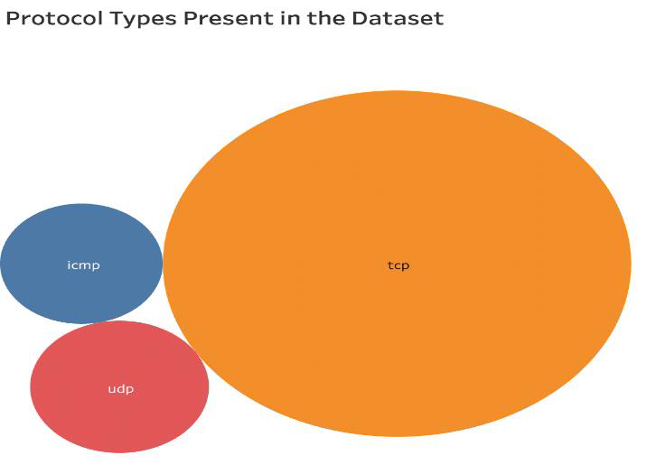
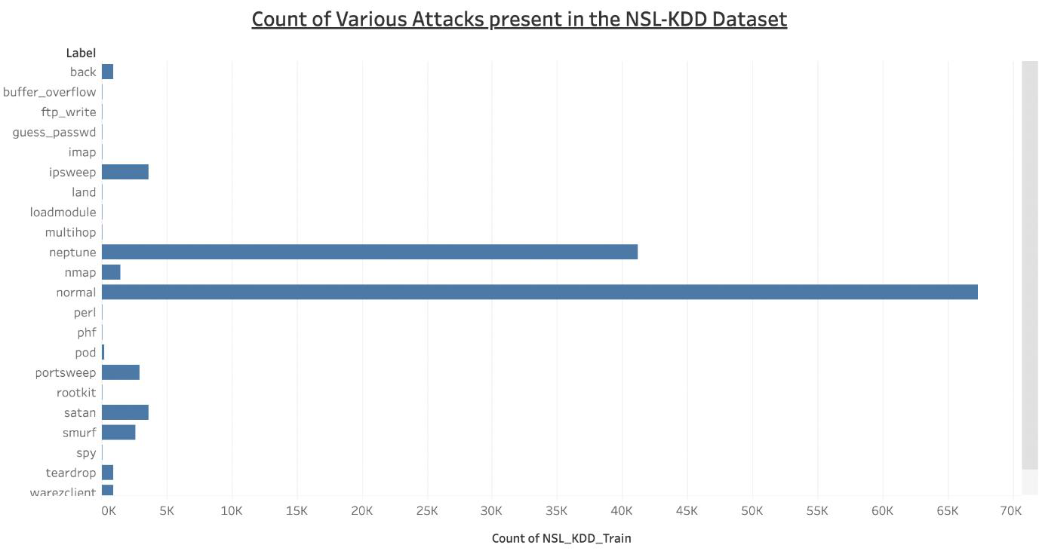
NSL-KDD Dataset
Total Features Present in the Dataset- 42
Class label: The type of network attack associated with each connection record Normal, DoS, Probe, U2R, R2L

Slide 19
Evaluation Metrics
Confusion Matrix: Table that displays the number of true positive, true negative, false positive, and false negative predictions made by a classification model
Accuracy: Overall view of the model's performance.{ (TP + TN) / Total }
Precision: Ratio of true positive predictions to the total number of positive predictions made by the model.{TP / (TP + FP) }
Recall: Ratio of true positive predictions to the total number of actual positive instances.{TP / (TP + FN) }
F1-Score: Harmonic mean of precision and recall.{2 * (Precision * Recall) / (Precision + Recall)}

Slide 20
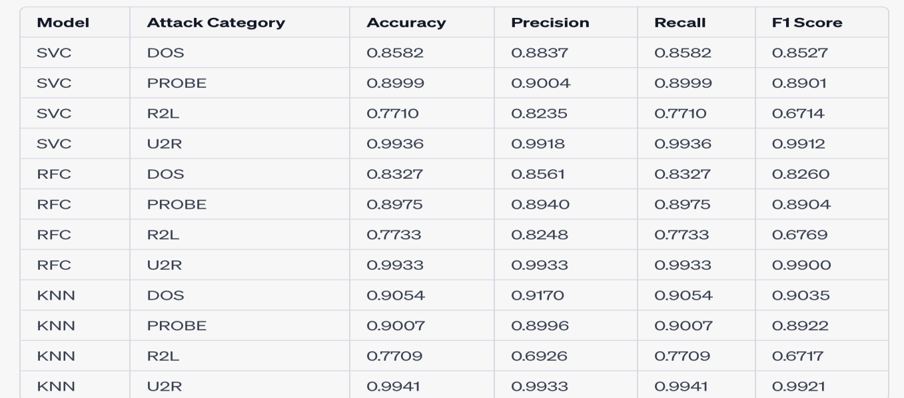
Results
Model Performance Evaluation Metrics
3 Models were used to predict 4 category of attacks, namely DoS, Probe, R2L and U2R.
SVC- Support Vector Classifier RFC- Random forest Classifier
KNN- K- Nearest Neighbors

Slide 21

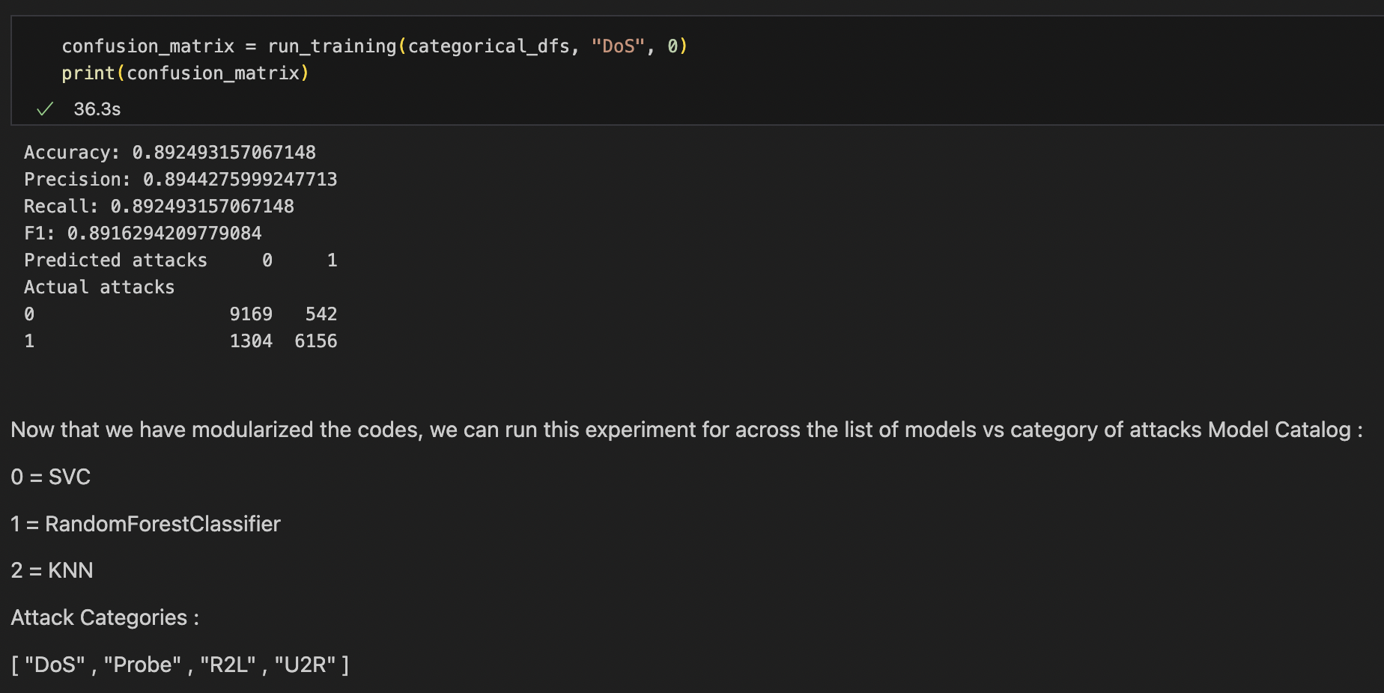
Execution Results
BEFORE EXECUTION
AFTER EXECUTION

Slide 22
THANK YOU
ANY QUESTIONS?

