Slide 1
Is salary and Years of Experience Linearly Proportional?
Prithviraj Kadiyala

Slide 2

Introduction
Salary - A fixed regular payment, typically paid on a monthly or biweekly basis but often expressed as an annual sum, made by an employer to an employee, especially a professional or white-collar worker.
How is salary related to Experience of the employee?

Slide 3
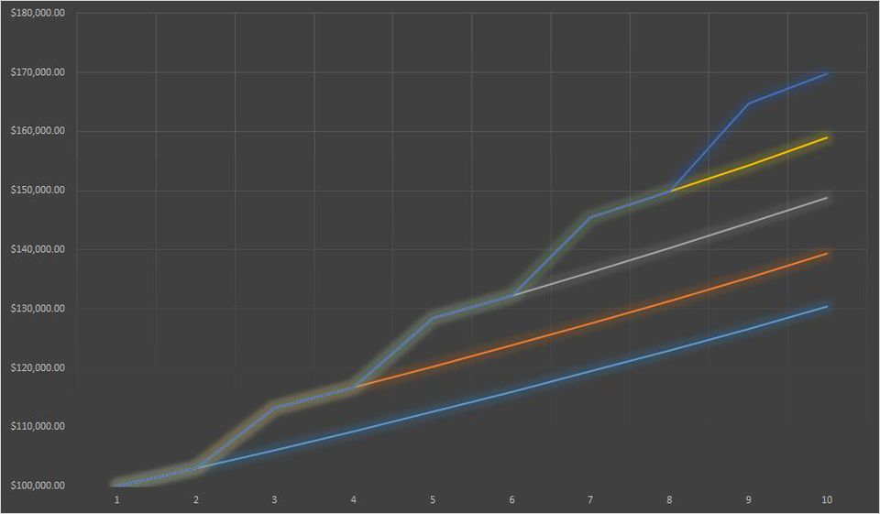
Graph Explanation
In the following website hereEmployees Who Stay In Companies Longer Than Two Years Get Paid 50% Less
This graph shows us Linear relationship.
But is it truly linear?

Slide 4
the data
The data we have today is about the salary with respect to different Years of Experience.
Data has been acquired to see if there is any linear relationship between the two.

Slide 5

Model
The model for simple linear regression is
$$y_{i}=β_{0}+β_{1}x_{i}+∈_{i}$$
The model for the estimate using residuals is
$$y_{i}=\hat{β_{0}}+\hat{β_{1}}x_{i}+r_{i}$$
where,
$$\hat{β_{1}}=\frac{{SS}_{xy}}{{SS}_{xx}}$$
and
$$\hat{β_{0}}=\overline{y}−\hat{β_{1}}\overline{x}$$

Slide 6
Assumptions
The Trend is Linear
Errors ~ N(0,  ²)
The errors are IID.

Slide 7
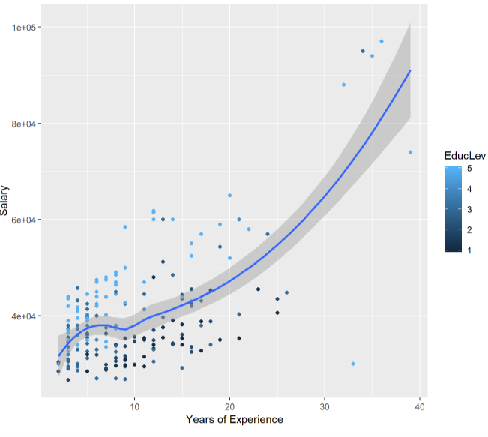
Plot of Original data

Slide 8

Theory for slr
The regression has five assumptions:
Linear Relationship
Multivariate Normality
Little or no Multicollinearity
No Auto Correlation
Homoscedasticity
The probabilistic model for SLR

Slide 9
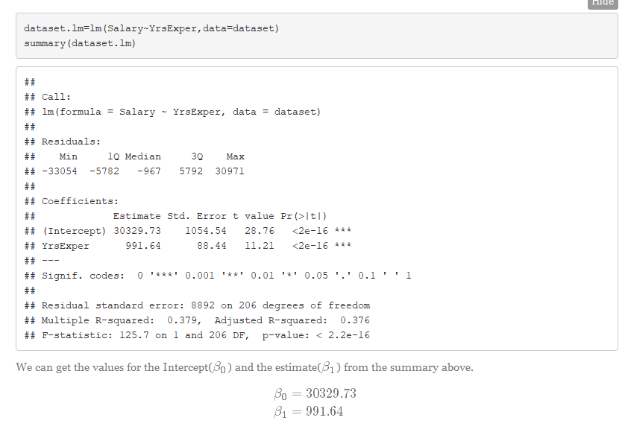
Checking Validity

Slide 10
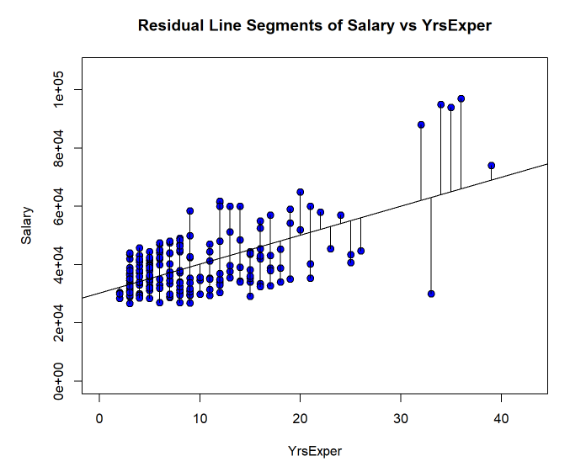
Residual Line segments

Slide 11
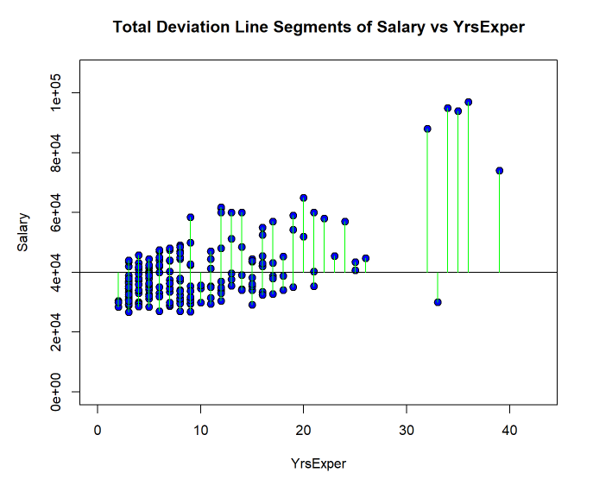
Total deviation from Mean

Slide 12
MSS, RSS and TSS
RSS = 16287668202
MSS = 9939439028
TSS = 26227107231
R^2 = MSS/TSS = 0.3789*
The value indicates that this model is not a very good fit for the data.
*The greater the value, the better the fit

Slide 13
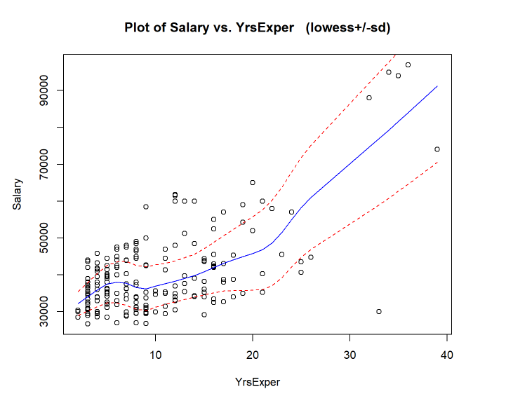
Trendscatter

Slide 14
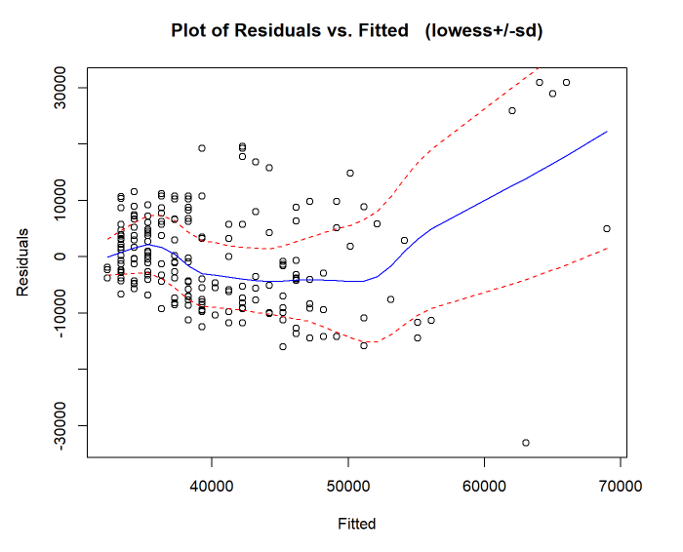
Res vs Fit

Slide 15
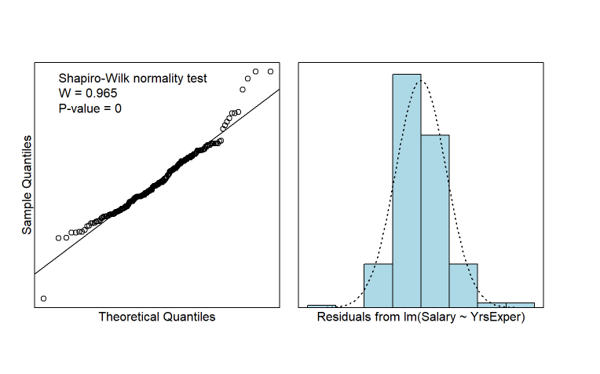
Shapiro-Wilk test (Linear MODEL)

Slide 16
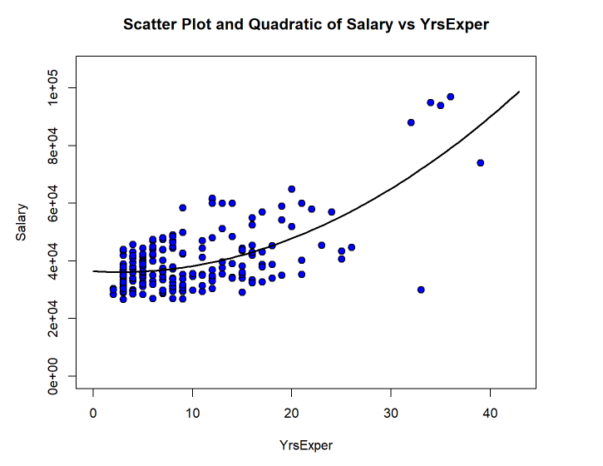
Quadratic MODEL

Slide 17
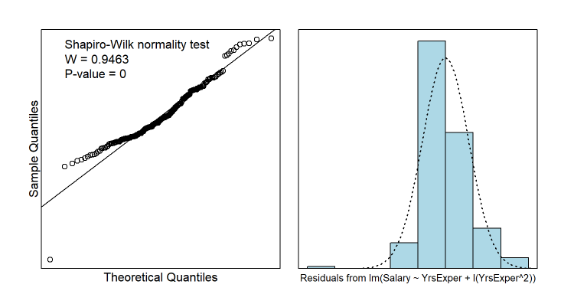
Shapiro-Wilk test(Quadratic model)

Slide 18
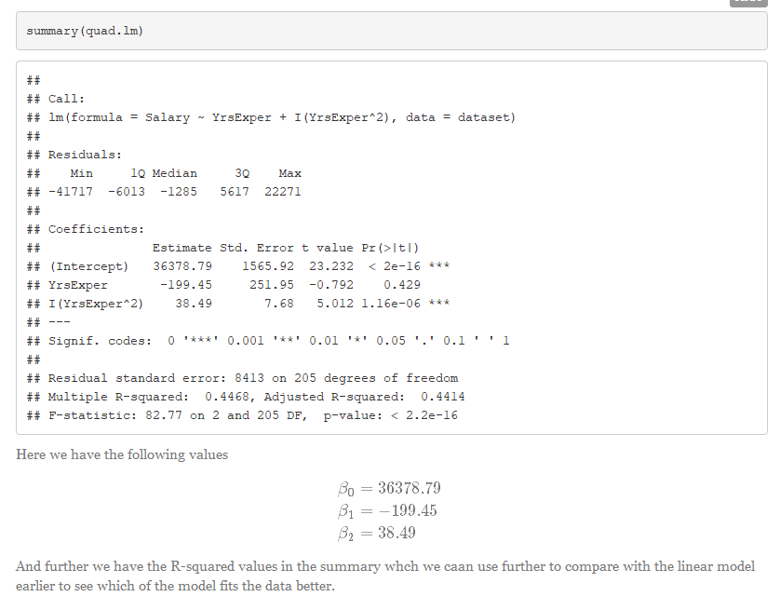
Summary(QUAD.lm)

Slide 19
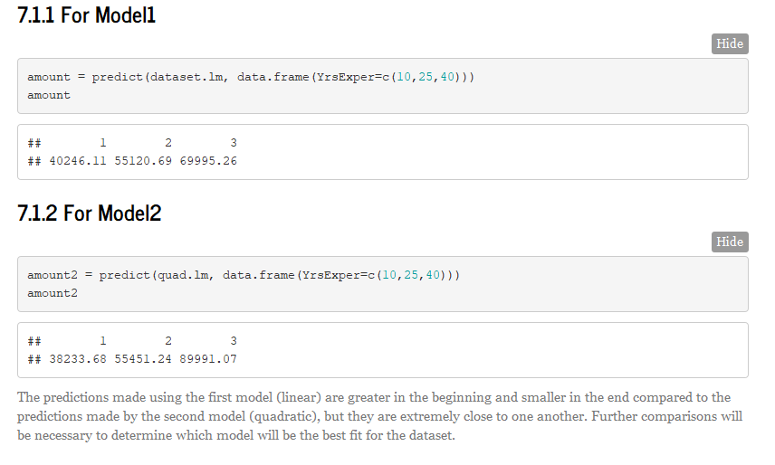
Prediction Analysis

Slide 20
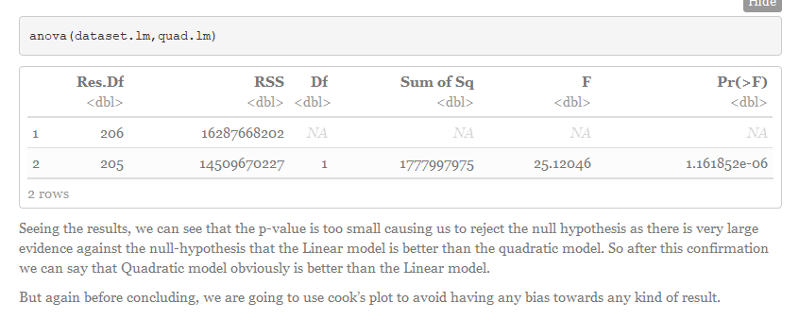
Anova

Slide 21
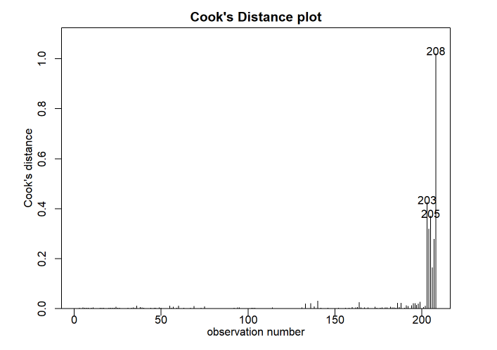
Cook’s plot

Slide 22
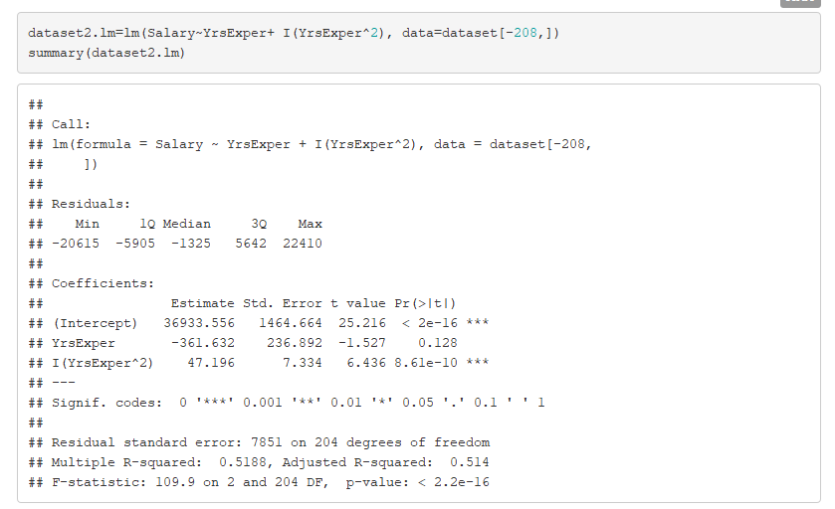
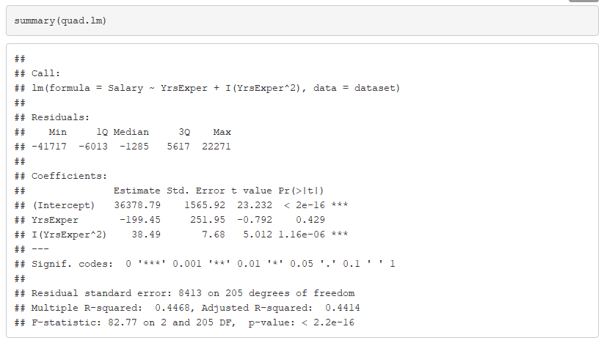
Summary comparison

Slide 23
Model Comparison
The quadratic model is plotting the relationship between the years of experience and salary more accurately than the linear model.
This can be backed up by the multiple R-squared values:
Quadratic Model : 0.514
Linear Model : 0.4414

Slide 24
Conclusion
This model is valid and satisfies the assumption of the linear model, though it is a poor predictor when we have a lot of data.
More data towards the higher area would give us a much more accurate data.
Quadratic model seems to have a better fir than the regular linear model.

