Slide 1
KidsZone
Group Members – Prithviraj Pawar (220343120085)
Siddharth Patil (220343120075)
Prithviraj Sonalkar (220343120086)
Mangesh Cheke (220343120056)
Project Guide – Mrs. Harshita Maheshwari

Slide 2
Contents
Introduction
Choice of topic
Proposed System
Methodology
Proposed System Model
Proposed Approach
Screenshot
System Requirements
Applications
Advantages & Limitations
Conclusion
Future Scopes
References

Slide 3
Introduction
KidsZone is a web application to help students as well as teachers.
It provides admin, student and teacher login.
Admin has administrative controls.
Students can take quiz of different subjects.
Teachers can add questions.

Slide 4
Choice of topic
Through this project student can take quiz of any subjects from their home
Saves the resources needed for physical tests
Easy & Fast
Advertisement Page

Slide 5
Proposed System
AIM:
1. It will help students and teachers
Proposed System:
1. Online Quiz
2. Instant results
3. Easy and time saver

Slide 6
Methodology
The objective is to create a web site that can perform the following:-
Connecting to an HTTPS site through GPRS/WIFI.
Opening the relevant HTML page using HTTPS POST & GET methods.
Read the data logically into student, teacher and admin.
Creating a local database.

Slide 7
Proposed System Model
There are three main modules:
Admin Student Teacher
1 Dashboard 1 Dashboard 1 Dashboard
2 All User 2 Subjects List 2 Student Table
3 Add/Remove Users 3 Quiz 3 Question List
4 Edit Users 4 Add/Delete Questions 4 Result 5 Log Out 5 Log Out 5 Log Out

Slide 8
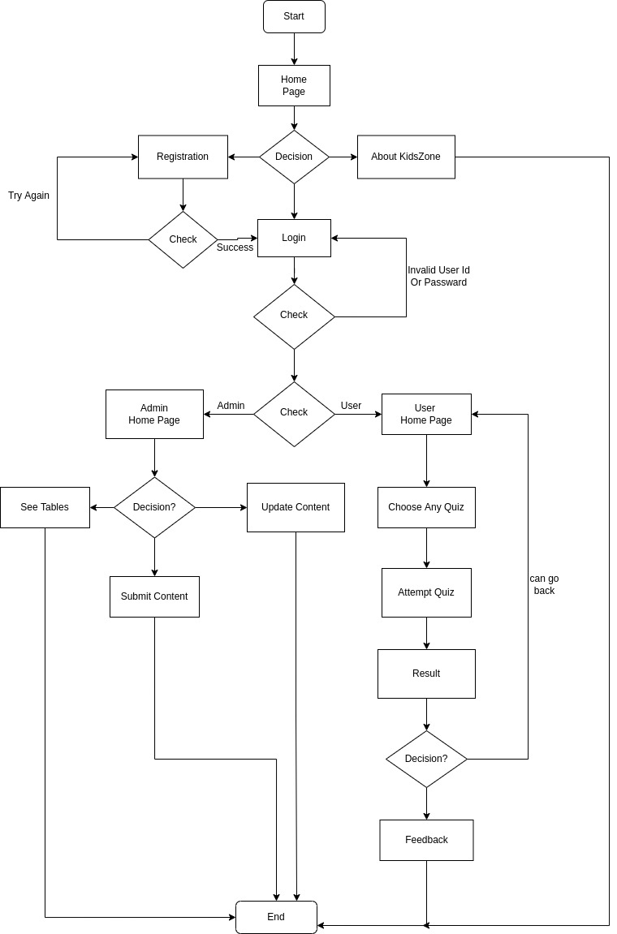
Proposed Approach

Slide 9
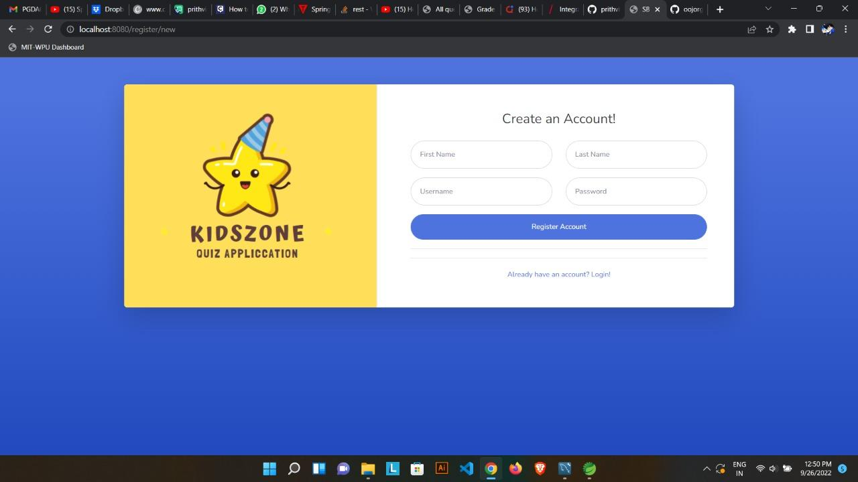
Screenshots

Slide 10
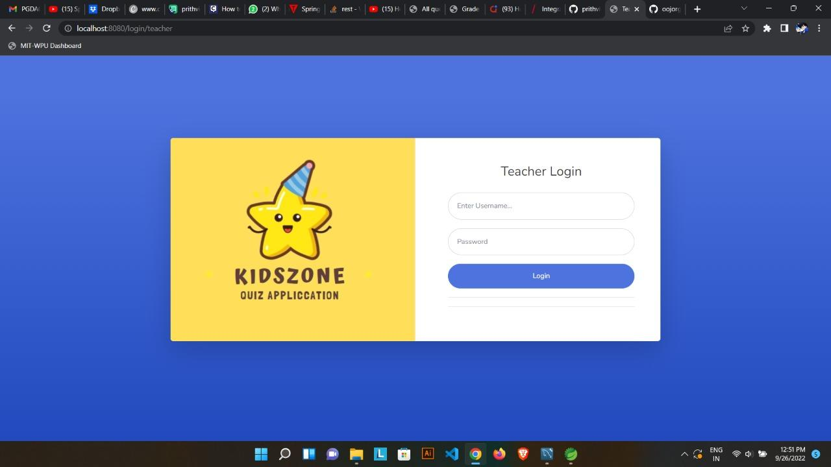

Slide 11
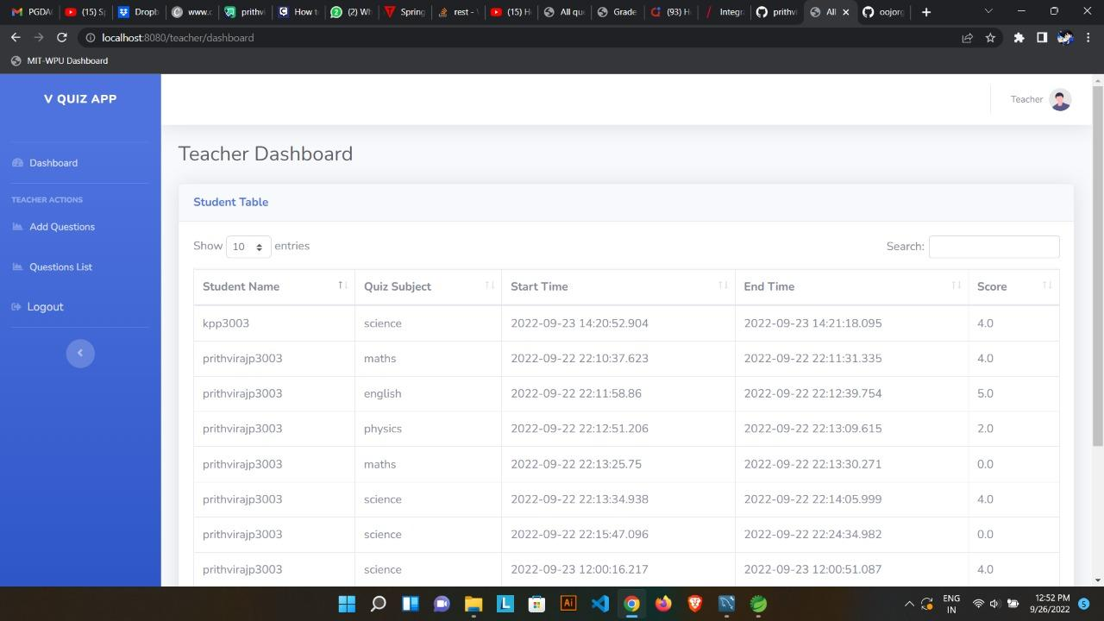

Slide 12
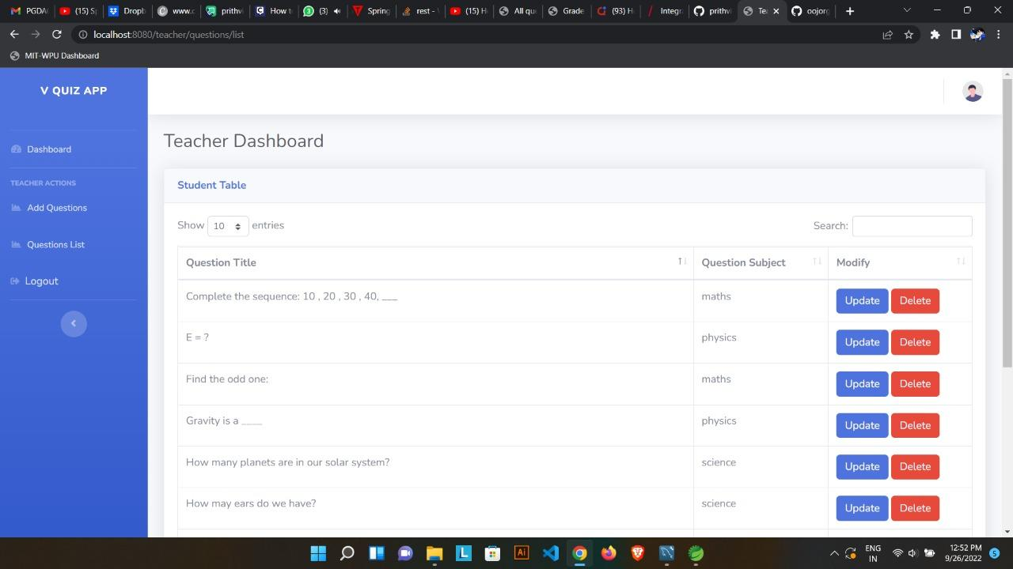

Slide 13
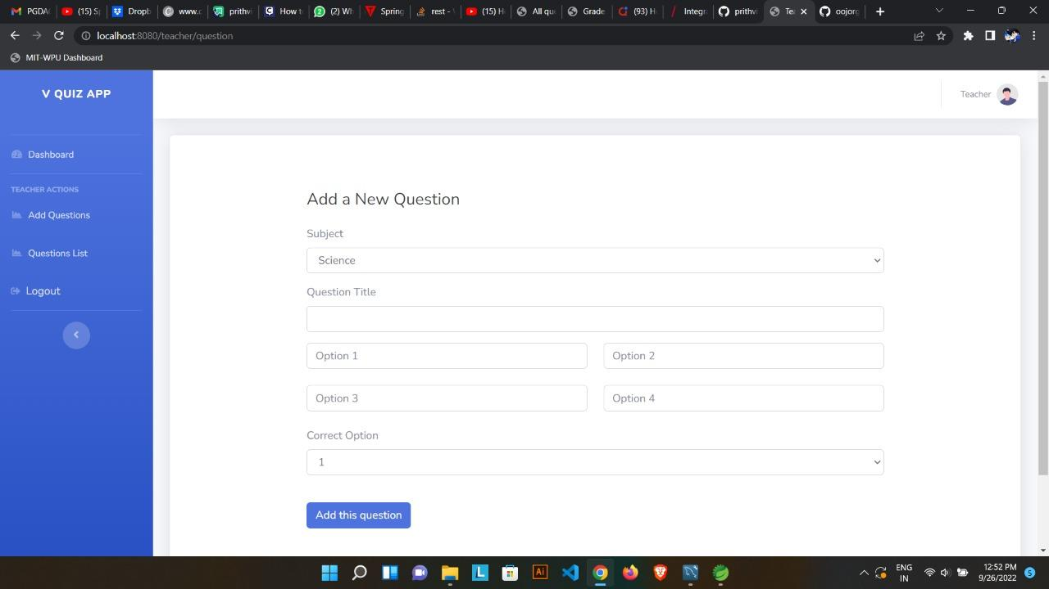

Slide 14
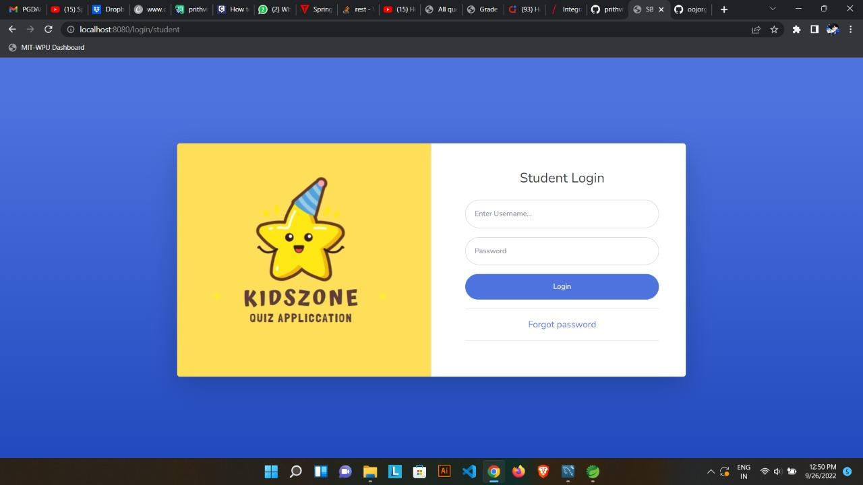

Slide 15
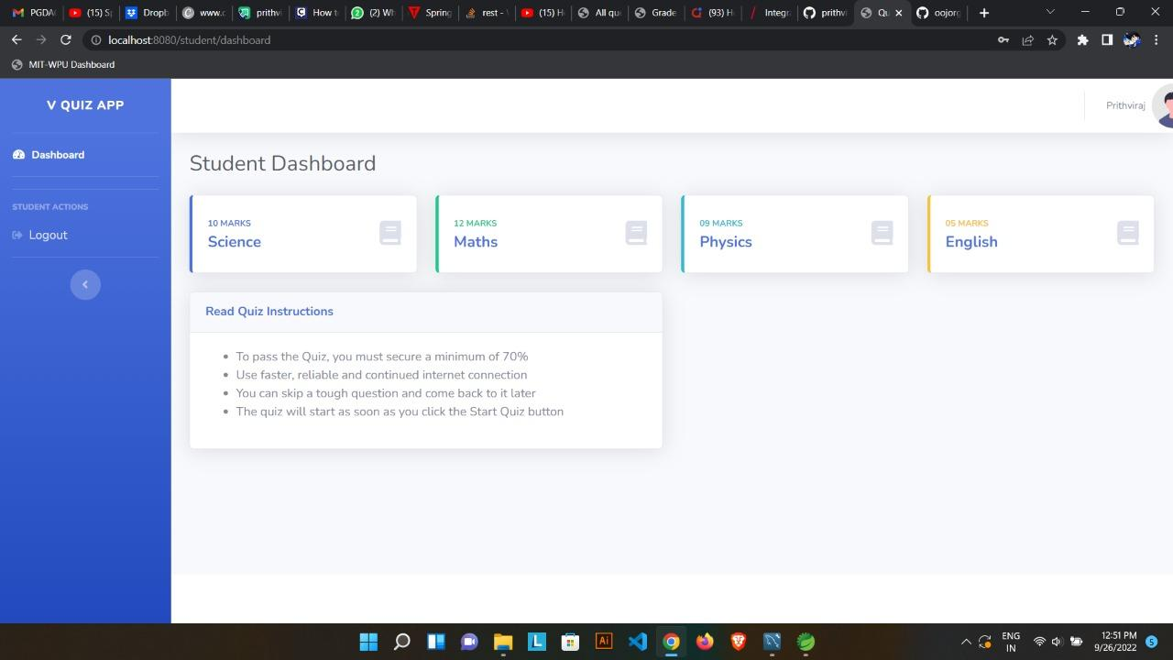

Slide 16
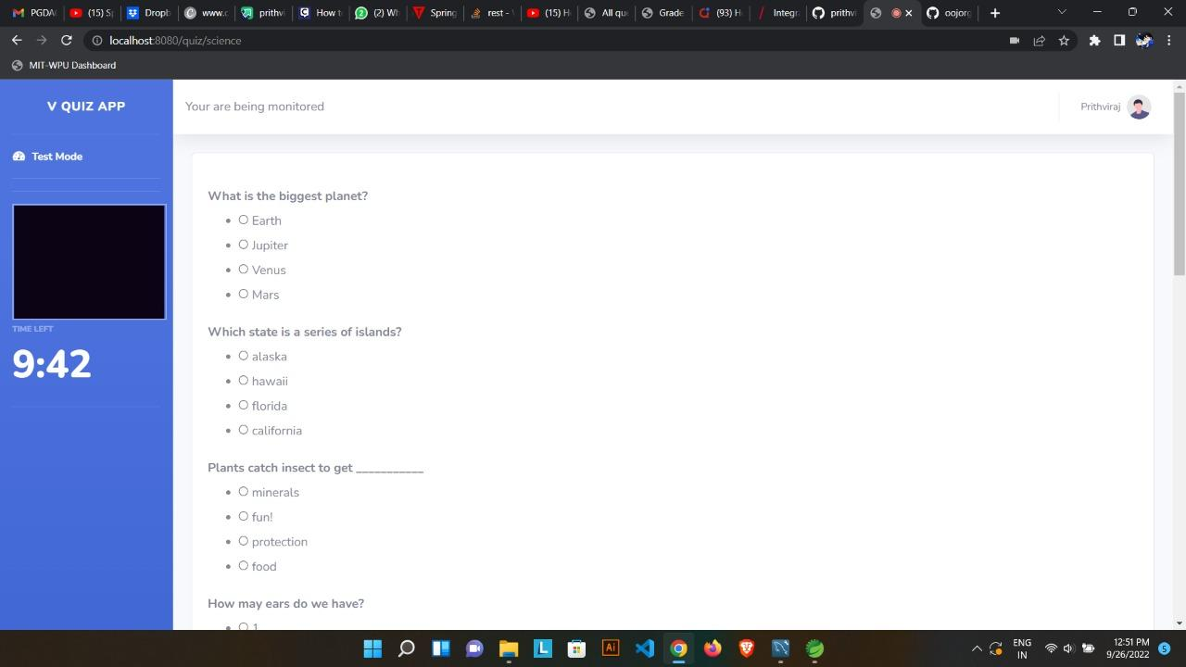

Slide 17
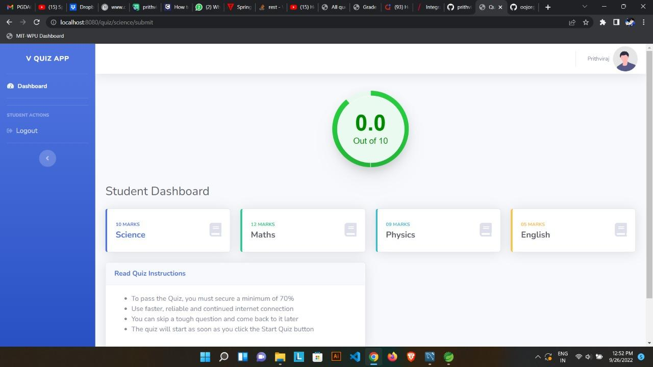

Slide 18


Slide 19
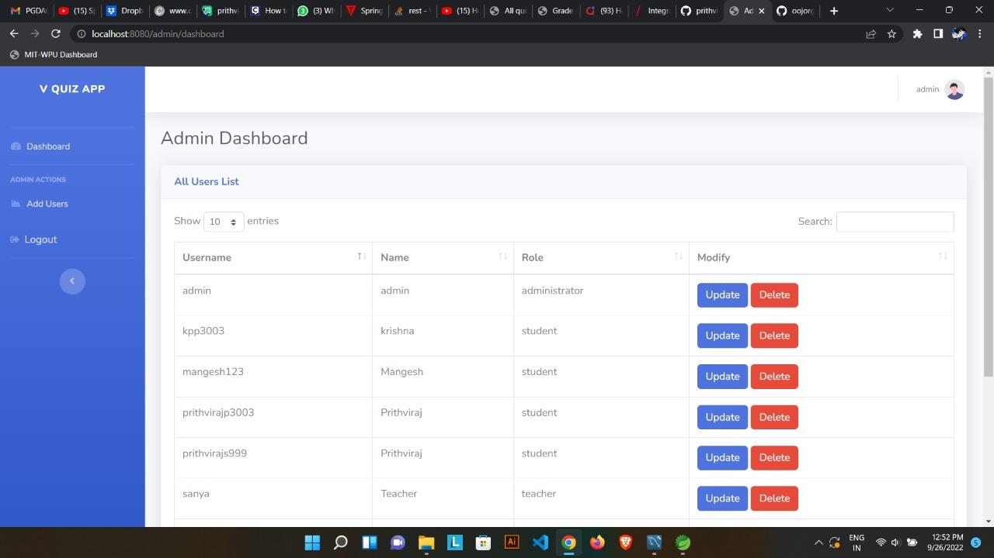

Slide 20
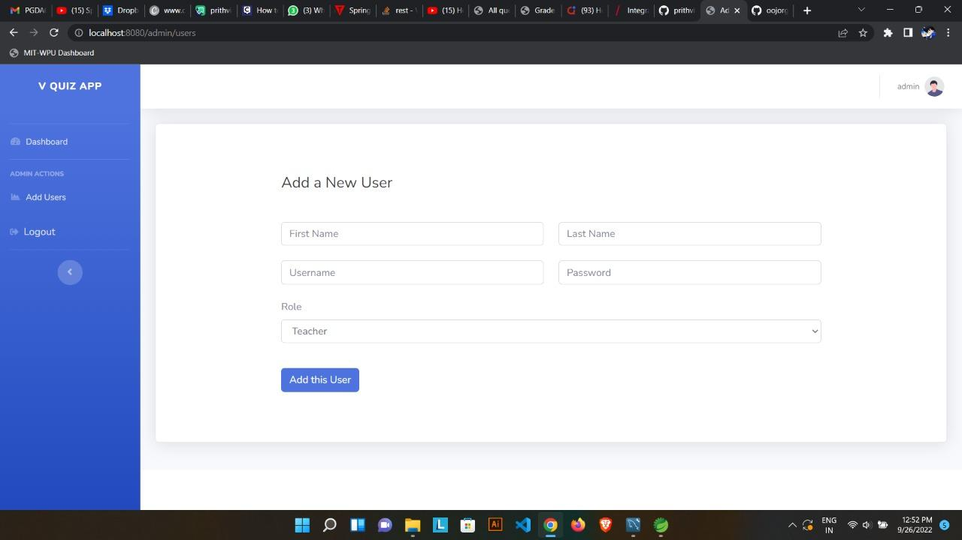

Slide 21
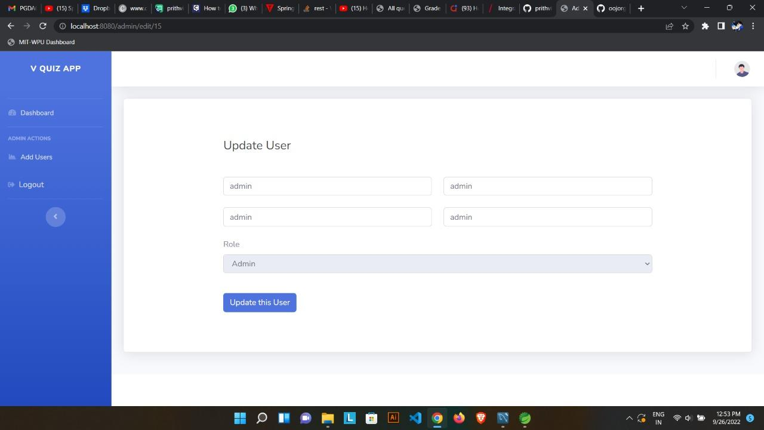

Slide 22
System Requirements
Software Requirements:
• Windows (All Versions)
• Tomcat 9
• Spring Tool Suite, MySQL Workbench
Hardware Components:
• Processor – i3
• Hard Disk – 5 GB
• Memory – 1GB RAM

Slide 23
Technologies Used
HTML : Page Layout has been designed in HTML.
CSS : Used for all designing part.
JavaScript : All Validation task and animations has been developed by JS.
JAVA : All the business logic has been written in JAVA.
MySQL : MySQL database has been used as database.
Tomcat : Project will run using Tomcat server.

Slide 24
Applications
Take online quiz
Can be used in any country
Educational Industry

Slide 25
Advantages
Friendly learning experience
Students don’t need to wait for the results.
Engaging activity for kids
Interactive user interface

Slide 26
Limitations
Accurate verification of the users cannot be done online.
It requires an extensive database and memory.

Slide 27
Conclusion
Kidszone online quiz system is a web-based system for kids to access quiz online.Nowadays most of the kids take quiz online and most parents dont have much time to spent with their kids regarding studies.This way kids often do bad in studies. This system is specifically meant for kids to access the quiz from anywhere this system will allow kids to take quiz and get results quickly. The system will provide user friendly and interactive user interface so the students will enjoy the quiz without getting bored

Slide 28
Future Scope
The improvements are needed on quiz types such as video quiz,animated quiz
Improvement in design.
Mobile Application
Improvement in interface part and admin-user module

Slide 29
References
Mr. Saleel Bagde for Database.
Mrs. Harshita Maheshwari for HTML JS & CSS also she was our project guide.
Mr. Raju Kolhe for JAVA.
https://www.slideshare.net
https://www.projectideas.co.in
A special thanks to Infoway Management who arranged extra lab time for us.

Slide 30
THANK YOU

