Slide 1


Slide 2
Project Highlights
Project Name :
Team Size :
BU Mentor Name : Mentor PS#
Team Members Details (Professional Stamp Size Photo with few lines of individual briefing
Intern Name
PS#
GENESIS Track Code
Education Details
Professional Skills
Intern Name
PS#
GENESIS Track Code
Education Details
Professional Skills
Intern Name
PS#
GENESIS Track Code
Education Details
Professional Skills

Slide 3
DIGIBOX USE CASES & WIREFRAMES
DigiBox is a content management system will be used in the aero industry.
DigiBox is having three different user: Admin, Studio and Airline
• Admin can add studio and airline user and manage user role. Also generate different reports
• Studio users can add, modify and remove the media contents from the system
• Airline users can buy a media like Movies, TV shows, Audios and special content from the studios and Labs

Slide 4
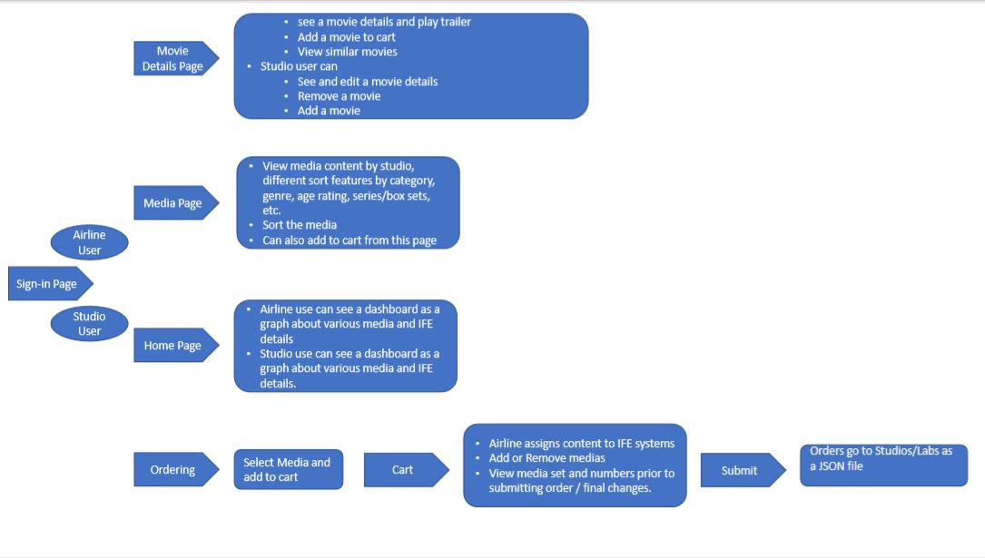
Detailed Design

Slide 5
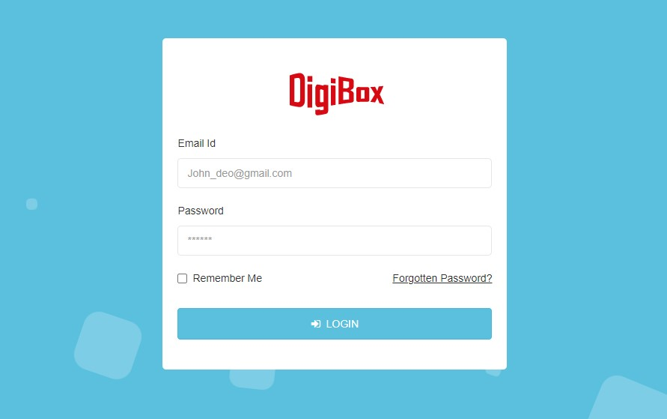
Sign-in Page
Sign-in page having below requirements:
Email ID: Accepts valid email ID, Mandatory filled
Password: Accepts password, Mandatory filled
Remember Me: if enabled, then the credentials will be auto filed from browser memory
Forgotten Password?: Not yet defined
Login: Validated the credentials and redirect to respective dashboard page otherwise display error on the same page

Slide 6
Media Page
Media – Movies Landing Page
Display the newest available releases for MOVIES in ALPHA order regardless of Studio (using the airline release date) by default
FILTER: Shall be able to filter by Airline release date, genre/category, age rating, language
SORT: Shall be able to sort ALPHA, Newest to Oldest,
SEARCH: Shall be able to SEARCH by title, actor
Shall be able to “Check” the boxes below poster to BULK add to cart and assign IFE systems, versions, languages later when viewing cart

Slide 7
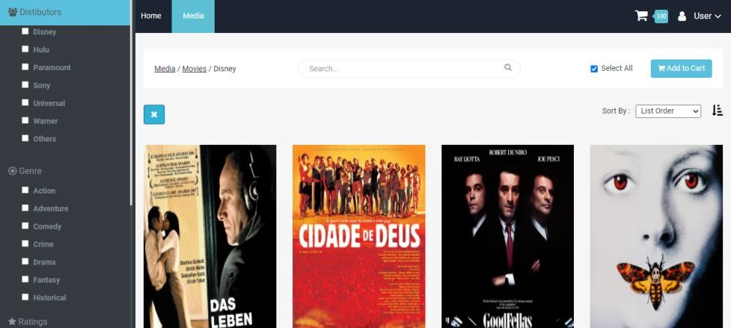
Media Page Preview

Slide 8
Movie Details Page
As a Airline User
User able to watch the trailer and switch between available poster
User able to add to cart
User able to see similar movies list
As a Studio User
User able to see a all the fields are in editable mode
User able to remove the movie
User able to add a new movie

Slide 9
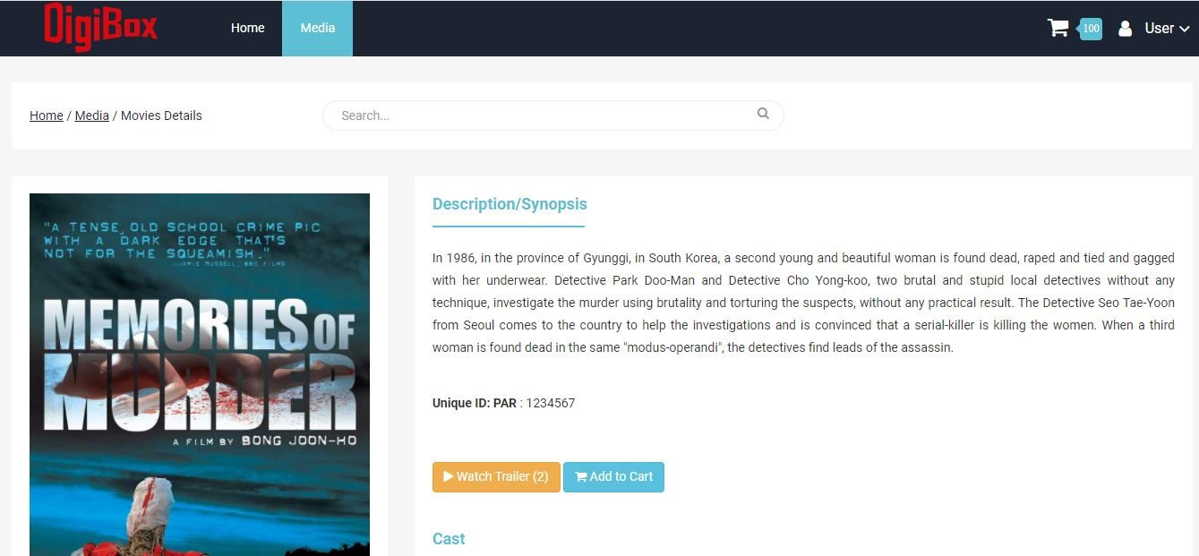
Movie Details Page Preview

Slide 11
Project Video Snippet

Slide 12
Future development that can be implemented further

Slide 13

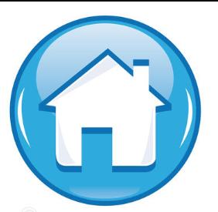
Thank You !

