Slide 1
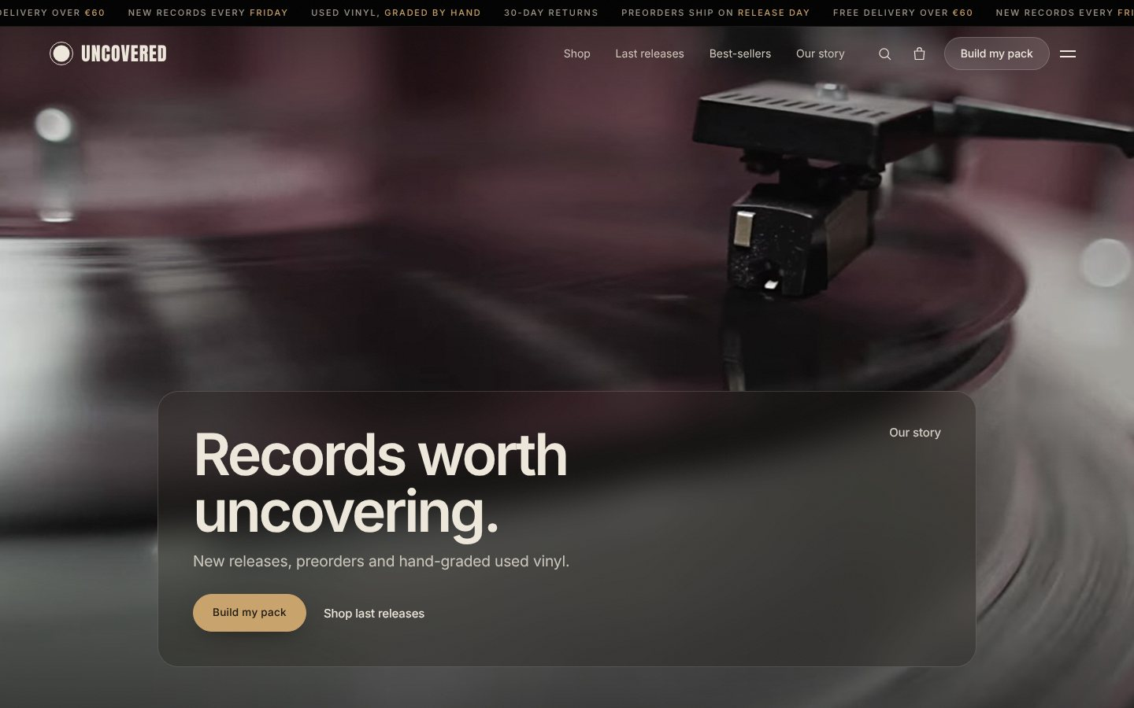

Records worth uncovering
Brand concept, market and the website experience
Prithwiraj Mukherjee
uncovered.store · uncovered-store.netlify.app
Notes:
Uncovered is an online record shop concept: new and used vinyl plus turntables, with a working one-page website.

Slide 2
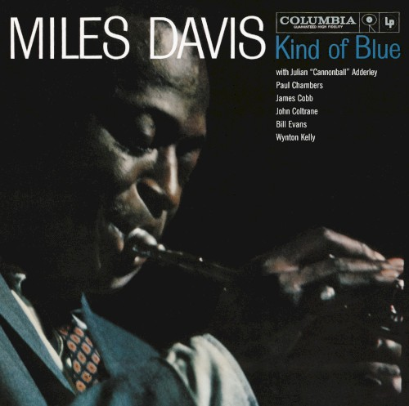



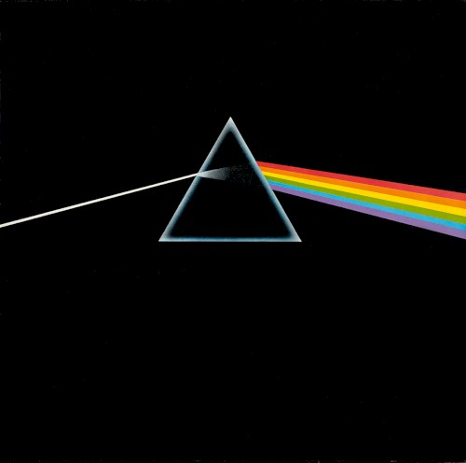

What we'll cover
CONTENTS
01
Brand introduction and concept
02
Market analysis
03
Competitor analysis
04
Products and services
05
Website and customer experience
06
Conclusion
Notes:
Six parts, following the brief's table of contents.

Slide 3
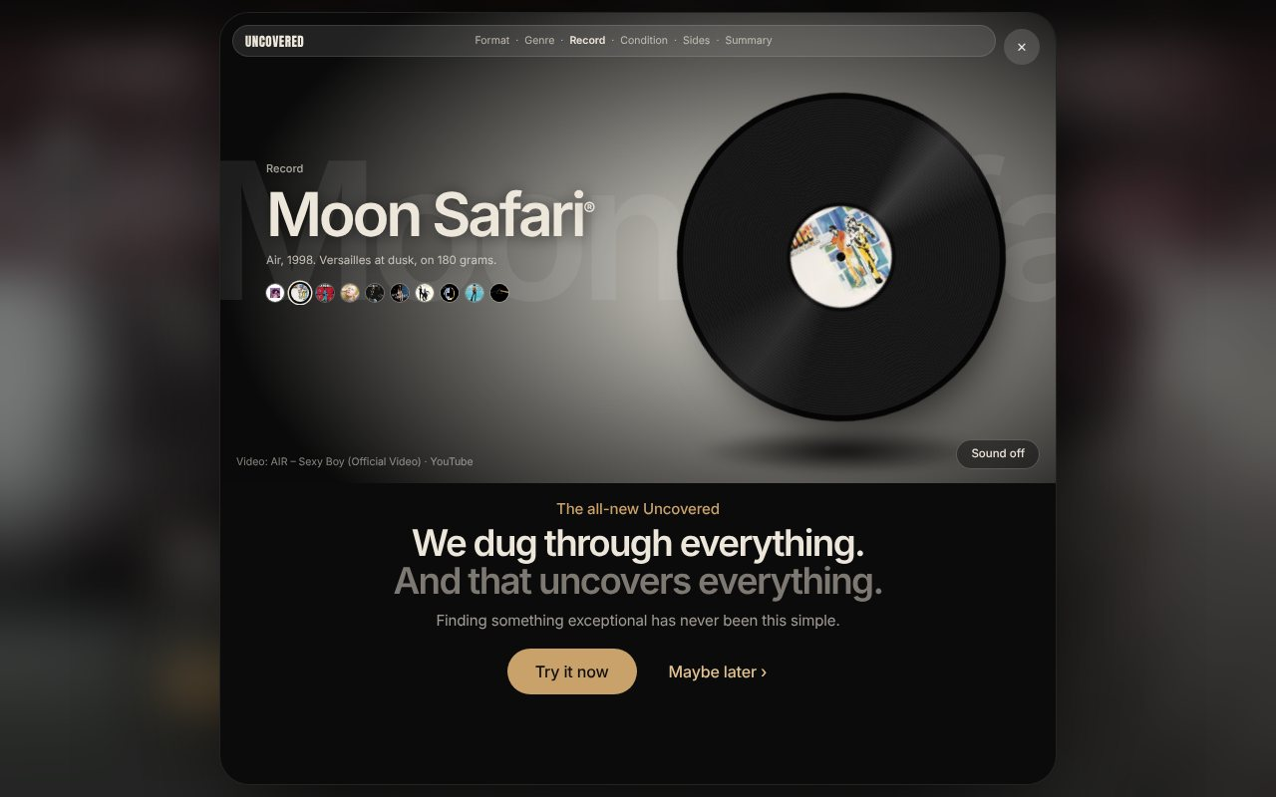
A record shop that does the digging for you
01 · BRAND INTRODUCTION
Buying vinyl online means guessing. Buyers hesitate at four moments:
What's worth buying?
Is this used copy any good?
Dozens of releases every Friday, and nobody choosing.
"Good condition" is a gamble on a scratch.
Which turntable do I need?
Will I miss it?
Preamps, belts and speakers stall first-timers.
Preorders and short runs sell out without warning.
The opening popup states the promise: "We dug through everything."
Notes:
The problem: none of these doubts is a dealbreaker alone, but together they turn a fun purchase into homework.

Slide 4
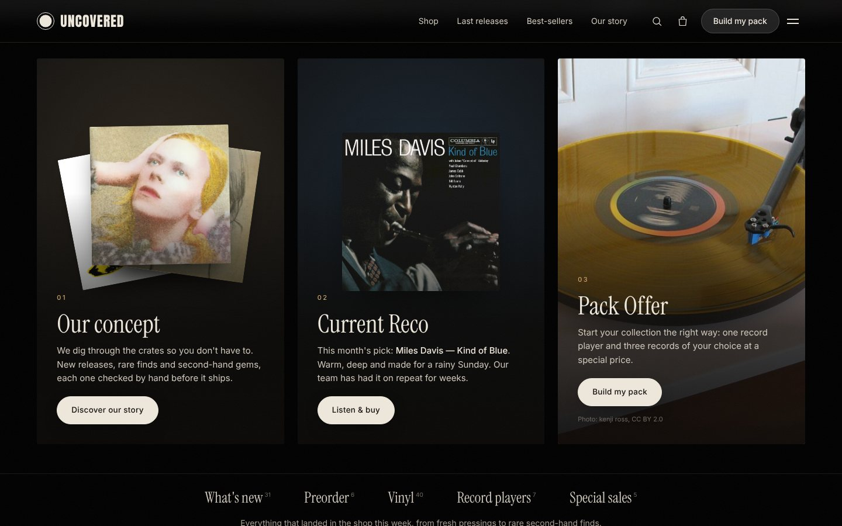
We dig through the crates so you don't have to
01 · CONCEPT
1
We choose
A monthly Current Reco, a Release of the week and ranked best-sellers.
2
We check
Every used record graded twice: the record and the sleeve (NM to G).
3
We bundle
Pack Offer: a turntable plus three records, 10% off.
4
We tell you first
One email every Friday: new arrivals, restocks, limited editions.
Our concept, Current Reco and Pack Offer panels on the homepage
Notes:
Tagline: Records worth uncovering. Every block of the page does part of the digging for the visitor.

Slide 5
Vinyl keeps growing while CD declines
02 · MARKET ANALYSIS
$1.04B
US vinyl revenue in 2025, up 9.3%: the 19th year of growth and the first time above $1B since 1983
€113M
French vinyl revenue in 2025, up about 15%, now well ahead of CD in value
~6M
vinyl records sold in France in 2025, against 8M CDs
Sources: RIAA 2025 year-end report (wholesale values); SNEP, French recorded music market 2025
Notes:
US: RIAA 2025 year-end, vinyl ~$1.04B wholesale (+9.3%), 46.8M units. France: SNEP 2025, vinyl ~€113M (+~15%), ~6M units; total French market €1.071B (+3.9%).

Slide 6
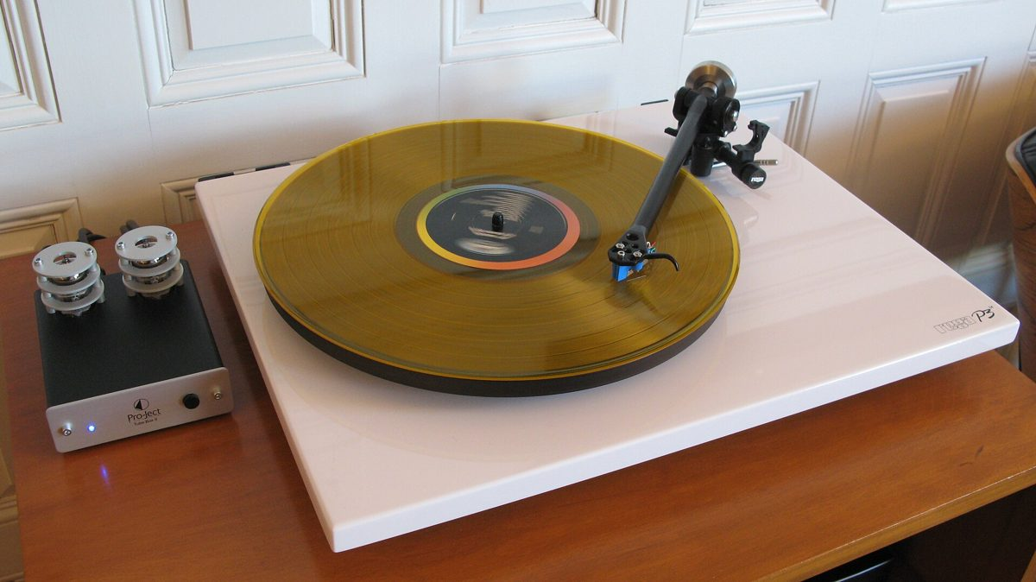

Three buyers, each with a different job to do
02 · TARGET CUSTOMERS
The first-time buyer
The crate digger
The gift buyer
"Get me started properly, without wasting money."
"Show me what's new and limited, and tell me honestly what condition it's in."
"Help me pick something safe for someone else."
Served by the Pack Offer and plain-English guidance.
Served by two-part grading, edition badges and Friday alerts.
Served by the Current Reco, best-seller ranks and 30-day returns.
Notes:
Jobs to be done per segment, from the brand blueprint.

Slide 7
Nobody combines range, expertise and trust online
03 · COMPETITOR ANALYSIS
 | Uncovered | Discogs | Amazon | Fnac | Indie record shops
Main strength | Curated, graded, explained | Largest used catalogue | Range and fast delivery | Trusted brand, stores nationwide | Expert staff in person
Curation | Monthly Reco, ranked best-sellers | Community data, little editorial | Algorithmic | Charts and promotions | Strong, mostly in store
Used vinyl | Graded by us: record and sleeve | Graded by each seller | Marketplace sellers | Marketplace sellers | Yes, varies by shop
First turntable | Pack: deck + 3 records, 10% off | Records only | Sells decks, little guidance | Sells decks | Advice in person
Our gap: an indie shop's curation and honesty about condition, with the ease of buying online and a one-step starter pack.
Notes:
Qualitative comparison of how each player sells vinyl online. Discogs sellers grade media and sleeve themselves; Uncovered grades every used record in-house.

Slide 8

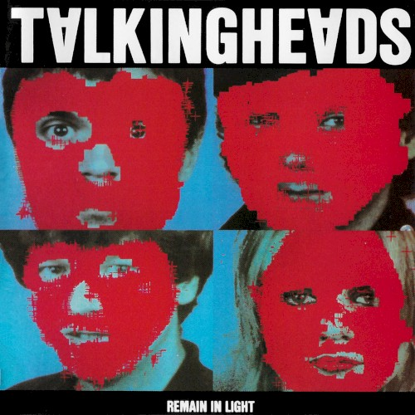
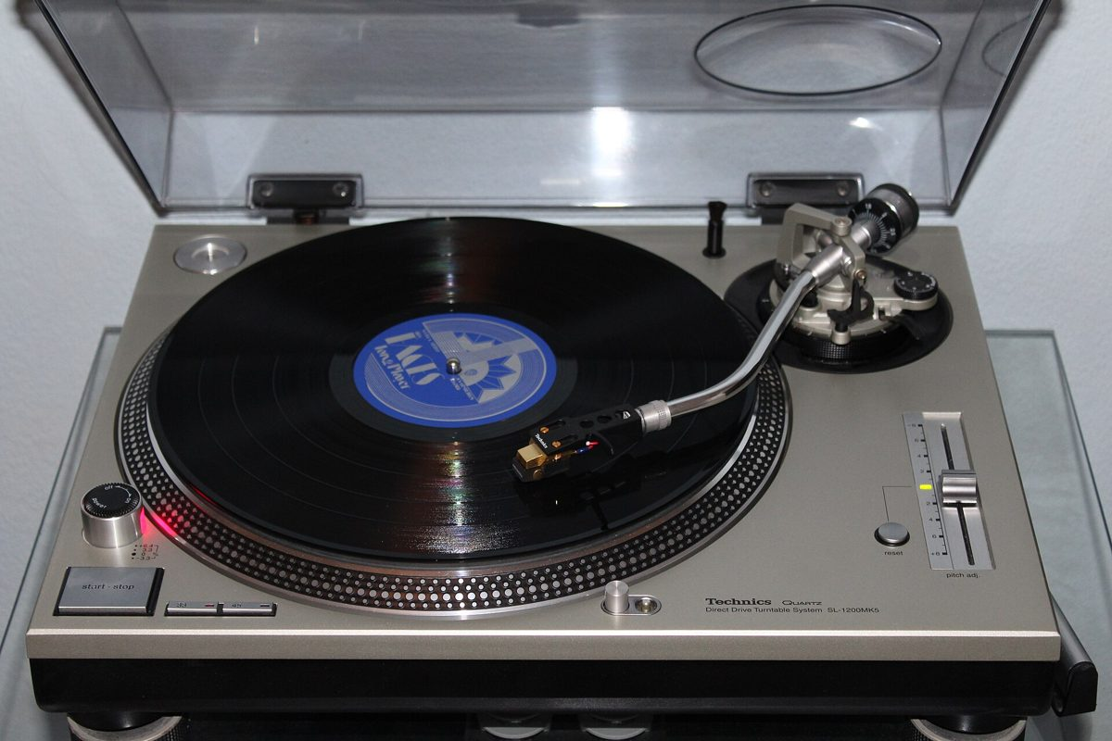
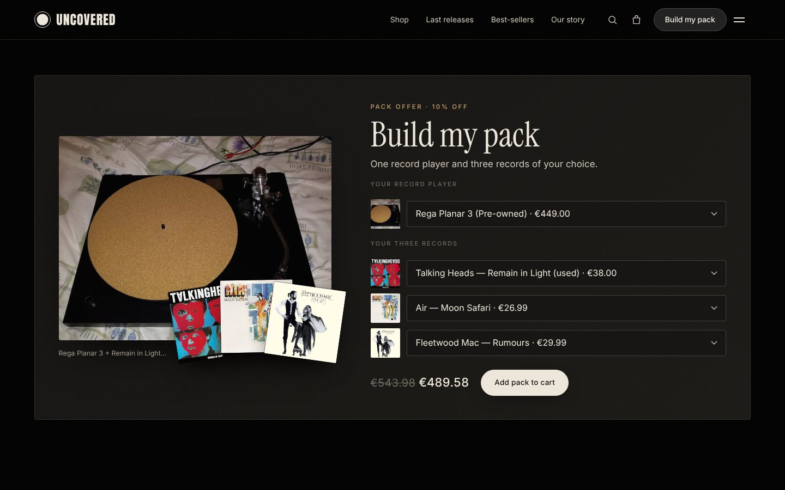
Records, record players and the pack that joins them
04 · PRODUCTS
Vinyl
Record players
Pack Offer
40 real records, new and used
What's new, Preorder, Special sales
Limited, Coloured and Signed editions
7 turntables, first deck to audiophile
Audio-Technica, Pro-Ject, Rega, Technics
Tested by the team before listing
Pick 1 turntable + 3 records
10% off, saving shown live
The picture updates as you choose
Notes:
Catalogue data from MusicBrainz and covers from the Cover Art Archive; turntable photos from Wikimedia Commons.

Slide 9
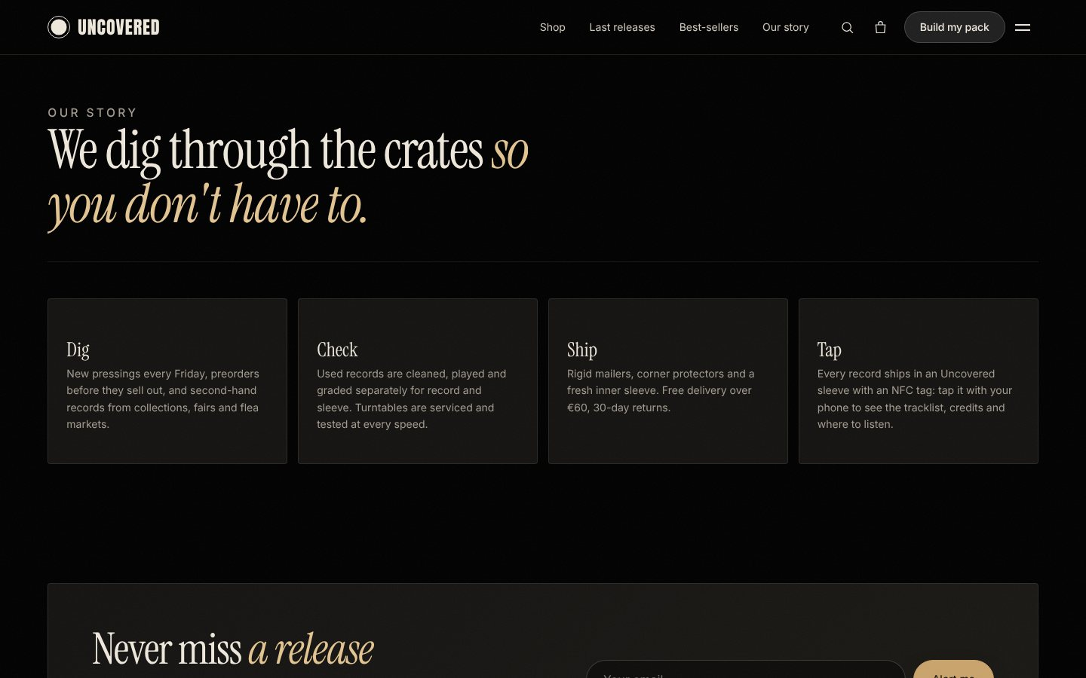
Services that remove every doubt before checkout
04 · SERVICES
1
Hand grading
2
Connected sleeve
Two grades per used record: vinyl and sleeve, on the NM to G scale.
An NFC tag in every Uncovered sleeve opens the record's page.
3
Listen first
4
Friday release alerts
30-second extracts before you add a record to the cart.
One email so nobody misses a preorder.
5
Free delivery over €60
6
30-day returns
Our story (Dig, Check, Ship, Tap) and the release-alert signup
Shown in the cart with a progress meter.
A safe choice for gift buyers.
Notes:
Each service answers one of the four buyer doubts.

Slide 10
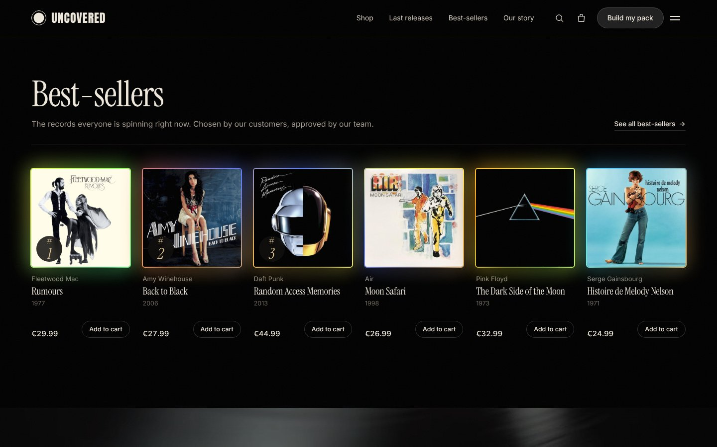
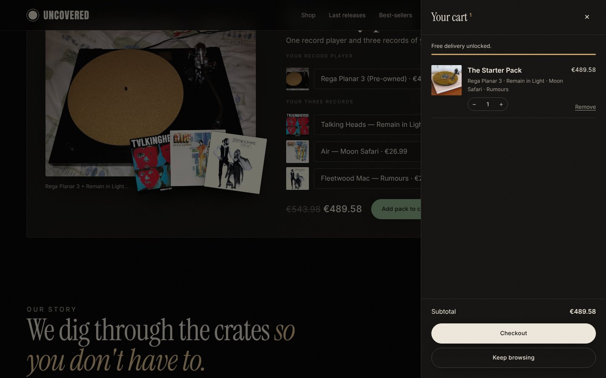
One page, one journey: from first look to cart
05 · WEBSITE AND CX
1
Land
2
Get a view
3
Discover
4
Build a pack
5
Buy
Video hero; delivery, grading and returns answered at once
Concept, Current Reco with a listen, Pack Offer
Last releases and ranked best-sellers
Deck + 3 records, live picture and saving
Slide-out cart with a free-delivery meter
Notes:
Live at uncovered-store.netlify.app. The full journey works on desktop and phone.

Slide 11
Signature moments that sell the feeling first
05 · WEBSITE AND CX
The opening
A small window of turntable footage expands to full screen, then a popup cycles records with their official videos.
Video on hover
Every record plays its official video when hovered, with a mute button; it returns to the cover on leave.
A glow for every record
An always-on colour frame drawn from the cover's own palette, pulsing at the music's pace.
Notes:
These moments are measured: opening try-it vs dismiss, and listen-to-add-to-cart.

Slide 12
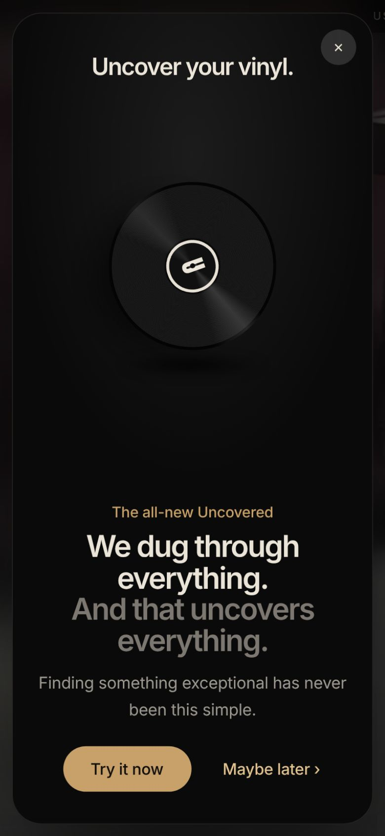
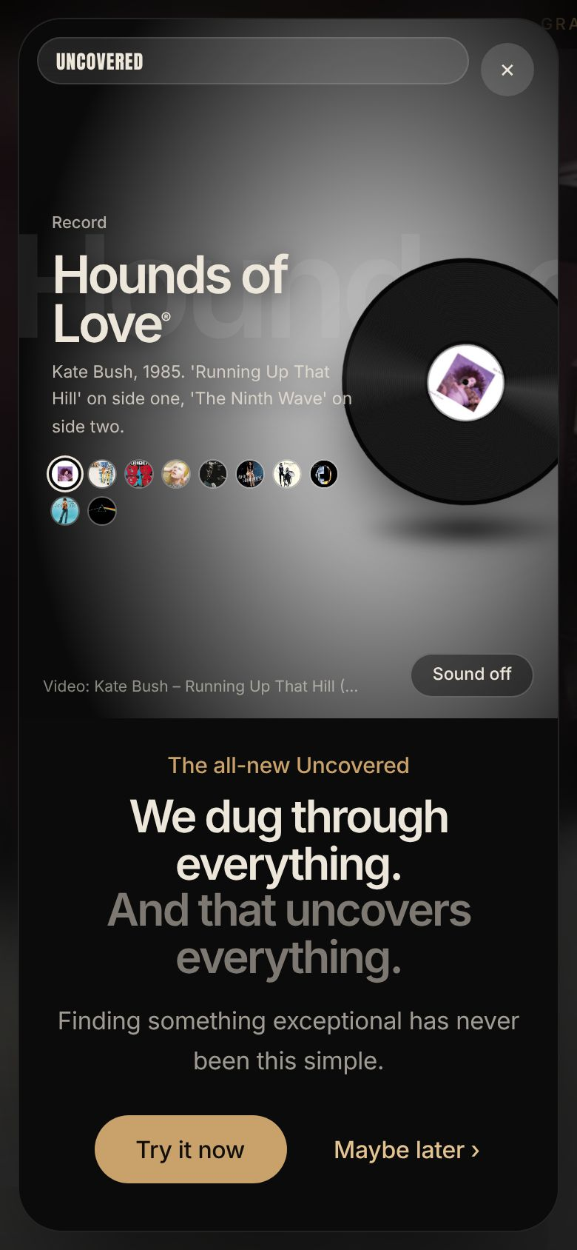
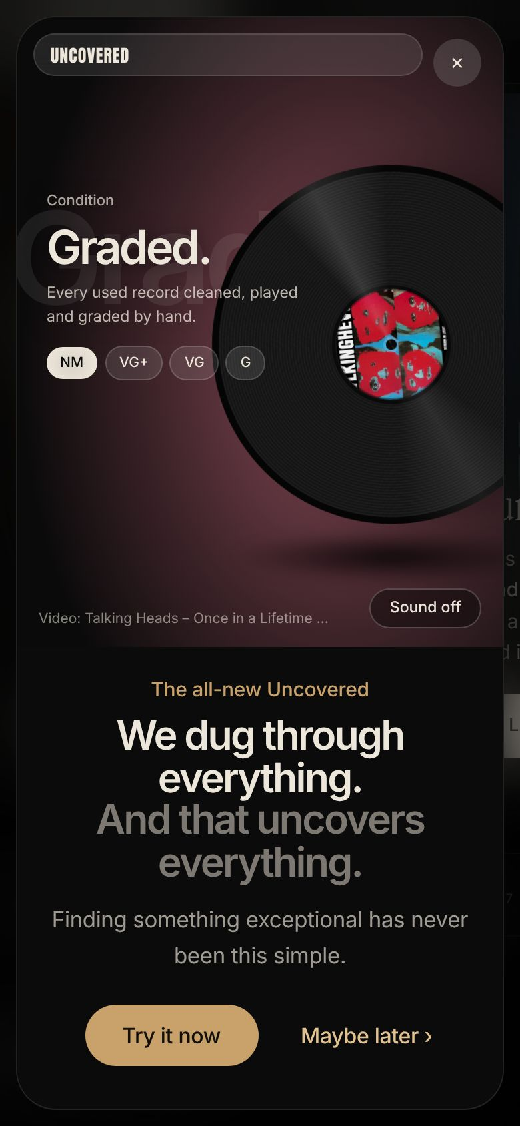
Built for the phone, measured from day one
05 · WEBSITE AND CX
What we track (events ready for GA4)
Visit-to-order conversion
product seen, add to cart, checkout, order
Opening
"Try it now" against "Maybe later"
Listening sells
30-second listen followed by add to cart
Bundles
Pack share of orders and average order value
Retention
Release-alert signups and Friday return visits
Notes:
Every event is pushed to window.dataLayer, ready for Google Tag Manager.

Slide 13
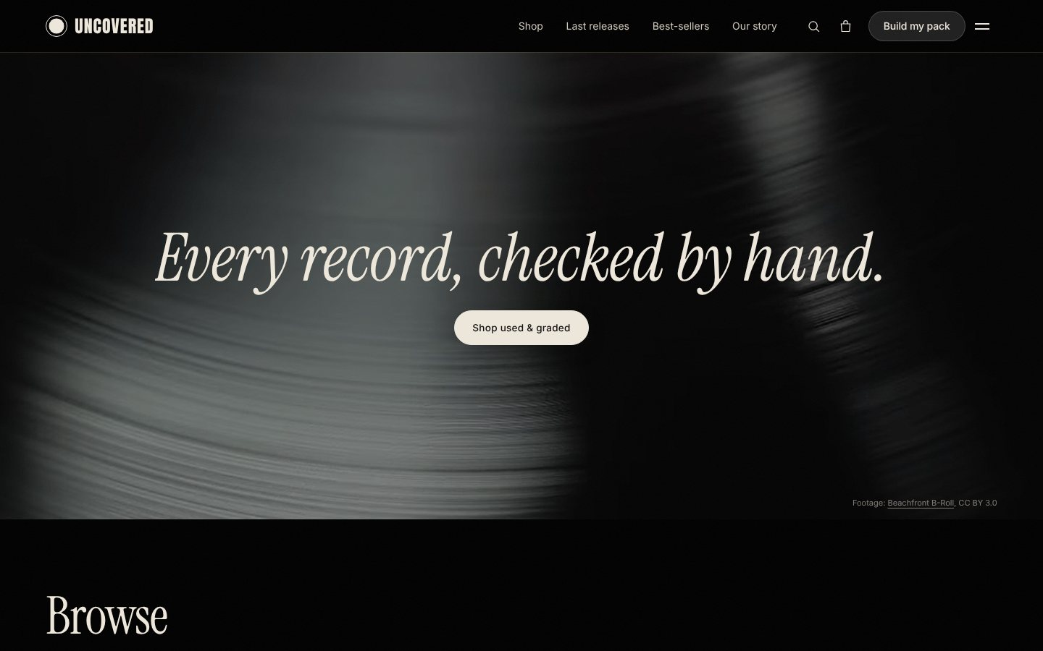
06 · CONCLUSION
Making record buying a pleasure again
1
A growing market
Vinyl is up for a 19th year in the US and about 15% in France.
2
A clear gap
Curation, honest grading and turntable guidance in one online shop.
3
A working prototype
Real catalogue, live journey, analytics ready.
Next steps
Validate prices and demand with real buyers
A/B test the opening popup
Pull keyword volumes and launch netlinking partners
uncovered-store.netlify.app
Notes:
Close with the live site link and invite questions.

