Slide 1

BOOK INVENTORY SYSTEM
Project By:
PRITI GAWADE
Notes:
NOTE:
To change the image on this slide, select the picture and delete it. Then click the Pictures icon in the placeholder to insert your own image.

Slide 2

About Book Inventory System
A Book Inventory System is a software application or process used to track and manage books in a store, library, warehouse, or any organization that handles books. Its primary purpose is to maintain an organized record of books, their availability, and their movement (whether sold, borrowed, or returned). This system helps ensure that an organization can effectively manage its book stock, sales, or borrowing operations.

Slide 3
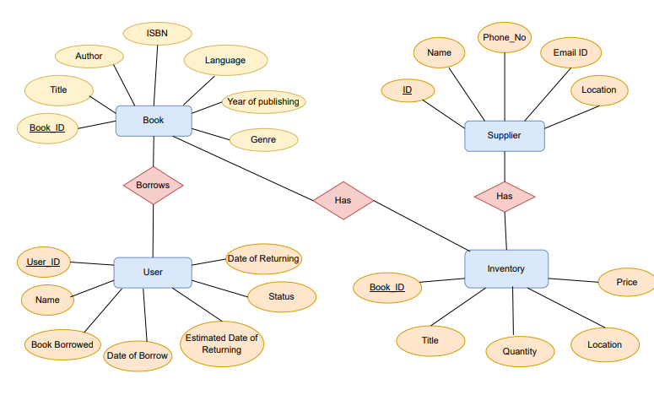
ER DIAGRAM

Slide 4
Key Features
Book Management:
The Book Management section helps to maintain the data of books that are available in the inventory. It gives the information of the book which lets user as well as administrator know about what the books are about. In addition to that, the administrator can add new books as well as update the details of book. If any book gets out of stock, then it can be removed as well.
Data Tracking
The Book Inventory tracks the quantity, location and price of the books that are available in the inventory. If any book gets purchased or borrowed, the quantity gets updated in the inventory accordingly.

Slide 5
Supplier Data Record Management:
This section helps to manage the supplier records. The administrator can add or remove suppliers as per the requirement. Also, the phone number or email address of suppliers can be updated if required. This helps the administrator to know the data of suppliers and makes contact efficient.
User Tracking
The administrator can track the data of user that borrows or purchases the books. If the book is borrowed, the dates of borrowing, estimated date of returning and actual date of returning the book gets tracked. If the user missed the estimated date of returning, the user is liable to getting charged with fine by administrator. This makes the administrator’s work of keeping record of users easy and efficient.

Slide 6
THANK YOU

