Slide 1

Bank Management System
Presented By:
Priti Gawade
Prachi Shinkar

Slide 2
Introduction
A Bank Management System is software designed to manage and streamline banking operations efficiently. It handles tasks such as account management, and customer, employee management, ensuring secure and accurate data handling.

Slide 3
Objective
Streamline banking operations like account handling,customer handling, employee handling. .
Ensure the safety and confidentiality of customer and financial data.
Minimize human errors and improve efficiency by automating routine banking tasks.

Slide 4
Technologies
Backend: Java, Spring Boot
Database: MySQL
Software: Spring Tool Suite, MySQL Workbench, Postman

Slide 5
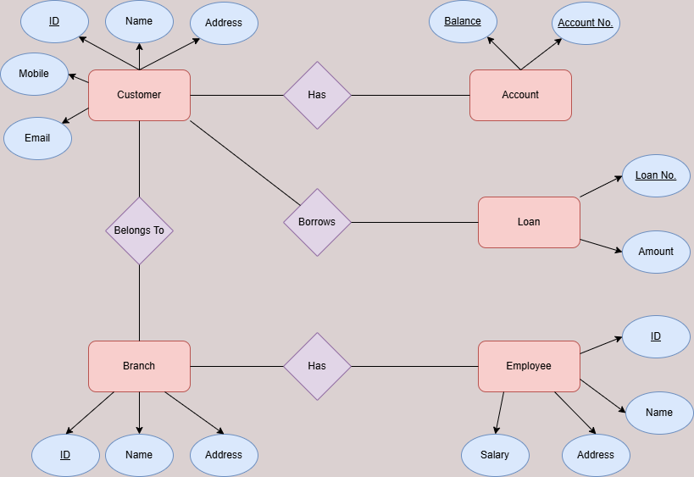
ER Diagram

Slide 6
Features
1. Customer Management:
We can manage customer details by adding new customers, updating the information, deleting the customer and being able to access the customer data.
2. Account Management :
We can manage account details by adding an account, updating the account details as required or deleting the account and also being able to access the accounts in database.

Slide 7
3. Employee Management :
We can manage employee details by adding, updating and deleting the employee information and also access the employee data.
4. Loan Management:
If there are any loans, it can be managed.
5. Branch Management :
We can manage branch details by adding the branch details or by updating, deleting or simply display the existing branches.

Slide 8


