Slide 1
Title Slide
Title: Real Estate Price Analysis Subtitle: Exploratory Data Analysis (EDA) Presented by: [Your Name] Date: [Presentation Date]

Slide 2
Objective & Dataset
Objective: Analyze real estate data to identify patterns and key factors influencing house prices.
Dataset Overview:
Source: Project3 data.csv
Features: Structural, temporal, location, and amenities
Target: SalePrice

Slide 3
Data Loading & Cleaning
Libraries Used: Pandas, NumPy Actions:
Loaded CSV into a DataFrame
Handled missing values (mode/median)
Removed duplicates
✅ Ensured data quality for analysis

Slide 4
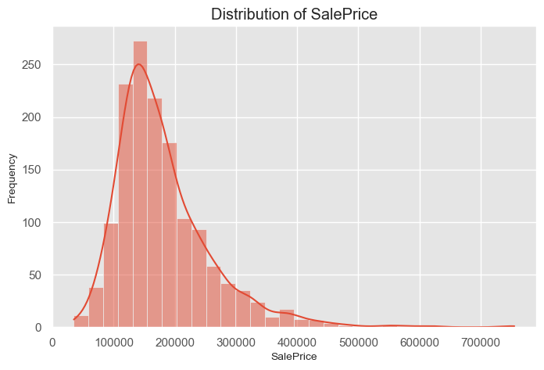
Univariate Analysis
Goal: Understand individual variable distributions Tools: Seaborn, Matplotlib Examples:
SalePrice distribution (right-skewed)
Categorical breakdown (e.g., MSZoning)
📊 Visuals: Histograms, Bar Charts

Slide 5
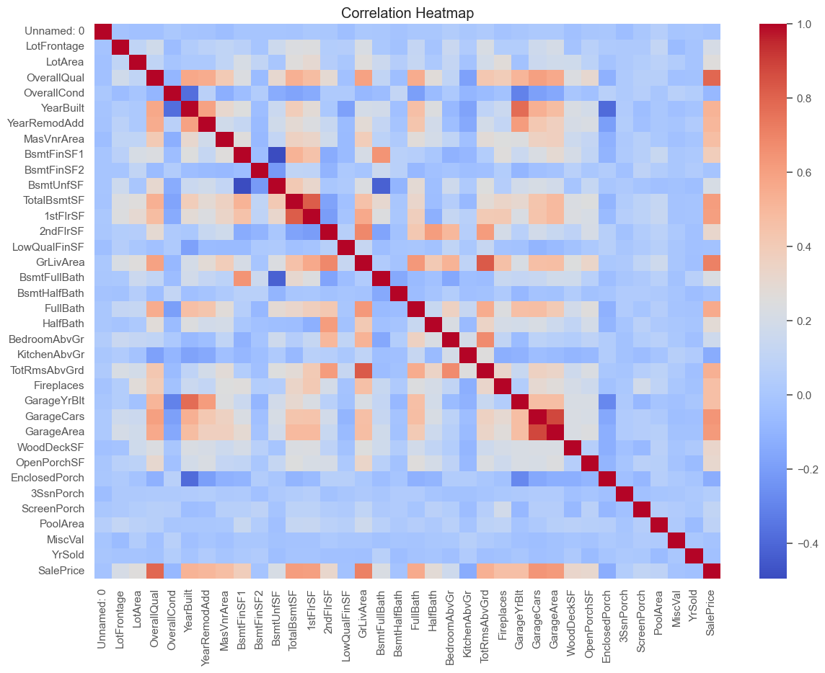
Multivariate Analysis
Focus: Correlation & relationships Tool: Correlation Heatmap Key Insight:
GrLivArea, OverallQual, and GarageCars highly correlate with SalePrice
📌 Helps prioritize features

Slide 6
Feature Engineering
HouseAge = YrSold - YearBuilt
RemodAge = YrSold - YearRemodAdd
PricePerSF = SalePrice / GrLivArea
🎯 Purpose: Enrich feature set for better insights & modeling

Slide 7
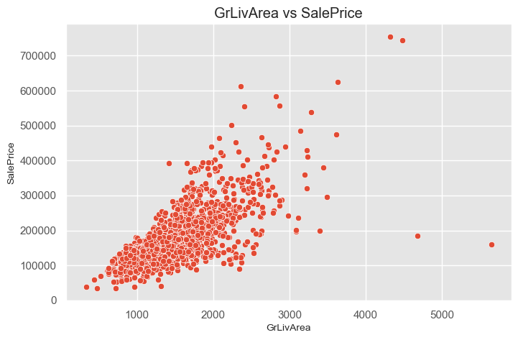
Size & Price Impact
Visuals:
GrLivArea vs SalePrice (positive trend)
Bedrooms vs SalePrice (box plot)
📈 Larger homes generally command higher prices

Slide 8
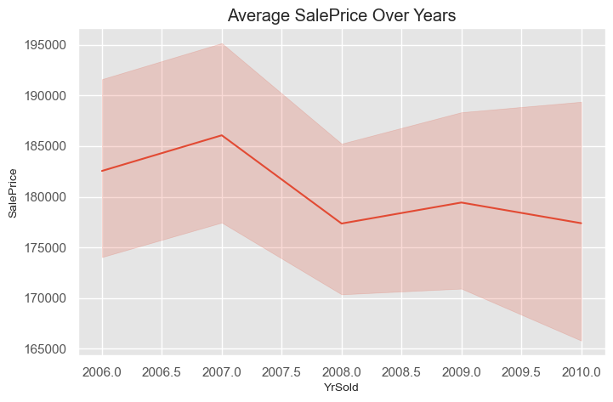
Market Trends
Analysis: Average SalePrice over YrSold Tool: Line plot
📅 Showed pricing trends across years 🧐 Useful for temporal forecasting

Slide 9
Amenities & Preferences
Explored:
Garage size vs Price (positive impact)
Pool area impact (higher price but rare)
💡 Amenities influence buyer behavior & pricing

Slide 10
Conclusion
Key Takeaways:
Living space & quality are top predictors
Engineered features improved understanding
Market behavior changes over time
Next Steps:
Model development
Deploy dashboards or interactive tools

