Slide 1
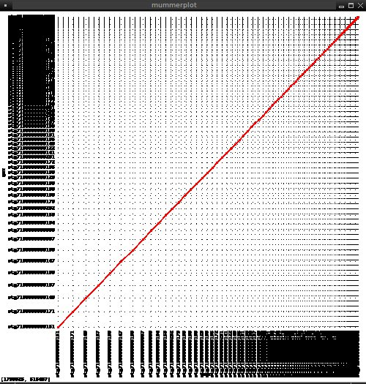
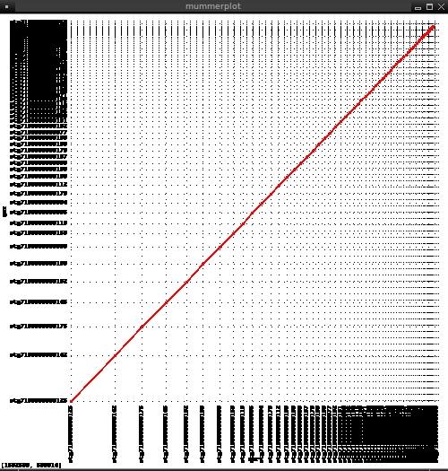
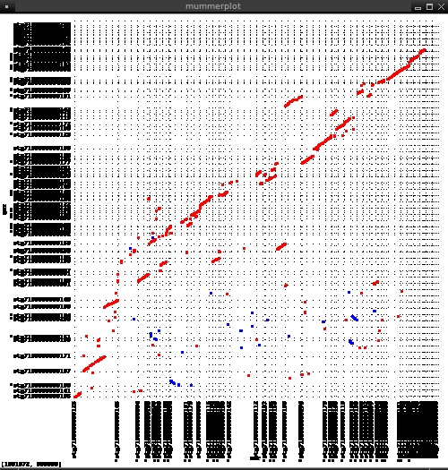
Unmapped vs unmapped contigs
Downei vs Downei contigs
MUMer plots
Downei vs unmapped contigs

Slide 2
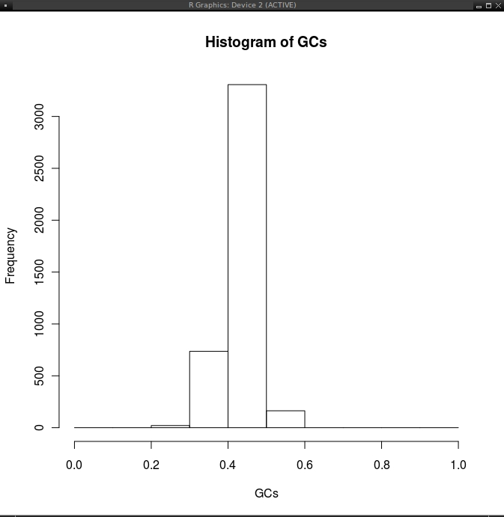
content frequency
includes both Downei and unmapped contigs
GC content calculated on 1Kb sliding window

Slide 3
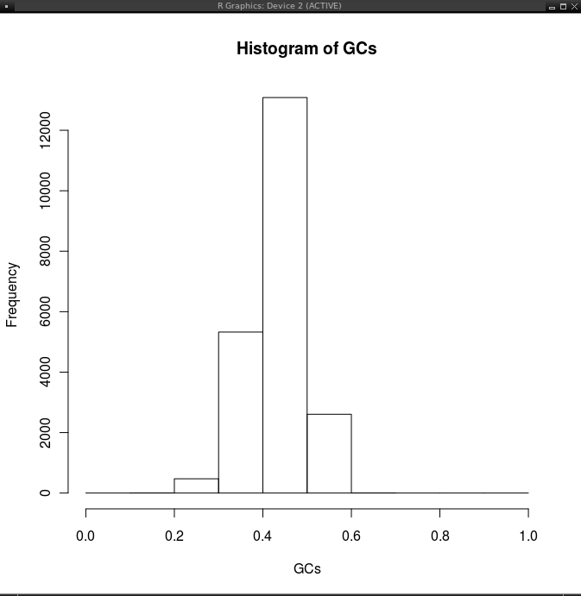
content frequency
includes both Downei and unmapped contigs
GC content calculated on
200bp sliding window

Slide 4
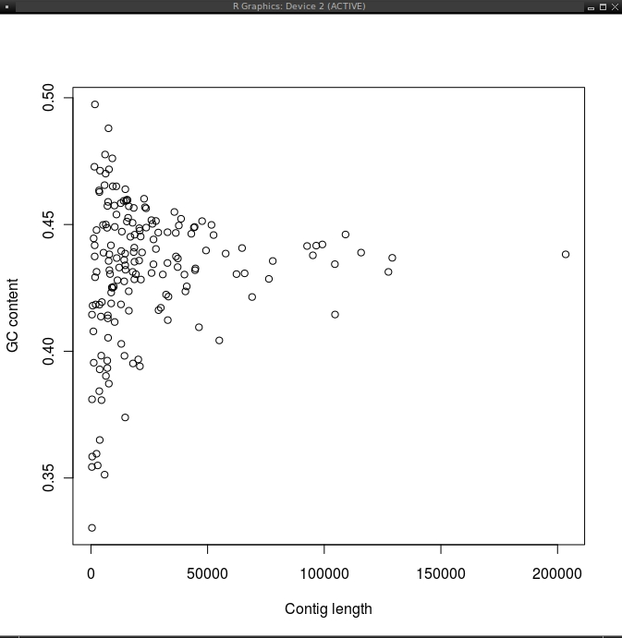
GC content VS contig length
includes both Downei
and unmapped contigs
GC content is calculated along the length of the entire contig

