Slide 1
Investigation of the E-Retail factors Affecting Customers Retention and Consumers purchasing decision in Indian E-Commerce
Submitted by: Priti

Slide 2
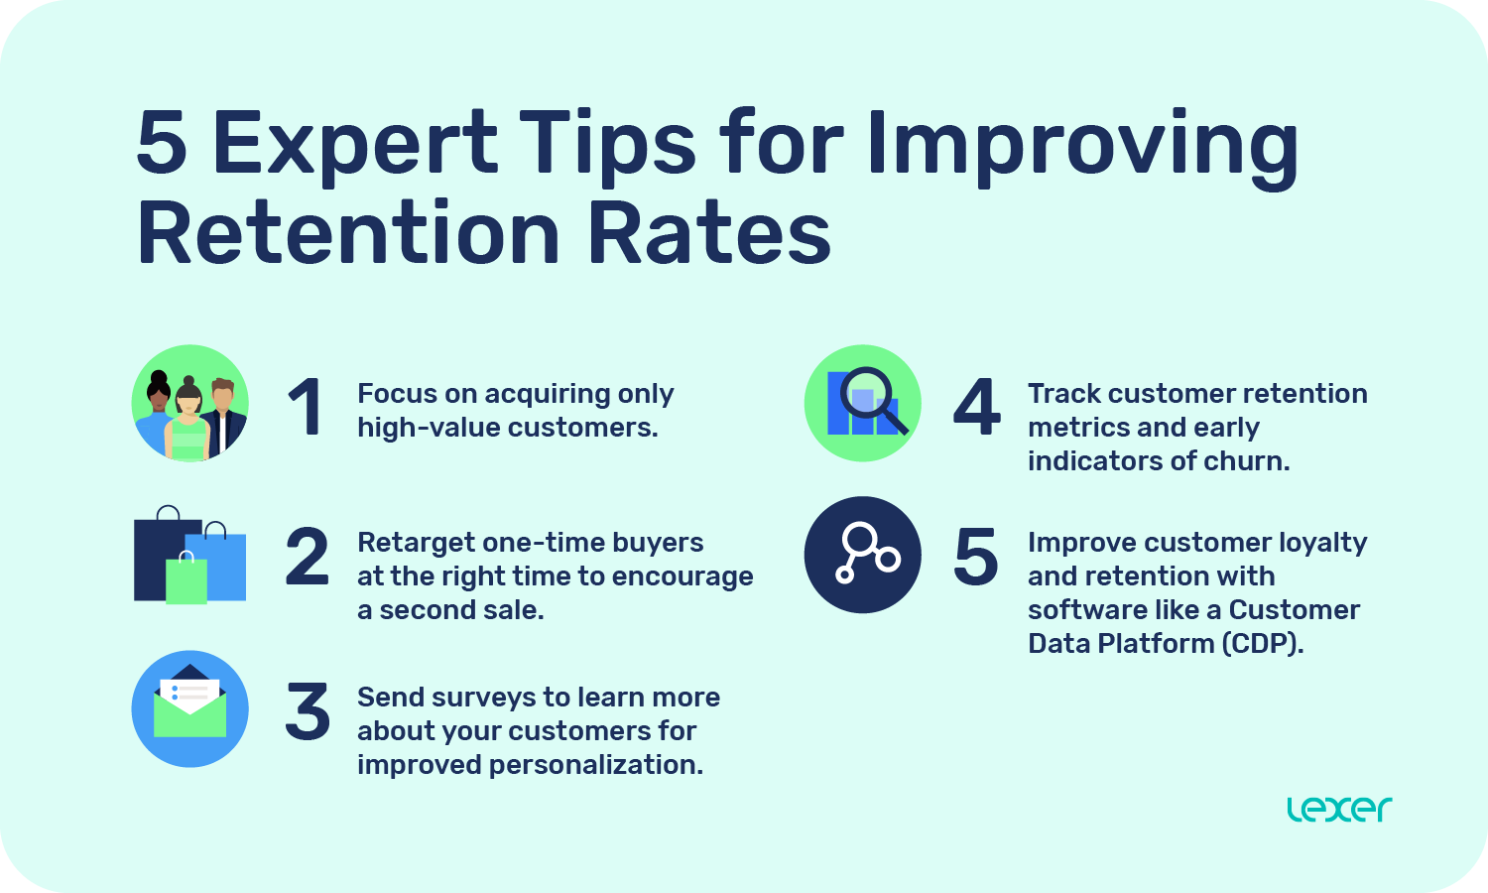

Slide 3
Problem Statement
In such a competitive market retaining customers and winning trust is very big challenge for e-retailers.
Understanding various factors that influence buying decision.
Understanding customer’s perception regarding selected online retailers.

Slide 4


Data Visualization and analysis
In this step I will analyze and visualize the data
I will use codes and plots available form different libraries for data analysis and visualization.
I will use NumPy for Numerical analysis
Pandas for performing operation on data frame
Matplotlib Provide visualization capability.
I will use Seaborn for more enhanced visualization and analysis

Slide 5
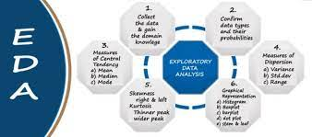
EDA Steps
For EDA , first changed the data columns name, which are questions in original data frame.
After changing name I just explored the data using different codes, i.e. head, tail and few samples of dataset, to understand the data.
Than I see shape of the data and check the null values present in the data .
Data frame have no null values and all the data is object type.
As the data is in object type I will mostly perform count plot.

Slide 6
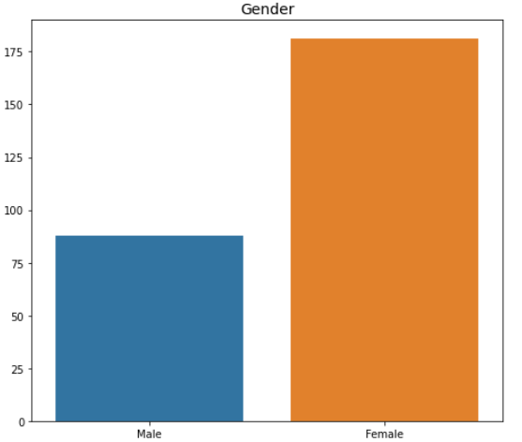
Majority of the Shoppers are Female

Slide 7
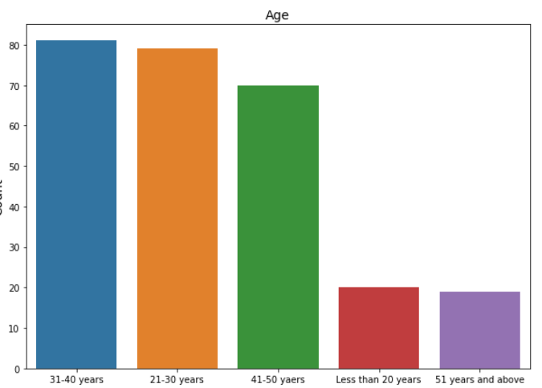
Majority of the shoppers are between 21-50 Years old.

Slide 8
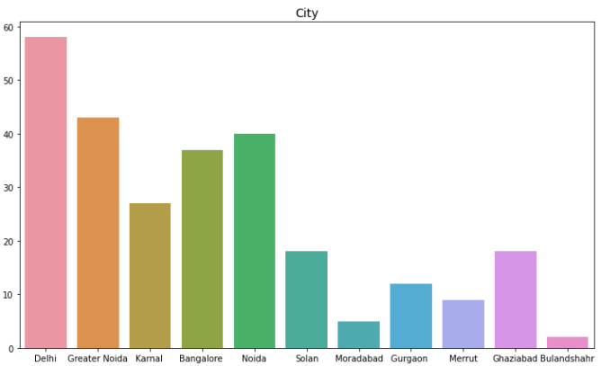
Majority of the shoppers are from Delhi, Noida, Bangalore.

Slide 9
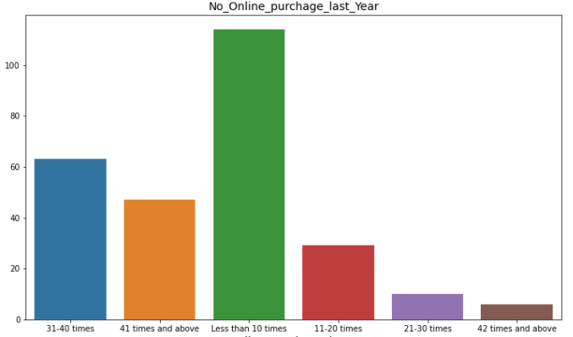
Majority of shoppers purchased less than 10 times last year.

Slide 10
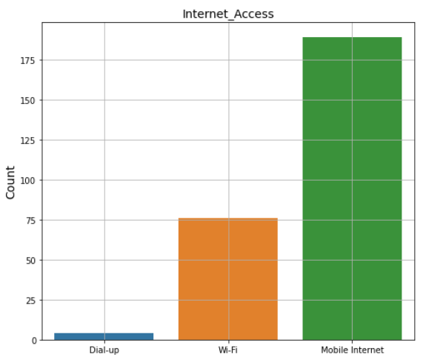
Majority of the online shopper’s Use Mobile Internet for online purchase

Slide 11
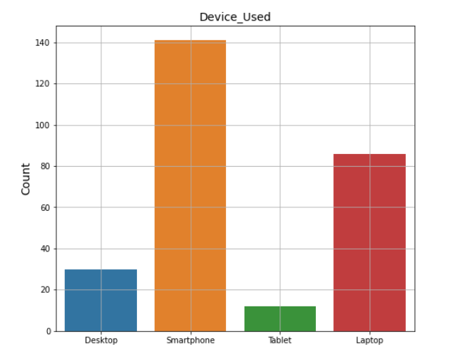
Majority of the online shopper’s Use Smartphone for online purchase

Slide 12
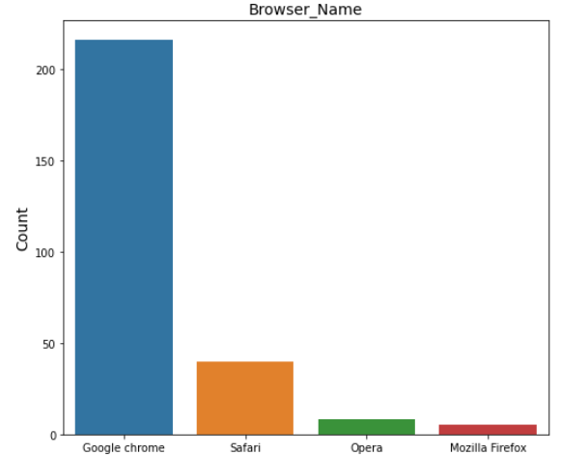
Majority of the online shopper’s Use Google Chrome for Exploring products

Slide 13
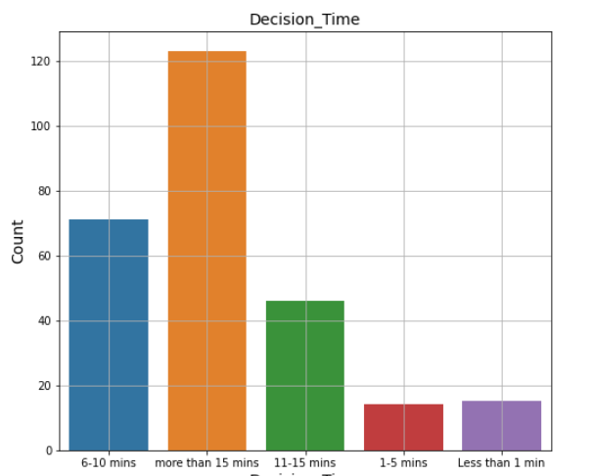
Majority of the online shopper’s take more than 15 min to make purchase

Slide 14
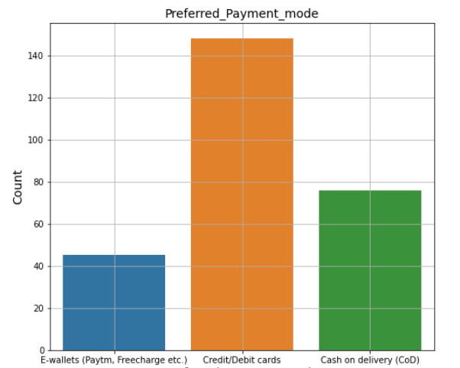
Majority of the online shopper’s Use Credit/Debit card for online purchase

Slide 15
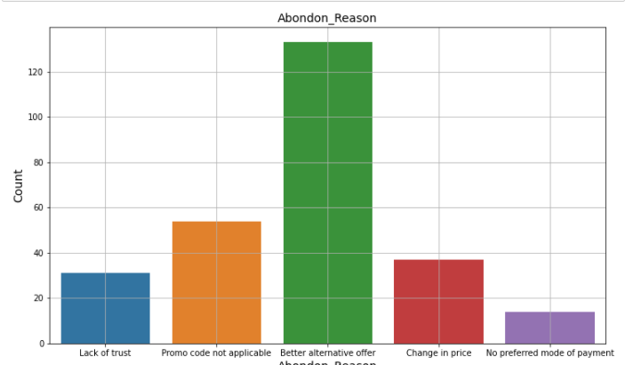
Majority of the shopper’s abandon because they find better option

Slide 16
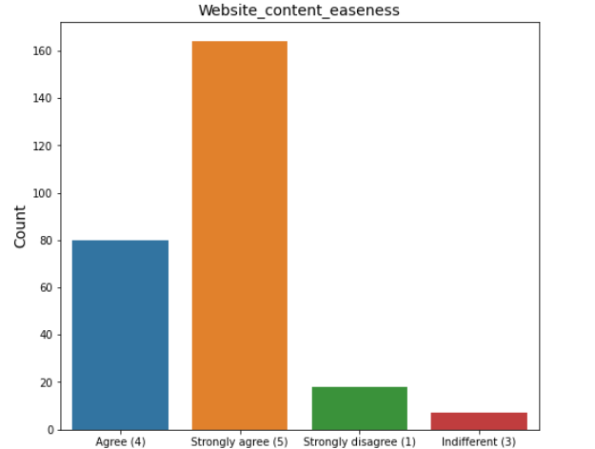
Majority of the online shopper’s strongly agree website content should be easy.

Slide 17
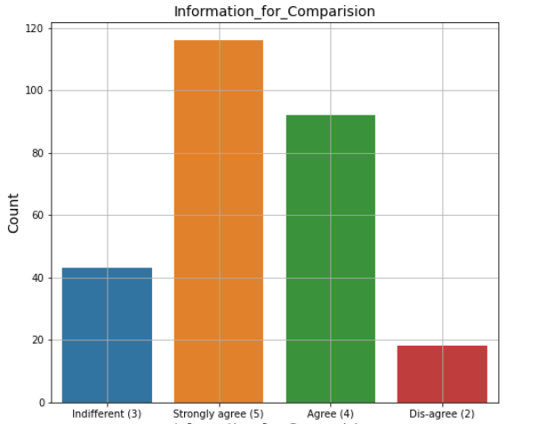
Majority of the online shopper’s agree that Highlighted information is easy to compare.

Slide 18
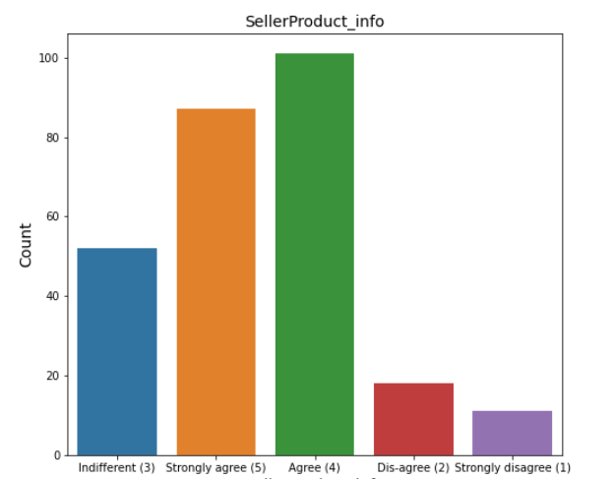
Majority of the online shopper’s agree there should be sellers and product information.

Slide 19
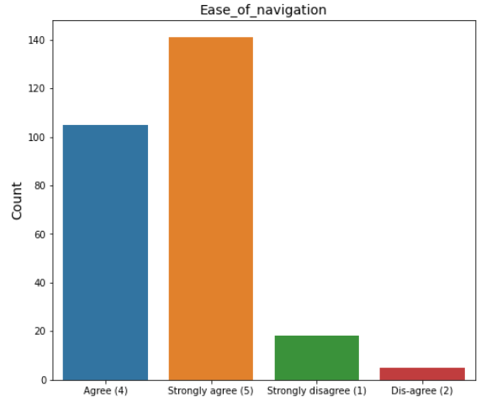
Majority of the online shopper’s Strongly agree, website should be easy to navigate.

Slide 20
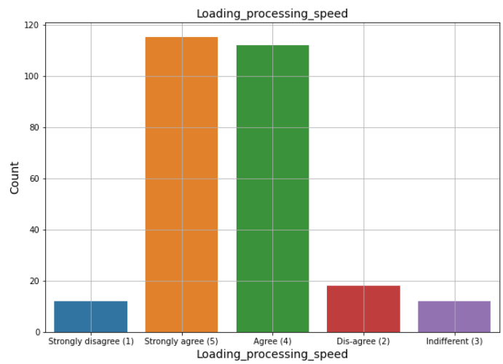
Majority of the online shopper’s Use Mobile Internet for online purchase

Slide 21
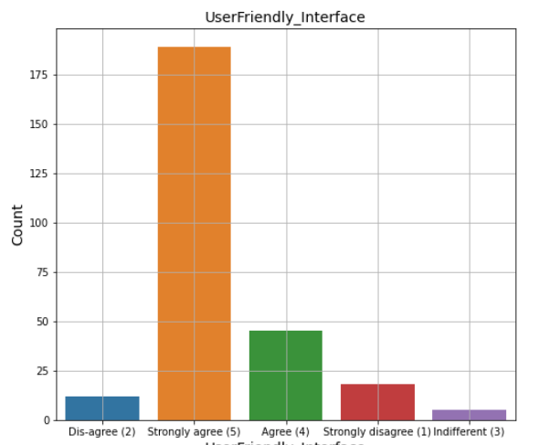
Majority of the online shopper’s Strongly agree, Website should be user friendly.

Slide 22
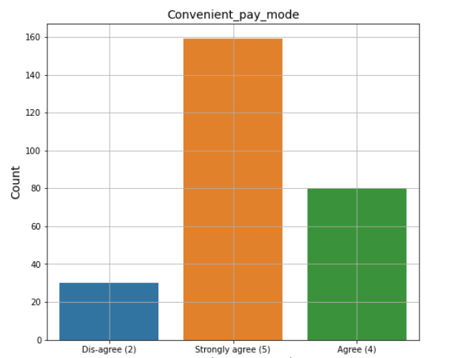
Majority of the online shopper’s Strongly agree to have convenient pay mode.

Slide 23
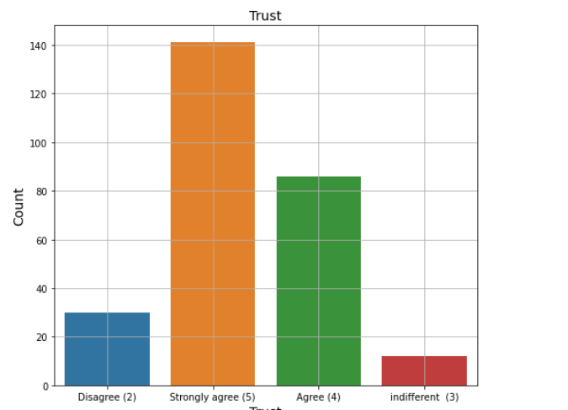
Majority of the shoppers are strongly agree to have trust for transaction, for making buying decision.

Slide 24
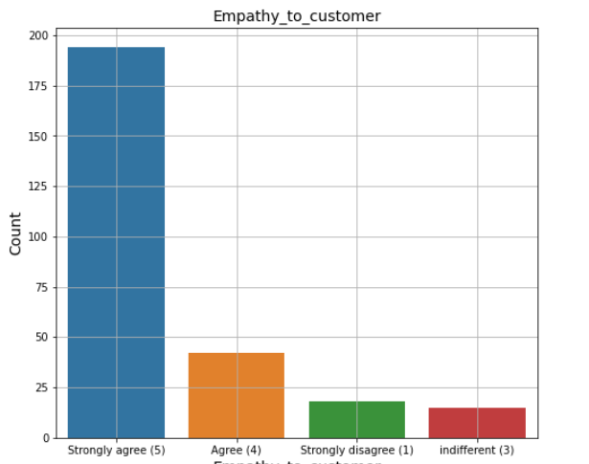
Majority of the shoppers are agree that having empathy to customers, affect the chance of buying

Slide 25
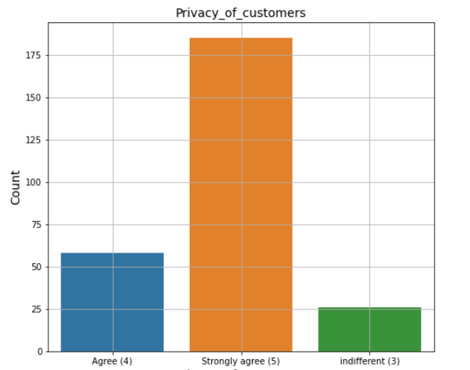
Graphs showing privacy play important role in making buying decisions, majority of the shoppers are strongly agree.

Slide 26
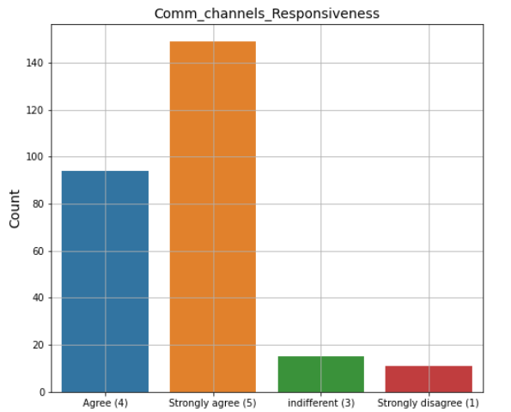
Majority of the shoppers are agree that having Responsiveness Communication channels, affect the chance of buying.

Slide 27
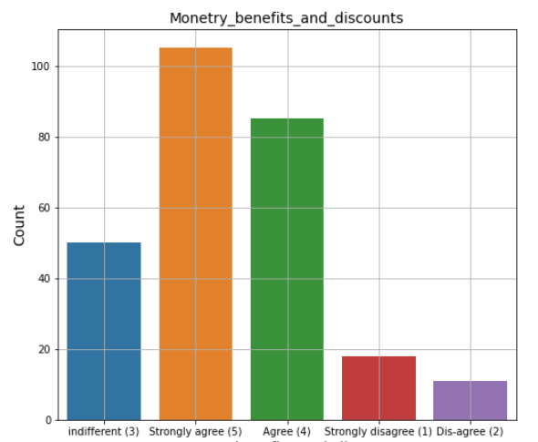
Majority of the shoppers are agree that online shopping gives Monetary Benefits and discounts.

Slide 28
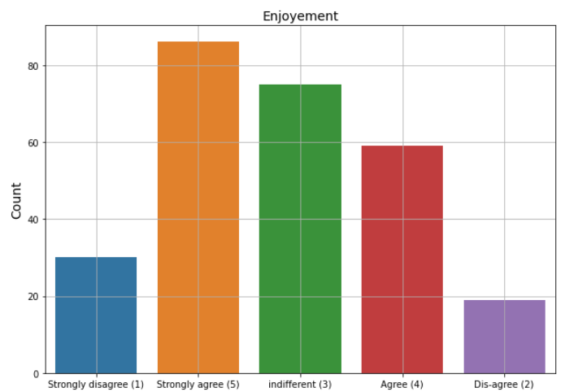
Majority of the shoppers are strongly agree to have enjoyment from online shopping online

Slide 29
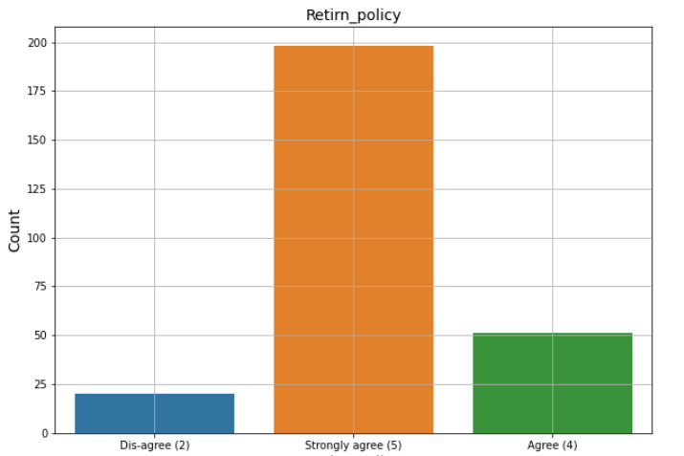
Majority of the shoppers are strongly agree that Return policy affect the buying decision.

Slide 30
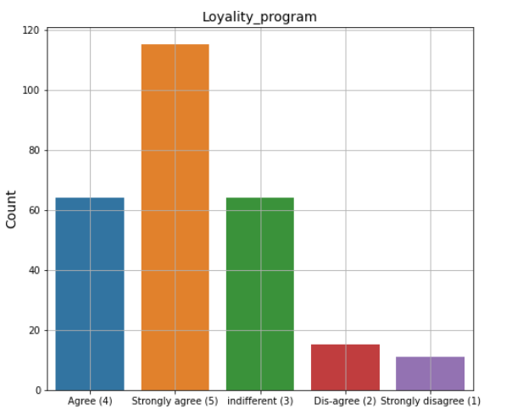
Majority of the shoppers are strongly agree that Gaining access to loyalty programs is a benefit of shopping online

Slide 31
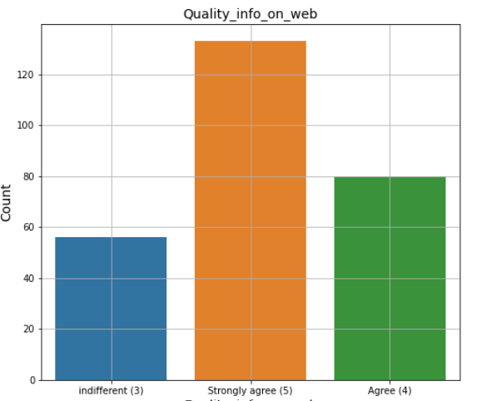
Majority of shoppers are strongly agree Displaying quality Information on the website improves satisfaction of customers

Slide 32
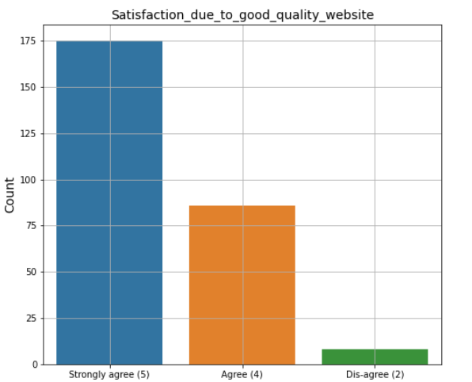
Majority of the shoppers are strongly agree User derive satisfaction while shopping on a good quality website or application

Slide 33
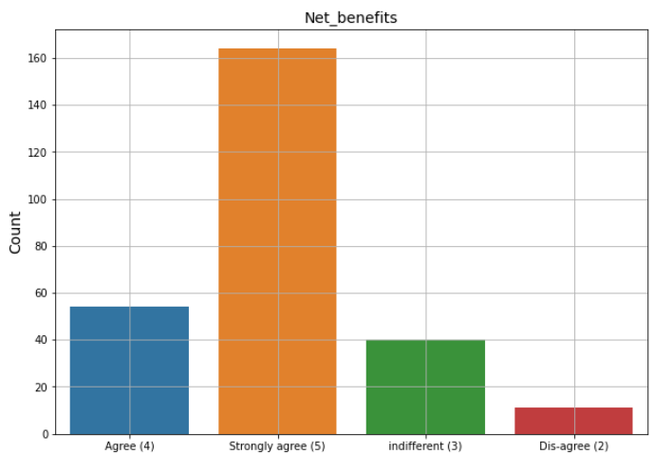
Majority of the shoppers are strongly agree that Net Benefit derived from shopping online can lead to users satisfaction

Slide 34
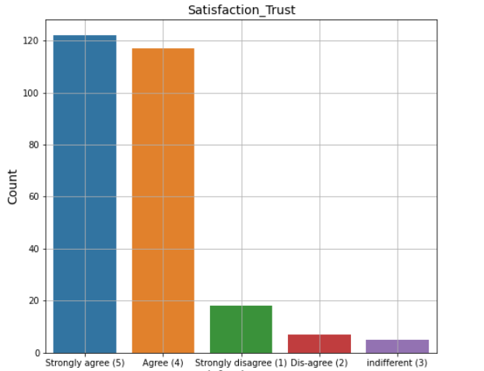
Majority of the shoppers strongly agree that User satisfaction cannot exist without trust

Slide 35
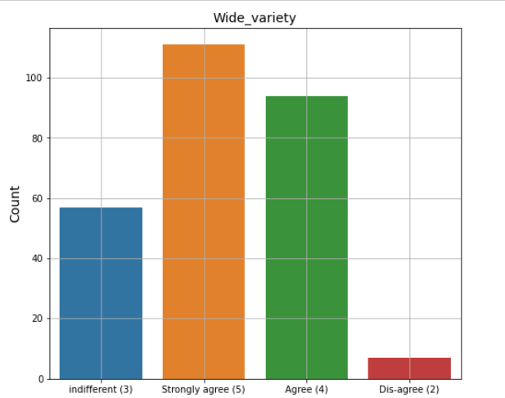
Majority of the shoppers are agree that online shopping Offering a wide variety of listed product in several category

Slide 36
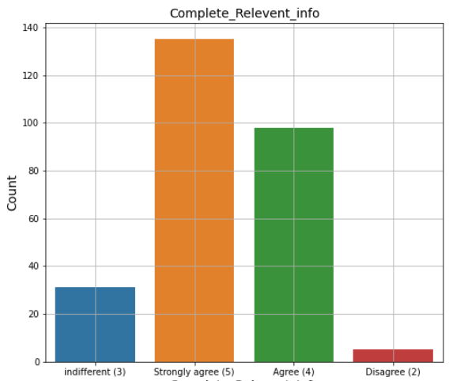
Majority of the shoppers are strongly agree that having complete and relevant product information increase chance of buying .

Slide 37
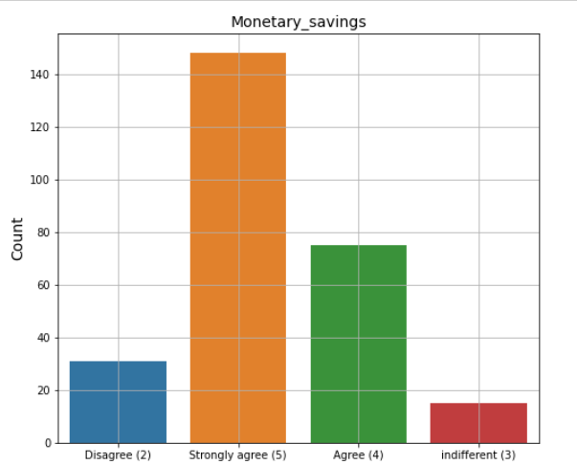
Majority of the shoppers strongly agree that online shoping provide monetary savings

Slide 38
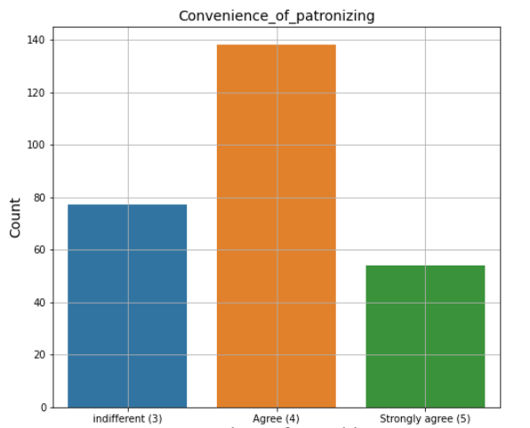
Majority of the shoppers are agree, There is Convenience of patronizing the online retailer

Slide 39
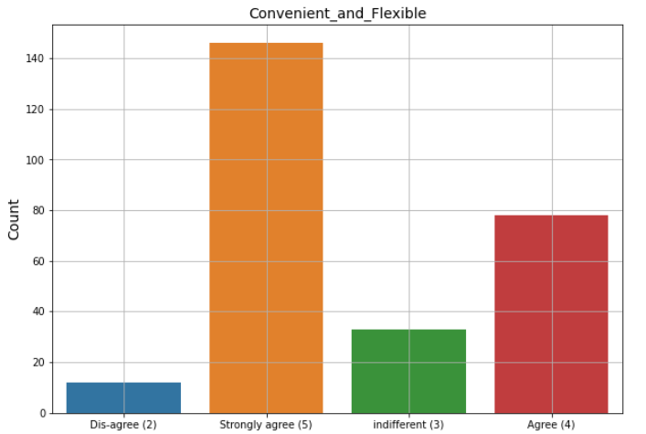
Majority of the shoppers are agree that Shopping online is convenient and Flexible.

Slide 40
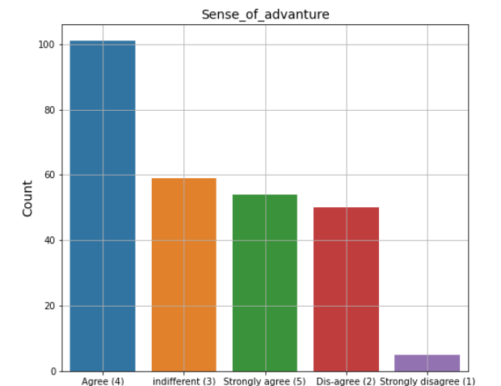
Majority of the shoppers are agree that Shopping on the website gives you the sense of adventure

Slide 41
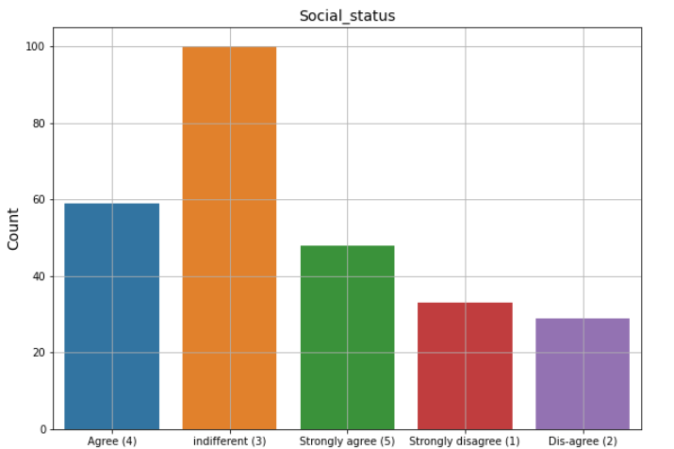
Majority of the online shoppers are having Indifferent views for Shopping on your preferred e-retailer enhances your social status

Slide 42
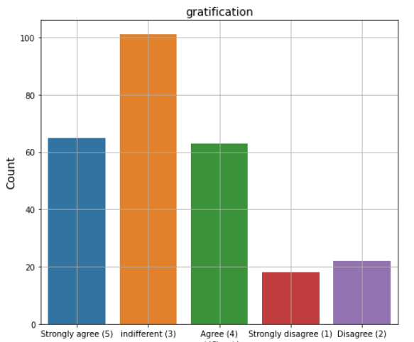
Shoppers having Indifferent view for feel gratification shopping on your favorite e-retailer

Slide 43
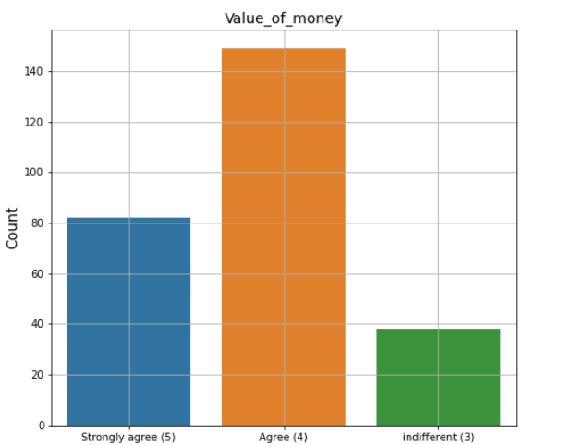
Majority of the shoppers are agree to have value of money.

Slide 44
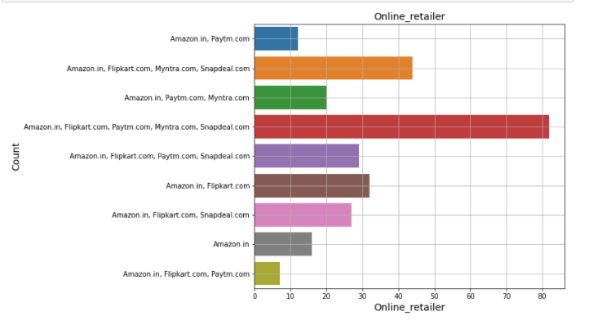
Majority of the shoppers are using multiple retailers for shopping online.

Slide 45
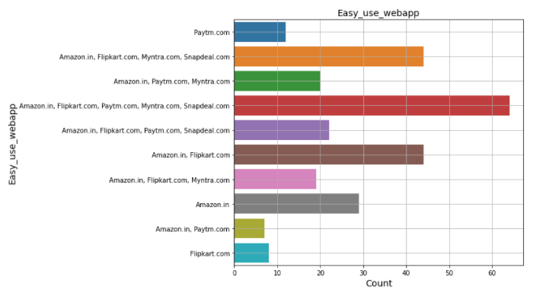
Majority of website and applications are easy to use.

Slide 46
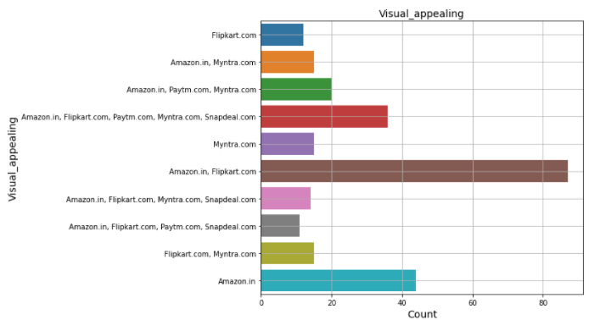
According Majority of shoppers Amazon and Flipkart having good visual appealing

Slide 47
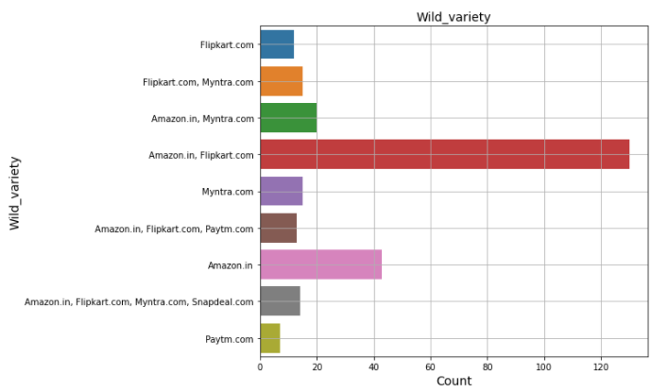
Amazon and flipkart are having wild variety of products on offer.

Slide 48
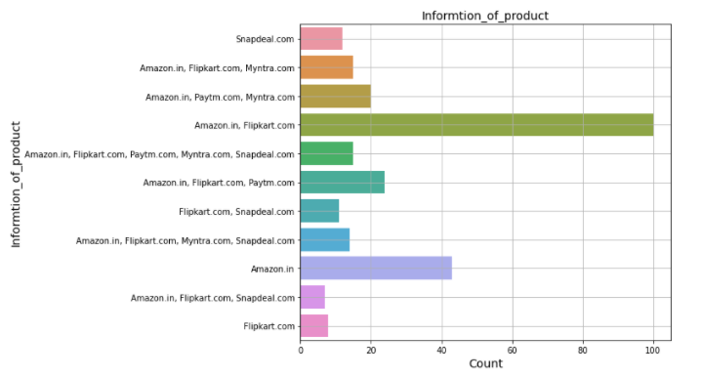
Amazon and Flipkart having Complete, relevant description information of products.

Slide 49
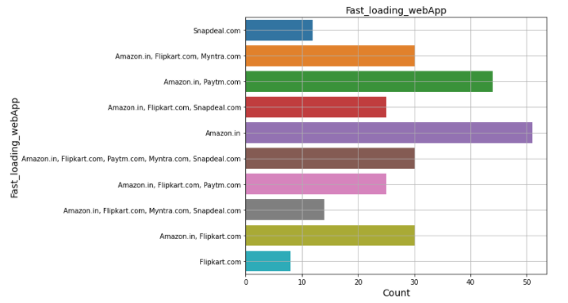
Amazon, flipkart and Paytm having fastest loading website and application

Slide 50
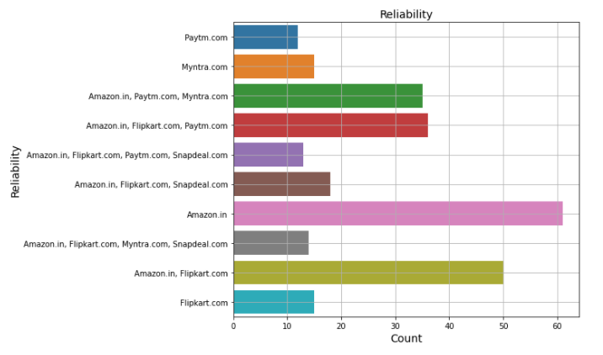
According to majority of the shoppers amazon is more Reliable website or application

Slide 51
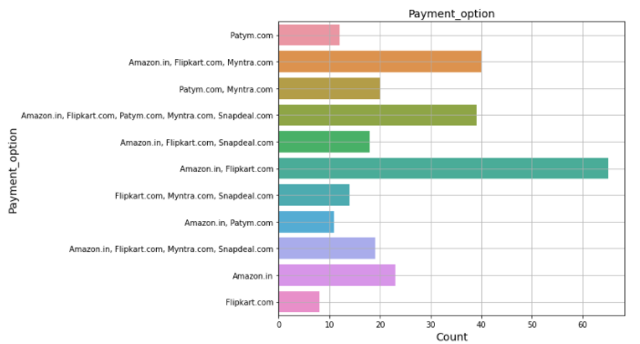
Amazon and Flipkart are having Availability of several payment options

Slide 52
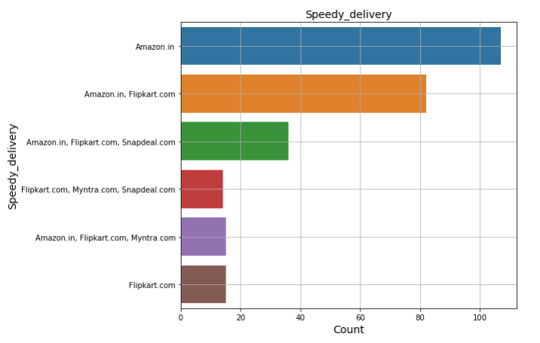
Amazon provide Speedy order delivery

Slide 53
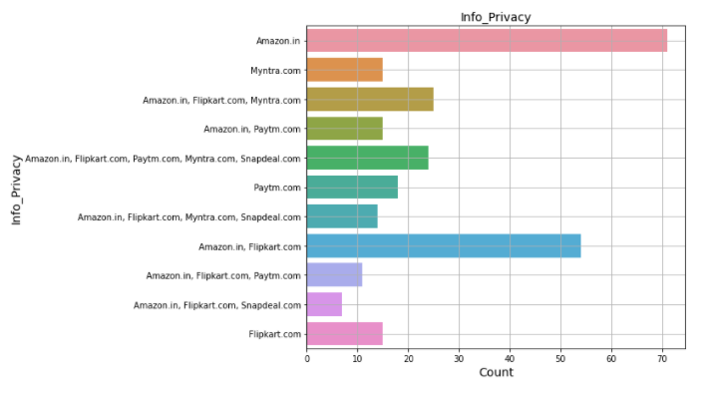
Majority of the shoppers recommend Amazon as best retails for providing Privacy of customers’ information

Slide 54

majority of retails provide Security of customer financial information, Amazon is on top.

Slide 55

Amazon is more Perceived_Trustworthiness than other retailers

Slide 56

Majority of the retailers provide online assistance through multiple channels

Slide 57

According to Majority of the shopper Myntra having Late declaration of price (promotion, sales period)

Slide 58

According to Majority of the shopper Myntra having longer page loading time, paytm is at 2nd place

Slide 59

According to Majority of the shopper Snap deal having Limited_payment_mode

Slide 60

According to Majority of the shopper Paytm having Long_delivary_period

Slide 61

Amazon make Change_in_website according to requirements of user.

Slide 62

According to majority of shoppers Amazon.in is Efficient website.

Slide 63

Amazon and Flipkart are most recommended retailers.

Slide 64

Age group 21- 50 years are actively purchasing online as compare to age less than 20 and 51 years above.

Slide 65

Here we can see in most of the cities Female buyers are more as compare to male.

Slide 66

We can see Girls taking more exploration time before making buying decision,

Slide 67

Majority of females are recommending Amazon and Flipkart

Slide 68
Conclusion
With increase in the internet access and mobile shoppers are switching form offline mode of shopping to online mode of shopping.
Majority of the shoppers find it
1. Easy
2. Shopping can done at any time
3. Time saving
4. value of money
The main factors which affect the customer’s retentions are satisfaction_ Trust, return policy, privacy of the user payment details, Fast delivery and return policy.

Slide 69
Thank you

