Slide 1















TechnoSparks
Predictive Intelligence for Security
Vishwakarma Institute of Technology, Pune
Team Leader:-
Sanskruti Deshmukh
Team Members:-
Prajwal Damre,Atharva Hire ,Priti Gosavi

Slide 2
Motivation
Cyber Threat Evolution: With cyber threats becoming increasingly sophisticated and unpredictable, there's a pressing need to stay ahead of malicious actors.
2. Limitations of Reactive Measures: Reacting to cyber threats after they occur often results in significant damage and loss. Proactive strategies aim to address vulnerabilities before they are exploited.
3. Protecting Critical Assets: Organizations understand the importance of safeguarding their sensitive data, intellectual property, and digital infrastructure from cyber threats to maintain operational integrity and competitiveness.
4. Regulatory Compliance: Compliance with industry regulations and data protection laws necessitates proactive cybersecurity measures to avoid hefty fines, legal consequences, and reputational damage.
5. Preserving Trust and Reputation: Maintaining trust with customers, partners, and stakeholders is paramount. Proactive cybersecurity measures help uphold reputation and credibility by demonstrating a commitment to security.

Slide 3
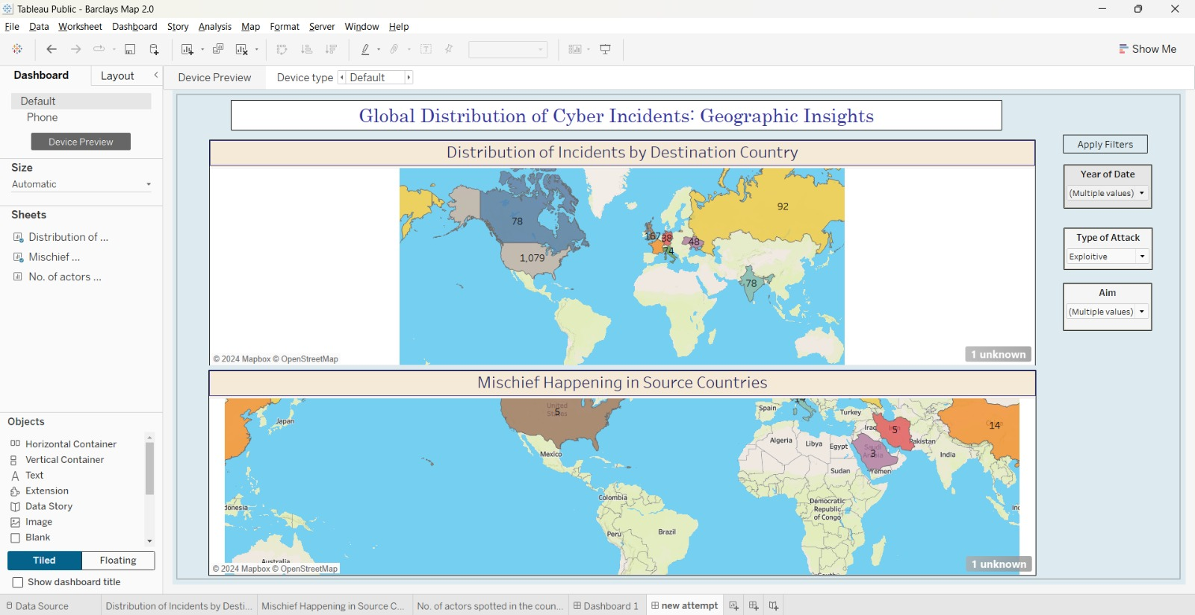
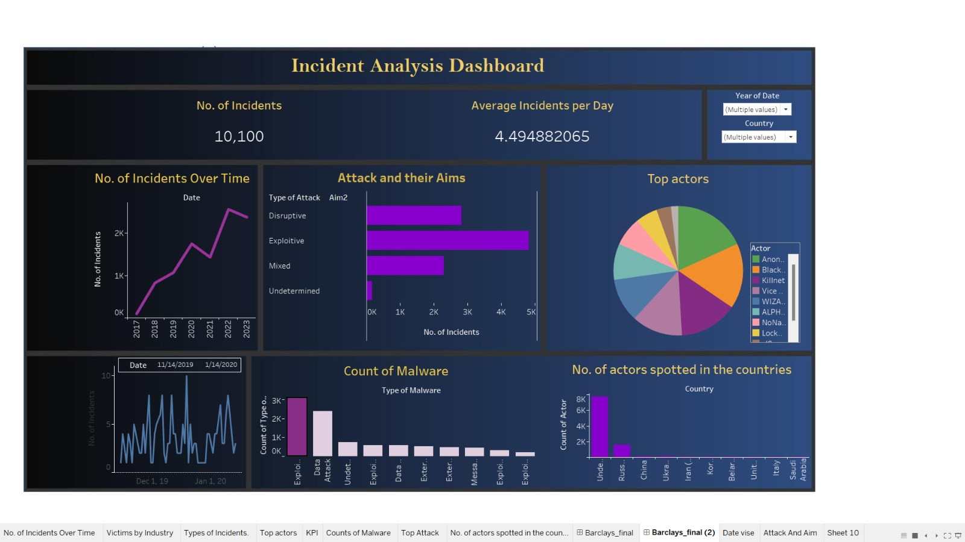
EDA Dashboard

Slide 4
Future Scopes
1. Enhanced Machine Learning Models: Continuously refine and improve machine learning algorithms to better identify patterns and relationships in cyber threat data, enabling more accurate predictions and proactive threat mitigation.
2. Real-time Threat Intelligence Integration: Integrate real-time data feeds from cybersecurity threat intelligence platforms to enhance predictive capabilities and provide timely alerts on emerging threats, ensuring organizations can respond swiftly to evolving cyber risks.
3. Automated Response Mechanisms: Develop automated response mechanisms that can dynamically adjust security controls and initiate mitigation measures in response to identified threats, reducing manual intervention and accelerating incident response.
4. Dynamic Mitigation Recommendations: Provide dynamic mitigation recommendations based on predicted threats, leveraging threat intelligence feeds and best practices to suggest tailored mitigation strategies for specific threats, thereby enhancing organizations' ability to defend against cyber-attacks effectively.

Slide 5

Thank you

