Slide 1
Project #2 Final Demo: [$1 Algorithm], [New Unistroke Dataset] Group 23: Sai Mohan Sujay Kanchumarthi, Priti Shyamrao Gumaste
[CIS6930] Human-Centered Input Recognition Algorithms Instructor: Dr. Lisa Anthony, Spring 2023
April 20, 2023

Slide 2
Project #2 Overview
Algorithm: $1 Algorithm
Language: Python
Existing dataset*: $1 Unistroke gestures [10 people]
New dataset*: $1 Unistroke gestures [6 New Users using 4 input modalities like Mouse, Touchpad, Stylus, Touchscreen]
Analysis: User-dependent recog. Accuracy, GHoST and GREAT (The Gesture Relative Accuracy Toolkit) tools.

Slide 3
Online / Live Demo
Present a gesture recognition demo.

Slide 4
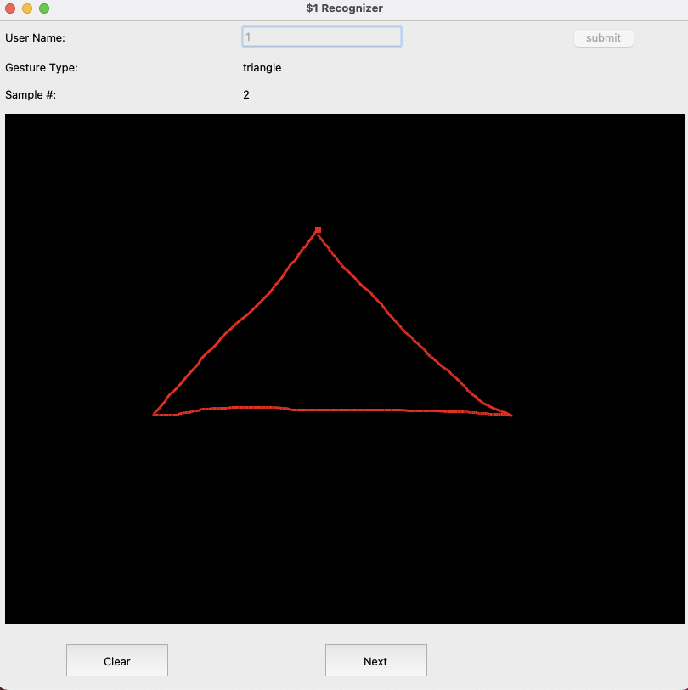
Collecting Data

Slide 5
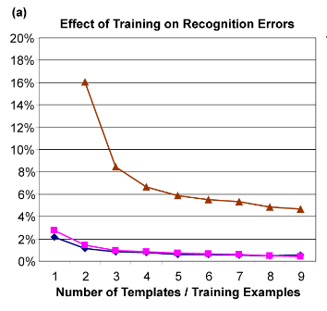
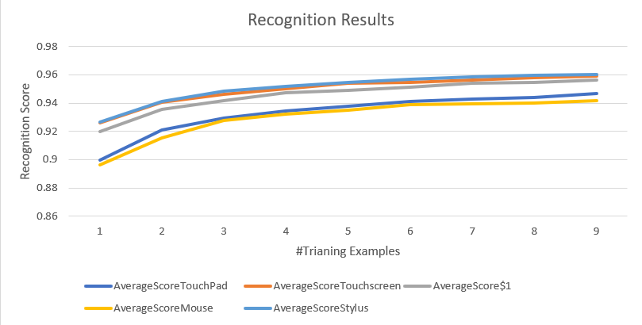
Offline Recognition Tests
Figure: Comparison of $1 dataset with different input modalities data.
Figure 9(a) from $1 paper

Slide 6
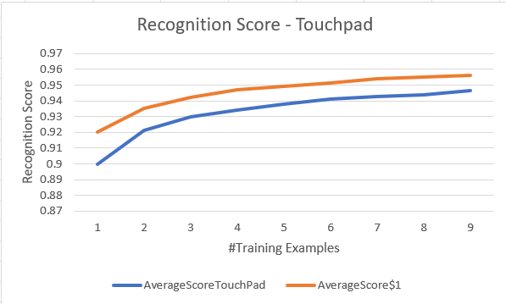
Recognition Tests - Touchpad
Recognition scores using the Touchpad input modality is less accurate when compared to the $1 dataset.
This could be due to inconsistency while drawing gesture with touchpad using a single finger.
Figure :Results comparing touchpad and data
from $1 paper

Slide 7
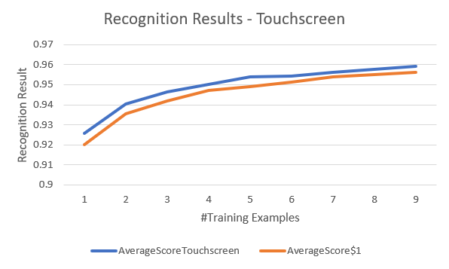
Recognition Tests - Touchscreen
Using touchscreen we were able to get good accuracy almost better than $1 data.
As user feel comfortable to draw using screen we got good results as expected.
Figure :Results comparing touchscreen and data
from $1 paper

Slide 8
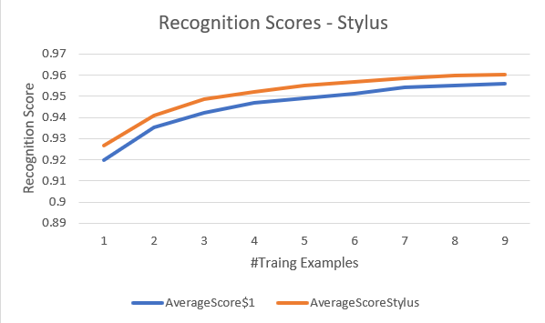
Recognition Tests - Stylus
With stylus we were able to achieve up to 96% accuracy.
As stylus is a user friendly approach for a user to draw gestures, we achieved good accuracy scores as expected.
Figure :Results comparing Stylus and data
from $1 paper

Slide 9
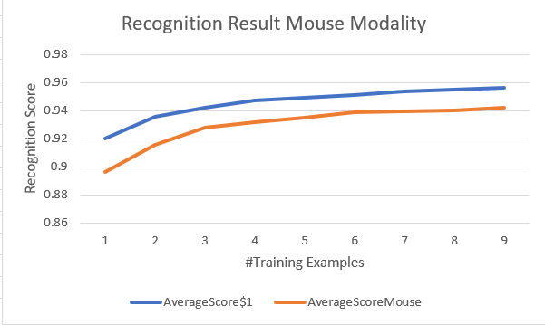
Recognition Tests - Mouse
Accuracy using mouse input modality was lesser.
This was expected as users were not comfortable drawing gestures using mouse. They felt uncomfortable especially at edges and curves.
Figure :Results comparing Mouse and data
from $1 paper

Slide 10
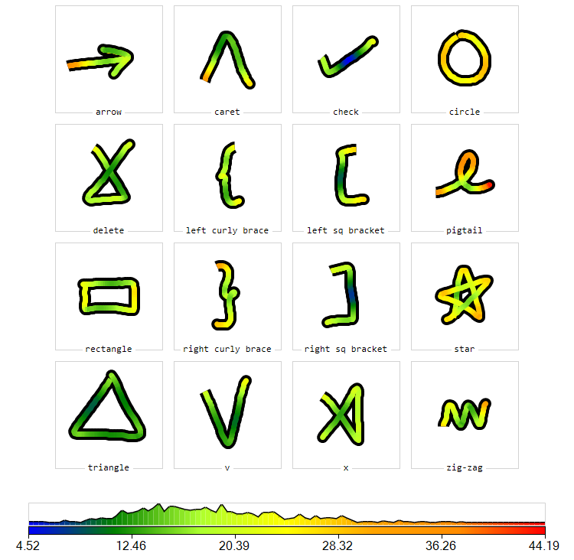
Analyses – GHoST - Stylus
Circle, Pigtail has most magnitude in data as they have warm colours such as orange and red. This high variability with stylus could be because of free hand drawing with stylus and more variation at curves.
Some parts of Check gesture has the least magnitude of data. We observe low variability at straight lines when users use stylus compared to curves using stylus.

Slide 11
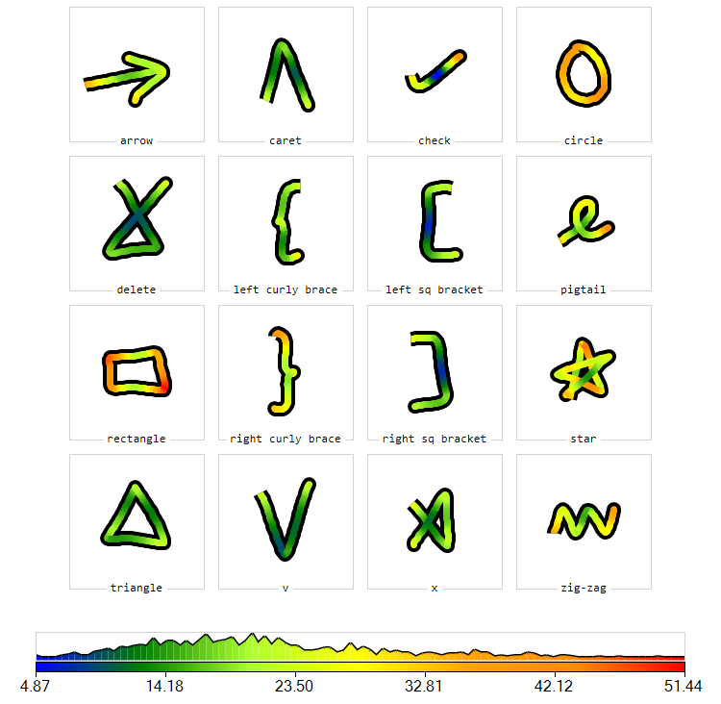
Analyses – GHoST - Touchscreen
Rectangle, circle, and star have the high variability. As users use fingers to draw on screen, they tend to deviate at curves and edges which caused high variability for these gestures.
V, right/left square brackets have the lowest variability. As these gestures have more straight lines and less curves and edges, users were able to draw more accurately.

Slide 12
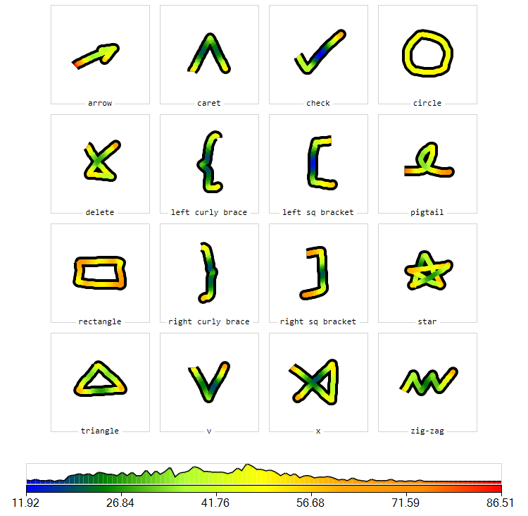
Analyses – GHoST - Mouse
Rectangle has the highest magnitude of data. Users may find it difficult to draw straight lines with edges and curves like right square bracket and circles using mouse as stability could be less while drawing such gestures.
Check and left square bracket have less variability – less magnitude of data. Users felt easy to draw these gestures as they are less complicated to draw using a mouse with little movements.

Slide 13
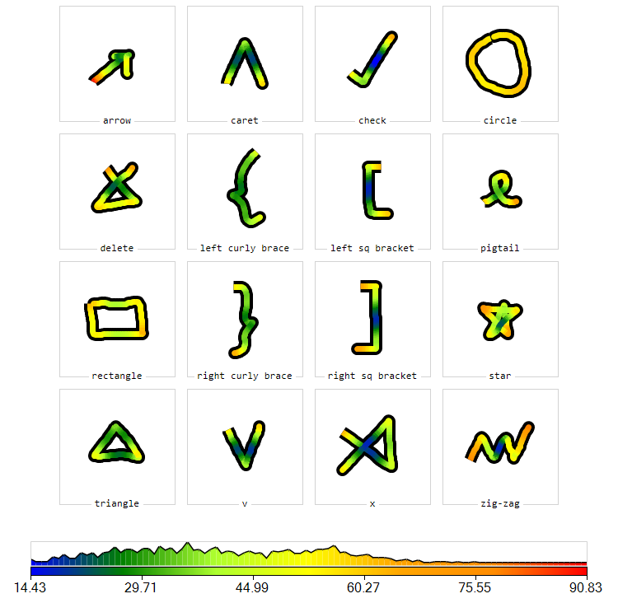
Analyses – GHoST - Touchpad
Circle has a higher magnitude of data. As users can use a single finger while drawing with touchpad, they may find it difficult to maintain consistency at curves and edges. By this we can observe high variability for all gestures at edges.
Parts of X, left/right square brackets, check have less variability. Less variability at centre of these gestures state that, even though users start at different start points, they tend to align at same position at middle of these gestures.

Slide 14
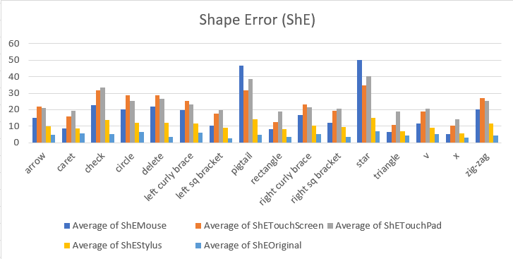
Analyses – GREAT – Shape Error
Shape Error is the Average spatial deviation from a reference gesture.
In all the bar graphs we can see that gestures drawn using different input modalities vary with respect to original data from $1 paper

Slide 15
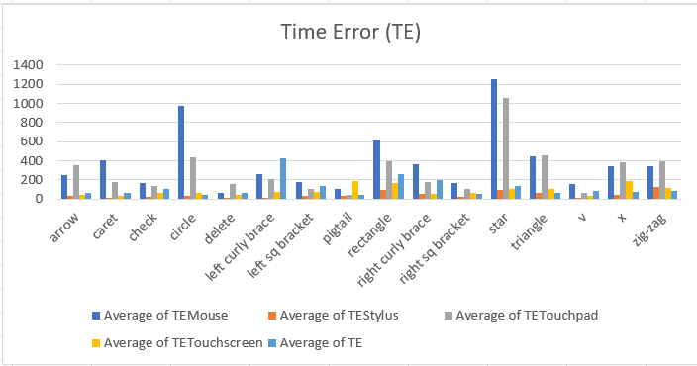
Analyses – GREAT - Time Error (TE)
Time Error is the Average temporal deviation from a reference gesture.
In most gestures, gestures drawn by mouse deviates from the original gesture with respect to original data from $1 paper

Slide 16
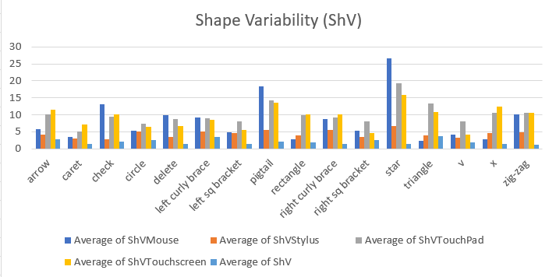
Analyses – GREAT - Shape Variability (ShV)
Shape Variability (ShV) Error is Total spatial deviation from a reference gesture
In most gestures, gestures drawn by touchscreen deviates from the original gesture with respect to original data from $1 paper

Slide 17
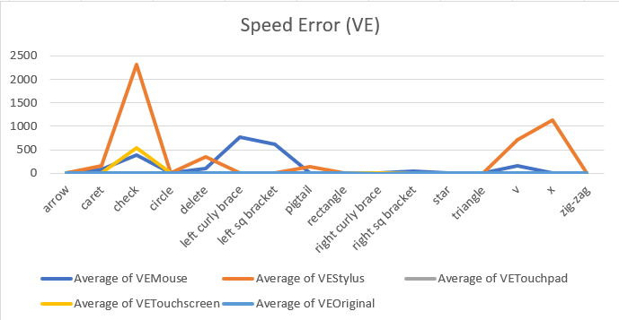
Analyses – GREAT - Speed Error (VE)
Speed Error (VE) is Average deviation in speed compared to a reference gesture.
Only a few gestures drawn using stylus have considerable VE when compared to other gestures.

Slide 18
Implementation and Challenges
Since we should collect data from different users using various input modalities like Mouse, Touchpad, Stylus, and Touchscreen it was a tedious task to coordinate and generate graphs, analysis tables using GREAT tool, and heat maps using GHoST tools.
We gathered four different datasets using four input modalities as mentioned above from each user (total of 6 users) which was 24 datasets. So it took some effort to handle the data and analyze it.

Slide 19
Predicted and Actual Outcome
Using different input modalities to collect new dataset gave us an insight about the behaviour of various users input for different gestures. Especially gestures that have more edges and curves tend to have high variability irrespective of the input tools used.
The more the straight lines the less variability found for gestures like Square brackets, Curly braces, X, V, Check.
We achieved good accuracy scores for Stylus and Touchscreen input data as expected. This shows that users were comfortable drawing gesture with these tools than mouse and touchpad.
Few gestures like curly braces, V, X have more variability at start and end points compared to those at the centre of these gestures. This shows that users tend to start and end at different points on canvas but due to the orientation of these gestures they maintained consistency at the centre irrespective of the input modality.
We mostly notice that for gestures such as circle, star, pigtal the Speed, Shape and time errors are high when using the mouse input modality, this could be because with mouse modality users face issue replicating the exact gesture, hence deviation from the expected figure.

Slide 20
The End!

