Slide 1
EXPIRY-AWARE BLOOD REDISTRIBUTION
RAKTSETU
OOP IN JAVA · COURSE PROJECT
Pritika Khandelwal · R037
MBA Tech AI · MPSTME
raktsetu-ubvx.onrender.com
EVERY UNIT COUNTS.
Finds blood that will expire unused and moves it, with staff approval, to the hospitals that need it.
Notes:
Good morning. Our project is RaktSetu: 'rakt' means blood and 'setu' means bridge. It finds blood units that are about to expire unused, and recommends moving them, with staff approval, to the hospitals that need them. We built it in Java as our OOP project, and it is live on the internet today.

Slide 2
BLOOD EXPIRES IN THE WRONG PLACE
THE PROBLEM
17.43 lakh
46%
5 days
units of blood discarded in India in 2025
of those were discarded because they expired
is all platelets last; red cells last 42
WHY IT HAPPENS
Supply follows donation camps, not patients
Short, fixed shelf lives
Stock reports are days out of date
THE GAP
e-Raktkosh shows where blood is. Nobody shows which units will be wasted, or where they should go. RaktSetu fills that gap.
Source: Rajya Sabha Unstarred Question 1882 (4 Aug 2026), e-Raktkosh data.
Notes:
In 2025 India discarded 17.43 lakh units of blood, and 46 percent of them expired. Platelets last only five days. Supply follows donation camps rather than patients, shelf lives are short, and stock reports are often days old. e-Raktkosh, the national system, shows where blood is, but not which units will be wasted or where they should go. That is the gap RaktSetu fills.

Slide 3
FIND IT. MOVE IT. PROVE IT.
OUR SOLUTION
1
2
3
4
Track
Centres log every bag; expiry is worked out per component.
Spot risk
14 days of usage show which units will not be used in time.
Plan & approve
Transfers go only where units will be used; the admin approves.
Serve & prove
Nearest safe blood for emergencies; every move on a tamper-evident log.
WHO USES IT
Administrator: builds the network, approves people and transfers
Blood-centre staff: log, report and dispatch stock
Hospital staff: raise requests, confirm delivery
BUILT WITH
Java 21 (7 modules) · Spring Boot · PostgreSQL · React. One engine runs a console app, a web app and a simulator.
Notes:
RaktSetu works in four steps: track every unit and its expiry; use the last 14 days of usage to spot units that will not be used in time; plan transfers only to centres that will use them, approved by the administrator; and serve emergencies from the nearest safe stock, logging every move. Three kinds of user share it, and one Java engine powers a console app, the web app and a research simulator.

Slide 4
THE TOOLS AND WHAT EACH ONE DOES
BUILT WITH
Java 21
The whole engine: OOP model, transfer planning, simulator. 7 Maven modules.
Spring Boot + Security
The web server and REST API; sign-in, roles and admin approval.
PostgreSQL (Neon)
The live database: stock, requests, accounts and the audit log.
React + TypeScript
The website staff and admins use, built with Vite; works on phones.
Maven
Builds the modules, runs the tests, packages the Windows release.
Flyway
Versioned database changes (V1–V12), applied automatically on start.
H2
Built-in database for the console app and the offline demo.
Leaflet + OpenStreetMap
The facilities map, and a directory of ~52,000 Indian hospitals and blood centres.
JUnit 5 + Vitest
230+ automated tests for the Java and the web code.
JMH
Benchmarks that guided the 66× faster emergency allocation.
Docker + Render
Packages the app and hosts it at raktsetu-ubvx.onrender.com.
GitHub Actions
Builds and tests every change before it can be merged.
Notes:
These are the tools we used and what each one does. Java 21 is the core: the whole object-oriented engine, in seven Maven modules. Spring Boot and Spring Security turn it into a web server with sign-in and roles. PostgreSQL, hosted on Neon, is the live database, and Flyway applies database changes in order. H2 is the built-in database for the console app and demo. The website is React with TypeScript, the map uses Leaflet and OpenStreetMap, JUnit and Vitest run over 230 tests, JMH measures speed, and Docker on Render hosts the live site, with GitHub Actions testing every change.

Slide 5
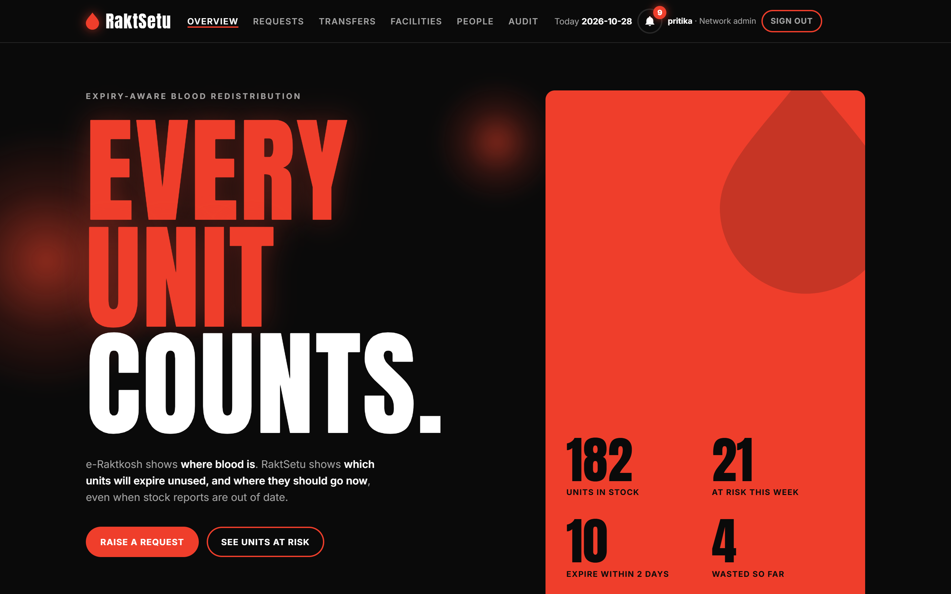
ONE GLANCE: STOCK AND RISK
THE APP · ADMIN VIEW
The first page the network administrator sees.
1
Whole network at a glance
182 units in stock across every centre, counted live.
2
Risk up front
21 units will likely expire unused this week, 10 within two days; listed soonest first.
3
Act from here
Raise an emergency request: nearest compatible blood within 90 minutes.
Notes:
This is the administrator's dashboard. It shows 182 units in stock, 21 at risk this week and 10 that expire within two days. Below it, the at-risk units are listed soonest first, so the administrator knows exactly what needs to move. Emergency requests search centres within 90 minutes, nearest first, using compatible units closest to expiry.

Slide 6
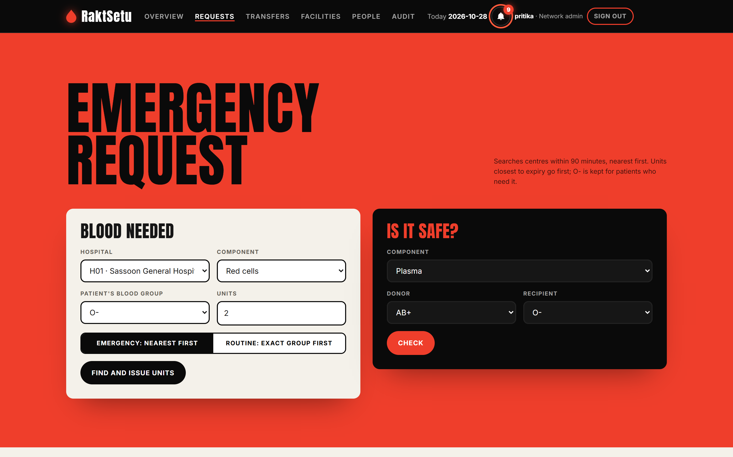
BLOOD WHEN A PATIENT NEEDS IT
THE APP · REQUESTS
Hospitals ask for blood here; the admin sees every request.
1
Emergency or routine
Emergency finds the nearest safe blood within 90 minutes; routine looks for the exact group first.
2
Is it safe?
Checks donor and recipient compatibility for each component before anything is issued.
3
Tracked to the bedside
Every request moves Reserved → On its way → Received; unmet ones are flagged.
Notes:
This is the requests page. A hospital asks for blood: in an emergency RaktSetu searches centres within 90 minutes, nearest first, and issues compatible units closest to expiry. The Is it safe panel checks compatibility for each component. Every request is then tracked from reserved, to on its way, to received.

Slide 7
OBJECT-ORIENTED BY DESIGN
OOP DESIGN
BloodComponent (abstract)
Facility (abstract)
ABSTRACTION
BloodComponent and Facility are abstract: the code works with “a component”.
ENCAPSULATION
Inventory keeps stock private, in expiry order; it changes only through its methods.
WholeBlood
HubBloodCentre
RedCellConcentrate
StorageCentre
Platelets
Hospital
FreshFrozenPlasma
Each Facility owns its Inventory (composition)
INHERITANCE
4 components and 3 facility types extend their parent; all errors extend RaktSetuException.
POLYMORPHISM
getShelfLifeDays() returns 5, 35, 42 or 365: one expiry rule for every component.
INTERFACES
AuditTrail · Transfusable · Identifiable · Repository<T>
RedistributionStrategy · DemandForecaster · AlertChannel
Notes:
Now the core of our project: the object-oriented design. We have two abstract classes, BloodComponent with four kinds of blood, and Facility with three kinds of facility. Each facility owns its inventory, which is composition. Interfaces keep the parts swappable. The next slides show each concept in our real code or in the live app.

Slide 8
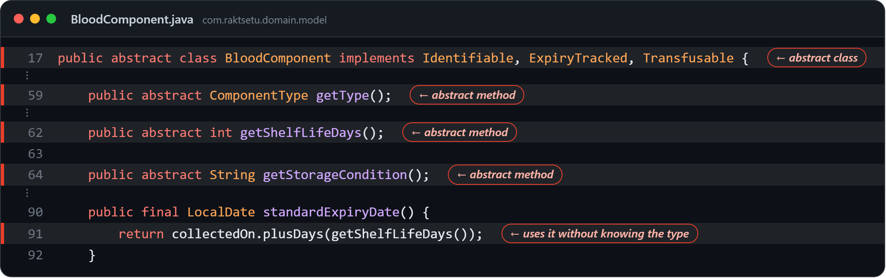
ONE EXPIRY RULE FOR EVERY KIND OF BLOOD
OOP · ABSTRACTION AND POLYMORPHISM
Real code from the repository · highlighted lines and ← tags show where the concept is
ABSTRACTION
BloodComponent is abstract. Its abstract methods (lines 59–64) force every kind of blood to state its type, shelf life and storage.
POLYMORPHISM
Line 91 calls getShelfLifeDays() without knowing the type. Java runs the subclass's override at run time: 5, 42 or 365 days.
WHY
A new component is one new class; the expiry logic never changes.
Platelets
@Override public int getShelfLifeDays()
→ 5 DAYS
RedCellConcentrate
@Override public int getShelfLifeDays()
→ 42 DAYS
FreshFrozenPlasma
@Override public int getShelfLifeDays()
→ 365 DAYS
Notes:
BloodComponent is abstract, so nobody can create a 'plain' blood component. Its abstract methods force every kind of blood to give its shelf life. On line 91 the code calls getShelfLifeDays without knowing the type, and Java runs the right override at run time: 5 days for platelets, 42 for red cells, 365 for plasma. That is run-time polymorphism.

Slide 9
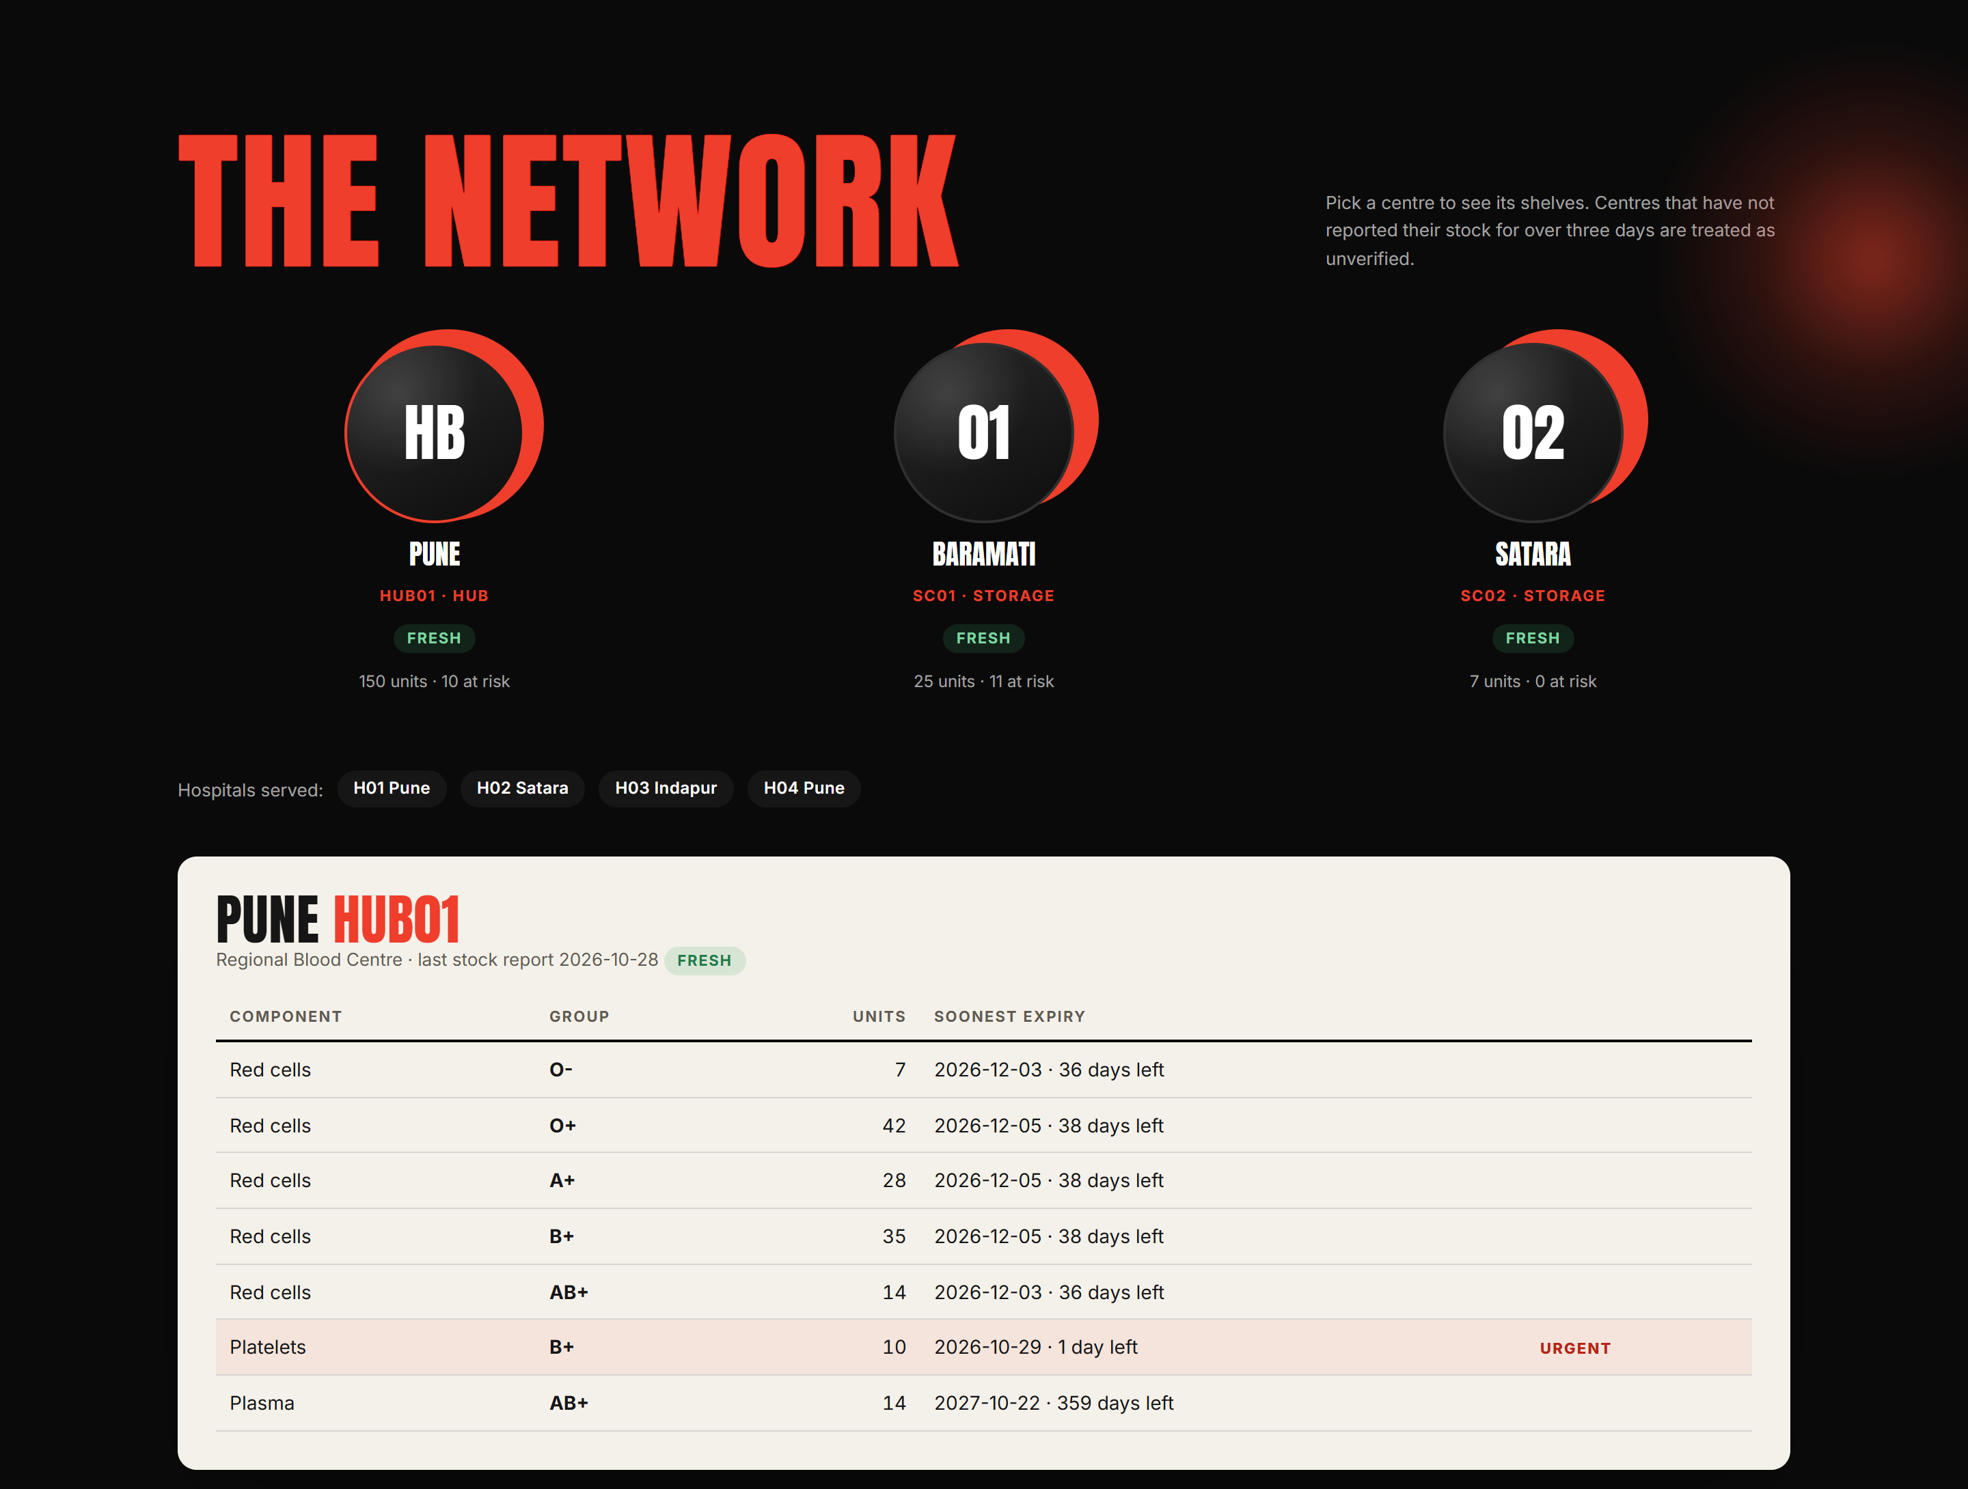
STOCK CHANGES ONLY THROUGH ITS METHODS
OOP · ENCAPSULATION
Screenshot from the live app · where users see this concept at work
WHAT
Keep data private; let the object guard its own rules.
IN RAKTSETU
Stock lives in private fields
The constructor is not public: only a Facility can create an Inventory
add() is the only way in: it refuses duplicates
WHY
Stock can never be double-counted or left out of expiry order.
IN THE APP Each centre's own Inventory, read only through its methods: counted per component and group, soonest expiry shown.
Notes:
Inventory keeps all its stock in private fields, so nothing outside can change it directly. The only way in is the add method, which refuses duplicate units and keeps the earliest expiry correct. Its constructor is not public, so only a Facility can create one. On the Network page, each centre's table is read through those methods.

Slide 10
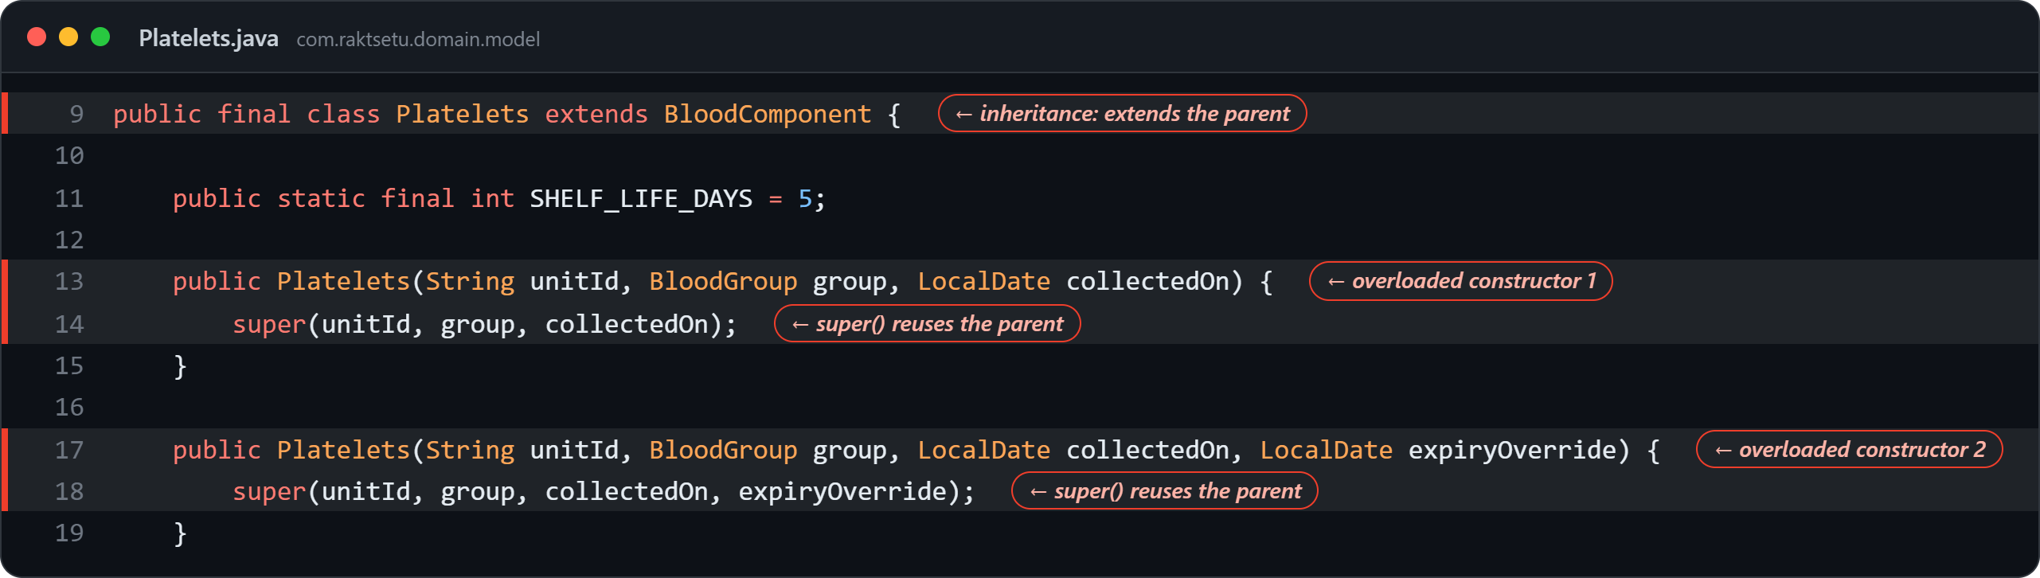
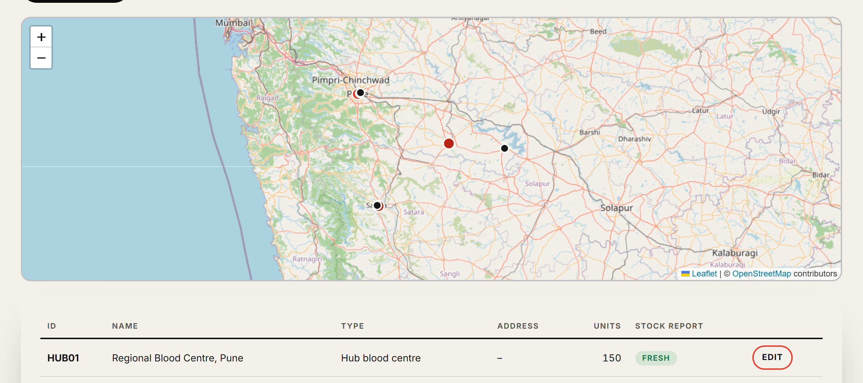
SHARED STATE WRITTEN ONCE
OOP · INHERITANCE
Real code from the repository · highlighted lines and ← tags show where the concept is
WHAT
A subclass reuses and extends its parent: an “is-a” relationship.
IN RAKTSETU
Platelets extends BloodComponent; super(...) reuses the parent's constructor (lines 14, 18)
Two constructors = overloading (compile-time polymorphism)
Hospital overrides canStore() to say no
WHY
Validation of IDs and dates is written once, in the parent.
IN THE APP
Hub, storage centres and hospitals on the map: all subclasses of Facility.
Notes:
Platelets extends BloodComponent, so a platelet unit is a blood component. Its constructors call super to reuse the parent's code, so checking the ID and dates is written once. It has two constructors, which is overloading. Hospital extends Facility and overrides canStore to return false, because hospitals hold no stock.

Slide 11
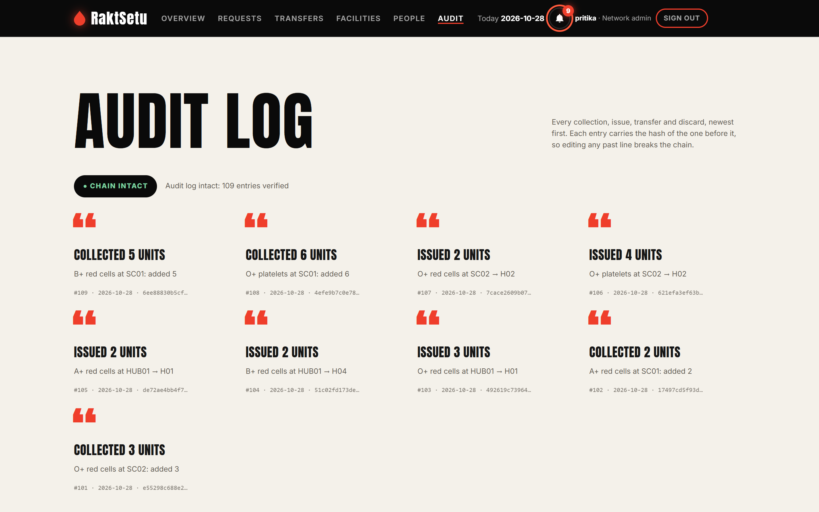
PROGRAM TO A CONTRACT
OOP · INTERFACES
Screenshot from the live app · where users see this concept at work
WHAT
A contract of methods a class promises to provide; a class can implement several.
IN RAKTSETU
The engine only knows AuditTrail
AuditLogger implements it; tests and the database implement it too
Transfusable has a default method
WHY
Swap where events are stored without touching the engine.
IN THE APP Every collection, issue and transfer reaches this log through the AuditTrail interface; the chain-intact check proves nothing was edited.
Notes:
AuditTrail is an interface: a contract with one method. The engine records events through it and never knows where they go: AuditLogger writes a file, the tests use memory, and the website uses the database, which is what you see on this Audit page. Transfusable shows a default method built on the abstract one.

Slide 12
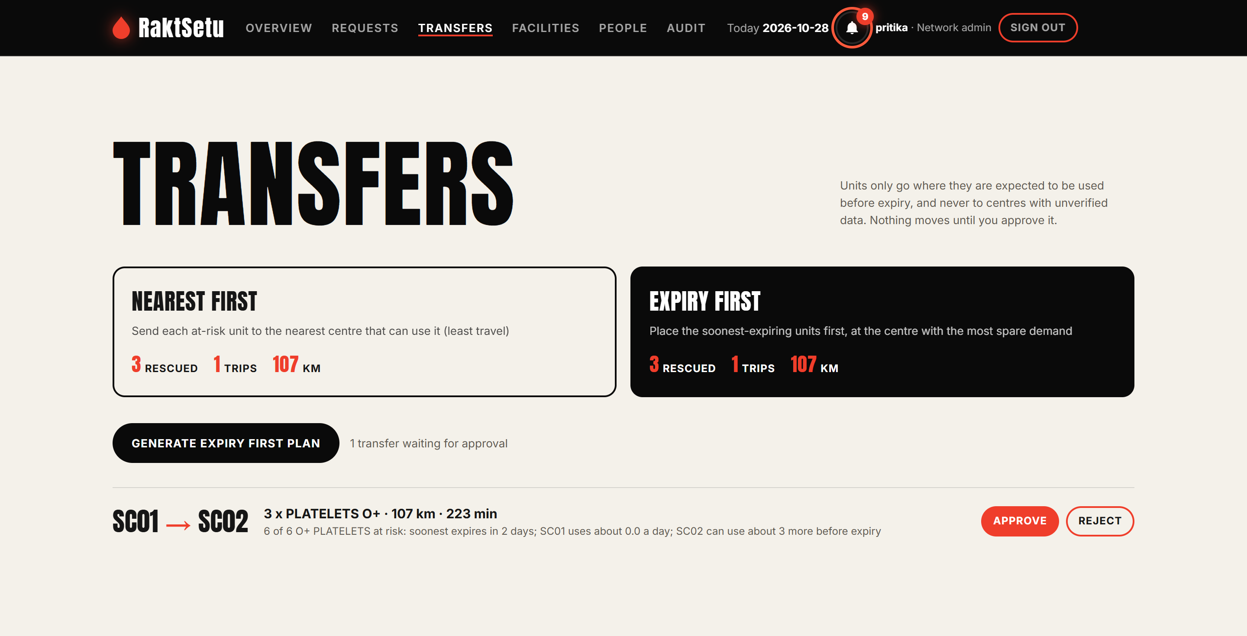
THE ALGORITHM IS FIXED, THE DECISIONS ARE NOT
OOP · ABSTRACT CLASS + DESIGN PATTERNS
Screenshot from the live app · where users see this concept at work
ABSTRACT CLASS + TEMPLATE METHOD
plan() is final: same steps and safety checks for everyone
Subclasses fill in only order() and choose()
STRATEGY
Expiry-first and nearest-first plug in here; the admin picks one on the Transfers page.
FACTORY
ComponentType.newUnit() creates the right kind of blood without naming subclasses.
IN THE APP Two Strategy objects run on the same data, side by side; the plan moves 3 O+ platelets Baramati → Satara and waits for Approve.
Notes:
This abstract class holds the planning algorithm. The plan method is final, so every strategy follows the same steps and checks; subclasses only fill in two abstract steps. That is the Template Method pattern. The strategies are the Strategy pattern: on the Transfers page the admin compares nearest-first and expiry-first, and nothing moves until they approve. ComponentType.newUnit is a factory method.

Slide 13
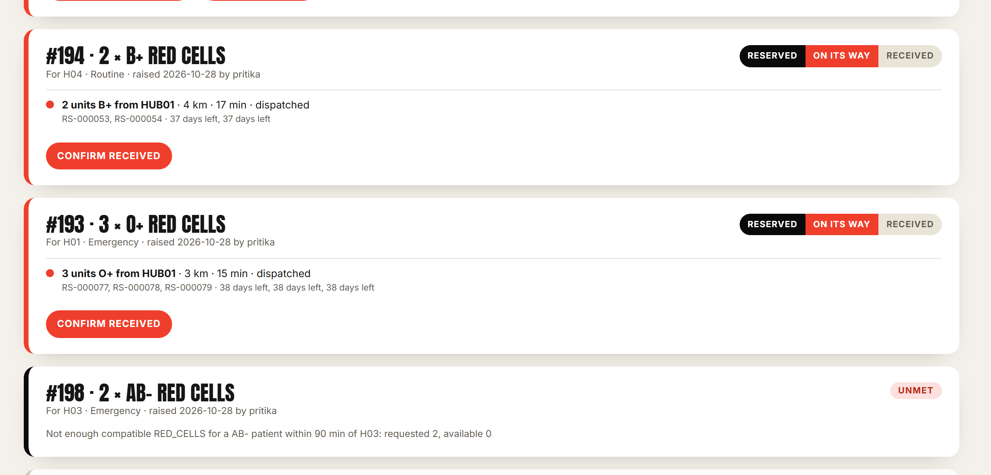
BUSINESS RULES AS CHECKED EXCEPTIONS
OOP · EXCEPTION HANDLING
Screenshot from the live app · where users see this concept at work
THROW
A custom exception extends RaktSetuException and carries the units requested and available
Inventory throws it when stock is short
CATCH
The console wraps each option in try
Each kind is caught separately and shown to staff
WEB APP
The same exception becomes HTTP 409. Nothing crashes.
IN THE APP Request #198 could not be met: the message (“requested 2, available 0”) is shown and the request is flagged UNMET.
Notes:
Business problems are custom checked exceptions. InsufficientStockException extends RaktSetuException and carries how many units were requested and available. The inventory throws it; the console catches it and keeps running; the website turns it into an HTTP 409. Here request 198 could not be met: the app shows requested 2, available 0, and flags it.

Slide 14
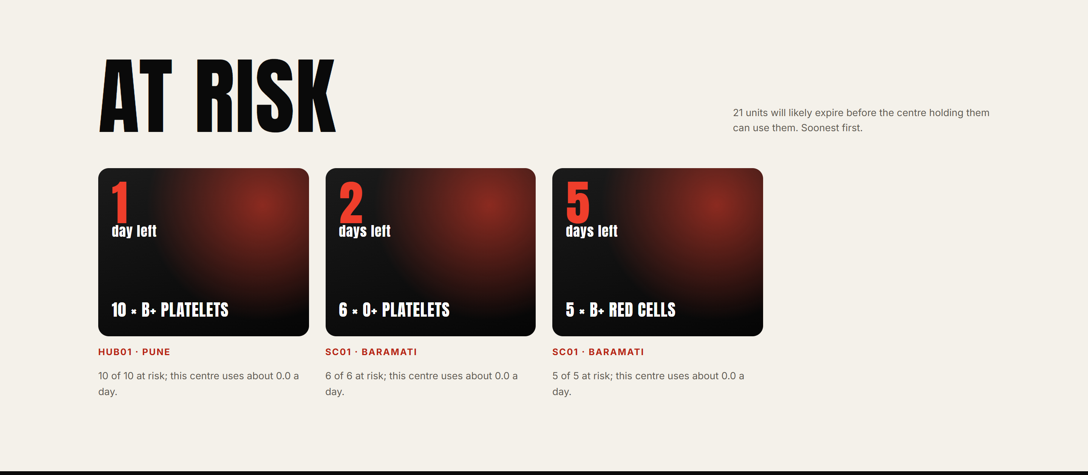
THE RIGHT TYPES AND DATA STRUCTURES
OOP · GENERICS, COLLECTIONS AND LAMBDAS
Screenshot from the live app · where users see this concept at work
GENERICS
Repository<T extends Identifiable>: one class stores facilities, units and orders, with no casts.
COLLECTIONS
An EnumMap of TreeSets keeps stock soonest-expiring first: add, issue and remove in O(log n).
LAMBDAS
The expiry order is a lambda comparator, FEFO = (a, b) -> ...; strategies sort with Candidate::unit and c -> c.source().getId().
IN THE APP At-risk units arrive already sorted, soonest expiry first, by the TreeSet and its lambda comparator.
Notes:
Repository is generic with a bounded type parameter, so one class stores any identifiable record with no casts. Stock is an EnumMap of TreeSets sorted soonest-expiring first. The sort order itself is a lambda: the FEFO comparator, first expiry, first out. That is why the At risk list is always soonest first.

Slide 15
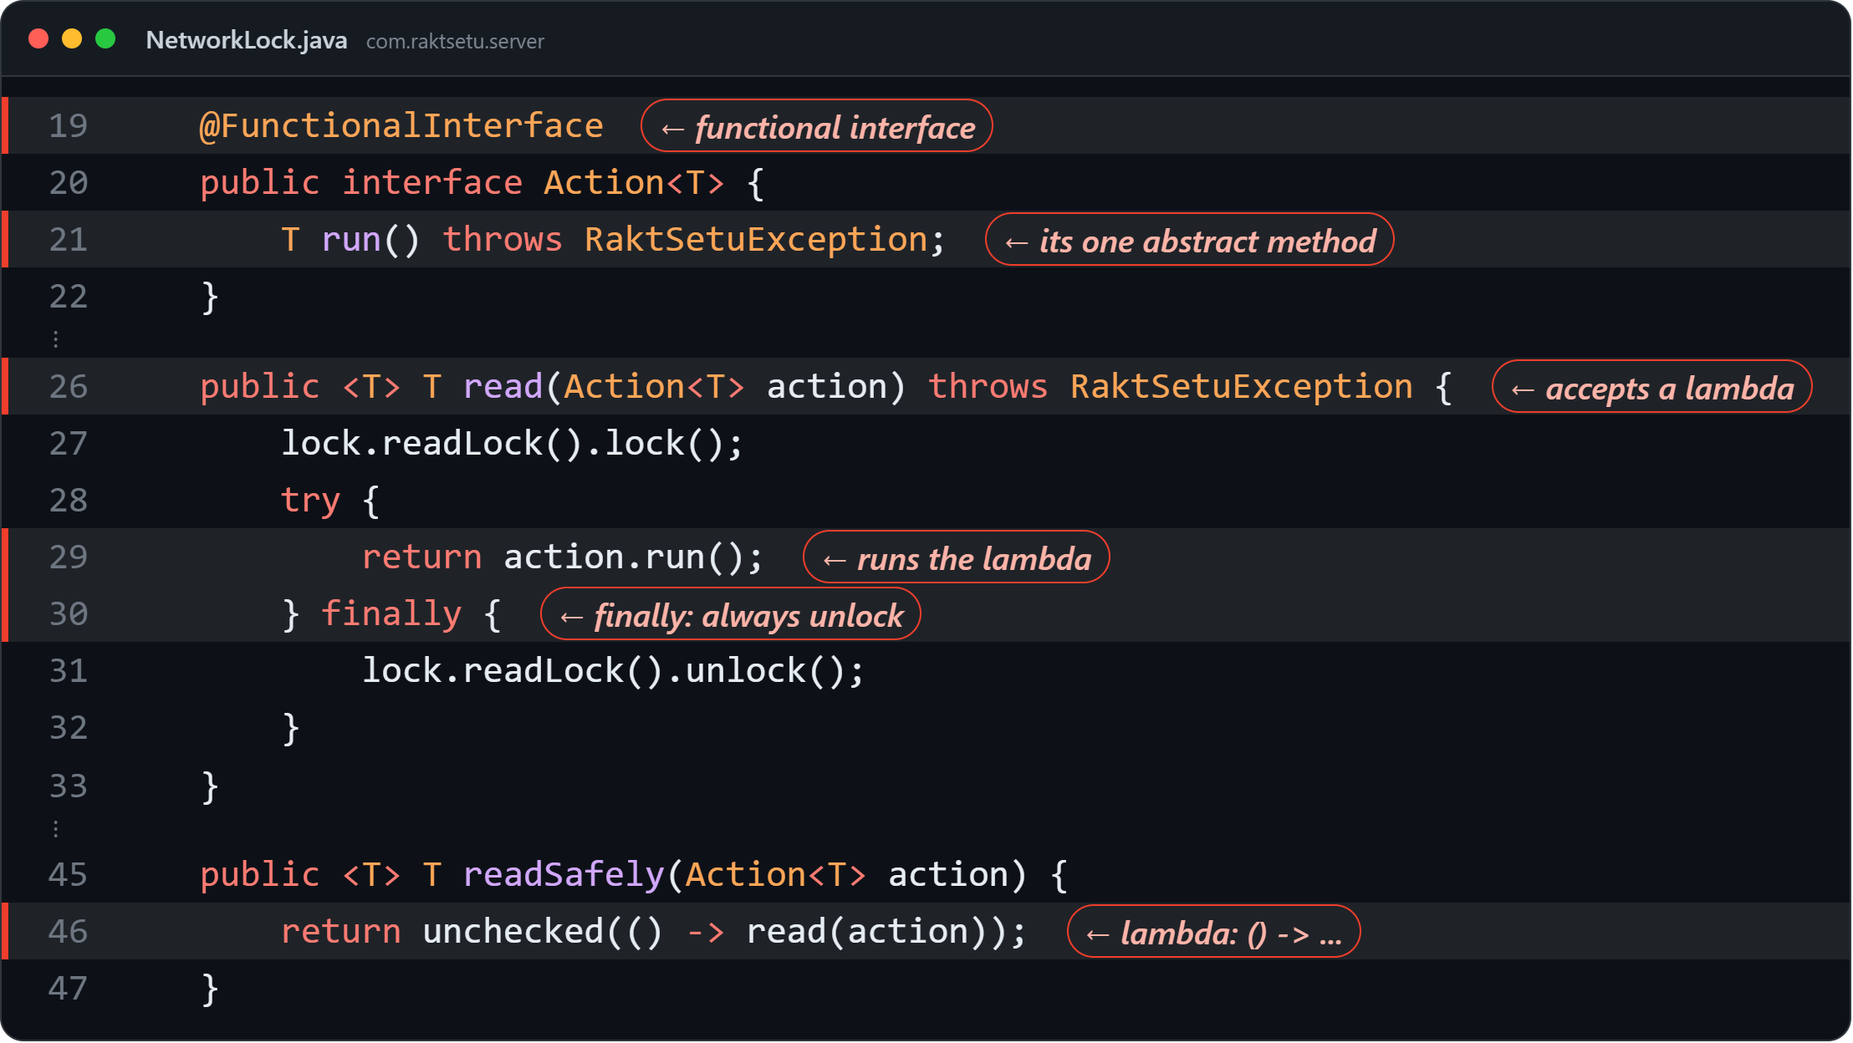
MANY USERS, ONE LOCK, ONE RECORD
OOP · MULTITHREADING, LAMBDAS AND FILE I/O
Real code from the repository · highlighted lines and ← tags show where the concept is
MULTITHREADING
A read-write lock lets many users read at once while a change waits; finally always releases it.
LAMBDAS
Action<T> is a @FunctionalInterface: one abstract method
Every web request passes its work in as a lambda: lock.writeSafely(() -> { ... })
FILE I/O
Each audit event is appended to a CSV file with a SHA-256 hash; synchronized stops threads interleaving.
Notes:
Many users share one network on the website, so a read-write lock lets reads run together while a change waits its turn; finally guarantees the lock is released. The work itself is passed in as a lambda: Action is a functional interface with one method, so each request hands lock.writeSafely an arrow function with its code. The console's audit log is a file: each line is appended with a SHA-256 hash, inside a synchronized method so two threads cannot write at once.

Slide 16
SUPPORTING RESEARCH
RESEARCH
Reducing Blood Product Wastage Through the Inter-Hospital Redistribution of Near-Outdate Inventory
Hajjaj et al. · Transfusion, 2024
This paper studies redistributing near-expiry blood products from hospitals with low usage to hospitals more likely to use them. It also evaluates transport failures and costs.
Read the full research paper →
View the PubMed record →
Notes:
Our approach is backed by published research. Hajjaj and colleagues, in the journal Transfusion in 2024, studied redistributing near-expiry blood products from hospitals with low usage to hospitals more likely to use them. They also evaluated transport failures and costs. That is exactly what RaktSetu does across a network.

Slide 17
TESTED, FAST, AND LIVE
RESULTS
−60%
THANK YOU
TRY IT LIVE
raktsetu-ubvx.onrender.com
Surprise finding: better forecasts did not mean better plans; judge them by the waste they prevent.
expired units in a 120-day simulation
QUESTIONS?
Notes:
In a 120-day simulation of a Pune district network, moving at-risk blood cut expired units by about 60 percent. Profiling made emergency allocation 66 times faster and the server 4.4 times faster, and more than 230 automated tests run on every change. One surprise: more accurate forecasts did not give better plans. Thank you; RaktSetu is live at raktsetu-ubvx.onrender.com, and we are happy to take questions.

