Slide 1
CNNpred: CNN Based Stock Market Prediction Using a Diverse Set of Variables
Presented By: Marco Cabre and Pritish Mishra

Slide 2
Introduction

Slide 3
Stock Market Prediction
Good prediction Models can significantly increase market efficiency
Increased value creation and maximizing returns
Applications
Trading Algorithms
Risk Analysis
Determining Trading Strategies
Most algorithms focus specifically on predicting the future of the markets

Slide 4
Related Works

Slide 5
Predictive Models
Artificial Neural Networks (ANN)
Naive Bayes
SVM
Random Forests
In Kara et al. (2011), 10 technical indicators were passed into ANN and SVM to predict movement of the Istanbul Stock Exchange
ANN > SVM

Slide 6
Feedforward shallow ANN
Use back-propagation algorithms to train ANN
Sometimes noise of stock information can cause learning processes to converge to suboptimal solutions
Can use genetic algorithm (GA) or simulating annealing (SA)
In Qiu et al. (2016) authors used GA and SA to find initial weights of ANN, and then the back-propagation algorithm is used to train the network.
This outperformed the standard ANN-based methods.

Slide 7
Deep ANNs
Neural networks with more than one hidden layer
In Moghaddam, Moghaddam, and Esfandyari (2016) authors predicted NASDAQ prices based on prices from 4 or 9 days earlier
Deep ANNs proved superior to shallow ones
In Arévalo, Niño, Hernández, and Sandoval (2016) Apple Inc.’s stock was predicted to a 65% directional accuracy using five hidden layer deep ANN

Slide 8
Recurrent Neural Networks
Type of neural network designed specifically to have internal memory so that they can extract historical features and make predictions based off of them.
LSTM is one of the most popular kinds of RNNs
In Nelson, Pereira, and de Oliveira (2017) technical indicators were fed to an LSTM to predict direction of stock prices on the Brazilian stock market
LSTM outperformed MLP

Slide 9
Convolutional Neural Networks
Deep learning algorithm whose ability to extract features has been proven in many domains
In Di Persio and Honchar (2016), CNN, LSTM, and MLP were all applied to the same historical data
Results showed CNN outperforming the other two

Slide 10
Background

Slide 11
Convolutional Neural Network
Input Layer
Convolutional layer
Pooling Layer
Fully connected layer
Output Layer

Slide 12

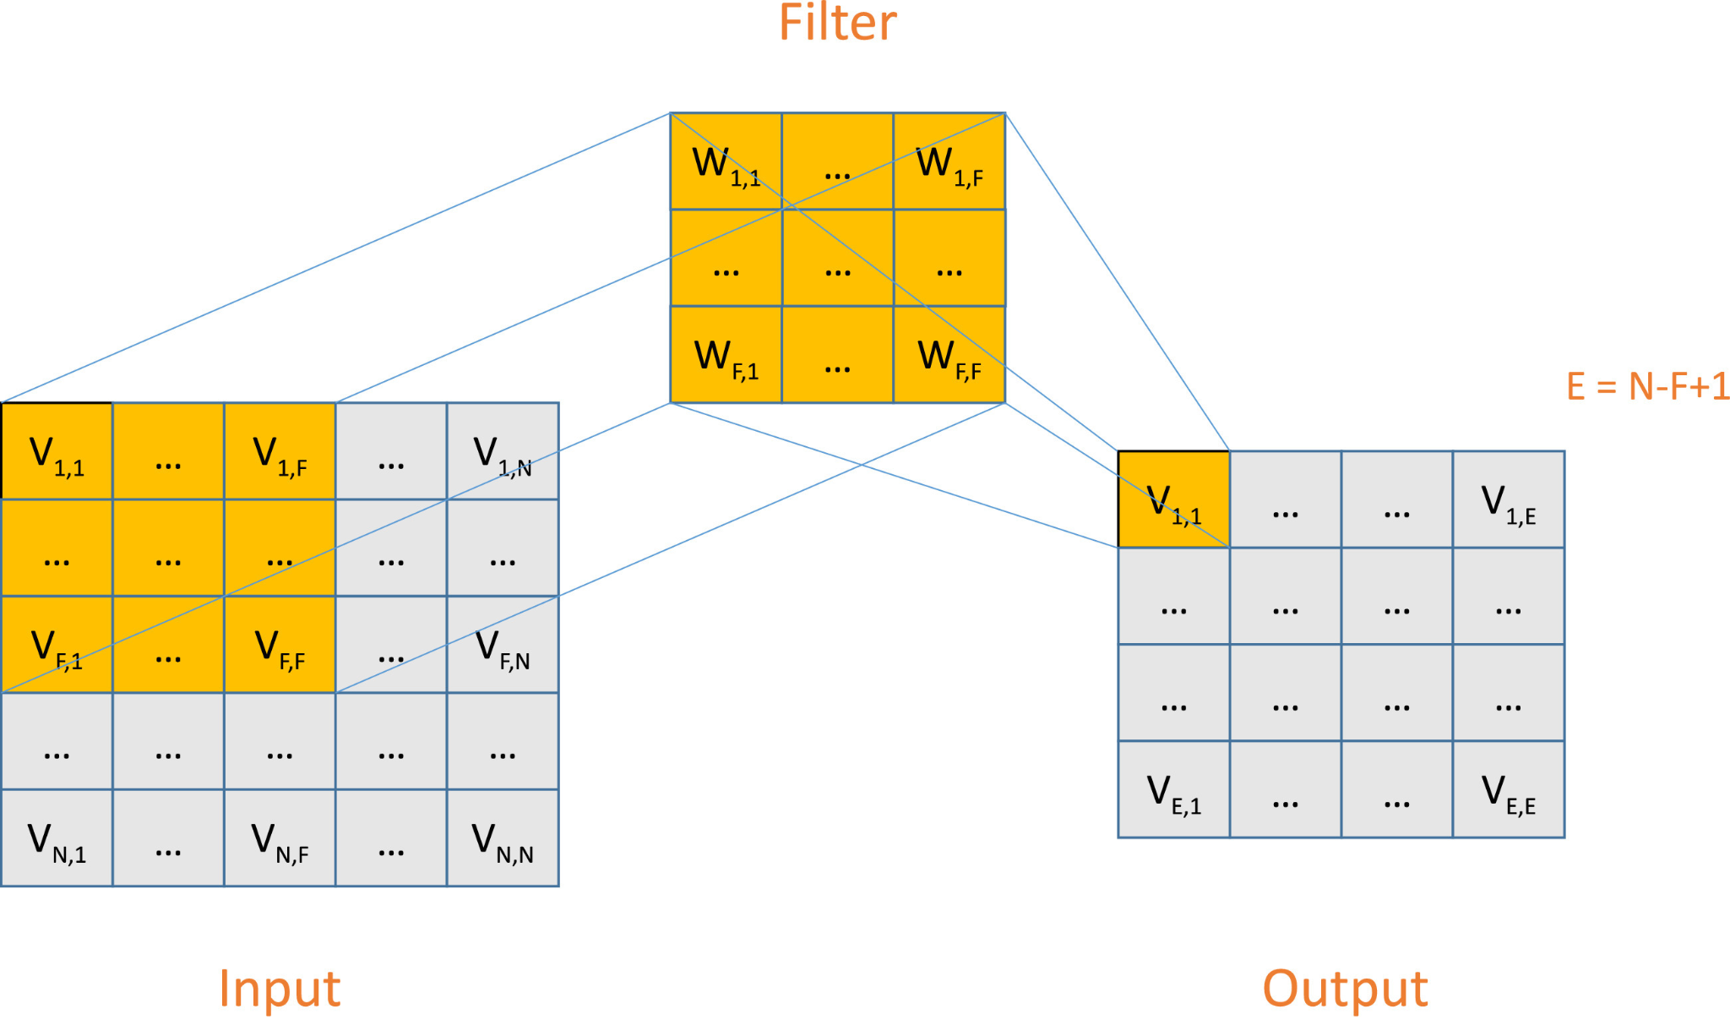

Convolutional Layer
Performs convolutional operation
Input and Filter can be considered functions
Convolutional Operation is an algorithm that measures the changes this causes

Slide 13
Pooling Layer
Subsamples the data
Reduces computational load and handles overfitting
Pools values together and converts pools into single values
Reduces the number of inputs going into the following layers
Typically uses Max Pooling

Slide 14

Fully Connected Layer
MLP Network
Responsible for converting extracted features in the previous layers to the final output
Relation between successive layers:

Slide 15
Dropout
Technique used for training deep neural networks
Prevents too much learning from training data
During each training session some of the data has a dropout rate, meaning that it won’t be looked at
This allows the model to not be reliant on the training data and to be more general

Slide 16
Current Work - CNNpred

Slide 17
What is CNNPred?
A Convolutional Neural Network (ConvNet/CNN) is a Deep Learning algorithm which can take in an input image, assign importance (learnable weights and biases) to various aspects/objects in the image and be able to differentiate one from the other.
General CNN Based Framework for stock market prediction
Two Variations: 2D-CNNpred and 3D-CNNpred
Based on 4 major steps
Representation of Input Data
Daily Feature Extraction
Durational Feature Extraction
Final Prediction

Slide 18
2D-CNNpred

Slide 19
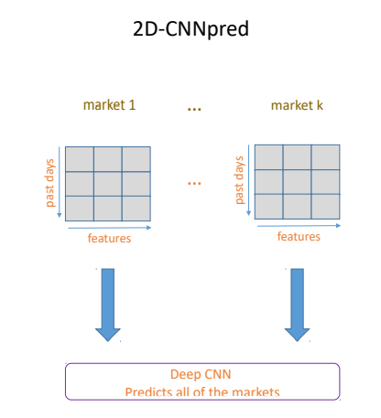
2D-CNNpred - Representation of Input Data
2 Dimensional Data Matrix/Tensor
Size of the matrix depends on:
Number of variables that represent each day
Number of days back into the history that are used to make the prediction
For an input with “f” variables spanning over “d” days, the input tensor’s size will be “d × f”
What are tensors?
Tensors are a type of data structure used in linear algebra, and like vectors and matrices, you can calculate arithmetic operations with tensors. It is, essentially, a generalization of vectors and matrices and can be thought of as a multidimensional array.
Notes:
General Model is a model valid for multiple markets.
The best model for this predicts any given market’s future based on its own history.
To achieve this, the model needs to be trained on data from several markets.
2-D CNNpred uses a 2d tensor to feed data into a specially designed CNN
The 2D model finds a general model for mapping a market’s history to its future fluctuations.
2D-CNNpred uses this approach and combines it with a variety of other variables.

Slide 20
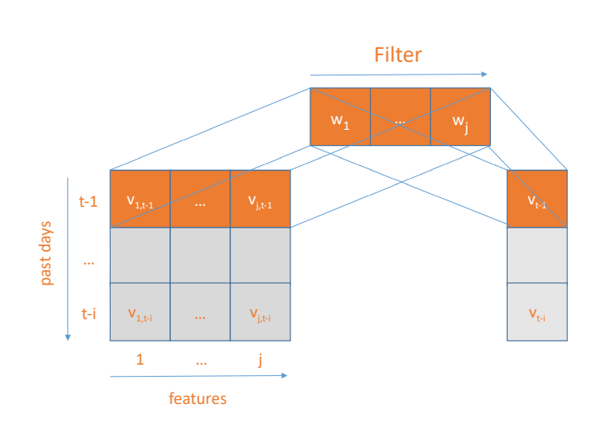
2D-CNNpred: Daily Feature Extraction
For daily feature extraction, 1 × number of initial variables filters are utilized.
Each filter covers all the daily variables and can combine them all into a single high level feature.
2D-CNNpred can construct different combinations of primary variables and drop useless variables using this layer.
This layer works as an initial feature extraction/feature selection module

Slide 21
2D-CNNpred: Durational Feature Extraction
These layers combine extracted features of different days to construct higher-level features for aggregating available information in certain durations.
As the first layer, these succeeding layers use filters for combining lower level features from their input to higher-level ones
2D-CNNpred uses 3×1 filters in the second layer.
The third layer is a pooling layer that performs a 2 × 1 max pooling, that is a very common setting for the pooling layers.
This layer is followed by another convolutional layer with 3 x 1 filters, which is followed by another pooling layer just like the first one.
Notes:
Each of those filters covers three consecutive days
This allows the algorithm to aggregate the information in longer time intervals and construct even more complex features

Slide 22
2D-CNNpred: Final Prediction
Features generated by the last pooling layer are flattened 365 into a final feature vector.
This feature vector is then converted to a final prediction through a fully connected layer.
This layer uses a sigmoid activation function so that the output is in the form of a probability in the range [0,1].
This prediction can be interpreted as the probability of a price increase of that market for the next day and this is an extremely valuable piece of information.
Notes:
Clearly, it is rational to put more money on a stock that has a higher probability of going up.
On the other hand, stocks with a low probability of going up are good candidates for short selling.
However, in their experiments, the authors discretize the output to either 0 or 1, whichever is closer to the prediction.

Slide 23
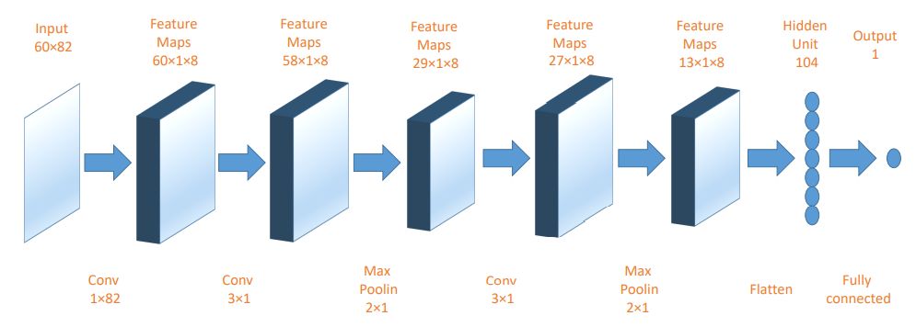
2D-CNNpred: Graphical Visualization

Slide 24
3D-CNNpred

Slide 25
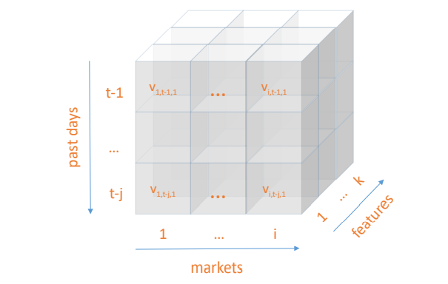
3D-CNNpred: Input Data Representation
Uses a 3-dimensional tensor to represent the input data
Each sample fed to 3D-CNNpred contains information from several markets.
The 3-D tensor is formed by the following 3 variables:
The initial Daily Variables
The Days of the Historical Record
Market from which Data is Gathered
If the dataset contains data from i different markets, k variables for each market, and data for j days in the past to predict for day t in the future, the tensor’s size will be i x j x k

Slide 26
3D-CNNpred: Daily Feature Extraction
The first layer of filters in 3D-CNNpred is defined as a set of 1×1 convolutional filters, while the primary variables are represented along the depth of the tensor.
This layer of filters is responsible for combining subsets of basic variables that are available through the depth of the input tensor into a set of higher-level features.
The input tensor is transformed by this layer into another tensor whose width and height is the same but its depth is equal to the number of 1 × 1 convolutional filters of layer one.
Same as 2D-CNNpred, the network has the capability to act as a feature selection/extraction algorithm.

Slide 27
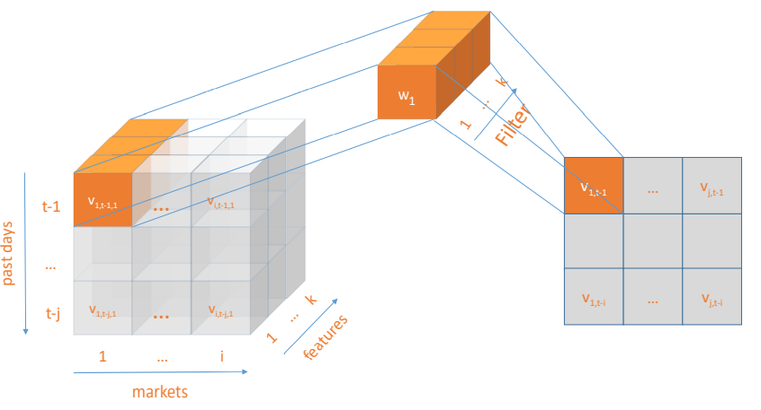
3D-CNNpred: Daily Feature Extraction

Slide 28
3D-CNNpred: Durational Feature Extraction
3D-CNNpred's input data provides information about daily variables and other markets.
Like 2D-CNNpred, the next four layers are dedicated to extracting higher-level features that summarize the fluctuation patterns of the data in time.
However, in 3D-CNNpred, this is done over a series of markets instead of one.
Width of filters in the second convolutional layer is defined to cover all pertinent markets
Filter height is set at 3 to cover 3 consecutive time units
Size of filters in this layer is: 3×number of markets.
The next three layers, like those of 2D-CNNpred, are defined as a 2 × 1 max pooling layer, another 3 × 1 convolutional layer followed by a final 2 × 1 max pooling layer
Notes:
So, the width of the filters inthe second convolutional layer is defined in a way that covers all the pertinent markets.

Slide 29
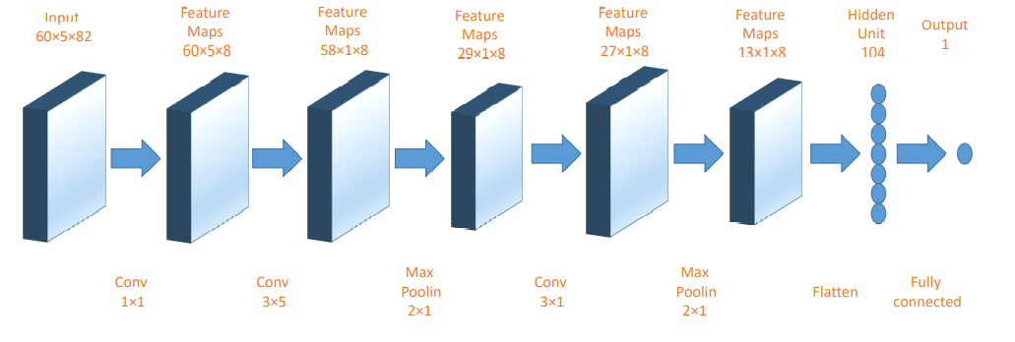
3D-CNNpred: Final Prediction
The output of 3D-CNNpred of the durational feature extraction phase is flattened and used to produce the final prediction.

Slide 30
Analysis and Results

Slide 31
Variable set for the analysis based on each market
82 variables representing each day in each market for each index have been used for the prediction task.
The authors divide the variables into 8 groups - primitive variables, technical indicators, world stock market indices, USD exchange rate, commodities, data from big companies in the US market, futures contracts, etc.
Some of the other variables used include Treasury bill rates, and term and default spreads.

Slide 32


Setting up the experiment
For all datasets, each sample has 82 variables, each of which are labeled according to the equation ->
The data is split into a 60-20-20 training-validation-testing split
Since the different variables can have different ranges, their values are normalized using the following formula:
Close_t refers to the closing price at day t.
Here,
Sigma = Standard Deviation
x_bar = mean
x_old = original value of x

Slide 33
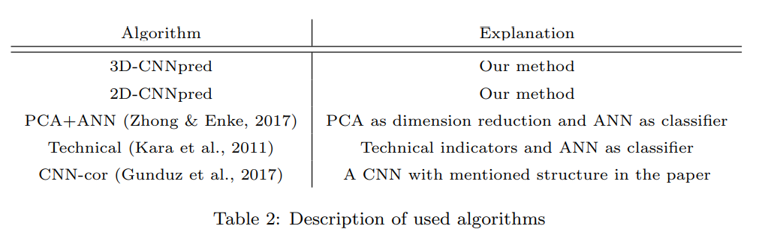
Methodology, Parameters, Baseline Algorithm
Here, the Macro-Averaged-F-Measure that is the mean of F-measures calculated for each of the two classes is used to compare the results of the different algorithms
For this CNN framework, all but the last layers use RELU activation functions.
The last layer uses a sigmoid activation function.
The baseline algorithms used include:
PCA + ANN (Zhong & Enke, 2017)
Shallow ANN using technical indicators (Kara et al., 2011)
CNN based 2-D input algorithm.
Descriptions of algorithms as used in the paper

Slide 34
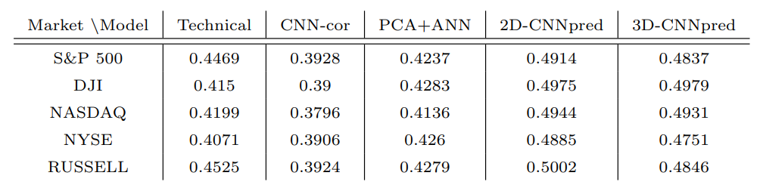
Experimental Results
The table represents the average F-measure values of the different algorithms
It clearly highlights that the difference in performance between the 2d-CNNpred, 3D_CNNpred and other algorithms is statistically significant.

Slide 35
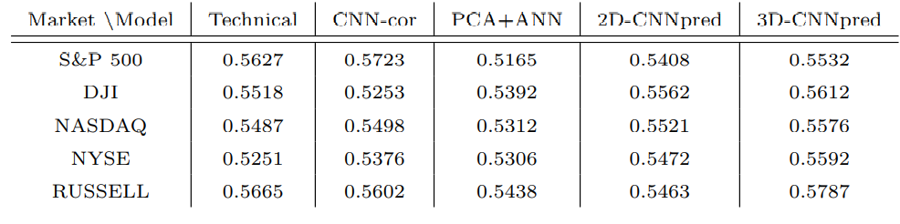
Experimental Results (cont...)
Best Performance F-measure values for all algorithms

Slide 36
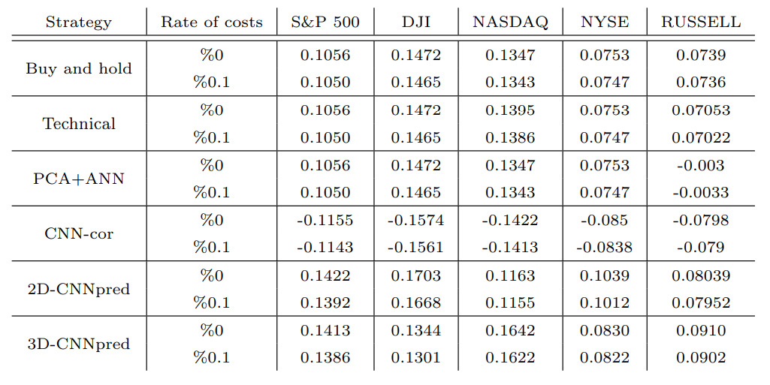
Market simulation and Results
Simulating trading strategies using these algorithms and comparing their performances:
The authors use the Sharpe Ratio and the Certainty Equivalent Return (CEQ).
Notes:
Trading Strategy used:
Each of the prediction algorithms is executed several times and their average prediction for the probability of the price going up in day t is calculated.
If this value is higher than 0.5, then the predicted label for day t is up, otherwise it is down.
When the predicted label for the next day is up the trading system fully invests on that index and holds the shares until some day with a down label comes in which situation the system sells all its shares and engages in a short selling process
Tables 5, 6 show the results of Sharpe ratio and CEQ return of CNNpred as well as other baseline algorithms and buy and hold strategy, with and without transaction 575 costs. In calculating CEQ return, risk aversion is 1. Table 7 shows value of investing $1 in both versions of CNNpred as well as buy and hold strategy at the end of the test period.

Slide 37
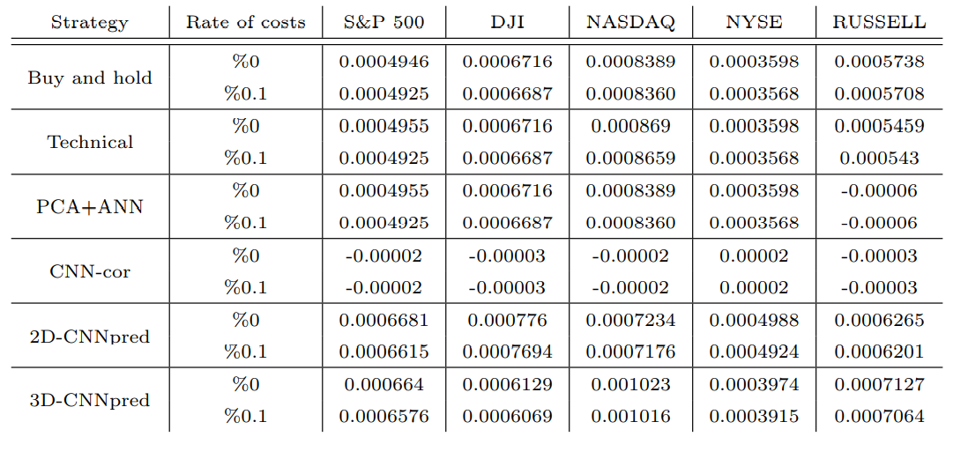
Market Simulation (cont...)
CEQ returns for various algorithms

Slide 38
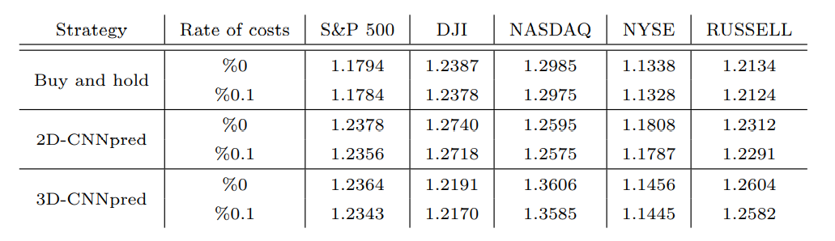
Market Simulation (cont...)
Value of investing $1 using various strategies at the end of the test period.

Slide 39
Conclusions
Clearly, from the various experiments performed, 2D-CNNpred and 3D-CNNpred significantly outperform the baseline algorithms.
Failure of the baseline algorithms might be attributed to them using shallow ANNs with only 1 hidden layer and limited feature extraction and prediction power when compared to the deeper CNN models.
Both the CNNpred frameworks have 2 significant advantages over the baseline algorithms:
First, it uses a rich set of features containing useful information for stock prediction
Second, it uses a deep learning algorithm that extracts sophisticated features out of primary ones.
Even other CNN based frameworks performed significantly worse. This performance can be attributed to their fundamental design and structural choices.
Notes:
A possible reason for that could be related to the information insufficiency of those ten technical indicators.
The authors expected that using more initial variables and incorporating a PCA module would improve the results but it did not improve the results as expected.
This observation demonstrates that adding more basic variables is not enough by itself without improving the model that 590 processes the information for feature extraction and prediction.

Slide 40
Shortcomings and Further Analysis

Slide 41
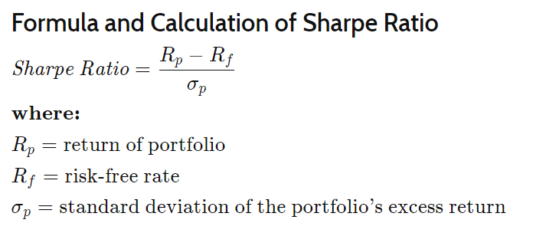

Shortcomings
Only uses F-measure to compare baseline algorithms
Only uses Sharpe Ratio when comparing the results of market simulations

Slide 42
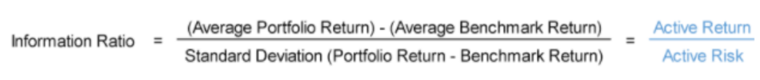
Further Improvements
Using percentage rate of return as a measure of performance
Use other comparative tests to get a better understanding of performance for the various frameworks used
Using the information ratio to measure performance against risk measures could provide valuable insight into the usability of the framework

Slide 43
Thank You

Slide 44
References
E. Hoseinzade and S. Haratizadeh, “CNNpred: CNN-based stock market prediction using a diverse set of variables,” Expert Systems with Applications, vol. 129, pp. 273–285, 2019.
J. Brownlee, “A gentle introduction to tensors for Machine Learning with NumPy,” Machine Learning Mastery, 05-Dec-2019. [Online]. Available: https://machinelearningmastery.com/introduction-to-tensors-for-machine-learning/. [Accessed: 18-Nov-2021].

