Slide 1

Project Work: Understanding the Customer Perception of Autonomous Vehicles Using Sentiment Analysis
Pritish Samant
First Supervisor:
Prof. Dr. Achim Rettberg
Second Supervisor:
Charles Steinmetz

Slide 2

Motivation
Four main reasons to study customer perception of autonomous vehicles through sentiment analysis:
Understand public acceptance and concerns
Improve design and features based on feedback
Enhance marketing strategies to target specific sentiments
Improve user experience by analyzing sentiments towards autonomous vehicles
Project Work
Notes:
Studying how people feel about autonomous vehicles or self-driving cars through sentiment analysis helps us make better decisions regarding autonomous vehicles. For example, if many people are worried about the safety of cars, and they post their concerns online then the car manufacturers can work on making the cars safer. This feedback is necessary to understand public perception . Also, by knowing what people like or don't like, companies can market the cars better to make more people interested. And this process of understanding, improving, and advertising can take time, but it's important to make sure everyone feels good about self-driving cars before they become common on the roads.

Slide 3
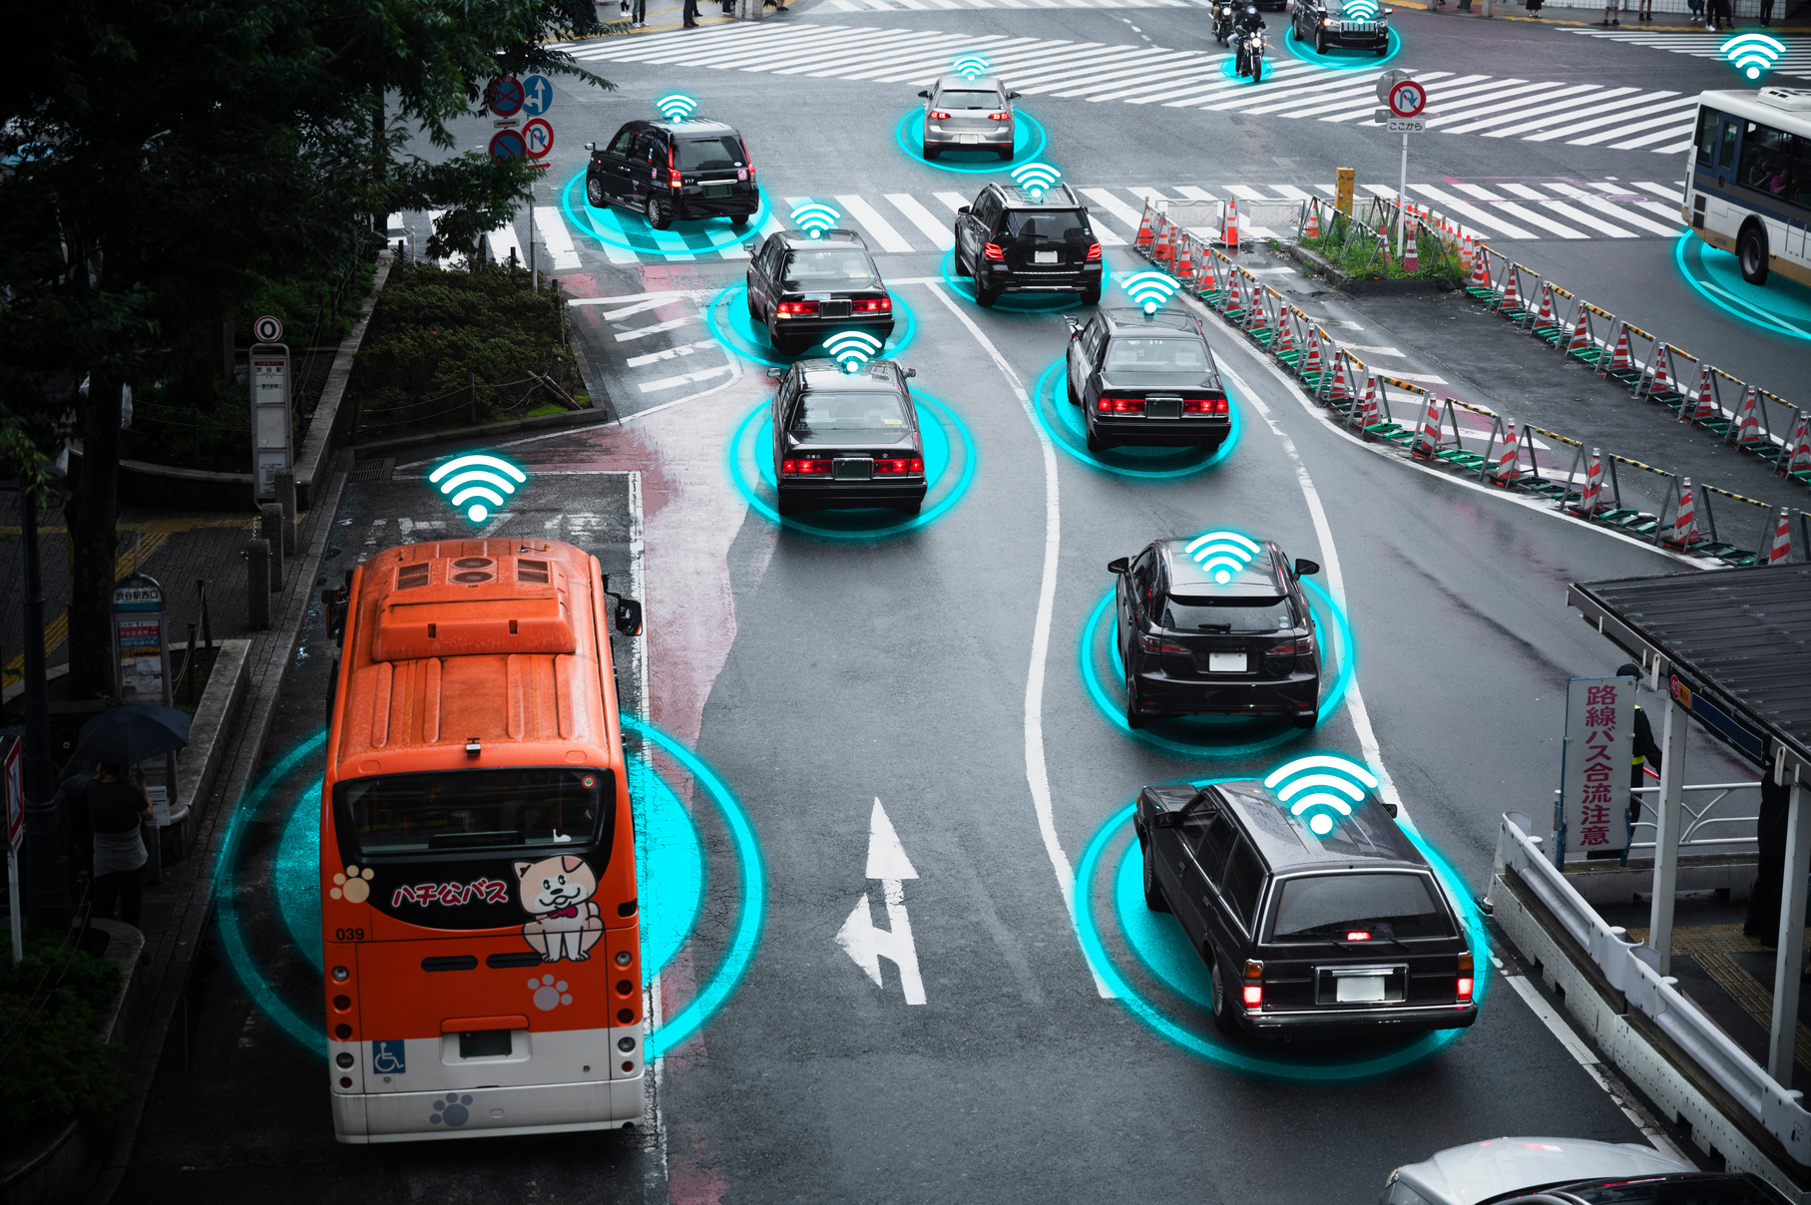
Autonomous Vehicles
Autonomous vehicles are self-driving cars that use sensors and software to navigate without human input.
They have the potential to increase road safety by reducing human errors and accidents.
Autonomous vehicles can improve traffic flow and efficiency by communicating with each other and traffic systems.
The technology is still being developed and faces challenges such as regulatory issues and public acceptance.
[1]
Project Work
Notes:
Autonomous vehicles are cars equipped with sensors and software that enable them to drive without human control. They're advantageous because they possess exceptional driving abilities, which can significantly reduce accidents on roads. These cars can communicate with each other and with traffic signals, which helps solve traffic congestion. However, despite their remarkable features, autonomous cars are still in the learning phase and encounter challenges such as navigating, regulations and ensuring passenger safety. Therefore, although we anticipate a future with self-driving cars, there's still groundwork to be done to ensure widespread acceptance of their presence on roads.

Slide 4
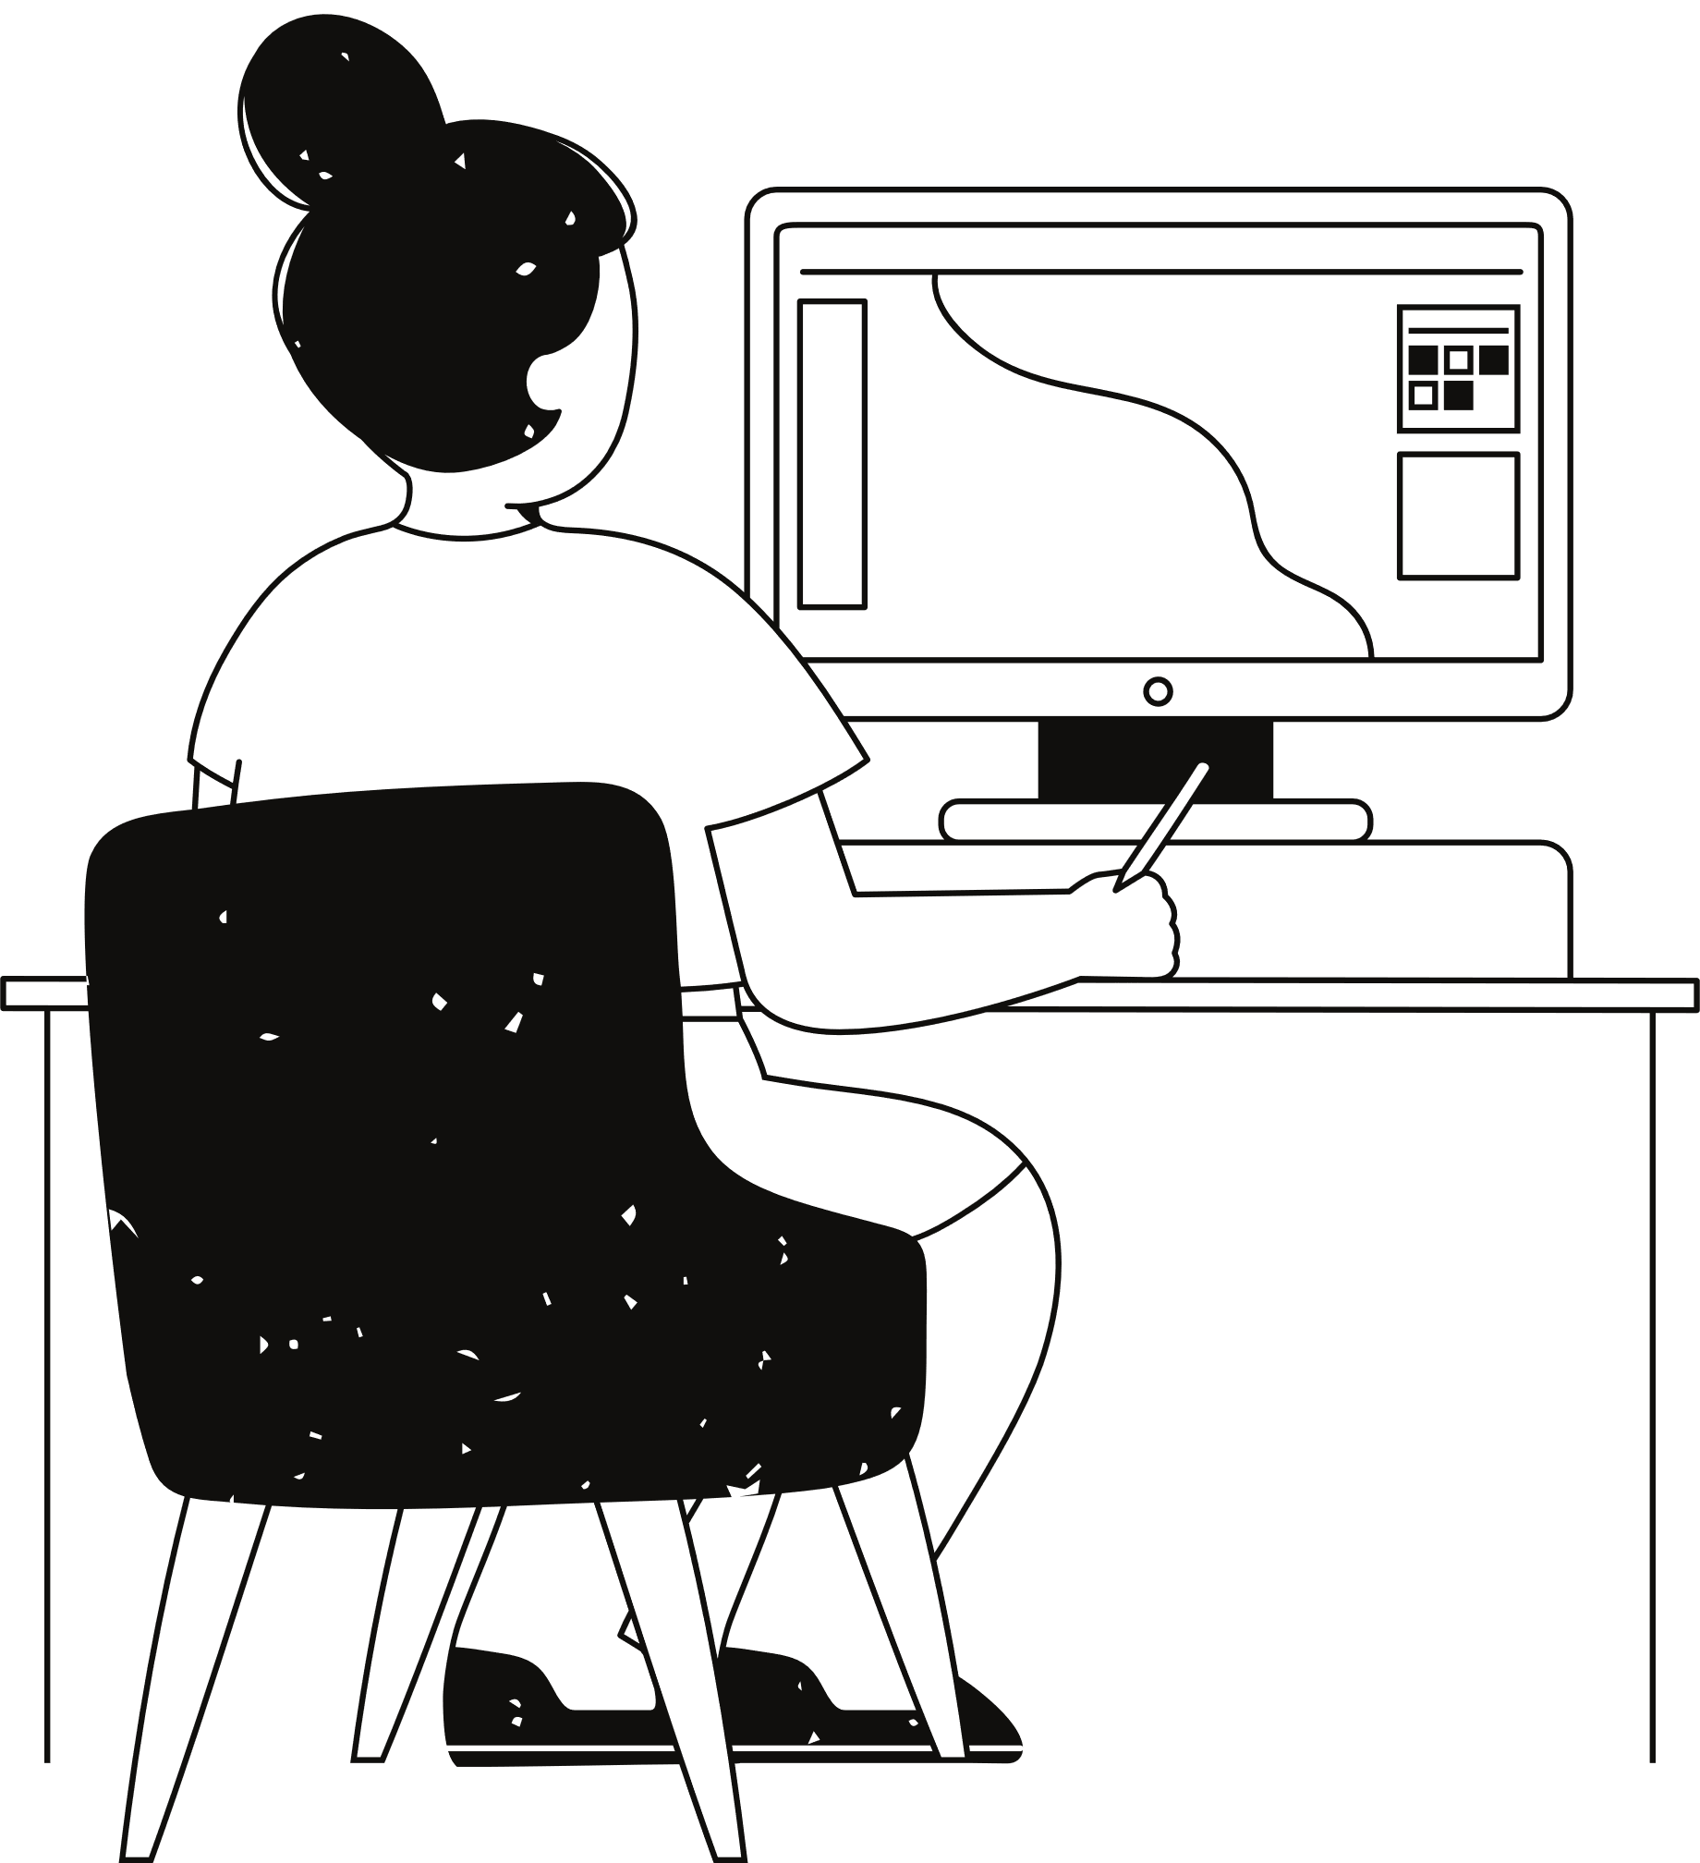
Perception of Autonomous Vehicles
Safety concerns
Convenience and time-saving benefits
Trust in technology and reliability
Environmental impact
Cost considerations
Project Work
Notes:
When discussing self-driving cars, there are several factors to consider. Firstly, safety is a major concern. People wonder if these cars can ensure our safety without a human driver. Additionally, trust in the reliability of these cars is important. These cars might be costly, which is another aspect to think about. At the same time, self-driving cars could benefit the environment by potentially reducing fuel consumption and emissions. Therefore, while self-driving cars seem promising, there's still multiple factors to ponder before they become common place on our roads.

Slide 5
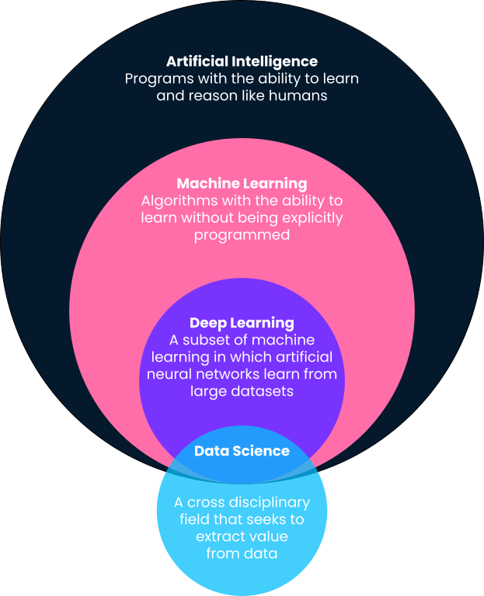
Machine learning
Machine learning is a subset of artificial intelligence that focuses on developing algorithms computers to learn from and make predictions based on data.
Machine learning can be categorized into three main types: supervised learning, unsupervised learning, and reinforcement learning.
Applications of machine learning include image and speech recognition, medical diagnosis, recommendation systems, financial forecasting, and autonomous vehicles.
Key concepts in machine learning include training data, feature extraction, model evaluation, and the trade-off between bias and variance.
[2]
Project Work
Notes:
Machine learning is a powerful tool that allows computers to recognize patterns and make predictions based on it. machine learning algorithms learn from experience. They analyze large amounts of data, identify patterns within that data, and then use those patterns to make predictions or decisions. There are various types of machine learning algorithms, including supervised learning, unsupervised learning, and reinforcement learning. As technology continues to advance, machine learning will undoubtedly play an important role in solving complex problems.

Slide 6
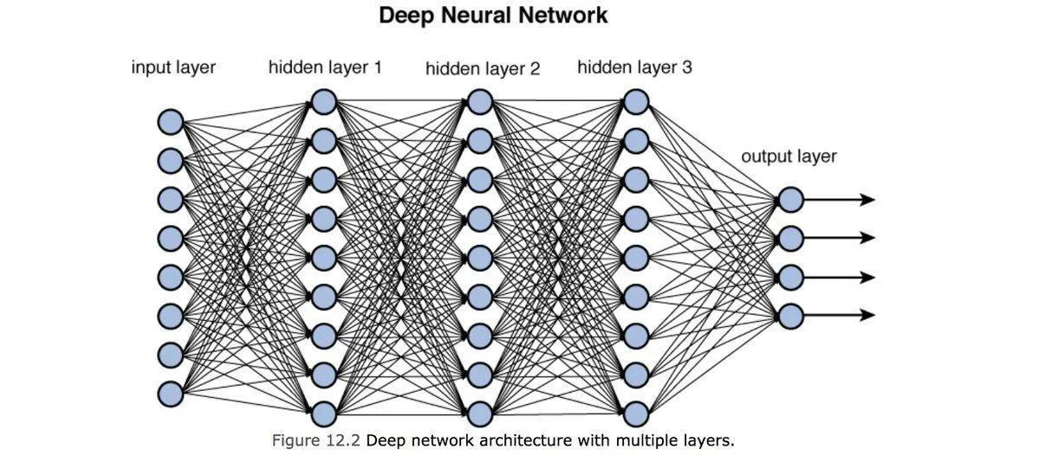
Deep Learning
Deep learning is a subset of machine learning that uses artificial neural networks to model and solve complex problems.
It involves training neural networks with large amounts of data to learn patterns and make predictions.
Deep learning algorithms can automatically discover features from the data, eliminating the need for manual feature extraction.
Applications of deep learning include image and speech recognition, natural language processing, and autonomous vehicles.
[3]
Project Work
Notes:
Deep learning is a type of machine learning which is a powerful tool for solving complex problems. It uses neural networks to learn from large amounts of data, to automatically learn features and patterns without the need of human. It consists of three different basic layers, input layer, hidden layers and output layer. Hidden layer can be either single layer or multiple layers which is based on the complexity of data to be processed. Each layer consists of neurons and every neuron has its own weight. When the data flows from one layer to another that is neuron flows from one layer to next layer along with its weight. Deep learning is mostly used in image and speech recognition and nlp.

Slide 7
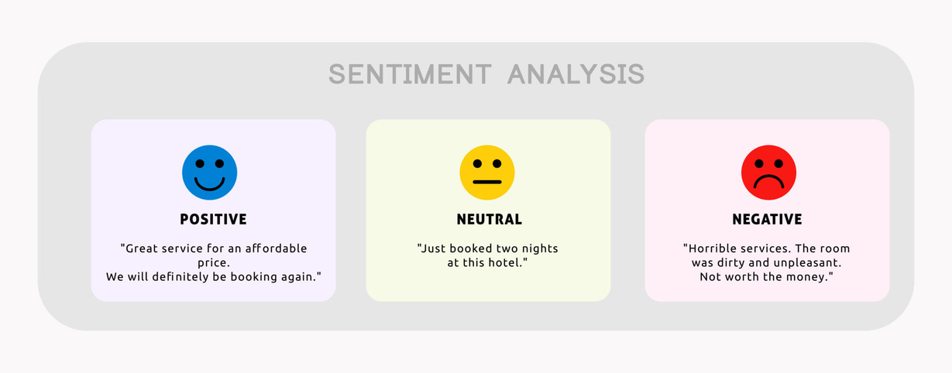
Sentiment Analysis
Sentiment analysis involves analyzing text to determine the sentiment or emotion expressed.
It can be used to understand opinions, attitudes, and emotions in social media, customer reviews, and other texts.
Techniques include natural language processing, machine learning, and lexicon-based methods.
Applications include brand monitoring, customer feedback analysis, and social media analytics.
[4]
Project Work
Notes:
Sentiment analysis is like figuring out how people feel by looking at what they write. For example, if someone says, "Autonomous vehicles are the future!" that's a positive sentiment. It's used to understand what people think or feel in places like social media or online reviews. It's really helpful for businesses to know what customers think about their products or how people feel about certain topics online. So, sentiment analysis helps with things like keeping an eye on a brand's reputation, listening to what customers say about products, and understanding trends on social media.

Slide 8

Method
01
02
03
04
Preprocessing: Clean and prepare the text data by removing noise and irrelevant information.
Feature extraction: Convert text data into numerical features for machine learning algorithms.
Model training: Use machine learning algorithms like LSTM, Decision trees, Logistics Regression and BERT to train the sentiment analysis model.
Data collection: Gather text data for training the sentiment analysis model.
Project Work
Notes:
The basic idea of implementation starts with collecting lots of text from different places to teach our computer about feelings. Then, we clean the data. Then we started with the modelling process. For this project, we started by importing all the required libraries. Here we used two different datasets, Data set D1 and Dataset D2. Dataset D1 is scraped from X (formerly twitter) using tweepy function. Data set D1 contains 80,000 texts. While dataset D2 is a popular open source labelled dataset available by dataworld. it has 11,000 datapoints. Then preprocessing is done on both the datasets. After that for text based classification, we used different ml models. These ml models were based on three types of models. Conventional ml model and deep learning based model and transformer based model. Conventional ml techniques we used were logistic regression and decision tree and for deep learning based, we used lstm and for transformer based we used bert. The accuracy was observed for all the algorithms on both the dataset and a conclusion was made.

Slide 9
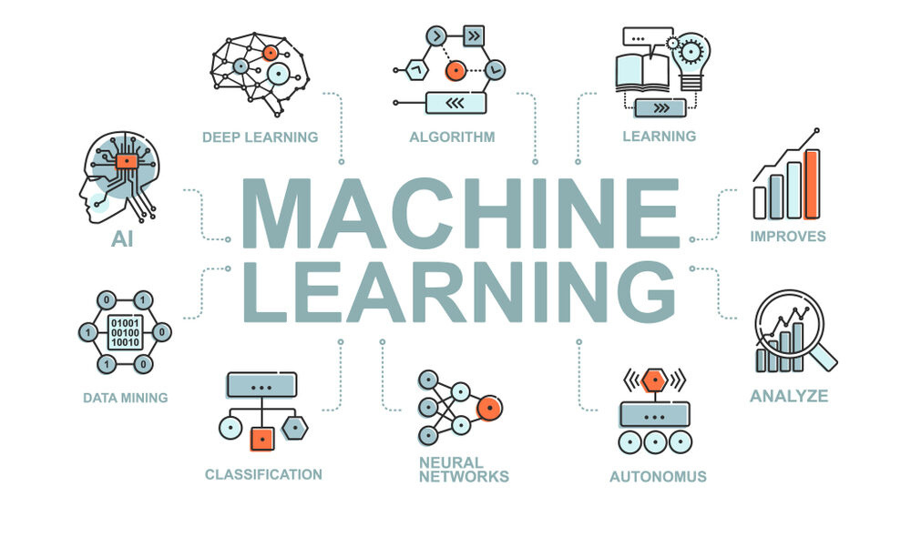
Machine learning Techniques
Utilizing supervised learning with labelled data
Employing unsupervised learning methods such as clustering
Leveraging deep learning techniques with neural networks
Applying transfer learning for domain adaptation
[5]
Project Work
Notes:
First, we use supervised learning, which is like teaching with labeled examples. Then, we try unsupervised learning, where the computer finds patterns on its own, like sorting things into groups. After that, we use deep learning, which is like teaching computers to think like our brains do Finally, we apply transfer learning, where we take what a computer learned in one task and use it to help with another task. These methods help computers learn and get smarter at different things!

Slide 10
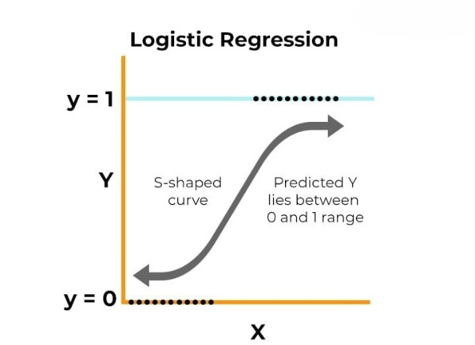
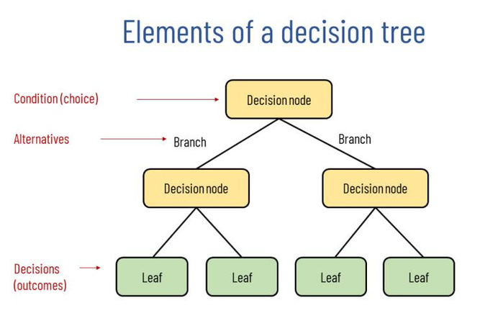
Conventional Machine Learning
Conventional machine learning techniques include logistic regression and decision trees.
Logistic regression is used for binary classification, predicting the probability of an event occurring.
Decision trees are a tree-like structure where each internal node represents a splitting attribute, and each leaf node represents a class label.
Both techniques are popular and widely used for their simplicity and interpretability in machine learning.
[6]
[7]
Project Work
Notes:
In traditional machine learning, we use methods like logistic regression and decision trees. Logistic regression helps us predict if something will happen or not, like whether the text is positive or negative. When there are only two possible class values, this is the best way to solve the problem. Decision trees is one of the most powerful machine learning technique yet a simple one. The structure of decision trees looks like a tree but working like a flow chart where each node represents a feature and each branch denotes a decision which is based on that feature and each leaf represents the result or classification. Decision tree works like splitting of a tree or branching from a tree where the outcome depends on the feature and the decisions it took in the process. Decision trees is mostly used for classification or decision making problems.

Slide 11
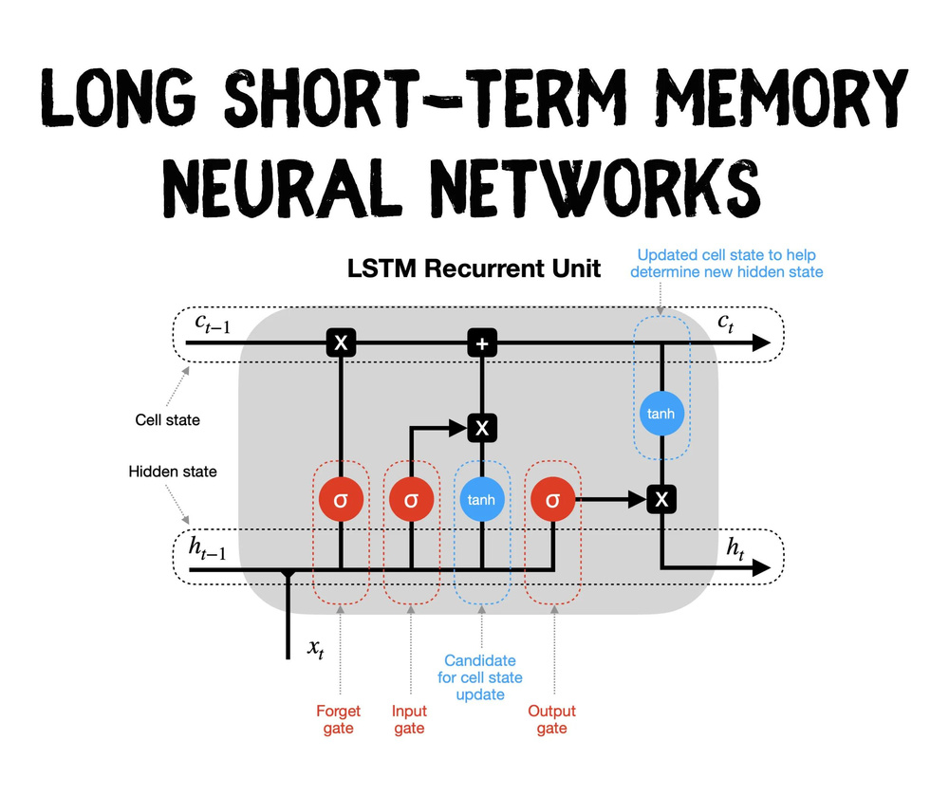
Deep learning based
Capture long-term dependencies in data.
Handle sequential data effectively.
Learn complex patterns in text data for sentiment classification.
[8]
Project Work
Notes:
LSTM, which stands for Long Short-Term Memory, is known to understand information over a long period. LSTM remembers the previous information captured while on old steps and can also determine the irrelevant information and forget it. This feature helps LSTM with sequential data tasks like speech recognition, sentiment detection, and time series analysis. For example, if we want to know how someone feels in a story, LSTM can figure it out by looking at all the words in the story and understanding the emotions behind them. So, LSTM helps computers understand big chunks of information and pick up on subtle patterns.

Slide 12
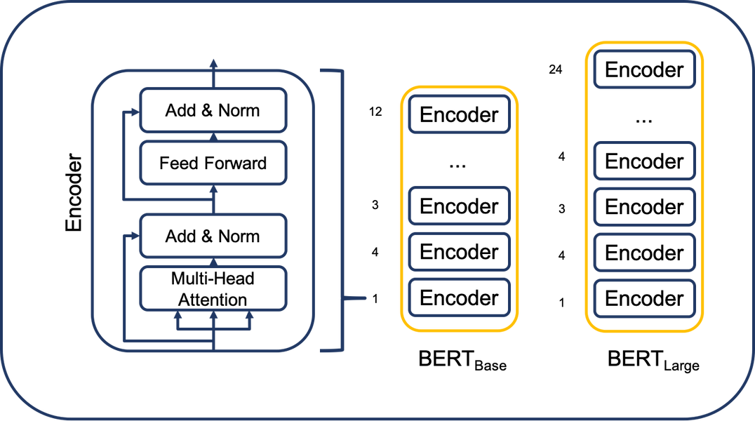
Transformer based
Transformer-based techniques like BERT are used for sentiment analysis.
BERT models capture context and relationships between words.
BERT enhances sentiment analysis accuracy and performance.
[9]
Project Work
Notes:
BERT is a transformer based architecture And is one of the first modern Large language models(LLM). BERT understands the meaning of the word in both direction and that’s where the term bidirectionality is referred as. Unlike other models, this feature allows the BERT to understand the words in a sentence in a better way with respect to context and the meaning of the words associated with the sentence. ChatGPT or BARD are some of the popular generative AI models that are based on transformer based Architecture.

Slide 13
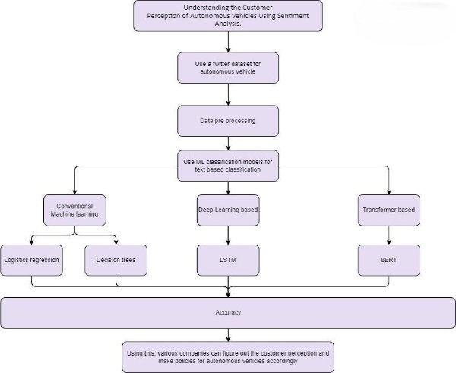
Implementation process
Data collection: Gather text data from various sources.
Text pre-processing: Clean and prepare the text data for analysis.
Sentiment classification: Determine the sentiment (positive, negative, neutral) of the text.
Evaluation: Assess the accuracy and effectiveness of the sentiment analysis model.
Project Work
Notes:
The general process to do sentiment analysis is First, we collect text from different places. Then, we clean it up to get it ready for analysis. After that, we decide if the text is saying something positive, negative, or neutral. Finally, we check how well our system is doing to make sure it's accurate. For this project, we used different machine learning algorithms to check the accuracy and figure out which model suits our data better.

Slide 14
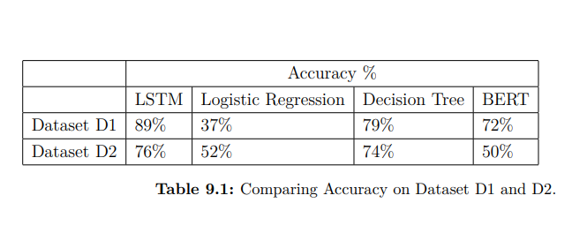
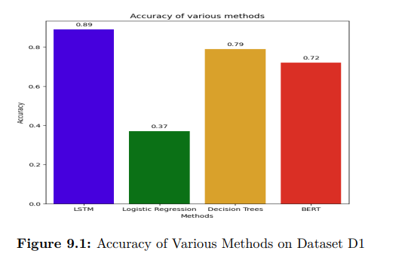
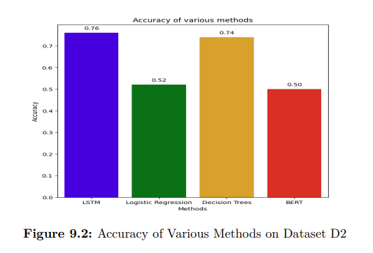
Results
For dataset D1, LSTM scored the highest accuracy of 89%. Decision trees were not much behind LSTM, with an accuracy score of 79%. BERT scored an accuracy of 72% while Logistics Regression scored 36%.
For dataset D2, it follows similar patterns with LSTM and Decision tree with an accuracy of 76% and 74% respectively. Logistic Regression scored an accuracy of 52% while BERT scored 50%.
Project Work
Notes:
In dataset D1, we observed that LSTM achieved the highest accuracy rate, reaching an impressiv 89%. Decision trees closely followed LSTM, achieving an accuracy score of 79%. BERT attained a respectable accuracy rate of 72%, while Logistic Regression trailed behind with a score of 36%.
Similarly, in dataset D2, LSTM and Decision trees maintained their high accuracy trends, with scores of 76% and 74%, respectively. Logistic Regression achieved an accuracy of 52%, while BERT performed slightly lower with a score of 50%. These findings suggest consistent performance patterns across both datasets, with LSTM and Decision trees emerging as robust performers in sentiment analysis tasks.

Slide 15
Conclusion
Advancements in technology have paved the way for exciting possibilities in the field of sentiment analysis
Four machine learning algorithms were tested
deep learning-based algorithm like LSTM worked the best for text-based sentiment analysis
Using machine learning techniques and improving them, it is possible to determine the sentiment of general people towards autonomous vehicles
With continued refinement and enhancement of machine learning techniques, it is becoming increasingly feasible to accurately gauge public sentiment towards autonomous vehicles.
Project Work
Notes:
With advancing technology, sentiment analysis is getting even better. We tried out four different ways computers learn, like machines learning from examples. One way, called LSTM, was the best at understanding feelings from text. By using these learning tricks and making them even better, we can figure out how most people feel about self-driving cars. It was observed that using machine learning techniques and improving them, it is possible to determine the sentiment of general people towards autonomous vehicles.

Slide 16

Future Work
Several promising techniques or methods can be explored
Higher version of the transformer-based algorithm
Social study to be done on customers
Project Work
Notes:
Several promising techniques or methods can be explored to understand customers perceptions of autonomous vehicles using sentiment analysis. This study was based on text based analysis. Integration of multi-modal data like incorporating additional data apart from text like images or videos can help with more accurate scenarios to begin with. The use of this study can be further extended to government agencies for policy drafting as well as in research field like robotics where the machine can be made to predict sentiment when its interacting with humans.

Slide 17
Thank you very much!
Project Work

Slide 18

References
[1] Image by <a href="https://www.freepik.com/free-photo/automatic-recognition-software-analyzing-city-collage_94958900.htm#query=Autonomous%20vehicles&position=1&from_view=search&track=ais&uuid=4729c413-4d7f-4416-aab7-c004ea6986b6">Freepik</a>
[2] https://www.fsm.ac.in/blog/an-introduction-to-machine-learning-its-importance-types-and-applications/
[3] https://towardsdatascience.com/training-deep-neural-networks-9fdb1964b964
[4] https://www.expressanalytics.com/blog/social-media-sentiment-analysis/
[5] https://www.datacamp.com/blog/what-is-machine-learning
[6] https://www.spiceworks.com/tech/artificial-intelligence/articles/what-is-logistic-regression/
[7] https://why-change.com/2021/11/13/how-to-create-decision-trees-for-business-rules-analysis/
[8] https://towardsdatascience.com/lstm-recurrent-neural-networks-how-to-teach-a-network-to-remember-the-past-55e54c2ff22e
[9] R Evtimov, A Maiwald, and M Falli. Bidirectional encoder representations
from transformers (bert).
Project Work

