Slide 1
Naos Data Engineering Internship Technical Assessment
Prit Italiya
3 Nov. 2024

Slide 2
Objective
1. Understanding average daily salary for Mexico.
2. Analyzing salary levels for different socio-economic levels.

Slide 3
Tools Used
Python, Pandas, Matplotlib, Seaborn, Jupyter Notebook

Slide 4
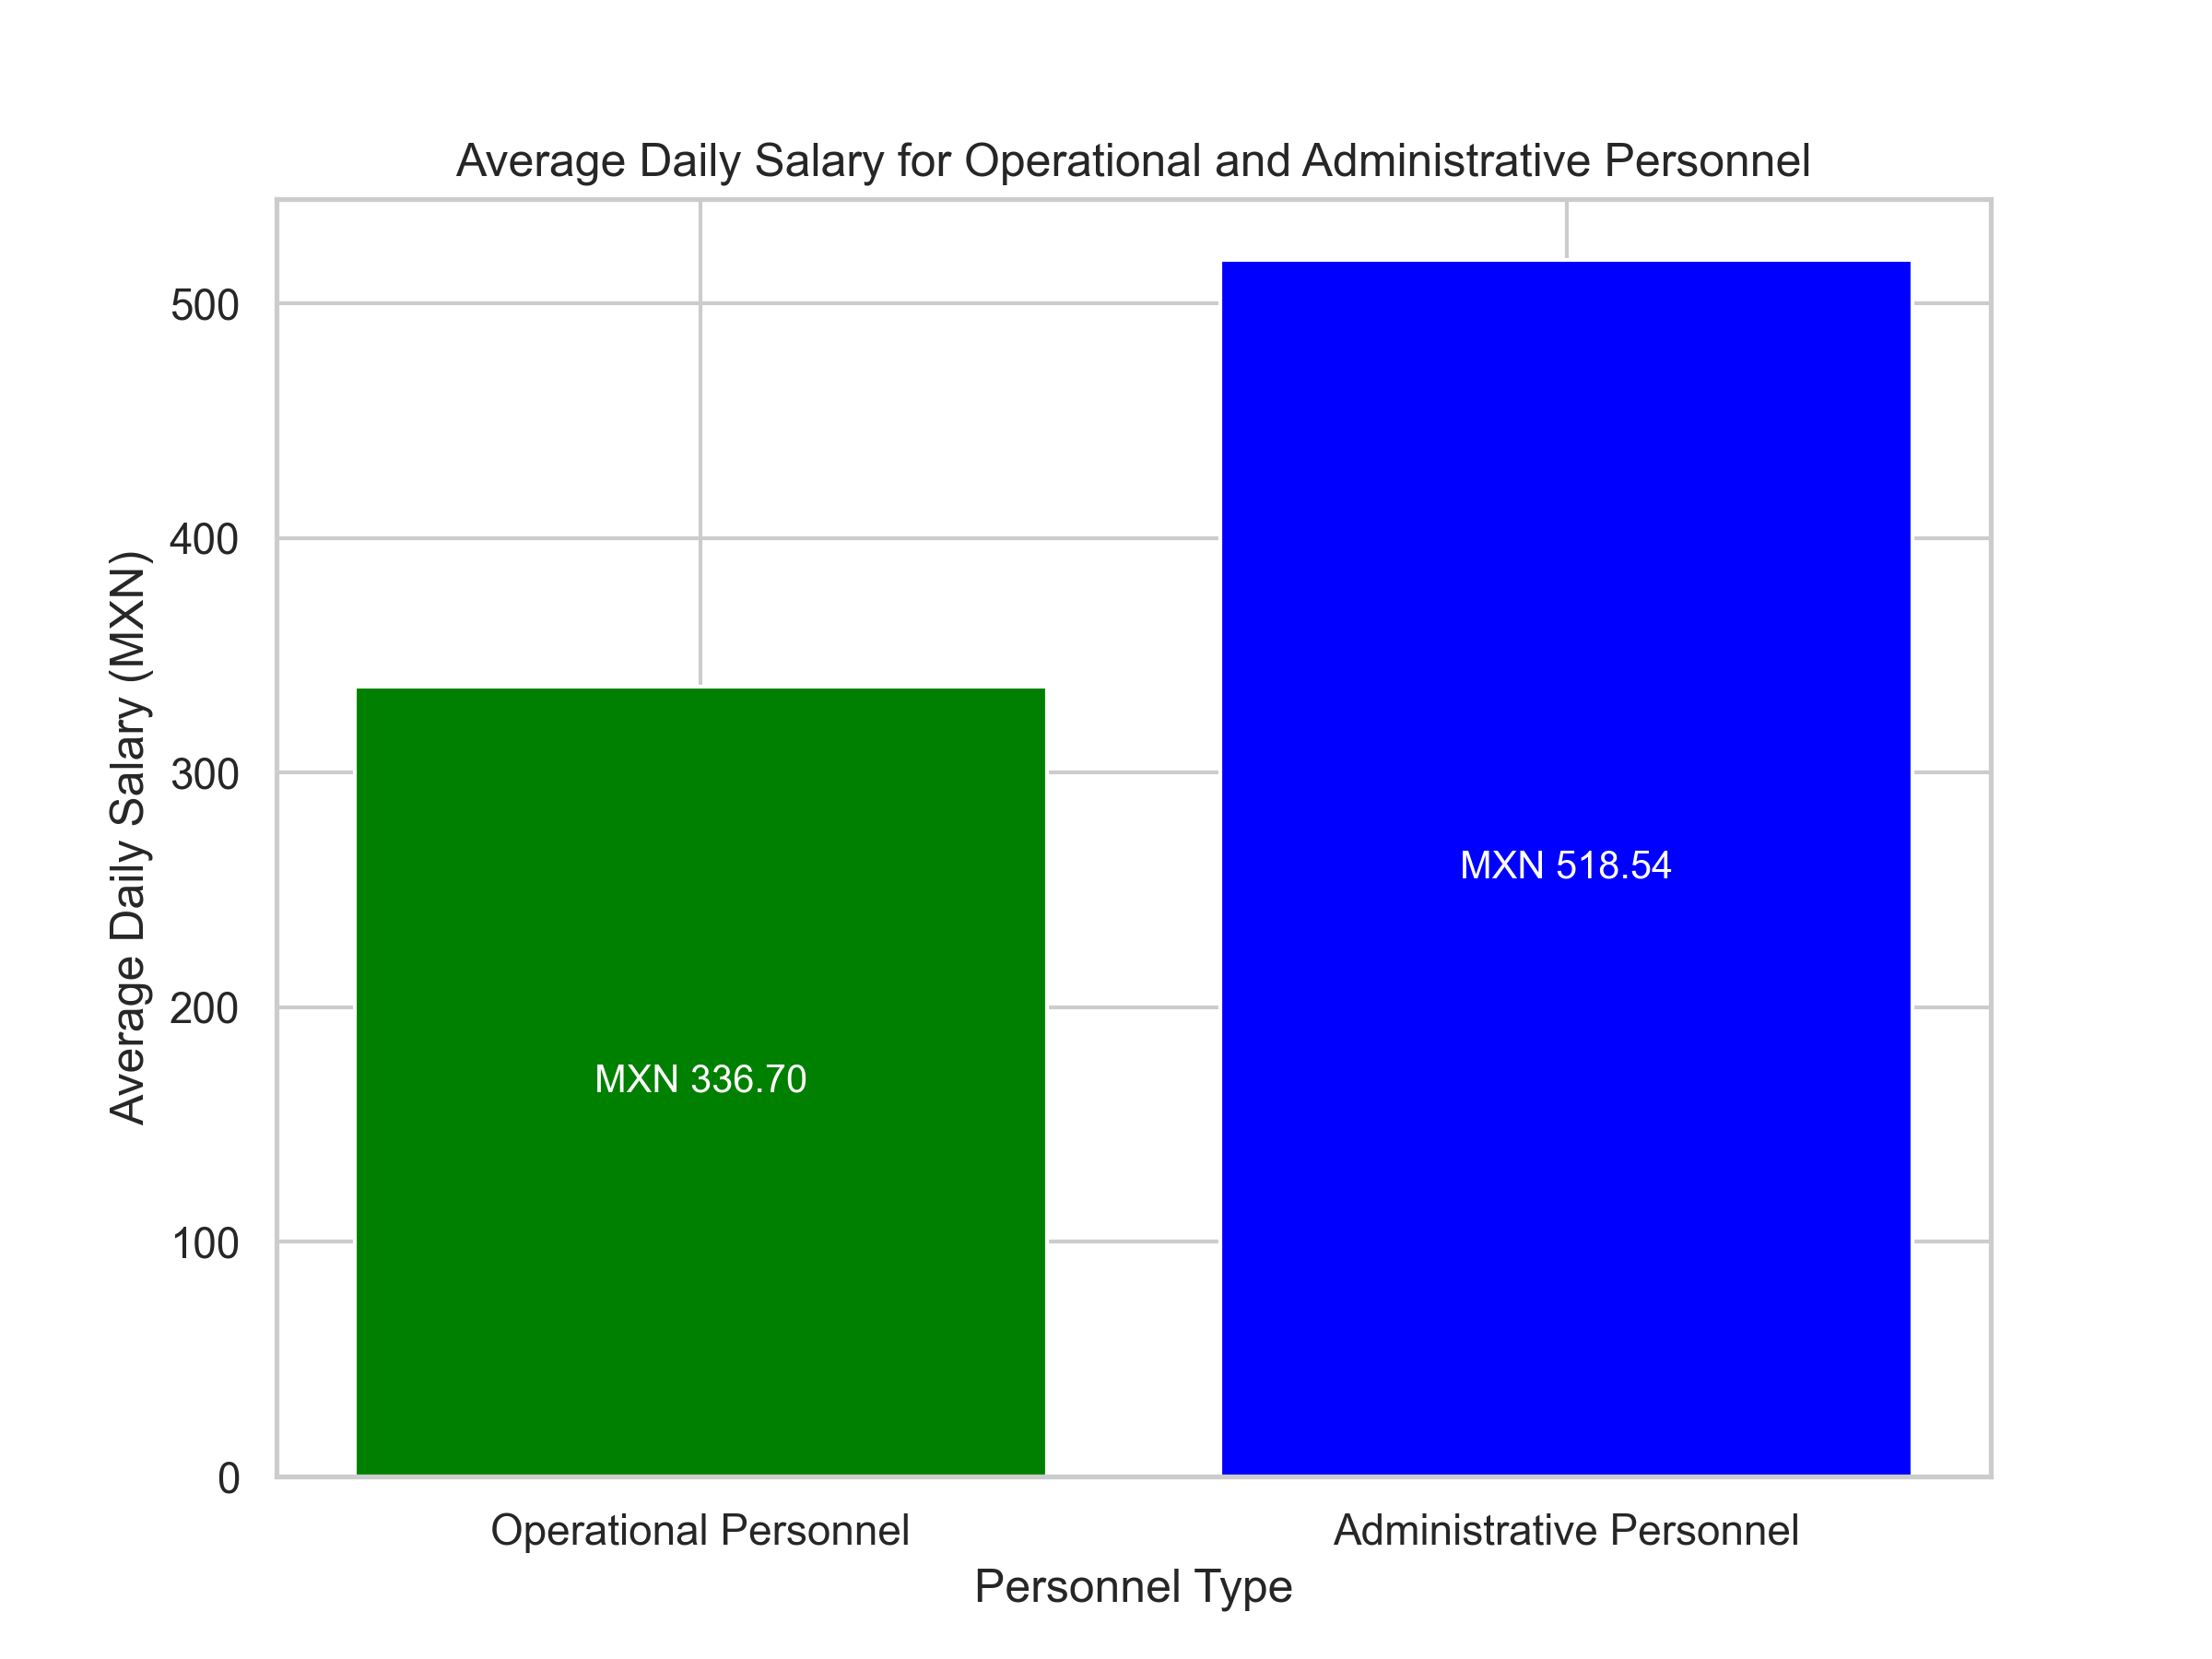
Average Daily Salary Analysis

Slide 5
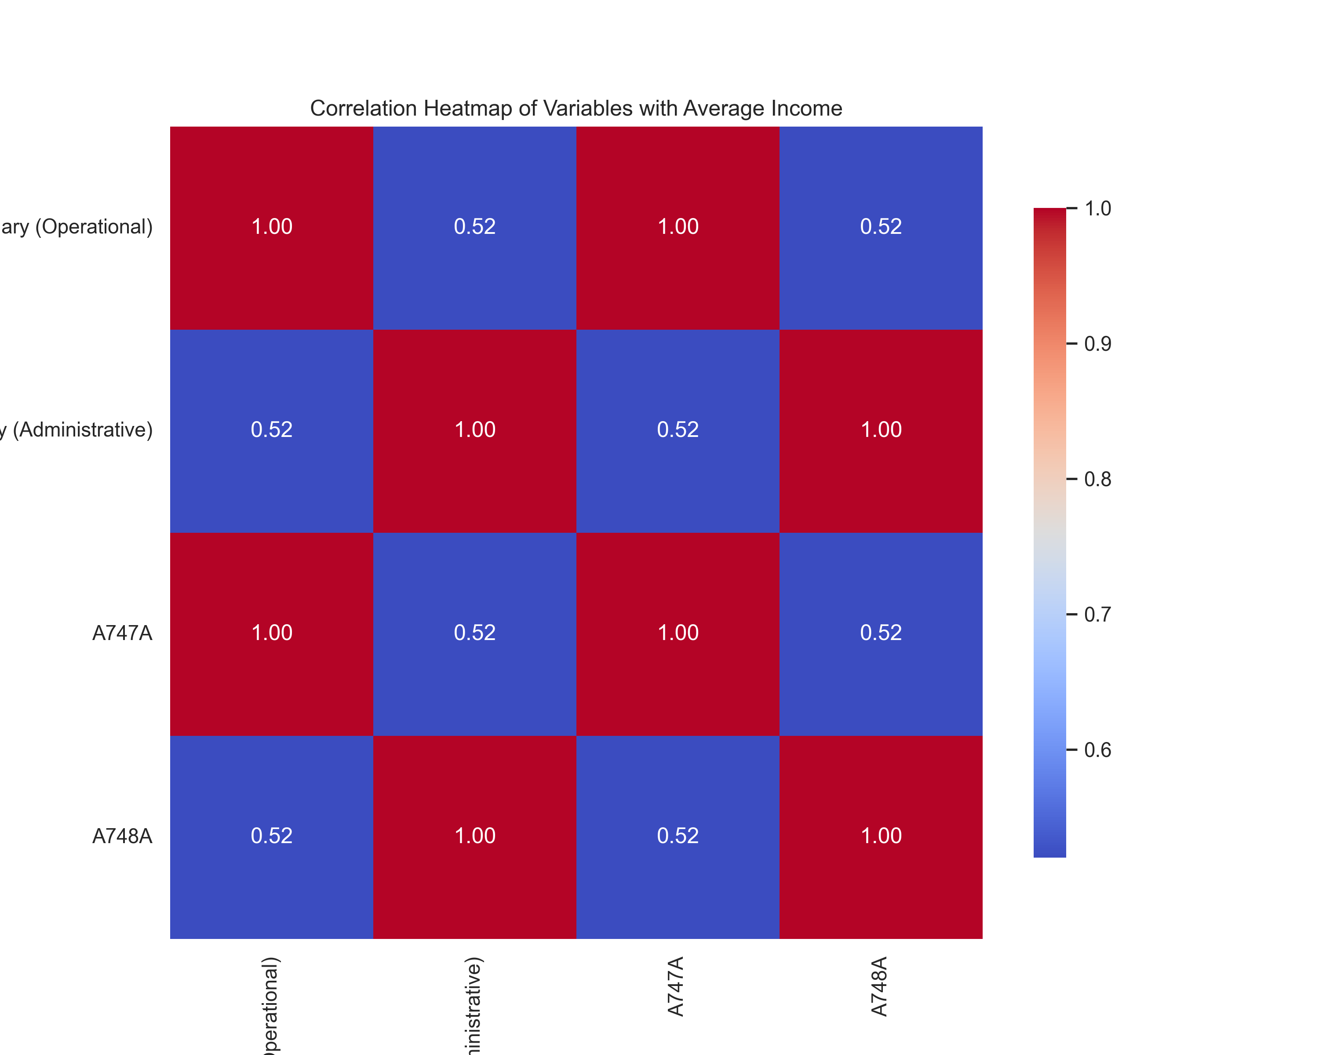
Correlation Analysis

Slide 6
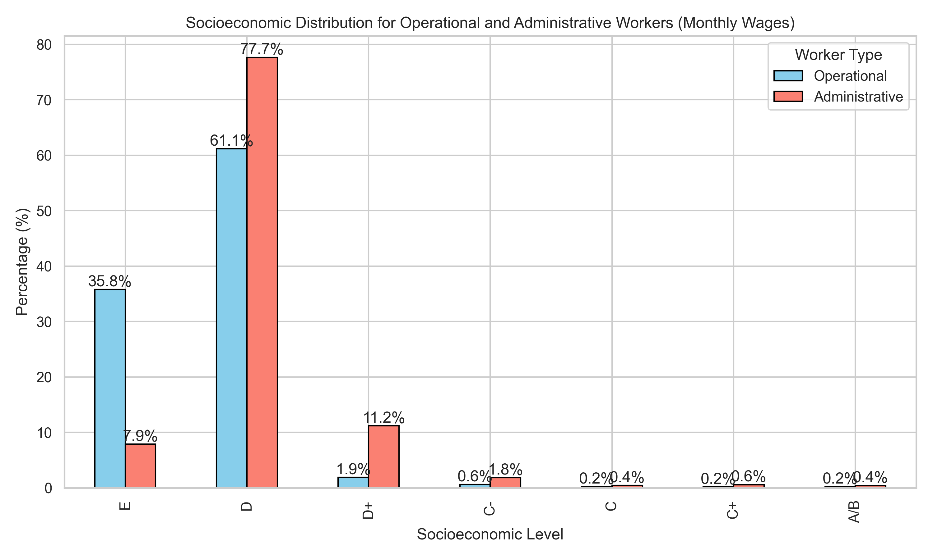
Socioeconomic Distribution

Slide 7
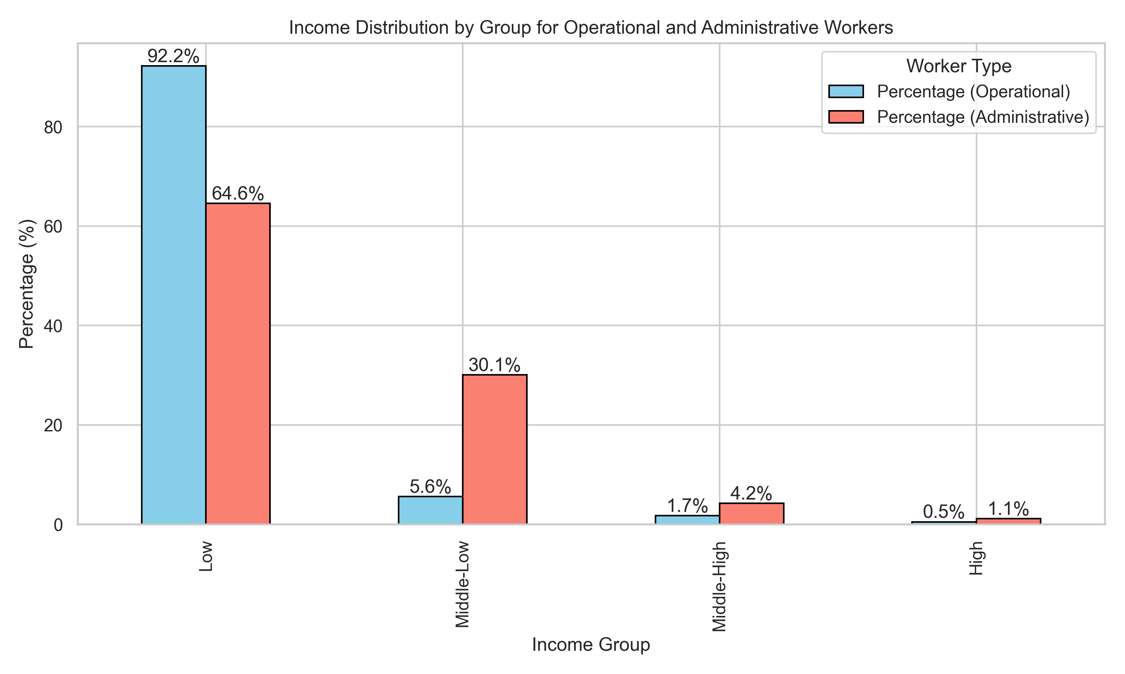
Income Distribution by Group

Slide 8
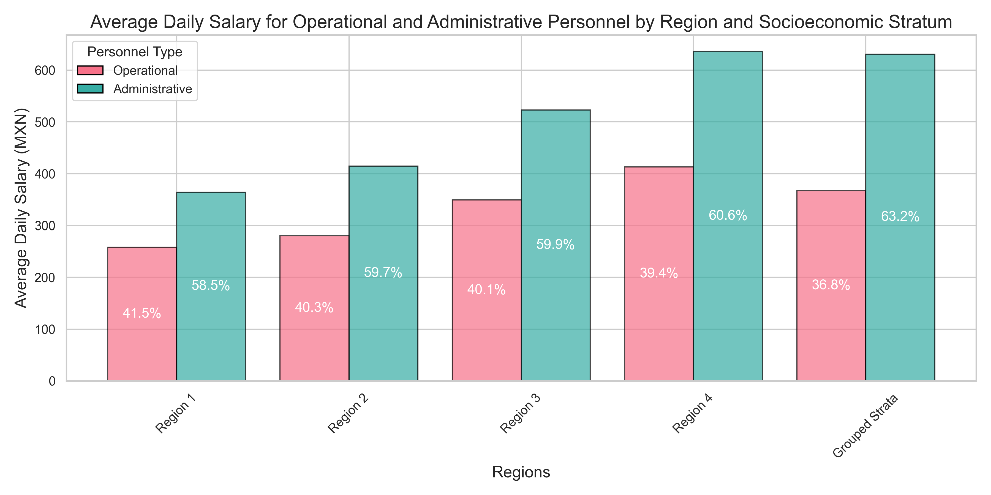
Income Distribution In Each of 4 Region

Slide 9
Summary of Average Monthly Income
1. The analysis reveals disparities in average monthly income across socioeconomic levels:
- A/B shows the highest average income.
- E has the lowest average income, indicating economic challenges.
- D and D+ levels comprise a significant portion of the workforce.

Slide 10
Average Monthly Incomes by Socioeconomic Level
Average Monthly Incomes (MXN) and % of People:
• E: Operational 35.8%, Administrative 7.9%
• D: Operational 61.1%, Administrative 77.7%
• D+: Operational 1.9%, Administrative 11.2%
• C-: Operational 0.6%, Administrative 1.8%
• C: Operational 0.2%, Administrative 0.4%
• C+: Operational 0.2%, Administrative 0.6%
• A/B: Operational 0.2%, Administrative 0.4%

Slide 11
Conclusion
It can be said that mostly administrative employee earn more compare to operational employees.
It is same for all regions across the Mexico.
So we can assume that occupation is main variable for higher income.

Slide 12
Additional Considerations
If I had time then I would try to prepare better graphs and try to analysis data in better way since It took so much time to translate data from Spanish to English.
I would have used more graphs and would have tried to find better correlations between variables.

