Slide 1
MILLSORPT-MILL SCALE TO METAL FREE
ID: 2011007
2011008
2011009
2011010
2011011
2011012
Presented by group-02

Slide 2



Introduction
TRIPLE WASTE TREATMENTS
Industrial waste, such as ferrous mill scale from steel manufacturing, poses serious environmental challenges. Our capstone project converts this waste into effective adsorbents for purifying water contaminated with heavy metals. By combining materials science with sustainable engineering, we deliver a cost-effective, eco-friendly approach to water pollution.
1
2
3
→
→
Mill Scale to Adsorbent
Purifying Contaminated Water
Heavy Metal to Resource
Reclaimed ferrous mill scale is processed into a low-cost, high-capacity adsorbent material.
The adsorbent captures heavy-metal ions, cleaning polluted water through adsorption.
Captured metals are recovered and returned as a reusable resource, closing the loop.

Slide 3
Methodology
Steps of our capstone project:
Collected mill scale.
Performed an XRD test (at the Atomic Energy Commission) to identify the phases in our mill scale.
In a 500mL glass beaker, 30g of mill scale powder was treated with 150mL of concentrated H₂SO₄.
We heated the mixture on a hot plate until all the precipitate formed and settled firmly at the bottom of the beaker.
We separated the remaining H₂SO₄ by decantation, transferred the precipitate into a porcelain bowl, and dried it until the H₂SO₄ evaporated and the precipitate became dry.
Then we dissolved the precipitate in water. By slightly heating, the remaining precipitate dissolved (180mL of water was added).

Slide 4
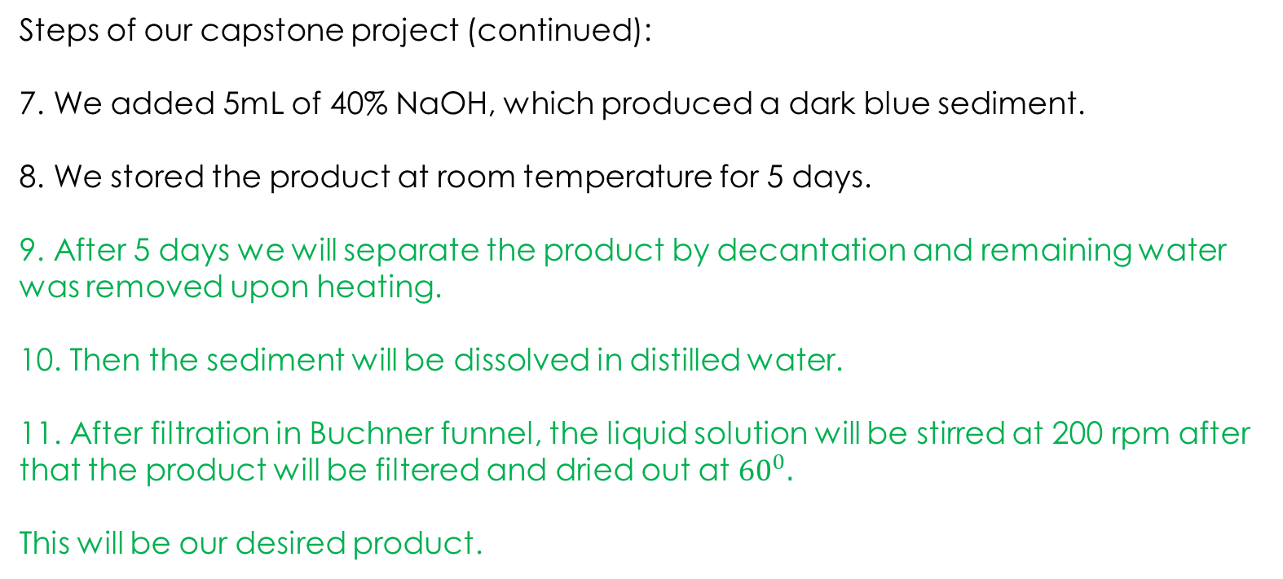
Steps of our capstone project (continued): 7. We added 5mL of 40% NaOH, which produced a dark blue sediment.
8. We stored the product at room temperature for 5 days.
9. After 5 days we will separate the product by decantation and remaining water was removed upon heating.
10. Then the sediment will be dissolved in distilled water.
11. After filtration in Buchner funnel, the liquid solution will be stirred at 200 rpm after that the product will be filtered and dried out at ${60}^{0}.$
This will be our desired product.

Slide 5
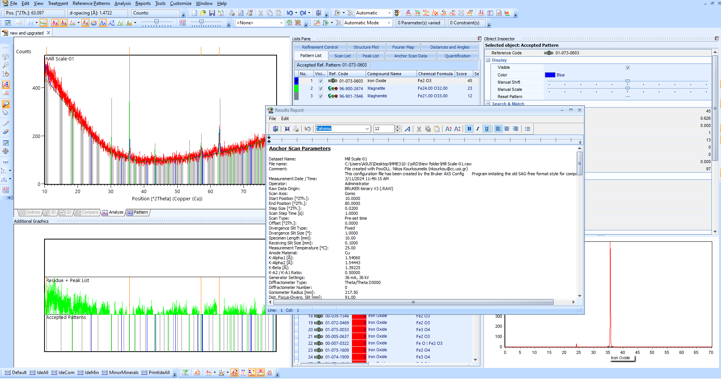

Slide 6
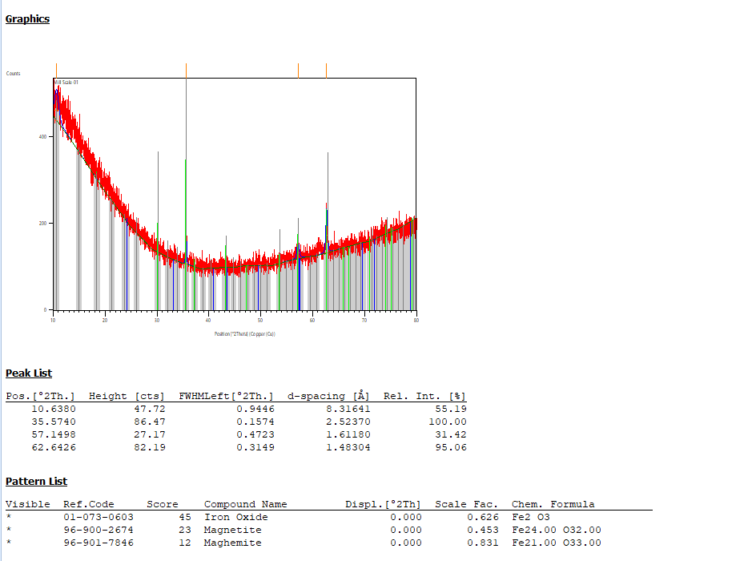

Slide 7
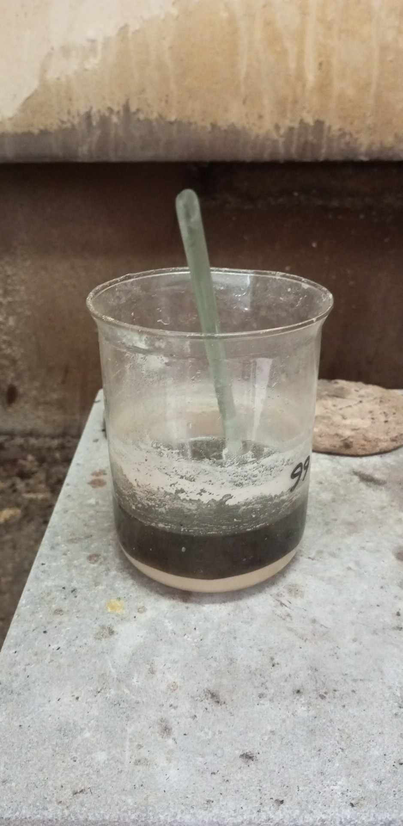
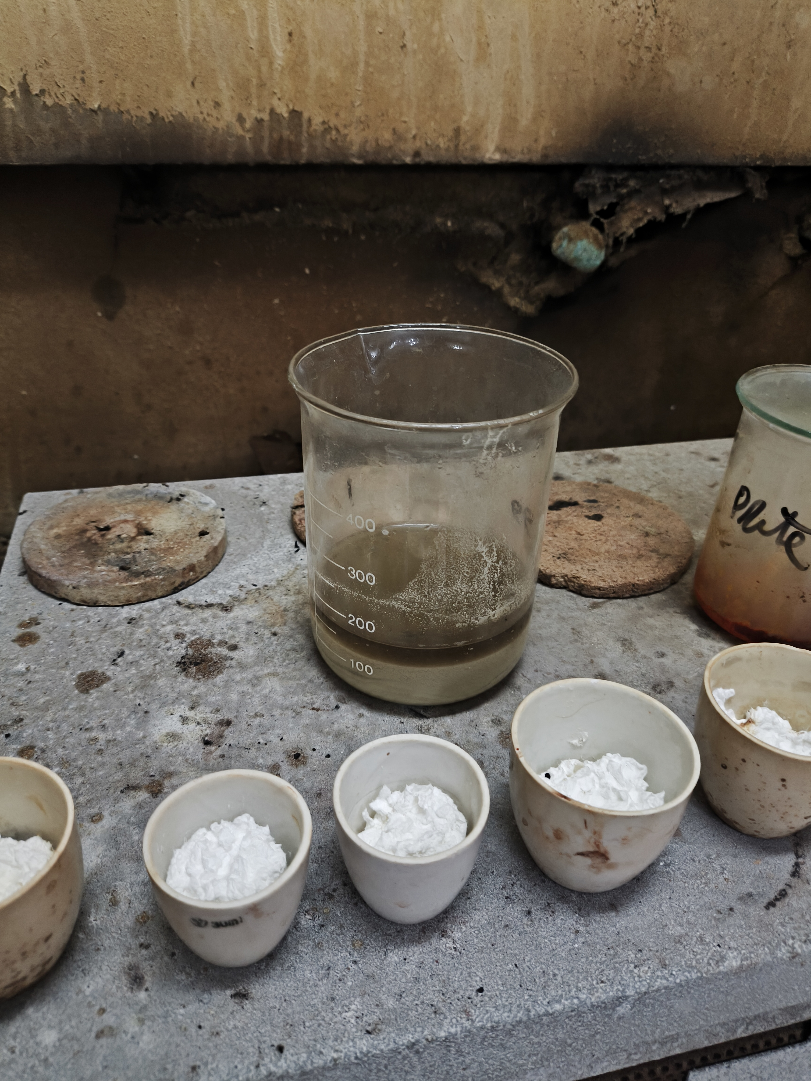

Slide 8
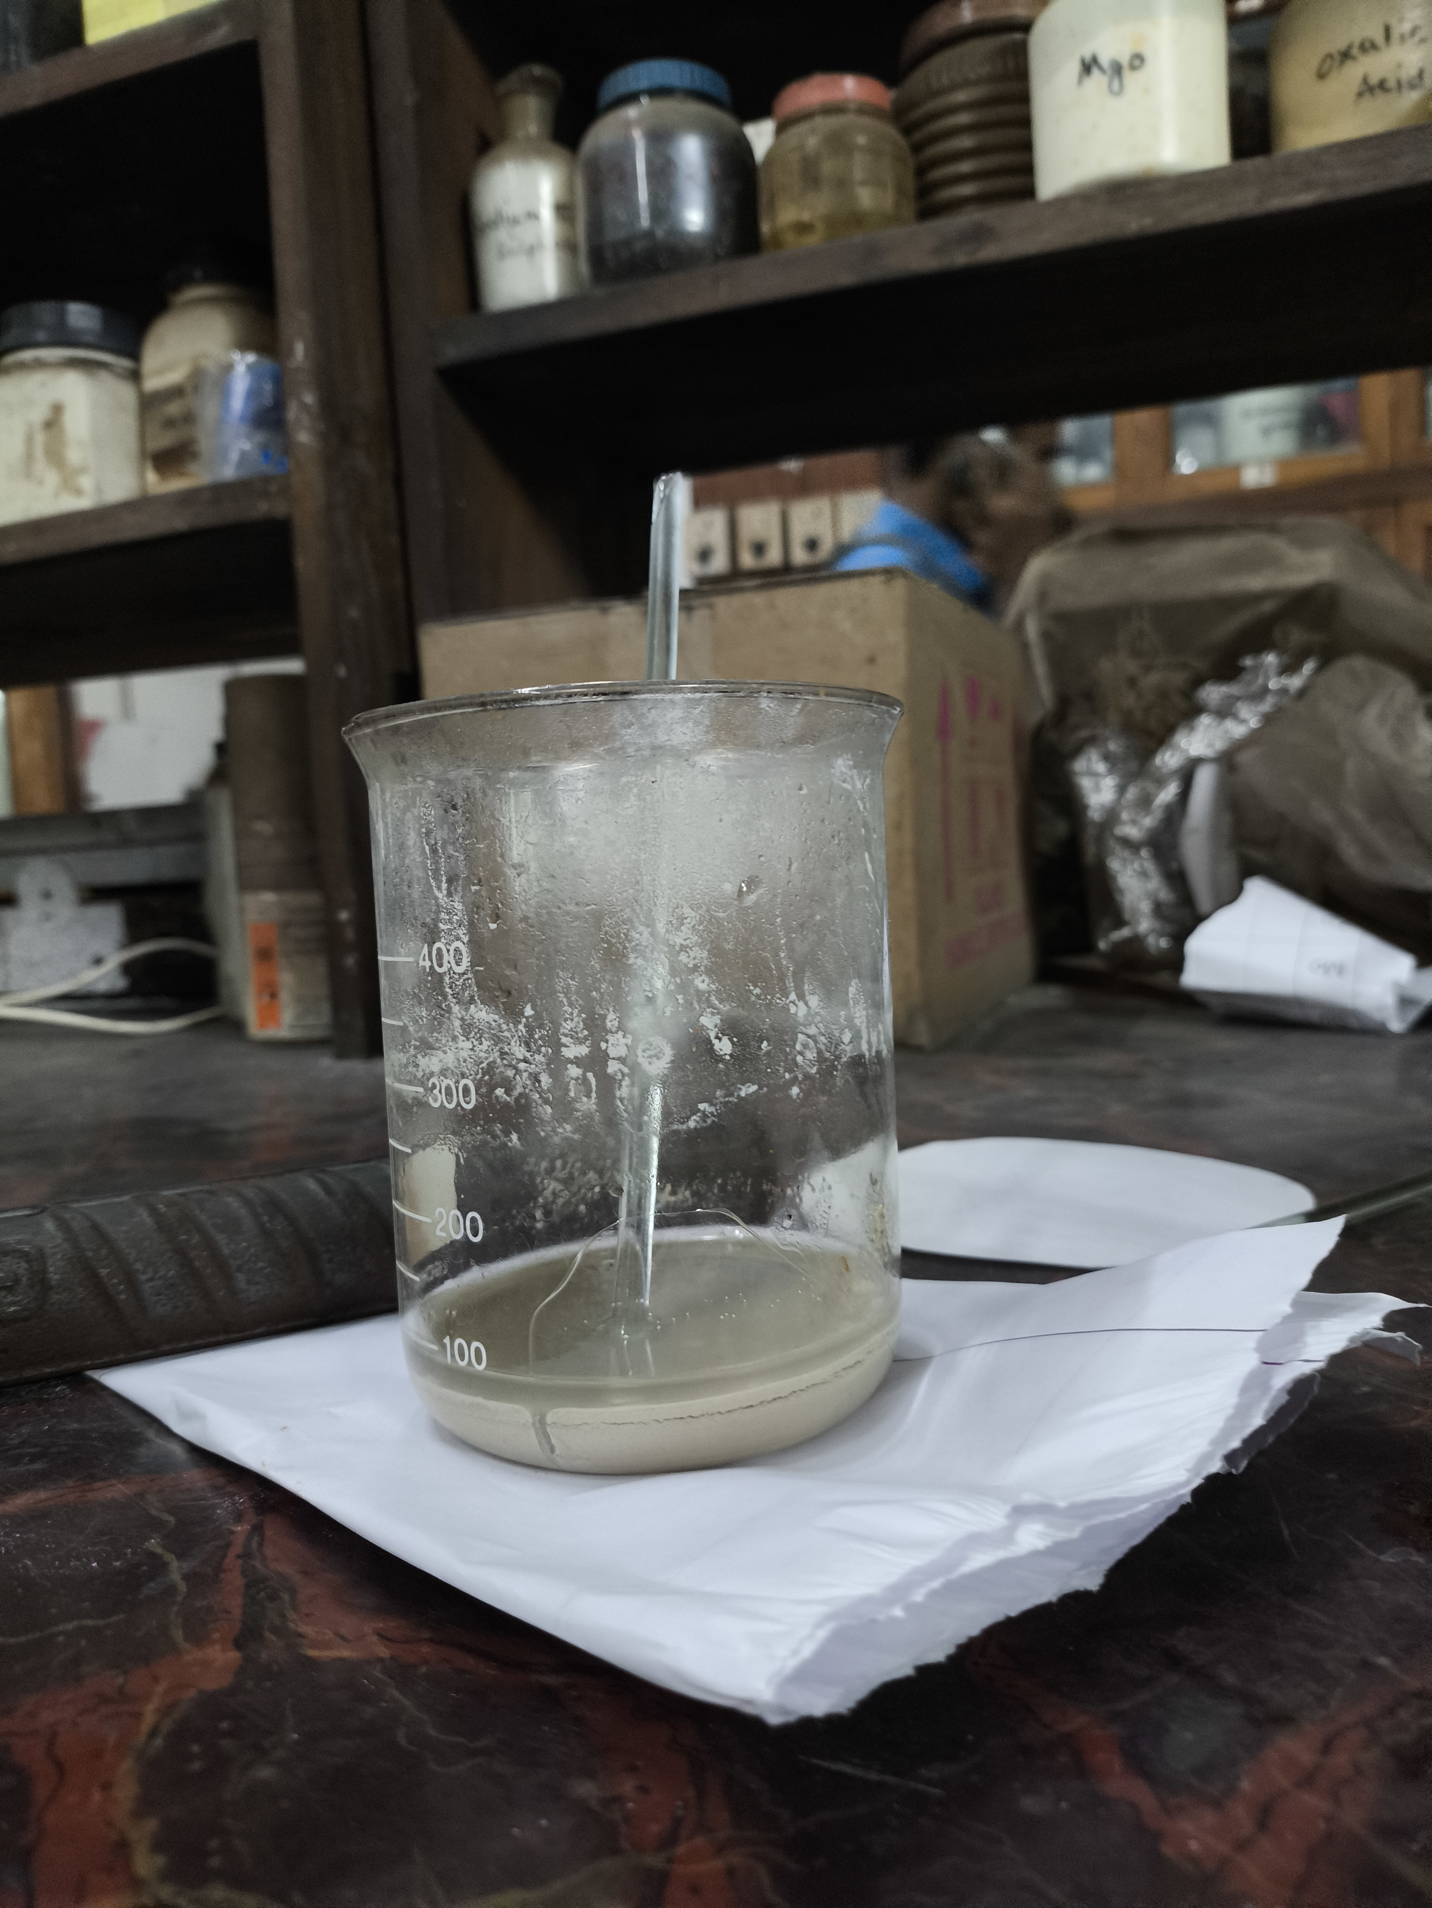

Slide 9
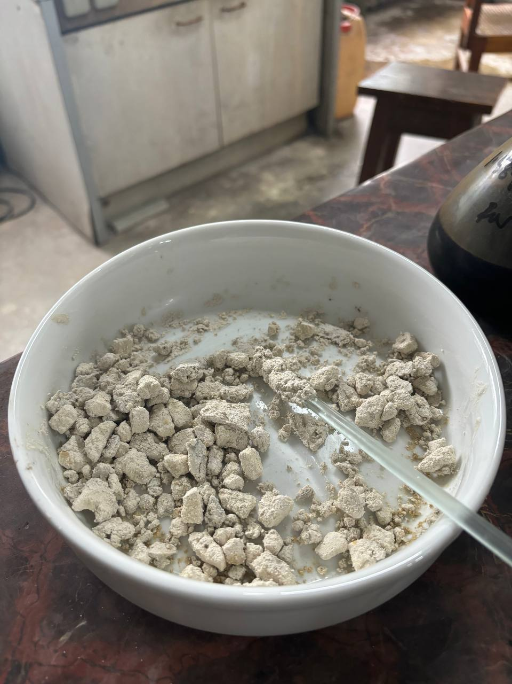

Slide 10
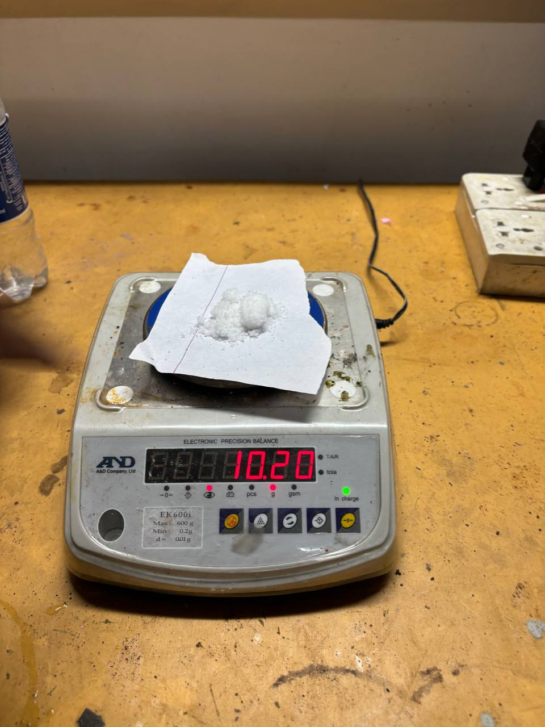
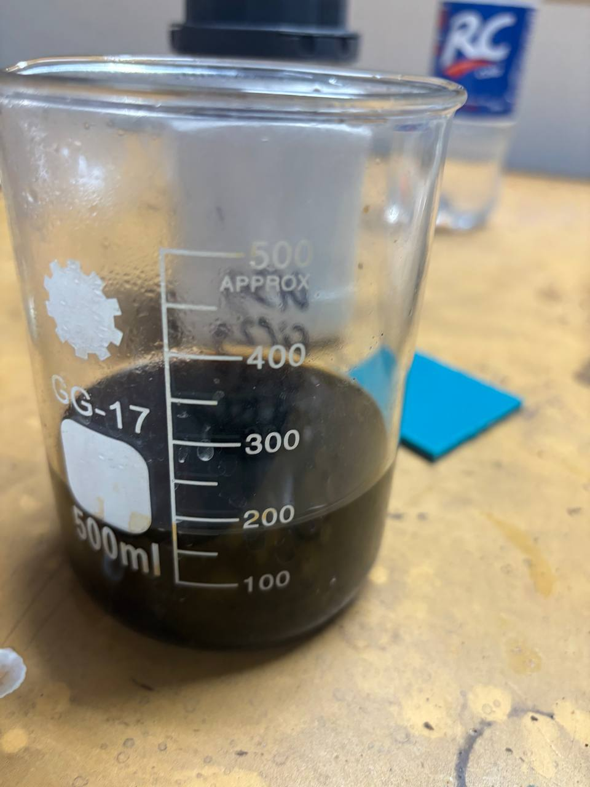

Slide 11
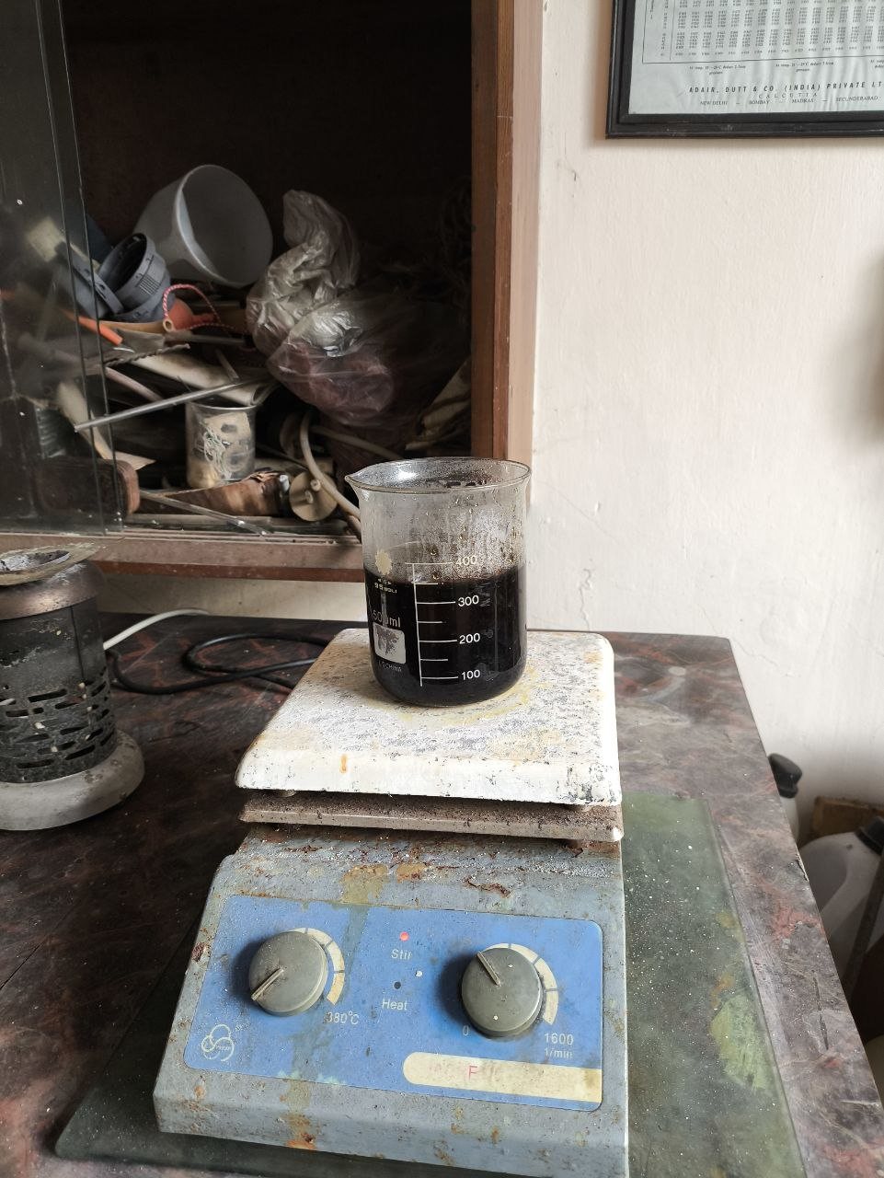

Slide 12
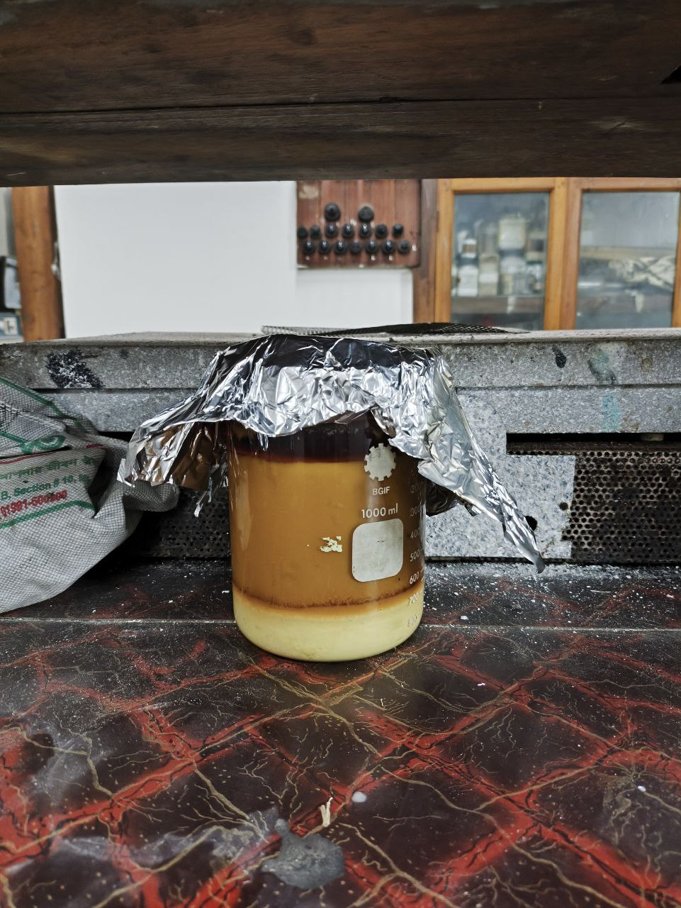
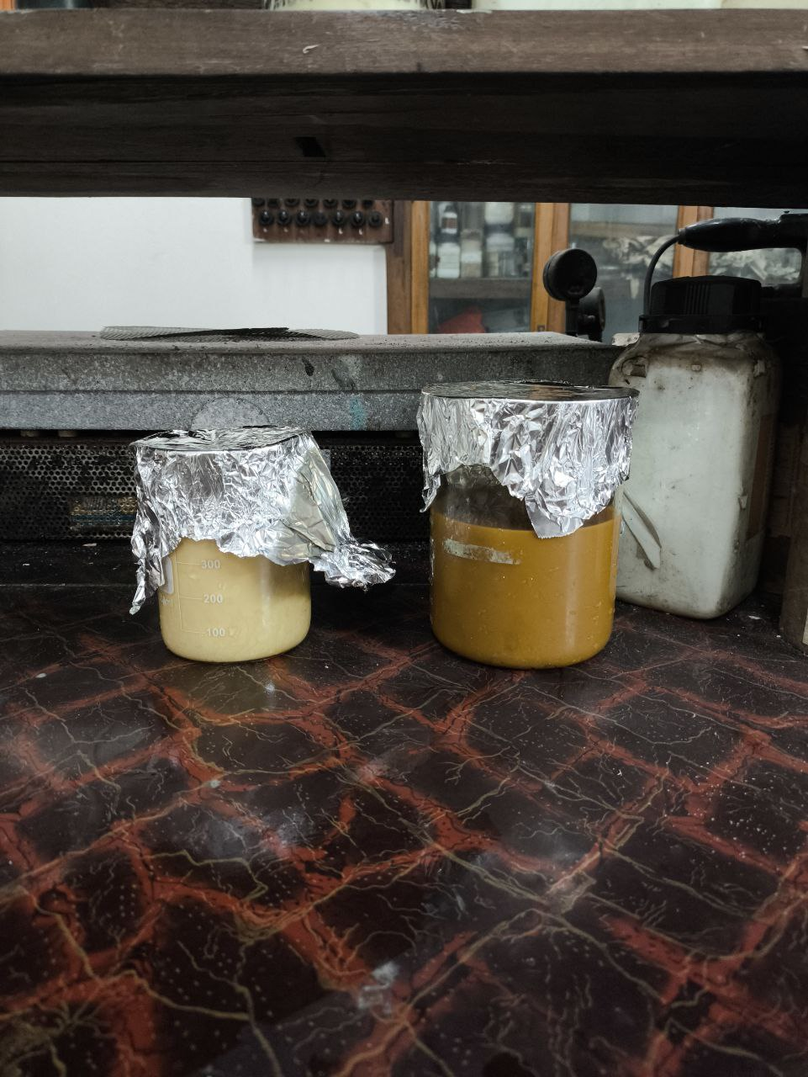

Slide 13
MILLSORPT-MILL SCALE TO METAL FREE SET UP
Presented by group-02

Slide 14
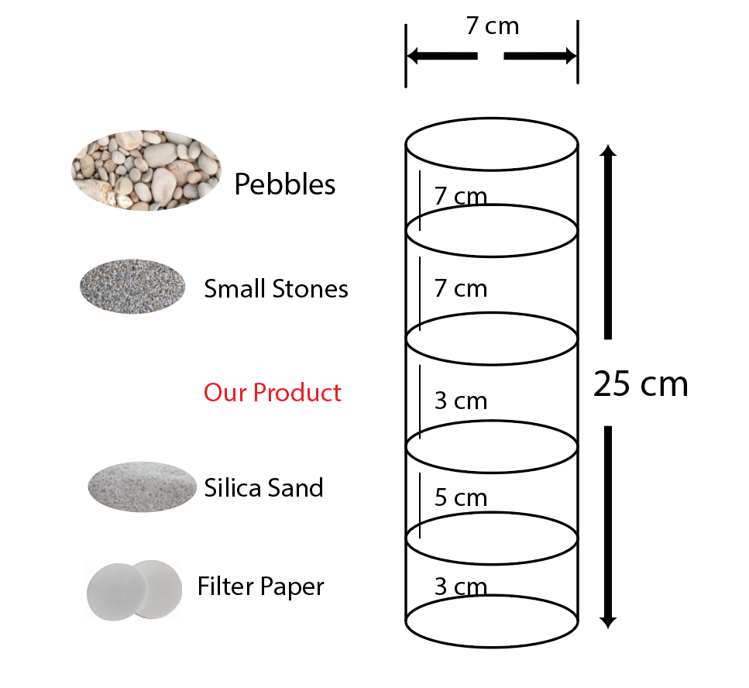
Charcoal
Design of our Filter

Slide 15
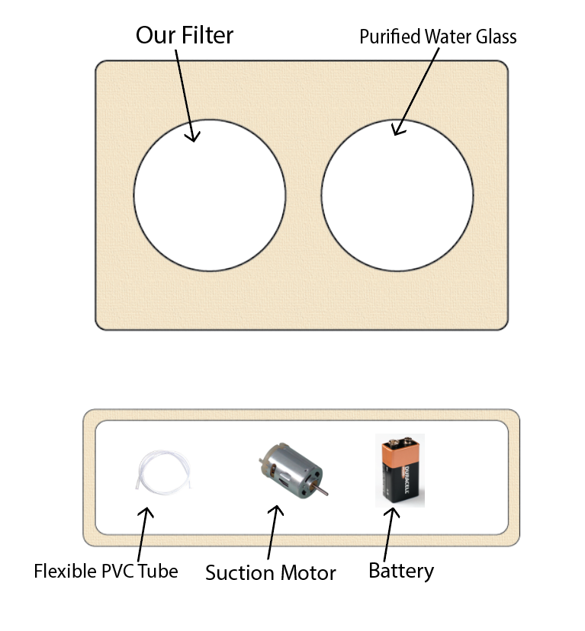
5 inches

Slide 16
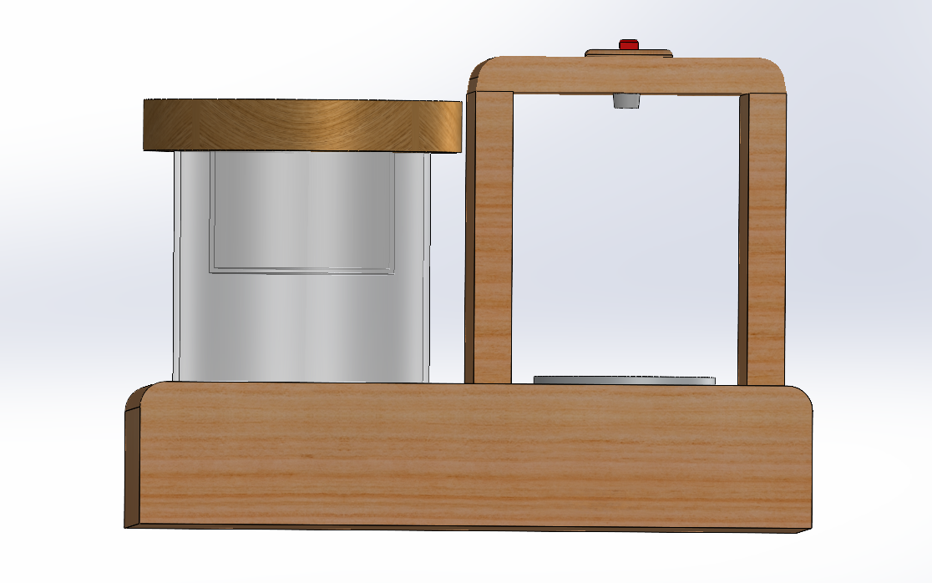
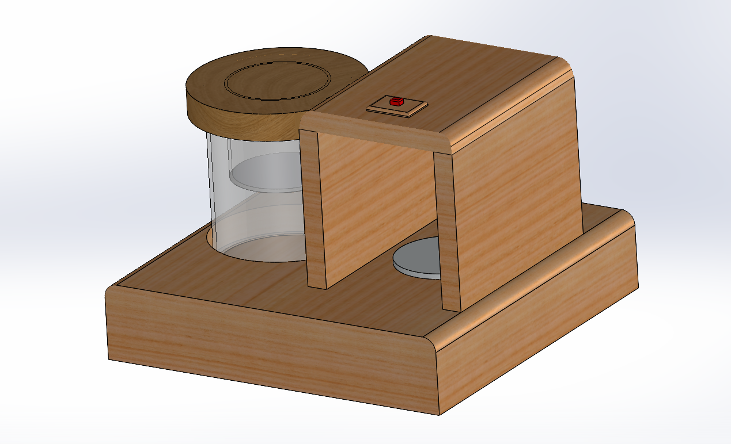
Purified Water Storage Compartment
Filter
8 inches
10 inches
17 inches

Slide 17
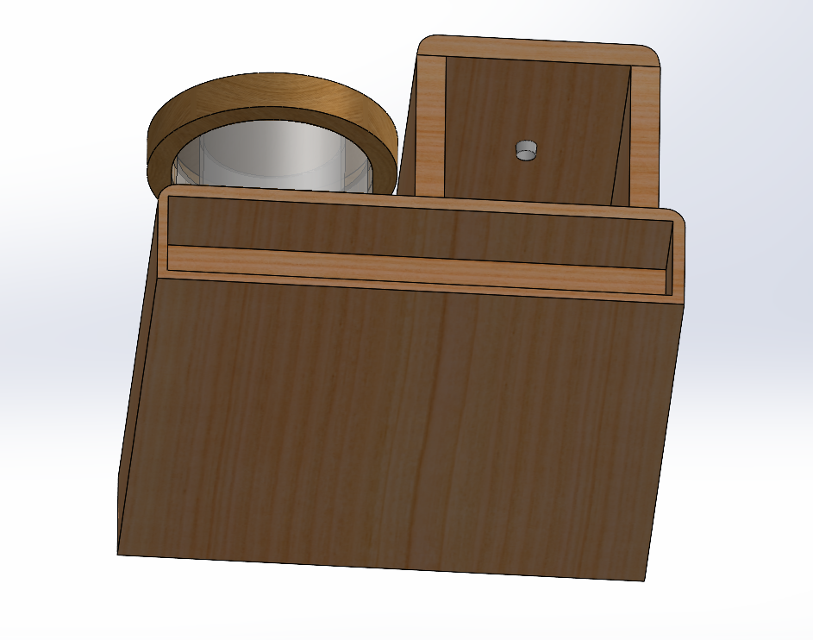
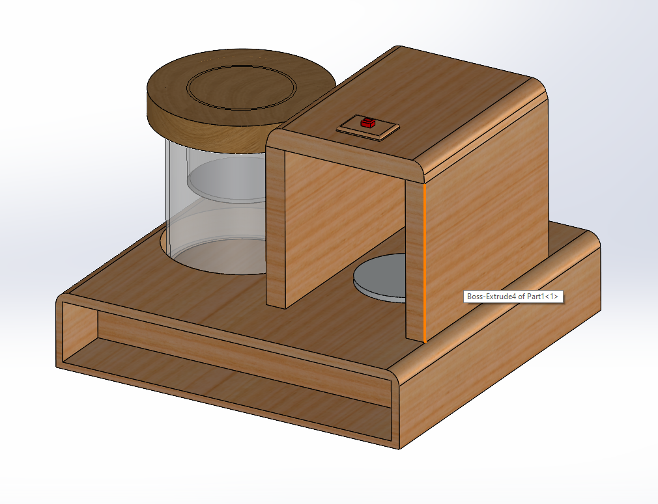
PVC tube ending path
Switch
5 inches

Slide 18
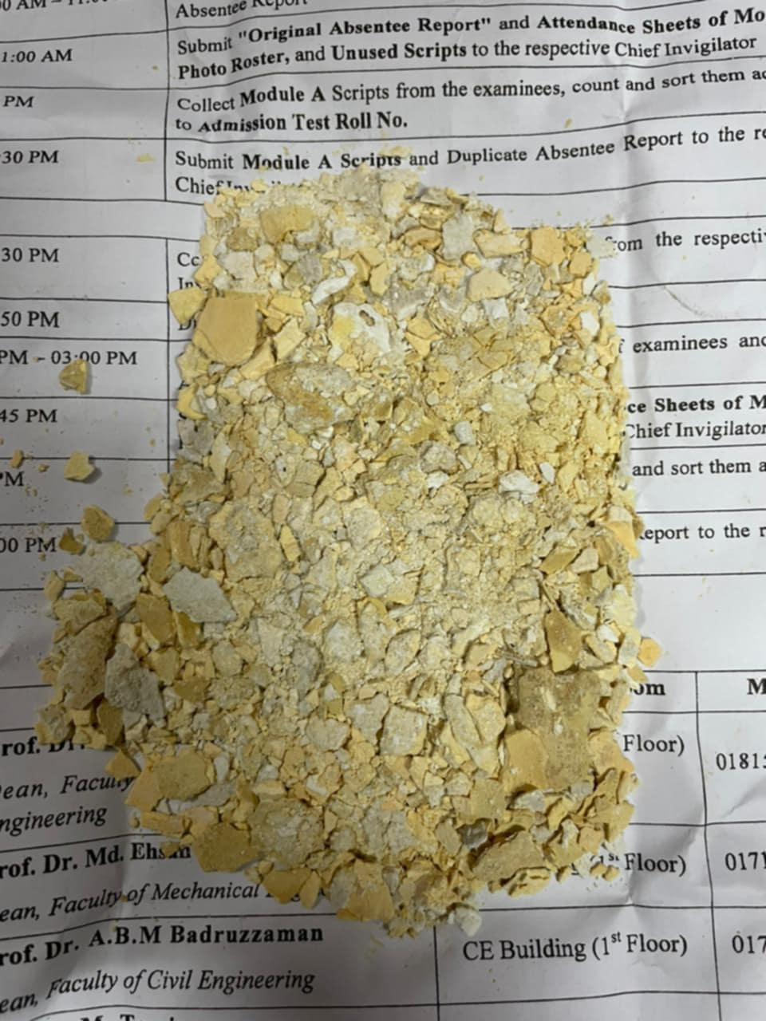
Our Product

Slide 19
Characterization Test of Our Product
Presented by group-02

Slide 20
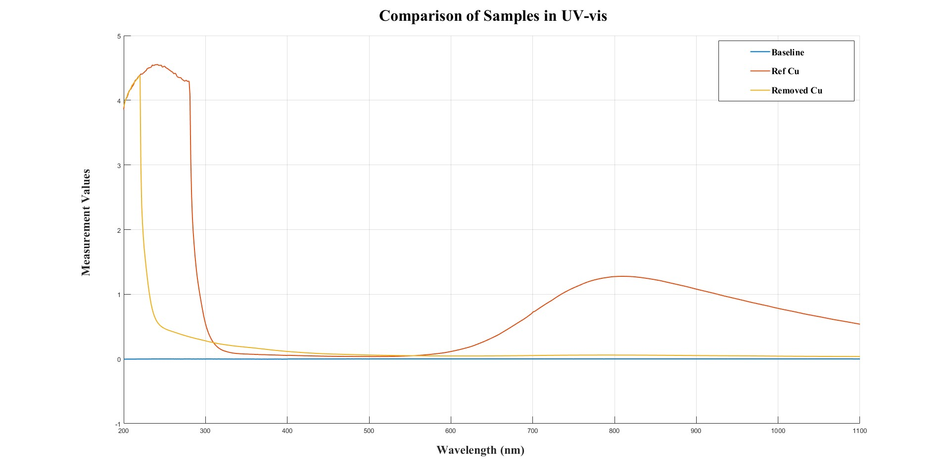
UV vis of Cu

Slide 21
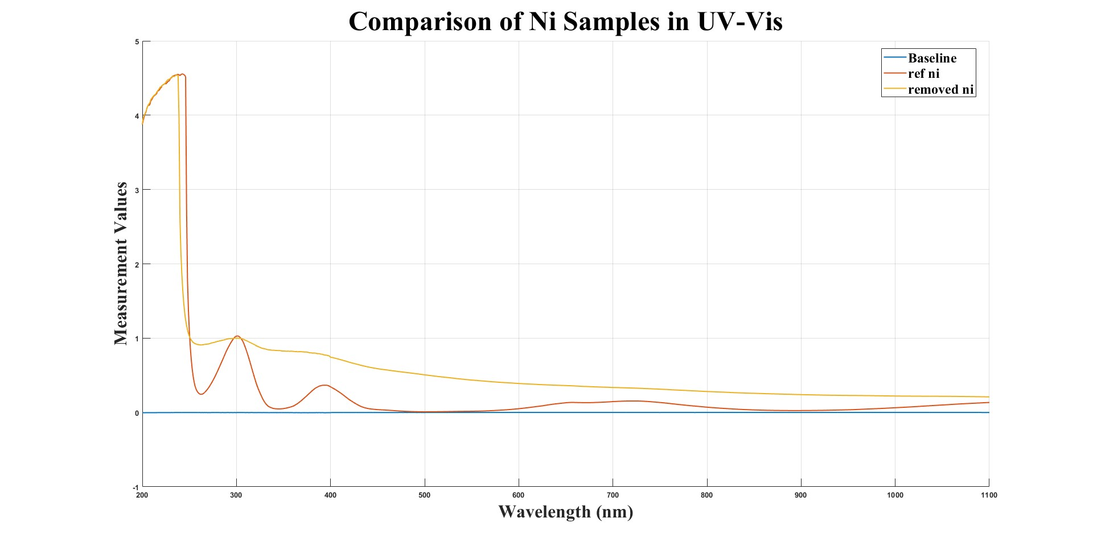
UV vis of Ni

Slide 22
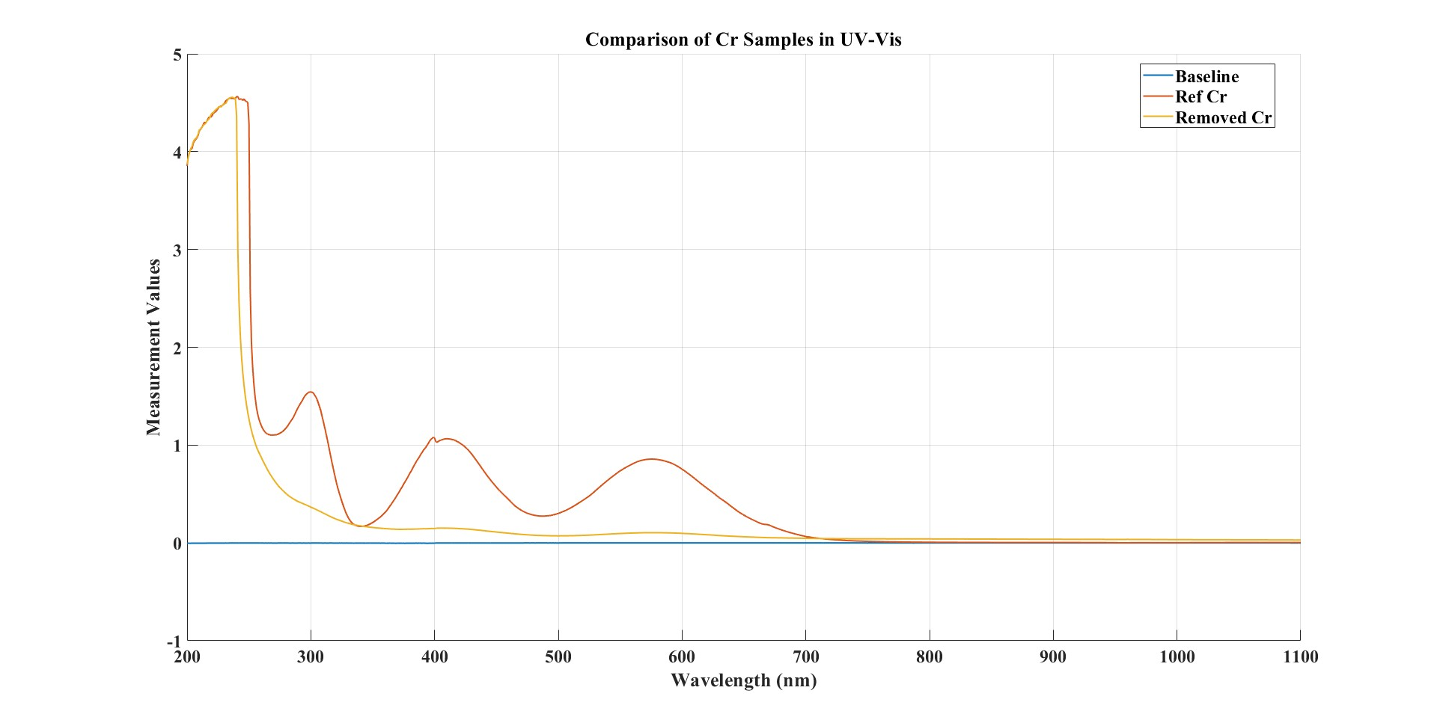
UV vis of Cr

Slide 23
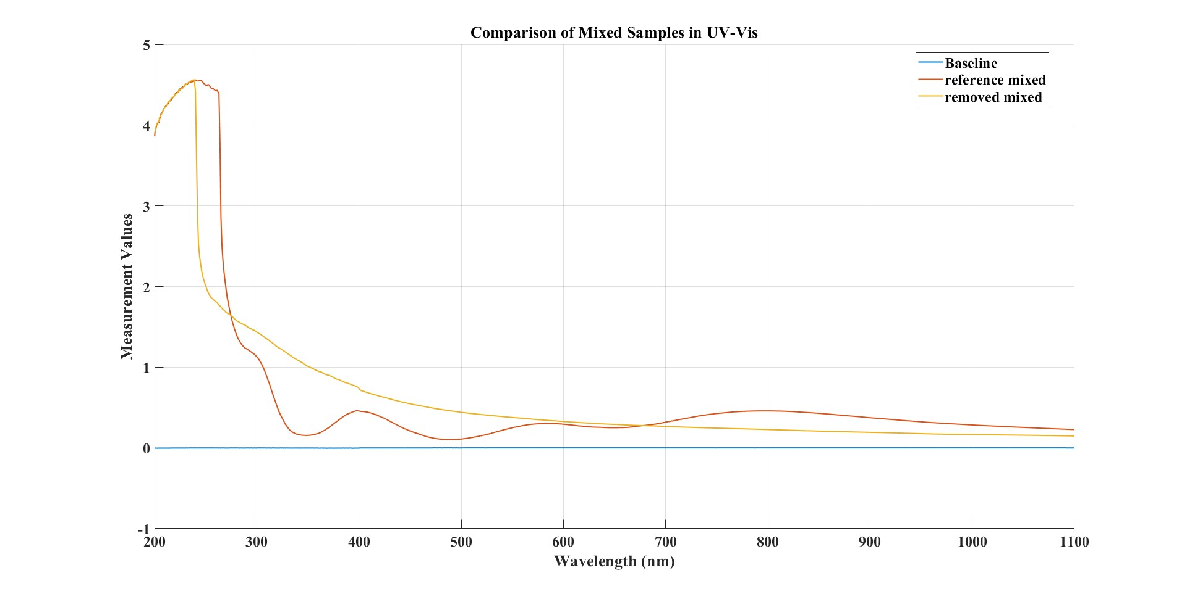
UV vis of Mixed sample

Slide 24
Calculations of AAS
For Cr:
Weight = 0.3 gm
Volume = 200 mL
PPM = (1500-6.641) PPM= 1493.359ppm
After treatment, Remained Cr in mixed sample= (162.509-6.641) ppm= 155.868ppm
After treatment, Remained Cr in individual sample= (355.836-6.641) ppm= 349.195ppm
So, Removed Cr in individual sample= 76.62%
Removed Cr in mixed sample= ~90%
---
For Cu:
Weight = 0.73 gm
Volume = 200 mL
PPM Calculation:
PPM = 3650 PPM – 6.63 PPM = 3643.37 PPM
After treatment (individual):
PPM = Sample – Blank
= 998.35 – 6.63
= 991.72 PPM
Removed Cu= 72.78%
After treatment (mix sample):
PPM = 407.16 – 6.63 PPM
= 400.53 PPM
Removed Cu= 89%

Slide 25
Continued
For Fe:
Fe came into treated water after treatment:
PPM = 42.11 PPM
---
For Ni (in mixed sample):
Weight = 2 gm
Volume = 200 mL
Before treatment:
PPM = 10000 PPM – 23.23 PPM = 9976.77 PPM
After treatment:
PPM = Mix – Blank = 421.48 PPM
Removed Ni= 95.76%

