Slide 1

COURSE NO: MME314
COURSE TITLE: MECHANICAL BEHAVIOUR OF MATERIALS LABORATORY
COURSE TEACHER:
1. AHSIUR RAHMAN NIRJHAR
LECTURER
2. KOUSHIK ROY CHOWDHURY LECTURER

Slide 2
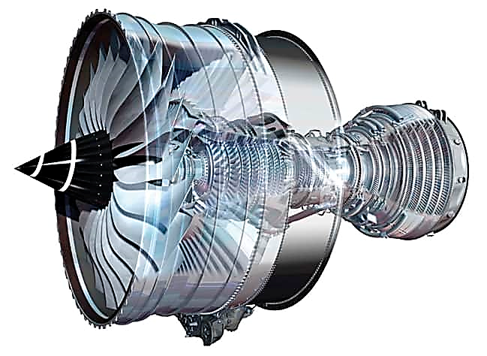
Creep Failure of Ni-Based Superalloy (K403)
Case Study of Creep Failure
Presented By
2011007-Hasan Al Banna
2011008-Mishal Islam Shely
2011009-Piyal Debnath
2011010-Joyita Talukder
2011011-Pritom Majumder
2011012-Swajun Majumder

Slide 3
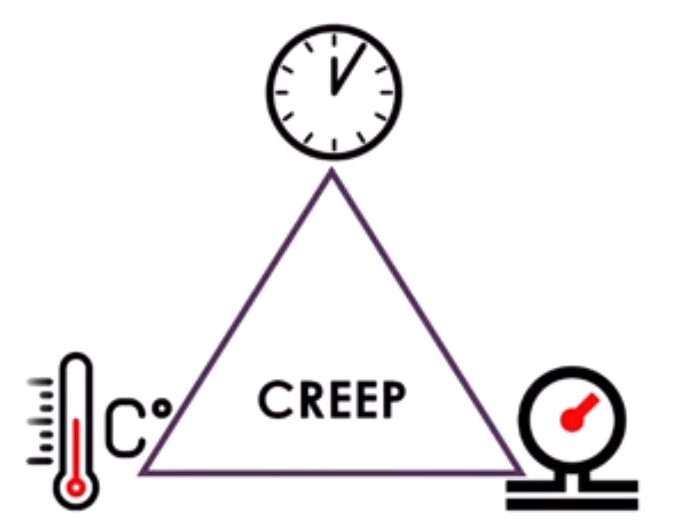
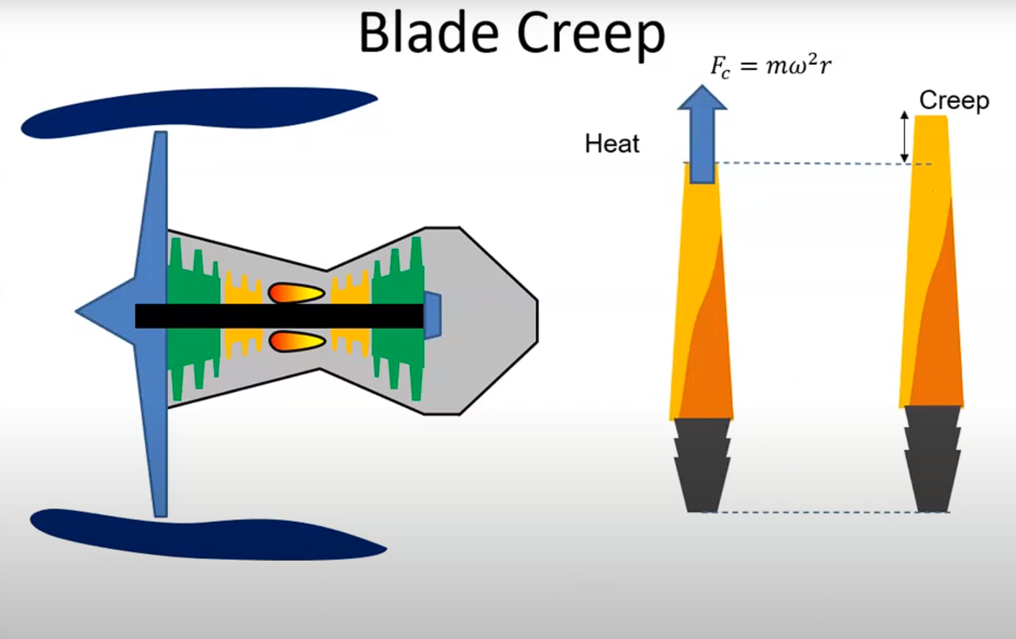
To Delve Deeper, Let's First Examine These Aspects.
What is creep?
How is it related to turbine blades?

Slide 4
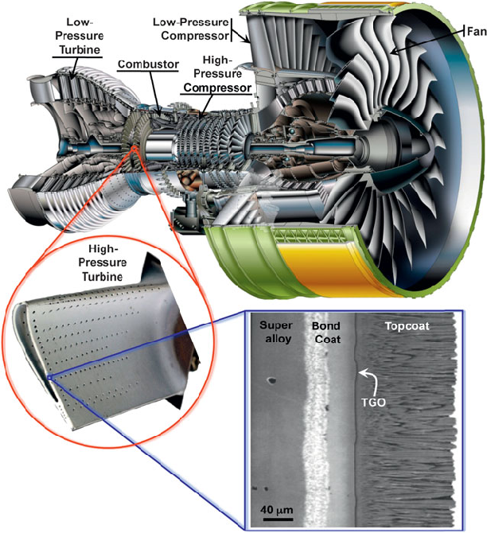
Examples of failures of Ni-based superalloy turbine blades. Such as aero-engine turbines, Nozzle guide vanes, Combustors.

Slide 5
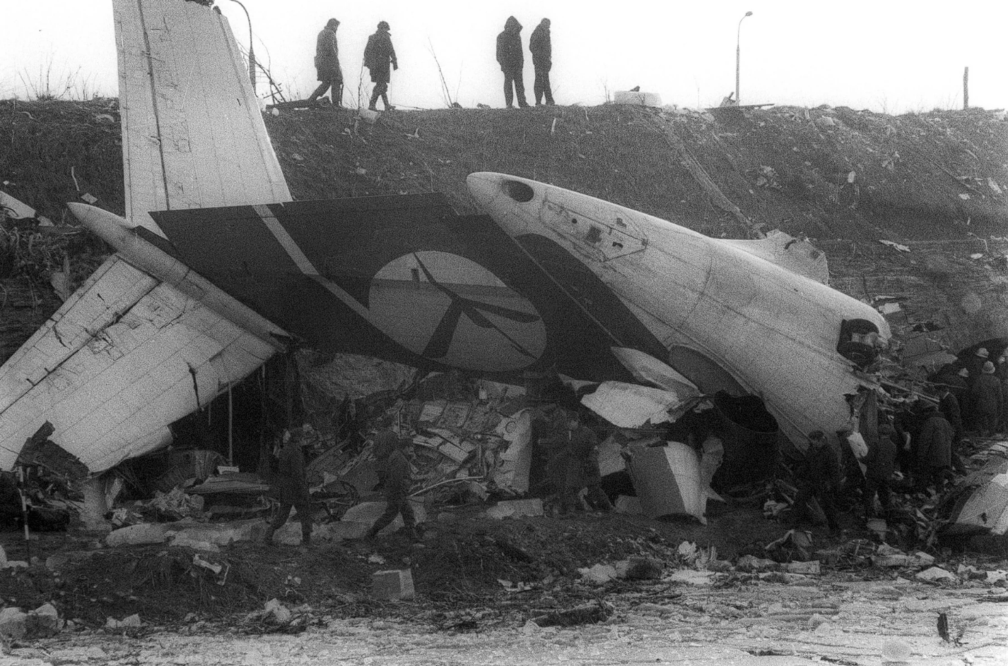
One of the examples
of aero-engine turbine
failure Is
LOT Polish Airlines Flight 5055 (1987)

Slide 6
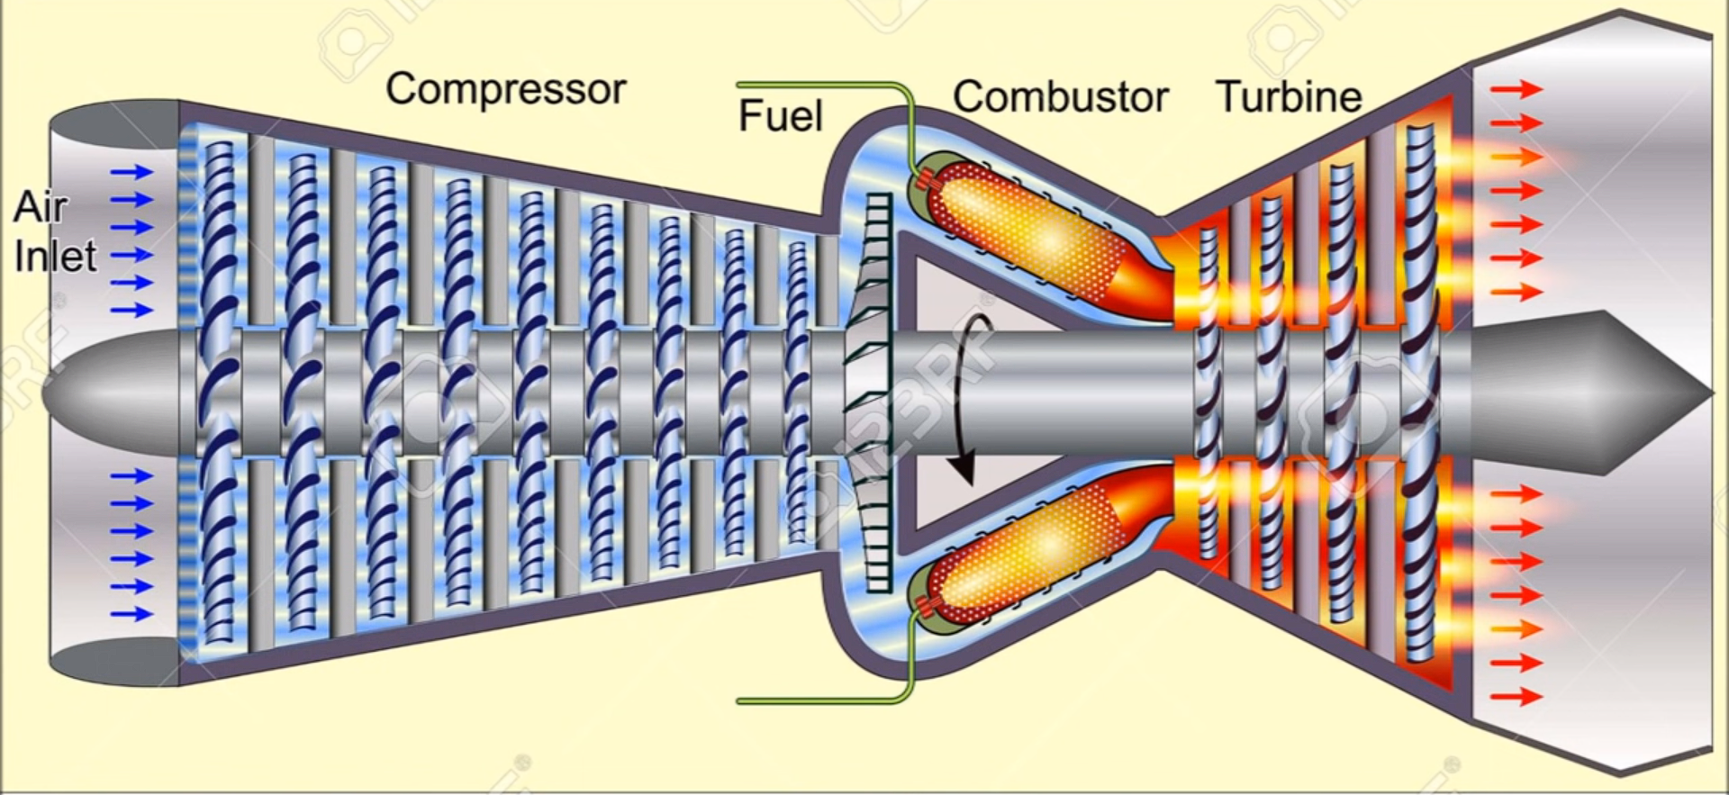
Relation of Turbine Blades and Superalloy
Air faces pressure while passing through the compressor
Due to fuel supply in combustor turbine blades go through heating process.
After certain time, creep develops in turbine blades.
Figure: Turbine blade

Slide 7
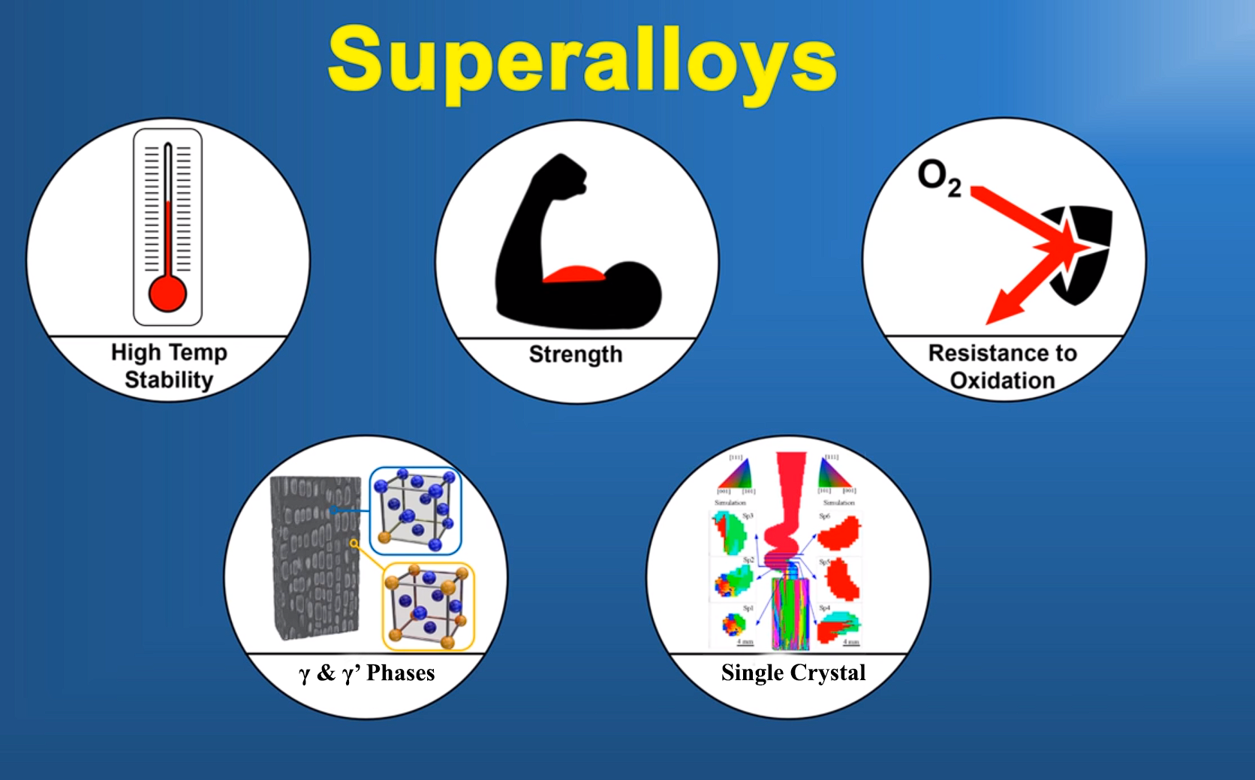

Slide 8
Composition of K403 Superalloy
Elements Contents
1)C 14%
2)Cr 11.32%
3)Co 5.41%
4)W 5.17%
5)Mo 4.24%
6)Al 5.32%
7)Ti 2.61%
8)Fe ≤1.0%
9)B 0.017%
10)Zr 0.6%
11)Ni Balance

Slide 9
In our case study we will explain:-
Qualitative and quantitative investigations are conducted to demonstrate the differences in the metal grains of failed turbine blades compared to others.
Understanding how tiny cavities migrate within the metal to accelerate creep failure.
The microstructural analysis is employed to clarify that the failure occurred due to creep along the grain boundary.

Slide 10
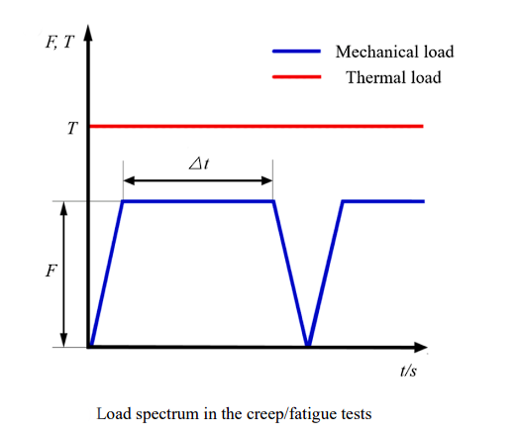
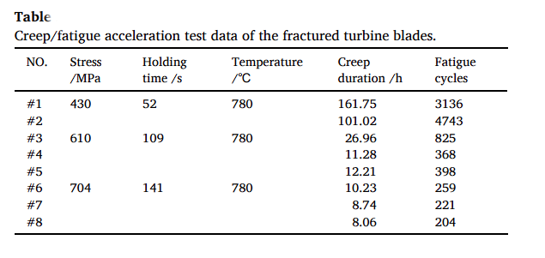
2 specimens Were Taken from K403 Superalloy
A0(C/F) = 430MPa, 52sec, 780°C
A2(C/F) = 704MPa, 141sec, 780°C

Slide 11
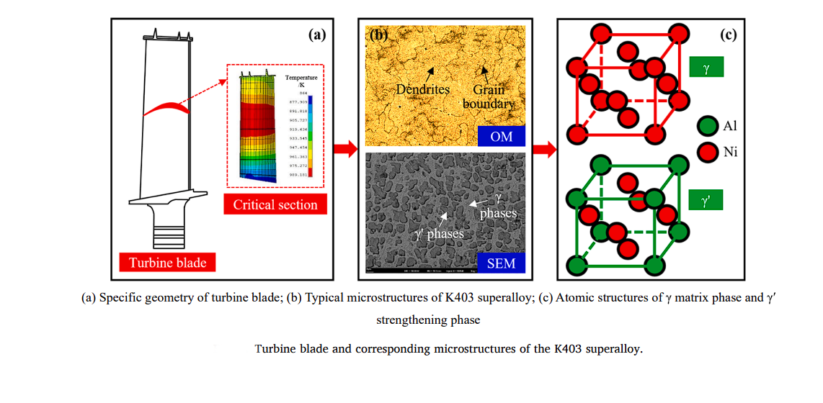
K403 Superalloy at Normal Conditions

Slide 12
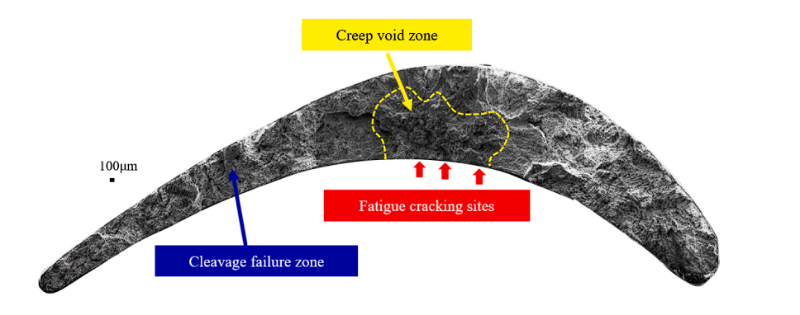
K403 Superalloy at A0(C/F)
Figure: A0(C/F)

Slide 13
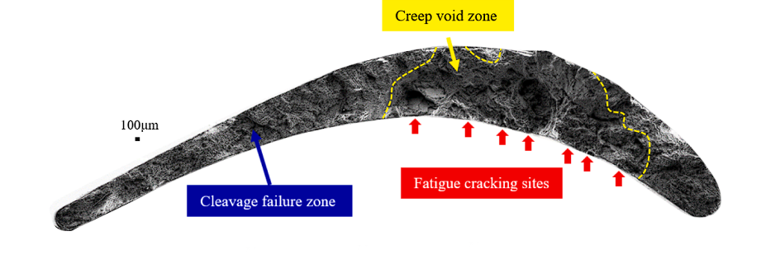
K403 Superalloy at A2(C/F)
Figure: A2(C/F)

Slide 14
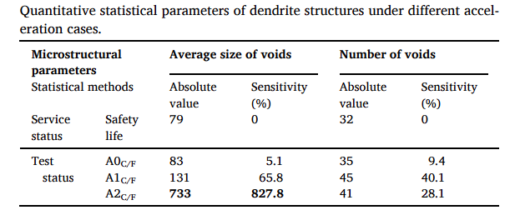

Slide 15
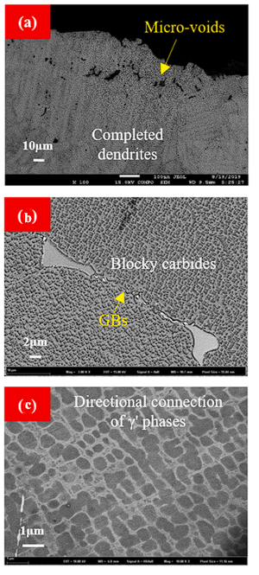
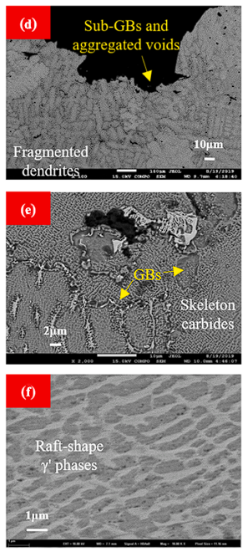
Cross-sectional microstructural morphologies of fractured turbine blades.
Dendrites
GBs
γ' phases
Figure: A0(C/F)
Figure: A2(C/F)

Slide 16
Difference Between Completed Dendrites and Fragmented Dendrites
Completed Dendrites | Fragmented dendrites
These exhibit a well-defined, continuous structure with smooth branches and well-developed secondary arms. They solidify completely, leaving no remaining liquid pockets within the structure. | These exhibit discontinuous, broken branches and incomplete solidification, often with remaining liquid pockets trapped within the structure.
Completed dendrites often offer better strength and ductility due to the absence of internal voids or weaknesses. | The presence of internal voids and weaknesses can compromise the material's overall strength and ductility.
The continuous structure promotes higher fracture toughness, meaning the material can resist crack propagation more effectively. | Fragmented structures can be more susceptible to crack initiation and propagation, leading to lower fracture toughness.
Their smooth morphology can improve machinability compared to fragmented structures. | Trapped liquid pockets can solidify as voids, creating porosity that further weakens the material and potentially compromises its performance.

Slide 17
Difference Between Blocky Carbides
and Skeleton Carbides
Blocky Carbides | Skeleton Carbides
These are compact, well-defined individual particles with a roughly equiaxed or blocky shape. | These form a network of interconnected, branched structures, resembling a skeleton. They can be continuous or discontinuous depending on the specific type and processing conditions.
High hardness and wear resistance | High-temperature strength
Improve strength and reduce toughness | Oxidation resistance
They can significantly decrease machinability due to their hardness. | Their network structure can slightly improve machinability compared to blocky carbides.
Used in wear-resistant components like cutting tools, bearings, and gears due to their excellent hardness and wear resistance. | Used in high-temperature components like turbine blades and discs due to their improved high-temperature strength and oxidation resistance.

Slide 18
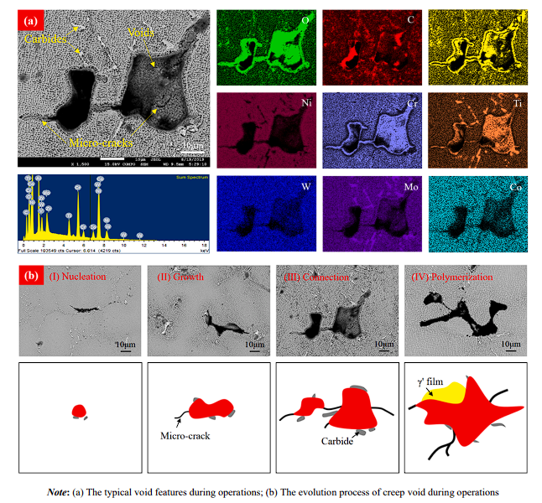
Propagation of Creep Voids

Slide 19
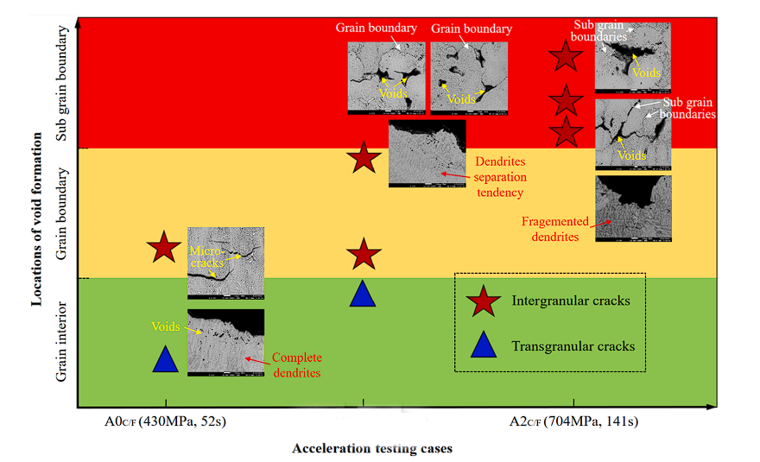
Propagation of Creep Voids Cont.

Slide 20
In Summary
A0(C/F) case:
Creep voids form mainly inside the grains and along original grain boundaries.
A2(C/F) case:
Large amounts of intergranular carbides precipitate, leading to complete fragmentation of dendrite structures and formation of new subgrains and boundaries. This results in the development of large intergranular pores and cracks concentrated along grain boundaries.
Conclusion:
Creep damage is caused by elemental diffusion at high temperatures, leading to intergranular void formation.
With increasing load, the dominant damage shifts from creep and fatigue damages to creep-dominated damage assisted by oxidation.
The failure mode transforms from a mixed mode of transgranular and intergranular to primarily intergranular mode.

Slide 21
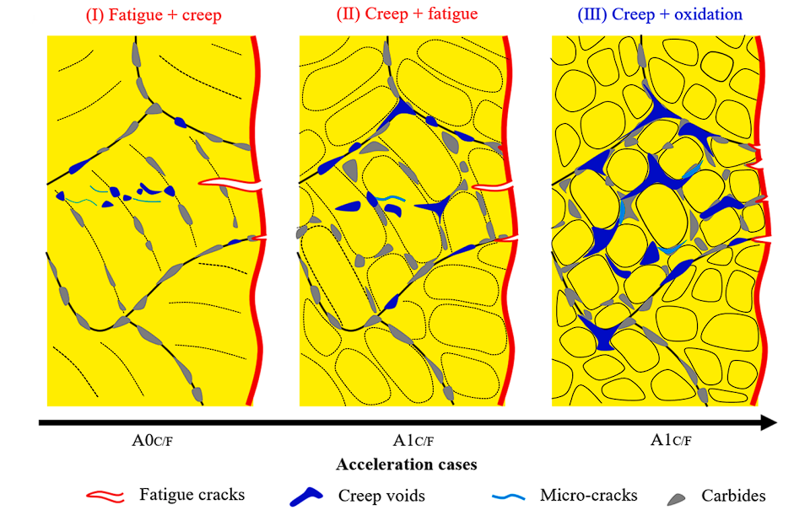
A2C/F

Slide 22
References
https://www.researchgate.net/publication/272565986_Nickel_Base_Superalloys_used_for_Aero_Engine_Turbine_Blades
https://www.sciencedirect.com/science/article/pii/S0142112321004114
https://www.sciencedirect.com/science/article/abs/pii/B9780128035818025741
https://www.youtube.com/watch?v=k6m5iJOk24o&list=PPSV
https://www.youtube.com/watch?v=1zHSK-Nlaz0&list=PPSV
https://www.youtube.com/watch?v=OhB9i-kdlwI&list=PPSV
https://www.youtube.com/watch?v=1tM96B77n0U&list=PPSV

Slide 23
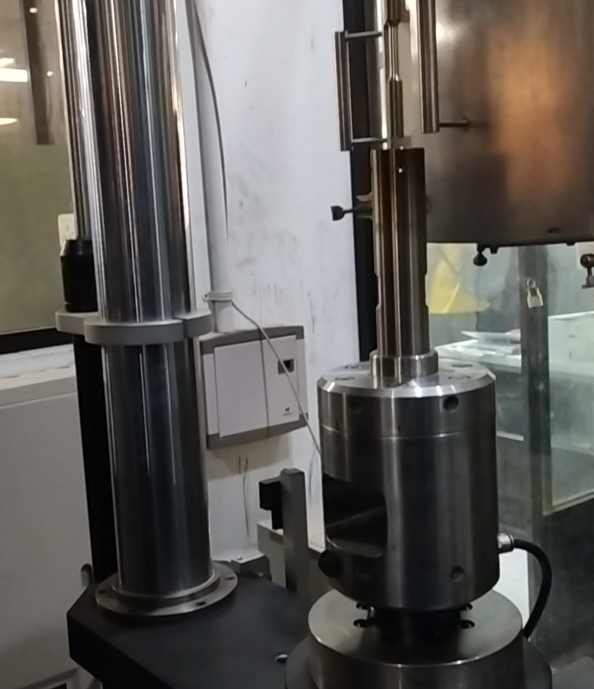
Thank you
Any questions?

