Slide 1
Investigation of Dielectric and Piezoelectric Properties of KNN (K_{0.5}Na_{0.5}NbO₃) with BCHfT (Ba_{0.85}Ca_{0.15}Hf_{0.1}Ti_{0.9}O₃) Composite Ceramics
Examiners
Prof. Md. Aminul Islam
Prof. Fahmida Gulshan
Dr. Mamun Al Rashed
and
Mr. Md. Miftaur Rahman
Presented by PRITOM MAJUMDER ID: 2011011 Session 1

Slide 2
Agenda
Motivation
Research gap
Objective
Methodology
Results
Structure–property relation & Conclusion

Slide 3
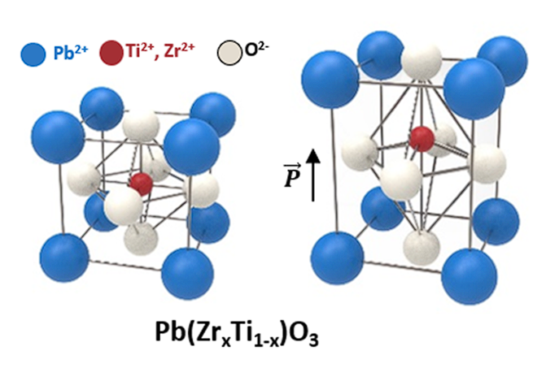
Why this research matters
THE ENVIRONMENTAL CHALLENGE
PZT Dominates
Toxicity Risk
Regulatory Push
The Mandate
Figure 1: Perovskite structure of Pb(Zr_{x}Ti_{1-x})O₃ (PZT) [1].

Slide 4
Why this research matters
PZT contains Pb²⁺ as an essential structural ion.
PbO can volatilize during high-temperature processing.
Machining and recycling may generate Pb-containing dust/waste.
RoHS, WEEE, and REACH motivate lead-free alternatives.
End-of-life disposal creates long-term lead contamination risk.
THE ENVIRONMENTAL CHALLENGE
100%
My mission is to develop a viable, environmentally friendly piezoceramic that perfectly balances high dielectric permittivity, low loss, and strong electromechanical coupling for next-generation sensors and transducers.
LEAD-FREE

Slide 5
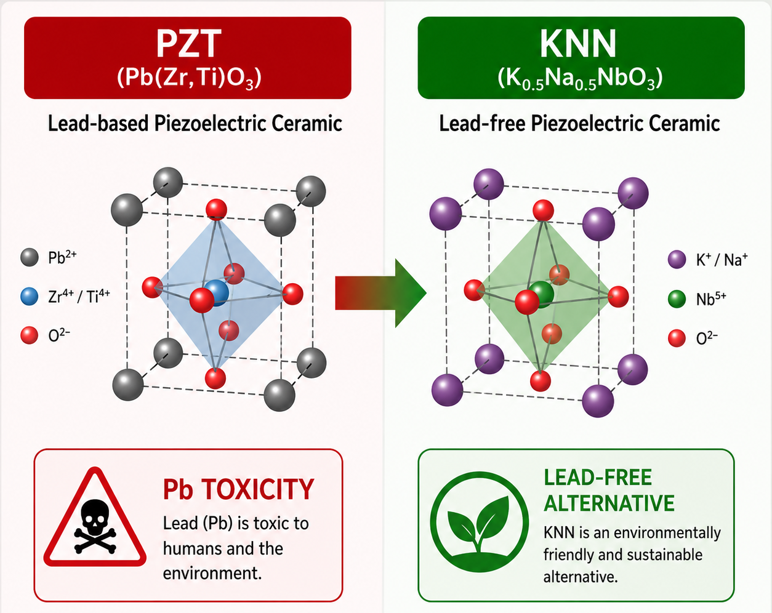
Why this research matters
THE PROMISE & PROBLEM OF LEAD FREE SOLELY KNN
THE PROMISE & PROBLEM OF LEAD FREE SOLELY KNN
K₀.₅Na₀.₅NbO₃ (KNN) is a lead-free perovskite piezoceramic.
Environmentally safer than lead-based PZT.
Shows ferroelectric and piezoelectric behavior.
Has relatively high Curie temperature above 400 °C.
Useful for sensors, actuators, transducers, and energy harvesting.
The future of piezoelectric ceramics depends on replacing toxic lead-based PZT with environmentally safe lead-free alternatives like KNN, without sacrificing functional performance.

Slide 6
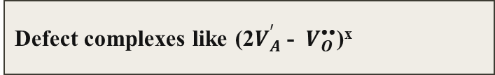
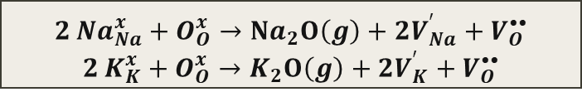
Why this research matters
THE PROMISE & PROBLEM OF LEAD FREE SOLELY KNN
THE PROMISE & PROBLEM OF LEAD FREE SOLELY KNN
Alkali
Volatilization
Narrow Sintering Window
1050 to 1130⁰C
Reduced density, high dielectric loss, and unstable piezoelectric performance.
$$2 {Na}_{Na}^{x}+O_{O}^{x}→Na_{2}O\left(g\right)+2V_{Na}^{′}+V_{O}^{••}$$
$$2 K_{K}^{x}+O_{O}^{x}→K_{2}O\left(g\right)+2V_{K}^{′}+V_{O}^{••}$$
Defect complexes like (2$V_{A}^{′}$- $V_{O}^{••}$)^{x}
secondary phase formation such as K–Nb–O or Na–Nb–O

Slide 7
Research IDEA
Environmental and health concern about PZT
1
Balancing between dielectric response and polarization stability
3
Less explored than common KNN doping or texturing
4
Problem of alkali volatilization controlled
2

Slide 8
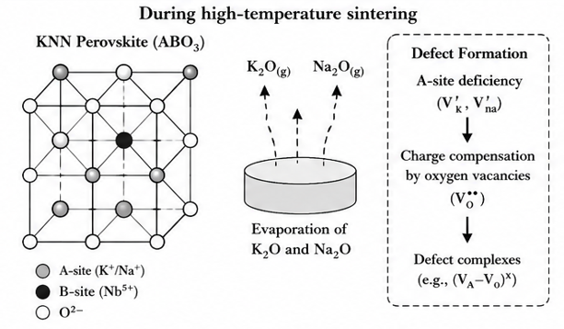
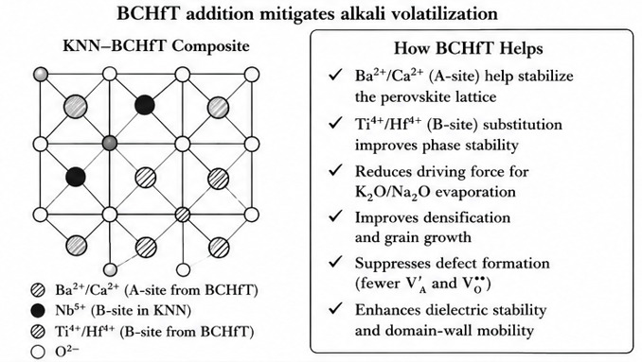
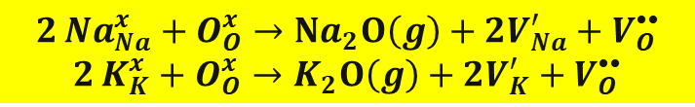
Research IDEA
$$2 {Na}_{Na}^{x}+O_{O}^{x}→Na_{2}O\left(g\right)+2V_{Na}^{′}+V_{O}^{••}$$
$$2 K_{K}^{x}+O_{O}^{x}→K_{2}O\left(g\right)+2V_{K}^{′}+V_{O}^{••}$$
[2]

Slide 9
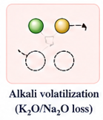
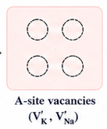
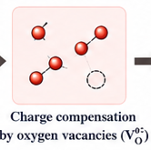
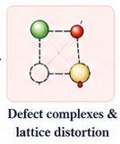
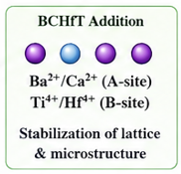
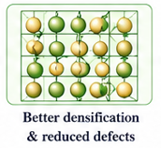
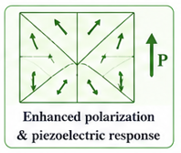
Research IDEA
BCHfT mitigates the alkali-volatilization problem by converting pure KNN from a defect-sensitive ceramic into a more structurally and dielectrically stable lead-free composite.

Slide 10
Research IDEA
Material / System Architecture | d33​ Value | Relative Dielectric Value (ε_{r}​) | Activation Energy (E_{a}​) eV | Curie Temperature (T_{c​}) | References
Pure KNN (Single Crystal) | 100pC/N | 219.6 | 1.60 | 418⁰C | [3]
0.99KNN-0.01BNN (Ceramic-Ceramic Composite) | 145 pC/N | 1657 | 0.89 eV - 1.59 eV | 394⁰C | [4]
Mn-doped KNN (Single Crystal) | 325pC/N | 703.7 | Varies | 407⁰C | [5]
Pure KNN (Polycrystal) | 80 - 160 pC/N | 451 | 0.97 eV | ~ | [6]
Etc…
KNN-BCHfT Composite | N/A | N/A | N/A | N/A | N/A

Slide 11
Summary of Hypothesis
KNN Processing: Sintering at 1090°C
Defect Chemistry: Alkali Volatilization
XRD &Microstructure: Porosity & Secondary Phases
Dielectric Relaxation & Oxygen Vacancies
Piezoelectric Climax: Why 1 wt% Beats 1.5 wt%
Expected modification of defect sensitive KNN behaviour

Slide 12
Methodology
Overview on Material Composition
Chemical Formula | Weight(%) Of Reinforcement | Sample Composition | Sample Name
K_{0.5}Na_{0.5}NbO₃ | 0 | K_{0.5}Na_{0.5}NbO₃ | Pure KNN
Ba_{0.85}Ca_{0.15}Hf_{0.1}Ti_{0.9}O₃ | 0 | Ba_{0.85}Ca_{0.15}Hf_{0.1}Ti_{0.9}O₃ | Pure BCHfT
K_{0.5}Na_{0.5}NbO₃-x% Ba_{0.85}Ca_{0.15}Hf_{0.1}Ti_{0.9}O₃ | 1 | K_{0.5}Na_{0.5}NbO₃-1% Ba_{0.85}Ca_{0.15}Hf_{0.1}Ti_{0.9}O₃ | KNN-1% BCHfT
 | 1.5 | K_{0.5}Na_{0.5}NbO₃-1.5% Ba_{0.85}Ca_{0.15}Hf_{0.1}Ti_{0.9}O₃ | KNN-1.5% BCHfT

Slide 13
Methodology
Raw Materials Weighting
K₂CO₃ + Na₂CO₃ + Nb₂O₅ → KNN BaCO₃ + CaCO₃ + TiO₂ + HfO₂ → BCHfT
Ball Milling
Powder, ZrO₂ ball, Ethanol
200rpm for 24hrs
Drying
Oven drying
70⁰C, 24hrs
Binder Preparation
5% PVA Solution
Grinding with mortar
Calcination
Rate 5⁰C/min
950⁰C for 6hrs
Grinding
Mortar and Pestle
Solid State Reaction Process
Green pellet formation
5kN force
Sintering
1090⁰C
10hrs
Characterization

Slide 14
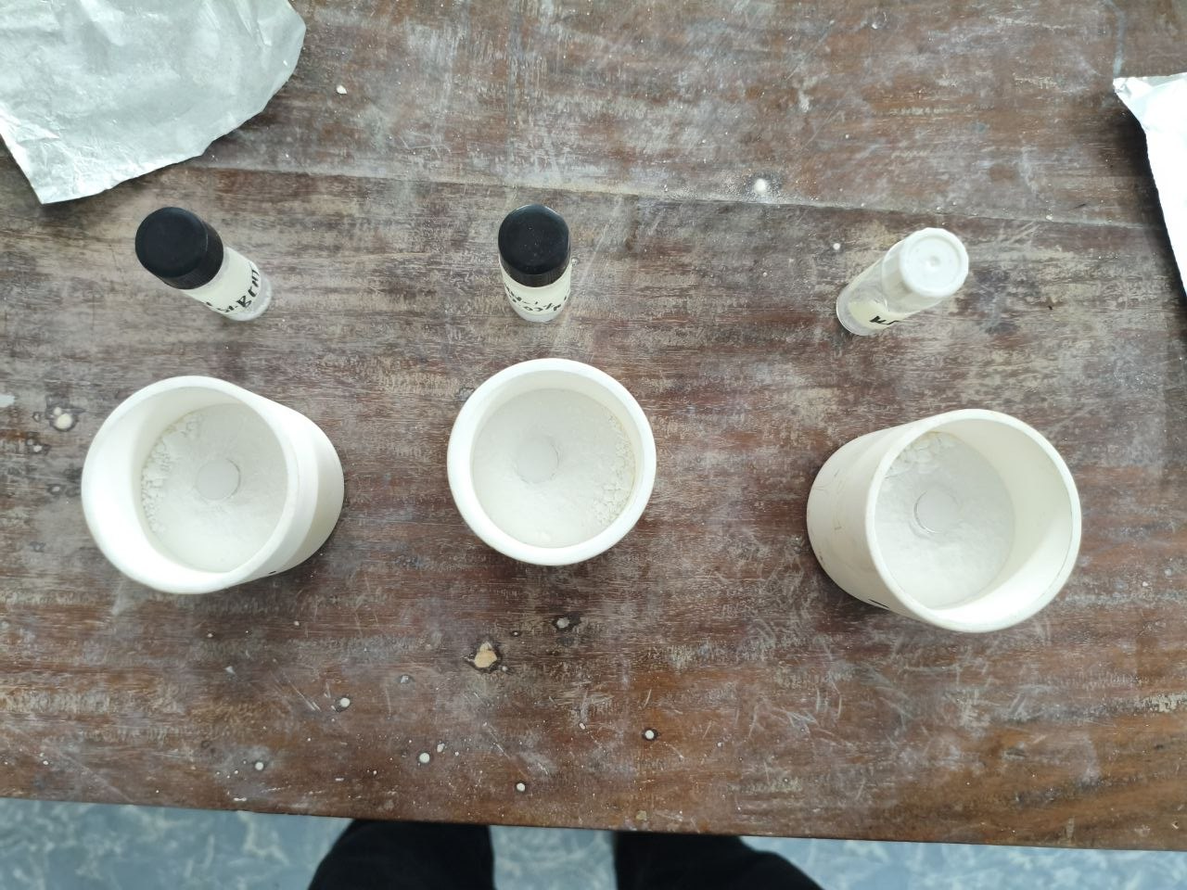
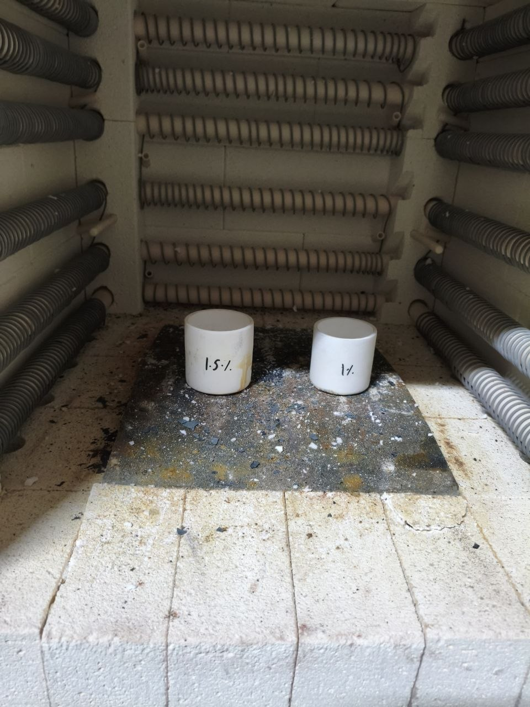
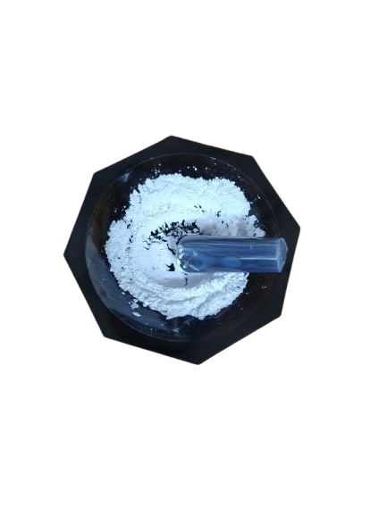
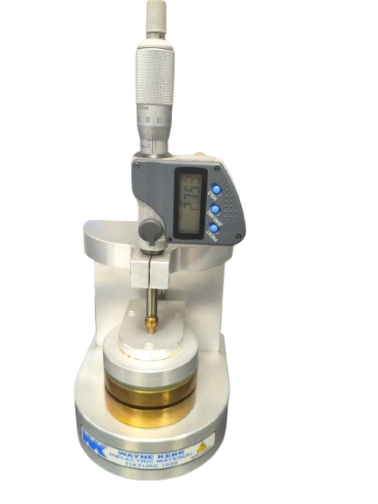
Methodology
Precursors Needed for 5gm Pure Sample and Composites
Sample | Precursors | Required mass
Pure KNN | Nb₂O₅ | 3.9052 g
 | K₂CO₃ | 1.0152 g
 | Na₂CO₃ | 0.7782 g
Pure BCHfT | BaCO₃ | 3.6568 g
 | CaCO₃ | 0.3273 g
 | TiO₂ | 1.5670 g
 | HfO₂ | 0.4636 g
KNN-1% BCHfT | KNN powder | 4.95 g
 | BCHfT powder | 0.05 g
KNN-1.5% BCHfT | KNN powder | 4.925 g
 | BCHfT powder | 0.075 g
Figure: Compilation of Solid-State Thesis Workflow

Slide 15
Result & Discussion
Characterization Overview | Structural Characterization | Total Performed Test=5
 | X-Ray Diffraction (XRD)
 | Morphological Characterization
 | Scanning Electron Microscopy (SEM)
 | Dielectric Test
 | Temperature Dependence Impedence Analysis
 | Frequency Dependence Impedence Analysis
 | Piezoelectric Test
 | d₃₃ Test

Slide 16
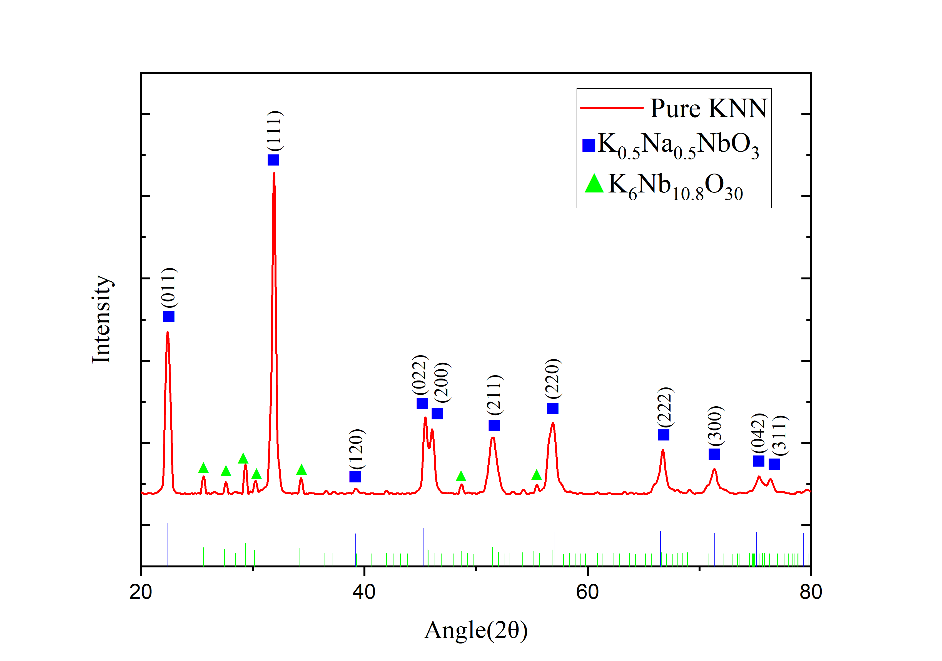
XRD Analysis
High Crystallinity is confirmed by sharp, intense diffraction peaks.
Primary Phase: KNN (K_{0.5}Na_{0.5}NbO₃)
Space Group: Amm2 (Ref: JCPDS 01-085-7128).
Secondary Phase: Trace Potassium Niobium Oxide (K₆Nb_{10.8}O₃₀).
Secondary Symmetry: Tetragonal (Ref: JCPDS 01-070-5051).
Figure: Pure KNN

Slide 17
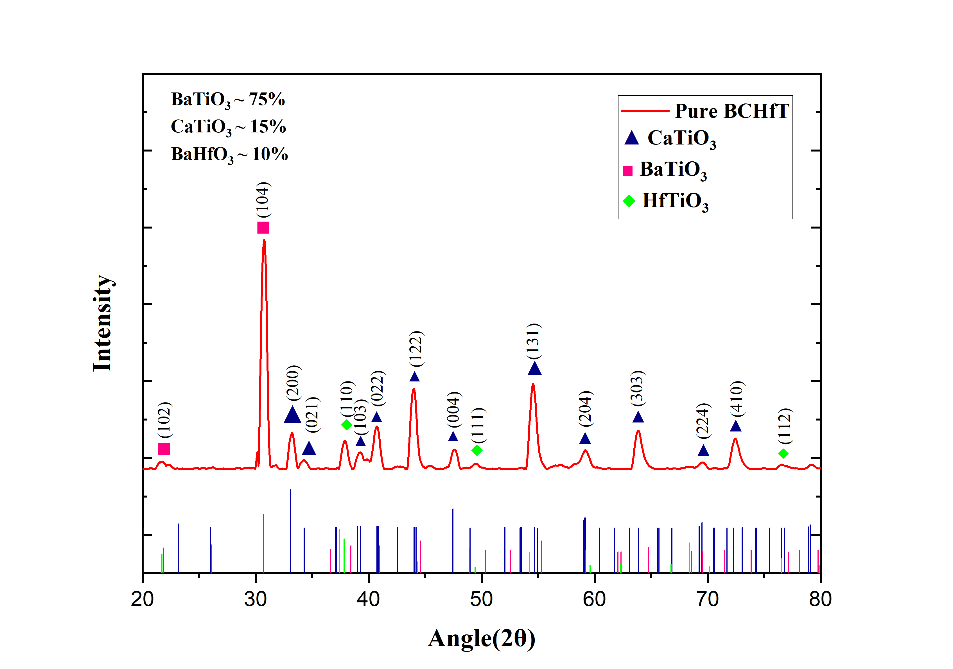
XRD Analysis
Diffraction pattern confirms three distinct phases in the pure BCHfT ceramic.
BaTiO₃ Phase: Hexagonal structure (Ref: JCPDS 00-013-0379).
CaTiO₃ Phase: Orthorhombic perovskite, Space Group: Pbnm (Ref: JCPDS 01-070-8503).
HfTiO₃ Phase: Hexagonal structure, Space Group: P6/mmm (Ref: JCPDS 00-034-0884).
75% BaTiO3 + 15% CaTiO₃ + 10% BaHfO₃
=
Ba_{0.85}Ca_{0.15}Hf_{0.1}Ti_{0.9}O₃
Figure: Pure BCHfT

Slide 18
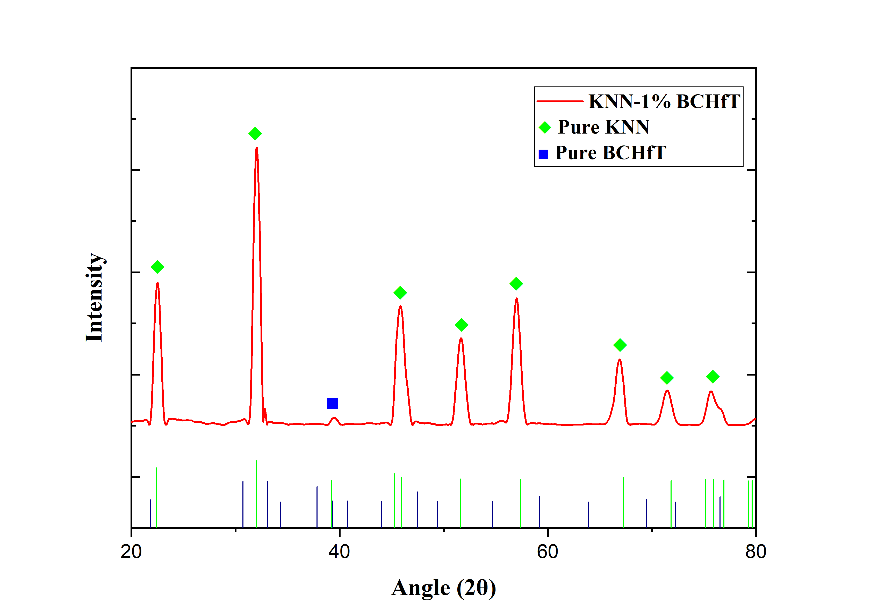
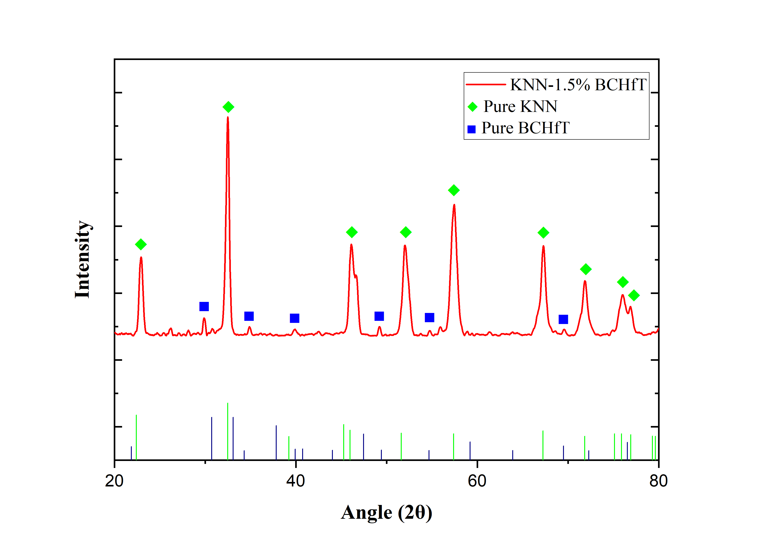
XRD Analysis
(a)
(b)
Figure: XRD analysis of a)KNN-1% BCHfT b) KNN-1.5% BCHfT

Slide 19
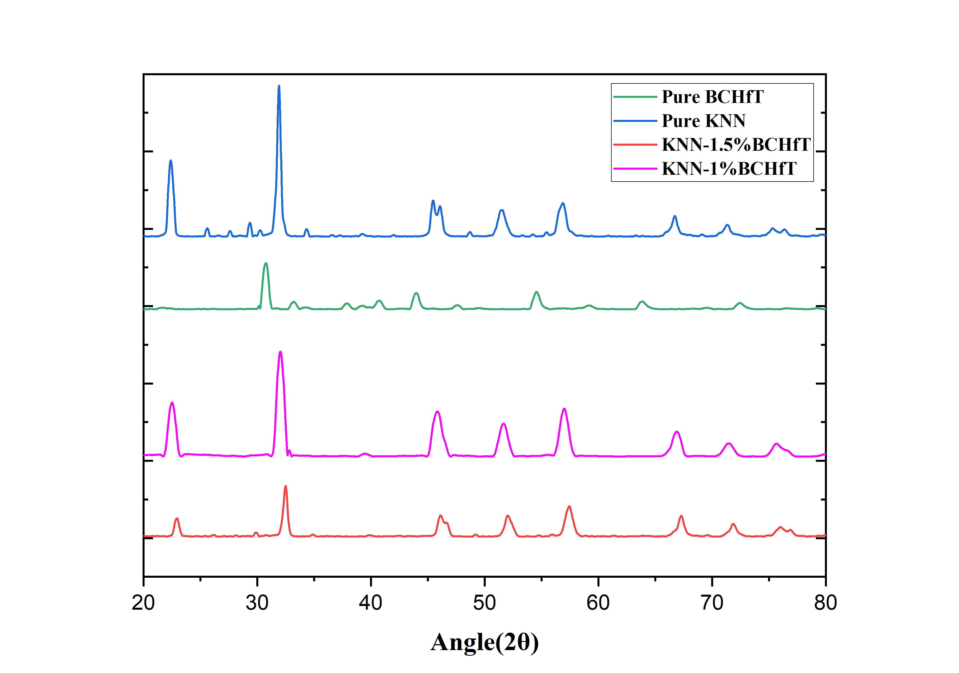
XRD Analysis
Figure: Compilation of all XRD curves

Slide 20
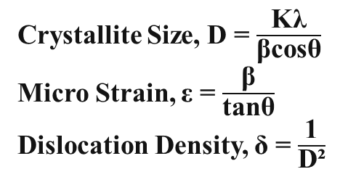
XRD Analysis
Crystallite Size, D = $\frac{\text{Kλ}}{\text{βcosθ}}$
Micro Strain, ε = $\frac{\text{β}}{\text{tanθ}}$
Dislocation Density, δ = $\frac{\text{1}}{\text{D}\text{²}}$
Samples | Crystallite Size,D nm | Micro Strain, ε ⨉ 10⁻³ | Disloccation density, δ ⨉ 10⁻⁵ nm⁻²
Pure KNN | 29.65 | 16.99 | 113.77
Pure BCHfT | 29.19 | 17.95 | 117.36
KNN- 1% BCHfT | 18.10 | 27.75 | 305.20
KNN- 1.5% BCHfT | 24.78 | 20.00 | 162.87

Slide 21
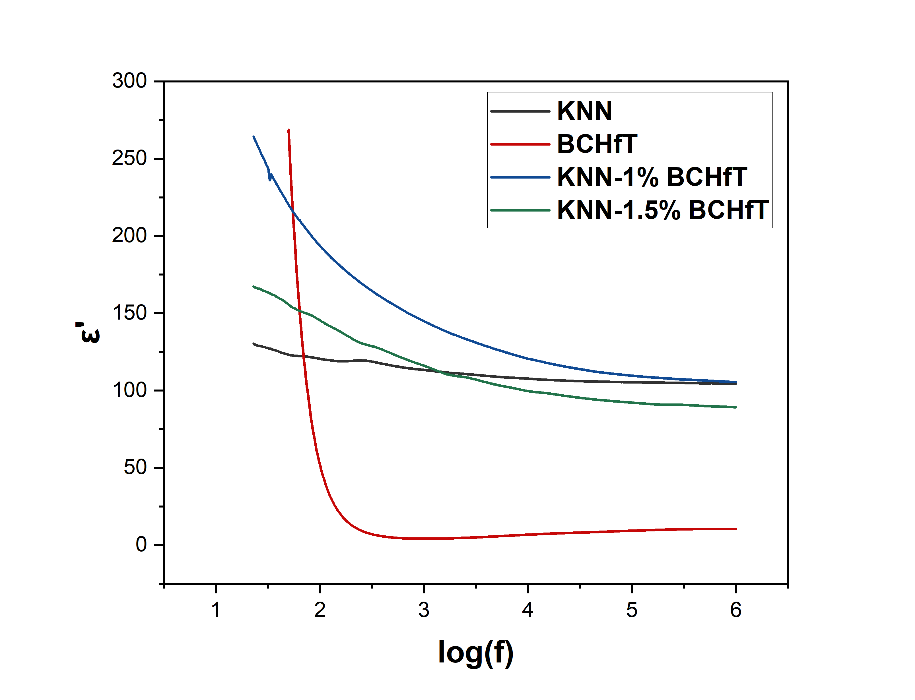
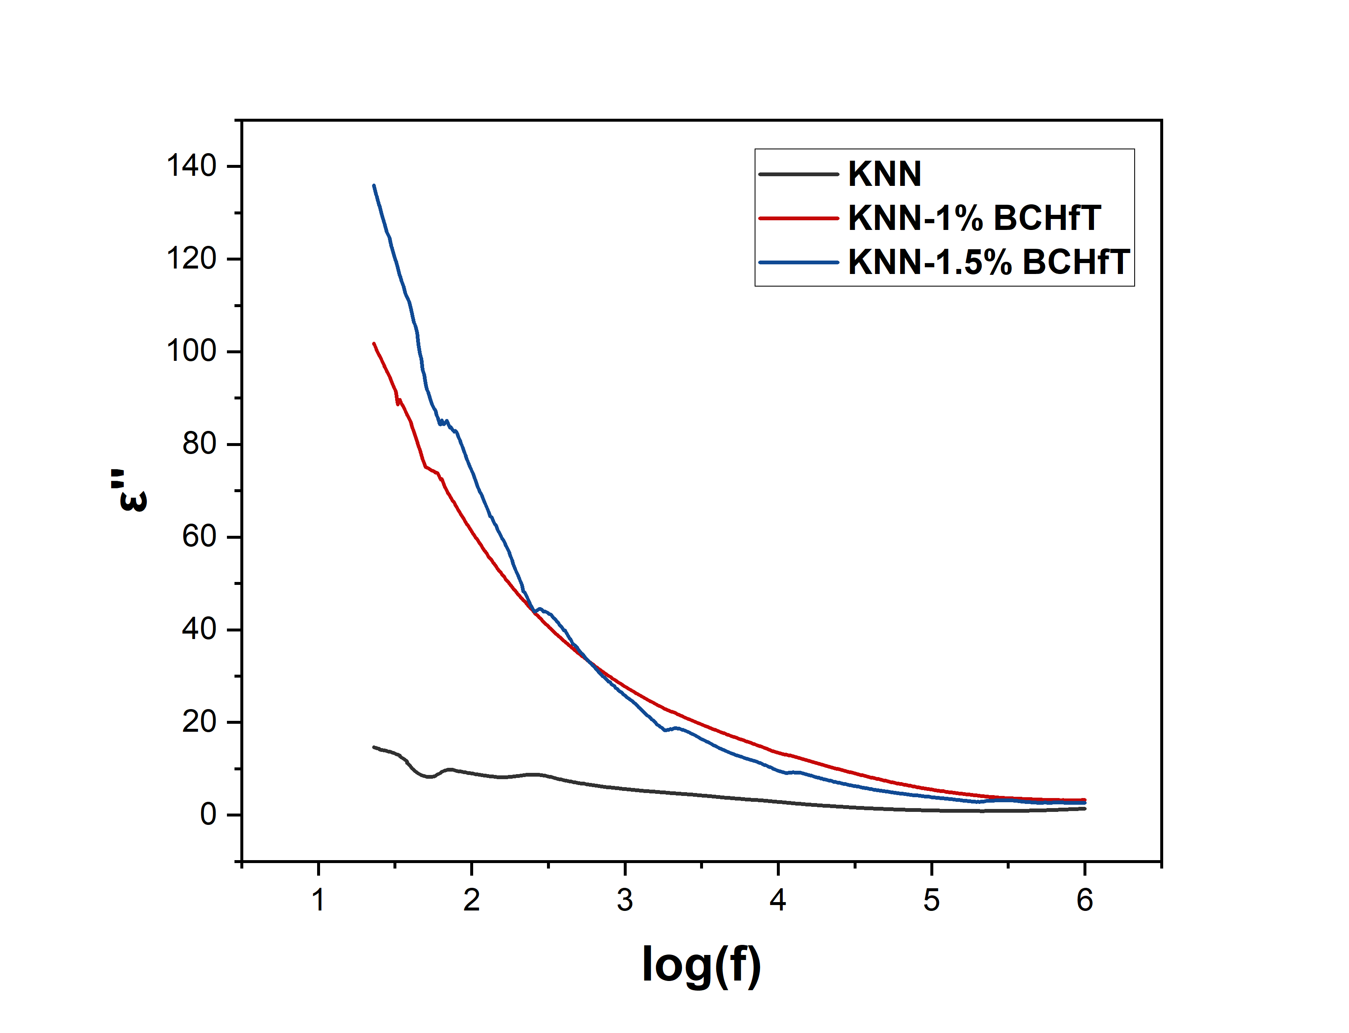
Frequency dependent dielectric Analysis
Platinum (Pt) coating was applied on both flat surfaces of the pellet for dielectric measurements, while the round edge was left uncoated.
Figure: Dielectric Constant vs logarithmic
frequency
Figure: Dielectric Constant (imaginary) vs logarithmic
frequency

Slide 22
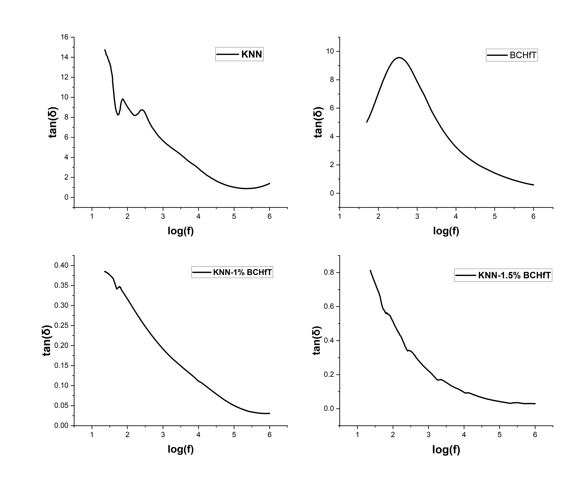
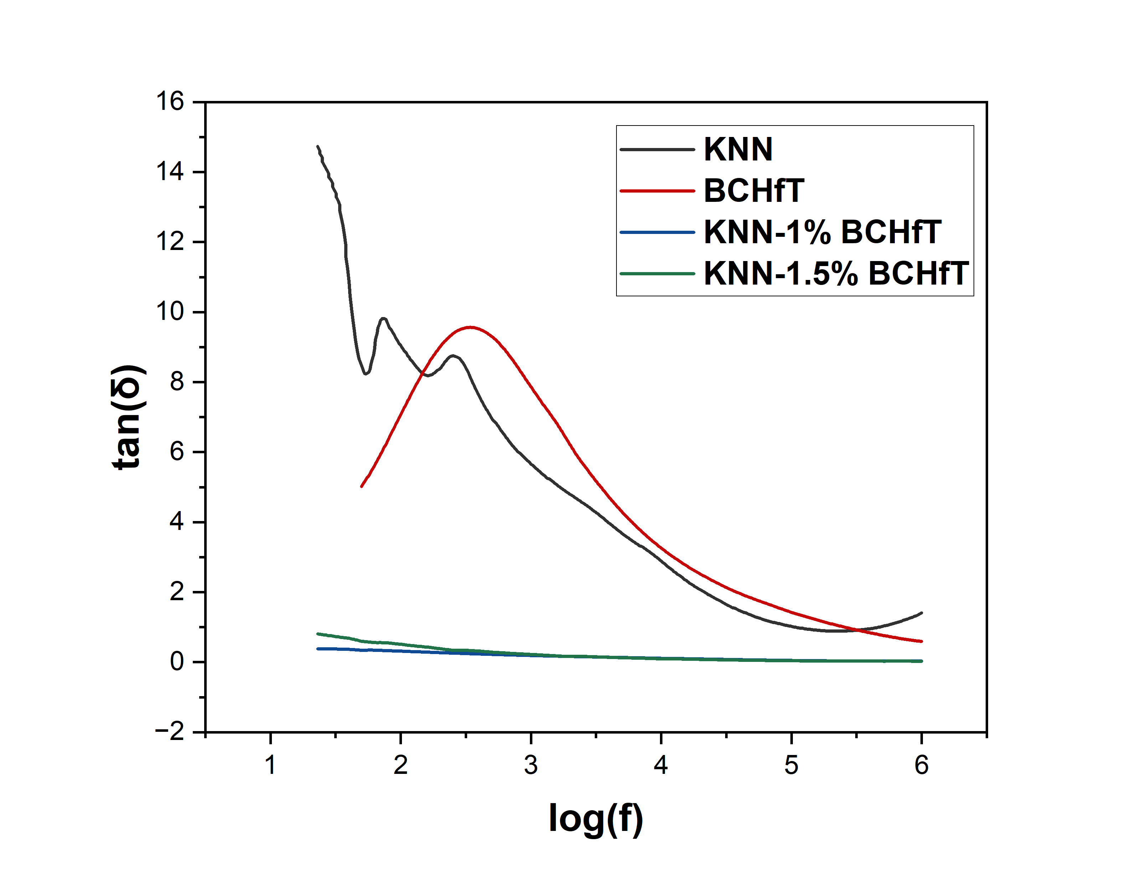
Frequency dependent dielectric Analysis
Figure: Merges of all the figure. a) KNN b)BCHfT c)KNN-1% BCHfT d)KNN-1.5% BCHfT

Slide 23
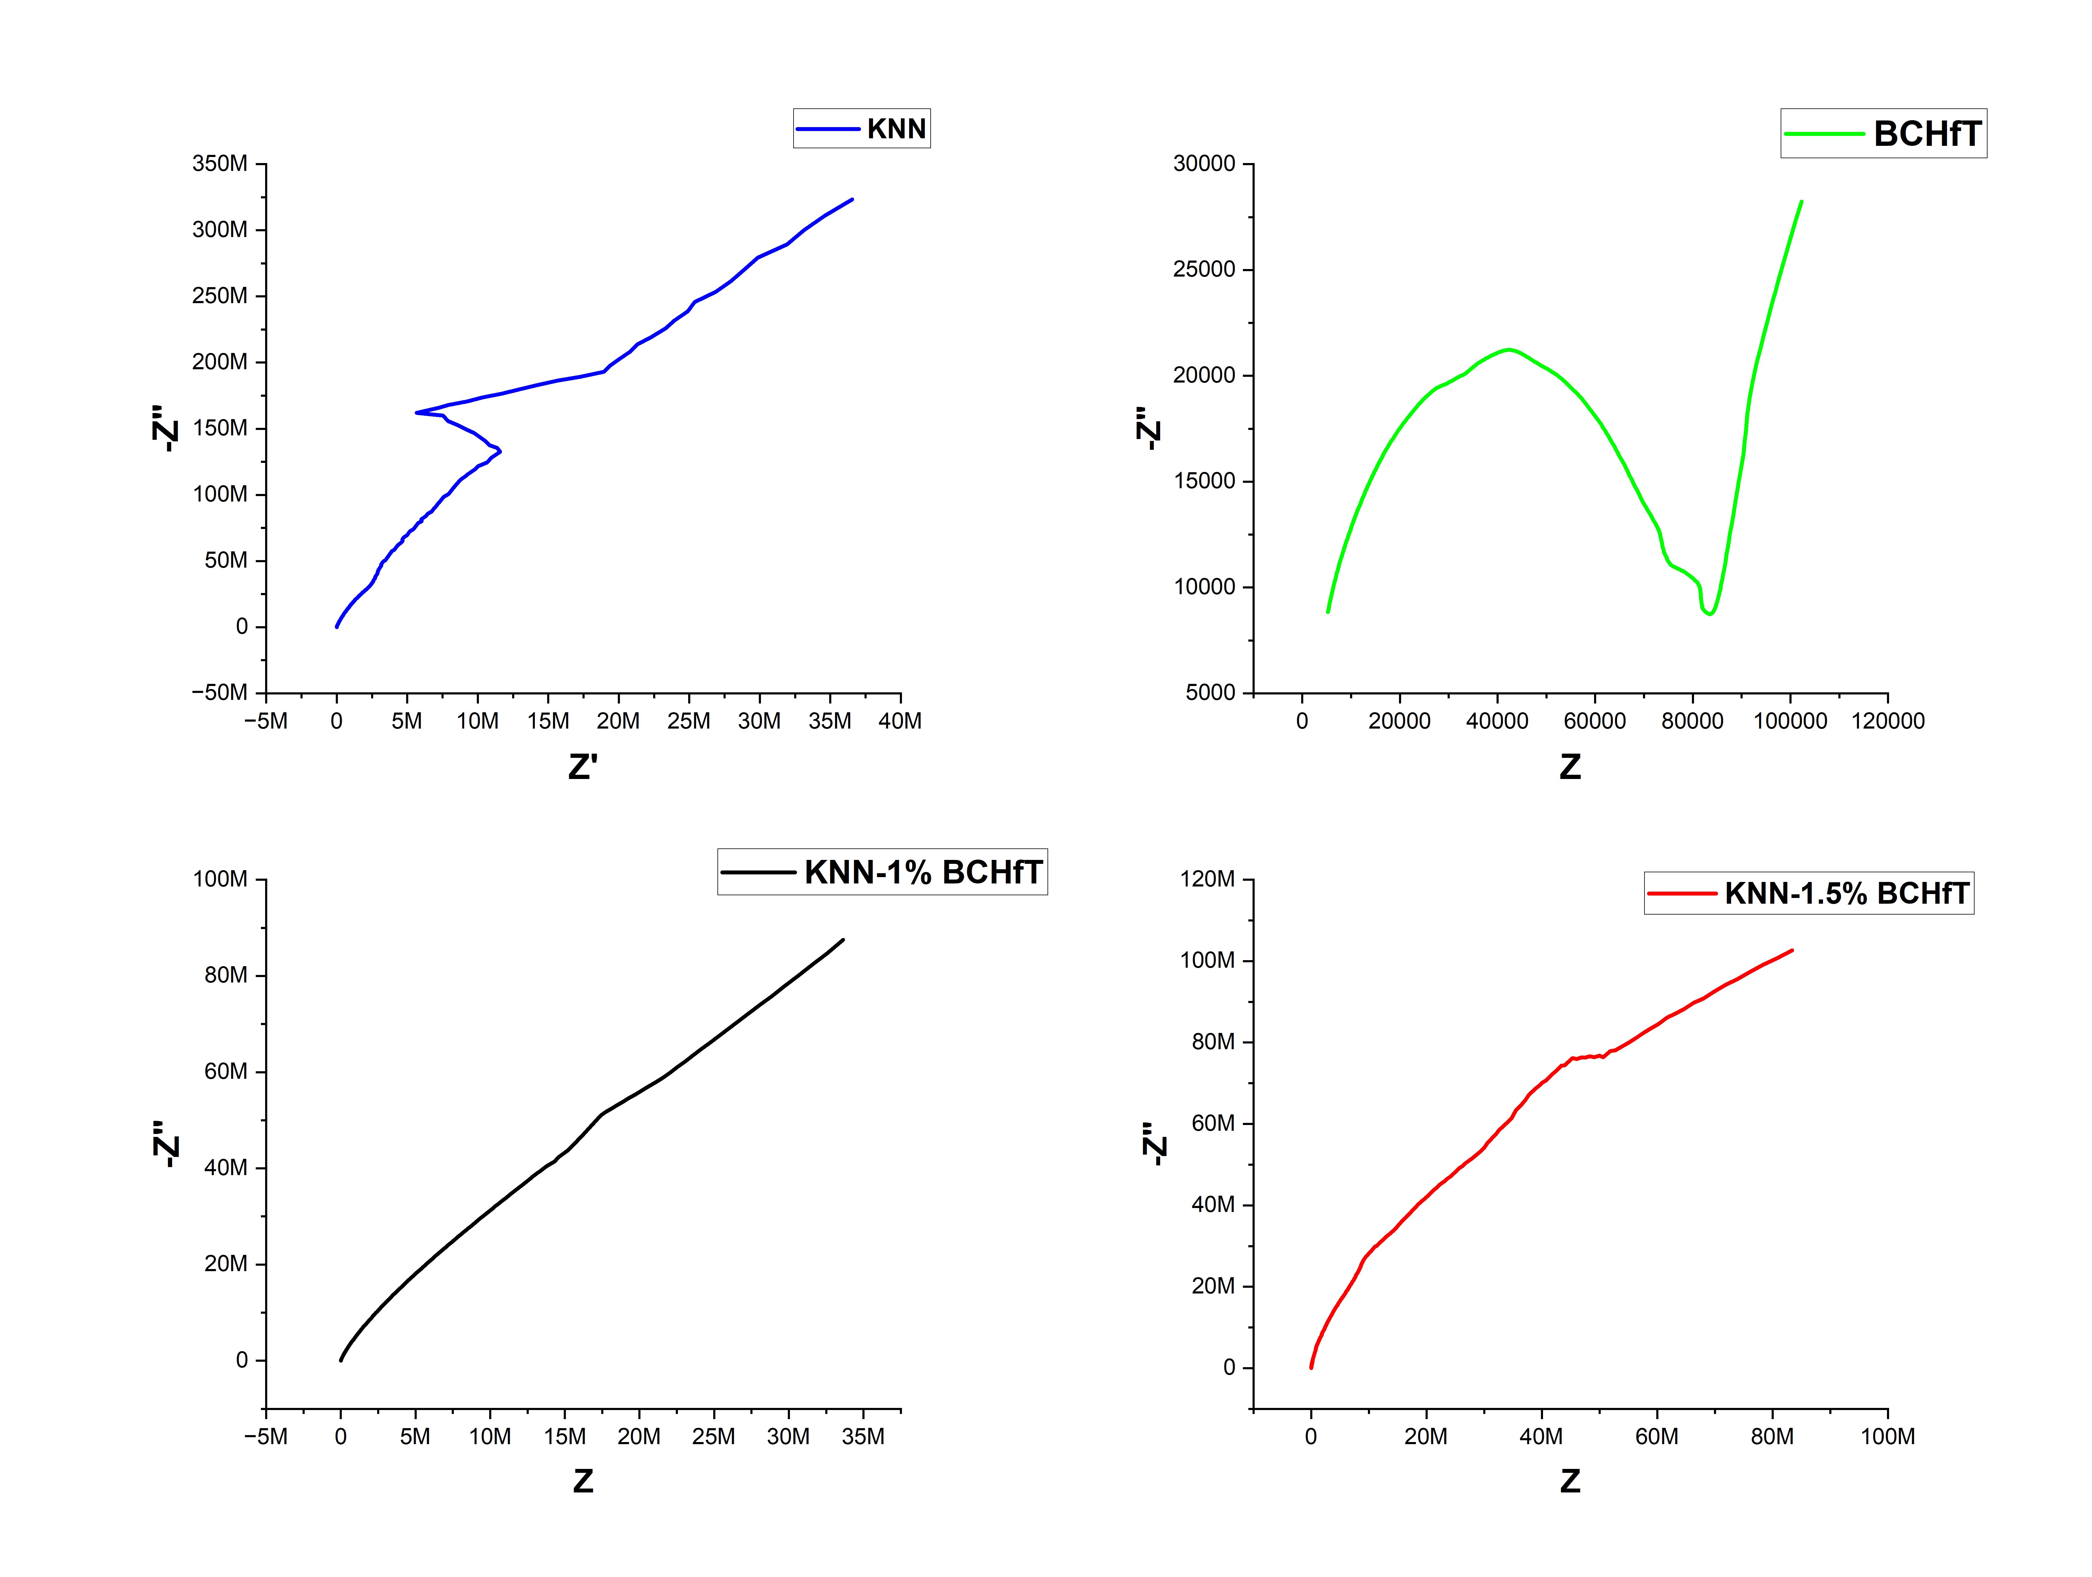
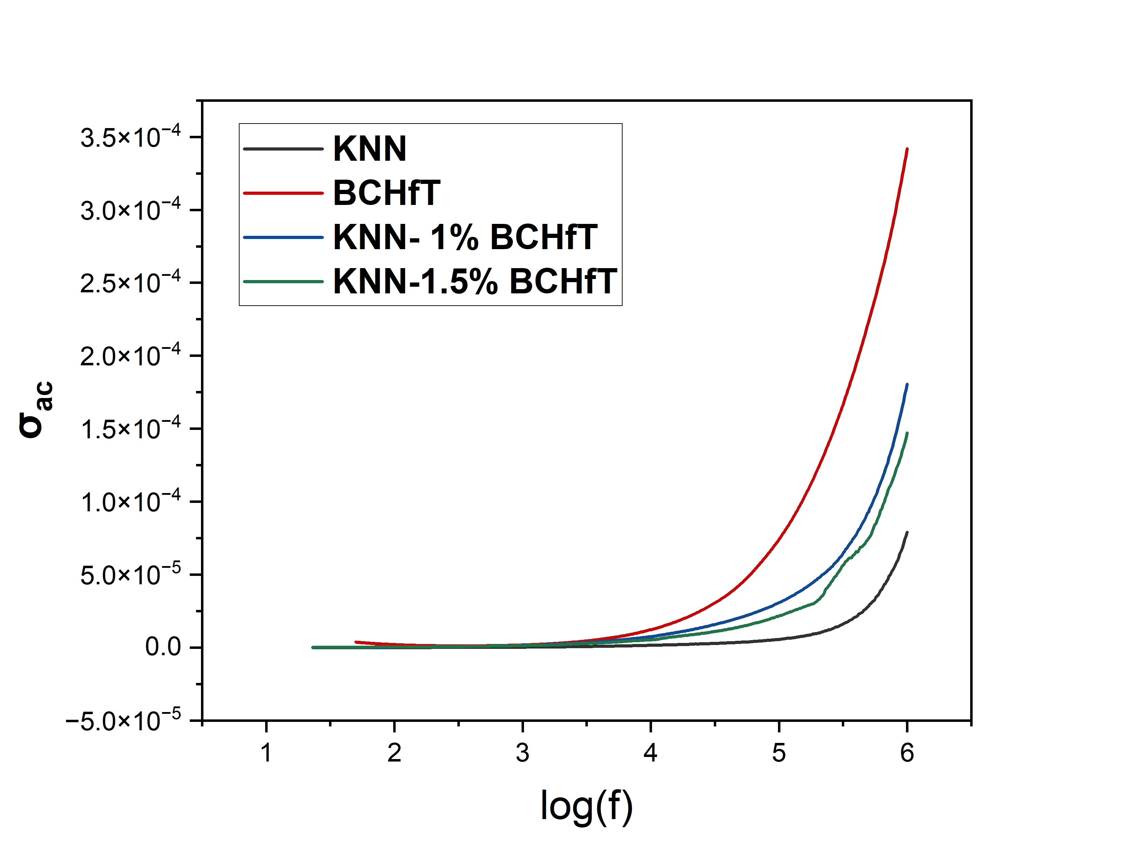
Frequency dependent dielectric Analysis
Hopping Conduction
Figure: Nyquist plot of all 4 composition: a)KNN b)BCHfT c)KNN-1%BCHfT d)KNN-1.5%BCHfT
Figure: Conductivity vs Logarithmic frequency

Slide 24
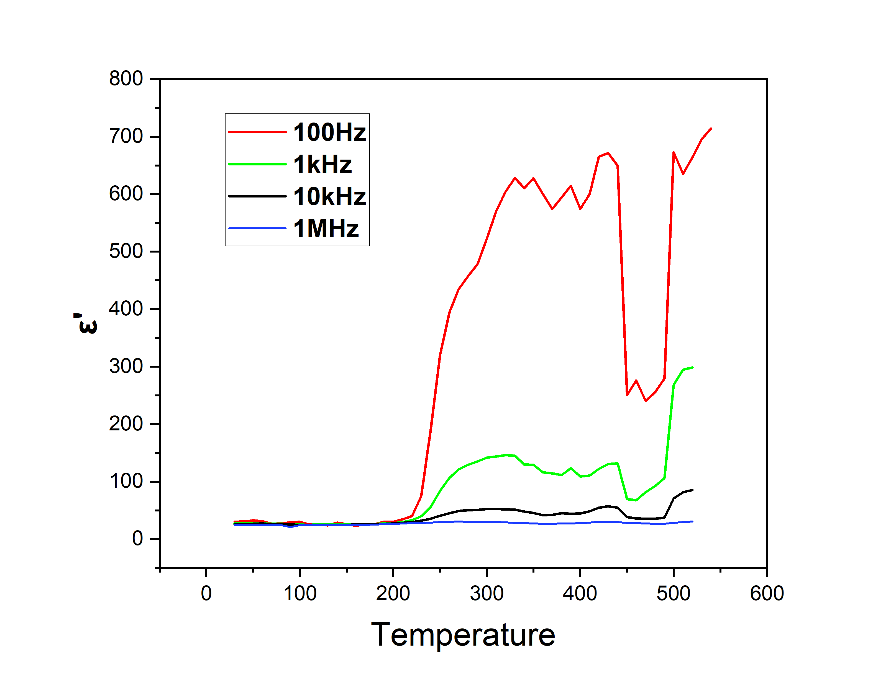
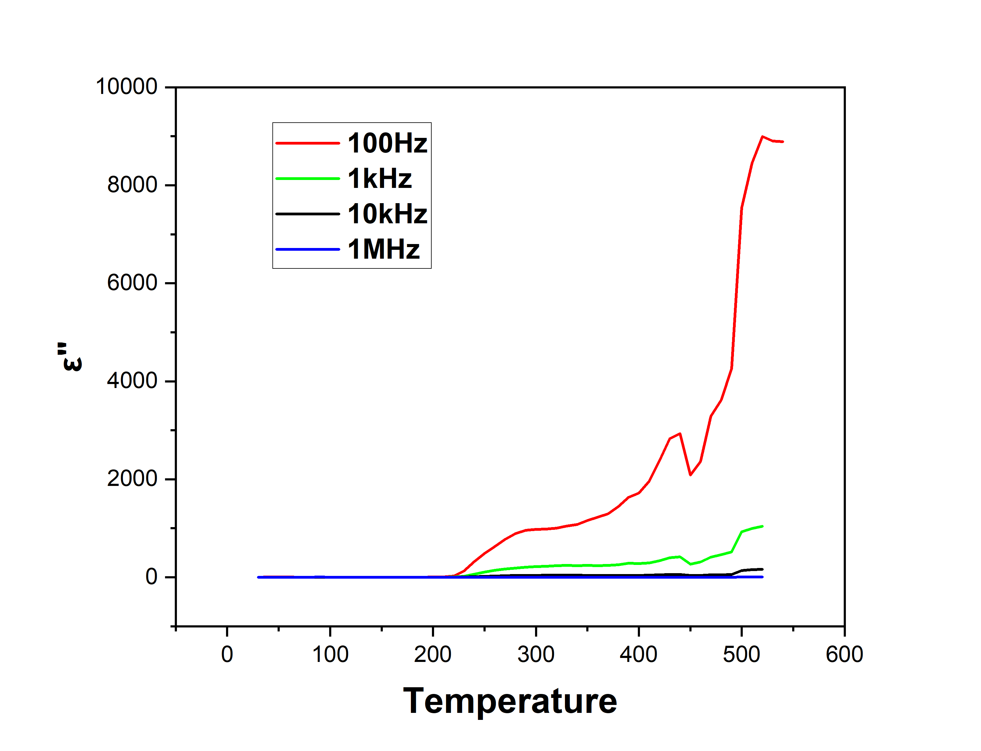
Temperature dependent dielectric Analysis
Figure: Dielectric constant vs Temperature
Figure: Dielectric constant(imaginary) vs Temperature

Slide 25
Temperature dependent dielectric Analysis
Tc is the temperature where materials become ferroelectric to paraelectric.
This phase transition occured 425-450⁰C region.
R-O>O-T>T-C
Polymorphic Phase transition:
Orthorhombic to tetragonal phase transition.
Curie Temperature,
T_{c} ~425-450⁰C
Figure: Dielectric constant vs Temperature

Slide 26
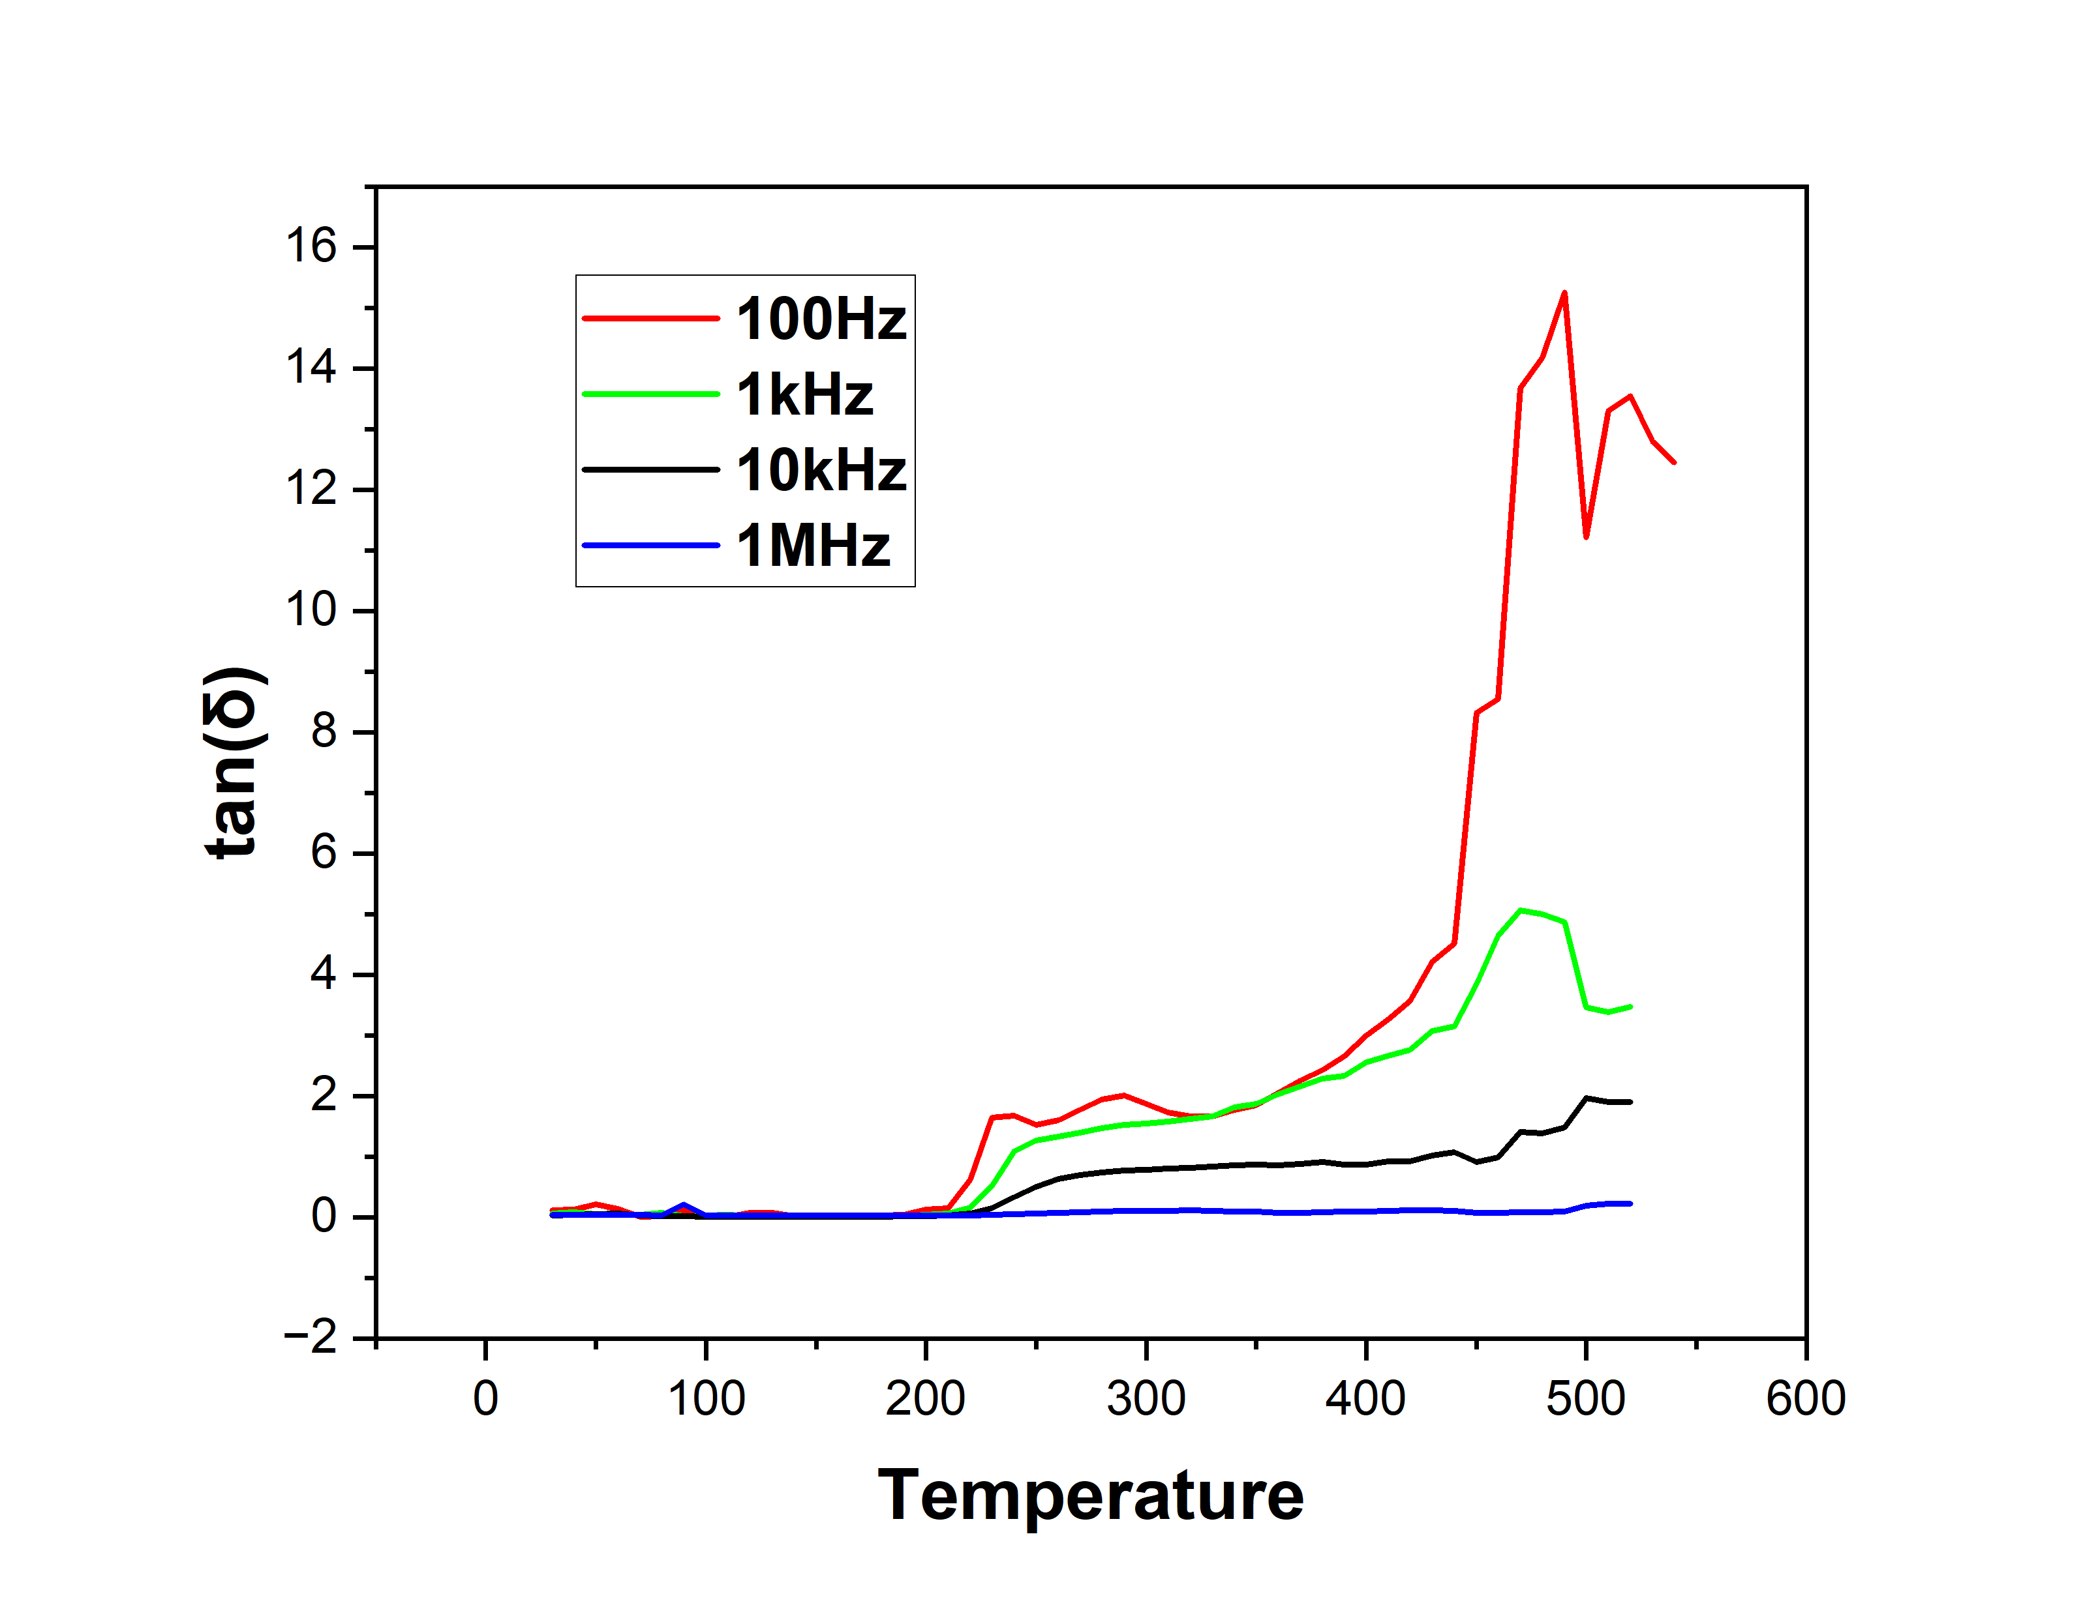
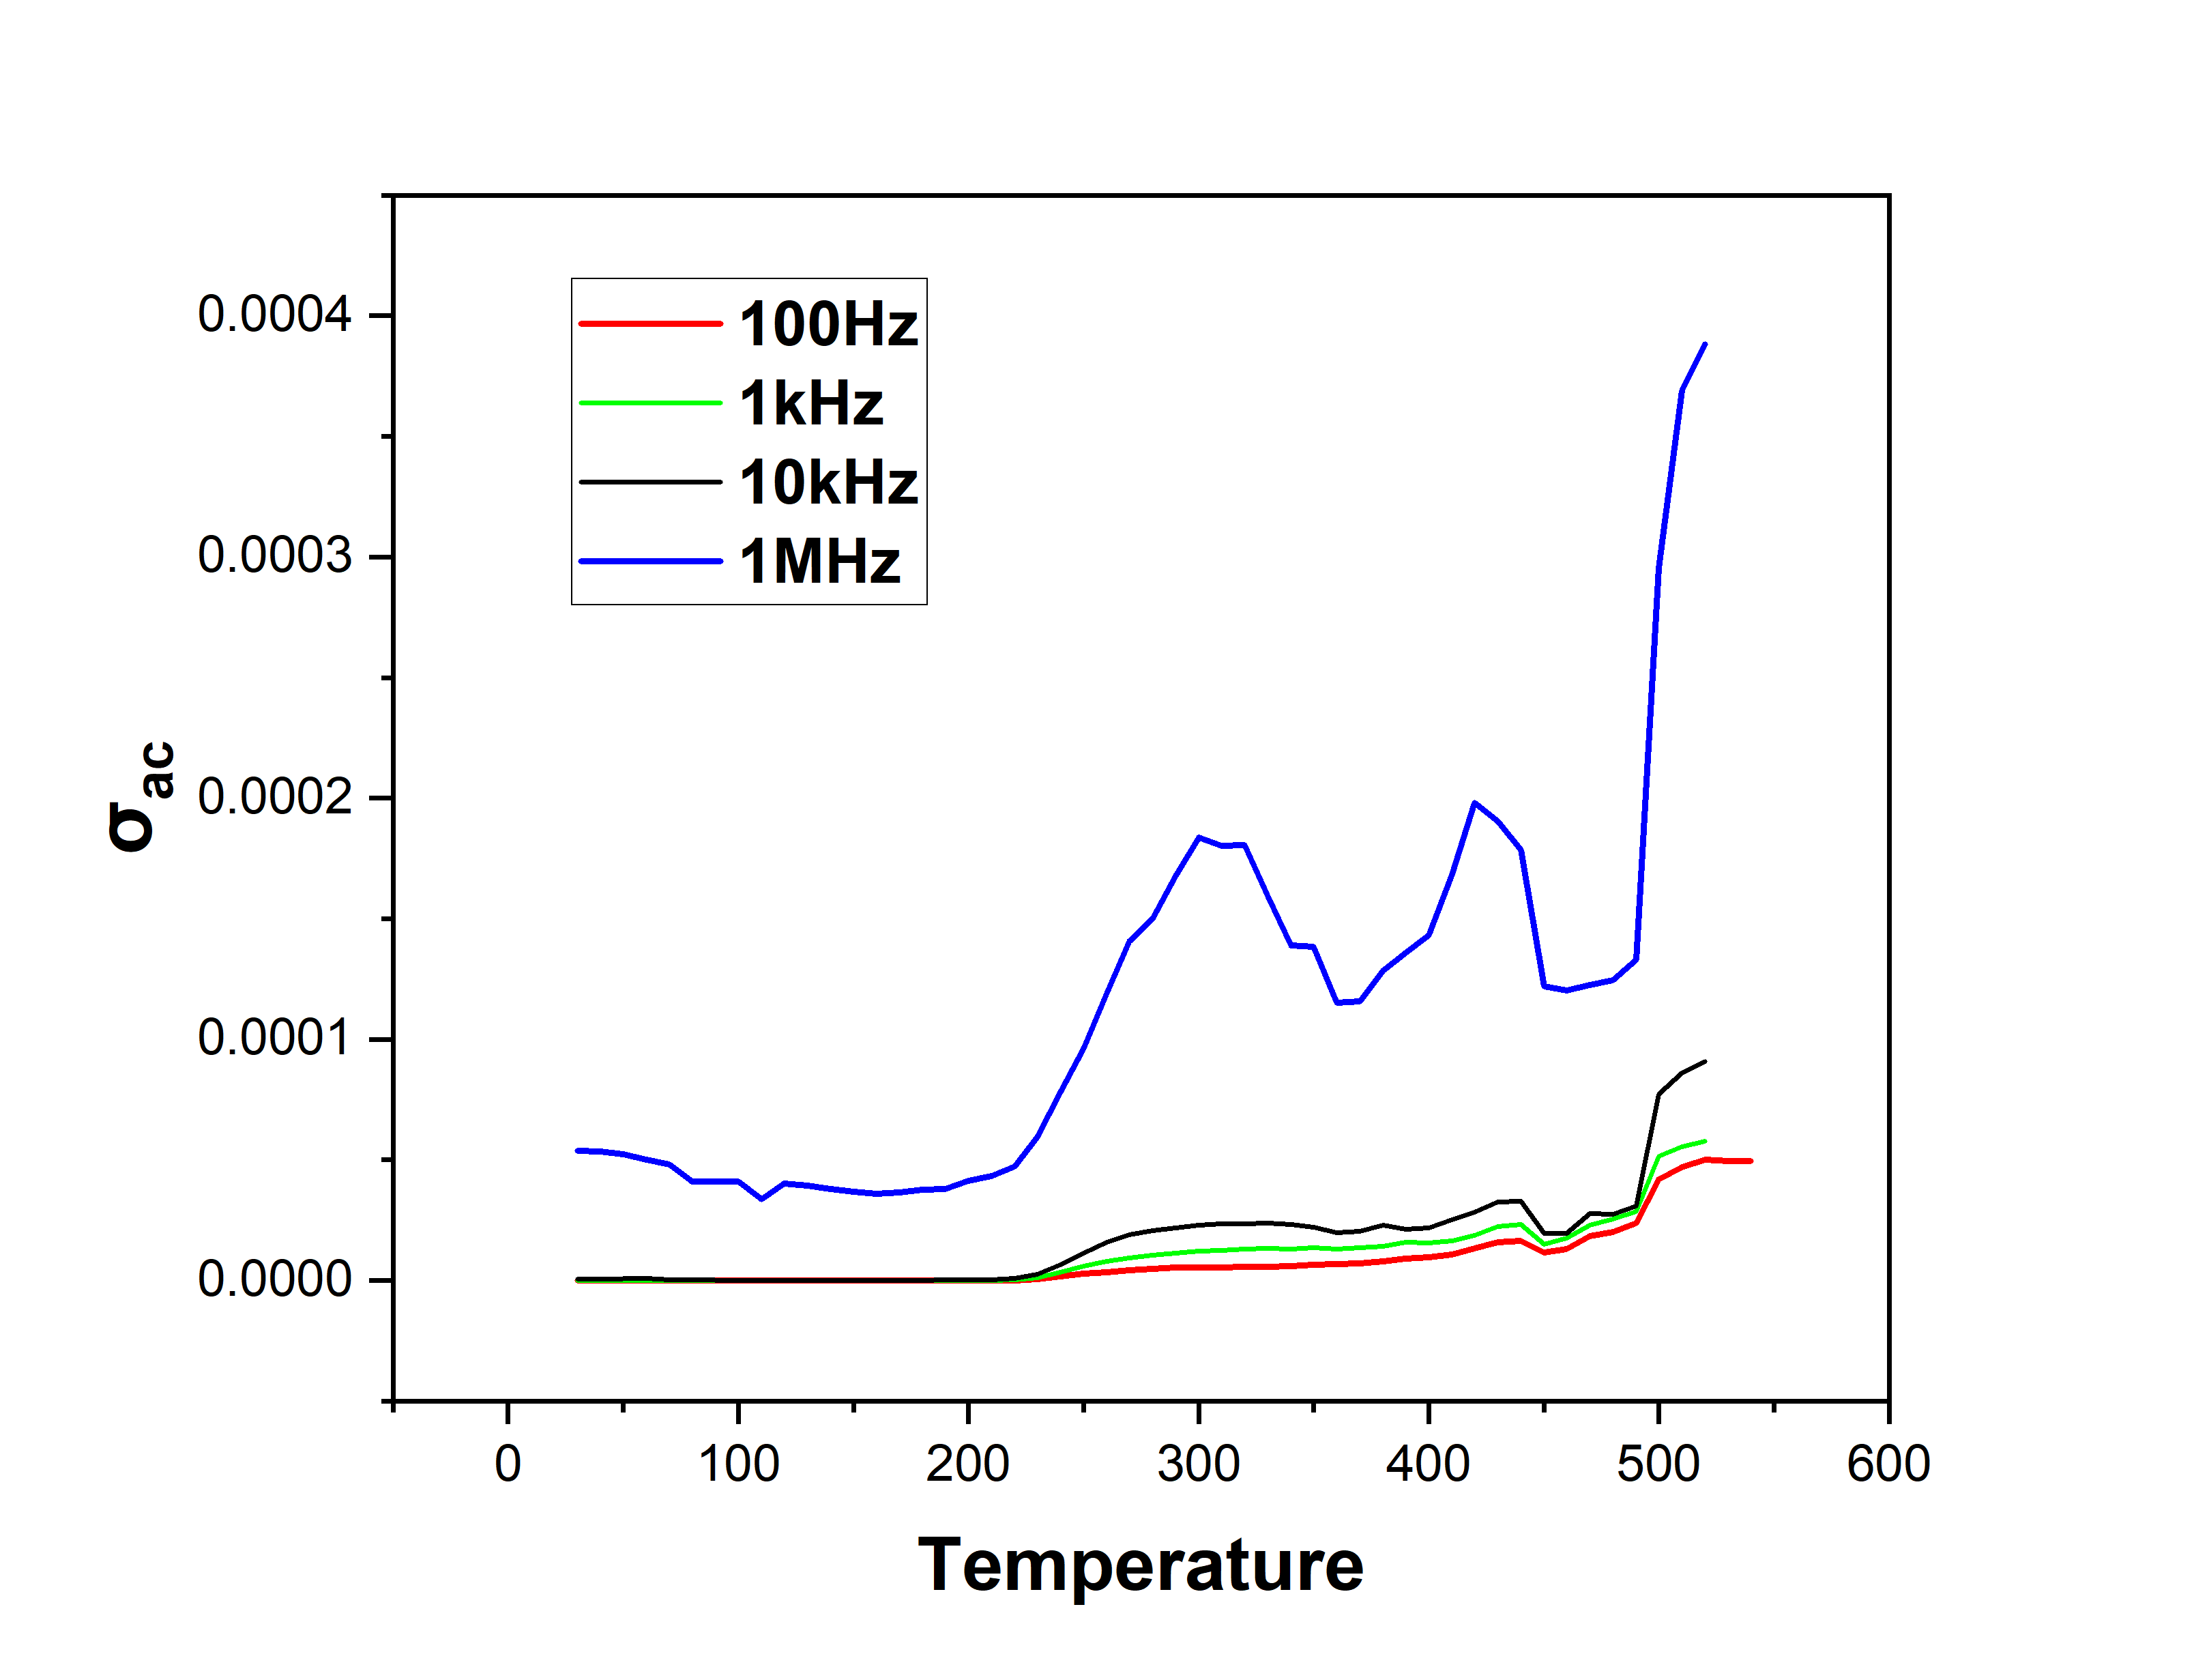
Temperature dependent dielectric Analysis
Figure: Dielectric loss vs Temperature
Figure: Conductivity vs Temperature

Slide 27
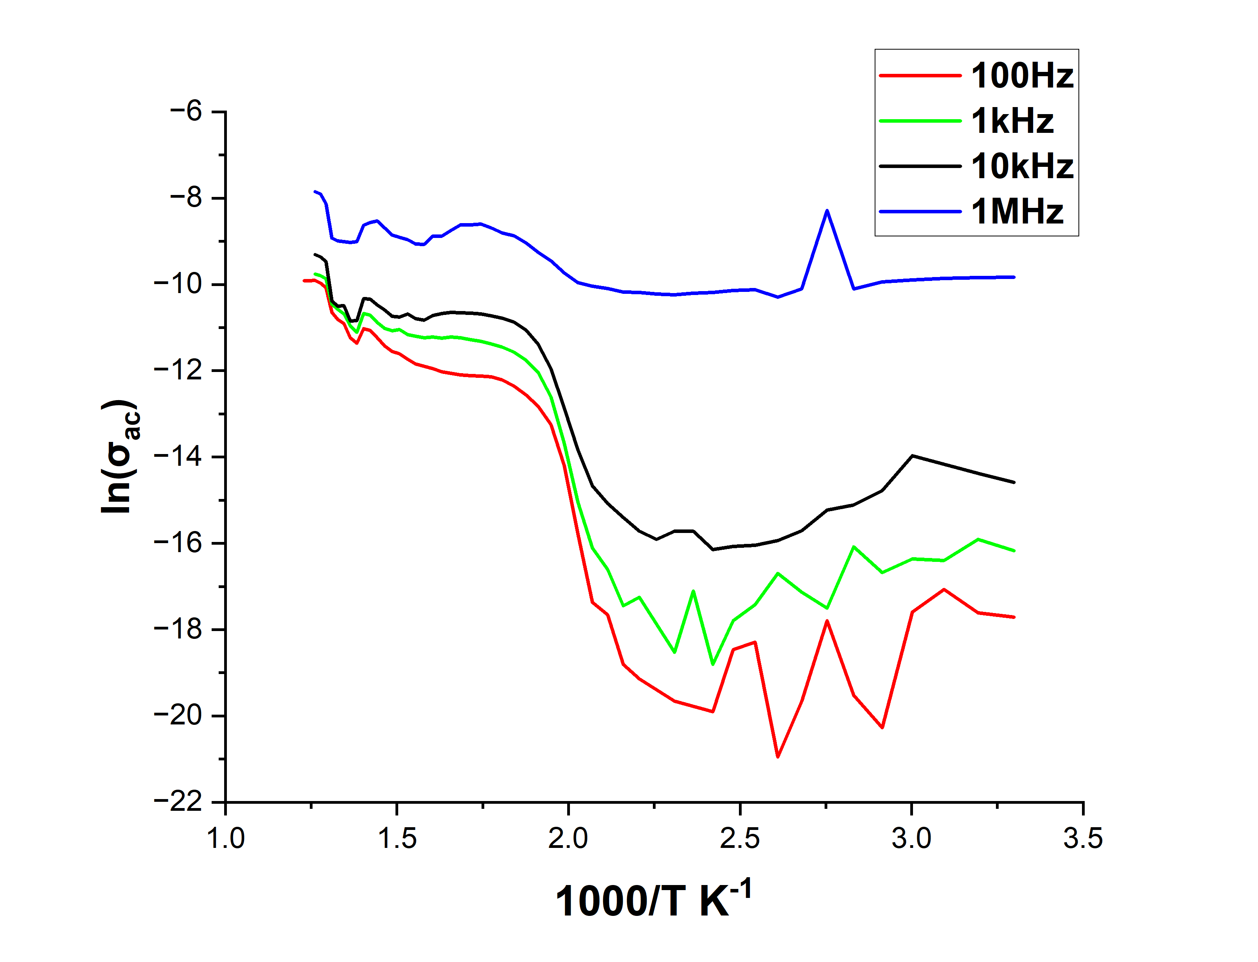
Temperature dependent dielectric Analysis
Figure: Arrhenius Plot

Slide 28
Temperature dependent dielectric Analysis
Frequency | Slope | Ea = −slope × k_{B} × 1000
100Hz | -7.62047 | 0.6576eV
1kHz | -15.6814 | 1.1395eV
10kHz | -20.39453 | 1.7599eV
1MHz | -20.9232 | 1.8055eV
Singly ionized= 0.3-0.5eV &
doubly ionized~0.5-2eV [7]
Apparent activation energy increases with measuring frequency, suggesting that high-frequency dielectric response requires a higher energy barrier for charge-carrier hopping.
The defect I worried about at the start, is the same defect that controlling conduction at the end.
Figure: Arrhenius Plot

Slide 29
SEM Analysis
(a)
(b)
Agglomerated and non-uniform grain morphology is observed, with fine particles distributed between larger angular grains.
Intergranular porosity suggests incomplete densification of the KNN–1.5 wt% BCHfT ceramic.
These pores, defects, and grain boundaries can enhance interfacial polarization, contributing to higher dielectric loss and reduced functional stability.
(c)
Microstructure explains why excess BCHfT may not improve performance beyond the 1 wt% composition.
Figure: SEM image of KNN-1.5% BCHfT at a)10000 b)20000 & c)30000 magnification

Slide 30
Piezoelectricity Analysis
Composition | Unpoled d₃₃ value
KNN | 13
KNN-1%BCHfT | 15.5
KNN-1.5%BCHfT | 12
Table: The unpoled d33 data for synthesized ceramics
KNN–1 wt% BCHfT shows the highest unpoled d₃₃ value of 15.5 pC/N, indicating an improved preliminary piezoelectric response compared with pure KNN.
Further increase of BCHfT to 1.5 wt% reduces d₃₃ to 12 pC/N, suggesting that excess BCHfT may introduce defect/interface effects that limit piezoelectric response.
Since the samples are unpoled, these values represent preliminary behavior; proper poling is required for reliable and optimized d₃₃ measurement.

Slide 31
Conclusion
KNN–BCHfT lead-free composite ceramics were successfully prepared by the conventional solid-state reaction route.
Dielectric analysis confirmed frequency- and temperature-dependent polarization behavior, with thermally activated defect-assisted conduction at elevated temperature.
Among the investigated compositions, KNN–1 wt% BCHfT showed the best overall response, including the highest unpoled d₃₃ value of 15.5 pC/N.
Excess BCHfT addition at 1.5 wt% reduced performance, likely due to porosity, defect/interface polarization, and incomplete densification.
KNN–1wt% BCHfT provides the best balance between dielectric stability and preliminary piezoelectric response, a validity of the comparative study.
KNN- BCHfT composite | d₃₃=15.5 pC/N (without poling) | ε_{r} =145.0419; 1kHz at 25⁰C | E_{a}~ 0.65-1.81eV | Tc~ 425-450⁰C | This thesis.

Slide 32
Future work
1
SEM analysis of other compositions
2
d₃₃ measurement with poling
3
P-E hysteresis loop
4
Density, porosity and electrode quality measurements

Slide 33
References
[1]J. Y. Kim, M.-J. Choi, and H. W. Jang, “Ferroelectric field effect transistors: Progress and perspective,” APL Materials, vol. 9, no. 2, Art. no. 021102, Feb. 2021, doi: 10.1063/5.0035515.
[2] L. Liu, H. Fan, L. Fang, X. Chen, H. Dammak, and M. P. Thi, “Effects of Na/K evaporation on electrical properties and intrinsic defects in Na0.5K0.5NbO3 ceramics,” Mater. Chem. Phys., vol. 117, no. 1, pp. 138–141, Sep. 2009, doi: 10.1016/J.MATCHEMPHYS.2009.05.024.
[3]Y. Zhang et al., “Effects of Mn-doping on anti-fatigue and anti-leakage current characteristics in KNN single crystals,” Applied Physics Letters, vol. 118, no. 4, p. 042903, Jan. 2021, doi: 10.1063/5.0039149.
[4]X. Chen, G. Liu, G. Huang, X. Li, X. Yan, and H. Zhou, “Good high-temperature stability and improved piezoelectric properties of (K0.5Na0.5)NbO3–Bi(Mg0.5Zr0.5)O3 ceramics,” J Mater Sci: Mater Electron, vol. 28, no. 17, pp. 13126–13131, Sep. 2017, doi: 10.1007/s10854-017-7146-5.
[5]Y. Zhang et al., “Effects of Mn-doping on anti-fatigue and anti-leakage current characteristics in KNN single crystals,” Applied Physics Letters, vol. 118, no. 4, p. 042903, Jan. 2021, doi: 10.1063/5.0039149.
[6]B.-Y. Li, X.-M. Chen, M.-D. Liu, Z.-D. Yu, H.-L. Lian, and J.-P. Zhou, “Improved ferroelectric and piezoelectric properties of (Na0.5K0.5)NbO₃ ceramics via sintering in low oxygen partial pressure atmosphere and adding LiF,” J. Adv. Dielect., vol. 11, no. 02, p. 2150012, Apr. 2021, doi: 10.1142/S2010135X21500120.

Slide 34
References
[7]S. Khardazi et al., “Structural, dielectric, ferroelectric and electrical properties of lead-free Ba0.9Sr0.1Ti0.9Sn0.1O3 ceramic prepared by sol–gel method,” Mater. Today Proc., vol. 51, pp. 2059–2065, Jan. 2022, doi: 10.1016/J.MATPR.2021.08.302.

Slide 35
THANK YOU SO MUCH
Pritom Majumder
📞01859472796
📩pritommajumder36@gmail.com

