Slide 1
Assembly Lab Project Minesweeper
Submitted by –
Jargis Ahmed
Pritom Saha
Submitted to –
Rumana Nazmul
Anna Faria
M. Tawfiqul Islam

Slide 2
Outline of the Presentation
About the game
Objectives of the game
Features of the game
How to play
Screenshots from the game
Things we used
Used Interrupts
Limitations
Conclusions

Slide 3
About the Game
Minesweeper is one of the most popular online and offline games of the world.
The game originates from the 1960s, and has been written for many computing platforms in use today. It has many variations and offshoots.
Minesweeper, a little game that debuted back in 1990 as part of the WINDOWS Entertainment Pack, before being promoted to a standard feature in WINDOWS 3.1 and onwards.
There is hardly any person who hasn’t played Minesweeper game at least once in his or her life.
And if you haven’t played the Minesweeper game at least once in your life, then hats off to you.

Slide 4
Objectives of the game
The objective of the minesweeper game is quite simple.
Minesweeper is a single player puzzle video game. The objective of the game is to clear a rectangular board containing hidden “mines” without detonating any of them, with help from clues about the number of neighboring mines in each field.

Slide 5
Features of the game
There is a Menu where the User can –
Press ‘p’ to play the game.
Press ‘c’ to see the credits.
Press the ‘esc’ button to exit from the game.
As the game was created on a 5x5 area, so there are 5 mines on the board. There are two numbers on the board, ‘1’ and ‘2’ that indicates the number of mines on the neighboring cells. There is also a flag icon, which is indicated by ’?’, that will be put on a cell if one right clicks.

Slide 6
How to Play
It’s easy to play Minesweeper. Click randomly until you hit a mine. When you do, you've won :) Good luck!
Keeping the jokes aside, the real way to play the game is described below –
The numbers indicate how many mines are touching that square. the objective is to find all of the mines. To do this, right click on a square that you think has a mine on it. When you right click, a flag should come up. When you've found all of them and clicked on all the squares without a mine, you win.

Slide 7
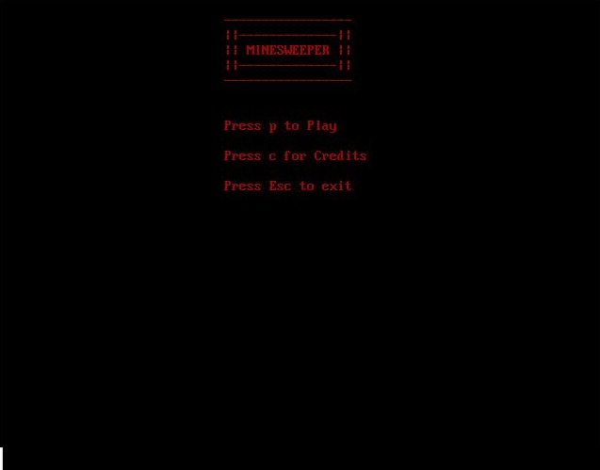
Screenshots of the Game

Slide 8
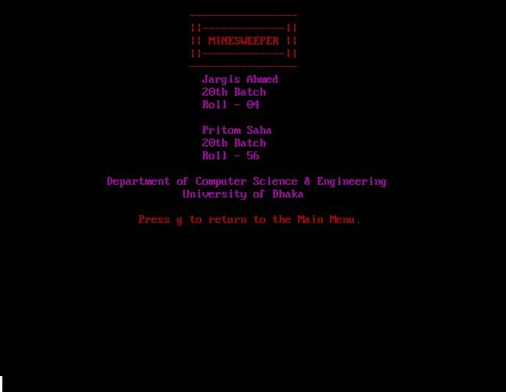
Screenshots of the Game

Slide 9
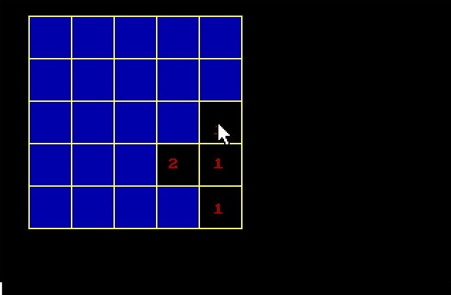
Screenshots of the Game

Slide 10
Things we used
Assembly language
DOSBox
TASM
The code is written in assembly language.
DOSBox is an emulator program that emulates an IBM PC compatible computer running a DOS operating system. Many IBM PC compatible graphics and sound cards are also emulated.
Turbo Assembler (TASM) is a computer assembler (software for program development) developed by Borland which runs on and produces code for 16- or 32-bit x86 MS-DOS or Microsoft Windows.

Slide 11
Used Interrupts
For this game we had to set the graphics mode at first. We moved 0h to ah register 13h to al register and called interrupt 10h.
Then after that we called interrupt 16h after we moved 0 to ah, which gets keystroke from keyboard.
In this project, everything had to be done by setting the cursor at first. That means we had to set the position where we want to print the mine or a number or to draw the row and column line etc. We also had to print ‘?’.

Slide 12
Used Interrupts
Interrupt 33h is called for using mouse functions. But first we had to move 01h to ax register.
In this game, we had to make sure that the empty area of the window remains unused.
We had to move 02h to ax to hide the mouse cursor.
We had to make sure that everything remains on the same page, that’s why we moved 0 to bh register.
We set the cursor by moving 02h to ah register and called interrupt 10h.

Slide 13
Used Interrupts
To Print a character we had to move the desired character to al register. We had to move 9h to ah register to print the characters in graphics mode. Then we moved a number to cx register that ensures the number of characters to be printed. Then we moved the color number to bl register.
We used dl and dh register for positioning the cursor. The dh register represents the row and dl resister represents the column.

Slide 14
Limitations
It’s very hard to debug a code while doing these kind of works. It may take someone hours to find a small bug in the code. It took us a whole day just to find out a small bug while doing mouse-related works.
Coding in assembly language is a hard task. It is very hard to code these games/apps in assembly.
Assembly language has it’s limitations. The running speed is just too slow. It takes a lot of time just to draw a single line.
It takes a lot of time just to write a simple code.
The size of the Minesweeper board is considered for only 5x5 square. It can be made dynamic for the user.

Slide 15
Conclusion
Despite the limitations, it was great fun doing the project of making one of the most played games Minesweeper. Although it was our initial plan to make the game more dynamic and to make the 5x5 square more random but due to the shortage of time and limitations of the assembly language it was hard to do those things. But the game is competitive enough to play again and again. This is our first project. We tried our best to make the game like the original one. More thing to come in the future for sure.
Last but not least we would like to thank our honourable teachers Runama Nazmul, M.Tawfiqul Islam and Anna Fariha for their continuous support and suggestions.

Slide 16
This is just the beginning.
Best of luck playing the game.
Thank you.

