Slide 1
Programming Lab Project
Race
Where it all Begins
Submitted by – Pritom Saha
Submitted to –
Anna Faria
Dr.MD.Asif hossain khan

Slide 2
Outline of the Presentation
About The Game
Objectives of the Game
Features of the Game
Game Play
Flow Chart
Limitations
Screenshots From the Game(Menu

Slide 3
About The Game
s
Car racing game is one of the most played online and offline games in the world.
One of the best car racing games is Need For Speed. It’s one of the most popular games!
There is hardly any person who has not played car racing game at least once in his or her lifetime.
And if someone hasn’t played a car racing game, then hats off to them!

Slide 4
Objectives of the Game
Creating a background for the game .
Drawing Enemy cars to haunt the Player’s car.
There are many Enemy cars with different colors.
There are various options on the main menu and the user can pick any of those!

Slide 5
Features of the Game
There is a Menu, where the user can select –
New Game -
High Scores -
Instructions-
Credits -
I have used Microsoft visual C++ 2010 compiler and BGI library to build the legendary game named Race!

Slide 6
Game Play
Usually 2D games are easy to play! But there are some concerns , there are some rules and regulations.
Usually a car racing game is a single player game.
The Car has to defy all odds, all restrictions to reach it’s destination!
After reaching it’s destination the game level ends and a new level is created and the situation gets harder and harder.

Slide 7
How To Play
Use directional buttons in the main-menu to navigate.
Click “Left Button” of the mouse.
Press “New game” to Start a Race.
Press “High Score” to See the Name and Score of the Ancestors.
Press direction buttons to navigate the Car.
Avoid the cars, if they touch the Car, the player will lose score.
Avoid Enemy cars to save your life.
The Score increases and the level changes.

Slide 8
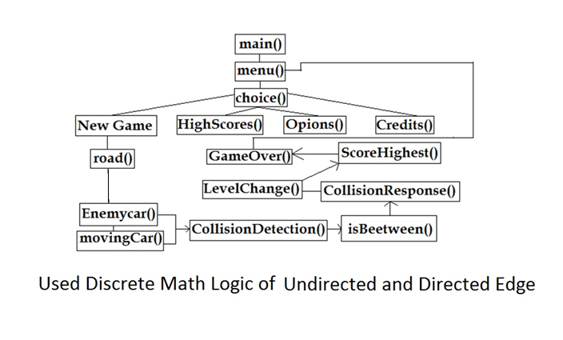

Flow Chart

Slide 9
Limitations
It’s very hard to debug a code while doing these kind of works. It may take someone hours to find a small bug in the code.
BGI has it’s limit, after some time the project may not work like before. It may become slower!
The speed of the enemy car increases in levels. The higher the level the more the speed , but it blinks too much!

Slide 10
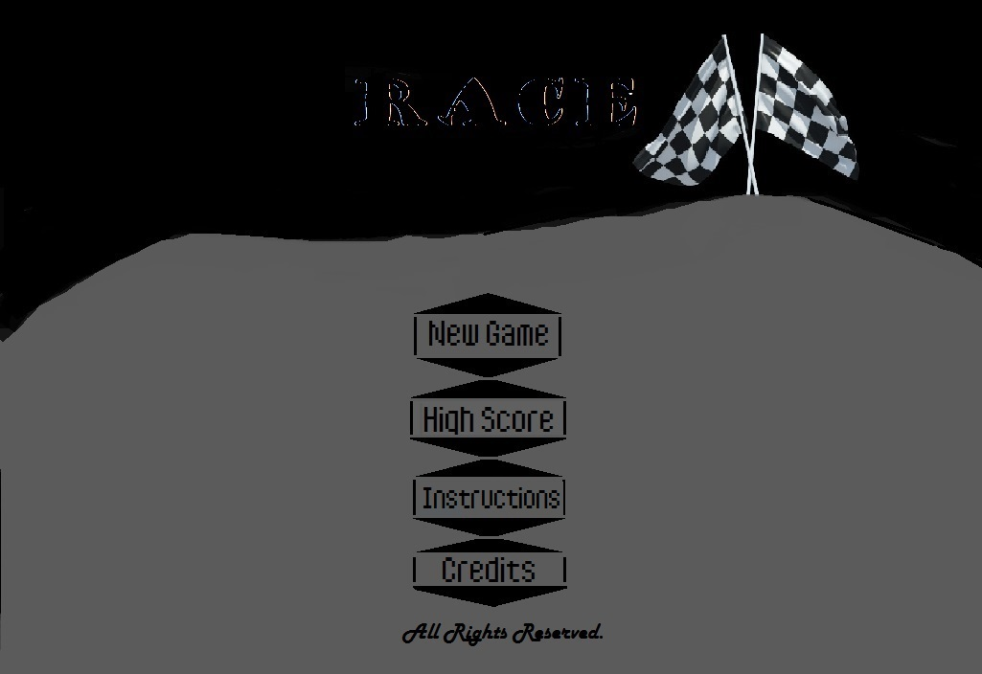
Screenshots From the Game (Menu)

Slide 11
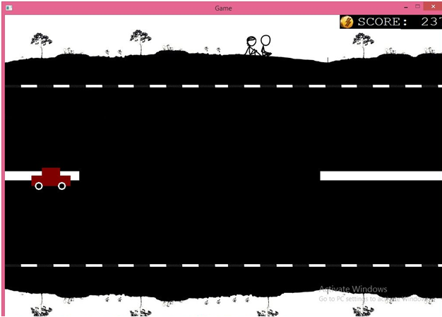
Screenshots From the Game (Level 6)

Slide 12
Conclusion
To ensure that this program works on all Windows devices, the .exe file
was built using Release Mode on Visual Studio 2010. The game was
coded to make optimal use of the BGI functions and to negate most of
its drawbacks. The idea was to implement a small Racing game and
although not entirely similar, Race – “Where It All Begins” has the
lights of Enemy car and ghosts! Which gives a taste of2D (actually 1D)
gaming experiences!
I would like to thank our honorable teachers – Dr. Md. Asif Hossain Khan
and our beloved Anna Faria ma’am for their continuous suggestions and
care!

Slide 13
This is just the beginning!
Thank You

