Slide 1



PRODUCT MANAGEMENT CASE STUDY
Designing a Governed
Data Product Marketplace
Taking enterprise data products from registration to governed, self-service consumption — discovery, subscription, contracts, and lifecycle management in one marketplace.
Pritom · Product Manager OvalEdge — Data Governance Platform

Slide 2
The Problem
Enterprise data was governed — but not consumable.
No discovery layer
Curated datasets existed in the catalog, but analysts and business users had no marketplace to browse, evaluate, and request them.
MY ROLE
Product Manager — owned the module end to end
Defined requirements and authored the formal SBD
Designed the lifecycle state model & marketplace UX
Built the Feature Specification Matrix (100+ specs)
Drove design decisions with engineering
Access was manual
Every data request meant tickets, emails, and waiting — no self-service subscription or approval workflow.
No contract or lifecycle control
Producers had no way to publish terms of use, version contracts, or safely edit live products without breaking consumer access.

Slide 3
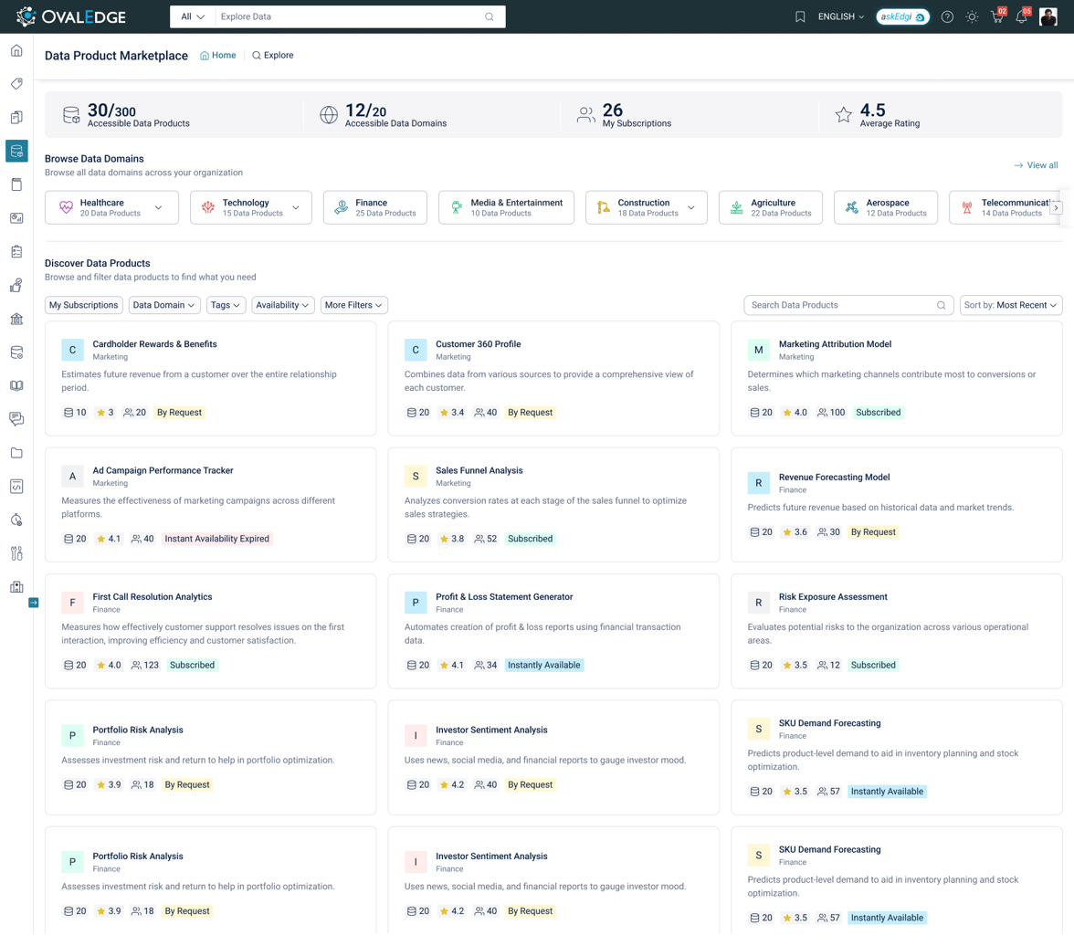




What I Designed
A self-service marketplace where governed data products are discovered, evaluated, and subscribed to.
Discovery & Explore
Domain carousels, featured products, faceted filters, and curation-score ranking.
Contracts & Trust
View-only data contracts, ratings, popularity, and governance roles on every card.
Subscription Engine
Instantly Available and approval-based flows with expiry, suspension, and revocation.
Notifications
Publish, republish, unpublish, and expiry events keep consumers informed.

Slide 4
Key Decisions & Trade-offs
Where PM judgment shaped the system.
LIFECYCLE STATE MODEL
New
→
Published
→
Draft
→
Inactive + Draft
→
Retired
Clone-and-Merge for live editing
Evaluated 5 approaches for editing published products. Chose cloning on Draft entry and merging metadata back on publish — consumers keep stable access while edits happen safely.
Trade-off: merge complexity vs. zero consumer disruption
Scoped out Archived status
Cut the Archived state to ship a leaner model. Retired covers end-of-life; documented the cut explicitly so it can be revisited with real demand.
Trade-off: completeness vs. focus and delivery speed
Contract change ≠ metadata change
Metadata-only republish restores access silently; contract changes force re-acceptance and suspend access until consumers agree — compliance built into the workflow.
Trade-off: friction vs. contractual integrity

Slide 5


Outcomes & Deliverables
From ambiguous discussions to an aligned, build-ready specification.
1
100+
5
20+
formal SBD aligning product & engineering
feature specs in the FSM
lifecycle states modeled & documented
notification events specified
WHAT THIS PROJECT DEMONSTRATES
Systems thinking
State machines, edge cases, and access logic modeled end to end
Spec-driven PM
Modular, composable docs that engineering builds from directly
Two-sided design
Balanced producer governance with consumer self-service

