Slide 1
Transaction data analysis (for DATA@ANZ)
BY: Pritpal Singh Pruthi

Slide 2
Avg. amount on each day for 3 different months
Highest avg. amount on a single day(August) is 497.3 on 20th day.
Highest avg. amount on a single day(September) is 376.5 on 17th day.
Highest avg. amount on a single day(October) is 463.8 on 15th day.

Slide 3
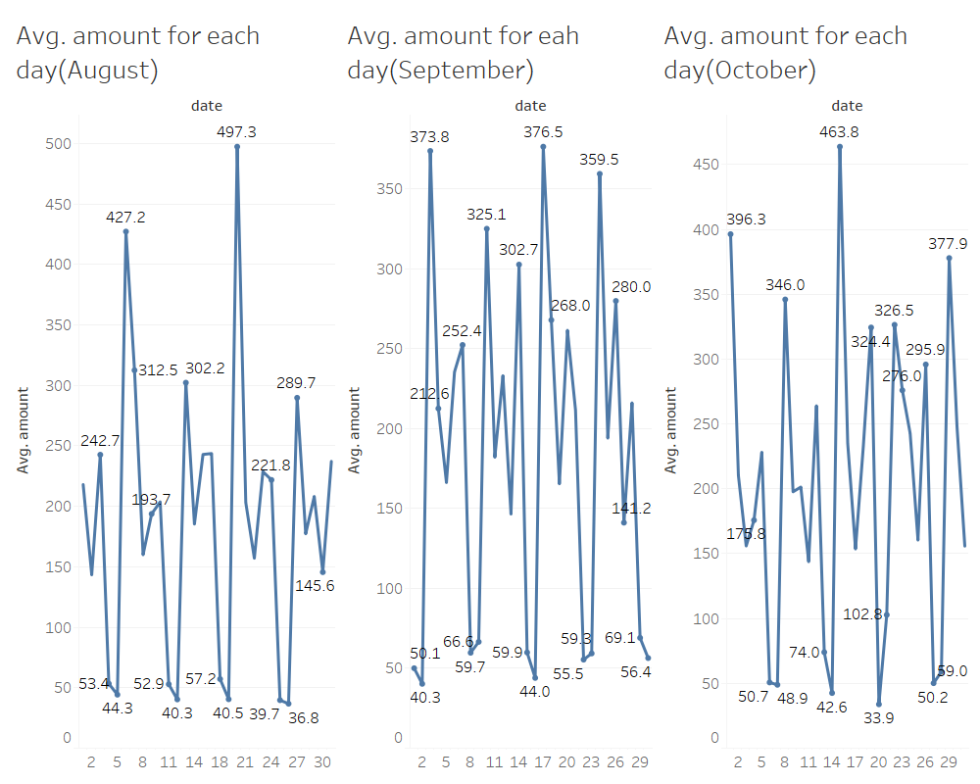

Slide 4
Transactions based on gender
Women are not less than men, there are approximately equal number of transactions made by men and women.
Most number of transactions on a single day are 172,174 and 168 in august,September and October respectively.
Maximum number of transactions ,i.e., 4087 are done in October

Slide 5
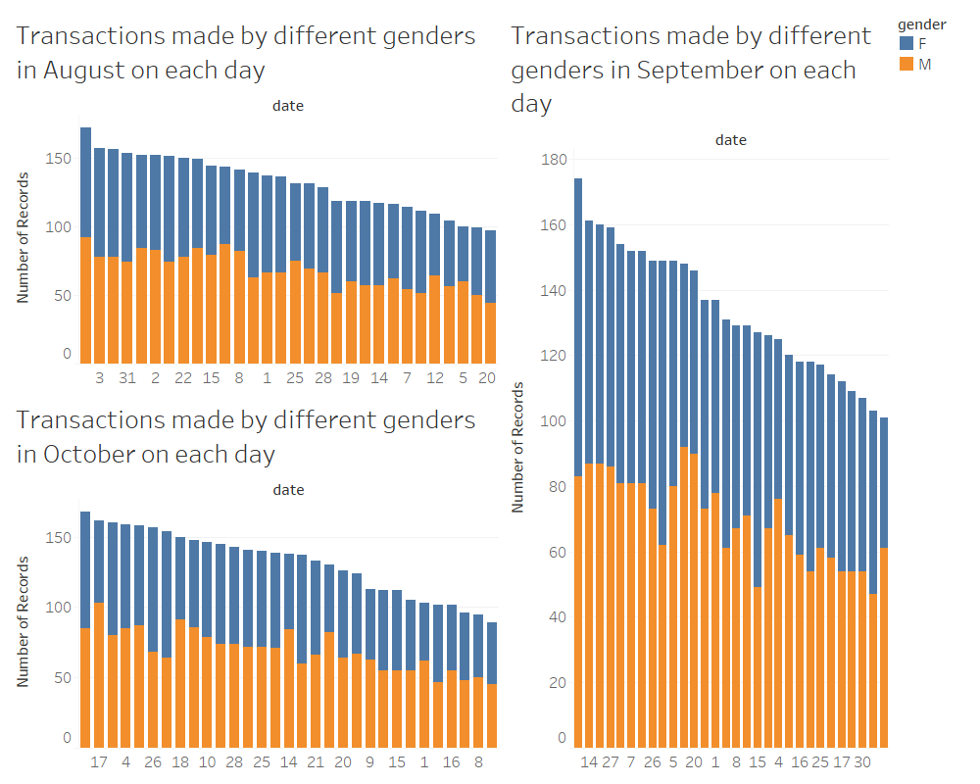

Slide 6
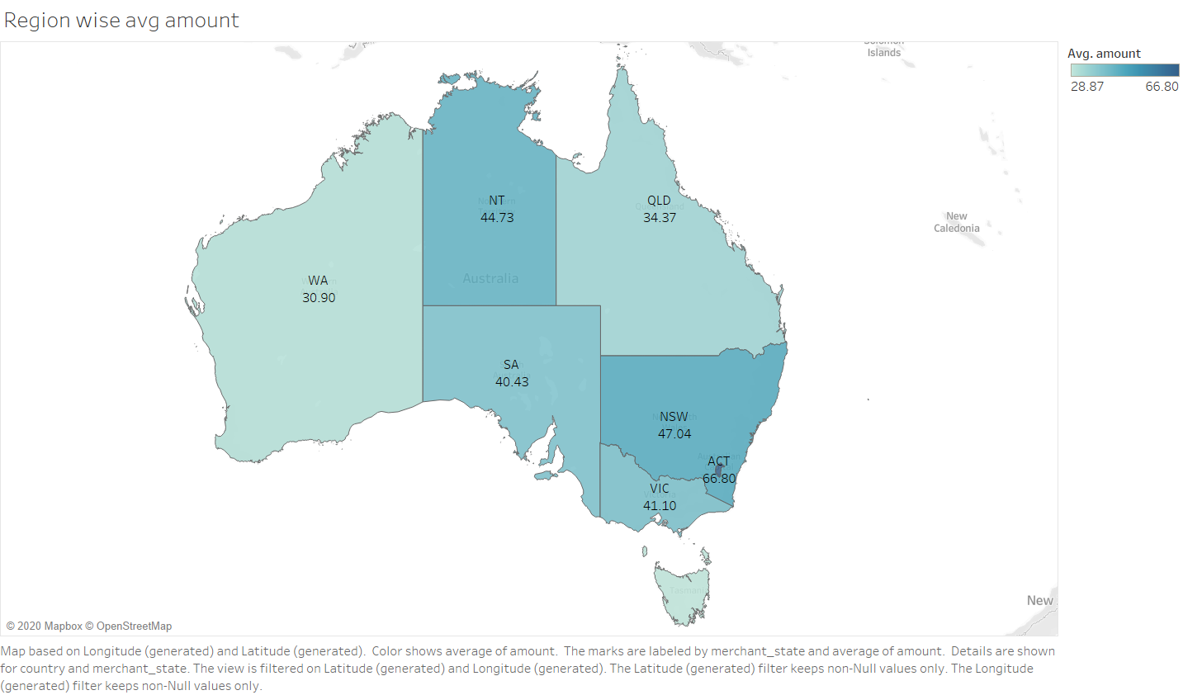
Region wise average
Max avg. amount in three months is from ACT

Slide 7
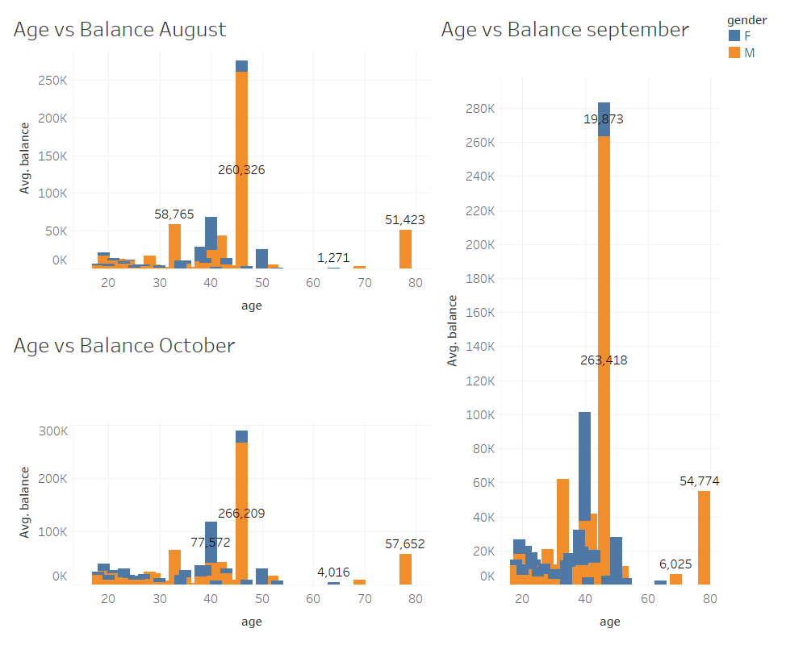
Avg. balance vs age
Customers with age 46 have the max. average balance in all the three months.

