Slide 1
Capstone Project : EcoTrack AI
EcoTrack AI
EcoTrack AI analyzes daily activities such as travel, electricity usage, and waste generation to estimate a user's carbon footprint. It provides personalized suggestions to reduce emissions and promote sustainable living.
🌱 Carbon Footprint Tracking
🚲 Eco-Friendly Travel Suggestions
⚡ Energy Saving Tips
📊 Weekly Carbon Report
An AI-powered carbon footprint tracker that helps users reduce their daily carbon emissions through smart suggestions.
Name: PRIT RAKHOLIYA | Enrollment: 23084013118
Stream: Computer Science & Engineering | College: R. N.G. Patel Institute Of Technology

Slide 2
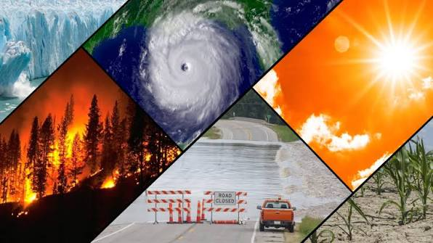
UN SDG 13: Climate Action
• Climate change is one of the biggest global challenges.
• Take urgent action to reduce climate change.
• Protect people, nature, and future generations.
• Every action counts.

Slide 3
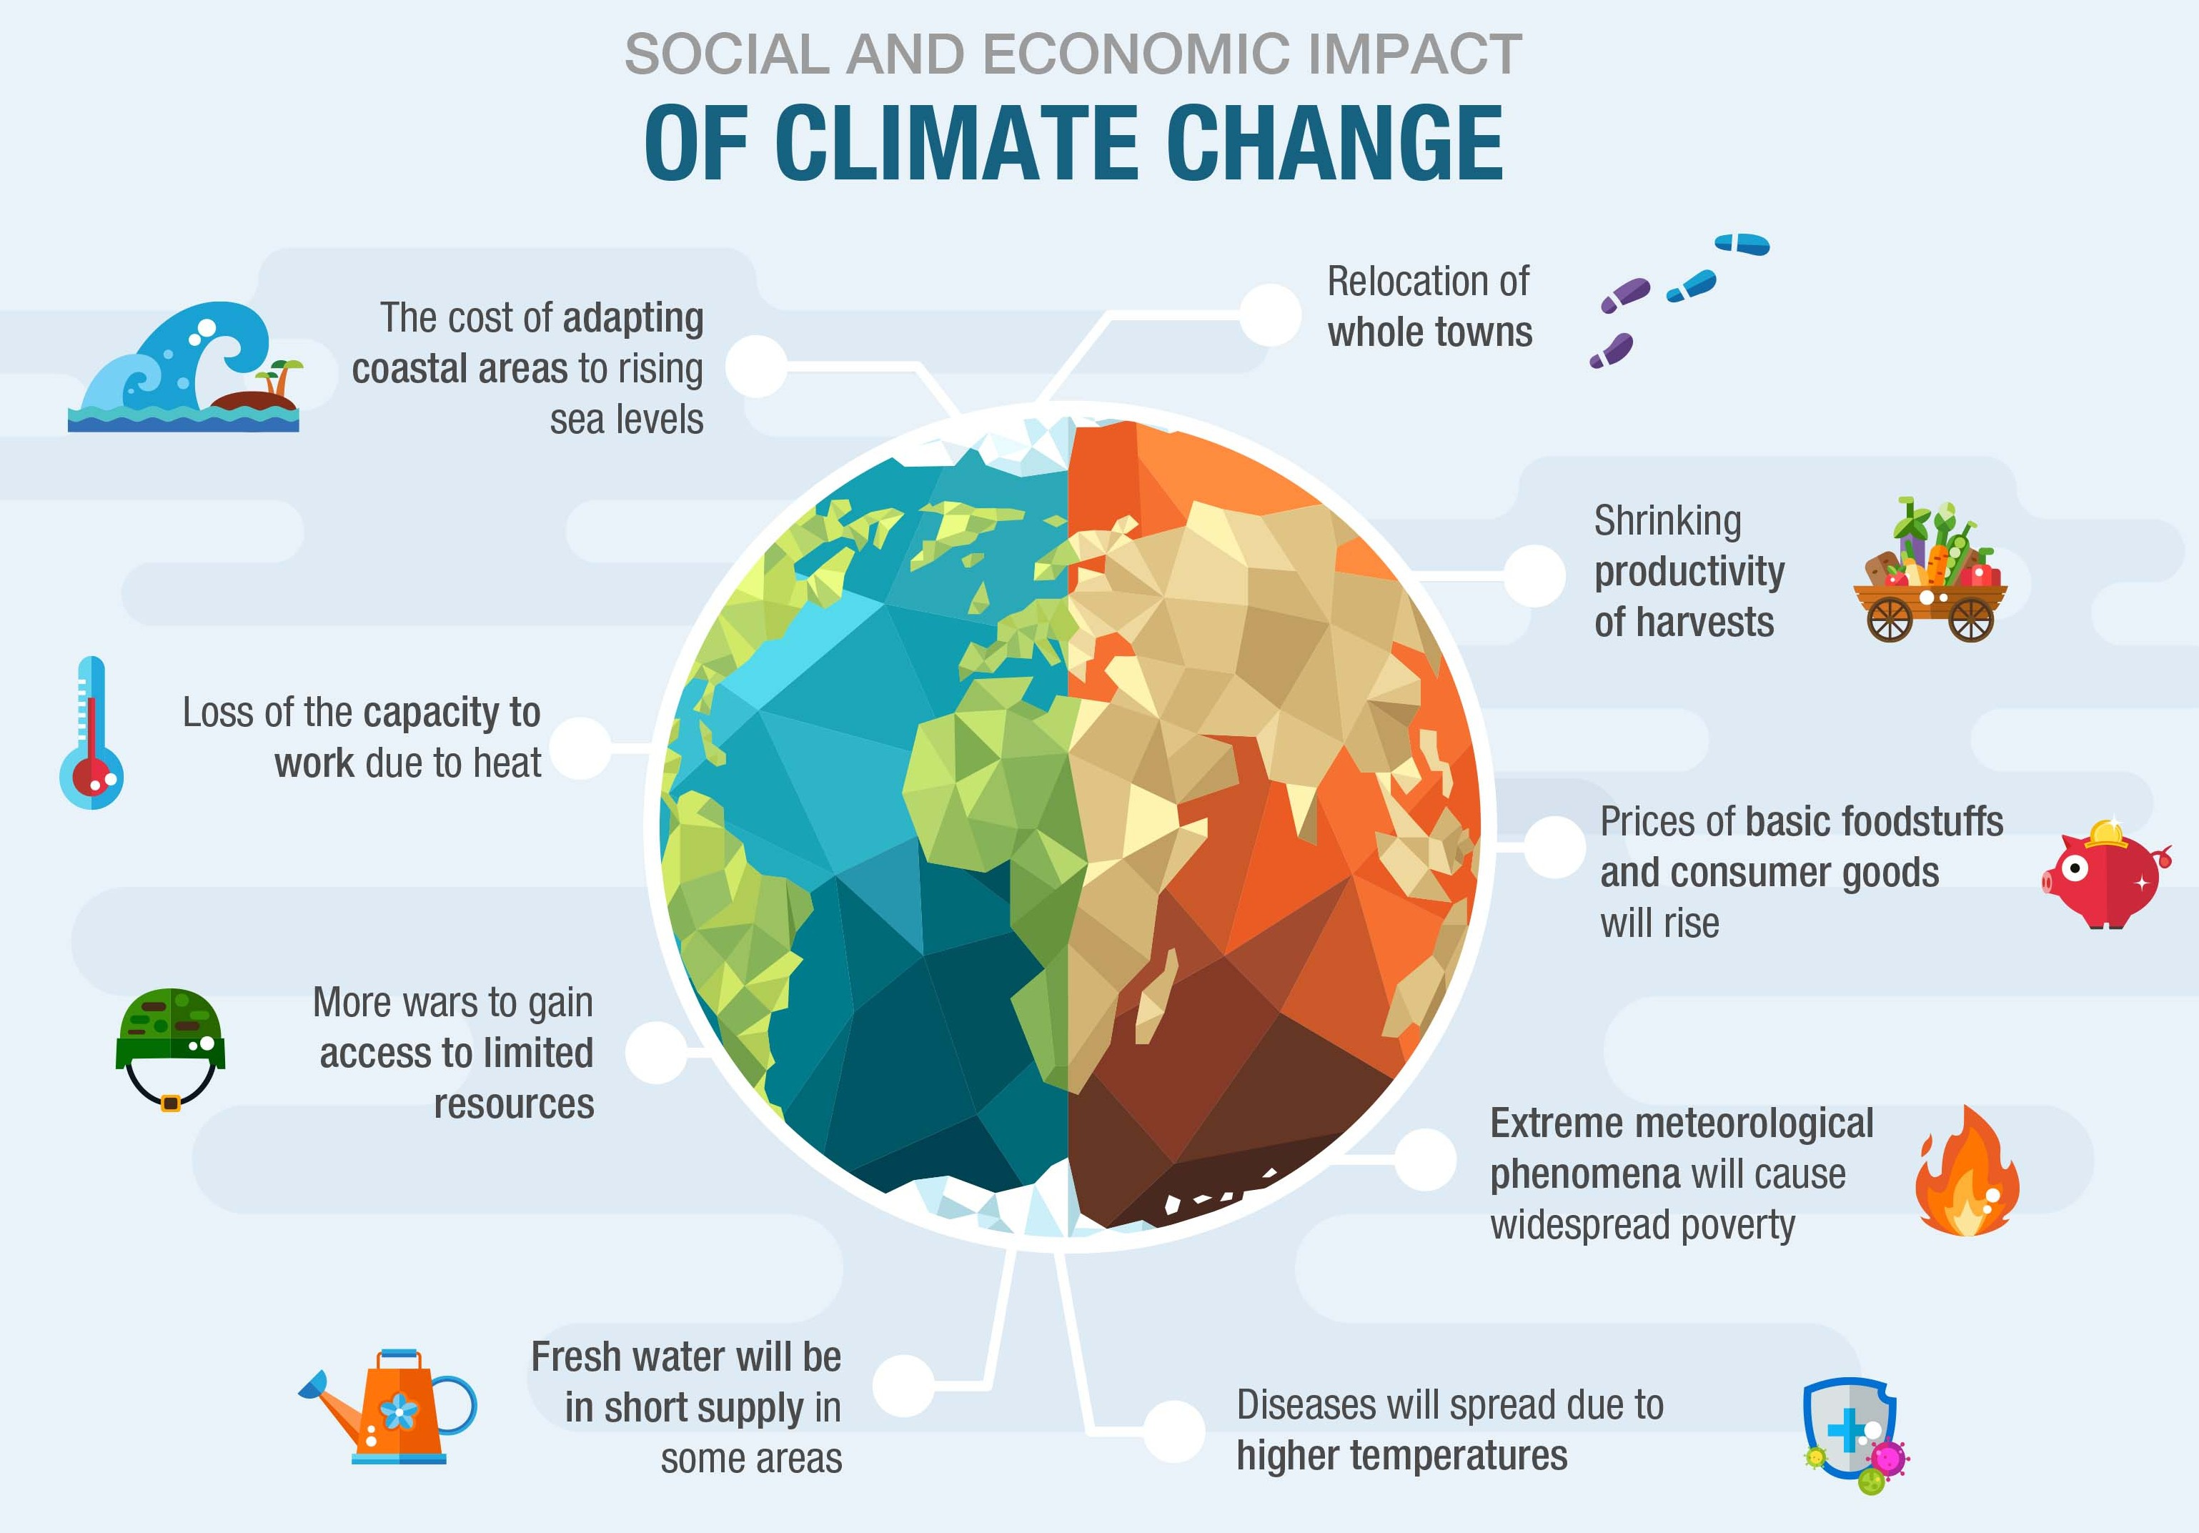
Causes & Global Impact
• Burning fossil fuels
• Deforestation
• Pollution
• Transport emissions
• Rising temperatures
• Floods & droughts
• Melting glaciers
• Biodiversity loss

Slide 4
AI & Technology
• AI predicts floods and wildfires.
• Smart energy management.
• Satellite climate monitoring.
• Precision farming.
• Challenge: AI also uses energy and water.
☀ Solar
🌬 Wind
🤖 AI
🌱 Trees
🚲 Green Life

Slide 5

Solutions & Our Contribution
• Use renewable energy.
• Plant more trees.
• Reduce plastic waste.
• Use public transport.
• Project: Climate Guardian AI tracks carbon footprint.

