Slide 1
Approximate Models for Fast and Accurate Epipolar Geometry Estimation
James Pritts
Ondrej Chum and Jiri Matas
Center for Machine Perception (CMP)
Czech Technical University in Prague
Faculty of Electrical Engineering
Department of Cybernetics

Slide 2
Introduction
RANSAC commonly used for robust epipolar geometry estimation
very effective
Runtime is given by
proportion of measurements that are good in the data
The sample size needed to hypothesize a model
Approximate models requires smaller sample size
But give worse estimates of epipolar geometry
Epipolar geometry estimation by hypothesizing approximate models fit from 2 region-to-region correspondences
Contributions
We propose 2 new 2 region-to-region methods for estimating epipolar geometry
Experimentally compare to previous approaches

Slide 3
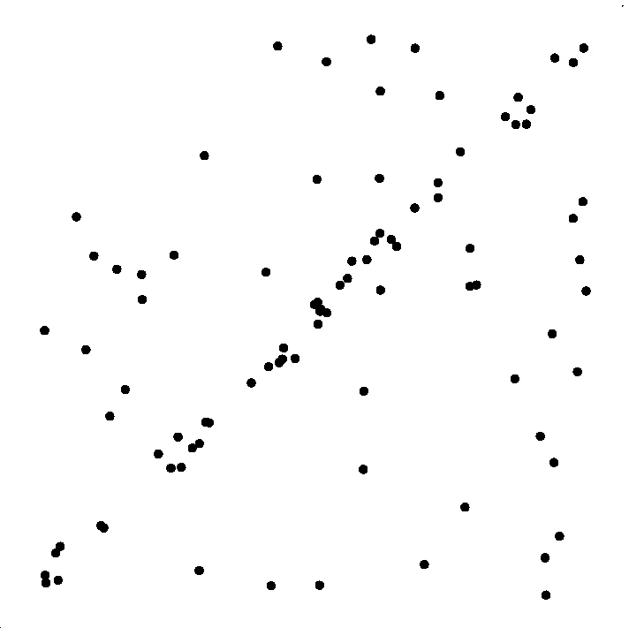
Fitting a Line
Least squares fit

Slide 4
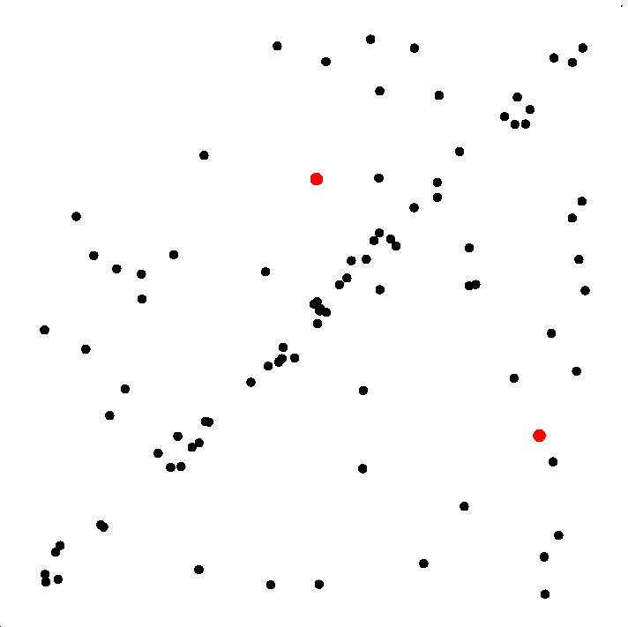
RANSAC
Sample s points

Slide 5
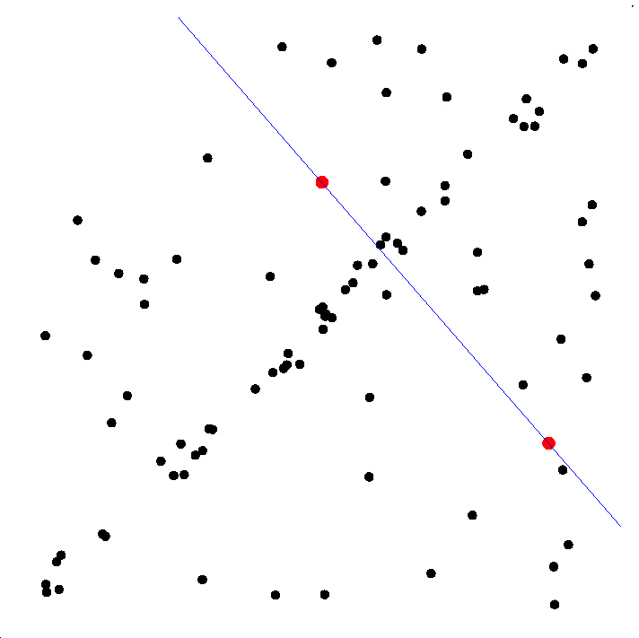
RANSAC
Sample s points
Fit model to sample

Slide 6
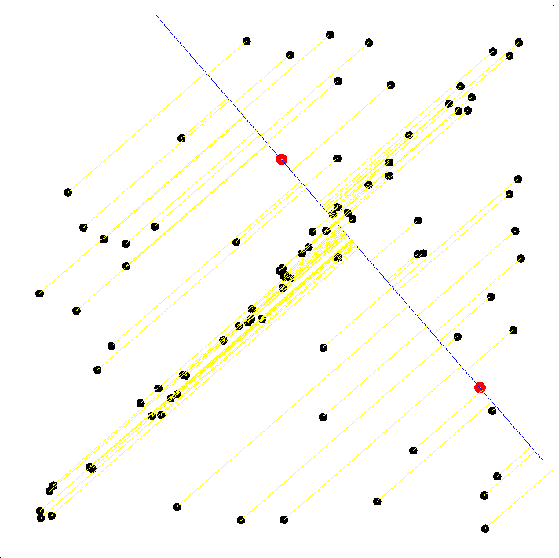
RANSAC
Select sample of m points at random
Fit model to sample
Calculate error for each measurement

Slide 7
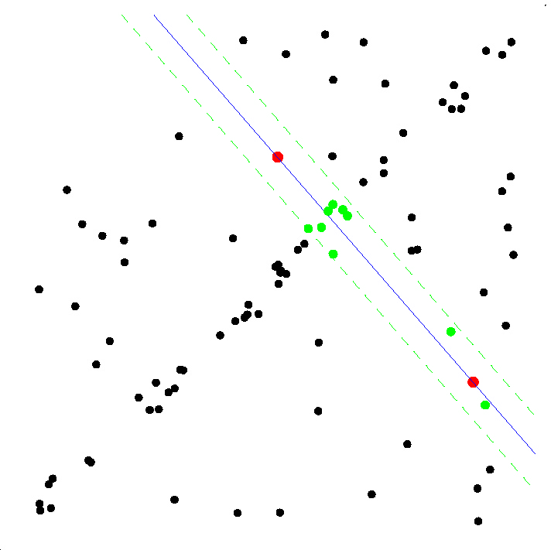
RANSAC
Select sample of m points at random
Fit model to sample
Calculate error for each measurement
Find consensus set

Slide 8
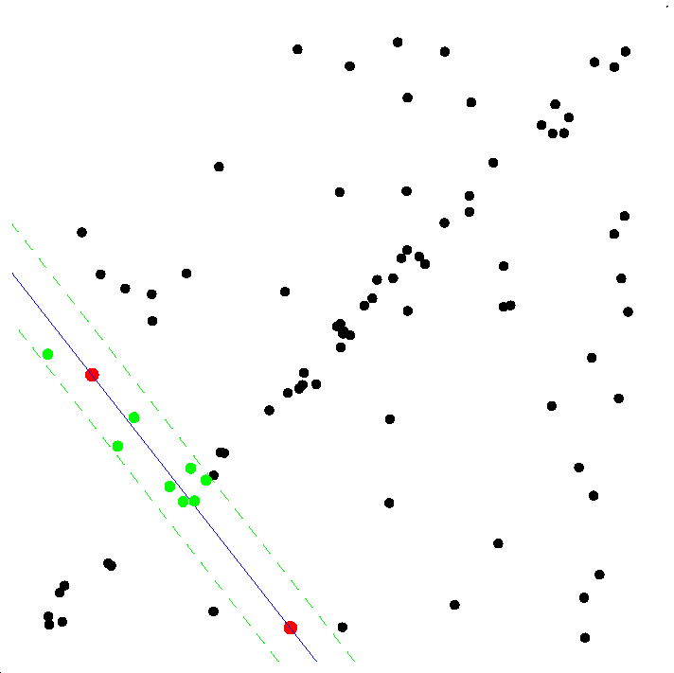
RANSAC
Select sample of m points at random
Fit model to sample
Calculate error for each measurement
Find consensus set
Repeat sampling
Hypothesize
Verify

Slide 9
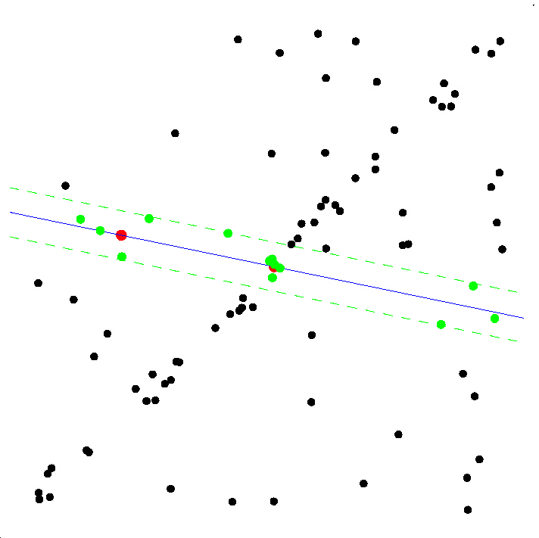
RANSAC
Select sample of m points at random
Fit model to sample
Calculate error for each measurement
Find consensus set
Repeat sampling

Slide 10
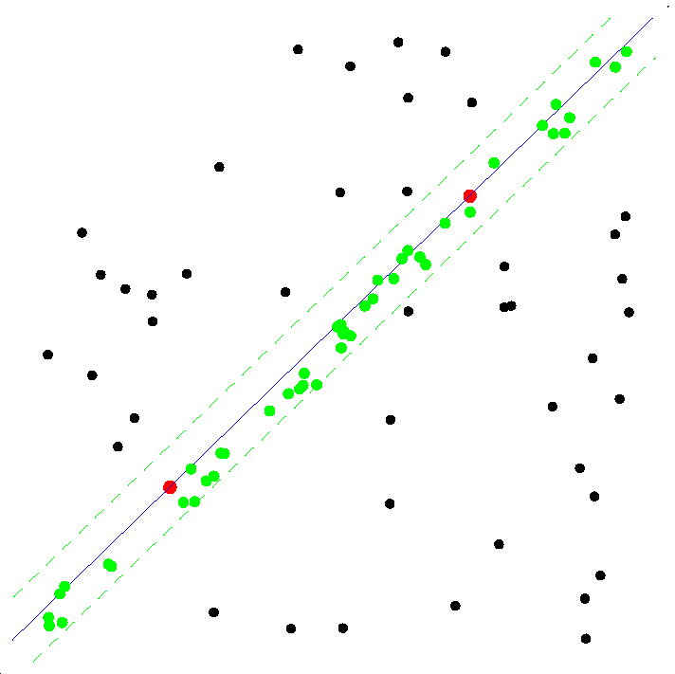
RANSAC
Select sample of m points at random
Fit model to sample
Calculate error for each measurement
Find consensus set
Repeat sampling

Slide 11
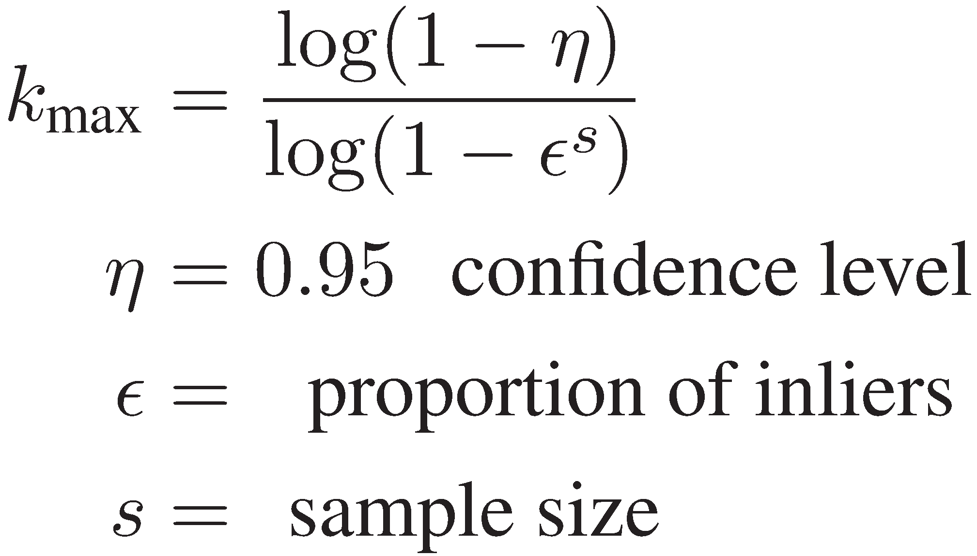
RANSAC
Terminates when finding a better solution is improbable.
Large sample size
means more
samples required!

Slide 12
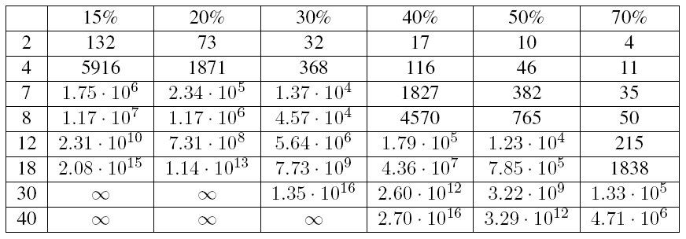
How bad is it?
Reduce sample size for fundamental matrix estimation by hypothesizing approximate models
I / N [%]
Size of the sample m
Difficult wide baseline stereo matching problems at 95% confidence

Slide 13
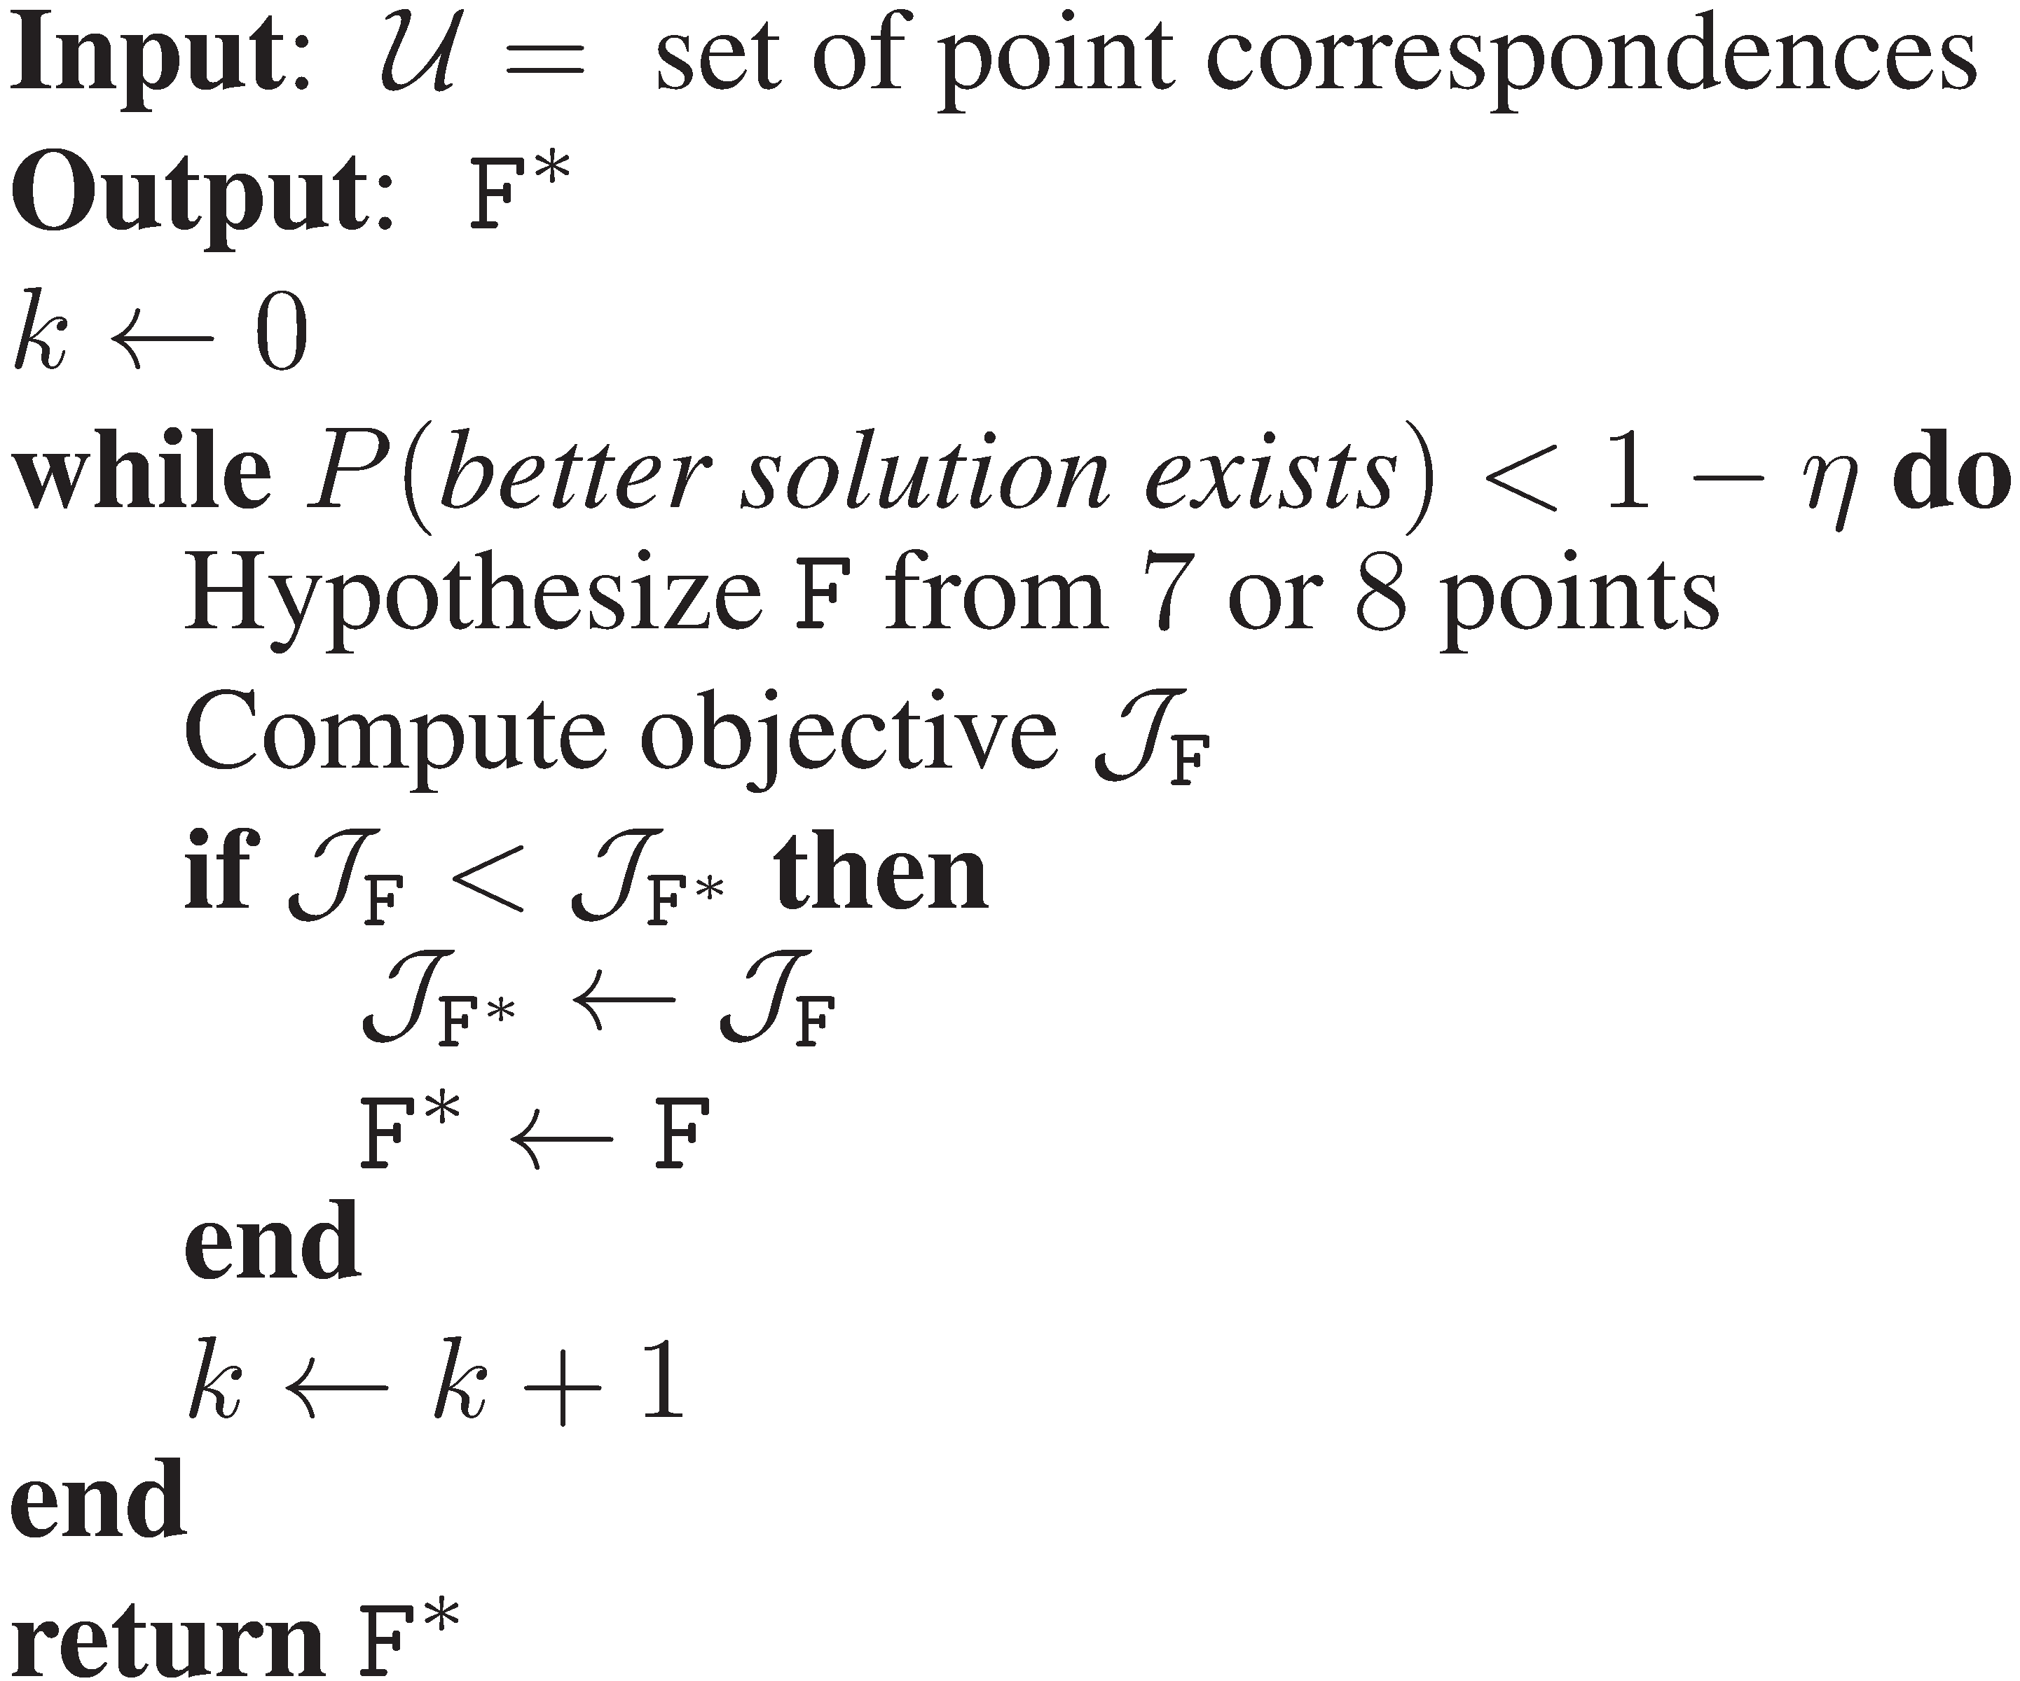
Classic RANSAC for F estimation
PROBLEM
Measurements are noisy
Hypotheses from small samples are only approximate
Classic RANSAC does not really work for complex models
Low accuracy, low precision
Need Locally Optimized RANSAC

Slide 14
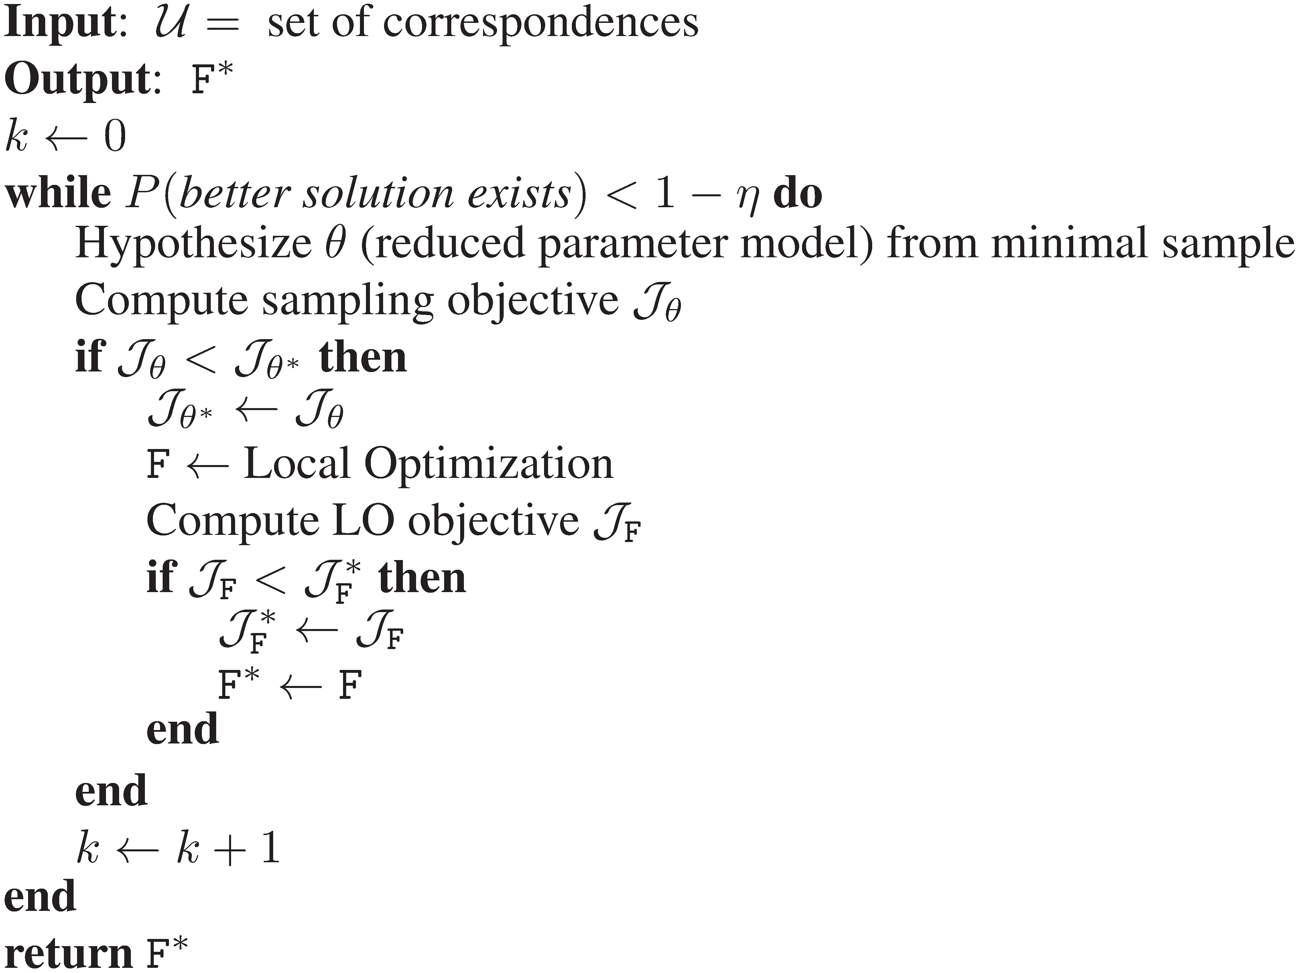
Generalized Model Optimization
Approximate hypothesis:
We propose 2 reduced
parameter models to estimate
the Fundamental Matrix from
2 regions
Model Optimization:
Local optimization step estimates
the Fundamental Matrix from the consensus set of the approximate hypothesis
O. Chum, J. Matas, and J. Kittler. Locally optimized RANSAC. In DAGM Symposium, 2003.

Slide 15
Feature-to-feature correspondences
Affine covariant features detected in images independently
Correspondences established based on SIFT descriptors
x’₃
x₃
DG
x₂
x₁
x’₁
DG
x’₂
image 1
image 2
Centers of the region regions provide point-to-point correspondences (x₁, x’₁)
(7 correspondences needed to estimate F)
Dominant orientation (gradient) provides additional
point-to-point correspondence (x₂, x’₂)
Full affine coordinate frame is given by an ellipse and dominant orientation (x₃, x’₃)
Region-to-region correspondence of affine covariant features provides three point-to-point correspondences: independent but ill-conditioned

Slide 16




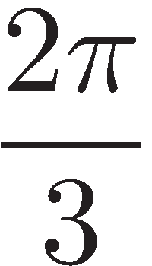

Prior methods I: BEEM
Constructs artificial points by locally approximating the image-to-image mapping to generate 8 linear constraints to estimate epipolar geometry
2 oriented ellipses, e.g. gotten by SIFT dominant gradient (DG)
Artificial
point
DG
DG
DG
L. Goshen and I. Shimshoni. Balanced exploration and exploitation
model search for efficient epipolar geometry estimation. Pattern Analysis
and Machine Intelligence, 30(7):1230–1242, 2008.

Slide 17

Prior Methods II: Perdoch et al.
RANSAC hypothesis is Essential matrix and focal length by 6-point algorithm
Estimation requires solving a system of polynomial equations
6 points gotten from oriented ellipse
Introduce constraints on intrinsic camera parameters: fixed focal length, square pixels and centered principal point
DG
DG
DG
Local Affine Frame (LAF)
M. Perdoch, J. Matas, and O. Chum. Epipolar geometry from
two correspondences. In Proc. of ICPR, pages 215–220, 2006.

Slide 18


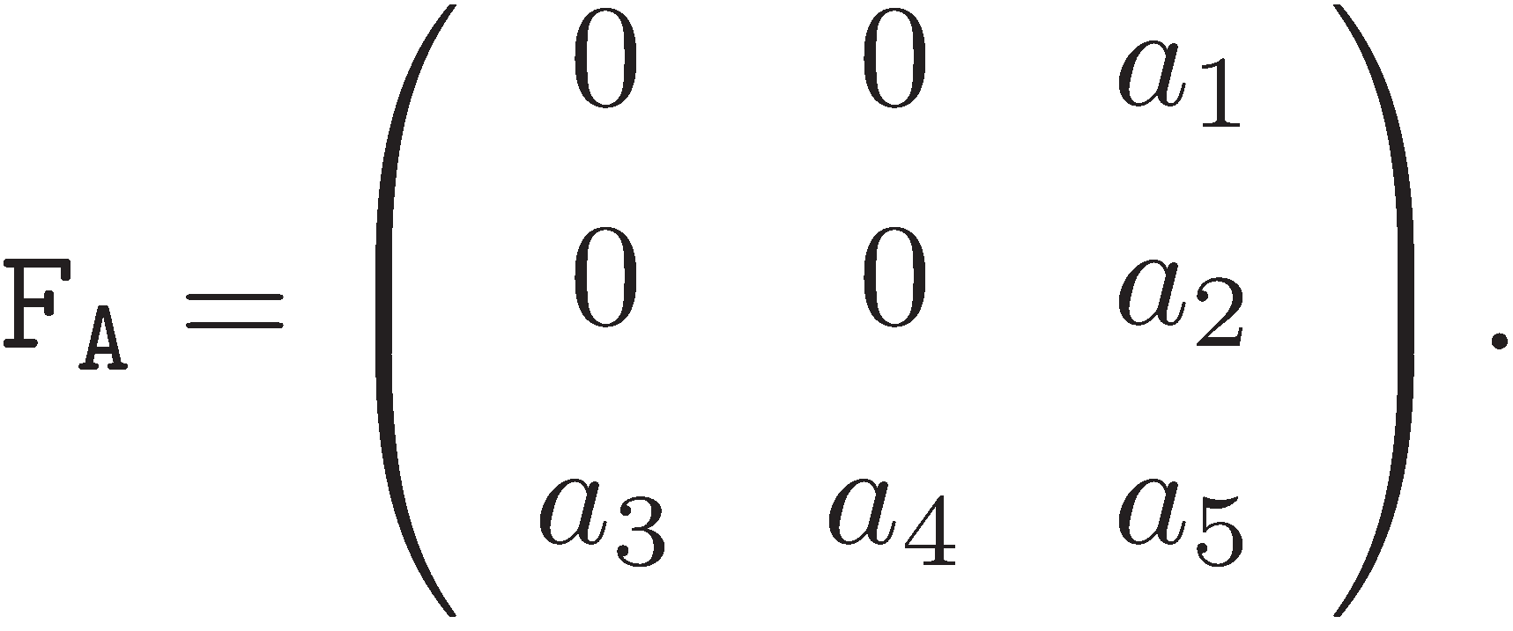
Affine epipolar constraint
Measured points are used to estimate an approximation of the global model
The first order approximation of can be written , where
Geometric meaning: affine cameras
Weak perspective
geometry

Slide 19

MLE
RANSAC hypothesis is the affine fundamental matrix
Point-point constraints used for estimation
Use extents and origin of 2 Local Affine Frames (LAFs) to get 4-6 points
Optional
point
DG
DG
DG
Local Affine Frame (LAF)

Slide 20

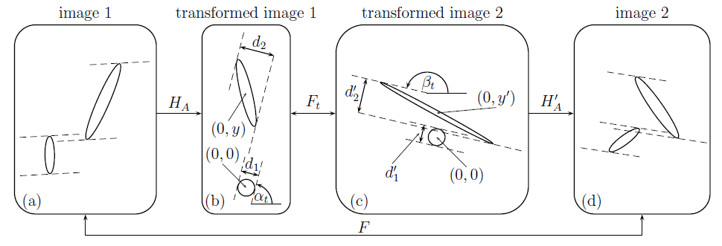
Arendelovic
RANSAC hypothesis is the affine fundamental matrix
Ellipses directly used for estimation
Introduces polynomial constraints on , results in quartic (0-4) solutions
Arbitrary unknown
rotation
Affine epipolar geometry estimated from two elliptical correspondences
0-4 hypotheses
Arandjelovic, Zisserman: Efficient Image Retrieval for 3D Structures , BMVC 2010

Slide 21
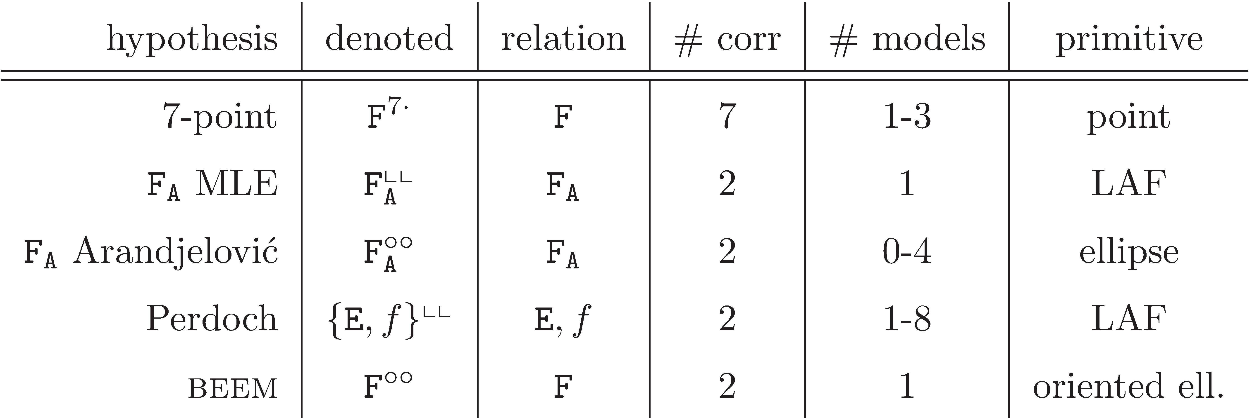
Summary of Hypothesis Generators
Proposed approximate models
Prior approximate models

Slide 22
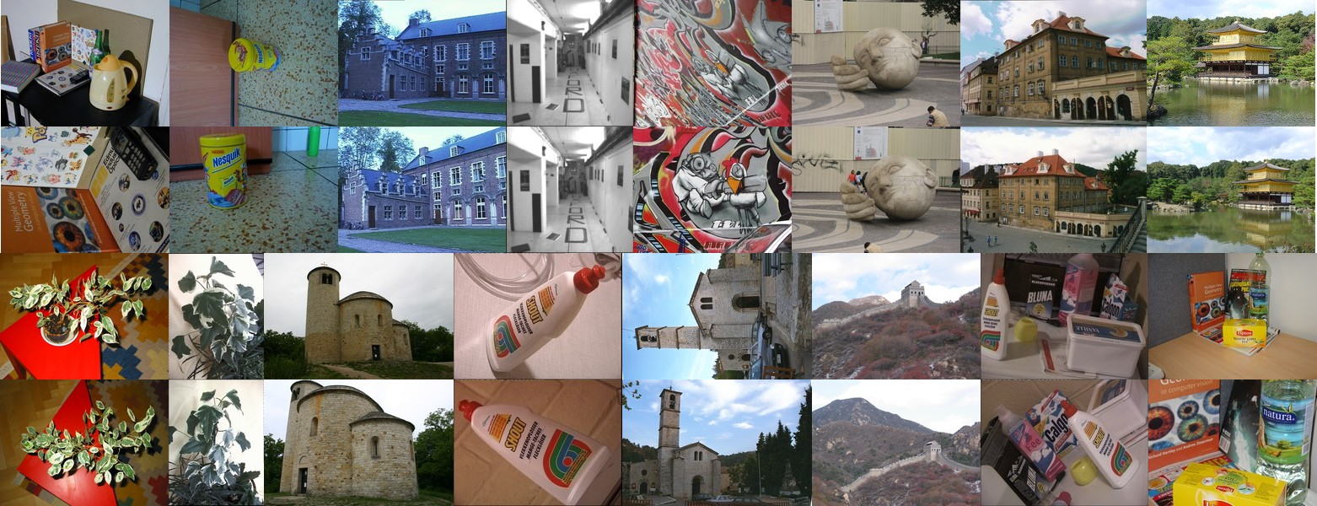
KUSVOD2 dataset
16 challenging wide-baseline stereo pairs with varied geometry
Hand annotated ground truth point correspondences
Reprojection error is used to evaluate accuracy of Fundamental matrix
Epipolar geometry estimated 500x for each pair
K. Lebeda, J. Matas, and O. Chum. Fixing the locally optimized
RANSAC. In Proc. of BMVC
.

Slide 23
CDF reprojection error
Empirical CDF of the RMS Sampson error for 8000 F estimations.
Error calculated on hand-annotated point correspondences for each stereo pair in the test set.

Slide 24
Speedup
20% more than
25x speed up
50% more than
10x speed up
Empirical CDF of the sample ratio, calculated as the ratio of the number of RANSAC samples required by the 7-point method to the denoted approximate model. Again for 8000 F estimations

Slide 25

Conclusions
Two two-region methods are proposed that reliably estimate F on a large class of stereo pairs
Most significant reduction in samples drawn and models evaluated can be achieved with the use of MLE.
Using the first order approximation to the global model improves accuracy and precision of epipolar geometry estimation compared to using local image approximations or constraining intrinsic camera calibration
Hypothesizing the affine fundamental matrix from 2 Local Affine Frames (LAFs) should be preferred to the previously proposed methods BEEM and Perdoch et al..

Slide 26
Additional material
Comes after this slide…

Slide 27
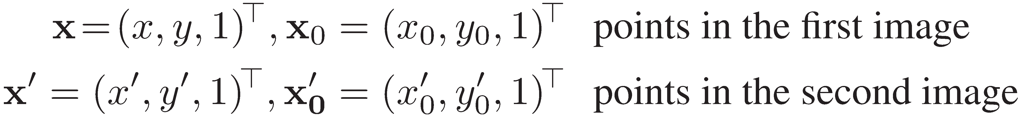


Affine epipolar constraint
Seek an approximation to the global model that uses only reliable constraints from local measurements.
First order approximation of about :
Where is the 1x4 Jacobian of
The approximation can be written , where
Weak perspective
geometry

