Slide 1
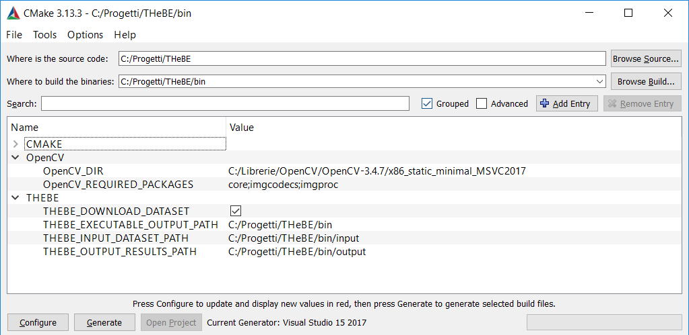
source folder (1)
project’s destination folder (2)
OpenCV installation path (3)
whether to download THeBE
dataset or not (4)
THeBE dataset path (5)
where to store output results (6)
(7) (8)

