Slide 1


Web Redesign
भा.कृ.अनु.प. – राष्ट्रीय ऑर्किड्स अनुसंधान केंद्र
पाक्योंग, सिक्किम -७३७१०६
ICAR- National Research Centre for Orchids
Pakyong, Sikkim -737106
Presented by
Pritam Shah
(YP II Computer)
ICAR NRC for Orchids AKMU/ ARIS Cell

Slide 2
Table of Content
Introduction
Problem Definition
Objective
Solution Strategy
Conclusion and Future Work
References

Slide 3
Difference
Web Application | Website
Dynamic Data User Interaction Quite Complex Structured Easy update content | Static Content No Interaction Simple Unstructured Content update not easy

Slide 4

Problem Definition
To make a web application.

Slide 5
Objective
Better Design
User friendly
Mobile friendly
Cross browser compatibility
Easy hassle free Updates
Easy maintenance
Custom dashboard

Slide 6
Solution Strategy
Futuristic approach
Use of PHP

Slide 7

Develop
Update
Events/News
Opportunity
Tenders
About NRCO
Staff Display
Organization Tree
Sub Centers Details
Publications
Staff Login
Services
Events/News
Opportunity
Tenders
About NRCO
Staff Display
Organization Tree
Sub Centers Details
Publications
Staff Login
NRCO
Maintenance
Figure 2: Overview

Slide 8
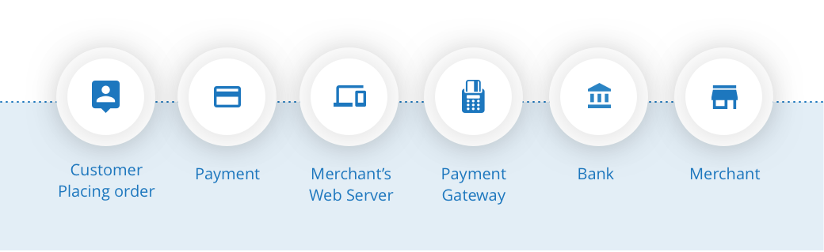
Payment Gateway
Figure 3: Steps in Online Payment

Slide 9
Business Model
Business to consumer (B2C)
Online intermediaries

Slide 10
Complexity
Design Issues
Payment Gateway
To find homestays.

Slide 11

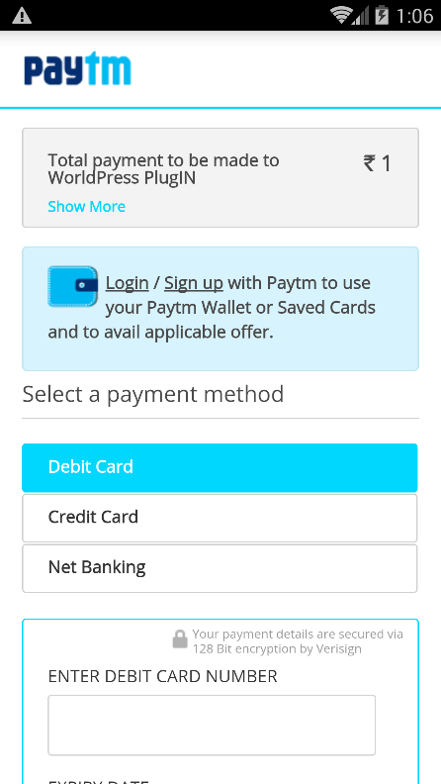

Mock Up Screen
Homestays
Homestays
Homestays
Homestays
East Sikkim
Homestay 1
Homestay 1
West Sikkim
Details
Price
South Sikkim
Homestay 2
North Sikkim
Homestay …
Book
Figure 4: Mock Up Screen

Slide 12
Reference
Adam Gerber, Clifton Craig, “Learn Android Studio”, press, 2015. . [7/8/18]
Data Communication and Computer Networks 5th Edition by Michael Duck and Richard Read. . [10/8/18].
http://www.homestays.com. [13/8/18]

Slide 13

Homestays
Feel the Culture
Homestays
East West South North
Sikkim
Thank You

