Slide 1
UC Security Model
CS714: Secure Computation

Slide 2
Logistics
Thanks for your feedback!
Optional Recap Class on Saturday
No new material will be covered (this is purely optional)

Slide 3
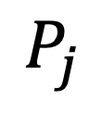
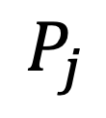
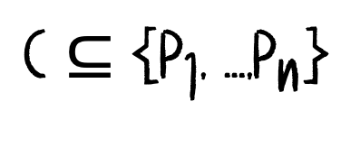
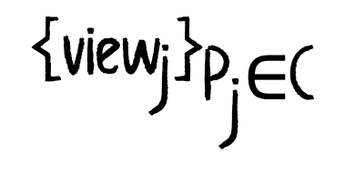

Defining Privacy
For each corrupted party
$$P_{j}$$
define
$${\text{view}}_{\text{j}}$$
the entire view of the party
$$P_{j}$$
$$\text{C}\text{ ⊆}\text{ \{}{\text{P}}_{\text{1}}\text{, …,}{\text{P}}_{\text{n}}\text{\}}$$
is the set of corrupted parties
$$\text{\{}\text{vie}{\text{w}}_{\text{j}}{\text{\}}}_{{\text{P}}_{\text{j}}\text{∈}\text{C}}$$
Information leaked to corrupted parties

Slide 4





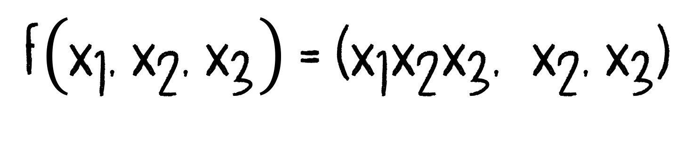






$$\text{f}\left({\text{x}}_{\text{1}}\text{, }{\text{x}}_{\text{2}}\text{, }{\text{x}}_{\text{3}}\right) \text{= (}{\text{x}}_{\text{1}}{\text{x}}_{\text{2}}{\text{x}}_{\text{3}}\text{, }{ \text{x}}_{\text{2}}\text{,}{ \text{x}}_{\text{3}}\text{)}$$
$$P_{3}$$
$$P_{1}$$
$$P_{2}$$
$$P_{1}$$
$$P_{2}$$
$$P_{3}$$
Instead of real input
$$x_{1}$$
the party
$$P_{1}$$
can use
$$x_{1}^{′}=1$$
$$P_{1}$$
can then learn
$${1⋅x}_{2}⋅x_{3}$$
The adversary can influence the output
This does not necessarily violate security (parties are allowed to choose arbitrary inputs)

Slide 5
A protocol proven secure in the UC model remains secure regardless of the context in which it is used.

Slide 6
Allowed vs Leaked Information
A protocol is private if the leaked values contain no more information than the allowed values.
Computational View
A protocol is private if the leaked values can be computed efficiently from the allowed values.

Slide 7

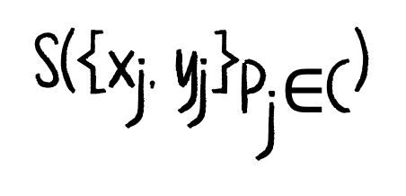
The Idea of a Simulator
An efficient algorithm that generates the leaked values from the allowed values
There exists an efficient simulator S such that:
$$\text{S}\text{(}{\text{\{}\text{x}}_{\text{j}}\text{, }{\text{y}}_{\text{j}}{\text{\}}}_{{\text{P}}_{\text{j}}\text{∈}\text{C}}\text{)}$$
&
$$\text{\{}\text{vie}{\text{w}}_{\text{j}}{\text{\}}}_{{\text{P}}_{\text{j}\text{∈}\text{C}}}$$
have the same distribution

Slide 8
The Idea of a Simulator
The adversary’s view can be simulated using only:
corrupted parties inputs
corrupted parties outputs

Slide 9
Behavioral Equivalence
When do we say that two interactive systems are behaviorally equivalent?
When the two systems get the same output on the same output ports, and get the same inputs on the same input ports
We are not interested in the internal structure of the Interactive Systems

Slide 10
Security via Behavioral Equivalence
UC security compares:
Real Protocol
Ideal Functionality
The real protocol must be behaviorally equivalent to the ideal functionality

Slide 11
Ideal Functionality
An ideal functionality F specifies how the protocol must behave.
The protocol may leak only allowed information.
Any information that can be computed from the inputs and outputs of the corrupt parties

Slide 12



Ideal Functionality: Secure Transfer
On input (mid, j, m) on
$$\text{ST}\text{.}\text{i}{\text{n}}_{\text{i}}$$
ST.leak
ST.infl
output (mid, i, j, |m|) on ST.leak
store (mid, i, j, m)
ST.in1
ST
ST.out2
Ignore any later input of the form (mid, j, m) on
$$\text{ST}\text{.}\text{i}{\text{n}}_{\text{i}}$$
ST.out1
ST.in2
On input (deliver, mid, i, j) on ST.infl
delete: (mid, i, j, m)
output: (mid, i, j, m) on
$$\text{ST}\text{.}{\text{out}}_{\text{j}}$$

Slide 13




Modeling Corruption
(passive corrupt, i)
on
ST.infl
The ideal internal state of party i.
This is defined as the previous messages of party i
And all the messages that are in the queue.
(active corrupt, i)
on
ST.infl
The ideal functionality records that party i is corrupt
Ignores inputs on
$$\text{ST}\text{.}\text{i}{\text{n}}_{\text{i}}$$
stops giving outputs on:
$$\text{ST}\text{.}{\text{out}}_{\text{i}}$$
Instead, whenever it gets (input, i, x) on ST.infl it behaves exactly as input came from:
$$\text{ST}\text{.}\text{i}{\text{n}}_{\text{i}}$$
Whenever ST is about to output a value y on
$$\text{ST}\text{.}{\text{out}}_{\text{i}}$$
It instead outputs (output, i, y) on ST.leak

Slide 14
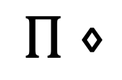
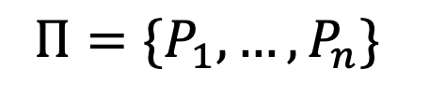
Protocols
$$Π=\{P_{1},…,P_{n}\}$$
be a protocol with resource name R
Let R be the ideal functionality for the resource R
$$Π⋄$$
R
a protocol using resource R
Ideal functionalities can play two roles:
Specifications of intended behavior
It can also serve as a network resource (a way for them to communicate)!

Slide 15



Protocols
On input (mid, j, m) on
$$\text{A}\text{T}\text{.}\text{i}{\text{n}}_{\text{i}}$$
AT.leak
AT.infl
output (mid, i, j, m) on AT.leak
store (mid, i, j, m)
AT.in1
AT
AT.out2
Ignore any later input of the form (mid, j, m) on
$$\text{A}\text{T}\text{.}\text{i}{\text{n}}_{\text{i}}$$
AT.out1
AT.in2
On input (deliver, mid, i, j) on AT.infl
delete: (mid, i, j, m)
output: (mid, i, j, m) on
$$\text{A}\text{T}\text{.}{\text{out}}_{\text{j}}$$

Slide 16
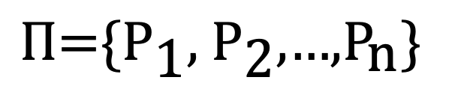
Protocols
$$\text{Π}\text{=}\text{\{}{\text{P}}_{\text{1}}\text{, }{\text{P}}_{\text{2}}\text{,…,}{\text{P}}_{\text{n}}\text{\}}$$
uses an ideal functionality to implement another ideal functionality
resource
P1
AT
P2

Slide 17
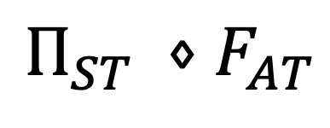
Protocols
AT.leak
AT.leak2
$$Π_{ST} ⋄F_{AT}$$
AT.leak1
AT.infl1
AT.infl
AT.infl2
ST.in1
AT.in1
ST.out2
AT.out2
P1
AT
P2
What does this mean?
ST.out1
AT.out1
AT.in2
ST.in2
Agent P1
On input (mid,2,m) on ST.in1, output (mid,2, hello) on AT.in1.
When receiving (mid, 2, ek) on AT.out1, sample encryption
c = E_{ek}(m)
and output (mid,2,c) on AT.in1.
Agent P2
On input (mid,1, hello) on AT.out_2,
generate key pair (ek,dk) and send (mid,1,ek).
On input (mid,1,c) on AT.out_2, compute
m = D_{dk}(c)
and output (mid,1,m) on ST.out_2.

Slide 18
Z
P1
AT
P2
S
Z
ST

Slide 19
How does Environment Z behave?
Picks some message m and inputs (mid, 2, m) on ST.in1
Then it sees (mid, 1, 2, hello) on AT.leak and inputs (deliver, mid,1,2) on AT.infl
Then it sees (mid, 2, 1, ek) on AT.leak and inputs (deliver, mid,2,1) on AT.infl
Then it sees (mid, 1, 2, c’’) on AT.leak and inputs (deliver, mid,1,2) on AT.infl
Then it sees (mid, 1, m’’) on ST.out2

Slide 20
Standalone Security
The protocol is secure when run alone.
Adversary interacts with only this execution.
Proof compares the real vs ideal world for a single run
Composed Security
Protocol remains secure even when composed with arbitrary other protocols
An adversary can interleave many executions
The environment can interact during execution

Slide 21
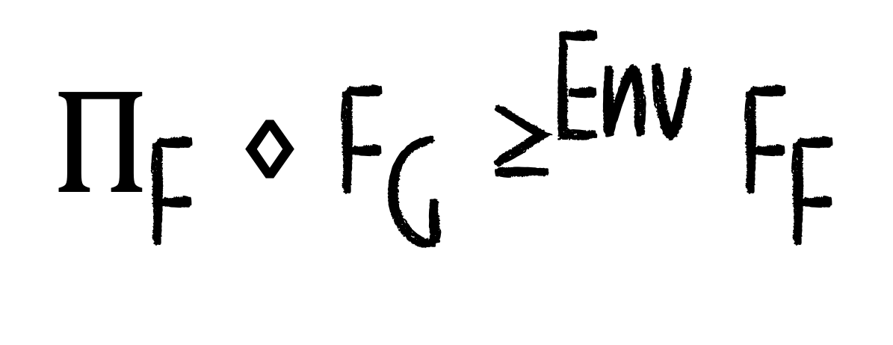
As secure as!
$${\text{Π}}_{\text{F}} \text{⋄ }{\text{F}}_{\text{G}}{\text{≥}}^{\text{Env}}{\text{F}}_{\text{F}}$$
Protocol
Resource
Ideal Functionality

Slide 22
Z
P1
AT
P2
Resource
Protocol
S
Z
ST

Slide 23

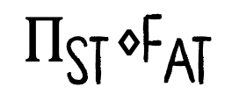

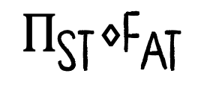
Composed Protocols
$${\text{Π}}_{\text{ST}}\text{⋄}{\text{F}}_{\text{AT}}$$
implements
$${\text{F}}_{\text{ST}}$$
with computational security, then:
$${\text{F}}_{\text{ST}}$$
can be securely replaced by
$${\text{Π}}_{\text{ST}}\text{⋄}{\text{F}}_{\text{AT}}$$
in any polynomial-time protocol

Slide 24
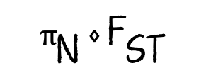
N.leak
N.infl
N.in1
N
N.out2
N.out1
N.in2
ST.leak1
ST.leak
ST.leak2
ST.infl1
ST.infl
ST.infl2
Q1
ST.in1
ST
ST.in2
Q1
N.in1
N.out2
N.out1
ST.out1
ST.out2
N.in2
$${\text{π}}_{\text{N}}\text{ ⋄ }{\text{F}}_{\text{ST}}$$

Slide 25


Composed Party
N
Composed Party
Q1
P1
AT
Q2
Q2
$${\text{π}}_{\text{N}}\text{ ⋄}{\text{ ( }\text{π}}_{\text{sT}}\text{ ⋄}{ \text{F}}_{\text{AT}}\text{ ) }$$
=
$${\text{(}\text{π}}_{\text{N}}\text{ ⋄}{ \text{π}}_{\text{sT}}\text{) ⋄}{ \text{F}}_{\text{AT}}$$
Composed Protocol

Slide 26

ST.leak1
AT.leak1
AT.leak
AT.leak2
ST.leak2
ST.infl1
AT.infl1
AT.infl
AT.infl2
ST.infl2
U
N.leak
N.infl
$${\text{π}}_{\text{N}}\text{ ⋄}{ \text{π}}_{\text{sT}}\text{ ⋄}{ \text{F}}_{\text{AT}}$$
Security of Composed Protocols:
U
Existence of a simulator

Slide 27
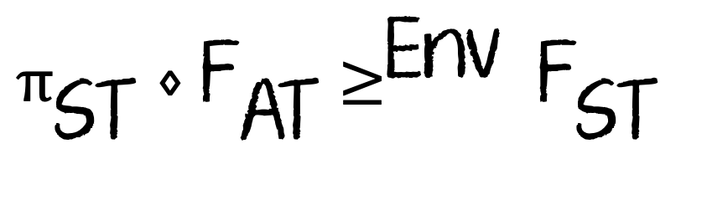
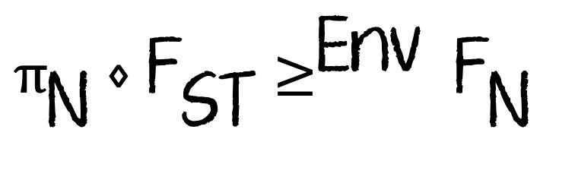
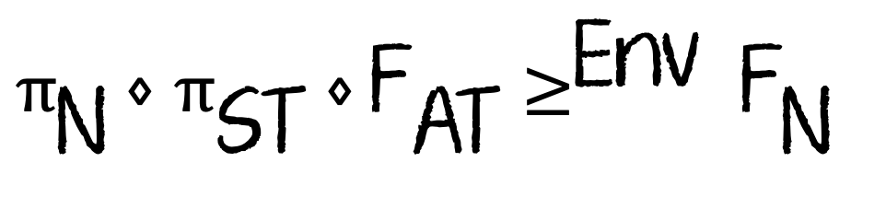
UC Theorem
Let Env be a set of polynomial-time environments
$${\text{π}}_{\text{N}}\text{ ⋄ }{\text{F}}_{\text{ST}}{\text{≥}}^{\text{Env}} {\text{F}}_{\text{N} }$$
$${\text{π}}_{\text{ST}} \text{⋄ }{\text{F}}_{\text{AT}}{\text{≥}}^{\text{Env}} {\text{F}}_{\text{ST} }$$
$${\text{π}}_{\text{N}} \text{⋄ }{\text{π}}_{\text{ST}} \text{⋄} {\text{F}}_{\text{AT}}{\text{≥}}^{\text{Env}} {\text{F}}_{\text{N} }$$

Slide 28
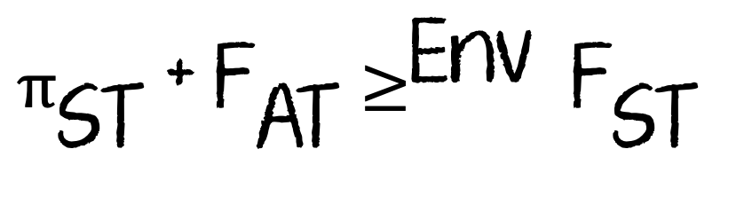
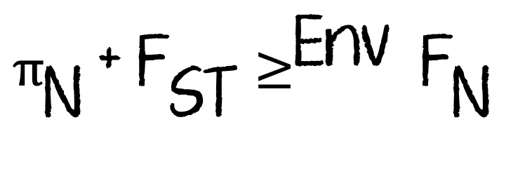
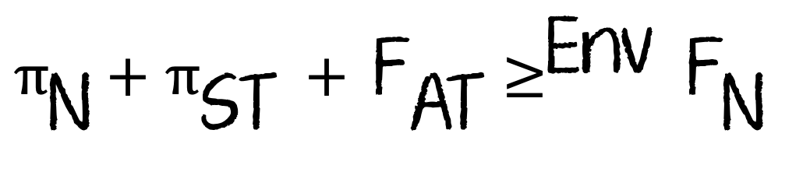
UC Theorem
Let Env be a set of polynomial-time environments (INTUITION)
$${\text{π}}_{\text{N}}\text{ + }{\text{F}}_{\text{ST}}{\text{≥}}^{\text{Env}} {\text{F}}_{\text{N} }$$
$${\text{π}}_{\text{ST}} \text{+ }{\text{F}}_{\text{AT}}{\text{≥}}^{\text{Env}} {\text{F}}_{\text{ST} }$$
$${\text{π}}_{\text{N}} \text{+} {\text{π}}_{\text{ST}} + {\text{F}}_{\text{AT}}{\text{≥}}^{\text{Env}} {\text{F}}_{\text{N} }$$

Slide 29
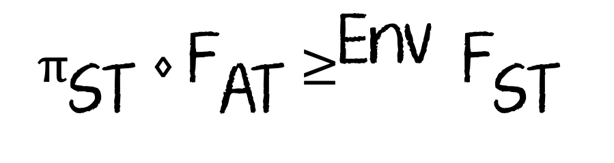
Q1
P1
AT
P2
Q2
S
$${\text{π}}_{\text{ST}} \text{⋄ }{\text{F}}_{\text{AT}}{\text{≥}}^{\text{Env}} {\text{F}}_{\text{ST} }$$
Q1
ST
Q2

Slide 30
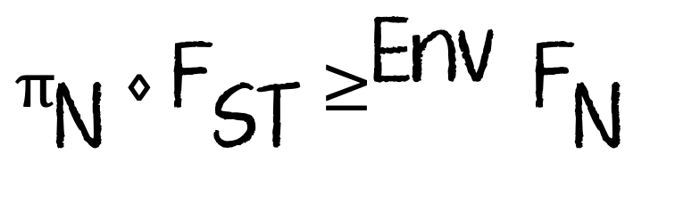
S
S
T
Q1
ST
Q2
N
$${\text{π}}_{\text{N}}\text{ ⋄ }{\text{F}}_{\text{ST}}{\text{≥}}^{\text{Env}} {\text{F}}_{\text{N} }$$

Slide 31
IS0 cannot be told apart from IS1
IS1 cannot be told apart from IS2
From the transitivity property, we have:
IS0 cannot be told apart from IS2

Slide 32
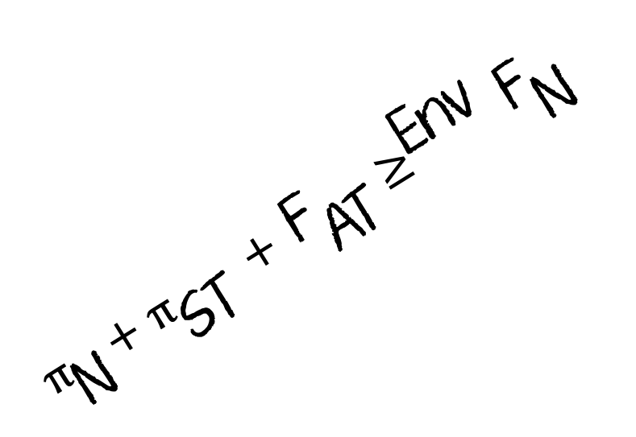
Q1
P1
AT
P2
Q2
S
U
$${\text{π}}_{\text{N}} \text{+} {\text{π}}_{\text{ST}} + {\text{F}}_{\text{AT}}{\text{≥}}^{\text{Env}} {\text{F}}_{\text{N} }$$
T
N

Slide 33
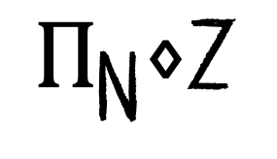
Is there any problem with the proof that we presented?
$${\text{Π}}_{\text{N}}\text{⋄}\text{Z}$$
is an environment
We are assuming that:

Slide 34
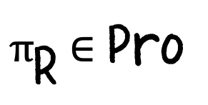
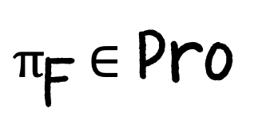
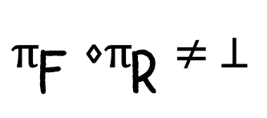
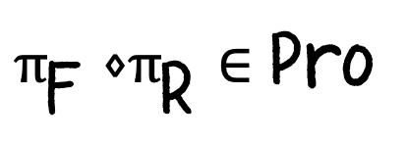
We let Pro be the set of simple and composed protocols in which all simple parties follow the rules for clocked entities and are recursive in polytime.
If
$${\text{π}}_{\text{F}} \text{∈ }\text{Pro}$$
is a protocol with the name F and resource name R
And
$${\text{π}}_{\text{R}} \text{∈ }\text{Pro}$$
Is a protocol with protocol name R and
$${\text{π}}_{\text{F}}\text{ ⋄}{\text{π}}_{\text{R}}≠ ⊥$$
Then:
$${\text{π}}_{\text{F}}\text{ ⋄}{\text{π}}_{\text{R}}\text{ ∈ }\text{Pro}$$

Slide 35







Defn
We let SIM be the set of interactive systems S that are a simulator for some protocol
There exists a protocol
$$Π_{F}$$
(composed or simple) with protocol name F and an ideal functionality
$$F_{F}$$
With the name F such that
$$F_{F}⋄S$$
have the same special ports
S follows the rules for clocked entities and is recursive polytime
S is corruption preserving
S is clock preserving
Lemma
If
$$\text{S}\text{ ∈} \text{Sim}$$
and
T $\text{∈ }\text{Sim}$
and T has two open special ports that connect it to the ideal functionality ports of S and
$$\text{S}\text{⋄}\text{T}\text{≠⊥}$$
then:
$$\text{S}\text{⋄}\text{T}\text{ ∈ }\text{Sim}$$

Slide 36
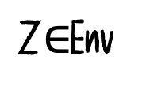
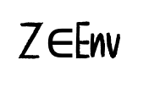

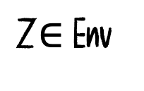
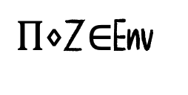
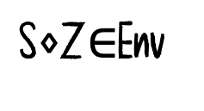
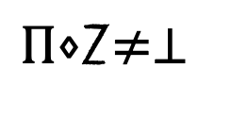
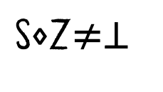
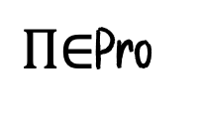
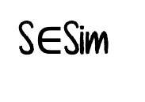
Defn
We say that ENV is an environment class if the following hold true:
Each
$$\text{Z}\text{∈ }\text{Env}$$
has the open port structure of the environment for some simple or complex protocol
For all
$$\text{Z}\text{∈}\text{Env}$$
and all
$$\text{Π}\text{∈}\text{Pro}$$
where
$$\text{Π}\text{⋄}\text{Z}\text{≠⊥ }$$
and the protocol ports of
$$Π$$
connect to the protocol ports of Z
it holds that:
$$\text{Π}\text{⋄}\text{Z}\text{∈}\text{Env}$$
For all
$$\text{Z}\text{∈}\text{Env}$$
and all
$$\text{S}\text{∈}\text{Sim}$$
where
$$\text{S}\text{⋄}\text{Z}\text{≠⊥ }$$
and the simulation ports of S
connect to the special ports of Z
it holds that:
$$\text{S}\text{⋄}\text{Z}\text{∈}\text{Env}$$

Slide 37
UC Theorem (on Board)

Slide 38
Revision of Chapter 4 on Saturday, 10:30 AM, KD 101
(This is optional; no new material)
Quiz 2 will be on Tuesday, 7-April-2026, Syllabus: Chapter 4

Slide 39
Adversaries and Their Powers
Threshold Security
Adaptive Security vs. Static Security
Active Security vs. Passive Security
Unconditional Security vs. Computational Security
Synchronous vs. Asynchronous

Slide 40
Threshold Security
Remember the CEPS Protocol:
The protocol is secure against
t < n/2
corrupted parties.
This is called Threshold Security!

Slide 41
Adaptive Security vs. Static Security
Environments in Env are allowed to corrupt the parties whenever they desire
Environments in Env are allowed to corrupt the parties before the protocol begins

Slide 42
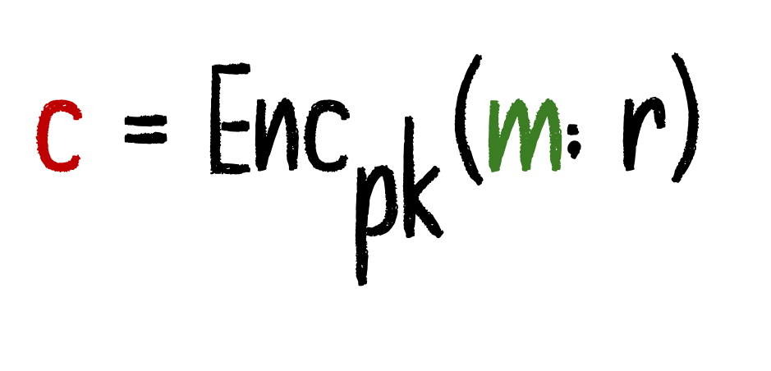
Regular Encryption
$$\text{c}\text{ = }\text{En}{\text{c}}_{\text{pk}}\text{(}\text{m}\text{; }\text{r}\text{)}$$
c is bound to a unique message m

Slide 43
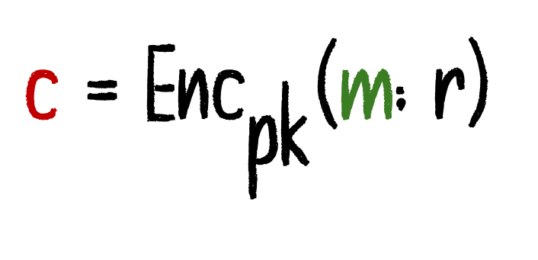
Non-Committing Encryption
Generate a fake public key pk
Generate a ciphertext c without knowing the message
Later, when given any message m, produce randomness r such that:
$$\text{c}\text{ = }\text{En}{\text{c}}_{\text{pk}}\text{(}\text{m}\text{; }\text{r}\text{)}$$

Slide 44
(active, corrupt, 1)
(active, corrupt)
Z
P1
AT
P2
(active, corrupt, 1)
S
Z
ST

Slide 45

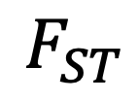
S is now allowed to send:
(send, 1, 2, mid, m')
on ST.infl at any point
In response
$$F_{ST}$$
stores
as if it came from ST.in1
(mid, 1, 2 m')
Then, S can send (deliver, mid, 1, 2) on ST.infl
In response
$$F_{ST}$$
outputs (mid, 1, m’) on ST.out2
Thus, S can output any message of his choice on ST.out1/ST.out2

Slide 46
So, how will the Simulation work?

Slide 47

What if P2 is corrupted?
Whenever S is activated, it checks whether it received some
(mid, 1, 2, |m|)
on ST.leak
If yes: It inputs (deliver, mid, 1,2) on ST.infl
In response,
$$F_{ST}$$
outputs (mid, 1, m) on ST.leak!
WHY?

Slide 48
The argument here was straightforward because we considered only two parties.
What can go wrong in a three-party setting?

Slide 49
Setting:
P1​: Sender
P2​: Receiver (corrupted/controlled by adversary Z)
P3​: Honest party
Adversary’s Goal
The environment Z tries to create a fake execution history.
It makes P2 output: (mid,3,m′)
Interpreted as: “P2P received message m′ from P3​”
But in Reality
P3​ never sent any such message
No corresponding input:(mid,2,m′) on ST.in3(mid,2,m′) on ST.in3​

Slide 50
Why This Breaks Simulation
Ideal functionality FST​ enforces:
A message from P3​ can be delivered only if P3​ actually sent it
Simulator’s Problem
To match the real-world view, the simulator must make: FST→(mid,3,m)
But this is impossible because FST​ never received input from P3P3​
Conclusion
Real world: Fake message appears
Ideal world: Such a message cannot be generated

Slide 51
How is this attack prevented?
Authenticated communication (i.e., messages cannot be forged as coming from another party)

Slide 52

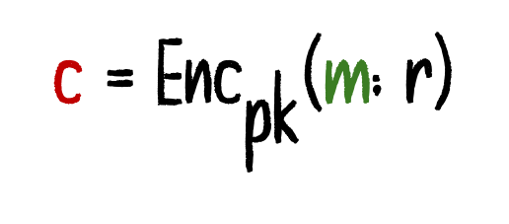
What changes in Adaptive Security?
Two parties P1, P2, using an encryption scheme like RSA​
Environment Z sends a random message,
$$m∈\{0,1\}^{k}$$
P1 encrypts:
$$\text{c}\text{ = }\text{En}{\text{c}}_{\text{pk}}\text{(}\text{m}\text{; }\text{r}\text{)}$$
After seeing the ciphertext, the adversary adaptively corrupts P1

Slide 53
What changes in Adaptive Security?
Now consider the simulation
Before corruption, S does NOT know m
(because P1 is still honest)
Produce a fake pk and a fake ciphertext c
S commits to some (pk,c)

Slide 54
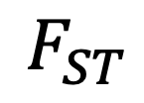
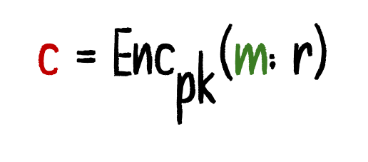
Later:
Adversary corrupts P1​
Now S learns the real m from:
$$F_{ST}$$
Now the problem: S must produce randomness r such that:
$$\text{c}\text{ = }\text{En}{\text{c}}_{\text{pk}}\text{(}\text{m}\text{; }\text{r}\text{)}$$

Slide 55
What is the solution then?

Slide 56
Active Security vs Passive Security
The environment takes complete control
Also called semi-honest setting

Slide 57
Unconditional Security vs Passive Security

Slide 58
Consensus Broadcast vs Point-to-Point Communication
Suppose a protocol requires a player broadcast a message to all the players.
It is not just enough to ask the player to send the same message to all the players.
Why?
We need a consensus agreement (Byzantine Agreement)

Slide 59
Synchronous vs Asynchronous

Slide 60
Synchronous Communication
Inward Clocking
Allows a party to send the messages to the ideal functionality in that round
Outward Clocking
Allows a party to receive the messages from the ideal functionality in that round

Slide 61
Q1
P1
AT
P2
Q2
We say that Z is a synchronous environment if it proceeds in rounds, where in each round it behaves as follows:
First, it does an inward clocking of all the parties that are not actively corrupted
Then in interacts with: Authenticated Transfer (Ideal Functionality)
Then, it does an outward clocking of all the parties that are not actively corrupted

Slide 62


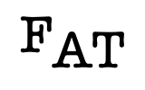
Q1
P1
AT
P2
Q2
We say that the composed party is inward clocked when:
Z first clocks Q1, then P1, then Z sends (inclock, i) on AT.infl and clocks
$${\text{F}}_{\text{AT}}$$
We say that the composed party is outward clocked when:
Z first sends (outclock, i) on AT.infl and clocks
$${\text{F}}_{\text{AT}}$$
then clocks P1 and then Q1
This allows
$${\text{F}}_{\text{AT}}$$
to send messages to the composed parties.

Slide 63










Synchronous Communication
If n parties,
$$P_{1}, P_{2}, …, P_{n}$$
are using
$${\text{F}}_{\text{AT}}$$
as a communication resource
Then, even though the parties are synchronized, the communication is not.
Why?
$${\text{F}}_{\text{AT}}$$
is not modeled as a synchronous resource.
How do we turn
$${\text{F}}_{\text{AT}}$$
to a synchronous resource?
On
(inclock, i)
Process all messages on
$$AT.in_{i}$$
as
$${\text{F}}_{\text{AT}}$$
does
On
(outclock, i)
for all stored values
$$(mid, j,i, m)$$
delete
$$(mid, j,i, m)$$
and outputs
$$(mid, j, m)$$
on
$$AT.out_{j}$$

Slide 64

Complete Breakdown
We say that the ideal functionality
$$F_{F}$$
does a complete breakdown, we mean that it starts behaving as if all parties are actively corrupted.
Models worst-case failure (all parties corrupted)
Functionality stops enforcing security
Leaks full internal state on F.leak
On (send, i, m): outputs m to party Pi
On input m from Pi: leaks (i, m)

Slide 65

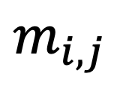




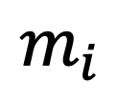

Secure Synchronous Communication and Broadcast
Ideal Functionality keeps track of three sets: A, P, and C
Actively Corrupted
Passively Corrupted
Corrupted
What will be the output on SC.leak?
Honest Inputs
Parse the message on
$$SC.in_{i}:$$
$$m_{i,1}, …, m_{i,n}, m_{i}$$
$$\{m_{i,j}\}_{j∈C} m_{i}$$
$$m_{i,j}$$
The message
$$P_{i}$$
is send to
$$P_{j}$$
$$m_{i}$$
The message
is broadcasting
$$P_{i}$$

Slide 66







Secure Synchronous Communication and Broadcast
Corrupted Inputs
$\text{(}\text{change}\text{, }\text{i}\text{, (}{\text{m}}_{\text{i}\text{,1}}\text{, …, }{\text{m}}_{\text{i}\text{,}\text{n}}\text{, }{\text{m}}_{\text{i}}\text{)}$)
where,
$$\text{i}\text{∈}\text{A}$$
and at a point before which the clock-out phase has started,
Store
$\text{((}{\text{m}}_{\text{i}\text{,1}}\text{, …, }{\text{m}}_{\text{i}\text{,}\text{n}}\text{, }{\text{m}}_{\text{i}}\text{)}$)
Overriding any previously stored input from the corrupted party i in this round
(As long as any passively corrupted or honest party has received outputs, actively corrupted parties can change their outputs)
Delivery
On input (clockout, i) on SC.infl
If there is any party for which
$$m_{i,1}, …, m_{i,n}, m_{i}$$
is not stored, then store
$$m_{i,1}, …, m_{i,n}, m_{i}=ε, …, ε$$
$${\text{Then}\text{: (}\text{m}}_{\text{i}\text{,1}}\text{, …, }{\text{m}}_{\text{i}\text{,}\text{n}}\text{, }{\text{m}}_{\text{1}}\text{,…, }{\text{m}}_{\text{n}}\text{)}$$
on
$$\text{SC}\text{.}\text{ou}{\text{t}}_{\text{i}}$$

Slide 67







Secure Synchronous Function Evaluation
set to 0
Initialize:
delivery-round
evaluated
inputs-ready
$$\text{input}\text{−}\text{rea}{\text{d}}_{\text{1}}\text{,…,}\text{input}\text{−}\text{read}{\text{y}}_{\text{n}}\text{∈}\text{\{}\text{0,1}\text{\}}$$
Honest Inputs:
$$\text{(}\text{clockin}\text{, }\text{i})$$
on SFE.infl. (Trigger!)
$$\text{i}\text{∉}\text{A}\text{ (}\text{honest}\text{)}$$
IF:
input
$$x_{i}$$
is received
$$\text{input}\text{−}\text{read}{\text{y}}_{\text{i}}\text{=0}$$
$$\text{input}\text{−}\text{read}{\text{y}}_{\text{i}}←\text{1}$$
THEN:
$$\text{Store}\text{ (}\text{i}\text{,}{\text{x}}_{\text{i}}\text{)}$$
Leak (input, i)

Slide 68









Secure Synchronous Function Evaluation
Corrupted Inputs:
$$\text{(}\text{change}\text{, }\text{i}\text{, }{\text{x}}_{\text{i}}\text{) }\text{where} \text{i}\text{∉}\text{A}\text{ (}\text{corrupted}\text{)}$$
If (evaluated == 0)
$$S\text{et} \text{input}\text{−}\text{read}←1$$
$$\text{Store}: \text{(}\text{i}\text{, }{\text{x}}_{\text{i}}\text{)}$$
overriding any previously stored for party i
Simultaneous Inputs:
If it holds in some round, then after the clock-in phase ends, there exists
$$i,j∉A$$
such that:
$$\text{input}\text{−}\text{rea}{\text{d}}_{\text{i}}←0$$
$$\text{input}\text{−}\text{rea}{\text{d}}_{\text{j}}←1$$
Then do a complete breakdown
If it happens in some round that after the clockin phase ends,
$$\text{input}\text{−}\text{rea}{\text{d}}_{\text{i}}←1$$
$$i∉A$$
$$I\text{nputs}\text{−}\text{re}ady←0$$

Slide 69


Secure Synchronous Function Evaluation
Evaluate Function:
Trigger: (evaluate)
IF:
inputs-ready = 1
(evaluated == 0)
$$\text{Set}\text{: }\text{evaluated}\text{ ←1}$$
THEN:
Compute:
$$(y_{1},…,y_{n}=f(x_{1},…,x_{n})$$
Leak outputs for parties in C

Slide 70


Secure Synchronous Function Evaluation
Simultaneous Output:
On input delivery-round on SFE.infl, where:
evaluated = 1 and delivery-round=0,
Proceed as follows:
If we are at a point where no party
$$\text{i}\text{∉}\text{A}$$
was clocked-out yet, then set:
$$\text{delivery}\text{−}\text{round}\text{=1}$$
Delivery:
Trigger: (clockout, i)
IF:
delivery-round = 1
Then:
Output yi​ to party i

Slide 71
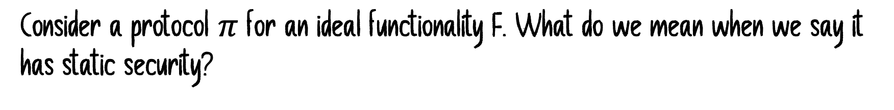
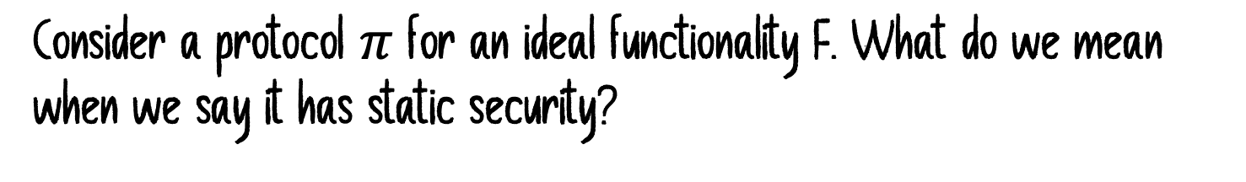
Revisiting Adaptive Security
What is the difference between Static and Adaptive Security?
Consider a protocol $π$ for an ideal functionality F. What do we mean when we say it has static security?
Formally, how do we establish the fact that we are dealing with static security?
Consider a protocol $π$ for an ideal functionality F. What do we mean when we say it has static security?
Will the simulator for a static environment for an adaptive environment?

Slide 72
What makes the simulator S, which works for a static environment, not work for an adaptive environment?
Can we somehow make it work?
There exists a class of protocols and functionalities for which this strategy will work.

Slide 73
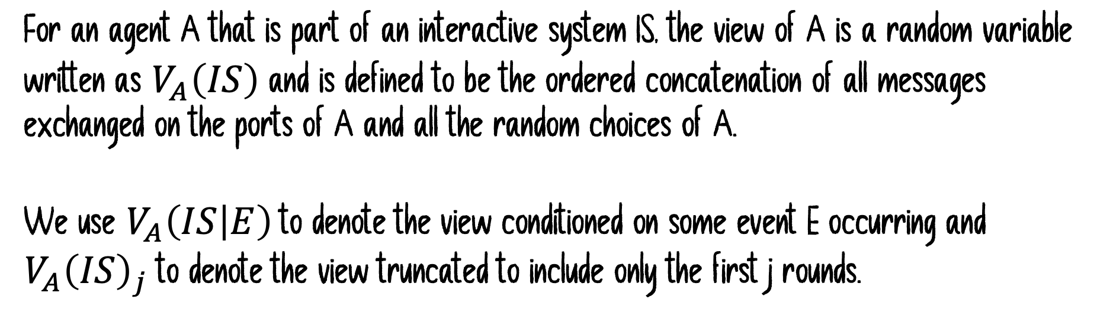
Adaptive Security vs. Static Security
For an agent A that is part of an interactive system IS, the view of A is a random variable written as $V_{A}\left(IS\right)$ and is defined to be the ordered concatenation of all messages exchanged on the ports of A and all the random choices of A.
We use $V_{A}\left(IS | E\right)$to denote the view conditioned on some event E occurring and $V_{A}{\left(IS\right)}_{j}$ to denote the view truncated to include only the first j rounds.

Slide 74
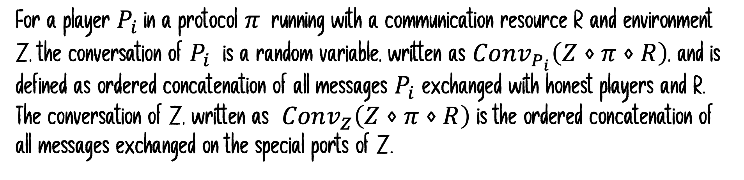
For a player $P_{i}$in a protocol $π$running with a communication resource R and environment Z, the conversation of $P_{i}$ is a random variable, written as $Conv_{P_{i}}\left(Z⋄π⋄R\right)$, and is defined as ordered concatenation of all messages $P_{i}$ exchanged with honest players and R. The conversation of Z, written as $Conv_{Z}\left(Z⋄π⋄R\right)$ is the ordered concatenation of all messages exchanged on the special ports of Z.
The conversation of party is the substring of its view

Slide 75

The ideal functionality F is said to be input-based if the following are satisfied:
Honest Behavior Equivalence: Consider executions of F where some set A is corrupted from the start and where a fixed ordered set of inputs $I_{F}$ is given to F during the execution. In any such execution, the outputs produced by F; and its state at the end have the distribution. In particular, the outputs do not depend on the corruptions that occur during the execution.
Publicly known input output provision: Each time F receives an input from $P_{i}$, F sends a message on its leakage port that some message has been received from $P_{i}$ . Furthermore, each time F sends a private output to $P_{i}$, it leaks that an output was given but does not leak the value.

Slide 76
Suppose that we are given an adaptive environment Z, and we want to show that the protocol is secure with respect to this environment
How can we use the static simulator S?
Can we just use S against Z?
S does not know how to handle corruptions in the middle.
Construct a family of static environments from Z.
For each set A that Z may corrupt, we construct an environment $Z_{A}$

Slide 77


The Environment $Z_{A}$
$Z_{A}$ first corrupts the set A, but initially it lets all the players in A play honestly
It runs a copy of Z internally and lets it interact with the protocol as usual.
Players in A are run honestly by $Z_{A}$ instead of themselves.
When Z corrupts a player in A
$Z_{A}$ gives control of the player to Z and continues
When Z corrupts a player not in A
$Z_{A}$ terminates

Slide 78


Let s denote an ordered sequence of players.
Let A(s) denote the set of players that are in s.
$E_{s}$ will be the event that the first |s| corruptions done are exactly the ones in s
$$V_{Z}\left(Z⋄π⋄R\right|E_{s})_s$$
If a corruption outside s occurs, we truncate the view at that point
$V_{Z}\left(Z_{A\left(s\right)}⋄IS\right|E_{s})={Extr(V}_{ZA(s)}\left(Z_{A\left(s\right)}⋄IS\right|E_{s})$)
A deterministic function

Slide 79

$V_{Z}\left(Z_{A\left(s\right)}⋄IS\right|E_{s})={Extr(V}_{Z(s)}\left(Z_{A\left(s\right)}⋄IS\right|E_{s})$)
A deterministic function
Why?

Slide 80
Lemma
$$V_{Z}\left(Z_{A\left(s\right)}⋄S⋄F \right|E_{s})≡V_{Z}{\left(Z⋄π⋄R |{ E}_{s} \right)}_{s}$$

Slide 81
Lemma
$$V_{Z}\left(Z_{A\left(s\right)}⋄S⋄F \right|E_{(s,i)})≡V_{Z_{A(s)}}{\left(Z_{A(s,i)}⋄S⋄F |{ E}_{(s,i)} \right)}_{s}$$
Appending s with i

Slide 82

Lemma
Consider an execution of the system $Z_{A(s,i)}⋄S⋄F$ until a point $E_{s,i}$ has occurred.
Let:
$V_{Z} \left(Z_{A\left(s,i\right)}⋄S⋄F\right|E_{s,i})_s =v$ and $St_{F}\left(Z_{A\left(s,i\right)}⋄S⋄F\right|E_{s,i})_s =w$
Let: $io_{s}$ be the string of inputs and outputs S has exchanged with F, and let $Conv_{Z}$ be the conversation of Z.
Then one can sample the distribution of $D_{v,w}$ from $io_{s}$ and $Conv_{Z}$

Slide 83

Defn
Patch is said to be a good sampling function if it satisfies the following:
It is polynomial-time computable
The output $Patch\left(io_{s}, Conv_{z}\right)$ is distributed according to $D_{\begin{aligned}io_{s}, Conv_{z} \\ \end{aligned}}$

