Slide 1
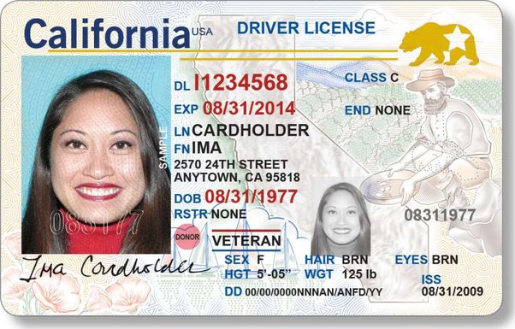
This is a test slide created on March 4th, 2024
This is a shape – March 6th 2024
John Doe is fantastic.
WordArt Jack Ryan
This is a table!!! Montreal General Hospital
Credit card number 5921 1122 4032 1230
Notes:
SPEAKER NOTES YAY! MARCH 6 2024

Slide 2
Engineer
Teacher
Warehouse Manager
Tutor
Pilot

