Slide 1







12-15-2025
PRESENTED BY
Ola Akinkunmi
in patial fulfilment for
Doctorate of Transportation Engineering
Proposal for the Development, Training and Evaluation of Autonomous Transport Agents using Reinforcement Learning.
Safe and Robust Reinforcement Learning in Transportation Agent Decision-Making with Real-Time constraint satisfaction.
aola@tongji.edu.cn

Slide 2
3 | Background of the Study
4 | Problem Statement
5 | Introduction
6 | Framework guiding the research
7 | Research Questions
8 | Design and Methodology
9 | Comparative Analysis
10 | Gaps in the current RL for Transportation
15 | Research Development Roadmap
Stupid Monkey if you game or flip
Agenda

Slide 3
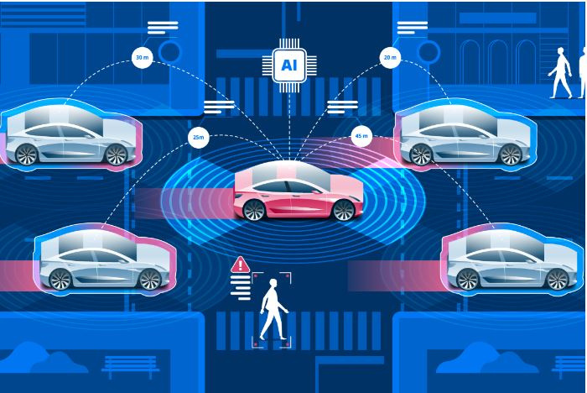
Background
Transportation agents represent the next significant phase of Physical Artificial Intelligence (PAI). They pose one of the hardest problems to solve due to their direct involvement with human lives and the real world. My research, development and agent training will focus on transportation industry, specifically on landing and driving application of Artificial Intelligence utilizing Proximal Policy Control (PPO)
PPO is a state-of-the-art algorithm in Reinforcement learning (RL). It is widely used in multiple industries including finance, chemistry, biomedical, traffic control, network engineering and cybersecurity. Importantly, PPO is also the core RL algorithm that currently enables frontier Large Language Models (LLMs) like OpenAI ChatGPT, Anthropic Claude and Google Gemini through techniques like Reinforcement Learning from Human Feedback (RLHF)
Image Source: https://www.smartcitiesworld.net/opinions/driving-autonomous-vehicles-forward-with-intelligent-infrastructure

Slide 4


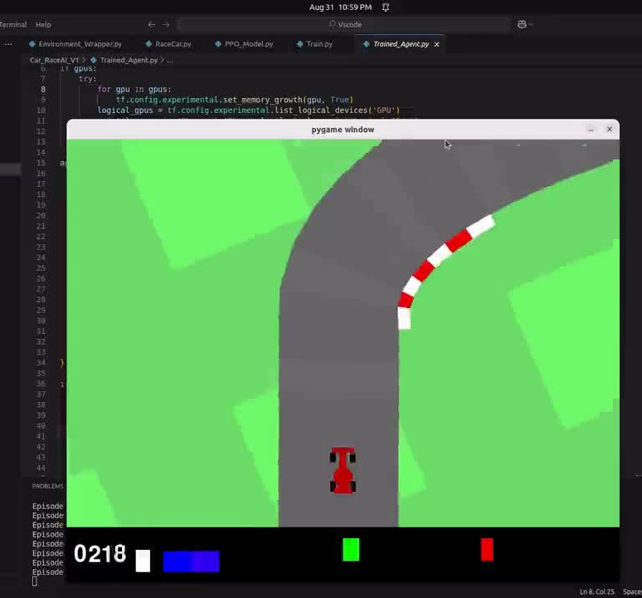
Problem Statement
Trained CarRacing-v3 agent with Proximal Policy Optimization (PPO) algorithm in OpenAI Gymnasium
Scope of the Solution
The core problem addressed by this research is the practical training of robust transportation agents for safety-critical tasks.
In addition to developing a comprehensive theoretical understanding of Reinforcement Learning (RL), the primary objective is to train multiple transportation agents using Proximal Policy Optimization (PPO) across diverse simulated environments. These environments such as OpenAI Gymnasium and Carla, feature integrated physics and world conditions designed to replicate real-world challenges. The successful training requires the agents to demonstrate the necessary intelligence to land and drive safely and successfully.

Slide 5
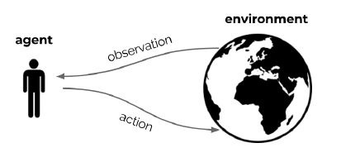

Introduction
Learning through interaction with the environment is the fundamental concept when considering the nature of intelligence. Reinforcement Learning theoretical foundation uses this concept in terms of the Reward Hypothesis, which posit that “any goal can be formalized as the outcome of maximizing the cumulative reward.” This optimization problem is solved through repeated interaction between an agent and its environment.
This process adheres to the logic of a sequential decision-making process. At each discrete time step t, the interaction loop proceeds as follows:
The Agent:
·Receives an observation O_{t} (representing the current state S_{t}) and a scaler reward R_{t} from the environment.
·Based on its current policy, the agent selects and executes an action A_{t}.
The Environment:
·Receives the agent’s action A_{t}.
·Transitions to a new state, emitting a new observation O_{t+1} (or S_{t+1})
·Provides a corresponding immediate reward R_{t+1}.
Image Source: https://www.youtube.com/playlist?list=PLqYmG7hTraZDVH599EItlEWsUOsJbAodm

Slide 6

Framework guiding the research
SMART Goals benefits?
-To ensure successful project execution, alignment and evaluation, the research will utilize the SMART framework to define project milestones and outcomes.
-This facilitates a clear and mutual understanding of what constitutes a satisfactory result allowing me to build and train autonomously with administrative oversight, assistance and support only required. SMART stands for:
Overview | Details
S Specific | What I want to acomplish is clearly defined and focused.
M Measureable | There is quantifiable data to measure and importantly a criteria for my success.
A Achievable | The project is realistic, within my skillset and the available resources of Tongji University.
R Relevant | Why this project is important, it’s alignment with my overall skillset, career and experience.
T Timebound | Timeframe for completion of the thesis and various project implementation is realistic.

Slide 7

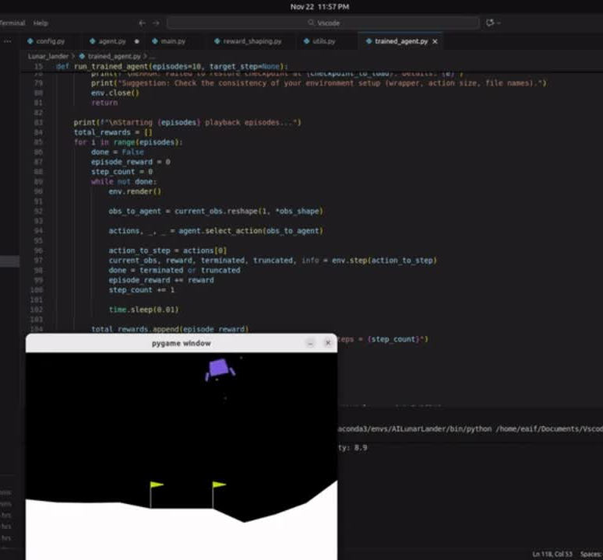


Research Questions
System Design and Navigation
Trained LunarLander-v3 agent with Proximal Policy Optimization (PPO) algorithm in OpenAI Gymnasium.
How can a Proximal Policy Optimization (PPO) framework be effectively architected and trained to endow multiple transportation agents with the decision-making ability required to navigate safely across diverse simulated environments and terrains?
Hyper-parameter and Reward Optimization
What specific hyper-parameters and reward structures are necessary to guarantee that the trained transport agents operate with the maximum safety and functional efficiency within the designated simulated environments?
Policy Evaluation and Success Criteria:
What objective and quantifiable metrics define a “well learned policy” for transportation agents in this context, and what level of performance is required to deem the training process successful?
Reproducibility and Robustness
Given the identical algorithmic code, hyper-parameters, and simulated environment, can a replicated training run consistently reproduce similar or demonstrably superior performance results?

Slide 8


Design and Methodology
The research design is strategically structured into three distinct tiers to ensure comprehensive development, rigorous experimentation and full control over the RL pipeline
Custom Model Development | Simulation Development for Agent Training | Experimental Science
This foundational tier involves the complete implementation and integration of the entire Proximal Policy Optimization (PPO) pipeline. This involves defining the compute environment, selecting the Operating System (Linux), setting up the development infrastructure, designing the Model architecture (Actor-Critic Network), and ensuring its compatibility with the specific AI use-case (transportation decision-making). | This tier utilizes established open-source simulation environments, specifically OpenAI Gymnasium and Carla, as the application layer. These platforms would be used to integrate the custom PPO algorithm and train the Reinforcement Learning agent to achieve the necessary navigational and operational intelligence under real-world-like physics and conditions. | This tier focuses on rigorous experimentation to maximize policy robustness and safety. It involves manipulating key variables, including training hyper-parameters, network size and custom reward/loss function.

Slide 9
Comparative Analysis
There are three preimary startegies for implementing real-world task involving Reinforcement Learning and this research and development would use the “full custom Production-Ready” approach, The strategies are as follows:
Level 1: High-Level Abstraction | Level 2: Custom Algorithm Implementation | Level 3: Full Custom Production-Ready Pipeline
The first approach utilizes highly abstracted, community-driven libraries, such as Stable Baseline3. These libraries are popular because they abstract complex mathematics and engineering, allowing for fast prototyping, benchmarking and execution of experiments with minimal code. Disadvantages include limited customization, significant abstraction overhead, and the framework being tied exclusively to the pytorch library. | The next level involves deeper implementation using native framework like Pytorch, TensorFlow or Jax. This involves using highly transparent, single-file implementation (Such as CleanRL) or writing the core algorithmic code and using it to train a single policy for different agents simultaneously in a vectorized Gymnasium environment such as (Boxing, HalfCheeter, Ant). This approach offers a better level of customization that level 1, but still limits agents’ autonomy. Since all agents in the vector share a single set of weights, they are all tied to a single general policy. | The chosen strategy for this research and development is to build a full custom Reinforcement Learning pipeline utilizing the TensorFlow framework e.g Policy-Value Network Architecture, Generalized Advantage Estimate (GAE) etc. It is suitable for production and tailored to the unique demands of safe transportation. This level of customization offers full control and maximum flexibility over every aspect of the algorithm, facilitating a deeper theoretical understanding, and enabling tailored performance for safety critical systems.

Slide 10
Gaps in the current RL for Transportation
While PPO is effective, its direct application to safety-critical transportation agents introduces specific challenges for this research which would also be addressed
Gaps Identified | Workaround / Solution Strategy
Safety as a Constraint | Constraint Policy Optimization (CPO)/Constraint Integration: The problem is modified from simple reward maximization to maximizing reward subject to a constraint on risk
Lack of Real-Time Constraint Satisfaction | Augmented Reward/Loss Function: A penalty term will be explictly integrated into the PPO loss function. This term will penalize the agent whenever a specific Real-Time constraint is violated forcing the policy to prioritize complaince
The Sim-to-Real Gap | Domain Randomization/ Domain Adaptation: The policy is trained to be robust to uncertainty by varying simulator parameters during training such as sensor noise, lightening, friction.
Reproducibility and Robustness | Hyper-parameter tuning and Seed Management: Policy stability is maximized through systematic management of training variables and random seeds across all training runs to ensure the learned policies are consistently reproducible

Slide 11

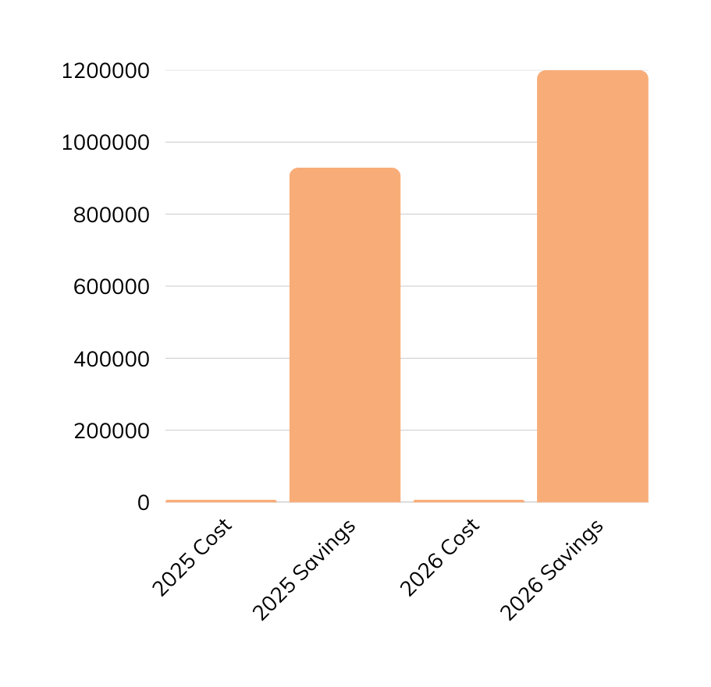
Budget Analysis Milestone
The decision to build a custom dedicated infrastructure offers significant financial advantages, demonstrating fiscal responsibility to the university.
Alternative 1 (Cloud Compute| $1.7M – $2.1M) | 3-year estimate: This is for 1-3 researchers using major Cloud Service Provider (Google Cloud: 2,128,500 including SME fees; Alibaba Cloud: Approximately 1.7M). This is the cost I have averted by using a dedicated server.
Alternative 2 (Datacenter CapEx) |$6M – $100M estimate: Capital expenditure for building a high-performance datacenter, excluding the substantial annual Operational Expenditure (OpEx) for maintenance, power and engineers.
My solution (Dedicated Personal Server): $30k – $40k is the Total Actual Cost to Tongji University/ Shanghai Government for the doctorate program length.
This proposal represents a net cost reduction of over $1.67M for the Transportation Department/Tongji University when compared to the minimum cloud compute alternative.

Slide 12
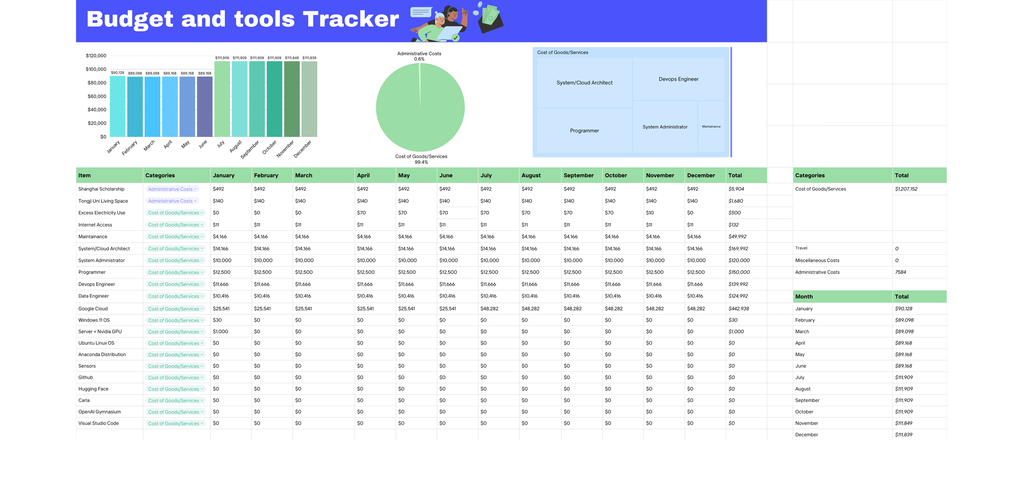

Slide 13
Education and Experience
My Education is highlighted below:
Doctor of Engineering (In view): Transportation Engineering, Tongji University, China
Master of Engineering (2016): Network Engineering, Toronto Metropolitan University, Canada
Bachelor of Science (2013): Computer Science, Babcock University, Nigeria
My Experience highlighted below:
Cybersecurity Advisor- Bank of Montreal Canada (2022)
Senior Cybersecurity Engineer/Team Lead (Micro and Macro Segmentation)- Toronto Dominion Bank Canada (2021)
Cybersecurity Systems Engineer- Cisco Systems Canada (2019)
Cybersecurity Consultant- Deloitte Canada (2018)
Specialist Solution Architecture- Bell Canada (2017)

Slide 14
1 | R. S. Sutton and A. G. Barto. Reinforcement learning: An introduction. MIT press, 2018, 2nd Edition.
2 | University of California. SMART goals; A how to guide. Page Number(s).https://www.ucop.edu/local-human-resources/_files/performance-appraisal/How+to+write+SMART+Goals+v2.pdf
3 | University of Toronto. Proposals. Page Number(s). https://ecp.engineering.utoronto.ca/resources/online-handbook/types-of-documents/proposals/
4 | D. Abel, A. Barreto, B. Van Roy, D. Precup, H. Van Hasselt, S. Singh. A Definition of Continual Reinforcement Learning. Page Number(s). https://deepmind.google/research/publications/a-definition-of-continual-reinforcement-learning/
5 | J. Schulman, F.Wolski, P.Dhariwal, A. Radford, O. Klimov: Proximal Policy Optimization Algorithms. arxiv:1707.06347, 2017
6 | J. Achiam, S. L. Hoang, J. Schulman. Constrained Policy Optimization. arXiv:1705.10528
7 | J. Tobin, R. Fong, A. Ray, J. Schneider, W. Zaremba, P. Abbeel. Domain Randomization for Transferring Deep Neural Networks from Simulation to the Real World. IEEE International Conference on Intelligent Robots and Systems (IROS), 2017
8 | J. Schulman, P. Moritz, S. Levine, M. I. Jordan, P. Abbeel. High-Dimensional Continuous Control using Generalized Advantage Estimation. International Conference on Learning Representations (ICLR), 2016
9 | My open-sourced PPO Model code: https://github.com/privateboss0/Model-Free_ReinforcementLearning_AI
10 | My open-sourced PPO training dataset: https://huggingface.co/privateboss
Resource Page

Slide 15
Research Development Roadmap
The project timeline is strategically structured to demonstrate feasibility and adherence to the Timebound element of the SMART framework and will proceed through a sequential, escalating path of complexity, focused on maximizing agent development and efficiency.
Development Title | Objectives | Deadline
Modular Software-Defined Vehicle | Built an end-to-end self-driving car simulation in Carla for day/night scenarios focusing on topological and array-based sensor visualization. | Completed.
Lunar Lander (Discrete action spaces) | Applied the PPO pipeline to Train a Lunar Lander agent to land safely using Discrete action spaces in Gymnasium environment. | Completed.
Car-Race (Continuous RL) | Applied the PPO pipeline to train a single continuous policy car-racing agent to get the maximum score within the time constraint in Gymnasium environment. | Completed.
Phase 2 is currently in the research and development stage but it would contain additional transportation agents. More details in the “Research and Development Proposal Document”

