Slide 1
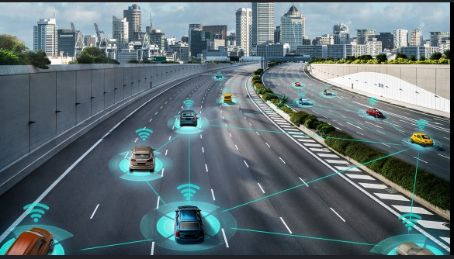


Self-Driving Vehicles
The evolution, implementation overview, safety, challenges, future improvement and demonstration.
By
Ola Akinkunmi

Slide 2




BUT WHAT EXACTLY ARE SELF-DRIVING VEHICLES?
A self driving vehicle is a complex system that integrates multiple fields (Electrical, Physics, Mechanical, Computer Science etc.) and Technologies ranging from Sensors/Hardware, Central Processing Units, Storage, Software, Networking, Artificial Intelligence, Cybersecurity etc. It is classified into Automated and Autonomous driving.
Let’s look at the Automated vs Autonomous Vehicles

Slide 3

AUTOMATED VEHICLES
In Automated vehicles, the person drives and the car helps OR the vehicle does most of the driving and the person assists. In any of the above configuration, the car does not replace the driver and overall safety is the responsibility of the driver. Examples include ADAS (Advanced Driving Assistance System).
What is the purpose of ADAS? They are passive and active safety systems designed to remove the human error component when driving. ADAS systems use advanced technologies to assist the driver and thereby improve drivers’ performance. Examples of ADAS technology include Adaptive Cruise Control, Park Assist, Door Open Alert, Lane Keeping, Departure and Centering suite, Vehicle steering, Blind Spot Detection, Emergency Breaking Collision Avoidance, Traffic Sign Recognition, Rare Collision warning, Surround View. etc.

Slide 4
AUTONOMOUS VEHICLES
In Autonomous Vehicles/Physical AI, the car does all the driving. It’s architecture is divided into the following:
END-TO-END ALGORITHM
MODULAR APPROACH
HYBRID MODEL
This is sub-divided into two categories:
Mediated Perception: This involves training the Computer Vision algorithm with human knowledge of known Avoidances(Traffic lights, Road markings, Pedestrians etc.). The neural network handles decision making and vehicle control.
Behavior reflex: The neural network mimics human behavior in a supervised learning approach. To teach the model, a human drives the car on the road or in a car racing simulation game e.g. Grand Turismo Sports, while the system records images and steering angles as training data.
This consist of two paradigms:
Reinforcement learning: This uses trial and error because it utilizes Deep Q Network (DQN), Asynchronous Advantage Actor Critic (A3C) or Proximal Policy Optimization (PPO) to maximize the cumulative rewards received by an intelligent system as it interact with the environment.
Direct Perception: This uses Deep Convolutional Neural Network (DCNN) to dynamically learn images for estimating Avoidances relating to Autonomous Driving in combination with reinforcement learning. Training data is also from human driver or car racing simulation recordings such as Grand Turismo.
This is the classical method for Autonomous Driving in the industry. The overall Driving Task is divided into four modules.(Sensor, Perception, Decision Making, Control Commands) with each module responsible for various subordinate functions such as Lidar, Object Detection, Path Planning, Acceleration etc. It is also known as rule-based design.
`

Slide 5
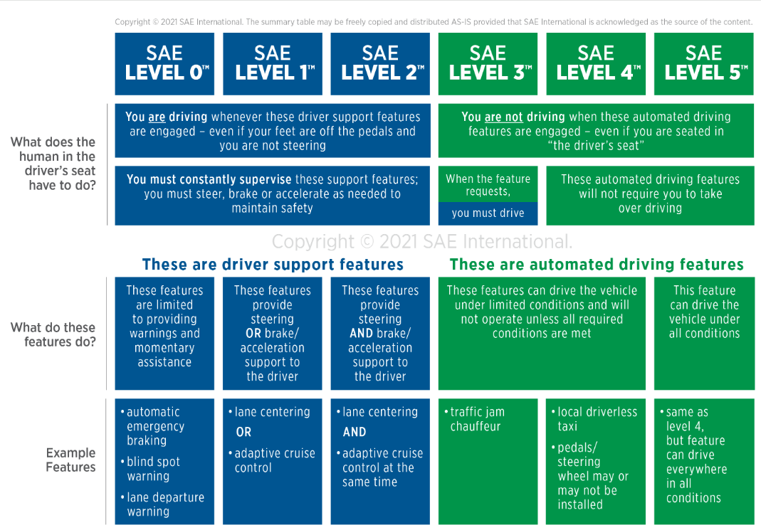
SAE LEVELS OF SELF-DRIVING VEHICLES
https://www.sae.org/blog/sae-j3016-update

Slide 6



Sensors currently serve as object tags for self-driving Vehicles they act as the eyes and ears for the car.
While sensors are very crucial to help vehicles understand their environment, it is important to understand that too much sensors have a net negative total effect as it can lead to unnecessary complexity, dispersed data points, which can lead to increased error rates for the fusion and AI algorithms to process at a particular point in time. The right balance of sensor technologies must be used.
Sensors can be classified into two major types based on functional principles which are:
-Proprioceptive and Exteroceptive sensors
-Passive and Active sensors
WHY DO WE NEED SENSORS IN SELF-DRIVING VEHICLES

Slide 7
FUNCTIONAL TYPEs OF SENSORS
PROPRIOCEPTIVE SENSORS
EXTEROCEPTIVE SENSORS
These are electronic devices that measure data and values internal to the AV system. E.g. motor speed, wheel load, battery voltage, Inertial Measurement Units (accelerometer, gyroscope, magnetometer)
These acquire information from the AV’s external environment such as distance measurement, sound amplitude, light intensity. Examples include Cameras, Ultrasonic, GNSS transmitters and receivers, Radio Detection and Range (RADAR), Light Detection and Range (LiDAR)
PASSIVE SENSORS
ACTIVE SENSORS
They receive and measure environmental energy entering the sensor e.g. microphones, temperature probes, Cameras, GNSS Receivers
Active Sensors emit energy into the environment and measure the reaction. They typically achieve superior performance because they manage a more controlled interaction with the environment, but the risk is that outbound energy may affect the very characteristic that the sensor is trying to measure. Active sensors include Ultrasonic, Radar, Lidar

Slide 8
Cameras: . It is a critical and popular component of autonomous driving because they are relatively inexpensive and have high-resolution capabilities. It works by detecting light emitted from the surroundings on a photosensitive surface. Limitations of cameras include difficulty identifying objects at long distances, bad weather conditions and low light conditions. There are 6 or more different types of camera implementations and selection depends on the function and use-case. They include: RGB camera, Depth Camera, Semantic Segmentation Camera, Instance Segmentation Camera, Dynamic Vision Sensor Camera, Optical Flow Camera etc.
Ultrasonic RADAR (Radio Detection And Ranging): It operates under the “echolocation principle” which Bats use to find their prey and used for contactless detection, positioning of objects, speed and location tracking etc. It emits micro/radio waves which bounces off objects in its path and the sensor receives the reflected signal. Ultrasonic Radars are independent from heat/cold weather conditions or the color of the object being detected. It works in bad or no lightening conditions and is not visible with human eyes. Downside is Ultrasonic Radar have a lower resolution than lidar or camera making it difficult to identify small objects or distinguish between similar objects.
UNDERSTANDING SELECT SENSOR FUNCTIONS

Slide 9
LIDAR( Light Detection And Ranging): Its operating principle is like RADAR but uses infrared laser light which is not visible to the naked eye to measure distances between objects after emitting light pulses on the object. There are multiple types of lidar technologies used for various functions such as Airborne Lidar mounted on drones and helicopters, Terrestrial Lidar on the ground which can be static or mobile, Bathymetric Lidar which uses green light to measure seafloor and riverbed elevations, Wind Lidar to measure windspeed, turbulence and direction, Spaceborne Lidar for global mapping, environmental studies and climate monitoring. In Autonomous Driving, the common Lidar types include Time of Flight Lidar, Flash Lidar, Scanning Lidar, Frequency-Modulated Continuous Wave. With each having its own positives and negatives.
GNSS Transmitter/Receiver: Global Navigation Satellite System is a critical component in autonomous driving. It refers to any satellite constellation that provides global positioning, navigation, and timing services e.g. include Galileo (EU), GPS (USA), GLONASS (Russia), Beidou (China). It relies on a network of satellites which orbit the earth and transmits signals using microwaves that allow a GPS receiver receive these services using a process known as satellite triangulation. GPS was originally developed by the US Department of Defense for use by the US Military during the cold war.
UNDERSTANDING SELECT SENSOR FUNCTIONS

Slide 10
MODEL-FREE REINFORCEMENT LEARNING
This is a technique within the Artificial Intelligence domain whereby an agent learns to take actions in an environment without needing any pre-defined model of the environmental dynamics. The agent directly interacts with the environment, learns from experiences and adjusts it’s behavior based on rewards, instead of trying to understand how the environment works.
It uses trial and error method to explore different actions in solving real-world problems like Energy Distribution and Management, Resource Management, Games Playing, Rocket Navigation, Descent and Landing, Biomedical Engineering, Autonomous Planet Exploration, Autonomous Driving, etc.
Common Algorithms include: Monte Carlo (MC), Temporal Difference (TD), Q-learning, SARSA
Currently, there are three top algorithms used for model-free reinforcement learning in classical and supercomputing. The choice among them often depends on the specific problem and environmental characteristics, since each algorithm has it’s weakness and strength. Let’s take a sneak peak in the next slide.

Slide 11
Model-Free Reinforcement Learning Algorithms
DEEP Q-NETWORK (DQN)
A3C(ASYNCHRONOUS ADVANTAGE ACTOR CRITIC)
PROXIMAL POLICY OPTIMIZATION (PPO)
It is a value based reinforcement learning technique that uses neural networks to approximate the Q-value function, which then estimates the expected future rewards for each action given a state. Often used in environments with discrete action spaces, such as Atari games.
It combines both value-based and policy-based approaches to leverage their respective strengths. It uses the Actor-Critic approach and implemented in environments with discrete and continuous action spaces where parallelization can be utilized.
-Actor: Represents the policy that selects actions
-Critic: Evaluates the action by estimating the value function.
It uses this mechanism to function
A policy is updated in the direction of the Actor by the critic
The Critic receives feedback from the environment and update the value function.
It is a Policy based reinforcement learning technique and is motivated by this question? how can we take the biggest possible improvement step on a policy using the data we currently have, without stepping so far that we accidentally cause performance collapse.
It simplifies the optimization process by using a surrogate objective function and clipping mechanisms to limit the policy update at each step. PPO is suited to natively handle continuous and high dimensional action spaces.

Slide 12
SAFETY IN SELF-DRIVING VEHICLES
Self-Driving cars, particularly Autonomous Vehicles Technology has been touted to revolutionize our roads with the promise of reducing road accidents, drunk driving, congestion, energy consumption and emissions/pollutions etc. While true and promising, the technology adoption is still nascent due to its direct correlation with human lives and properties, therefore safety must be paramount.

Slide 13
ETHICS IN AUTONOMOUS VEHICLES
Trolley problem, in moral philosophy, was first posed by the contemporary British philosopher Philippa Foot and is used in ethics, psychology, warfare, artificial intelligence etc. It involves ethical dilemmas to allows us to think through the consequence of an action and consider whether it’s moral value is determined solely by its outcome.
MIT University has one specifically for Autonomous Driving scenarios called Moral Machine where participants can design their scenarios or browse through other peoples scenarios: https://www.moralmachine.net
Let’s take a look at my designed scenario: “If the breaks of a car fail due to a cyberattack and the car has 2 passenger's in the front seat, a biker without a helmet on the right lane, and a truck in front on a highway going at 150m/h. Then the truck is suddenly forced to an emergency stop in the ‘’overtakelane'' because a dog ran across from the woods, making driving reckless to the other road users on the overtake lane. Should the AV crash to the biker to reduce speed and possible kill him/her, rear end the truck and possibly kill the two passenger, or hit the curb to potentially kill the passenger at the driver side?”

Slide 14
Public Assurance:
Expectation of super human level for machine performance immediately.
Trust is easily given, and extreme distrust when an accident occurs.
AV vendors cannot just put autonomous vehicles on the road without state licenses as it’s a recipe for chaos. Proper simulation, track testing and public road testing during off-hours must be conducted first.
Industry Standard:
Traditional Safety Regulators are still struggling to understand software, AI centric framework and test in the automotive sector.
While 99% is great, autonomous driving safety requires 99.9999%.
Technical Nightmare:
From a game theory perspective, there are lots of rational and irrational players involved in cooperative and competitive games when using the road.
It’s impossible to consider all driving scenarios so engineers have to reimagine the AI algorithms capable of excellent optimization and generalization to solve this problem.
WHY IS AUTONOMOUS DRIVING SAFETY DIFFICULT

Slide 15
Its in the Miles:
300+ million miles of real autonomous driving is needed to validate.
Let’s take a look at where we are now in 2025?
Apollo Go by Baidu: Founded in 2017
Total miles: Not Publicly Available
Public Road Miles: Not Publicly Available
Simulated Miles: Not Publicly Available
Zoox by Amazon: Founded in 2014
Total miles: Not Publicly Available
Public Road Miles: 2+ million
Simulated Miles: Not Publicly Available
Waymo by Google: Founded in 2009
Total miles: 40+ million
Public Road Miles: 25+ million
Simulated Miles: 20+ billion
Using the Marathon analogy. Waymo has impressive results and leading, but we are still in mile 3.4 out of 26.2miles or 5.4 of 42.1km for safety scenario validation.
WHY IS AUTONOMOUS DRIVING SAFETY A TECHNICAL NIGHTMARE

Slide 16
WHY IS AUTONOMOUS DRIVING SAFETY A TECHNICAL NIGHTMARE CONTD
System Architecture, Software or Model change: Any drastic update in system architecture e.g. from monolithic, distributed or microservices architecture perspective or a change in the software architecture, framework, language etc. or a change in the AI architecture, algorithm, model etc. can result to drastic reliability, response, performance, or behavioral change etc.

Slide 17
Centralized vs Distributed vs Decentralized Architecture
CENTRALIZED
DISTRIBUTED
DECENTRALIZED
A monolithic architecture is an identical, single, large computing network or application with one code base that couples all of the business logic together. It is restrictive and time-consuming because a change means updating the entire stack by accessing the code base, build and deploy the updated version.
Advantages include: Easier development and deployment, easier debugging, simplified testing and performance
Disadvantages include Barrier to modern adoption, bottlenecks and single point of failure, lack of scalability and flexibility, slower development speed.
Popular Centralized use cases can include Enterprise Resource and Planning (ERP) Systems, Banking Systems, Customer Relationship Management(CRM) Systems, Email Servers. etc.
In distributed computing, individual nodes work together to achieve a common goal. It is the natural evolution of Monolithic systems. Distributed computing types include client-server, multi-tier, peer-to-peer, service oriented architecture and microservices. Examples of Client-Server architecture include Carla simulation where the server runs the simulation, the client retrieves information and requests changes in the simulation. Peer-to-peer example include fail-over mechanisms in network and cyber architecture, microservices examples include kubernetes or orchestration tools for network and cybersecurity. Global examples of distributed systems include Distributed Databases like Amazon DynamoDB, Cloud Computing Platforms like Microsoft Azure, Content Delivery Networks like Cloudflare
Its advantages include Transparency, Error detection, Great Scalability, Better performance, Load Sharing etc. but can become very complex and difficult to manage.
In decentralized systems/computing, decision-making, control and operation is distributed that no single entity has complete control of the entire system/network. Each node operates independently but collaborates with others to achieve a common goal. Cryptography plays a key role to ensure security and privacy in decentralized systems.
Benefits include privacy and security for the users, node autonomy and redundancy, scalability effectiveness, Efficiency and Fault Tolerance etc.
Top examples of decentralized systems include Blockchain (Database), Tor (Network)
Feel free to check out my Cryptography and Tor opensource project:
https://github.com/privateboss0/Artificial_Intelligence_MIT/tree/goddevil/MIT_AI.ME/Cryptography
https://github.com/privateboss0/Secure_Tor_Ip_Changer

Slide 18
FOUR HARD PROBLEMS FOR SAFE AUTONOMOUS VEHICLES.
To attain a fully safe autonomous vehicle, engineers have to develop and integrate four major hard technologies to make it a reality which are Software, Network engineering, Cybersecurity and Artificial intelligence. Let have a high level overview of each of them and their impact.
SIDE NOTE: The top generalized Computer Science branches include Database, Graphics and Visualization, Data structure and algorithms, Scientific Computing.

Slide 19
SOFTWARE
NETWORKS
CYBERSECURITY
Software Engineering is a generalized branch of Computer Science that deals with the design, development, testing, and maintenance of software applications. Software engineers apply engineering principles and knowledge of programming languages to build software solutions.
Software is a set of instructions, data or programs used to operate computer systems and execute specific tasks.
Network Engineering is a specialized branch of Computer Science that deals with the design, implementation and management of computer networks for the transportation of instructions and data through a supported medium such as wireless, fiber optics cables etc. using algorithms/protocols, techniques and technologies.
Computer network is a system of interconnected devices that share data and resources.
Cybersecurity Engineering is a specialized branch of Computer Science that focuses on designing, implementing and managing the cyber protection, detection and response of computer systems, digital assets, and data at rest or in motion from physical and cyber threats using algorithms, techniques and technologies.
Cybersecurity refers to safeguarding computer software, systems and networks from threats that can lead to unauthorized information disclosure, misuse, theft or damage, disruption in services etc.

Slide 20
ARTIFICIAL INTELLIGENCE
Artificial Intelligence is a specialized branch of Computer Science that focuses on creating machines that can perform tasks that typically require human intelligence such as reasoning, decision making, learning and problem solving using computational power, algorithms and data to simulate human creativity, thinking, autonomy and behaviors.
AI is a technology that enables computational systems to perform tasks typically associated with human creativity and intelligence.

Slide 21
ROBOTAXIS AS SAFETY BENCHMARK
Fundamentally, Robotaxis utilize multiple sensors such as Camera, Lidar and Ultrasonic Radar and fuse the independent data together from the sensing devices to have an accurate model of the real world.
This real world view and information is then parsed to the Artificial Intelligence Agent to make driving decisions.

Slide 22

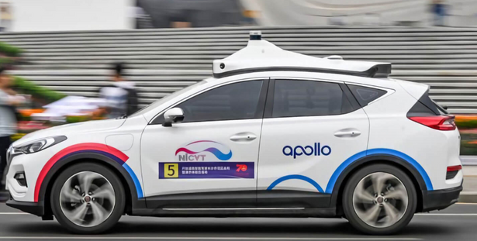
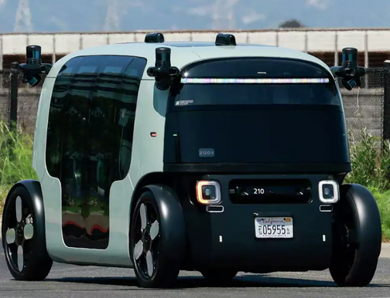
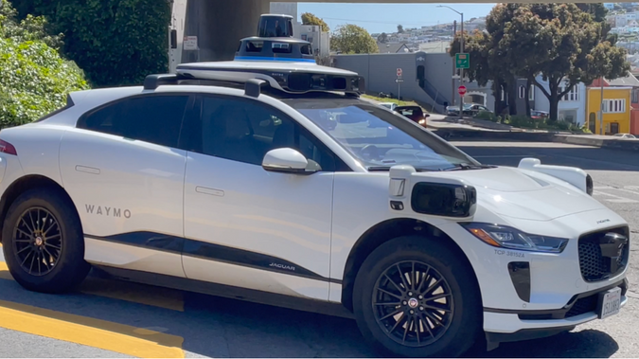





LOOKING AT TOP ROBOTAXI’S IN CHINA AND USA

Slide 23
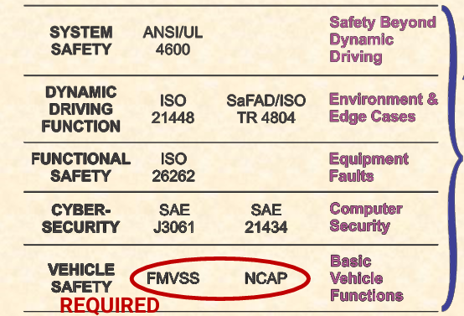
SAFETY STANDARD IN AUTONOMOUS VEHICLES
Since Autonomous vehicles are still in the nascent phase, safety regulations are relaxed so as not to strangle and stifle innovation.
Out of the 5 safety standards shown in USA, only 1 is actually required, but every crash is covered in the media, so vendors approach with a bit of common sense especially in robotaxis

Slide 24
DOES ADEQUATE SENSORS MEAN SAFETY?
Too little sensor information means there would be blind spots missed, too much sensor information can result to information overload, sensor interference and artificial noise.
But generally, sensors do not equate to safety, but an adequate balance is a very good step in the right direction, because the Rule Based Agents, Hybrid Agents or Reinforcement Learning Agents can make bad or good decisions and generalize only on what it can see.
Self Driving Car vendors use multiple techniques and technologies to ensure and verify the safety of the vehicles. I will discuss two prominent ones in the next slides

Slide 25

REMOTE OPERATORS
Thanks to the continuous advancement of wireless and fiber optic technologies, Self-Driving cars can incorporate Remote Operators to ensure safety in real time communication. Here are the multiple levels of Remote Operators involved.
Full Remote Driving
Remote Safety Operators
Remote Safety Intervention
This is utilizing various technologies to allow an individual drive and control the vehicle remotely.
Remote Safety Operators take control of the vehicle frequently or infrequently. Typically when a customer calls in, or in a unique case for the vehicle.
Here the Autonomous Vehicle request assistance to the Remote Operators to get through any issue it encounters that it cannot navigate

Slide 26
DIGITAL TWIN
This is another technique used for safety. It is the accurate virtual representation of an object, system or environment that exists in the physical or real world. It uses Real-Time Data, Machine Learning, Simulation, Reasoning etc. to help make decisions.
In general self-driving car vendors use one, two or the combination of Simulation/Digital Twin Technologies (e.g. Airsim, Carla), test track environments and public road testing to ensure their vehicles are safe for commercial purposes.

Slide 27
Simulation vs Digital Twin
Oftentimes Simulators and Emulators/Digital Twins are often confused with each other, so I will simplify it here.
Simulators
Hybrids
Digital Twin
These are typically the bridge between Simulators and they can be a virtual replica of a process, system, environment of an actual physical asset but not connected in real time to it’s real world counterpart.
Hybrids can be a representation of the actual physical asset similar to Digital Twin but without the live updates, or it gets the exact live update with a different engine altogether. examples include GNS3 for Networking and Carla for Autonomous Driving.
In the examples mentioned, Software or Intelligence is independent.
Simulator is a virtual environment created to replicate a real-world process, system or environment without affecting the actual entity. The simulator is typically not connected to the real world in real-time and the software is not representing the real world counterpart. Examples include Packet-Tracer for Networking and Mathlab for self-driving cars etc.
In the examples mentioned, Intelligence is independent factor of the simulated environment.
Digital twin is a virtual replica of a process, system, environment of an actual physical asset connected in real time to it’s real world counterpart. It is a living, breathing representation of the physical twin continuously updated with data from sensors and other sources. Example: Virtual Machines connected to the internet for live updates.
In the example mentioned, while the continuous updated environment is a very important part to the virtual and real world, the Software and Intelligence is the independent factor.

Slide 28
FUTURE LOOK INTO AUTONOMOUS VEHICLES
-Replacing the bulky mechanical lidar on the rooftops or hoods of self-driving cars with Integrated Photonic Lidar that can be shrunk into headlights, backlights and sides for an accurate, clear and complete 360 degree view.
-Sensors will also serve as future perception handlers for autonomous vehicles as the Neural Networks and Merging Algorithms will be shifted forward and handled by the sensors.
-The fusion of Networking, Cybersecurity and Artificial Intelligence for safe autonomous driving.
-Although we are still in the very early stages of quantum computing devices, all the current algorithms in Networking, Cryptography and Reinforcement Learning have a quantum equivalent to improve privacy, speed, efficiency, security etc. Active research area with gradual progress due to limitations in quantum hardware.

Slide 29
“The only way of discovering the limits of the possible is to venture a little way past them into the impossible”- Arthur C. Clarke
THANK YOU!!!

Slide 30
RESOURCES
https://carla.readthedocs.io/en/latest/ref_sensors/
https://ieeexplore.ieee.org/abstract/document/10285393/authors#authors
https://www.sae.org/blog/sae-j3016-update
https://github.com/privateboss0
https://www.moralmachine.net/
https://www.apollogo.com/
https://waymo.com/safety/
https://zoox.com/journal/robotaxi-rider-safety/
https://www.atlassian.com/microservices/microservices-architecture/microservices-vs-monolith
https://www.atlassian.com/microservices/microservices-architecture/distributed-architecture
https://www.geeksforgeeks.org/distributed-vs-decentralized-systems/
https://effectphotonics.com/insights/the-power-of-integrated-photonic-lidar/
https://users.ece.cmu.edu/~koopman/lectures/index.html
https://www.hks.harvard.edu/publications/trolley-problem-mysteries
https://www.youtube.com/watch?v=zYkrOxQDPEo
Google Gemini

