Slide 2
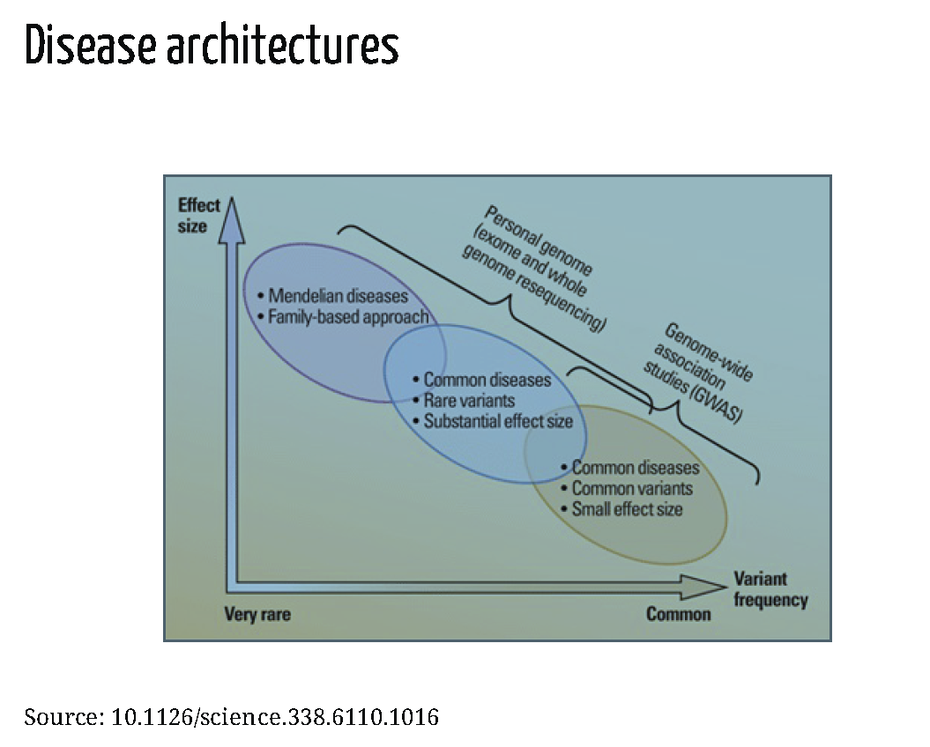

Slide 3
Predicting diseases – a major application of genetic studies

Slide 4
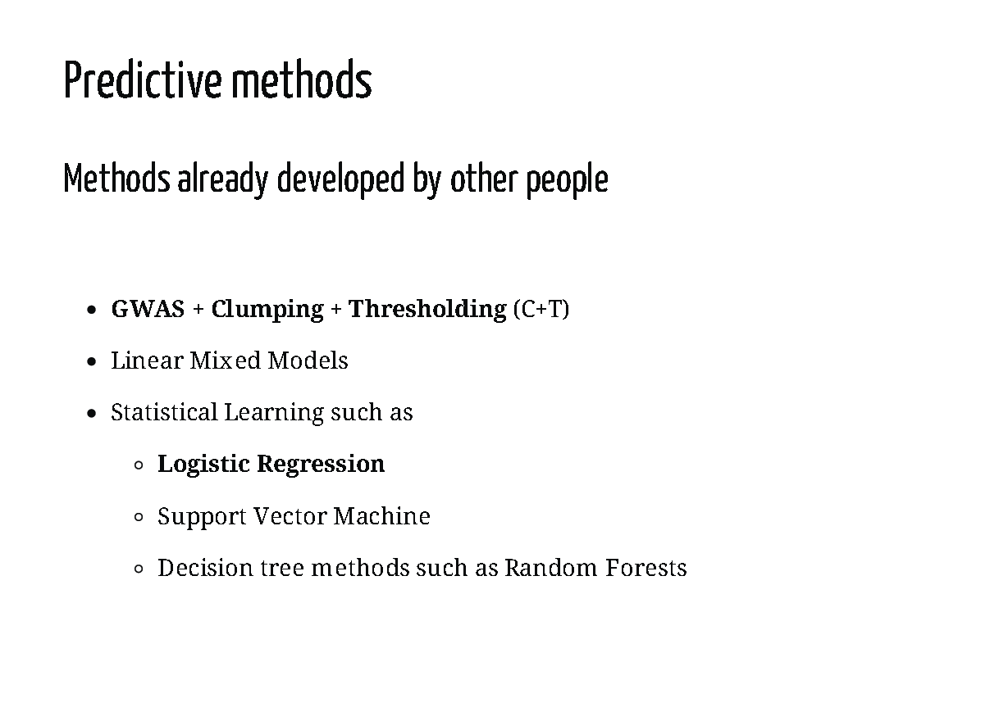
Add multiple REFs

Slide 5
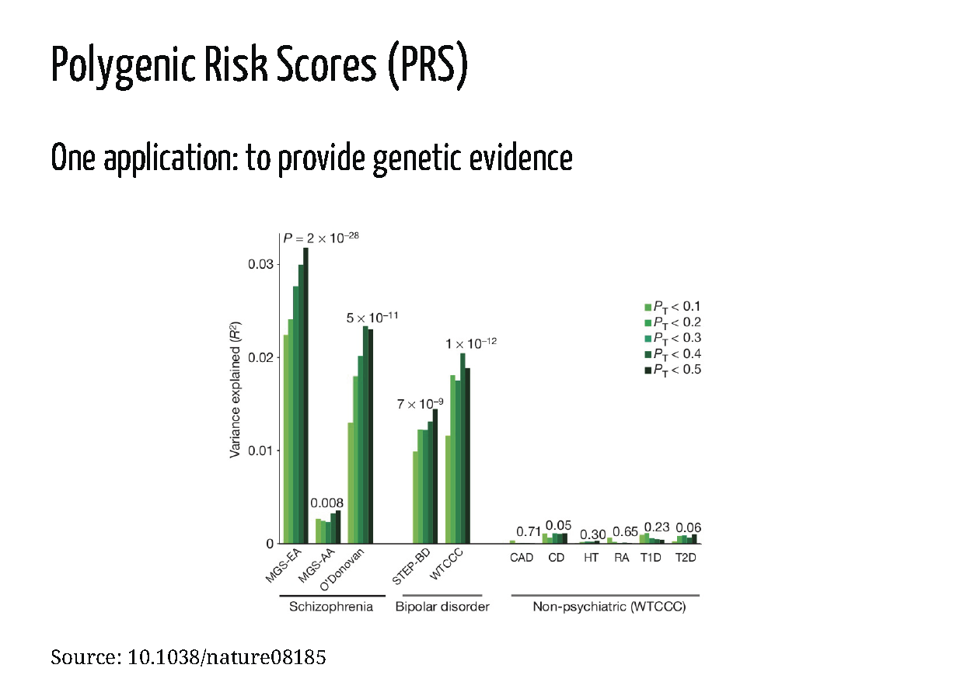
Describe a bit further PRS
As this is the standard

Slide 6
Transition to your method

Slide 7
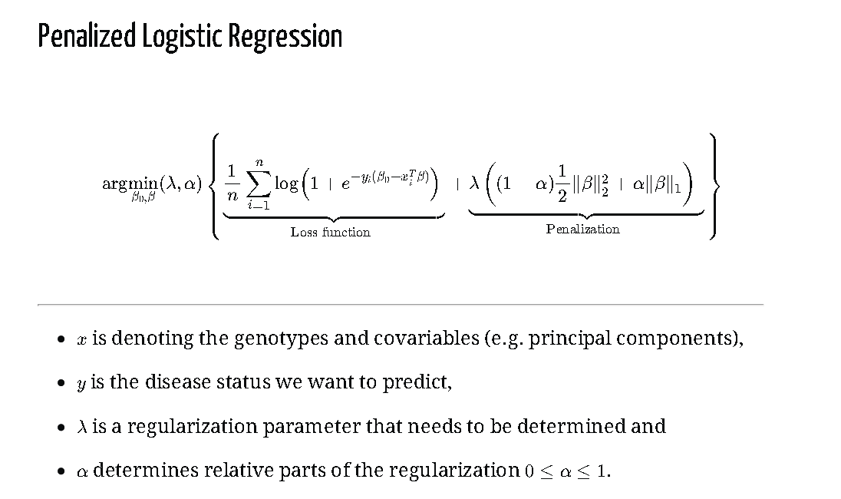

Slide 8
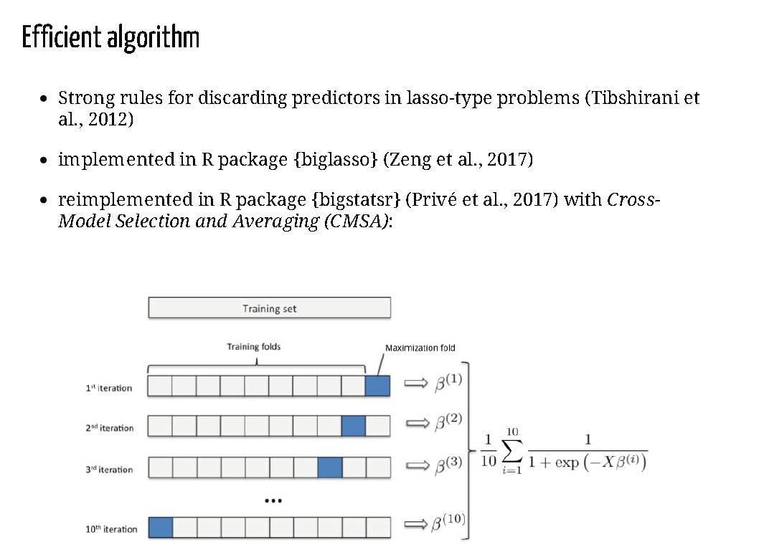

Slide 9
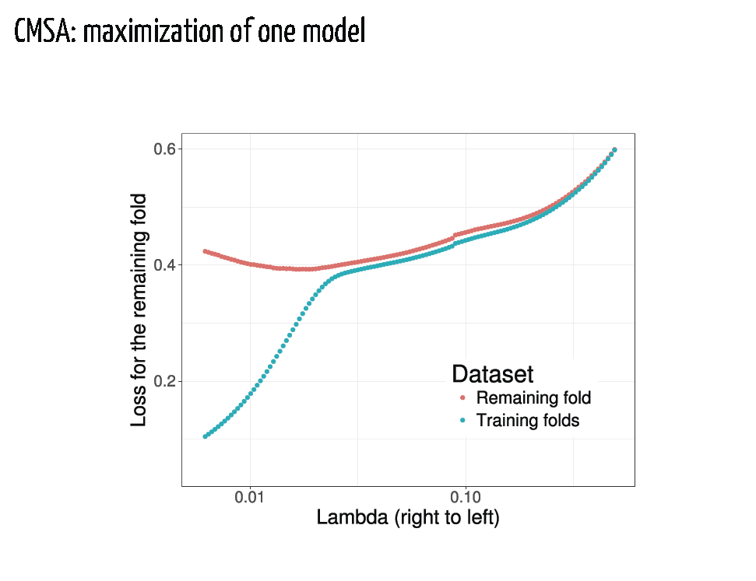

Slide 10
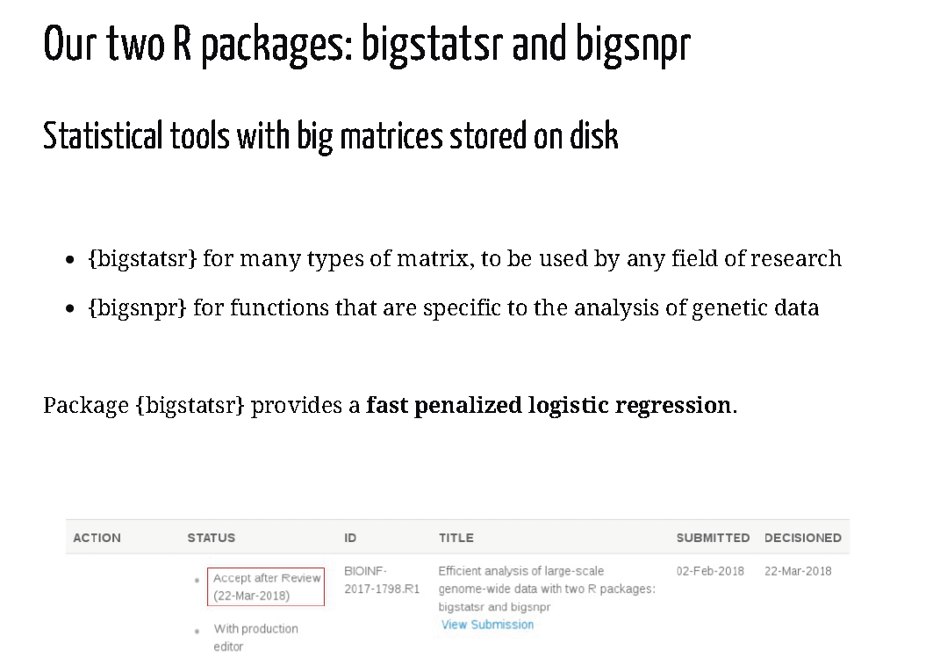
Implementation
+ limitation in application
How many SNP / how many individuals

Slide 11
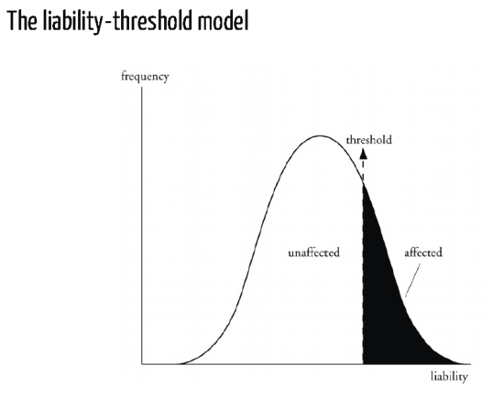
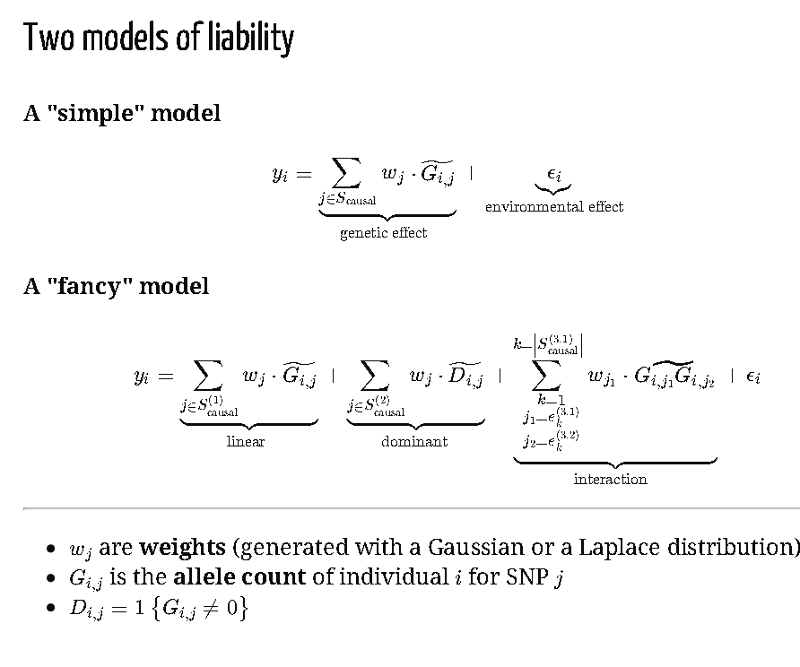
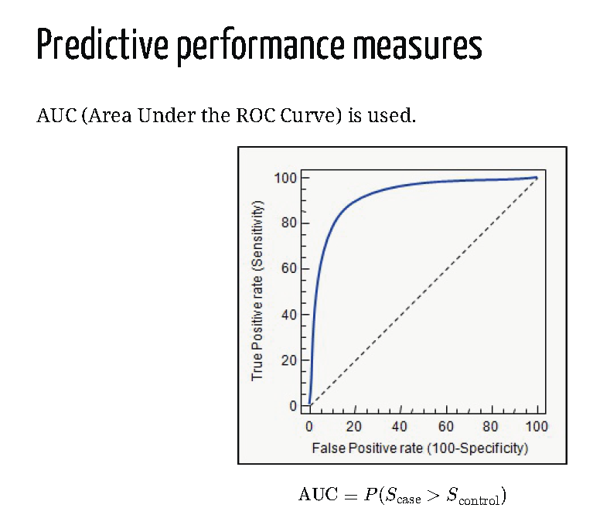
Evaluation of performances : simu + eval (AUC) + compar (PRS)
Will be compared against:
PRS-max =????
PRS-all=????
PRS-stringent=??????

Slide 12
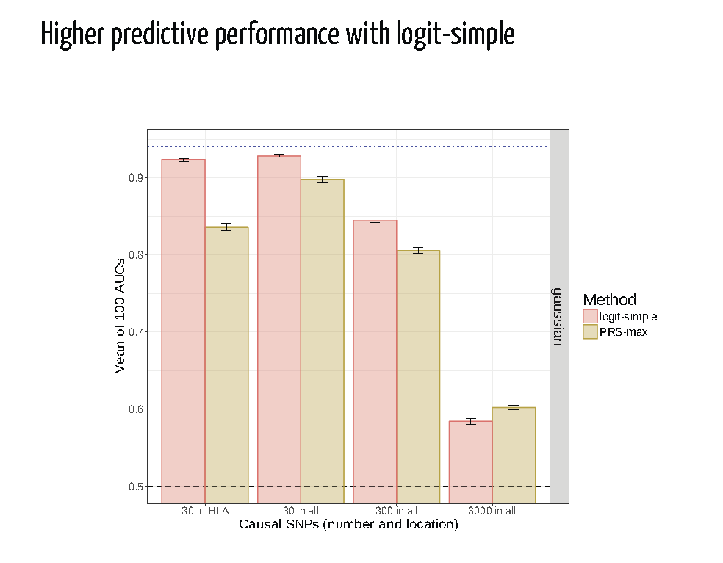
Logit perform better in most scenario …

Slide 13
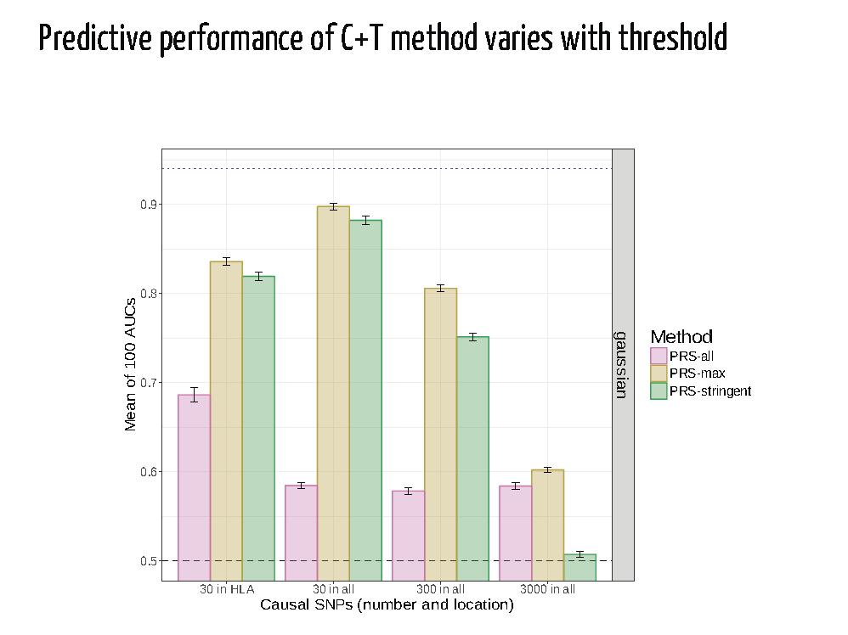
PRSmax is the optimal – however it is almost never achieved in practice

Slide 14
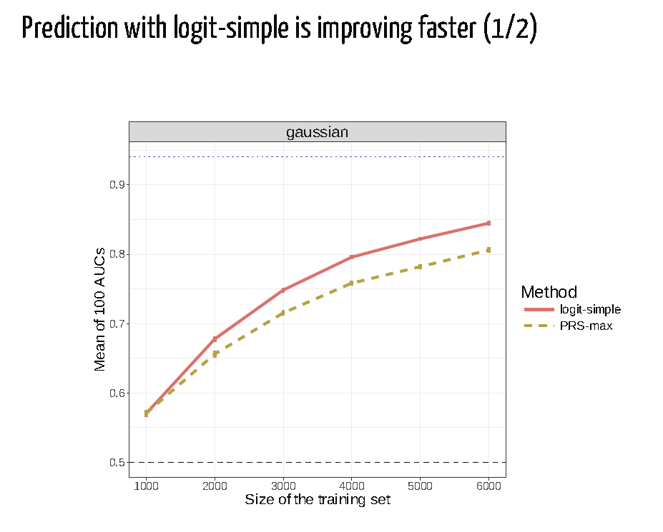

Slide 15
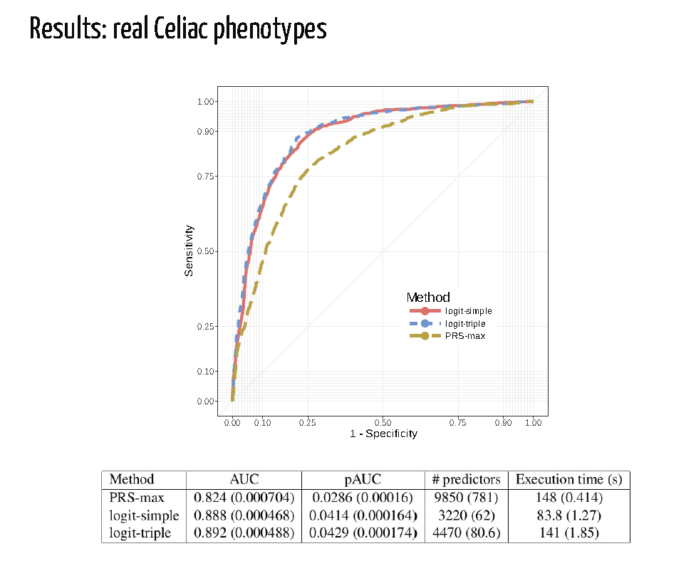
Performances in Real data analysis
Describe data:
WTCCC
N cases/ N control
UK ancestry only
N snp

Slide 16
