Slide 1
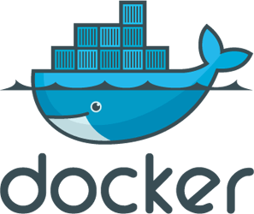

Docker
a
practical example
George Herczeg

Slide 2





Introduction
Docker
a
practical example
Introduction
This presentation explains a possible application of Docker in context of a theoretical discussion between
- Ms. Unni Fy (the requestor of an application) and
- Mr. Naga Ro, the expert (the implementer of the application)

Slide 3
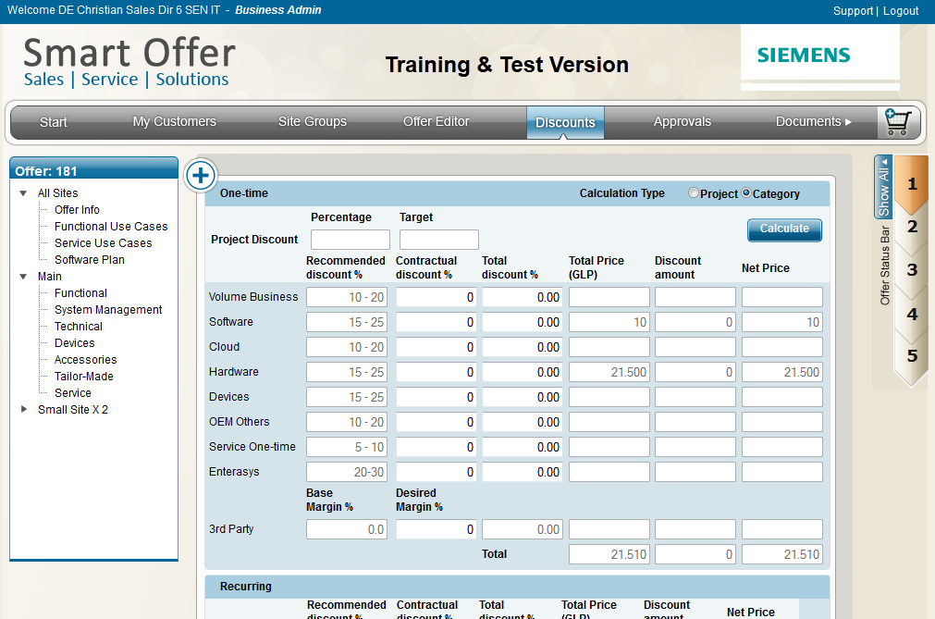





Introduction
Docker
a
practical example
The customer request
Ms. Fy: Can you build us an application which would calculate the prices of our products and services? Let us call the parts of the highly distributed SOA application SmartOffer, PricingService and Service Engine!
Mr. Ro: Sure, we can! We will build a high sophisticated java-based application, running on a specific version of the JRE, JBoss and using several Oracle, MySQL and Mongo databases. We would install the apps on several servers to ensure reliability and load distribution.

Slide 4

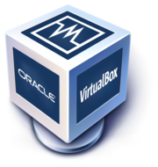


The problem
Docker
a
practical example
Problem – first solution?
Ms. Fy: Ohhh, that sounds complicated! Do your apps really have so much prerequisites? Our IT Service Provider (ATOS) will need a lot of time to set up all the servers and the necessary JRE and JBoss. Every change in the software requirements will cause a long delay until everything is prepared. I have a better idea: you could set up some virtual machines with the necessary environment and we would just install and run it!
Mr. Ro: Yes, I see the problem: the setup of an application specific environment is effort intensive and takes a lot of time. However, we wouldn‘t recommend using virtual machines, because that would mean to run several virtual operating systems on the host. This would put unnecessary high load on the hardware.

Slide 5

The solution
Docker
a
practical example
Problem & real solution
Ms. Fy: Hmmm, I see your point. What else can we do to provide a defined environment and avoid the effort intensive manual setup of the requirements?
Mr. Ro: I think, I have the solution: I could describe the necessary requirements in a simple text file. So… → You could use this environment description to automatize the server setup → We could use this description to set up our internal development & test systems There is an application, Docker, which can use such text-based environment description to automatically download, install and run the required software on the target hardware. You can run many different docker-based applications with possibly different requirements, on the same machine, as they all run in different encapsulated, completely isolated environments.

Slide 6
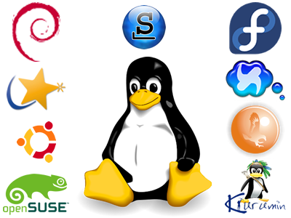



The solution
Docker
a
practical example
Problem & real solution
Ms. Fy: Your description of Docker sounds good, but pretty similar to the features of a virtual machine. Are you sure the app will run efficiently in a Docker container?
Mr. Ro: The crucial advantage of Docker is, that the apps run natively on the host system in an isolated environment. Our apps have as much direct access to the hardware, as normal applications have (through the direct usage of the Linux kernel functions). Docker uses the Linux specific APIs to reach the complete isolation of the process but allow direct host operating system access.

Slide 7
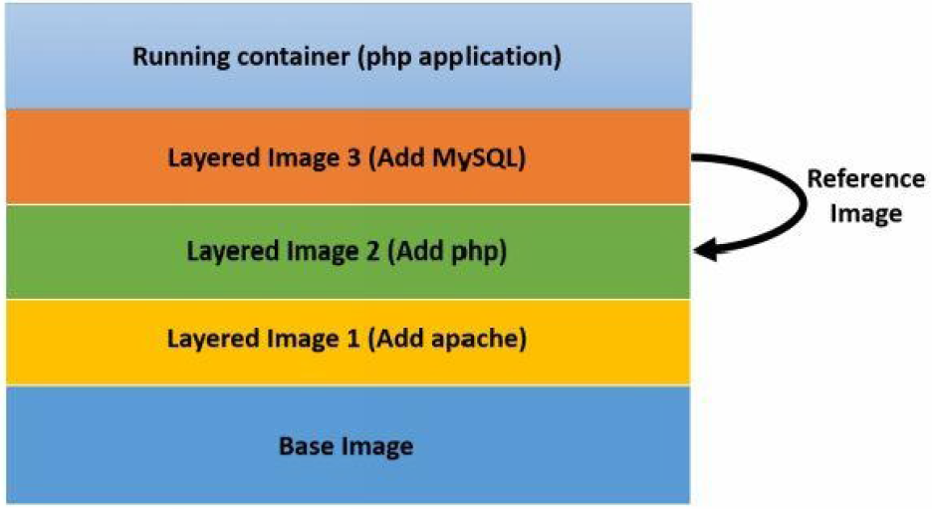
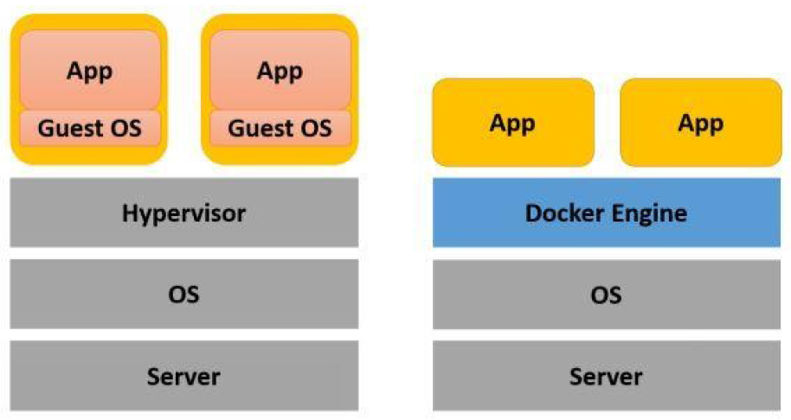
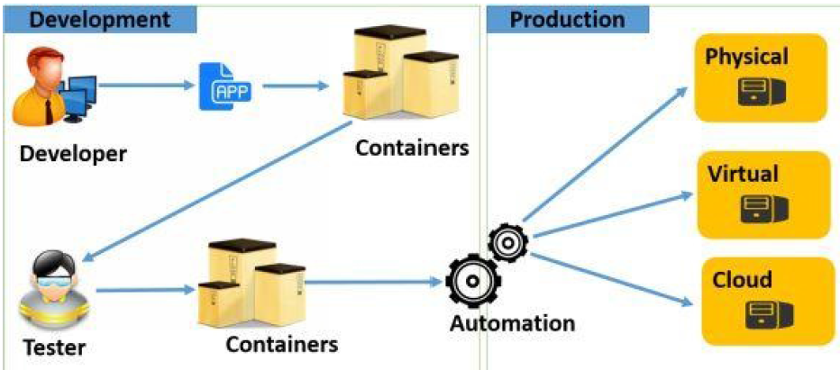
The solution
Docker
a
practical example
The architecture of Docker
VM vs. Docker: which one is more lightweight?
Layered Architecture (described in a Dockerfile)
Development workflow in well defined environment.

Slide 8
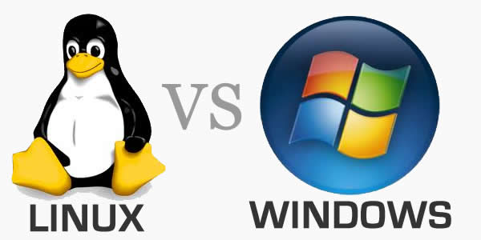


Pitfall?
Docker
a
practical example
A solution without trap?
Ms. Fy: Coool! I see the advantages of Docker. Let‘s develop all of our apps from now on immediately with it! This way, we have reliable & well-defined system requirements description which can be used for - setting up development environments - setting up test environments - setting up automated all servers of the production landscape
Mr. Ro: Sorry, but there is a little trap: Docker uses Linux specific API to ensure the efficient system access, so the software can only run on Linux, but not on Mac or Windows. We can use virtual machines with Docker on the development systems, but this is no way in a productive cluster. However, Docker is good for the majority of our apps in the SmartOffer environment, as most of the apps aren‘t using windows specific API, so can run on Linux. Docker is suitable for apps offering their services through TCP/HTTP (no GUI) on Linux systems.

Slide 9



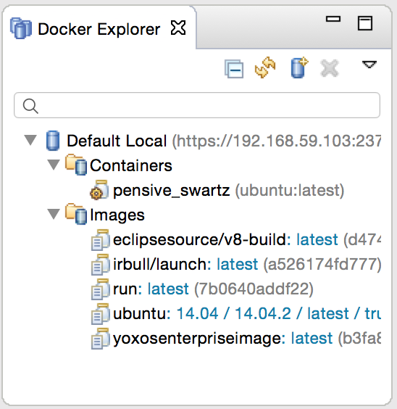
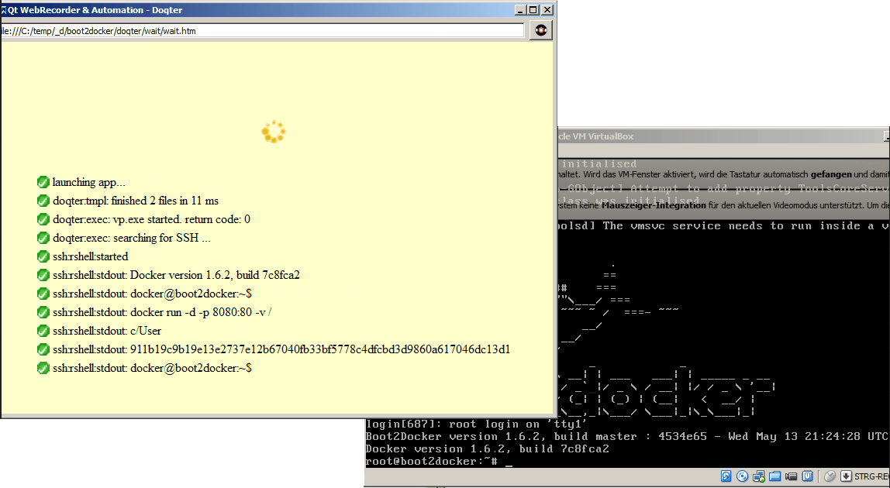
Internal considerations
Docker
a
practical example
Internal organization
Docker is a cool system allowing a text based definition of the runtime environment of our application. However, should now every member of the implementation team (often using windows systems) become an expert in defining Docker environments? I think, we can make the work of our team members easier: → by predefining the Docker files and make these available for the other team members. These can then download and install boot2docker for windows and with a little configuration effort they can run the development environment. → we could use an Eclipse plugin to configure Docker visually http://eclipsesource.com/blogs/2015/06/19/docker-tools-top-eclipse-mars-feature-4/
→ we could use Doqter to set up the Docker environment on the development systems automatically and avoid changing the system settings on the developer machines (https://www.yammer.com/nagarro.com/#/Threads/show?threadId=552997185)

Slide 10
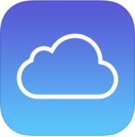
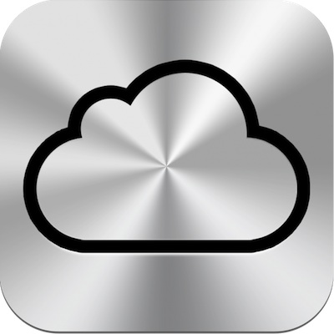
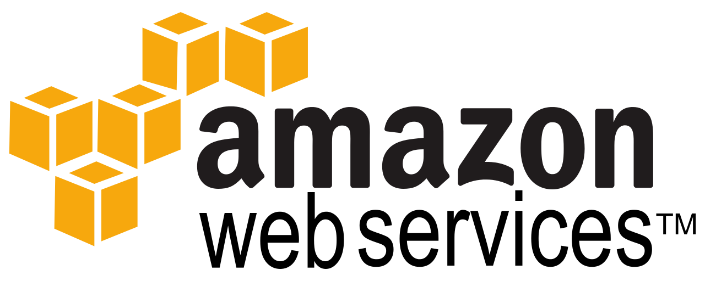
Does Docker speak Cloud?
Docker
a
practical example
Can Docker Cloud?
Ms. Fy: I have one last concern about using Docker… On the long term, we would like kick out our IT Service Provider, as too expensive, and bring our SmartOffer App into the Cloud. Would Docker also work in the Cloud, e.g. on the Amazon AWS?
Mr. Ro: I have good news for You: Docker is ideal for the DevOps approach: → In general, Docker can run on every Linux based systems; so we can use arbitrary PaaS / IaaS Provider to run our app with Docker. → Our recommended Cloud Provider, Amazon AWS, offers support for Docker out-of-the-box: http://aws.amazon.com/de/about-aws/whats-new/2014/04/23/aws-elastic-beanstalk-adds-docker-support/ With Elastic Beanstalk we are able to bring your app into the Cloud without higher efforts.

Slide 11

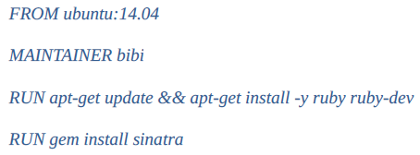
Technical background technical (only for the technical staff) (technical stuff)
Docker
a
practical example
The technic
The different applications run in isolated environment with their own required software. But, … I would like to use the MySQL Docker container from my Application running in another container. → You have to define the interfaces which should be allowed to be used from outside. Eg. the port mapping allows to specify that the MySQL DB port of the container should be reachable on (possibly other) port from outside. Just run Docker with a parameter specifying this. Another possible solution: linking. Example: sudo docker run -d -P —name web —link db:db my/webapp python app.py
That sounds to be a lot of work to set up a Docker container for my app, needing JRE and JBoss AS. → There are a lot of predefined container definitions already available in the internet. You can build up your container definition file based on a predefined Docker file, if necessary. You also can set up your own private Docker hub/repo.
Are there tools which could help me using Docker in a big distributed environment? → Yes: Vagrant, Chef, … they help you orchestrating larger Docker networks.
I don‘t see the further advantages of Docker, it is just a single little linux-specific executable… Maybe another info helps seeing the impact of Docker: a lot of Cloud Provider use Docker in the background, often with the help of Chef (eg. Heroku).
I would like to administer my Docker instances remotely. No problem: use the REST/JSON interface of Docker!

Slide 12


Thanks for your attention Lets start the Miracle with Docker! Questions? Feedback? Ideas? Please let us know!

