Slide 1

HurricAne Disruption by Electrical-conversion System
(H.A.D.E.S)
Shawn Chng
Jovan Tan

Slide 2
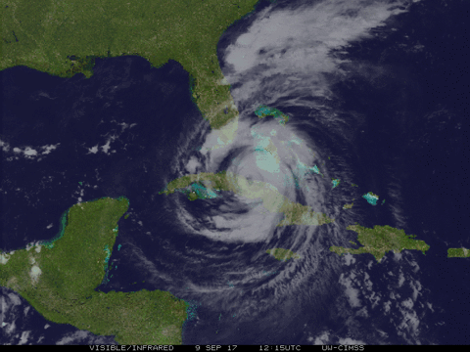
Overview
Background
Problem
Proposed Solution
Benefits
Conclusion

Slide 3
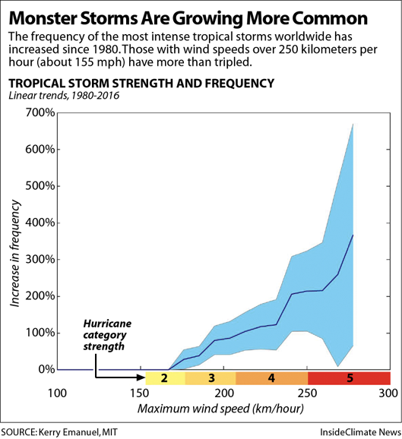
Background
Excerpt from website:
"The environment for all such storms has changed because of climate change. The oceans are warmer, especially in the upper 100 meters, which is most important for such storms," Trenberth said. "This makes available more energy via water vapor for the storms and makes for more activity: more intensity, bigger and longer lasting storms, with heavier rainfalls."
Notes:
Background:
Talk about how climate change, which comes about as a result of global warming, contributes to the increase of hurricane activity. Find graphs of hurricane occurrences.

Slide 4
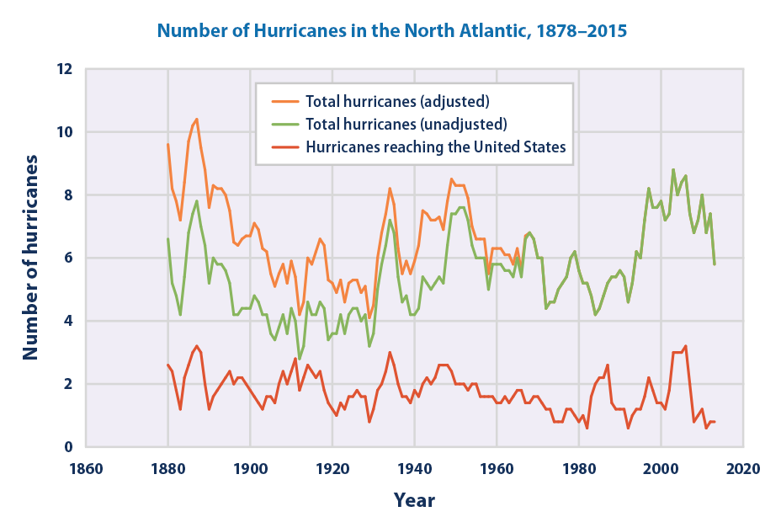
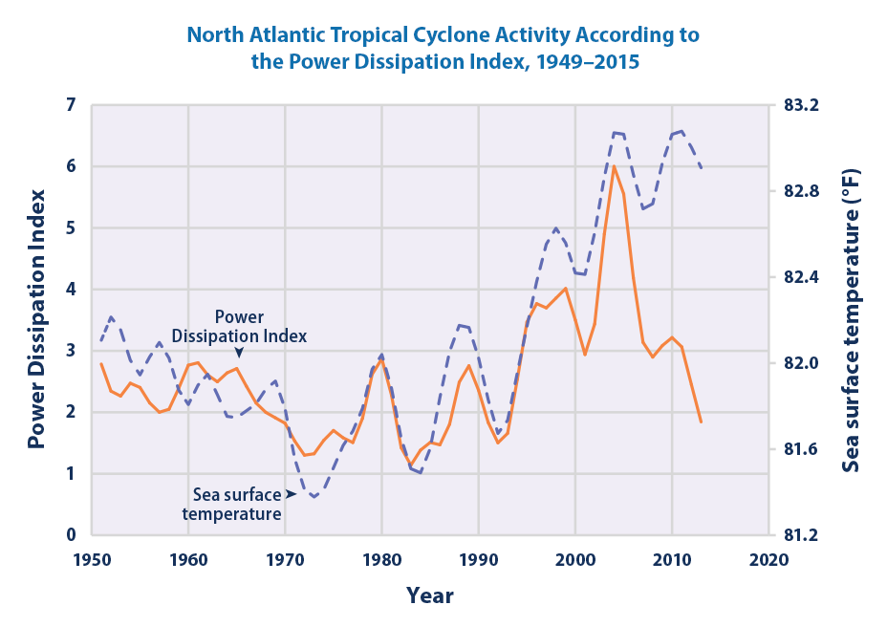
Power dissipation index: relative minimum strength of storm system
EPA, 17-Dec-2016
Notes:
Background:
Talk about how climate change, which comes about as a result of global warming, contributes to the increase of hurricane activity. Find graphs of hurricane occurrences.

Slide 5
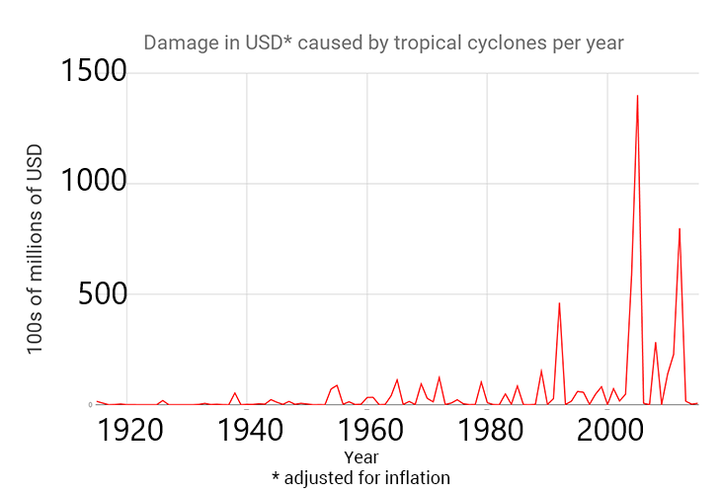
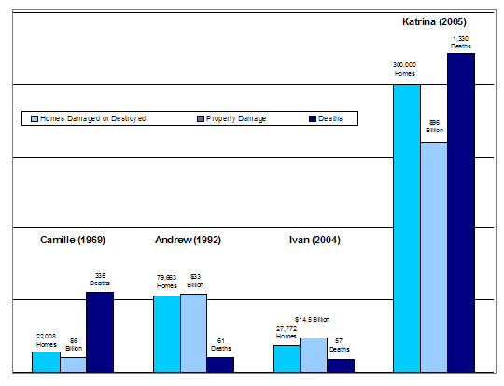
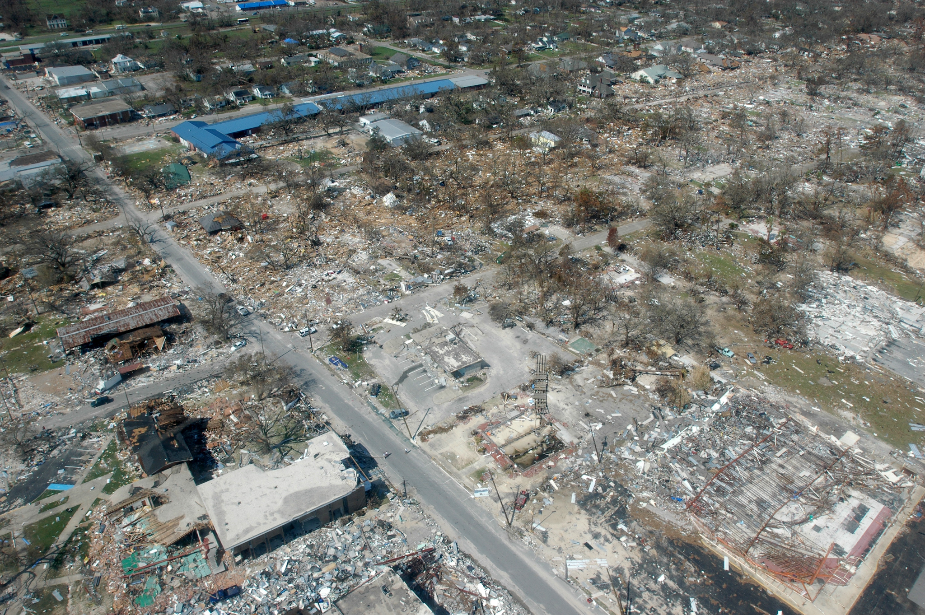
Problem
Damage caused by Hurricane Katrina:
300,000 homes damaged/destroyed
1330 deaths
$96 billion in property damage
Notes:
Problem:
Talk about the costs of damage caused by various hurricanes. Show pictures of various damages. Display bar graph of costs per hurricane. Elaborate on what that money can be used for instead (funding climate change research).

Slide 6
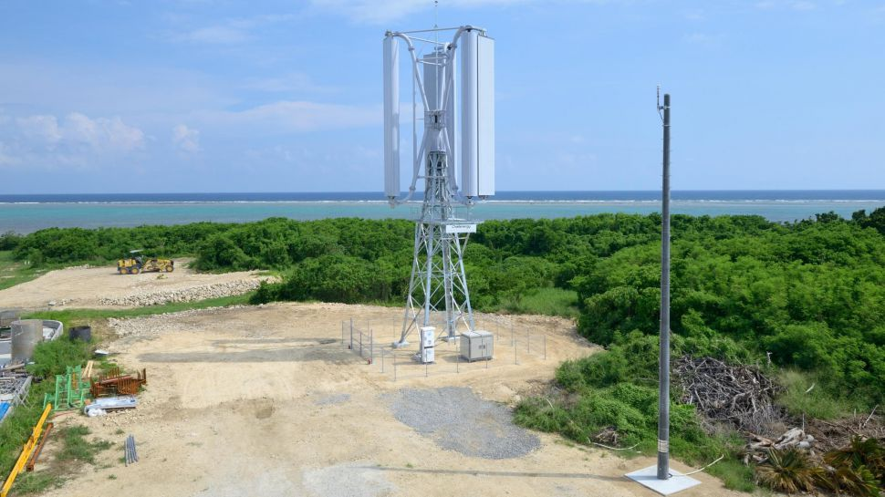
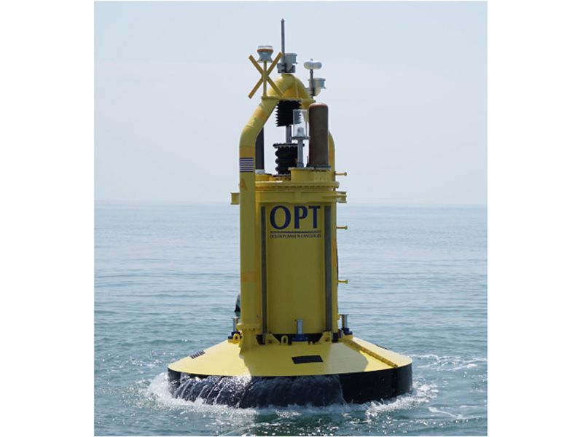
Current technology
Stationary (eg. mounted on the floor or in the ocean)
Able to withstand strong winds.
Challenergy’s typhoon-proof turbines
(Image credit: Challenergy)
Ocean Power Technologies’ PB3 PowerBuoy
Notes:
Solution:
Insert picture of current technology. Explain briefly how it works. Insert picture of our product. Explain how our product does better using the law of conservation of energy. Because our product is mobile, it will follow the storm hence it will remain as a closed system

Slide 7
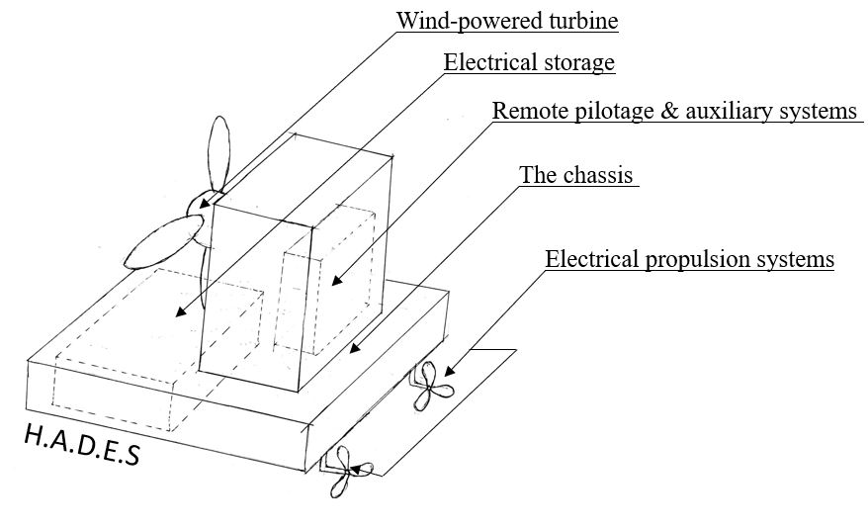
The Solution (H.A.D.E.S)
Ability to ‘chase’ the hurricane.
Continuously reducing the energy of the hurricane.
Law of conservation of energy - In a closed system, energy cannot be created or destroyed, it can only be converted from one form to another.
Notes:
Explain the difference between the current product and H.A.D.E.S.
So what is so special about this ? Explain with law of conservation of energy.

Slide 8
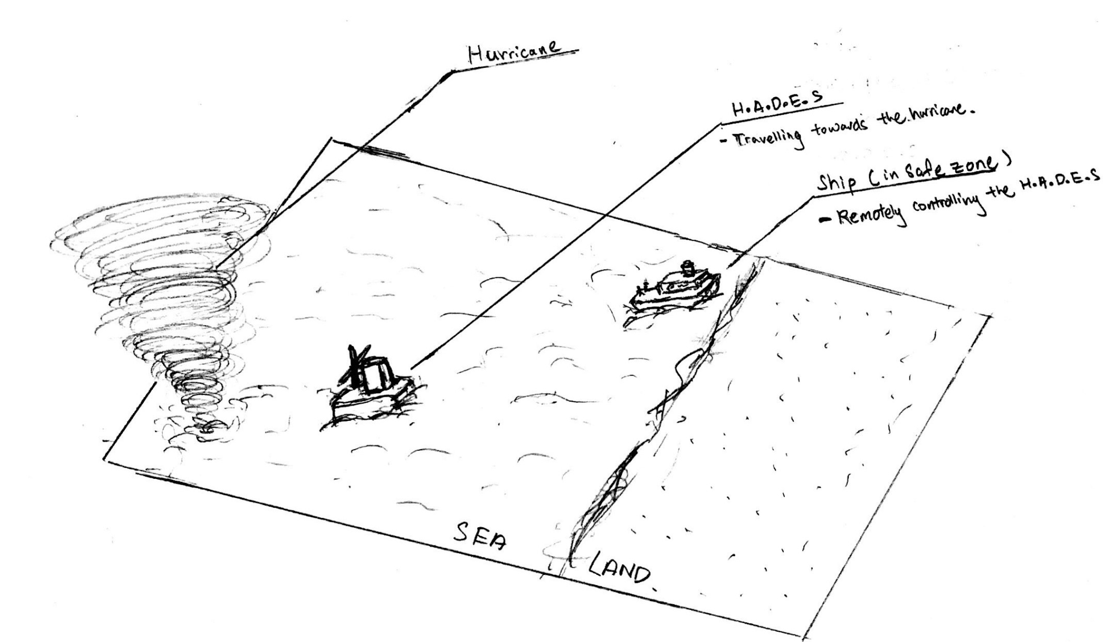
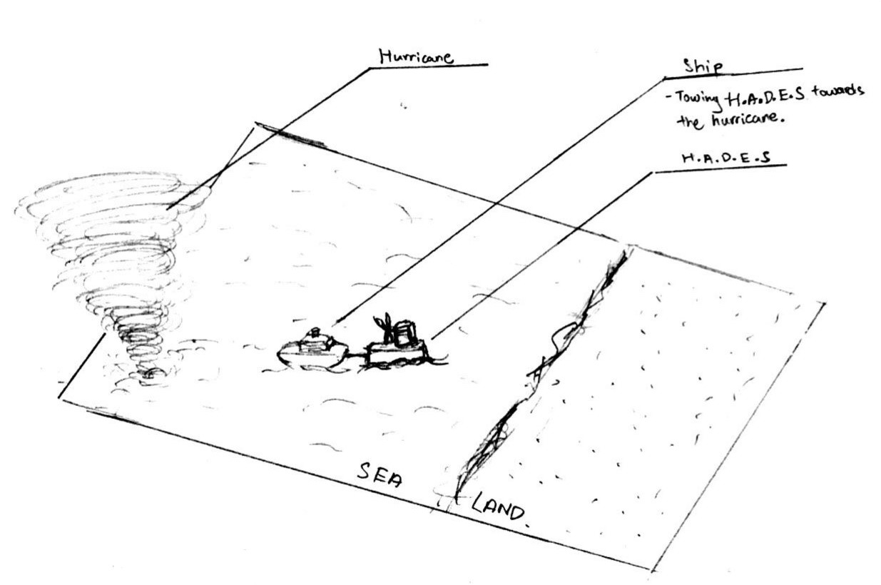
Deployment
STEP 1:
STEP 2:

Slide 9

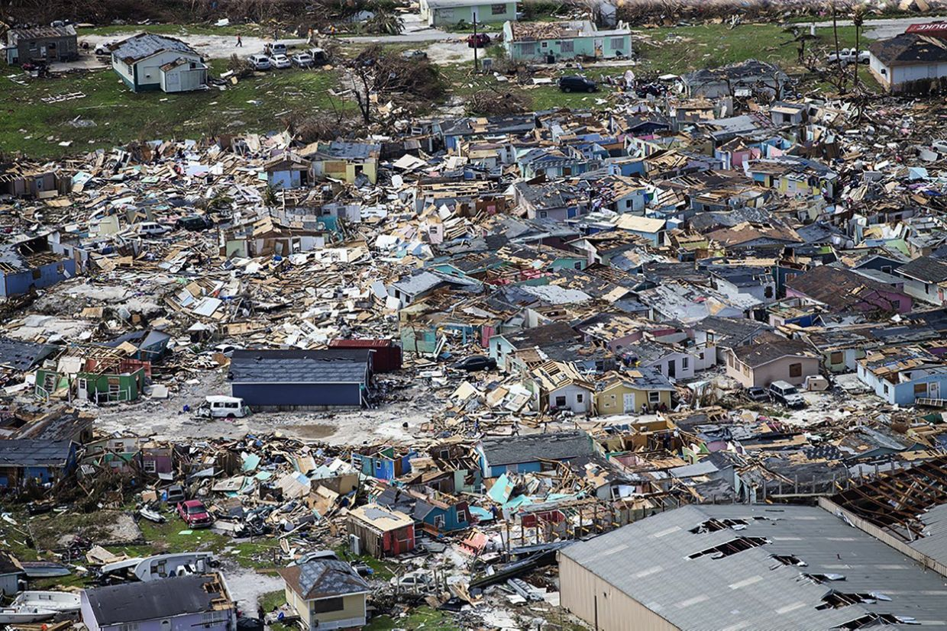


Benefits
Close to zero infrastructural damage
No lives lost
Minimal disruption in economy
Notes:
Benefits:
Explain how our product can benefit countries and the world overall

Slide 10
Conclusion
Notes:
Conclusion:
Talk about how while Singapore does not experience hurricanes, we will definitely feel the other effects of climate change such as rising sea levels and increasing daytime temperature. Talk about how our product focuses on this aspect of climate change(hurricanes) and seem to be treating the symptom and that while small, it is still a step to combating climate change
Increasing monster storms and climate change, we can no longer ignore this problem.
So let H.A.D.E.S solve this one aspect of climate change so that we can focus on the others

Slide 11
References
Slide 3: B. Berwyn, S. Shankman, D. Hasemyer, P. McKenna, M. Lavelle, N. Kusnetz, D. Gearino, B. Berwyn, and G. Gustin, “Why Are Hurricanes Like Dorian Stalling, and Is Global Warming Involved?,” InsideClimate News, 03-Sep-2019. [Online]. Available: https://insideclimatenews.org/news/03092019/hurricane-dorian-climate-change-stall-record-wind-speed-rainfall-intensity-global-warming-bahamas. [Accessed: 01-Nov-2019].
Slide 4: “Climate Change Indicators: Tropical Cyclone Activity,” EPA, 17-Dec-2016. [Online]. Available: https://www.epa.gov/climate-indicators/climate-change-indicators-tropical-cyclone-activity. [Accessed: 27-Oct-2019].
Slide 5-1: L. S. Hwang, “Analyze This: Seasonal hurricane costs have been rising sharply,” Science News for Students. [Online]. Available: https://www.sciencenewsforstudents.org/blog/analyze/analyze-seasonal-hurricane-costs-have-been-rising-sharply. [Accessed: 27-Oct-2019].
Slide 5-2: “List of costliest Atlantic hurricanes,” Wikipedia, 27-Oct-2019. [Online]. Available: https://en.wikipedia.org/wiki/List_of_costliest_Atlantic_hurricanes. [Accessed: 31-Oct-2019].

Slide 12
References
Slide 5-3: National Archives and Records Administration. [Online]. Available: https://georgewbush-whitehouse.archives.gov/reports/katrina-lessons-learned/chapter1.html. [Accessed: 27-Oct-2019].
Slide 6-1: J. Carter, “Super Typhoon Hagibis: could new tech turn Japan's super storms into 50 years of power?,” TechRadar, 11-Oct-2019. [Online]. Available: https://www.techradar.com/news/could-new-typhoon-turbines-turn-japans-super-storms-into-electricity. [Accessed: 31-Oct-2019].
Slide 6-2:M. Z. Donahue, “Can We Capture Energy From a Hurricane?,” Smithsonian.com, 12-Oct-2016. [Online]. Available: https://www.smithsonianmag.com/innovation/can-we-capture-energy-hurricane-180960750/. [Accessed: 31-Oct-2019].

