Slide 1
Employee Data Analysis using Excel
STUDENT NAME: PRIYANKA.S
REGISTER NO:312209854
NM ID:4A04F80A30B8F11B23F4EC1937AAD865
DEPARTMENT: B.COM (ACCOUNTING&FINANCE)
COLLEGE: VALLIAMMAL COLLEGE FOR WOMEN

Slide 2
PROJECT TITLE
Employee Performance Analysis using Excel

Slide 3


AGENDA
Problem Statement
Project Overview
End Users
Our Solution and Proposition
Dataset Description
Modelling Approach
Results and Discussion
Conclusion
3/21/2024 Annual Review

Slide 4

PROBLEM STATEMENT
The performance of each employee in departments analysed to find out the growth of that employee and overall departments of each and every departments of a company.

Slide 5

PROJECT OVERVIEW
.
This analysis is based on the Trend ,Feature and various factors like business units , Employee status, Employee type. By considering these factors we get to know that which department performed well and which one need to Improve.

Slide 6


WHO ARE THE END USERS?
The end users are the employee of the organisation, managers and all sectors of the Industry.

Slide 7

OUR SOLUTION AND ITS VALUE PROPOSITION
Pivot Table
Graphical Representation

Slide 8

Dataset Description
Employee data – edunet dashboard
4 feature
Business units
Employee type
Gender
Performance rating

Slide 9

THE "WOW" IN OUR SOLUTION
The performance level is easily identified by pivot table and chart representation.
3/21/2024 Annual Review
9

Slide 10
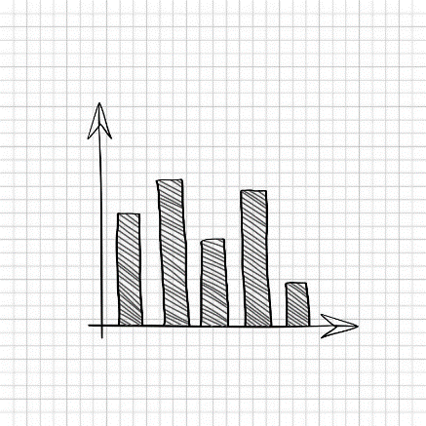
MODELLING
Data collection – Downloaded from edunet
Features – Identified all the features
Performance level- Highly performed departments
Datavisualization – graphical represents
10

Slide 11
RESULTS
11

Slide 12
RESULTS

Slide 13
RESULTS

Slide 14


conclusion
We can analysis that the Performance of the employee are low in count based on Current employee rating. So the management or the Team Lead can motivate the low performing employee to high or Very high performing employees.

