Slide 1
Python GUI Calculator
Project using Tkinter

Slide 2
Problem Statement
To design and develop a Python-based Calculator application with a Graphical User Interface (GUI) using Tkinter.
The calculator should perform basic arithmetic operations like addition, subtraction, multiplication, and division. It should also have clear and evaluate functionalities.

Slide 3
Features
• GUI built using Tkinter
• Equation display area to show input and output
• Buttons for numbers (0-9) and operators (+, -, *, /)
• Functionality for evaluate (=) and clear (C)
• Error handling for invalid inputs

Slide 4
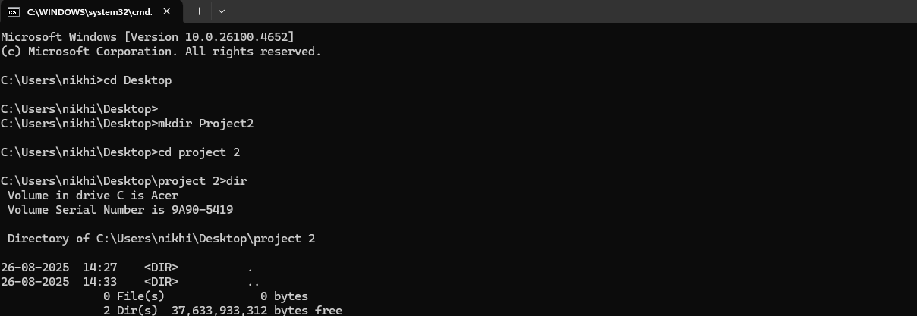

Slide 5
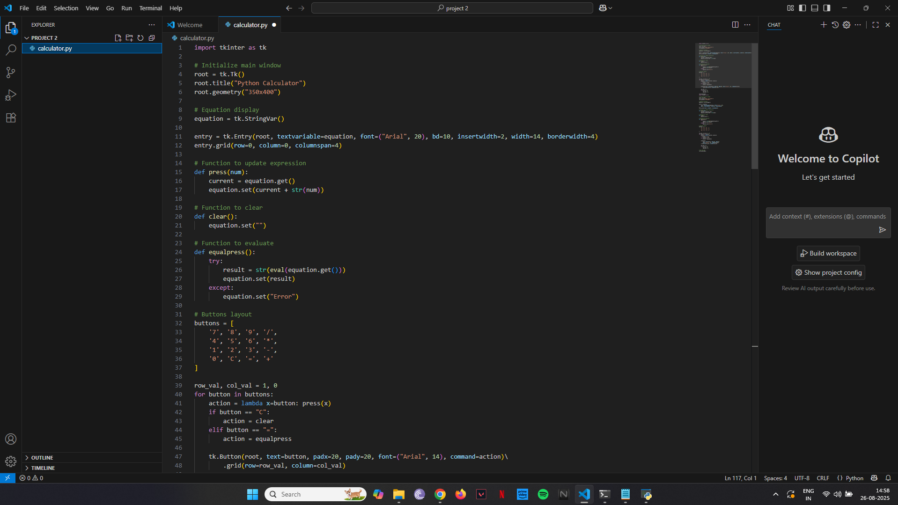

Slide 6
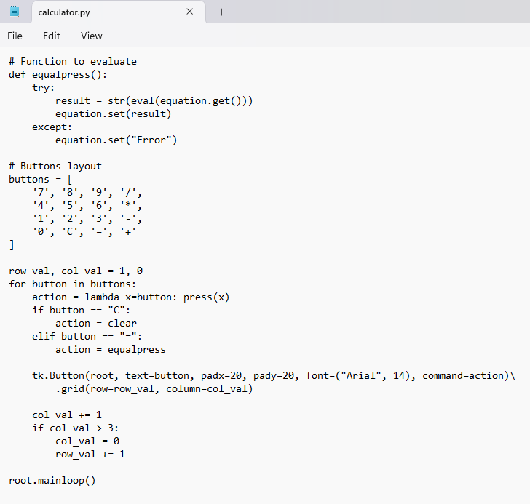
Code Snippets

Slide 7
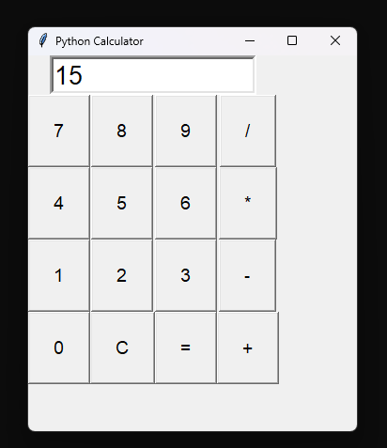
Output Screenshots
Sample GUI Output:

