Slide 1
INVESTMENT ASSIGNMENT SUBMISSION
Name: Priya Aggarwal
Email: Priya27aggarwal@gmail.com

Slide 2
Abstract
The idea behind this approach is to provide the Best investor in Best countries with Best sectors to Spark Funds.
Spark Funds has two minor constraints for investments:
Wants to invest between 5 to 15 million USD per round of investment
Wants to invest only in English-speaking countries because of the ease of communication with the companies it would invest in
Goals:
Best Funding Investment Type
Best Top 3 English Countries
Best Sectors with Top3 countries having large no of investments.

Slide 3
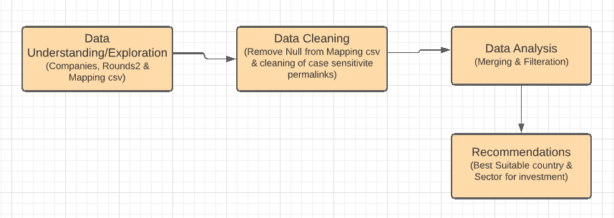
Problem solving methodology

Slide 4

Data Understanding & Cleaning
Step1: Load the companies and rounds data
Step2: Checked unique companies present in companies and rounds2 dataframe
Step3: Merge the two dataframes (companies & rounds2) in single master frame i.e. Master_frame on the basis of permalink of companies df and company_permalink of rounds2 for analysis.
Step4: Before merge convert the permalink and company_permalink into lower case because both columns are not same format.
Step5: Get a new Master dataframe (master_frame)

Slide 5
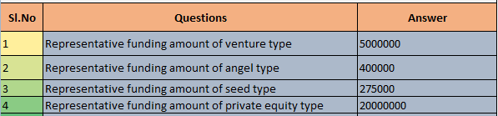
Investment Type Analysis
The funding types such as seed, venture, angel, etc. depend on the type of the company.
Requirements: Spark Funds wants to invest between 5 to 15 million USD per investment round
So most suitable Investment Type for Spark Funds in Venture because its median is 5 million.

Slide 6
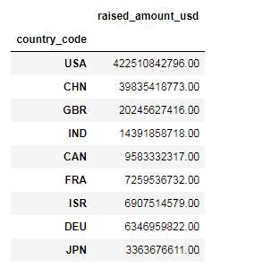
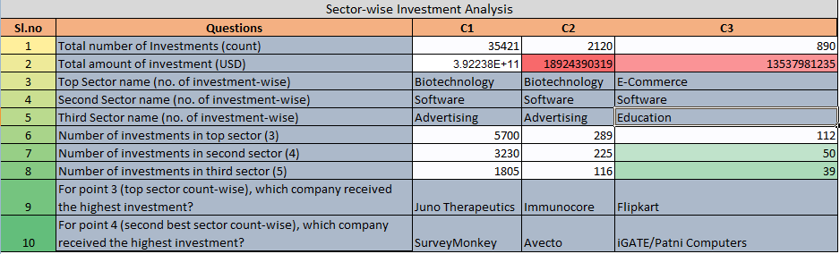
Country & Sector Analysis
Requirements: Spark Funds wants to invest in countries with the highest amount of funding for the chosen investment type. This is a part of its broader strategy to invest where most investments are occurring and the total amount of investments in each main sector for each of the three countries.
Result: Top 3 countries C1-> USA, C2-> GBR, C3-> IND. We exclude the CHN because English is not official language there.
And the best sectors represent in above table corresponding to country respectively.

Slide 7
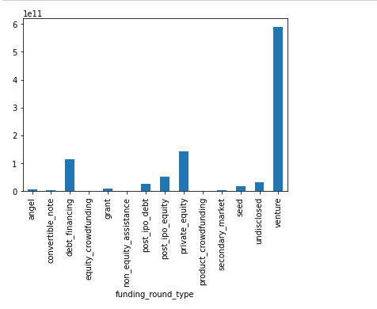
Representative Amount of Investment

Slide 8
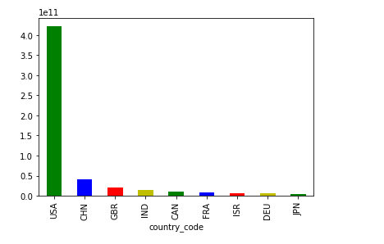
Top 9 countries against the Total amount of investments

Slide 9
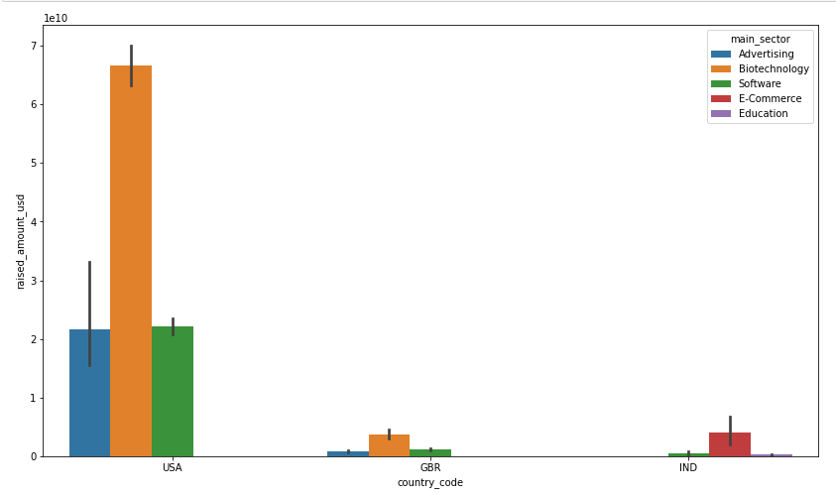
Investments in the Top 3 sectors of the Top 3 countries

Slide 10
Conclusions
Investment Type Analysis: Most suitable Funding Type is venture because its lies in the range of investment amount 5M to 15M.
Country Analysis: Top 3 English Countries for investments are:
USA
GBR
IND
Sector Analysis:
No. of Investments | USA | GBR | IND
Top Sector | Biotechnology | Biotechnology | E-Commerce
Second Sector | Software | Software | Software
Third Sector | Advertising | Advertising | Education
Top Sector Companies | Juno Therapeutics | Immunocore | Flipkart
Top Second Companies | SurveyMonkey | Avecto | iGATE/Patni Computers

