Slide 1
Prediction of Bird Species

Slide 2
Abstract
In this study, we present a comprehensive approach for the prediction of bird species using Convolutional Neural Networks (CNNs). The dataset comprises images representing 525 different bird species, with 80% allocated for training and 20% for testing. We used a special kind of artificial intelligence called Convolutional Neural Networks (CNNs) to help our program understand different features in the bird pictures. To train our program, we resized the pictures, convert the image into grey scale, adding the gaussian blur, extracting the features to make sure it could recognize birds accurately. The CNN architecture helped our program learn the patterns and features of each bird species. We trained the program using the 80% of images, and then we tested it using the other 20% to see how well it could guess the bird species. The input for the model will be image of the bird for which we need to find out the specie type. for this image pre-processing is applied and then passed to the model for specie detection. This kind of technology could be useful for monitoring wildlife and conserving different bird species. This study lays the groundwork for future research in using computers to identify animals in pictures, especially in the field of bird watching.

Slide 3
Objective
Birds are everywhere, and they come in all shapes and colors. But figuring out which species of bird which can be hard, especially if you're not an expert. That’s why we are using Convolutional Neural Network [CNN] model! to recognize patterns in picture
This model take picture of bird species and figure out and say what kind of bird it is. This way, even if you’re
not a bird expert, you can still figure out which bird you're looking at.
Our goal is to make it easier for everyone, from bird lovers to scientists, to identify birds just by taking a picture.

Slide 4
Scope of the Project
The scope of the project involves utilizing convolutional neural networks (CNNs) to predict the species of birds from images. This includes acquiring and annotating a diverse dataset of bird species images, training and fine-tuning CNN architectures, evaluating model performance, and deploying the trained model for real-world use. Additionally, considerations for scalability, optimization, and future enhancements will be explored to ensure the system's effectiveness and adaptability in the field of bird species prediction.

Slide 5
Literature Survey
Title: Image Classification Using Deep Learning and Neural Networks
Journal: International Journal of Engineering Research & Technology (IJERT),2003
Methodology:
● The paper uses deep learning, deep neural networks, image classification, and TensorFlow to identify and
classify bird species from images1.
● The paper employs a large dataset of 400 bird species, with 58388 training images, 2000 test images, and 2000
validation images2.

Slide 6
● The paper applies convolutional neural networks (CNNs) to extract features from the images and reduce their dimensionality.
● The paper compares the performance of different CNN architectures, such as VGG-16, MobileNet, and ResNet-50, on the task of bird species classification.
● The paper evaluates the accuracy, precision, recall, and F1-score of the models, as well as the confusion matrix and the classification report.

Slide 7
Advantages:
● Powerful Models: The paper uses special computer models (neural networks) that are really good at understanding images. These models can learn complex features from the pictures, just like how we learn to recognize faces or objects.
● Lots of Examples: By using a large dataset, the computer learns from many different bird species1. It’s like learning about birds from a diverse group of experts.
Disadvantages:
● Computational Complexity: Training these models takes a lot of computer power and time. It’s like solving a really hard puzzle—it requires a powerful computer.
● Data Bias: If the dataset mainly has certain types of birds, the computer might struggle with less common species. It’s like studying only popular birds and missing out on the rare ones

Slide 8
Literature Survey
Title: Automatic Bird Species Identification for Large Number of Species
Journal: IEEE Explore journal,2011
Methodology:
● The input is a sequence of video frames of a flying bird taken by an unknown camera.
● The output is a ranked list of candidate bird species based on their likelihood.
● The method consists of four steps:
● Motion segmentation: Extract the bird boundary from each frame using optical flow, background motion model, Mahalanobis distance, and active contour algorithm.

Slide 9
● Salient extremities recognition: Find the inter-wing tip distance (IWTD) from the bird boundary by searching for the maximum distance across frames in a wingbeat period and along the wing spreading direction (WSD).
● Periodicity analysis: Apply Fast Fourier Transformation (FFT) to the IWTD series to obtain the wingbeat frequency (WF) and its error bound. Use a kinematic model of the bird wing and prove that the WF is invariant to camera parameters and motion trajectory3.
● Species prediction: Use a likelihood ratio-based metric to compare the extracted WF with the prior knowledge of WF distributions for different bird species. Return a short ranked list of candidate species4.

Slide 10
Advantages:
● It helps quickly and effectively monitor bird populations without disturbing them.
● By using recorded bird songs, it avoids the need for direct interaction with the birds, minimizing disturbance.
Disadvantages:
● Accuracy depends on the quality of recorded bird songs, and noise in the environment can make identification
challenging.
● The identification model may not work well for bird species not included in its training set, limiting its applicability.

Slide 11
Literature Survey
Title: Bird Species Identification Using Deep Learning
Journal: International Journal of Engineering Research & Technology (IJERT),2019.
Methodology:
● The paper uses a deep convolutional neural network (DCNN) to classify bird species from images.
● The paper uses the Caltech-UCSD Birds 200 (CUB-200-2011) dataset, which contains 11,788 images of 200 bird categories, with annotations such as part locations, binary attributes, and bounding boxes2.

Slide 12
● The paper converts the bird images into grayscale format and generates an autograph, which is a network of processing nodes that calculates a score sheet for each node and predicts the bird species based on the score sheet analysis3.
● The paper uses the GoogLeNet framework, which is a DCNN architecture with 22 layers and multiple inception modules, to train and test the model on the bird images.
● The paper uses Tensorflow, which is a software library for deep learning, to implement the DCNN model and perform parallel processing using GPU technology.

Slide 13
Advantages:
● It presents a novel method for bird species classification based on deep convolutional neural networks (DCNN) and autograph generation.
● It achieves high accuracy (90.93%) on the Caltech-UCSD Birds 200 (CUB-200-2011) dataset, which is a challenging benchmark for fine-grained recognition.
Disadvantages:
● It does not compare its results with other state-of-the-art methods for bird species identification, such as pose-normalized models or attribute-based models.
● It does not provide any analysis or discussion on the limitations or challenges of its approach, such as the computational cost, the data augmentation techniques, or the generalization ability.

Slide 14
Literature Survey
Title: Prediction of species richness of breeding birds by landscape-level factors of urban woods in Osaka Prefecture, Japan
Journal: IEEE Explore journal,2011
Methodology:
● The authors used bird records from various sources to obtain the species richness of forest birds in 28 urban parks and three mountains in Osaka Prefecture, Japan.
● The authors measured the environmental variables of the urban parks, such as woodland area, elongation, distance to mountain, distance to nearest woods, and percentage of woodland and field cover within 25 km2 outside the parks

Slide 15
● The authors compared the fitness of three models to describe the species-area relationship: the power function, the exponential function, and the logistic function.
● The authors performed multiple regression analysis and principal component regression analysis to predict the species richness by the environmental variables and selected the best models based on the adjusted R2 and Akaike’s information criterion (AIC).
● The authors conducted canonical correspondence analysis (CCA) to examine the relationships between species occurrence and environmental variables and identified the nested subset pattern of species composition.

Slide 16
Advantages:
● Learned a Lot: The study looked at what makes different birds live in city woods. It thought about things like how big the woods are, where they are, and what kinds of homes birds like. It also compared different ways of guessing how many bird types there are.
● Good Ideas for City Planning: The research gives good ideas for making cities better for nature. It says it's important to have bigger woods, different kinds of homes for birds, and to connect city woods to other areas where birds come from. Disadvantages:
● Not Enough Info: The study only looked at 28 parks in one part of Japan. So, what it found might not be true for other places. It also didn't think about how things change over time or how people and other animals can bother birds.
● Old Info: The study is from 1999, so it might not show what's happening now with birds in cities. Some of the ideas and ways they checked things might be old and not used anymore. Title:

Slide 17
Literature Survey
Title:: Hierarchical Classification of Bird Species Using Their Audio-Recorded Songs
Journal: Journal: IEEE Explore journal,2013
Methodology:
● The authors use a hierarchical classification approach to the bird species identification problem from audio recordings12. They compare three types of approaches: flat, local model, and global model.
● They use the MARSYAS framework to extract acoustic features from the audio signals, such as spectral centroid, rolloff, flux, zero crossings, and MFCC.
● They use the Global-Model Naive Bayes (GMNB) algorithm as the global-model classifier, which is an extension of the classic Naive Bayes algorithm that takes into account the hierarchical class structure of the bird species taxonomy.

Slide 18
● They use the flat Naive Bayes and the Local Classifier Per Parent Node (LCPN) approach as the baselines for comparison. The LCPN approach trains a flat classifier for each non-leaf node in the hierarchy and uses a top-down strategy for testing.
● They use the hierarchical precision, recall, and F-measure as the evaluation metrics, which are adapted from the standard precision, recall, and F-measure to account for the hierarchical nature of the problem.
● They conduct experiments on a dataset of 1320 bird song records from 48 bird species, which are organized in a hierarchical tree according to the scientific classification of birds.

Slide 19
Advantages:
● It addresses a challenging and practical problem of recognizing bird species from their vocalizations, which can have applications in bioacoustics, ecology, conservation, and education.
● It explores a novel and effective approach of using a global-model hierarchical classifier, the GMNB algorithm, which can leverage the taxonomic structure of the bird classes and achieve higher accuracy than flat or local-model classifiers.
Disadvantages:
● It relies on a limited and imbalanced dataset of 48 bird species, which may not cover the diversity and variability of bird vocalizations in the real world. It also does not consider the effects of noise, interference, or environmental factors on the audio signals.
● It uses a simple and fixed feature extraction method, based on MARSYAS, which may not capture the rich and dynamic information contained in the bird sounds. It also does not compare its features with other state-of-the-art methods, such as deep learning or spectrogram-based features.

Slide 20
Literature Survey
Title: Bird-SDPS: A Migratory Birds’ Spatial Distribution Prediction System
Journal: Journal: IEEE Explore journal,2013
Methodology:
● The authors introduce Bird-SDPS, a system for predicting the spatial distribution of migratory birds based on GPS tracking data and remote sensing data12.
● The system consists of four main components: GPS records manager, remote sensing data manager, multi-model manager, and visualization controller34.
● The GPS records manager preprocesses and reformats the GPS data into spatial grids, which represent the frequency of birds’ occurrence in a geographic area

Slide 21
● The remote sensing data manager extracts environmental variables from remote sensing files, such as temperature, precipitation, land cover type, etc., and stores them in a NoSQL database (HBase) for efficient retrieval5.
● The multi-model manager integrates five different species distribution models: Maxent, SVM, GLM, RF, and DT, and provides an expansion interface for new models. It also evaluates the models using AUC and other metrics.
● The visualization controller uses Web-GIS to display the GPS data, the environmental data, and the prediction results on a map, and provides interactive functions for users.

Slide 22
Advantages:
● Helps Birds: The system uses GPS and remote sensing to track birds' travels. This helps us understand where they go, where they like to live, and what they need. This info is super useful for studying nature, planning to protect birds, and preventing diseases they might get.
● Compares Different Ideas: The system is like a smart tool that can use many ways to understand bird movements. It can compare different ways of figuring things out, helping us choose the best methods.
Disadvantage:
● Needs Big and Good Data: The system relies on lots of info about bird travels and the environment. Handling and storing this big and complicated data is a challenge. If the data isn't good, it can make the system less accurate.
● Might Miss Some Things: The system uses models that guess where birds might be based on the environment. But it might not understand all the reasons or interactions that affect birds. It also might not consider how things change over time or in different places.

Slide 23
Literature Survey
Title: Simultaneous Segmentation and Classification of Bird Song using cnn
Journal: IEEE Explore journal,2017
Methodology:
Researchers used a smart computer program to find and identify bird sounds in audio recordings. The program, like a special brain (CNN), could do both jobs at once. It looked at graphs of sound intensity over time (spectrograms), labeled pixels as background or bird species, and learned to do this by looking at many examples. The program predicted labels for each pixel and identified bird sounds by looking at connected groups of labeled pixels. It combined multiple bird species if they were in the same recording.

Slide 24
Advantages:
1. Innovation: This method is new and combines finding bird sounds and identifying species in one step, unlike traditional methods.
2. Better Results:
It performs better than other methods, giving more accurate results.
Disadvantages:
1. Needs a lot of computing power: Training the computer model is computationally expensive and requires a lot of labeled examples.
2. Limited use: It's good for finding bird sounds in certain recordings but might not work well for other tasks or environments. Success depends on having good examples to learn from.

Slide 25
Literature Survey
Title: Automatic Bird Species Identification for Large Number of Species
Journal: IEEE Explore journal,2011
Methodology:
● The input is a sequence of video frames of a flying bird taken by an unknown camera.
● The output is a ranked list of candidate bird species based on their likelihood.
● The method consists of four steps:
● Motion segmentation: Extract the bird boundary from each frame using optical flow, background motion model, Mahalanobis distance, and active contour algorithm.

Slide 26
● Salient extremities recognition: Find the inter-wing tip distance (IWTD) from the bird boundary by searching for the maximum distance across frames in a wingbeat period and along the wing spreading direction (WSD).
● Periodicity analysis: Apply Fast Fourier Transformation (FFT) to the IWTD series to obtain the wingbeat frequency (WF) and its error bound. Use a kinematic model of the bird wing and prove that the WF is invariant to camera parameters and motion trajectory.
● Species prediction: Use a likelihood ratio-based metric to compare the extracted WF with the prior knowledge of WF distributions for different bird species. Return a short ranked list of candidate species.

Slide 27
Advantages:
● It helps quickly and effectively monitor bird populations without disturbing them.
● By using recorded bird songs, it avoids the need for direct interaction with the birds, minimizing disturbance.
Disadvantages:
● Accuracy depends on the quality of recorded bird songs, and noise in the environment can make identification challenging.
● The identification model may not work well for bird species not included in its training set, limiting its applicability.

Slide 28
Dataset Collection
We have collected a dataset consisting of 89,885 bird images sourced from Kaggle. These images are categorized into 525 classes representing 525 species of birds. This diverse dataset provides a rich source of information for training our model.

Slide 29
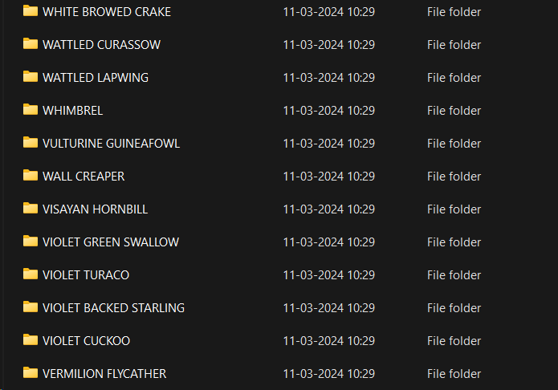
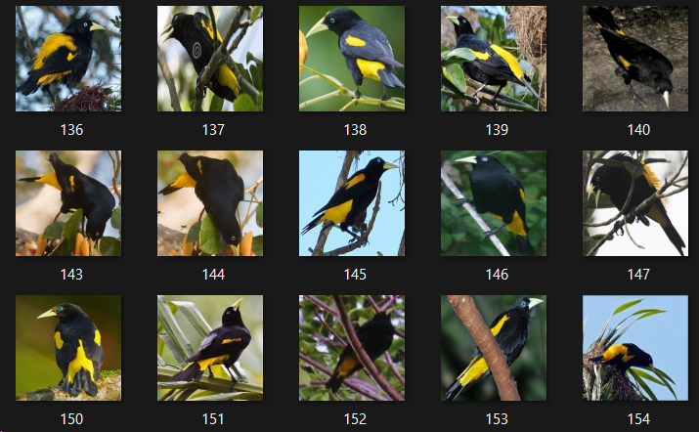

Slide 30
METHODOLOGY
Dataset Collection
Input Image
Data Preprocessing
Image Processing
Image Resize
Image Grayscale
Image Extraction
Passing image to model
Model Creation
Prediction

Slide 31
Modules
Data Collection:
Gather a diverse dataset of bird images. These images should cover various species, backgrounds, and lighting conditions.
Data Preprocessing:
Clean and prepare the dataset. This involves resizing images, normalizing pixel values, and handling any missing data.
Split the dataset into training, validation, and test sets.
Model Selection:
Choose an appropriate machine learning model. In our case, we’re using a Convolutional Neural Network (CNN).
Configure the architecture of the CNN, including the number of layers, filters, and activation functions.

Slide 32
4. Model Training:
Train the CNN using the training dataset. The model learns to recognize patterns in bird images.
Optimize hyperparameters (like learning rate) to improve performance.
Monitor training progress using validation data.
5. Deployment:
Once the model is trained, deploy it to a production environment.
Set up an API or web service to accept bird images for prediction.
6. Prediction:
Users can submit bird images to our system.
The deployed model processes the image and predicts the bird species.

Slide 33
Algorithm
Step-1: Data collection
Step-2: Data Augmentation
Step-3: Image rescaling
Step-4: Image preprocessing
Step-5: Model creation
Step-6: Model compilation
Step-7: Fitting the data
Step-8: Testing on validation data
Step-9: Saving the model

Slide 34
References
1. P. Srinadh Department of CSE Koneru Lakshmiah Education Foundation Vaddeswaram, Andhra Pradesh, India.” Image Classification using Deep Learning and Neural Networks”.2023 International Journal of Engineering Research & Technology (IJERT) http://www.ijert.org ISSN: 2278-0181 IJERTV12IS030117`. DOI: 10.17577/IJERTV12IS030117
2. Carlos N. Silla Jr. School of Computing, University of Kent at Canterbury Canterbury, UK. “Automatic Bird Species Identification for Large Number of Species” . 2011 IEEE International Symposium on Multimedia. DOI: 10.1109/ISM.2011.27
3. Prof. Pralhad Gavali, Ms. Prachi Abhijeet Mhetre, Ms. Neha Chandrakhant Patil, Ms. Nikita Suresh Bamane, Ms. Harshal Dipak Buva Rajarambapu Institute of Technology, Rajaramnagar, India “Bird Species Identification using Deep Learning “ 2019 International Journal of Engineering Research & Technology
DOI : 10.17577/IJERTV8IS040112
4. YOSIHIRO NATUHARA* and CHOBEI IMAI Osaka City Institute of Public Health and Environmental Sciences, 8-34 Tojo-cho, Tennoji-ku, Osaka 543, Japan .” Prediction of species richness of breeding birds by landscape-level factors of urban woods in Osaka Prefecture, Japan “ 1999 INTERNATIONAL JOURNAL OF ENGINEERING RESEARCH & TECHNOLOGY DOI :10.1023/a:1008869410668

Slide 35
5. Carlos N. Silla Jr Post-Graduate Program in Informatics (PPGI) Federal University of Technology of Parana (UTFPR-CP) Cornelio Proc ´ opio, Brazil ´ carlosjunior@utfpr.edu.br “Hierarchical Classification of Bird Species Using Their Audio Recorded Songs “ 2013 IEEE International Conference on Systems
DOI: 10.1109/SMC.2013.326
6. Yuanchun Zhou∗, Jing Shao∗, Xuezhi Wang∗, Ze Luo∗, Jianhui Li∗ and Baoping Yan∗ ∗Computer Network Information Center Chinese Academy of Sciences, Beijing, China P.O.BOX 100190 “Bird-SDPS: A Migratory Birds’ Spatial Distribution Prediction System “2013 IEEE 9th International Conference on e-Science DOI: 10.1109/eScience.2013.12
7. Revathy Narasimhan, Xiaoli Z. Fern, Raviv Raich School of EECS, Oregon State University, Corvallis, OR 97331-5501, USA {narasimr, xfern, raich} “SIMULTANEOUS SEGMENTATION AND CLASSIFICATION OF BIRD SONG USING CNN” 2017 IEEE International Symposium on Multimedia DOI: 10.1109/ICASSP.2017.7952135
8. Wen Li and Dezhen Song “Automatic Bird Species Detection Using Periodicity of Salient Extremities” 2013 IEEE International Conference on Robotics and Automation (ICRA) DOI: 10.1109/ICRA.2013.6631407

Slide 36
Conclusion
Using this model called a Convolutional Neural Network (CNN) can help us figure out what kind of bird is in a picture. This CNN learns from lots of bird pictures to accurately tell one bird species from the picture. This method could be really helpful for learning about birds.

Slide 37
Thanks!

