Slide 1
Digital Portfolio
STUDENT NAME: Priyadharshini S
REGISTER NO AND NMID:24131210500122032 AND asanm121anm12124213032
DEPARTMENT: BCA
COLLEGE: Immaculate college for women / Annamalai university

Slide 2
PROJECT TITLE
Student Portfolio developed with HTML, CSS and JavaScript

Slide 3


AGENDA
Problem Statement
Project Overview
End Users
Tools and Technologies
Portfolio design and Layout
Features and Functionality
Results and Screenshots
Conclusion
Github Link
3/21/2024 Annual Review

Slide 4

The lack of a personalized platform to showcase academic achievements, skills, and projects creates a challenge for students during internships, job applications, and academic evaluations. Traditional resumes provide limited interactivity and fail to demonstrate technical skills effectively. Hence, a digital portfolio is required to present information in a structured, engaging, and accessible format.
PROBLEM STATEMENT

Slide 5

This project involves the development of a responsive student portfolio website using HTML, CSS, and JavaScript. The portfolio highlights personal details, academic qualifications and skills in a professional manner. The objective is to create a platform that is visually appealing, easy to navigate, and adaptable across devices.
Project Overview

Slide 6

• Students – to showcase their academic and technical profile • Recruiters – to evaluate student skills, achievements, and projects • Faculty – to assess student progress and provide academic references • General Audience – to gain an overview of the student’s background and expertise
End Users

Slide 7

• HTML – for content structure. • CSS – for styling and layout. • JavaScript – for interactivity and dynamic features. • Visual Studio Code – as the development environment. • Git and GitHub – for version control and deployment
Tools and Technologies

Slide 8
Portfolio design and Layout
The portfolio follows a clean, minimalistic design to ensure clarity and professionalism.
It includes a homepage with personal introduction, sections for academic details, skills, project highlights, and a contact page.
A responsive layout ensures accessibility on desktop and mobile devices, maintaining consistent design aesthetics.
It involves two way design by maintaining multi-tab page in desktop and scrollable page in small and medium devices.
8

Slide 9
• Interactive navigation bar for smooth browsing in large screen devices. • Responsive design compatible with multiple devices. • Dedicated sections for About Me, Education, Skills, and Resume. • Contact box for easy communication with links. • Integration with GitHub to showcase project repositories. • User-friendly interface with clear typography and layout.
Features and Functionality

Slide 10
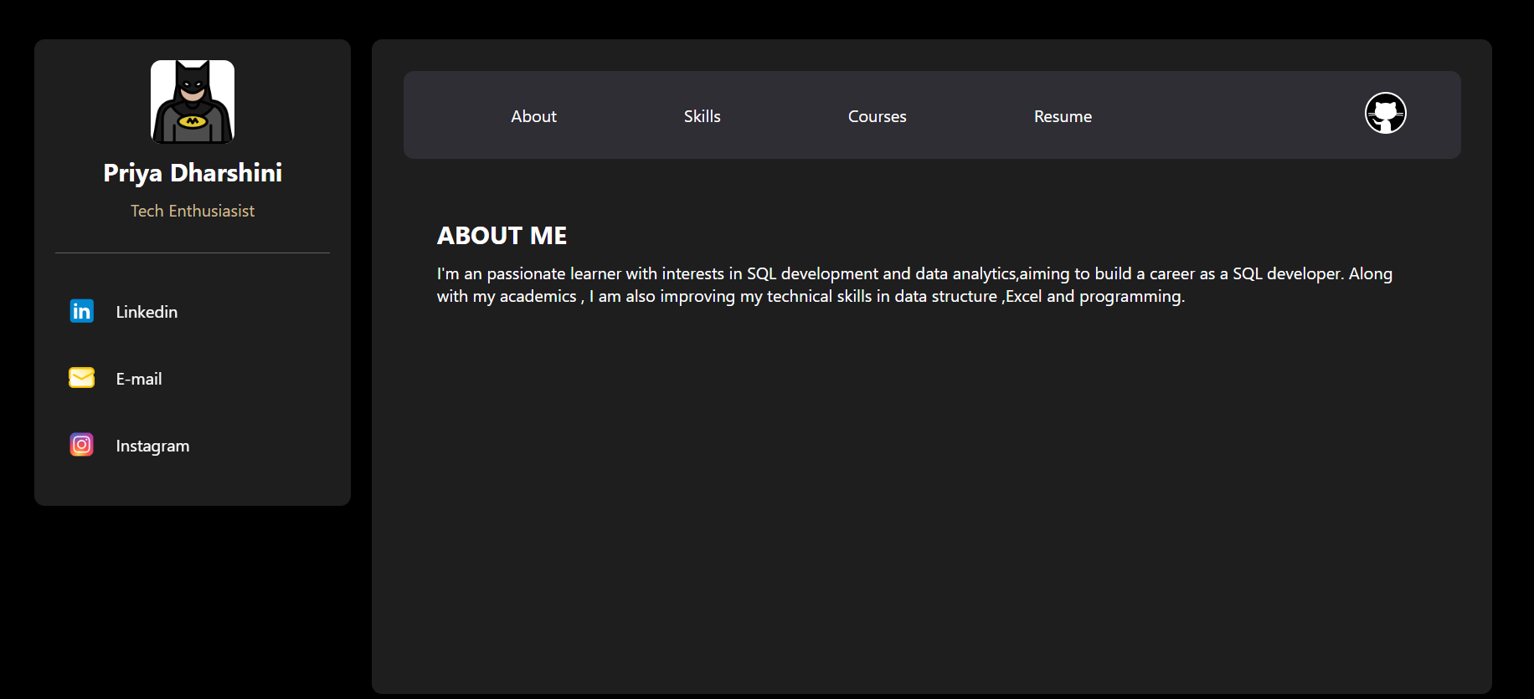

RESULTS AND SCREENSHOTS
3/21/2024 Annual Review
10

Slide 11
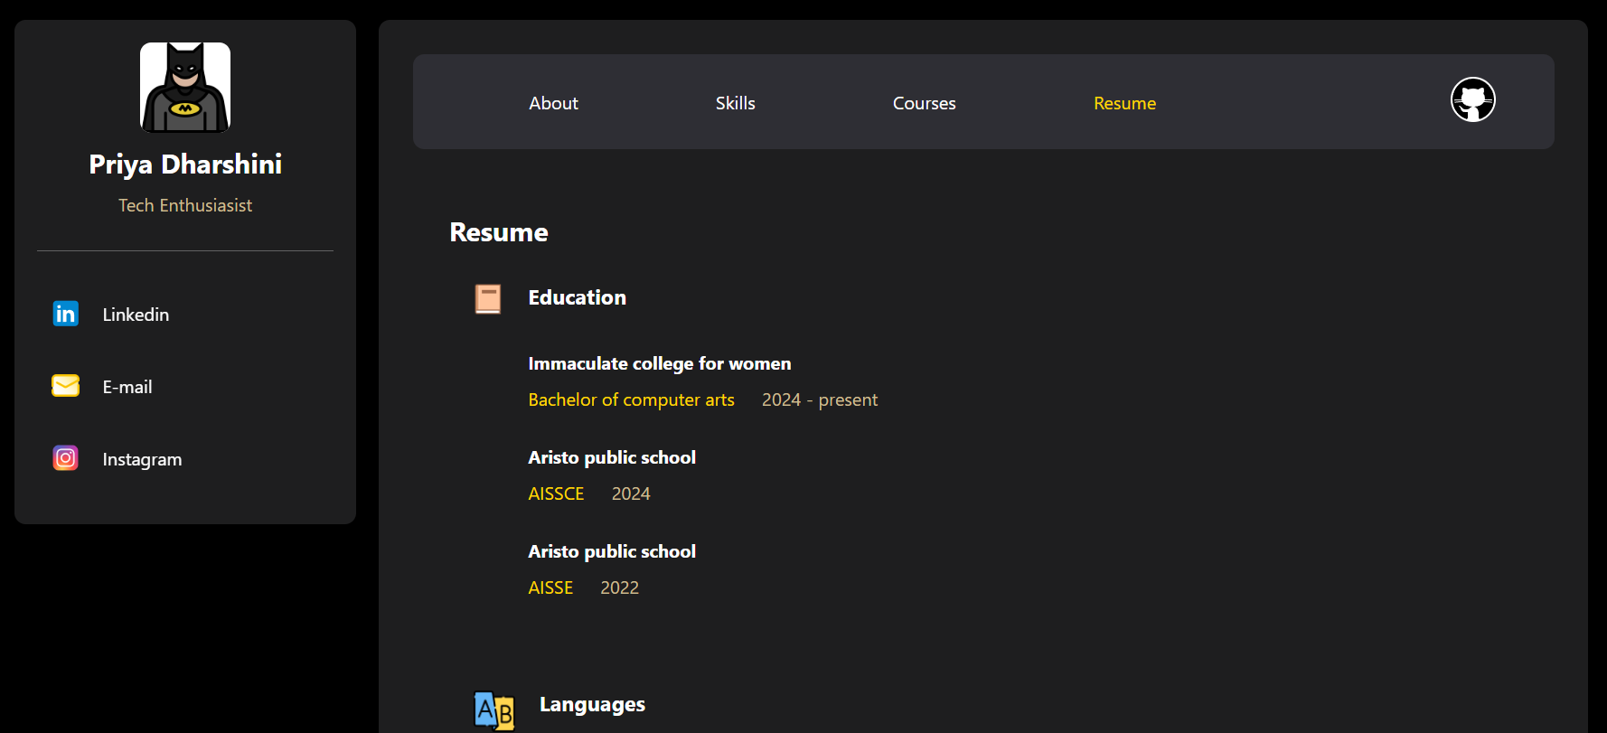
RESULTS AND SCREENSHOTS
3/21/2024 Annual Review
11

Slide 12
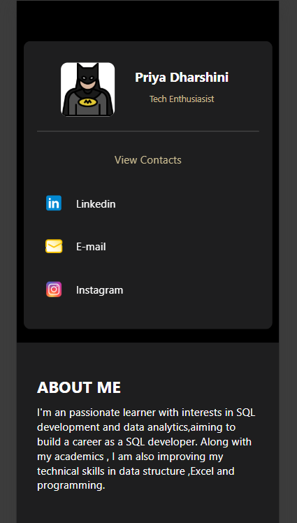
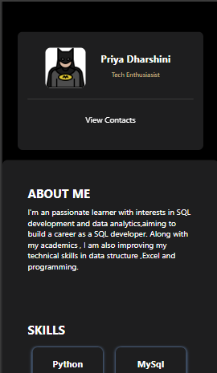
RESULTS AND SCREENSHOTS
After clicking view contacts
3/21/2024 Annual Review
12

Slide 13
The portfolio website successfully addresses the limitations of traditional resumes by providing an interactive, accessible, and professional platform to represent academic and technical accomplishments. It serves as a valuable tool for students to enhance their digital presence and for recruiters to evaluate candidates effectively.
Conclusion
13

Slide 14
GitHub link
https://github.com/priya-dharshini-11/Priyadharshini-TNSDC-FWD-DP

