Slide 1

Ultrasound of gall bladder
By
Faculty of MIATA

Slide 2

ANATOMY AND PHYSIOLOGY OF THE GALLBLADDER
The gallbladder, which is located posterior to the right lobe of the liver within the gallbladder fossa, is considered an intra-peritoneal organ.
Although the location of the gallbladder relies on the position of the patient, a useful landmark to locate the gallbladder fossa is the main lobar fissure.
This pear-shaped sac is used to store and concentrate bile.
It has three distinct layers within its walls.
The mucosal layer is the inner most layer.
It consists of multiple folds and rugae.
The middle layer of the wall is the fibromuscular layer, whereas the outer is the serosal layer.

Slide 3
The gallbladder has a neck, body, and fundus.
The neck is contiguous with the cystic duct, which connects the gallbladder to the rest of the biliary system at the level of the common hepatic duct.
The portion of the biliary tree that lies distal to the union of the cystic duct with the hepatic duct is the common bile duct.
The fundus is the most dependent portion of the gallbladder and therefore is a common location for gallstones to collect

Slide 4
Blood supply to the gallbladder is via the cystic artery, a branch of the right hepatic artery.
The gallbladder contracts as a result of cholecystokinin, a hormone released by the duodenum.
As chyme enters the duodenum, cholecystokinin is released.
Bile then flows from the gallbladder through the cystic duct and into the common bile duct.
Although the most common variant in gallbladder shape is the Phrygian cap, other variants may be noted (Table 3-1).
Other positional and developmental anomalies of the gallbladder include duplication, floating gallbladder, agenesis, and hypoplasia.

Slide 5
Gross Anatomy
The gallbladder is mostly intraperitoneal and is located in the gallbladder fossa, which is on the visceral surface of the liver.
It lies between the right and left lobes of the liver and posterior and caudal to the main lobar fissure.
The gallbladder is a pear-shaped structure with a thin wall that is <3 mm.
It is approximately 8 cm in length, with a transverse diameter <5 cm.
The gallbladder is divided into three main segments: fundus, body, and neck. The fundus is the most anterior segment, while the neck has a fixed anatomic relationship to the right portal vein and main lobar fissure.

Slide 6
Gross Anatomy
The neck tapers to form the cystic duct.
The spiral valves of Heister are located in the cystic duct, and stones may collect here.
The right and left hepatic ducts join to form the common hepatic duct whose function is to transport bile to the gallbladder.
Bile enters and exits the gallbladder via the cystic duct.
The cystic
duct unites with the common bile duct to transport concentrated bile to the second portion of the duodenum.

Slide 7
Gallbladder Variants and Anomalies
Junctional Fold. Is the most common variant, which is a fold or kinking located on the posterior gallbladder wall between the body and neck.
Phrygian Cap. A fold located in the fundal portion of the gallbladder (Fig. 4–5).
Hartmann’s Pouch. A small sac located between the junctional fold and the neck of the gallbladder.
It is an area where stones may collect (Fig. 4–5)
Septation. A thin wall or partition into the lumen of the gallbladder. This is seen as a thin linear hyperechoic structure within the gallbladder.
Congenital anomalies are rare; the gallbladder can have an ectopic location and be found intrahepatic.

Slide 8
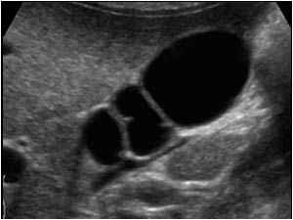
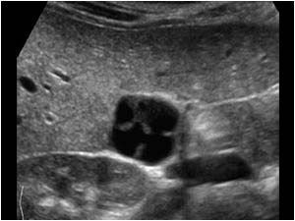
Septated GB

Slide 10
Function
The three main functions of the gallbladder are to concentrate bile, store the concentrated bile, and transport the bile to the duodenum.
The release of the hormone cholecystokinin is stimulated when food enters into the stomach, especially fatty foods and dairy products.
Cholecystokinin stimulates the gallbladder to contract and the sphincter of Oddi to relax and open.
The intraductal pressure decreases with the contraction of the gallbladder and the opening of the sphincter of Oddi.
The bile flows to the small intestine, which aids in the digestion of food by breaking down fatty foods and dairy products.

Slide 12
Laboratory Values of Biliary Tract Disease
White Blood Count (WBC). Increases in cases of infection, acute cholecystitis, chronic cholecystitis, cholangitis
Serum Bilirubin. Increases in cases where the biliary system becomes obstructed, gallbladder carcinoma
Abnormal Liver Function Tests
Serum Alkaline Phosphatase (ALP). Increases in cases of posthepatic jaundice

Slide 13
Prothrombin Time (PT). The clotting time is longer in patients with acute cholecystitis, carcinoma of the gallbladder, and prolonged common bile duct obstruction.
Aspartate aminotransferase (AST) and alanine aminotransferase (AST) are abnormal in cases of cholecystitis, choledocholithiasis, and any injury to the bile ducts

Slide 14
SONOGRAPHY OF THE GALLBLADDER
A gallbladder sonogram should be performed after the patient has had nothing to eat for at least 4 hours, although a period of 8 hours is optimal.
The gallbladder should be evaluated in the supine, left lateral decubitus, prone, upright, and any other position needed to demonstrate the mobility, or lack of mobility, of any apparent intraluminal objects.
The gallbladder neck and fundus should be examined closely, as these locations are common sites for gallstones to accumulate.

Slide 15
Patients who have had a recent cholecystectomy may have some residual fluid located within the gallbladder fossa.
Right upper quadrant sonography may be needed to further assess these patients for residual choledocholithiasis or postoperative complications.

Slide 16
The normal gallbladder appears sonographically as an anechoic, pear-shaped structure.
Often, it may be seen at the level of the main lobar fissure and portal vein.
The size of gallbladder is variable, although the normal ranges are said to be 8–10 cm in length and no more than 5 cm in diameter.
The gallbladder wall should measure no more than 3 mm in thickness.
The gallbladder wall may be focally or diffusely thickened (Tables 3-2 and 3-3).

Slide 17
Pathology of the Gallbladder Reasons for Gallbladder Wall Thickening >3 mm (Table 4–6) TABLE 4–6 • Reasons for Gallbladder Wall Thickening >3 mm

Slide 20
GALLBLADDER PATHOLOGY

Slide 21
Cholelithiasis
Biliary stones that form within the gallbladder are called gallstones, or cholelithiasis.
Gallstones typically consist of a mixture of cholesterol, calcium bilirubinate, and calcium carbonate.
Cholelithiasis formation has been associated with many risk factors and predisposing conditions (Table 3-4).
Gallstones are more commonly seen in female patients.

Slide 22
Moreover, patients who are fat, female, fertile, flatulent, fair, and forty have been shown to have higher incidence of gallstones.
Gallstones have been found in children, in newborns, and in the fetus.
Pediatric patients who have hemolytic anemia, such as sickle cell disease, and those with Crohn disease have an increased risk for developing gallstones.

Slide 24
Cholelithiasis
Clinically, patients who have gallstones may be asymptomatic.
But biliary colic is often present.
Other findings include abdominal pain after fatty meals, epigastric pain, nausea and vomiting, and pain that radiates to the shoulders.
Sonographically, a cholelithiasis appears as a mobile, echogenic structure within the gallbladder lumen that produces an acoustic shadow (Fig. 3-1).

Slide 25
Cholelithiasis
A gallbladder that is completely filled with gallstones may exhibit the wall-echo-shadow sign (WES sign).
In this situation, only the gallbladder wall and shadowing from the gallbladder fossa are observable (Fig. 3-2).
It is important to note that tiny folds within the cystic duct, the spiral valves of Heister, can also produce a posterior shadow, and therefore suggest the presence of tiny gallstones in that area.
Changing the patient position and altering scanning planes often resolve this dilemma.

Slide 29
Gallbladder Sludge
Sludge, or viscid bile, within the gallbladder is most often associated with biliary stasis.
Sludge may be found in patients who have co-existing gallstones or gallbladder carcinoma and in those suffering from jaundice, liver disease, hyperalimentation, or sepsis.
Also, patients who have been fasting or are on total parenteral nutrition may have gallbladder sludge.
Sludge is typically asymptomatic.

Slide 30
Occasionally, sludge can be thick and mimic an intraluminal gallbladder mass.
This is referred to as tumefactive sludge.
The mobility of this type of sludge should be observed carefully.
Tumefactive sludge may also form into sludge balls, which will be mobile and will not produce an acoustic shadow.
Sonographically, sludge appears as a collection of low-level, nonshadowing, dependent echoes within the gallbladder lumen (Fig. 3-3).

Slide 34
Gallbladder Polyps
A gallbladder polyp or cholesterol polyp is a projection of tissue from the gallbladder wall that protrudes into the lumen of the gallbladder.
On varying the patient’s position, polyps will neither shadow nor move (Fig. 3-4).
Cholesterol polyps are the most common type of polyps.
They are caused by cholesterolosis, which result from the disturbance in cholesterol metabolism and accumulation of cholesterol within the wall of the gallbladder.

Slide 35
Polyps may be solitary or multiple and will appear sonographically as echogenic, nonshadowing, and nonmobile projections of tissue.
Most polyps are benign, incidentally discovered, and measure less than 5 mm.
However, a rapidly growing polyp or large polyp is worrisome for gallbladder carcinoma.

Slide 38
Adenomyomatosis
Benign hyperplasia of the gallbladder will result in adenomyomatosis.
With adenomyomatosis, the epithelium and muscular layers of the gallbladder wall have tiny pockets called Rokitansky–Aschoff sinuses.
These sinuses contain cholesterol crystals that produce comet tail artifact (Fig. 3-5).
Adenomyomatosis may be focal or diffuse and is clinically silent and insignificant.

Slide 41
Acute Cholecystitis
The sudden onset of gallbladder inflammation is referred to as acute cholecystitis.
The most common cause of acute cholecystitis is a gallstone that has become lodged in the cystic duct or neck of the gallbladder.
Right upper quadrant pain and leukocytosis are often associated with acute cholecystitis.
Other laboratory findings may include an elevation in alkaline phosphatase and aminotransferase.
Bilirubin may also be elevated if obstruction to the ducts occurs.

Slide 42
Patients will complain of focal tenderness over the gallbladder with transducer pressure when the gallbladder is inflamed.
This is termed a positive sonographic Murphy’s sign.
Other sonographic findings include gallstones, pericholecystic fluid, wall thickening, and sludge (Fig. 3-6).
Acute cholecystitis has several sequelae, many of which are life-threatening conditions (Table 3-5).

Slide 44
Acute Cholecystitis
Chronic cholecystitis results from the intermittent obstruction of the cystic duct by gallstones.
With gangrenous cholecystitis, the gallbladder becomes necrotic and develops abscesses within its walls.
Bacterial invasion within the gallbladder wall describes emphysematous cholecystitis.
Cholecystitis and its complications can lead to perforation of the gallbladder.
Whenever perforation occurs, the patient has an increased risk of death as a result of peritonitis.
When medical treatment is not appropriate, a cholecystectomy is typically performed to relieve the symptoms of acute cholecystitis.

Slide 46
Acalculous Cholecystitis
Acalculous cholecystitis presents with all of the symptoms and sonographic findings of cholecystitis except no gallstones are present (Fig. 3-7).
This form of acute cholecystitis is more commonly found in children, recently hospitalized patients, or those who are immunocompromised.

Slide 50
Gallbladder Enlargement
The gallbladder should not exceed 5 cm in width and 8–10 cm in length.
The transverse measurement is more indicative of gallbladder enlargement.
An enlarged gallbladder can be caused by a blockage of the cystic duct.
This is referred to as a hydropic gallbladder.
Patients with a hydropic gallbladder may be asymptomatic or may complain of epigastric pain, nausea, and/or vomiting.

Slide 51
An enlarged gallbladder is often palpable on physical examination.
Courvoisier gallbladder describes the clinical detection of an enlarged, palpable gallbladder caused by a pancreatic head mass.
Patients with Courvoisier gallbladder will have painless jaundice

Slide 54
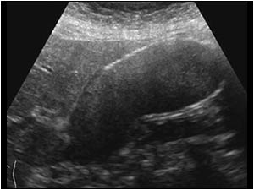

Slide 55
Gallbladder Carcinoma
Gallbladder carcinoma is rare, although it is the most common cancer of the biliary tract.
It is thought to be caused by chronic irritation of the gallbladder wall by gallstones.
Therefore, gallbladder carcinoma is almost always associated with gallstones and the mass may actually contain gallstones.
Furthermore, there appears to be an increased risk for developing gallbladder carcinoma in patients who have porcelain gallbladders and in those who suffer from chronic cholecystitis.
Patients may be asymptomatic at the time of detection, or they may suffer from nausea, vomiting, unexplained weight loss, right upper quadrant pain, jaundice, or hepatomegaly.

Slide 56
Gallbladder carcinoma may appear sonographically as a distinct, nonmobile, hypoechoic mass within the lumen of gallbladder or as diffuse gallbladder wall thickening.
An irregular polypoid mass may also completely fill the gallbladder fossa at the time of diagnosis.
Whenever a mass is visualized within the gallbladder lumen it should be measured.
Gallbladder carcinoma is highly suspected if a polyp or mass within the gallbladder measures greater than2 cm.

Slide 57
When confused with tumefactive sludge, color Doppler can reveal vessels within the malignancy (Fig. 3-8).
The most common metastatic disease of the gallbladder is malignant melanoma.
It may appear sonographically similar to primary gallbladder cancer.

Slide 59
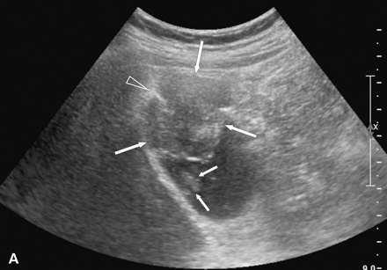
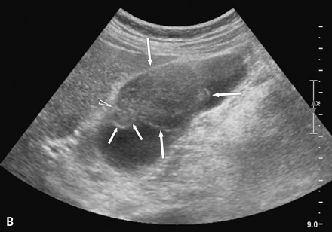

Slide 60
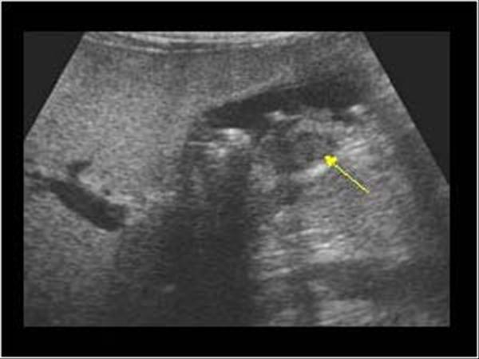

Slide 63
Causes of Low Level Echoes in the Gallbladder Lumen/with Mobility
Biliary Sludge. The most common cause of sludge is stasis of bile attributable to cholecystitis, extrahepatic obstruction, hyperalimentation, or in patients who have been NPO for a long period of time.
Sludge is a common precursor to gallstones.
Sludge appears as low-level nonshadowing echoes in the dependent portion of the gallbladder that moves with a change in the patient position.
Other causes of mobile low level echoes within the gallbladder lumen include; blood, pus and viscous bile.
Intraluminal echoes that do not shadow or are nonmobile include: polyps, cholesterosis, artifacts, septi (junctional fold), and gallbladder carcinoma.

Slide 64
Cholelithiasis (Gallstones).
Patients may present asymptomatic or with right upper quadrant (RUQ) pain and a history of nausea and vomiting after eating.
Cholecystitis is sometimes present.
The following sonographic characteristics need to be present in order to diagnose gallstones:
1. Echogenic foci—Echogenic due to the acoustic mismatch between the stones and bile
2. Posterior acoustic shadowing—Most of the sound is absorbed (attenuated), producing a shadow.
3. Gravity dependent—Stones are gravity dependent and move to the most dependent portion of the
GB when the patient position is changed.

Slide 65
Structures That Can Mimic Gallstones
• Gas in the duodenum
• Surgical clips from post-cholecystectomy
• Valves of Heister and folds in gallbladder
Shadowing from the spiral valves of Heister—refraction artifact from the cystic duct
Bowel—usually not a clean shadow
Air in the biliary tree—from previous surgery or GB fistula
Low-level echoes in the gallbladder lumen—no shadowing

Slide 66
Polyps. Polyps are not gravity dependent and do not move with changing patient position.
Adenomyomatosis. Hyperplastic change in the gallbladder wall (Table 4–6).
Causes of gallstones in children include hemolysis; for example, sickle cell disease, cystic fibrosis, malabsorption syndrome (Crohn’s disease), hepatitis, and congenital biliary anomalies (choledochal cyst, biliary atresia).
Mirizzi Syndrome. Refers to a common hepatic duct obstruction caused by a stone in the cystic duct with a normal common bile duct.
Most patients present with clinical findings of RUQ pain, jaundice and fever.

Slide 67
Acute Cholecystitis.
Acute cholecystitis is inflammation of the gallbladder wall with decreased gallbladder function.
Acute cholecystitis is usually caused by an obstruction at the level of the cystic duct, bacterial infection in the biliary system, or pancreatic enzyme reflux.
Clinically, the patient may present with acute RUQ pain that may radiate to the right scapular area.
Patient may have a sonographic Murphy’s sign which is a focal pain over the gallbladder when compressed by the transducer, this should not be confused with clinical Murphy’s sign in which tenderness occur with a sudden stop in inspiratory effort when pressure is applied to the RUQ.

Slide 68
Sonographic findings may include diffuse gallbladder wall thickening >3 mm; gallstones; “halo” sign suggestive of subserosal edema; cystic artery along the anterior gallbladder wall; transverse diameter >5 cm; sludge; and pericholecystic fluid.
The laboratory findings in acute cholecystitis may include elevated serum bilirubin and abnormal liver function test results.

Slide 69
Benign Tumors of the Gallbladder—Benign tumors of the gallbladder are rare.
They represent overgrowth of the epithelial lining. Patients are usually asymptomatic.
Adenoma—The most common of the benign gallbladder tumors. They are frequently located in the fundus portion of the gallbladder and <1 cm in size.
Sonographically, they appear as low-level echo masses that do not shadow or move to the dependent portion of the gallbladder.

Slide 70
Adenomyomatosis (a form of hyperplastic cholecystosis)—
Characterized by:
• Hyperplasia of the epithelial and muscular surfaces of the gallbladder wall
• Epithelial and intramural diverticula (Rokitansky-Aschoff sinuses)

Slide 71
There are various types and the most common type is usually located at the fundus.
They may also be annular or they can be either diffuse or segmental
Sonographic appearance:
Diffuse or segmental wall thickening
Intraluminal diverticula (RS sinuses) may be filled with bile, sludge or stones and appear either as anechoic or echogenic with distal shadowing or comet tail artifact.

Slide 72
The reverberations are the sonographic appearance that differentiates this disease from an adenoma.
Cholesterolosis (strawberry gallbladder)—A form of hyperplastic cholecystosis.
The gallbladder usually appears normal on ultrasound.
Polyps—Small echo-densities attached to the gallbladder wall by a stalk; they do not shadow or move to the dependent portion of the gallbladder

Slide 73
Carcinoma of the Gallbladder—The most common biliary malignancy.
Pancreatic cancer is the most common malignant cause to obstruct the biliary tree.
Most carcinomas of the gallbladder are adenomas.
They usually do not occur until the sixth or seventh decade and are more common in women than men.
Previous gallbladder disease; for example, inflammatory disease or gallstones are often precursors.

Slide 74
Gallstones are usually present.
Most patients have direct extension into the liver and surrounding structures (lymphatic).
Signs and symptoms are similar to chronic cholecystitis (may be asymptomatic, loss of appetite, nausea, vomiting, intolerance to fatty foods and dairy products.)

Slide 75
Sonographic appearance usually includes gallstones in addition to:
Solid mass filling the gallbladder lumen (most common type)
Localized thickened gallbladder wall with a small gallbladder lumen
Fungating mass projecting from the gallbladder wall into the lumen
Secondary findings:
Liver metastasis
Regional lymphadenopathy

Slide 78
Thank you

